Slide 1
Halbach magnets: accelerator physics requirements
Dejan Trbojevic
OUTLINES
A. Basics of the Non Scaling Fixed Field Alternating Gradient (NS-FFAG) Accelerator
B. Summary of the 54 page Halbach magnet report
C. Halbach Magnet Properties?

Slide 2
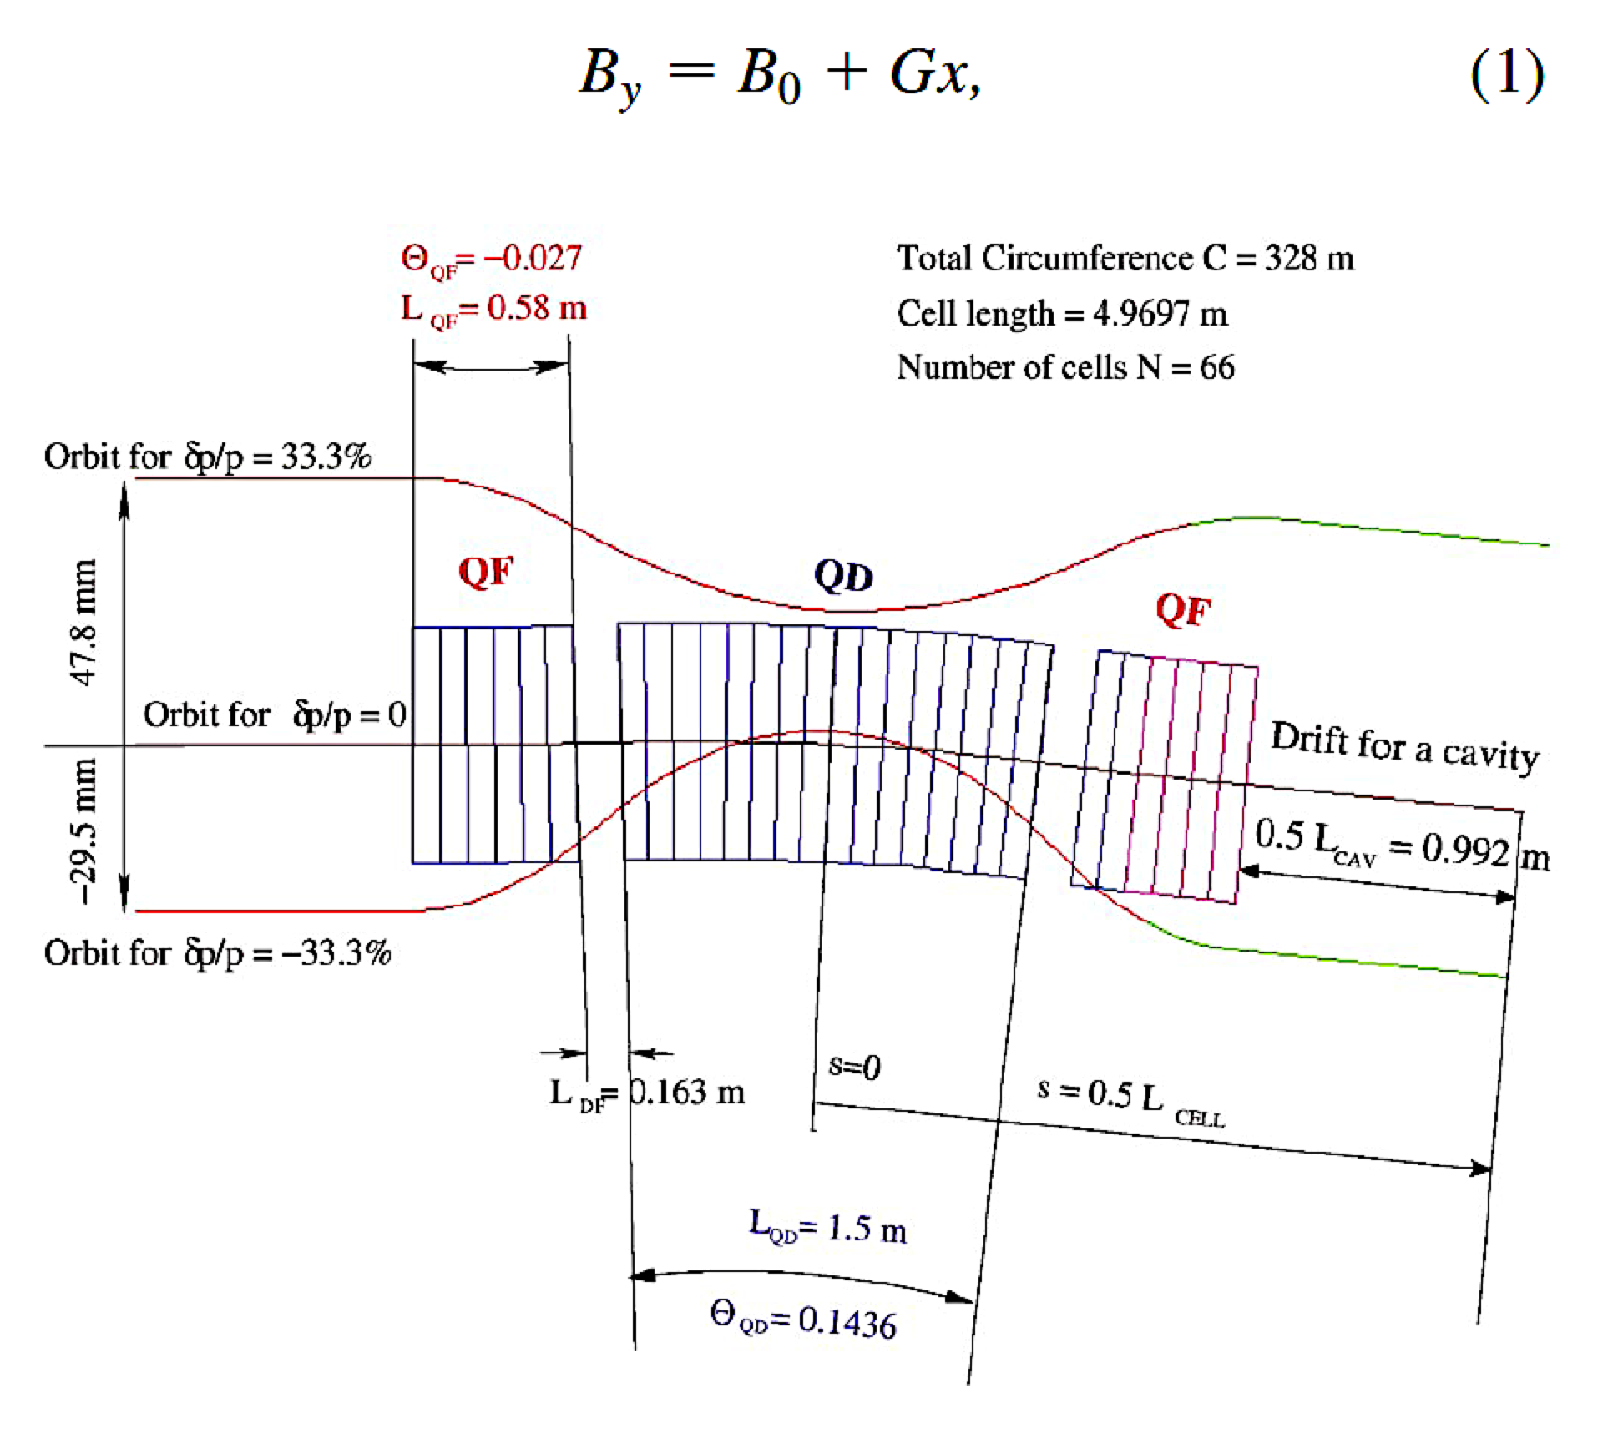
A. Basics of the NS-FFAG
Strong focusing, small dispersion D_{x}, large momentum acceptance δp/p, linear magnetic field: B_{F,D}=B_{o} + G•x (requires combined function magnets)
Δx = D_{x} * δp/p, small aperture Δx=± 2 cm allows large momentum 4 times in energy if D_{x}= 3 cm → δp/p =±60%!
← LINEAR MAGNETIC FIELD
Orbit offsets Δx are largest in the focusing combined function magnet
Orbit offsets Δx are smallest in the defocusing combined function magnet

Slide 3
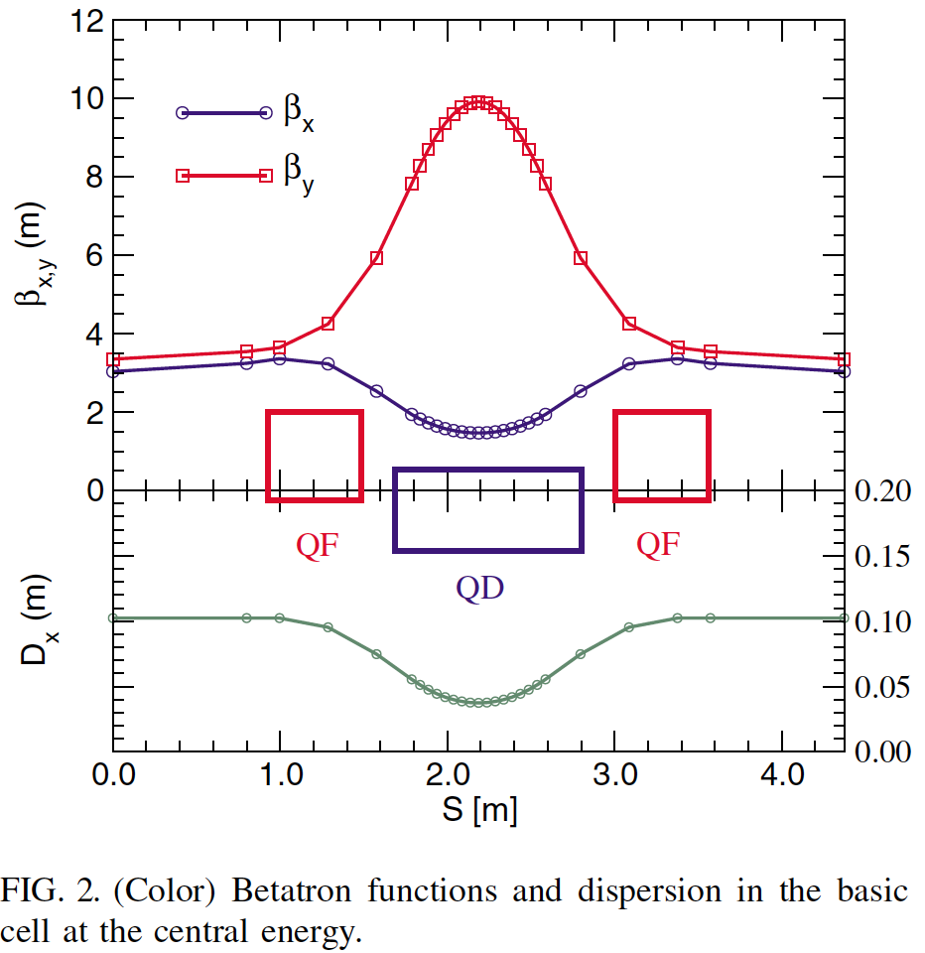
A. Basics of the NS-FFAG
STRONG FOCUSING LATTICE
SIMILAR TO THE LIGHT SOURCE LATTICES TO REDUCE THE DISPERSION FUNCTION OR TO FIND THE MINIMUM OF THE
H FUNCTION the minimum of the β_{X} is the the middle of the bending defocusing magnet
Maximum of the β_{Y} is in the middle of the bending defocusing magnet

Slide 4
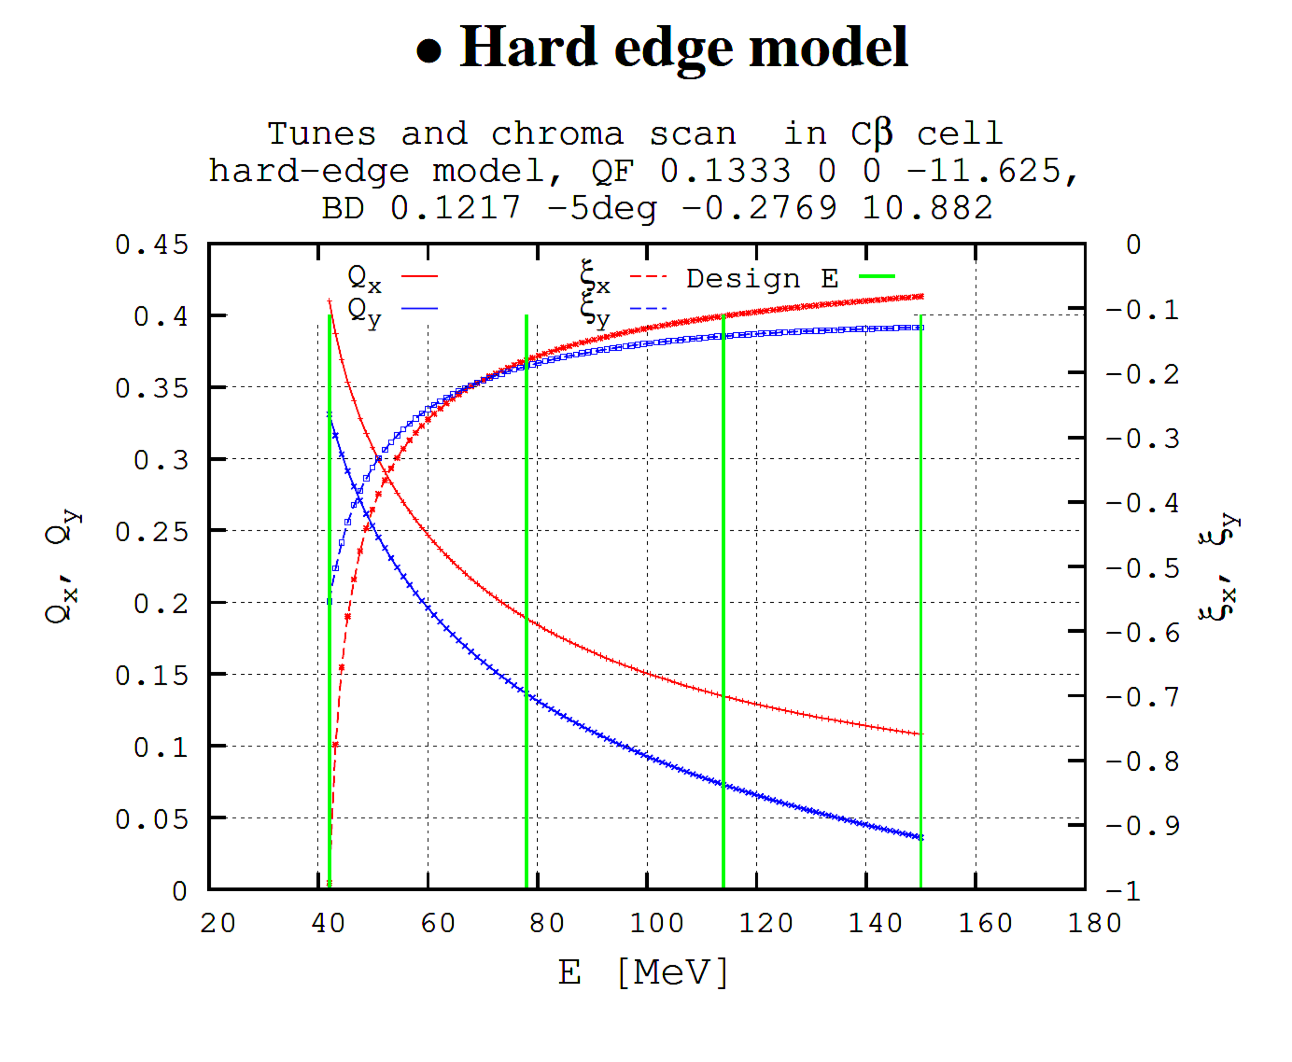
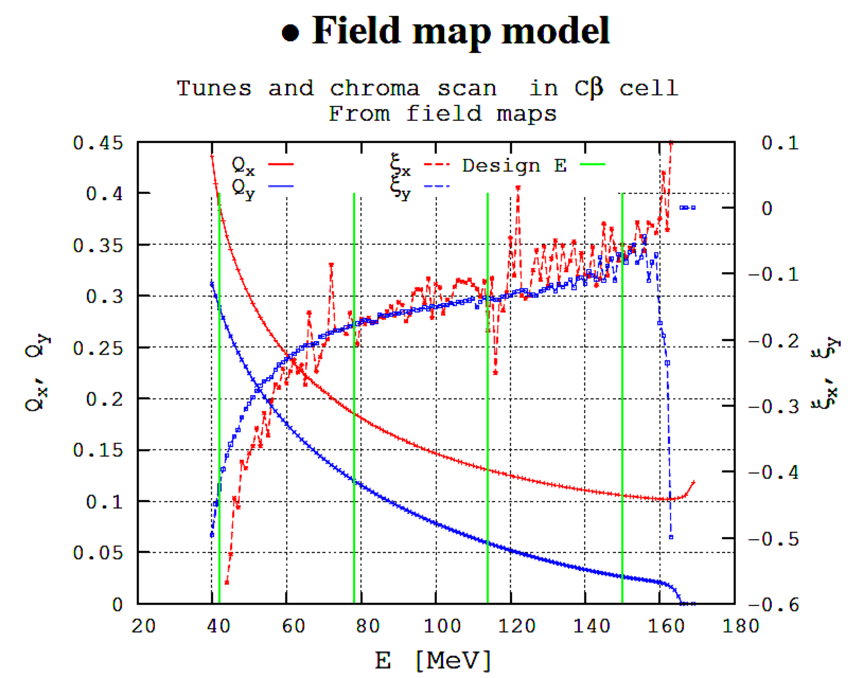
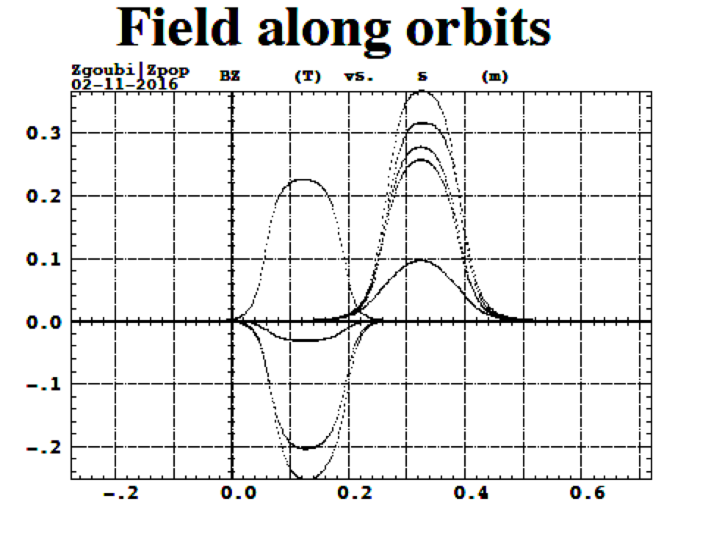
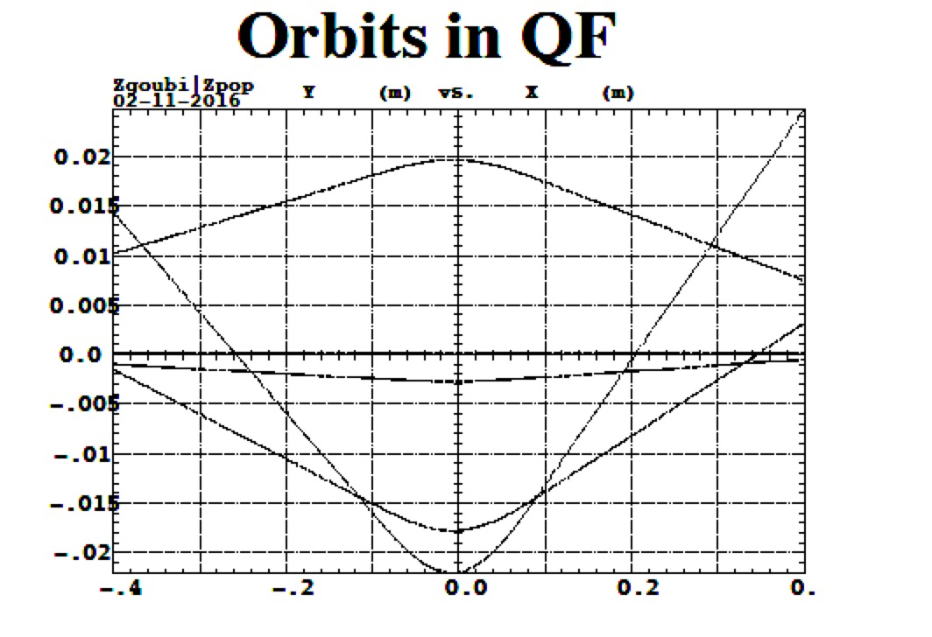
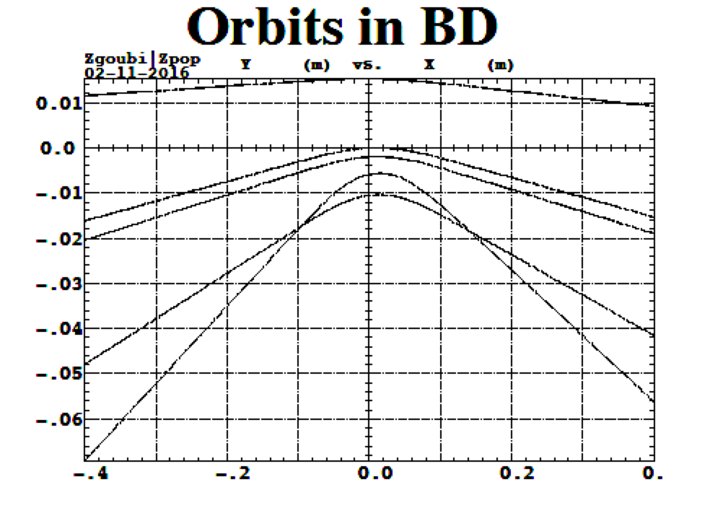
Lattice Properties of the CBETA baseline design with E_{max}=150 MeV from the hard-edge model and from the 3D OPERA field maps from Francois Meot and ZGOUBI program
Do the modeling and analysis results validate the Halbach magnet designs?
T
Twelve 250 MeV CBETA prototype magnets were built with well established procedure:
The lattice design with stable orbits, required tune range for the energy range is obtained using the Hard-edge model. This is confirmed by three different codes PTC, ZGOUBI, and Muon1.
This is used as basis for the focusing quadrupole QF and defocusing combined function magnets BD, designs with ‘OPERA 3D’ program. There are necessary tuning of the magnet gradients during this step. The lattice properties are obtained from the particle tracking through the ‘OPERA 3D’ magnetic fields and until they produce the same results as obtained from the hard-edge design. This represents the end of the magnet design.
The QF and BD are assembled and measured without any corrections
A 32 iron wires of different width or different lengths are used to correct errors in the magnetic field by Stephen Brooks correction analysis program.
Iron shimmed magnets are measured again and the final product with required field accuracy is obtained.
Details are presented in the following presentation by Stephen Brooks

Slide 5
Do the modeling and analysis results validate the Halbach magnet designs?
T
Twelve 250 MeV CBETA prototype magnets were built with established procedure:
The lattice design with stable orbits, required tune range for the energy range is obtained using the Hard-edge model. This is confirmed by three different codes PTC, ZGOUBI, and Muon1.
This is used as basis for the focusing quadrupole QF and defocusing combined function magnets BD, designs with ‘OPERA 3D’ program. There are necessary tuning of the magnet gradients during this step. The lattice properties are obtained from the particle tracking through the ‘OPERA 3D’ magnetic fields and until they produce the same results as obtained from the hard-edge design. This represents the end of the magnet design.
The QF and BD are assembled and measured without any corrections
A 32 iron wires of different width or different lengths are used to correct errors in the magnetic field by Stephen Brooks correction analysis program.
Iron shimmed magnets are measured again and the final product with required field accuracy is obtained.
Details are presented in the following presentation by Stephen Brooks.

Slide 6
B. Summary of the 54 page Halbach magnet report
We presented a technical design, detail cost estimate, and time schedule of the Halbach type of magnets in a separate report available:
https://www.dropbox.com/s/m1bqiukx5t9cuz9/Halbach_Magnets_Review_Dec17_2016.pdf?dl=0
The review shows details of the new CBETA Halbach magnet design based on the existing design. All magnet and drift dimensions are kept the same as in the base line CBETA lattice design with a maximum energy of E_{MAX}=150 MeV.
The current information on the Halbach magnets was not available at the time of the March Magnet review review. In all prior applications the beam was in the center of the magnets (synchrotrons). The Non-Scaling Fixed Field Alternating Gradient (NS-FFAG) has a significant range of beam positions in the magnets, not a single point. Questions, objections, and concerns about Halbach magnets have been addressed.

Slide 7
Halbach Design Properties
1. ELECTRON ORBITS FIT IN THE MIDDLE OF THE GOOD FIELD
8. VACUUM PIPE IS ROUND AND BPM’s HAS 4 BUTTONS
5. SMALL DISTORTIONS FROM CORRECTOR
2. PERMANENT MAGNET MATERIAL IS USED EFFICIENTLY
3. QUALITY OF THE MAGNETIC FIELD IS EXCELLENT
4. THERE IS NO CROSS TALK BETWEEN MAGNETS
9. THE SIZE OF THE MAGNETS AND CORRECTORS ARE SMALL
6. WRONG ARGUMENT FOR eRHIC R=300→5m
10. DETAIL COST OF THE 220 HALBACH MAGNETS IS $2.2M
7. CORRECTION SYSTEM IS SIMPLE 2% OF ΔG/G

Slide 8
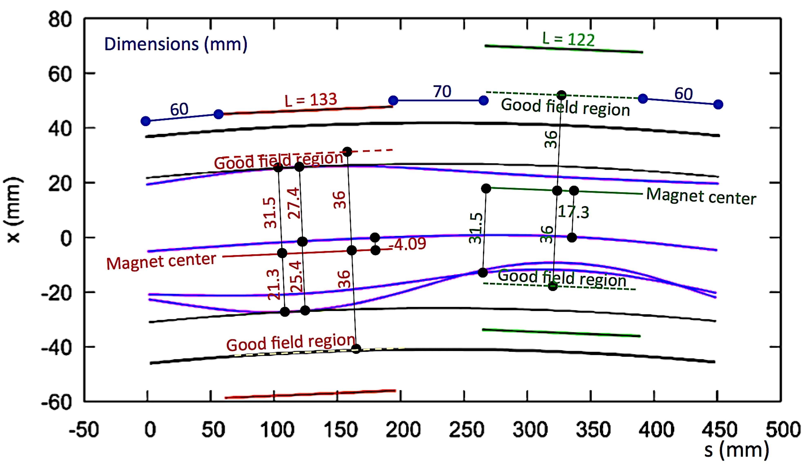
C.1 From the lattice point of view: for the same magnet dimensions and gradients orbit offsets are smaller: 31.5 mm → 22 mm!
ORBITS ARE ALMOST COMPLETELY IDENTICAL IN BOTH CASES BUT THE MAGNETS ARE PLACED DIFFERENTLY. THE BEST FIELD REGION IN THE HALBACH CASE IS WHERE THE BEAM IS.
THIS NOT TRUE FOR THE HYBRID-IRON RADIALY DISPLACED QUADRUPOLE MAGNETS AS SHOWN BELOW

Slide 9
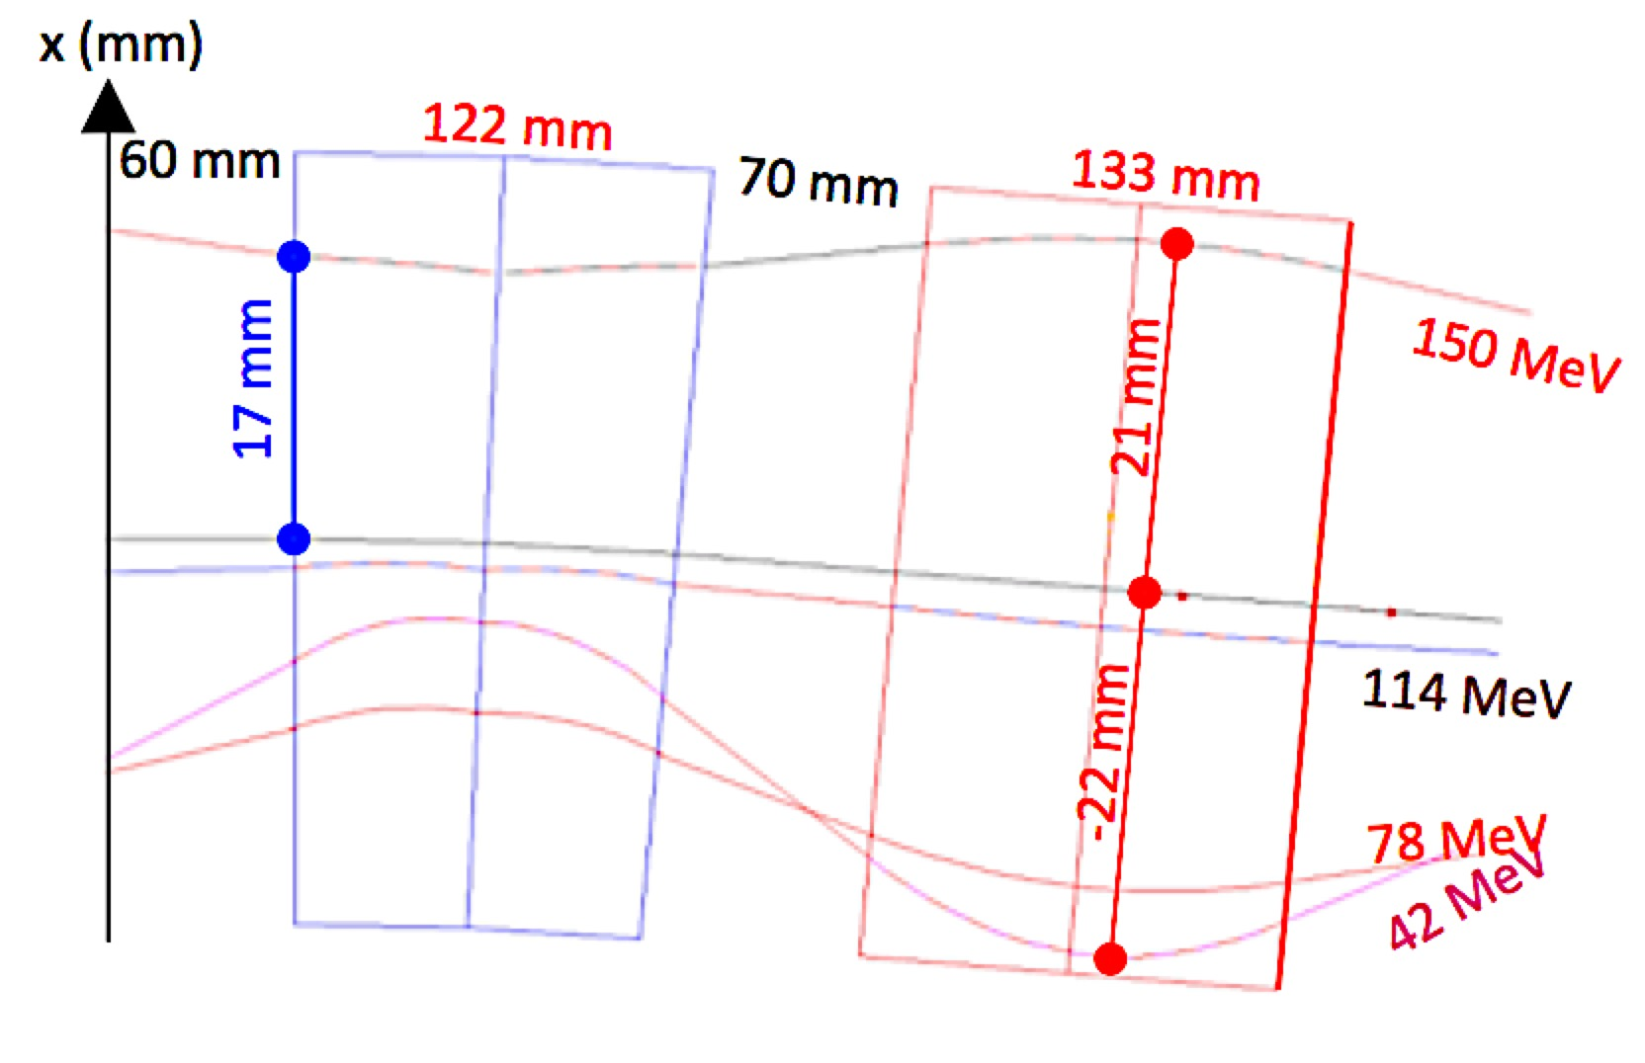
C.1 From the lattice point of view: for the same magnet dimensions and gradients orbit offsets are smaller: 31.5 mm → 22 mm!

Slide 10
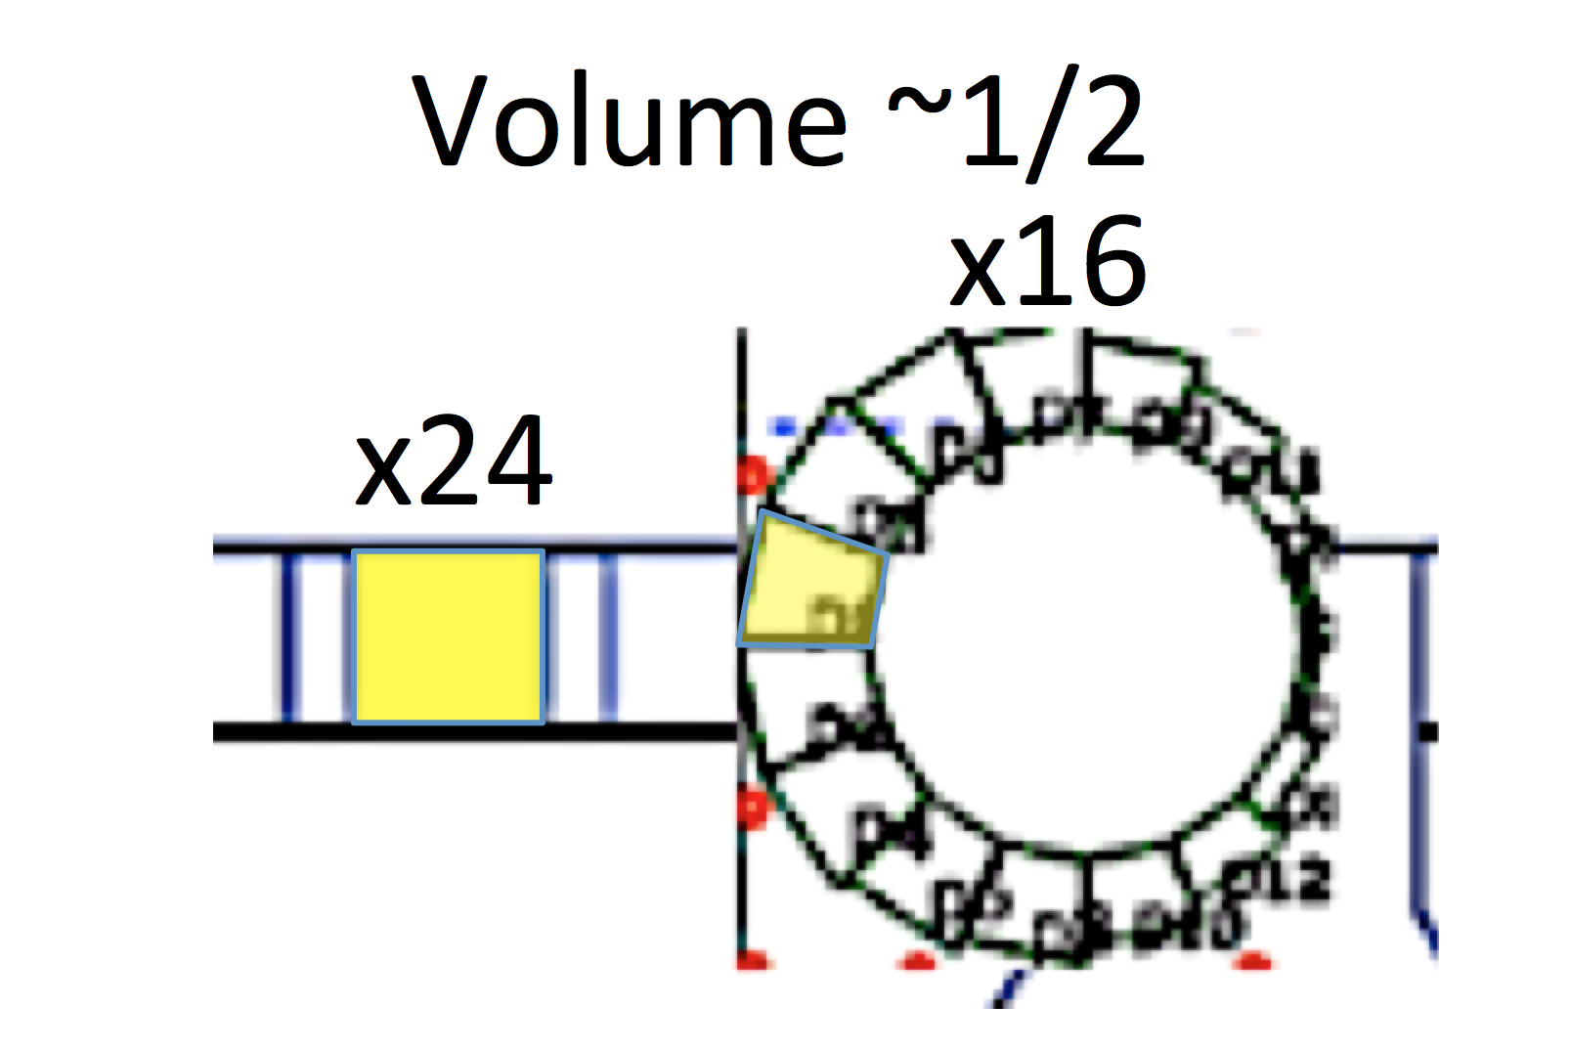
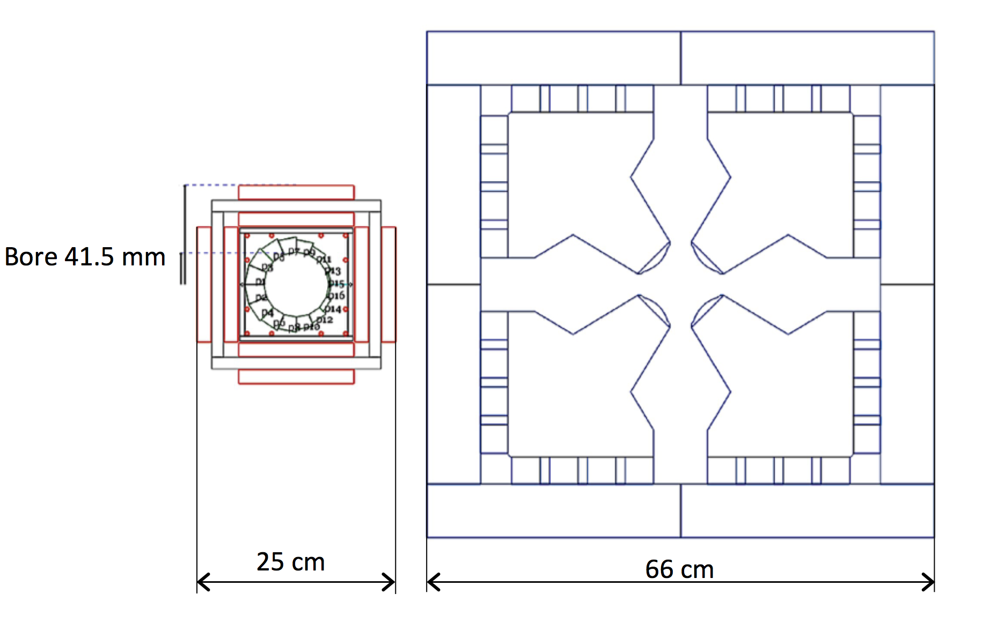
C. 2 The Halbach magnets (focusing quadrupole and defocusing combined function magnet) are the most efficient way in using the
permanent magnet material
iron:
417.8 cm²
Halbach:
QF→34.3 cm²
BD→51.9 cm²
RATIO=835.6/86.2
Larger volume for
RATIO=9.7 times

Slide 11
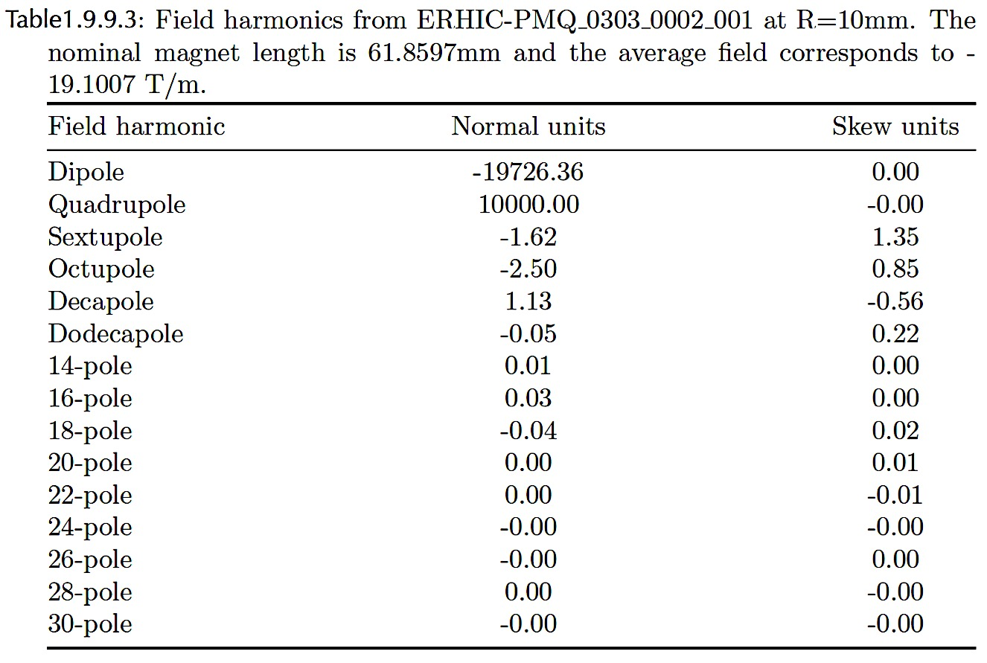
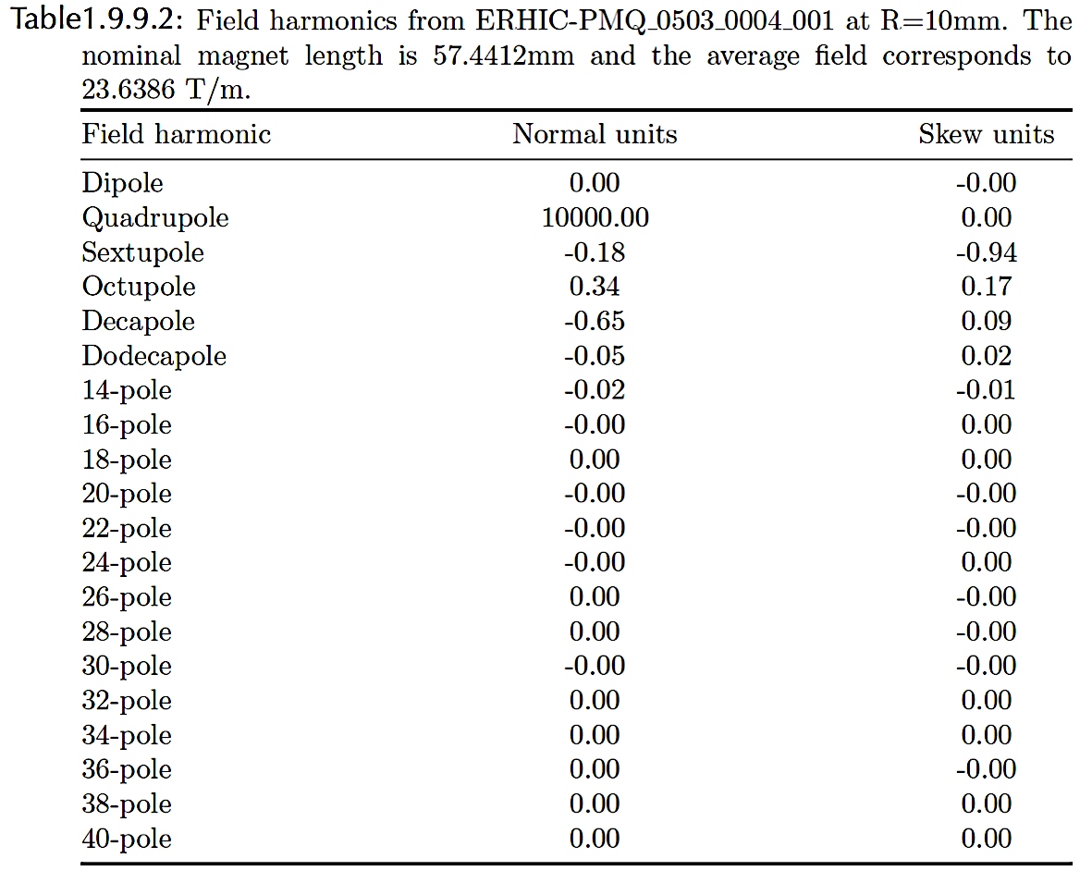
C.3 Superb Quality of the magnetic field obtained by measurements

Slide 12
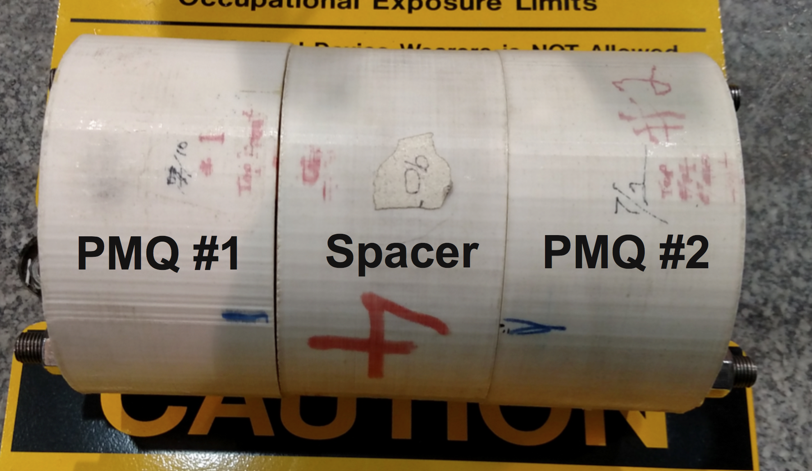
C.4 No cross talk between the magnets-proved by measurements and simulations

Slide 13
C.5 Small effect of the iron frame correctors on the magnetic field inside of the Halbach magnet
The corrector iron frame was placed around the Halbach magnet and measured with harmonic coil in every possible case: magnetic field without the iron frame, with the frame but without powering the correctors, with powering horizontal corrector, powering the vertical corrector and so on. The effect measured was 0.2 % change of the quadrupole field!!! The Hybrid iron magnet has significant cross talk.
1.
2.
3.
4.
Animesh Jain Measurements
Summary of the Corrector frame measurements
Field superposition was tested for a permanent magnet quadrupole in horizontal and vertical dipole fields of ~20 mT each.
Presence of iron yoke of the window frame dipole enhances the quadrupole field by ~ 0.5%.
Use of a 1 m long rotating coil causes some error in the analysis due to double counting of background fields.
For higher harmonics, the deviation from a perfect superposition is less than 5 units (0.05% of the quadrupole field) at a reference radius of 10 mm.
Error in the dipole and quadrupole terms can be much more, up to ~30 units (normalized to quadrupole field.)

Slide 14
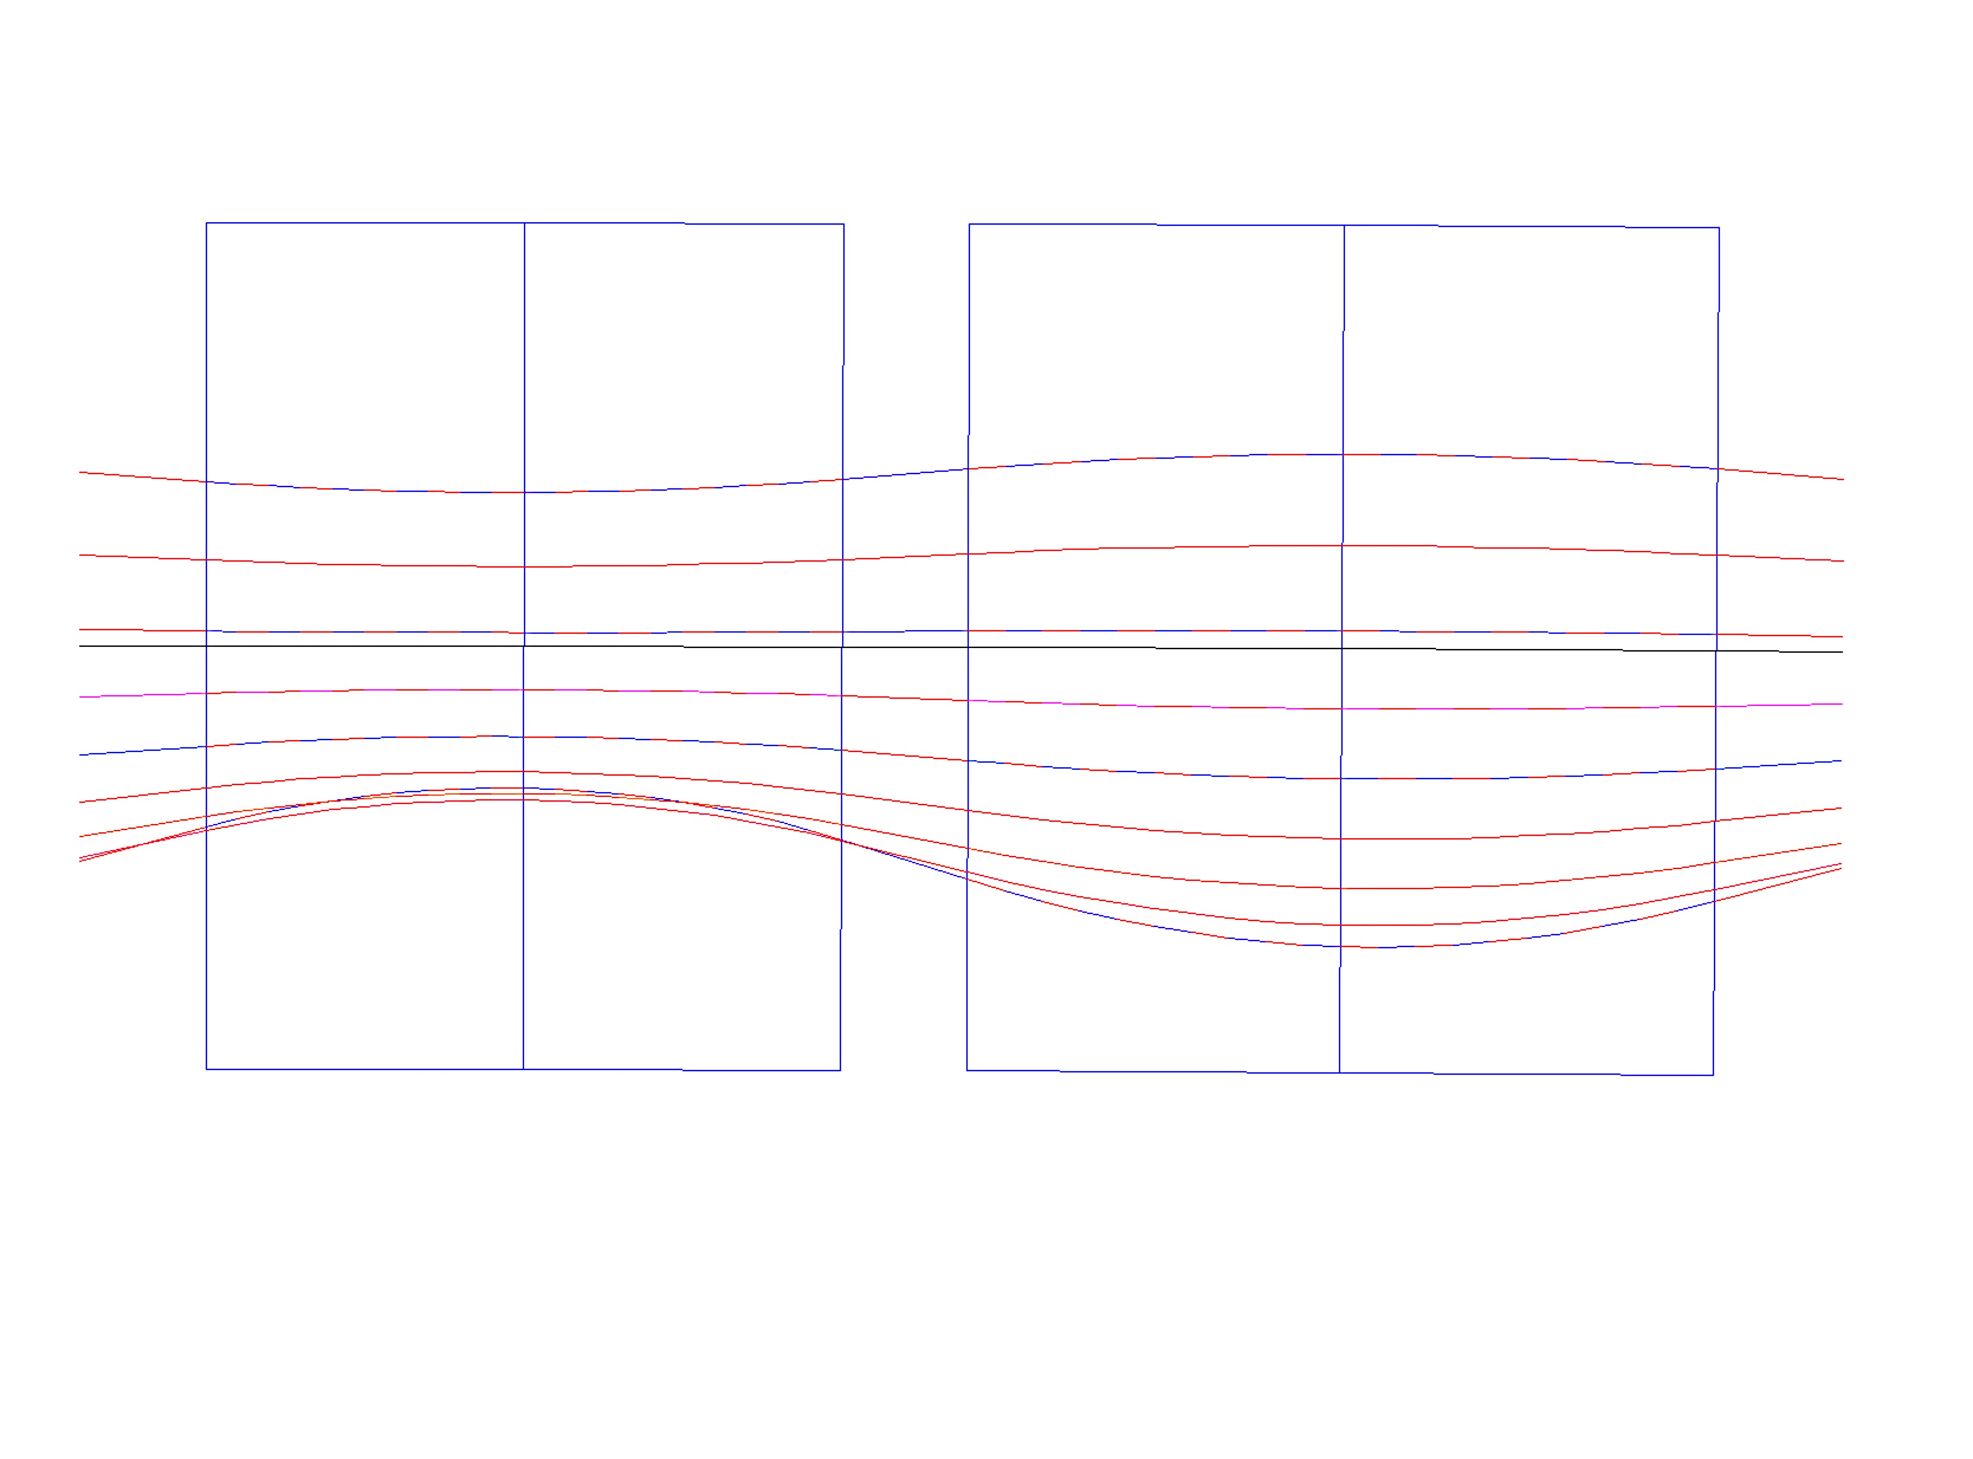
C.6 Wrong Argument for eRHIC vs. CBETA magnets R_{eRHIC} = 300 m R_{CBETA}=5 m
High Energy NS-FFAG Cell
Synchrotron Radiation:
for 10 mA 20 GeV 3.32 MW
for 10 mA 15 GeV 1.62 MW
for 10 mA 16.67 GeV 1.95 MW
B_{Fo}= 0.181 T,
G_{F}= 34.42T/m
x_{Foffset}= -5.26 mm
B_{Do} = 0.181 T,
G_{D} = -34.42 T/m
x_{Doffset}=+5.26 mm
x(mm)
B_{Fmax,min} =[0.446,-0.225] T
BD
QF
x(mm)
10
B_{Dmax,min}=[0.443,0.046] T
20.00 GeV
1.3
D-Quad center
18.34 GeV
6.6
5.26
7.7
16.67 GeV
E_{CEN}=16.198 GeV
12.96
0
15.005 GeV
-7.6
F-Quad center
-5.26
13.34 GeV
11.68 GeV
-11.8
10.01 GeV
6.54
8.345 GeV
-10
6.68 GeV
B_{D}=B_{Do} + G_{D}•x
B_{F}=B_{Fo} + G_{F}•x
ρ_{D}=300.01 m
ρ_{F}= 302.3 m
θ_{D}=3.366 mrad
θ_{F}=3.927mrad
20 cm
CBETA 150 MeV angles:
θ_{D} θ_{F}
58.57 mrad 28.7 mrad
1.01 m
20 cm
20 cm
1.187m
L = 2.797 m

Slide 15
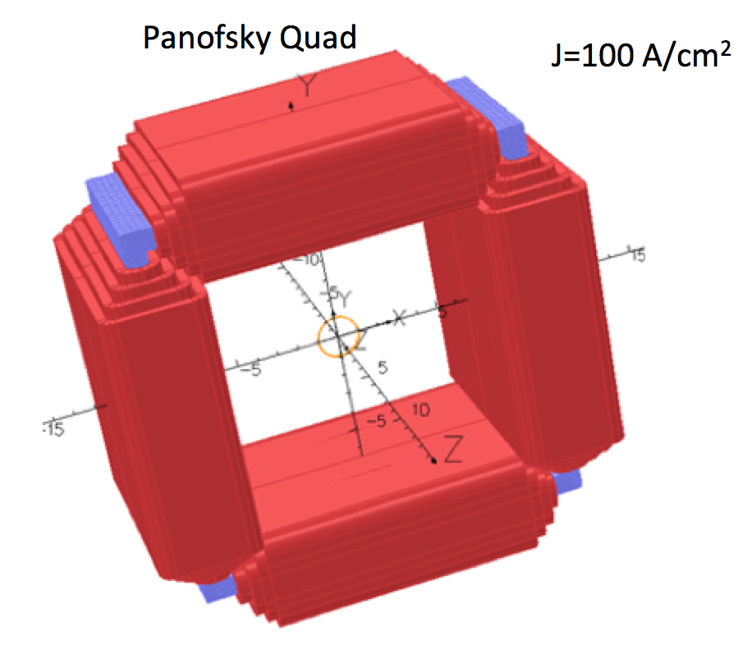
C.7 The iron corrector frame is a very simple correction system.
DOES NOT LONGITUDINALLY
AFFECT THE
7 cm and 12 cm
drift space
PROVIDES
2% of the QUADRUPOLE GRADIENT
4 times stronger horizontal and vertical correctors

Slide 16
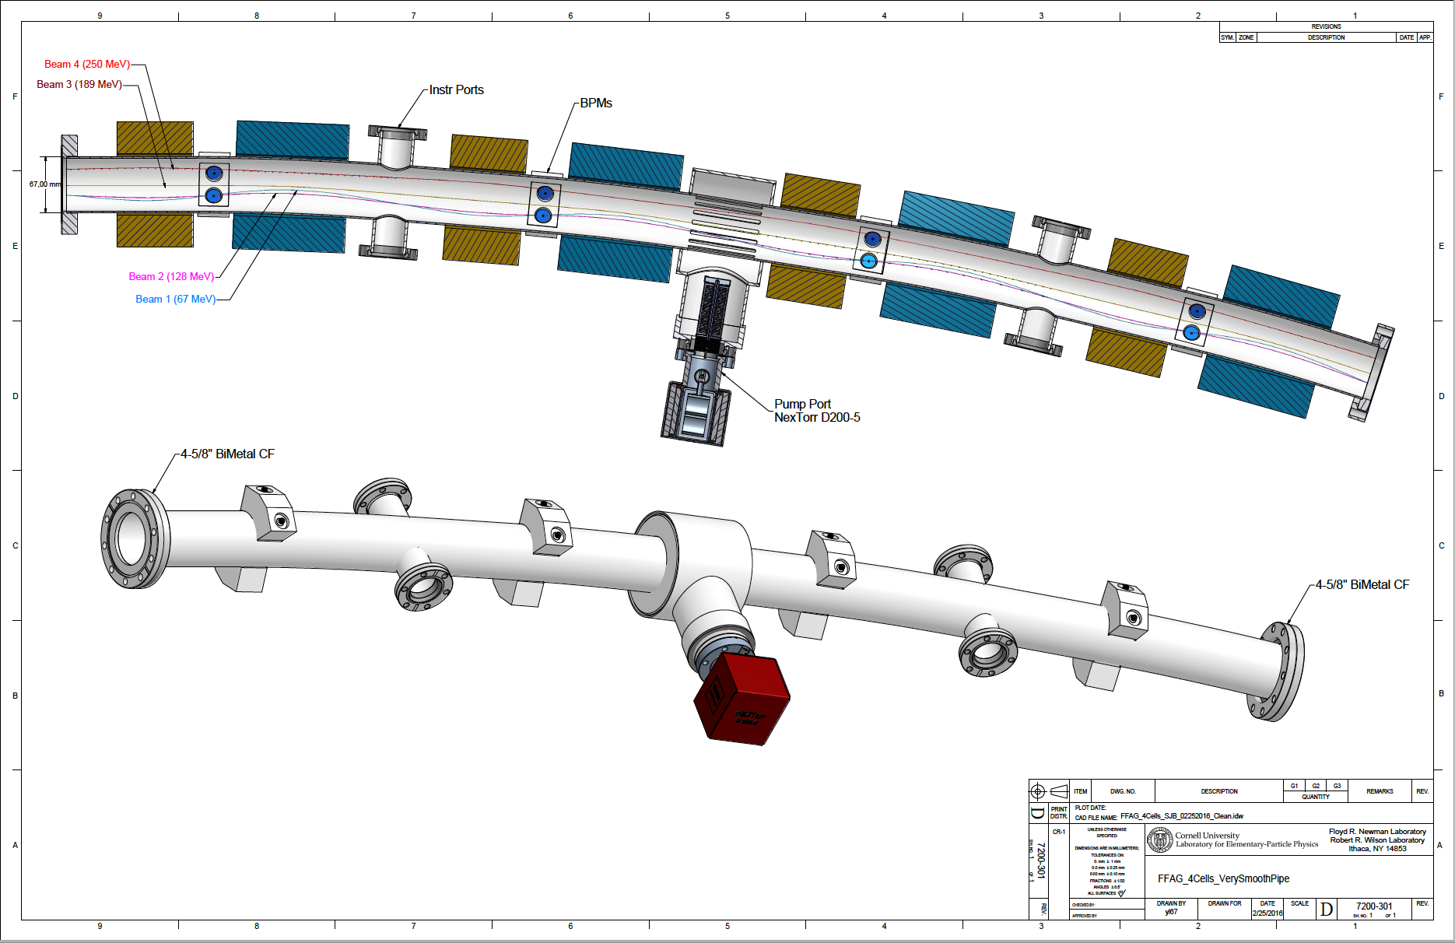
C.8 Bent round pipe fits through both Halbach magnets with enough clearance
Round pipe allows use of the 4 button BPMs: savings in electronics $660,000 → $330,000

Slide 17
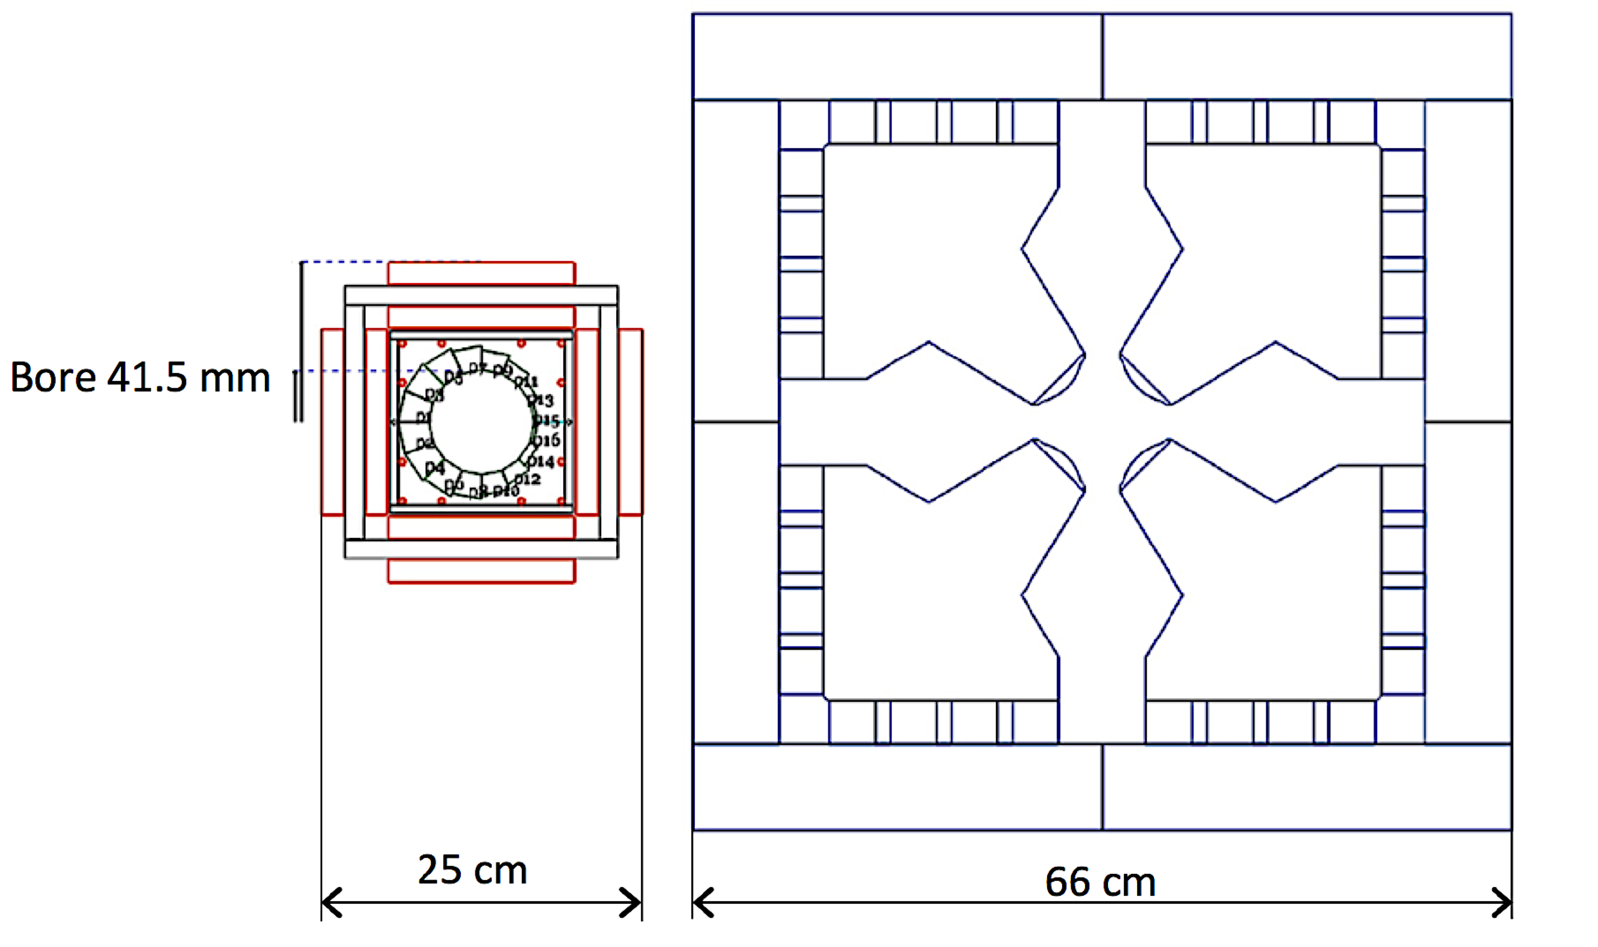
C.9 SIZE OF THE MAGNETS IS SIGNIFICANLY SMALLER
ALLOWS EASIER:
ASSEMBLY – THE CRANE IS NOT NECESSARY
ACCESS TO THE VACUUM PIPE AND INSTRUMENTS
LONGITUDINAL DRIFTS ARE NOT SHORTENED BY THE CORRECTORS

Slide 18
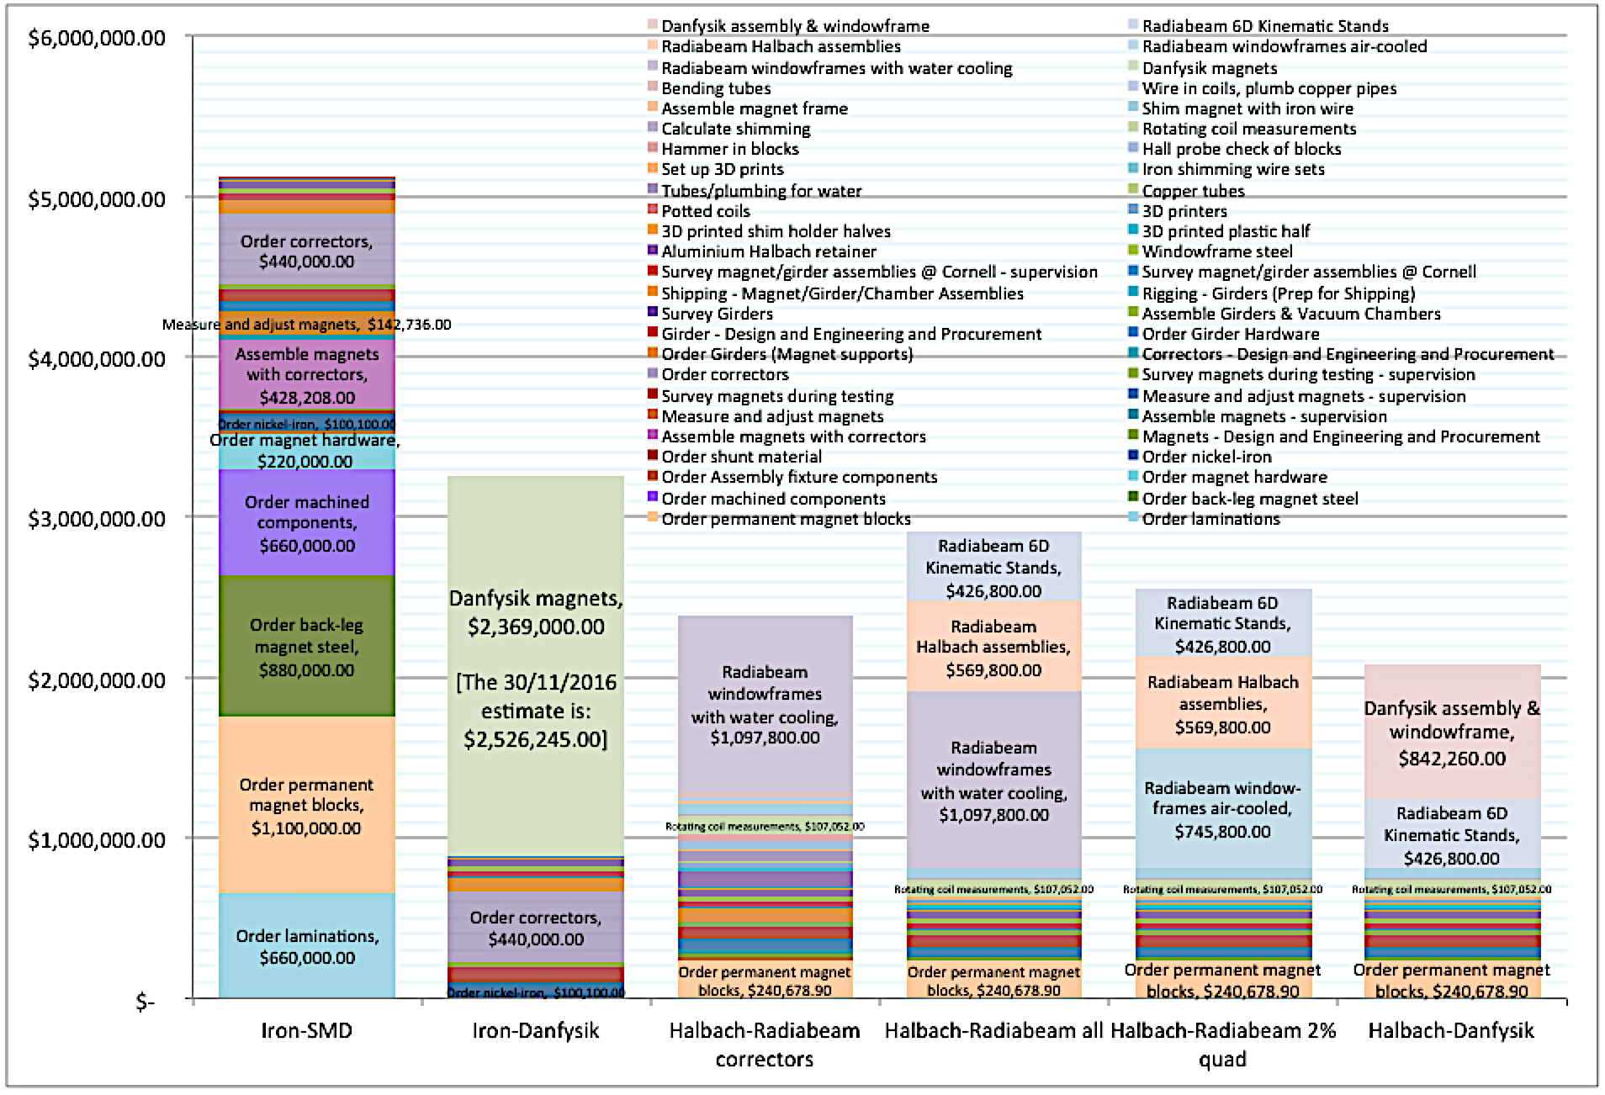
C.10 Cost is significantly smaller $1.2M

Slide 19
SUMMARY:
The lattice design of the NS-FFAG shows that the optimum of the magnetic field is a combination of the focusing quadrupole and defocusing combined function magnet. This is due to placement of the different energy orbits at the middle of the two magnets
Additional properties of the Halbach magnets like: most efficient use of the permanent magnet material, excellent quality of the magnetic field, no cross talk between the magnets, small effect of the correction system on the magnetic field inside of the Halbach magnets, wrong assumption that the CBETA magnets should be the same as the eRHIC magnets, simple correction system widely used, allowed round vacuum pipe, small size of the magnets, and very reasonable cost.

Slide 20
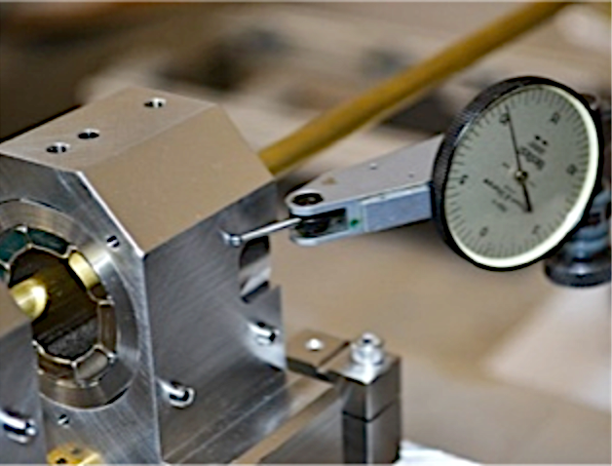
APPENDIX: Answers to the ‘March 2016 Committee Members’ concerns
- Mike Harrison (BNL) conclusion was that both magnets can be built but are not optimal. His complaint was that hybrid-iron-dominated magnets are too wide and he made a suggestion to reduce the maximum energy of E_{max}=200 MeV if they are to be used. The Halbach magnet has appeal because it is smaller and has no crosstalk but the corrector is too large and produces too much heat. –
Answers: The design with the maximum energy of E_{max}=250 MeV, analyzed by Mike Harrison did have large corrector size 30 cm and corrector coils required water-cooling. For the CBETA base line lattice with the maximum energy of 150 MeV every dimension shrinks according to 250→150 MeV reduction of the BRHO. In addition for the gradient correction of ΔG/G ≤ ±2% the 1.5 cm thick windings have the current density of 1A/mm² with outside dimensions 25 cm, while the measured limit for water cooling requirement is 2 A/mm² (the ΔG/G≤ ±2% was obtained by multiplying by 10 the maximum value of the gradient error from the twelve built prototype magnets of 0.2%x10= 2%). It is correct that the cross talk between the magnets does not exists and this was shown not only by the 3D OPERA magnetic field superposition study also by direct harmonic coil measurements of the two magnets separated longitudinally by 6 cm. This was not available at the time of the March 2016 review.
Sasha Temnykh (Cornell) selected the hybrid-iron dominated magnet. The Halbach magnets are much more complicated than the hybrid-iron-dominated magnets. Their manufacturing would require fabrication of much larger number various types of components. That will increase significantly probability of errors, production risk, time and cost in comparison with second type. Taking into account number of various types of PM blocks in the Halbach magnet and unavoidable errors in magnetization and in dimensions, one can expect more difficulties in procedure of magnetic field tuning. Again that will drive up production time and cost. –
Answers: Legitimate concerns of Sasha Temnykh for the large number of various types of components so far did not show to be a serious problem, at least in the 250 MeV Halbach prototype magnet productions. We have also contacted few other companies (“Electron Energy Corporation-EEC” in Pennsylvania and “RADIABEAM” in California) and obtained answers that they had already build large number of special permanent Halbach type magnets without serious problems as shown in Figure on the right built by RADIABEAM similar to our design. In addition the estimated cost of the Halbach magnets with respect the hybrid-iron-dominated magnets is at least $1.2 M less, contrary to the predictions of Sasha Temnykh.

Slide 21
Toshiya Tanabe (BNL) –
It appears that simulation used single value of 1.025 for the permeability of NdFeB magnet. To be more precise, one must use two different values for easy and hard directions. At the NSLS-II undulator, we use μ_{EASY}=1.05 and μ_{HARD} =1.15. That’s why you don’t get exact superposition of fields in higher order multipoles when PM magnet and Window Frame magnets are combined.
Answer: This is a legitimate concern and we had paid serious attention to it. Animesh Jain did confirm by the harmonic coil measurement with a single Halbach magnet, with the unpowered corrector frame, and with powered corrector frame the effect mentioned above and this is shown in the Appendix. As already mentioned above the effect is ΔG/G ≤ ±0.2%. For the new magnets we need to perform at least one measurement of both Halbach magnets with and without the corrector frame, without and with powering the corrector windings to calibrate the effect to what is the required size for correction.
Since PPM quad has magnetic material close to the beam pipe, the demagnetization by irradiation must be avoided by using PM with high intrinsic coercivity. 22 kOe does not seem to be conservative enough.
-Answer: This legitimate concern is accepted and a new material is used for design with the permanent N35UH, B_{R}=1.17-1.21 T, H_{c}(KOe)=10.8-11.4,H_{CI}(KOe) >25, BH_{max}(MGOe)=33-35, T_{MAX}(Cº)≤180, where UH means more resistant to demagnetization and radiation damage. A difference in price due to this request is from $174,756.30 to $240,678.90.
-Yoke material of the Window Frame corrector is not specified in the report. Even though PM quads have minimum magnetic interaction and WF magnet is known to have better stray field characteristics, these WF magnets in closely place condition may create interaction with adjacent ones.
Answers: This concern is quite appropriate. We have studied with OPERA 3D effect of five magnets with corrector frames with correctors on in one direction or opposite directions as shown in the Animesh Jain report. The effect is present but it is very small.
https://www.dropbox.com/s/qow3pphtv3bhgle/ANIMESH_JAIN_PMQ_in_Dipole.pptx?dl=0
I also concur to use NdFeB magnets instead of SmCo ones. However the argument “a radiation test has shown NdFeB of an appropriate grade survives >100 Gy of radiation” cannot ensure the selected grade is adequate unless the same magnetic circuit instead of a single magnet was irradiated.
Answers: We followed the advice and the 250 MeV prototype magnets as well as the future 150 MeV are built with NdFeB magnetic material, but with a reasonable magnetization B_{R} ≈ 1.17-1.21.

Slide 22
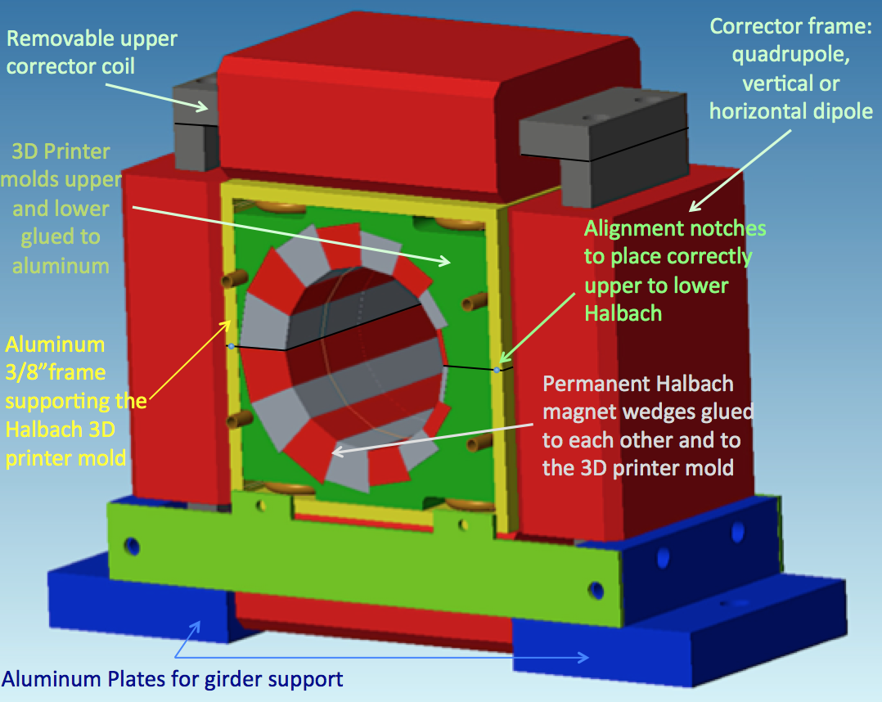
It is recommended that higher quality magnet (from Shin-etsu) be used instead of cheaper alternatives. –
Answer: We have built twelve magnets with ALSTAR-MAGNETICS (http://allstarmagnetics.com) and so far did not see any problem with the permanent magnet material. A difference in cost is 50% and our budget is very limited.
2% correction ability with Panofsky coils may not be enough. A part of this correction might be consumed to compensate temperature fluctuation.
Answer: As stated above we have tested twelve prototype Halbach magnets and the largest difference with respect to the expected gradient is ΔG/G ≤ ±0.2%. It has been decided to use 10 times the value ΔG/G ≤ ± 2%, mostly due to our limitation on the current density through the correction coils of <1 A/mm². We are using water cooling system through the aluminum supporting frame:
Copper pipes for the water-cooling system

Slide 23
My recommendation: provided that the vacuum chamber can be designed without much difficulty, I recommend, “Iron dominated magnet solution” due to the following reasons:
Easy correction capability with EM coils. Interaction issues appear to have been solved. Risk of PM demagnetization is smaller because of larger distance from the beam pipe compared to Halbach design. If it is really necessary, temperature compensation scheme can be incorporated.
Answers: The Halbach magnet comparison to the Hybrid-iron-magnets so far shows few not negligible advantages with respect to the Hybrid-iron-dominated magnets: first is the cost reduction, no interaction issues, simpler, smaller size, simple correction system, round vacuum chamber, dramatically smaller weight, excellent magnetic field quality (after the correction), etc. Following advice of the permanent magnet selection reduced the risk of demagnetization “3)”.

