Slide 1
Halbach Magnets: Design, Prototypes & Results

Slide 2
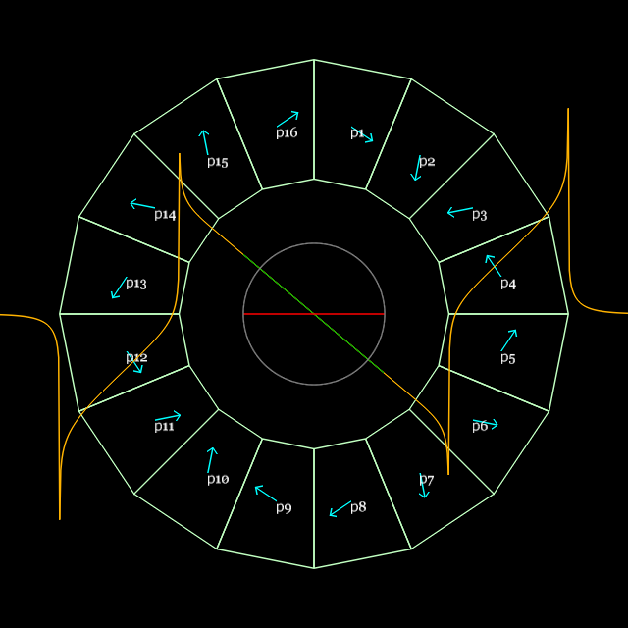
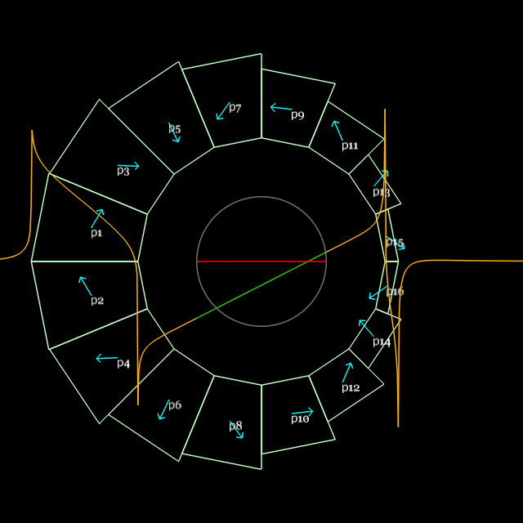
Prototype Design and Parameters
QF
Based on Dec 2015 lattice, when pieces were ordered (E_{max}=250MeV)
BD
Parameter | “QF” magnet | “BD” magnet | Units
Length | 57.44 | 61.86 | mm
Dipole B_{y}(x=0) | 0 | -0.37679 | T
Quadrupole dB_{y}/dx | -23.624 | 19.119 | T/m
Inner radius (magnet pieces) | 37.20 | 30.70 | mm
(shim holder) | 34.70 | 27.60 | mm
“Pole-tip” field (magnet pieces) | 0.879 | (-)0.964 | T
Outer radius (magnet pieces) | 62.45 | 59.43 | mm
(tubular support) | 76.2 | 76.2 | mm

Slide 3
250MeV Prototypes vs. CBETA 150
Parameter | CBETA QF | Prototype QF | CBETA BD | Prototype BD | Units
Length | 133.30 | 57.44 | 121.70 | 61.86 | mm
Gradient | -11.625 | -23.624 | 10.882 | 19.119 | T/m
Dipole at centre | 0 | 0 | -0.27690 | -0.37679 | T
Good field radius | 23.00 | 20.20 | 23.00 | 13.70 | mm
Blocks inner radius | 41.50 | 37.20 | 41.50 | 30.70 | mm
Blocks outer radius | 53.94 | 62.45 | 67.12 | 59.43 | mm
Max field in good field region | 0.267 | 0.477 | (-)0.527 | (-)0.639 | T
Max field at “pole tip” | 0.482 | 0.879 | (-)0.729 | (-)0.964 | T

Slide 4
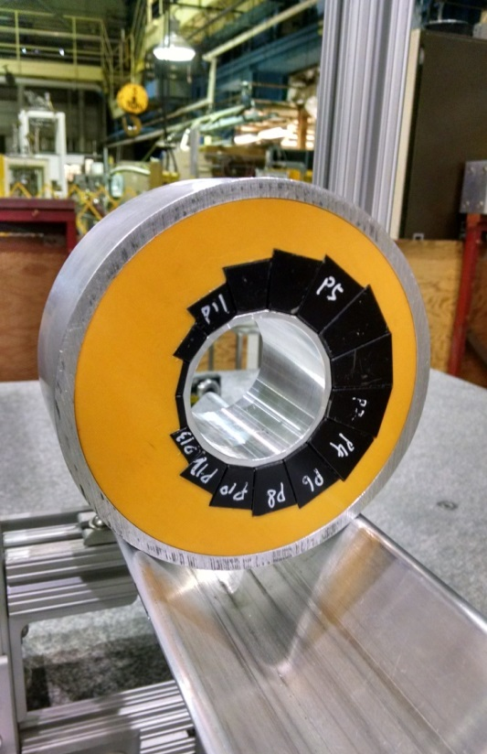
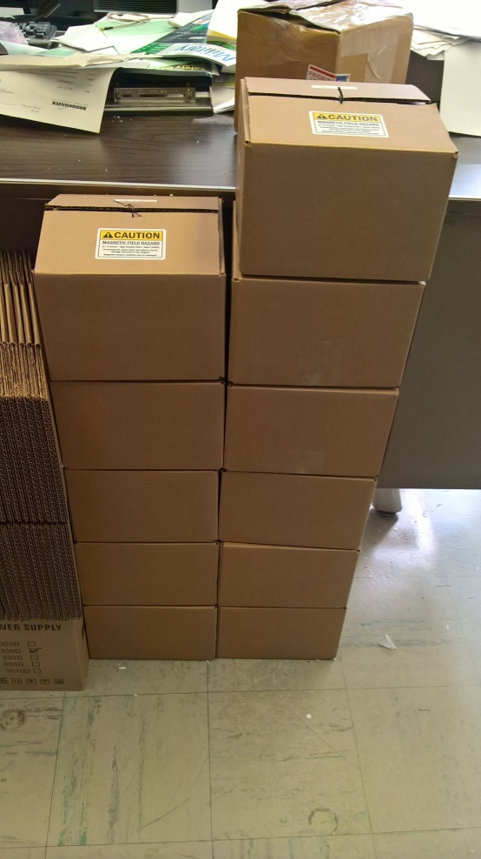
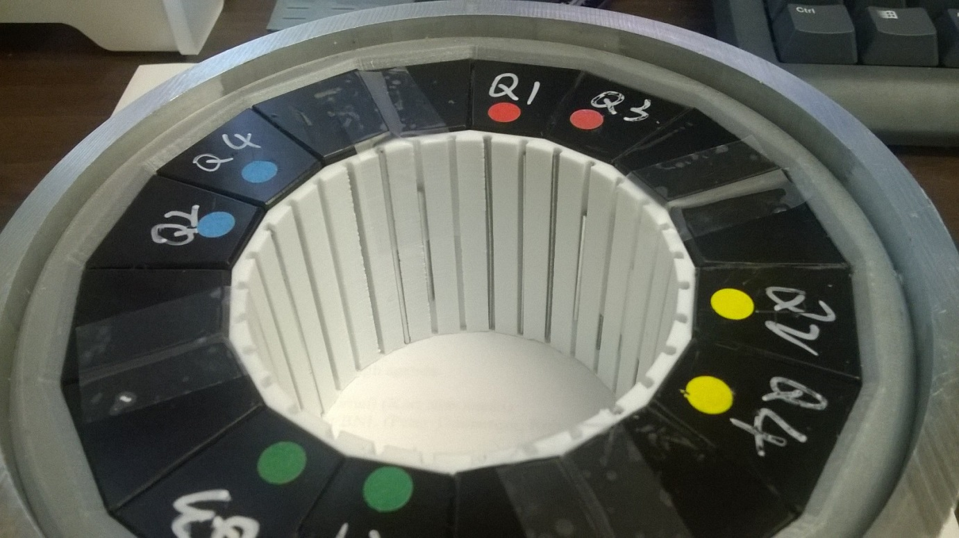
12 magnets (6 QF, 6 BD) have been built as part of CBETA R&D. Shimming (left) has been done on 5 out of 12 with good results.

Slide 5
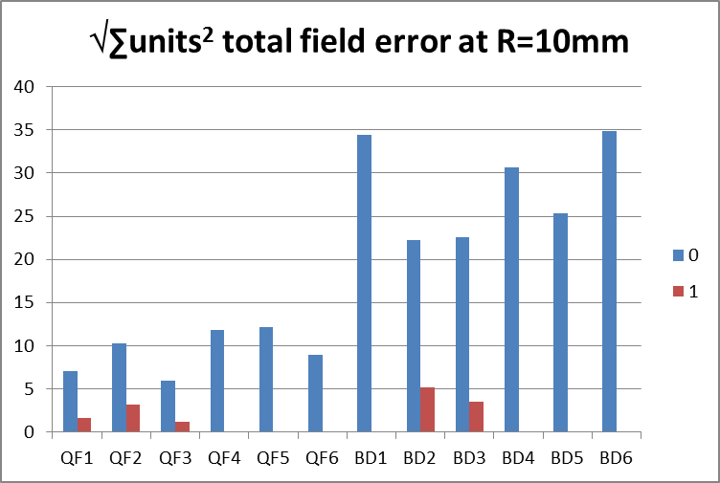
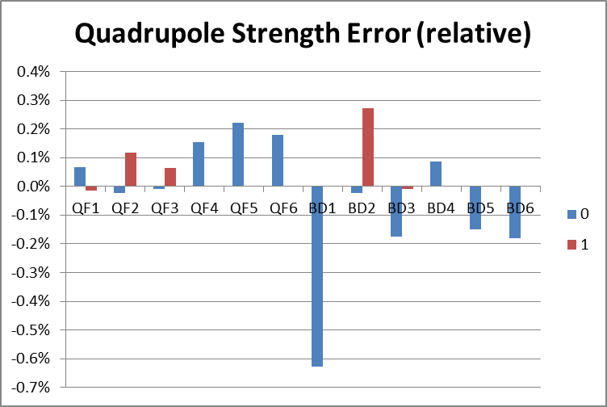
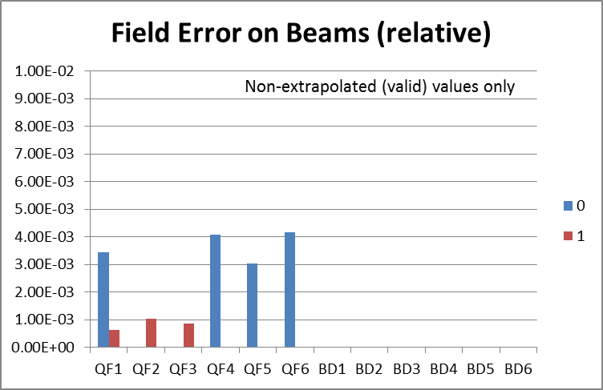
Prototype Field Quality Results
Measured on BNL magnet division’s rotating coil in Bldg. 902
“units” are 10⁻⁴ of main field
“0” is before shimming and “1” is after one iteration of shimming; extra iterations are possible

Slide 6
Best so far: QF3 (iter 1)

Slide 7
QF3 (iter 1) at R=25mm

Slide 8
Worst so far: BD2 (iter 1)

Slide 9
All QF shim iter 1 results

Slide 10
All BD shim iter 1 results

Slide 11
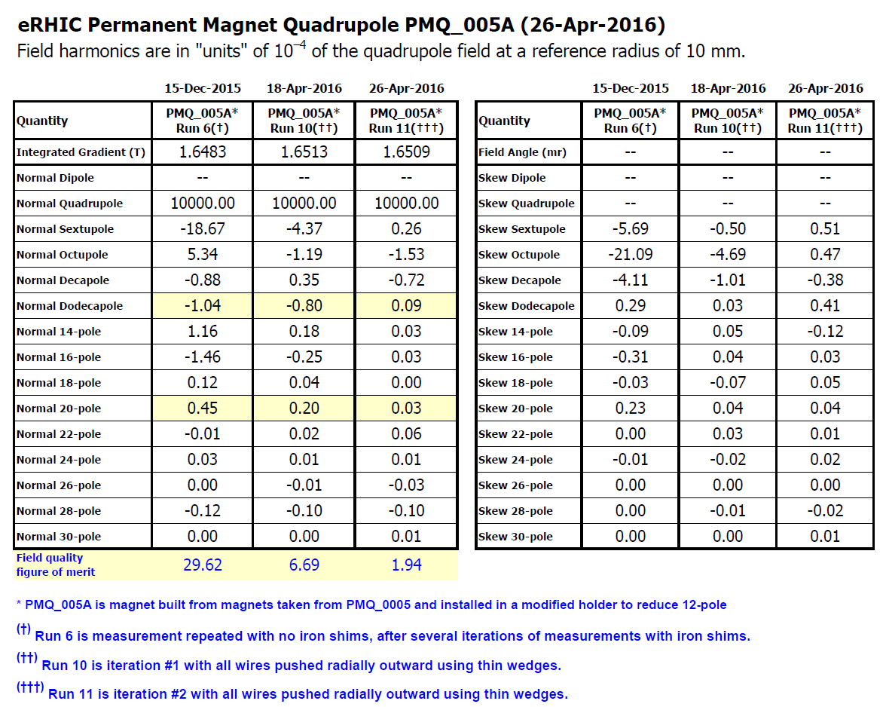
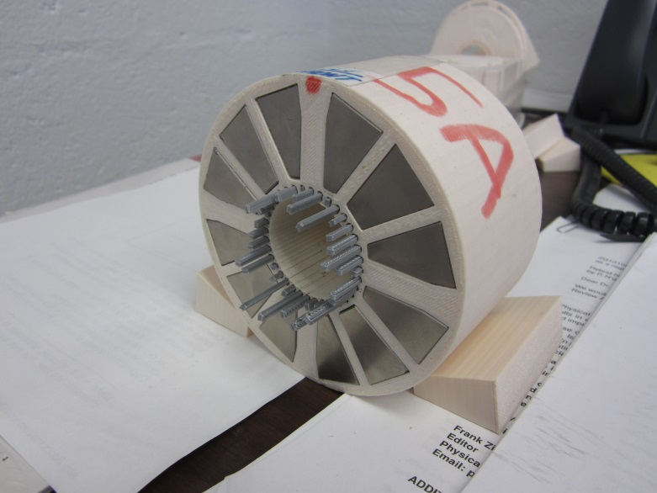
2nd shimming iteration on quad 5A
Of a previous test quadrupole magnet “5A”
3D printer was worse so had to use clamps for position accuracy!
1 iter → 4.4x, 2 iters → 15.3x

Slide 12
BD Design for CBETA 150MeV

Slide 13
QF Design for CBETA 150MeV

Slide 14
BD Assembly for CBETA 150MeV

Slide 15
QF Separation for CBETA 150MeV

Slide 16
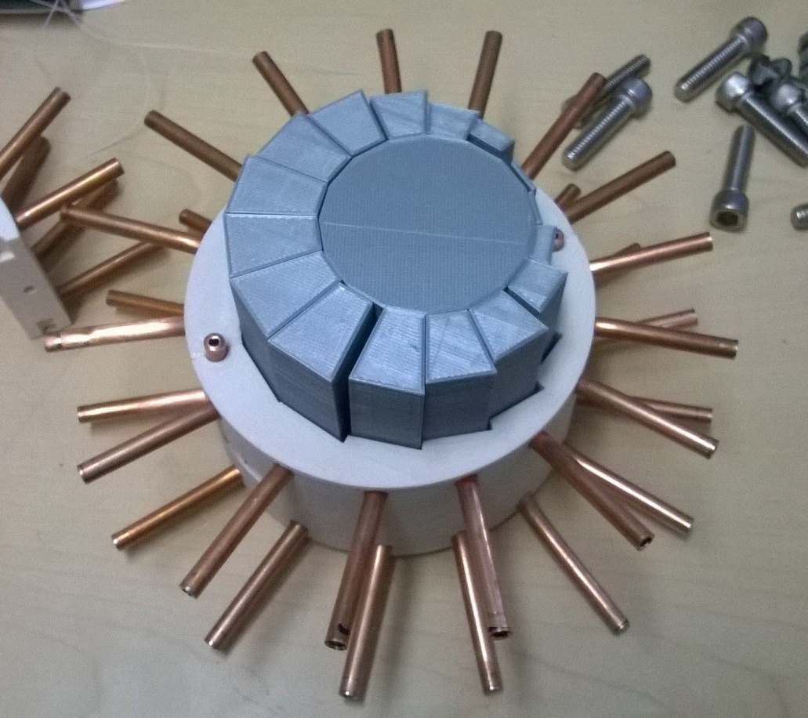
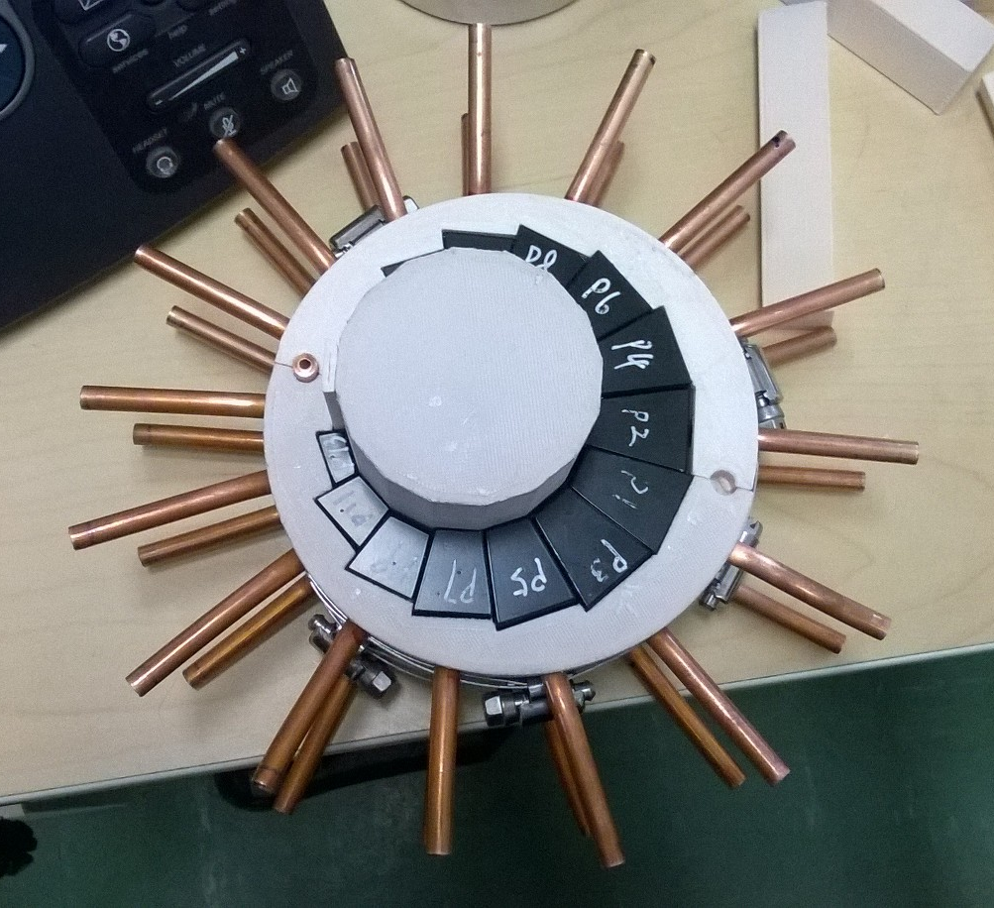
PM assembly using dummy blocks
Replace blocks one by one. This is how we did it, but manufacturer’s choice.

Slide 17
Controlled! assembly of two halves
Tooling concept by Steven Trabocchi

Slide 18
Magnet Sizes
Cross-sectional area of PMs:
QF = 34.3 cm²
BD = 51.9 cm²
Iron magnet 32*13.1 = 417.8 cm²

Slide 19
BACKUP

Slide 20
Magnet with 3D Printed Parts
Halbach quadrupole using NdFeB, 23.6 T/m, R=34.7mm bore (0.82T max), 10⁻⁴ errors at R=10mm
Material cost: $1100. No alignment better than 0.25mm required anywhere. Assembled with mallet.

Slide 21
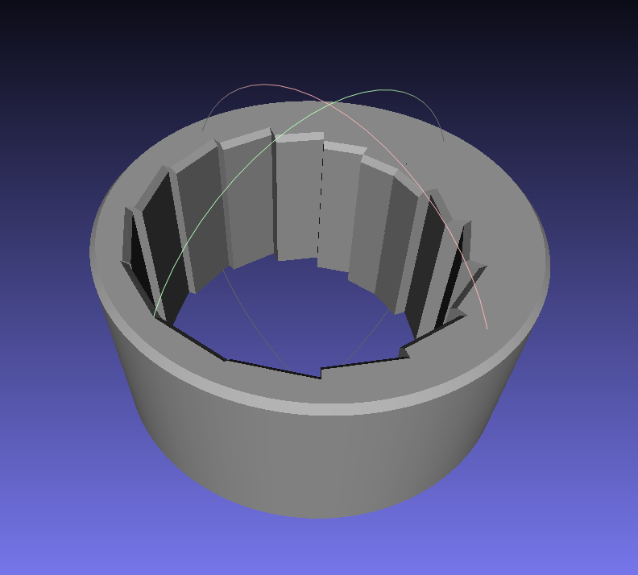
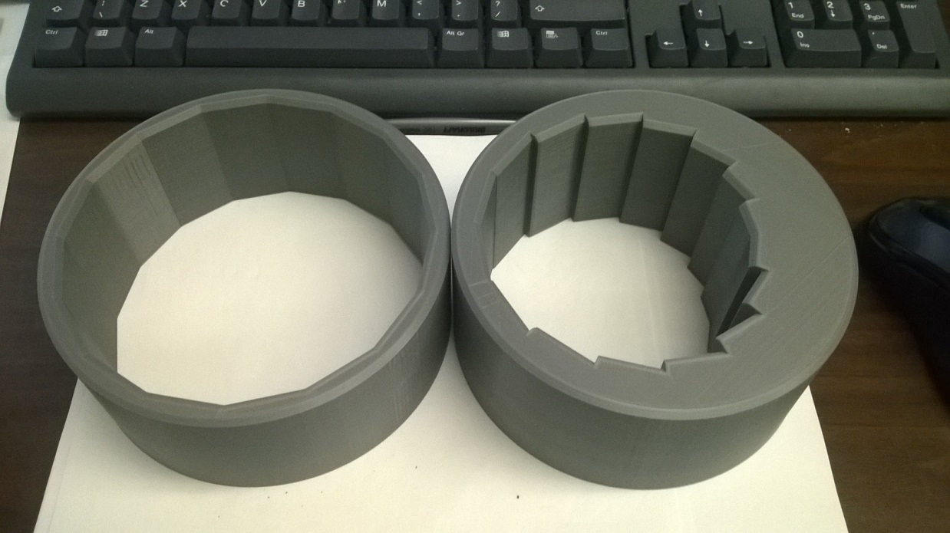
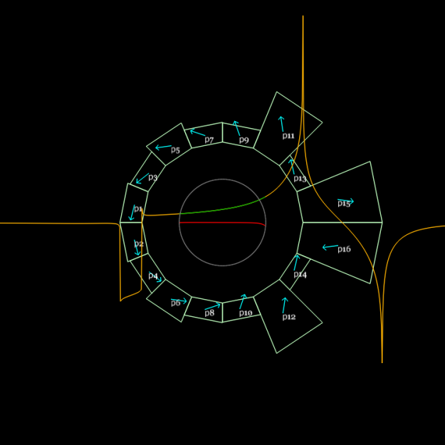
Custom and Cheap – is it possible?
Combined function dipole+quad
Magnet design program generates mesh
Design for B_{y} = B₀r^{k}
3D printed
Material cost: $800

Slide 22
Generalised Halbach design
My current sheet approximation code (PM2D) is good enough
Material grade: N35SH from AllStar Magnetics, B_{r}(eff.)=1.194T

Slide 23
Photos of magnets (unshimmed)

Slide 24
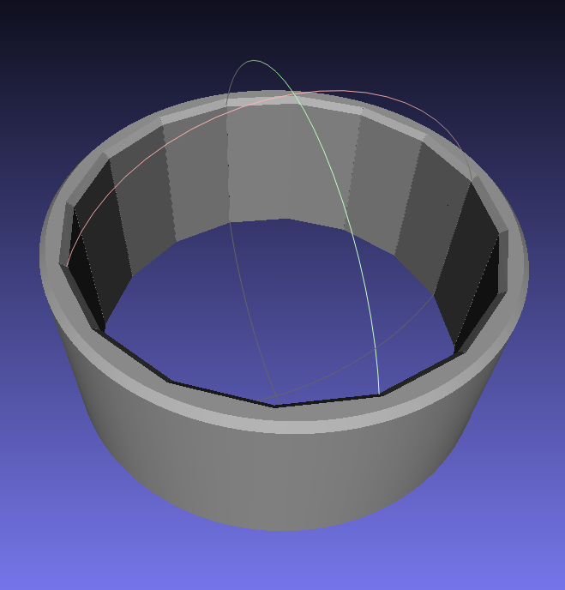
3D Printed Magnet Holder
Field optimiser
→ Magnet wedge dimensions
3D print file (.stl mesh)
and block spec. for manufacturer

Slide 25
Shimming Results (one iteration)
One iteration of shimming reduces multipoles by between 3.2x and 6.5x
Re-measured on different sized rotating coil check
Re-aligned the coil, check
Software error!
No improvement

Slide 26
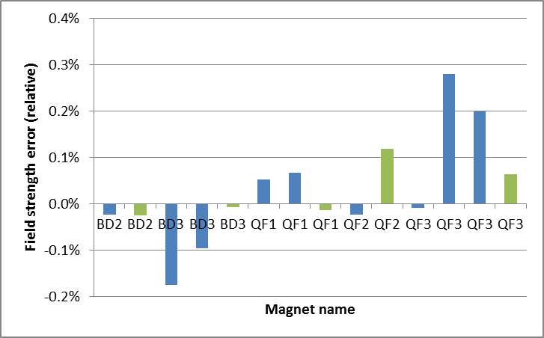
Field Strength vs. Spec
Average (integrated) quadrupole for 1st shim iteration:
-19.1142, -19.1176 T/m for BD
goal: 19.1191 T/m
23.6203 to 23.6514 T/m for QF
goal: -23.6236 T/m
Overall sign error because I got the Hall probe the wrong way around during block testing

Slide 27
Cost and Labour per Magnet
Permanent magnet wedges (AllStar N35SH)
$1052.67 per QF magnet (16 wedges)
$758.00 per BD magnet (16 wedges)
Labour ~8h per magnet: 3h measurement, 2h shimming, 2h assembly, 1h 3D printer setup
Required infrastructure
3D printer ($2-3k), used Ultimaker 2 Extended+
Rotating coil (~$50k)

Slide 28
Benefits
No power consumption
No power supply, no copper wires or windings
Any field shape you like within strength limits
No “cross-talk” between iron surfaces in compact lattices
Can be assembled with mallet
1e-4 accuracy is possible after shimming
Seems cheap, at least for short magnet length

Slide 29
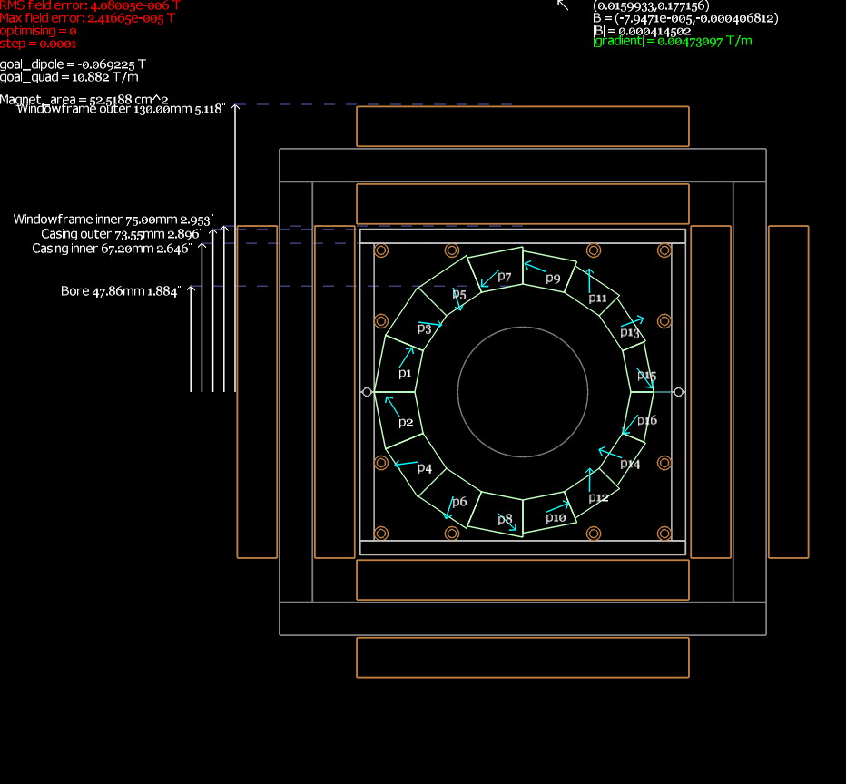
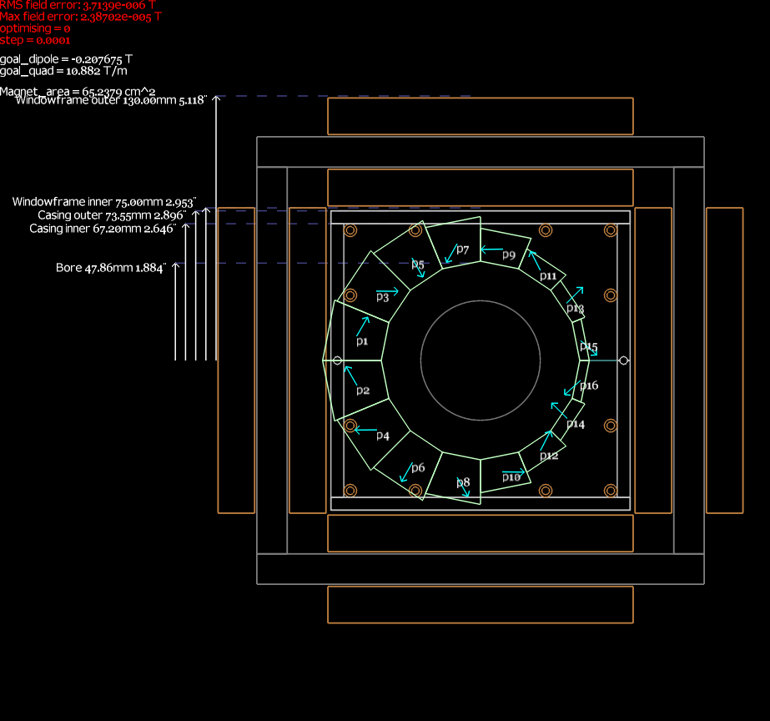
Transitional Magnets for CBETA

