Slide 1
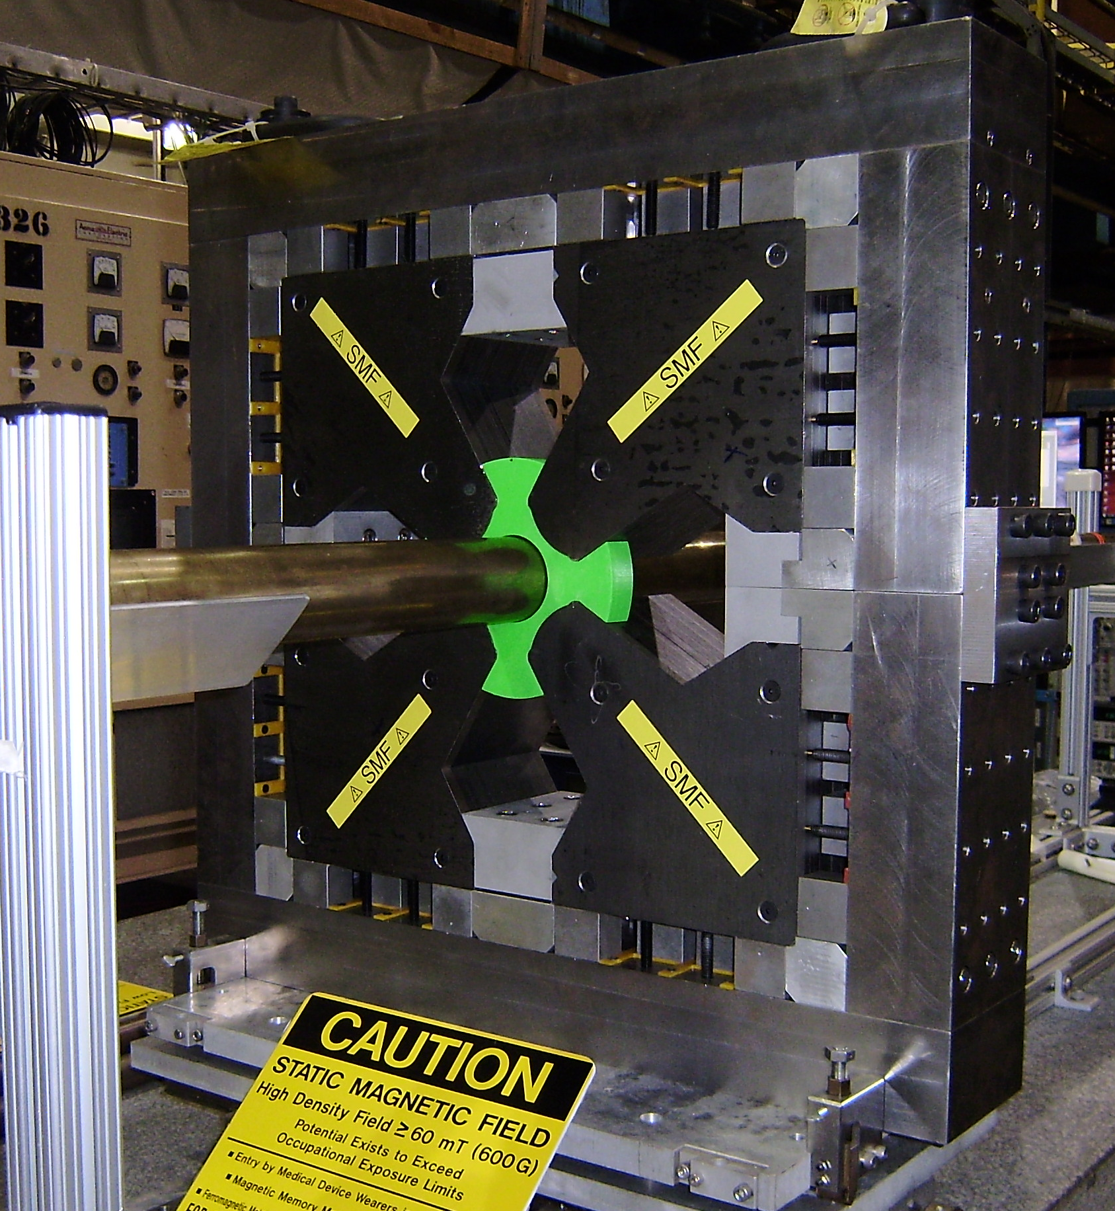

Slide 2
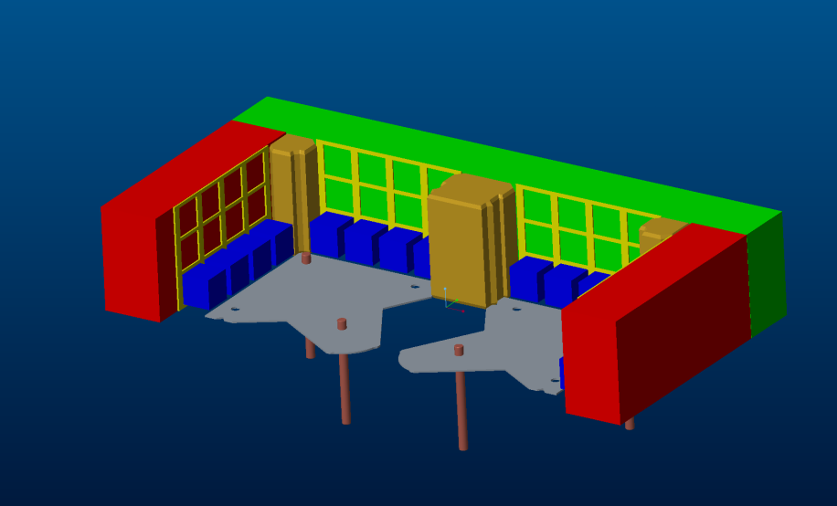
Methodology of assembly:
Add a row of permanent magnets.
Stack up laminations.

Slide 3
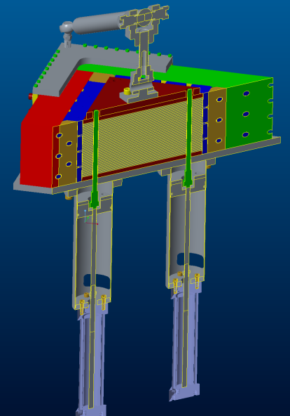
Assembly fixture used
Mechanically actuated hitch pin
Double acting air cylinders

Slide 5
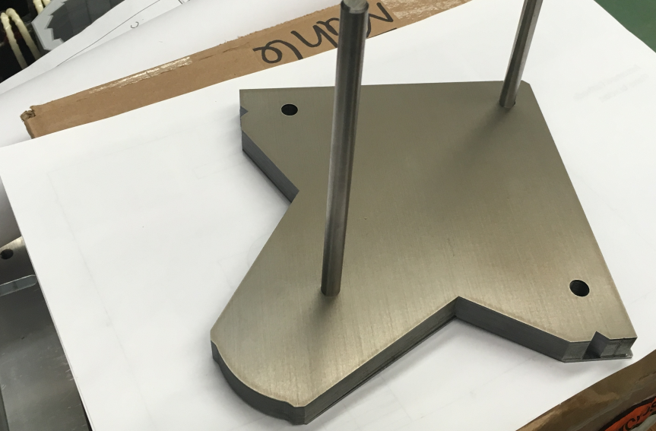
Arrows indicate potential lamination stack weld areas to reduce stack shearing movement.
Add hydraulics to improve stack density.

Slide 6
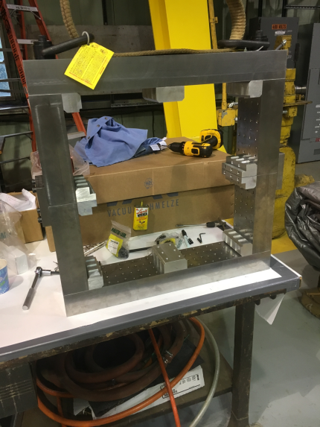
Magnet backleg assembly should be assembled, adjusted, and pinned before addition of permanent magnets and poles.

Slide 7
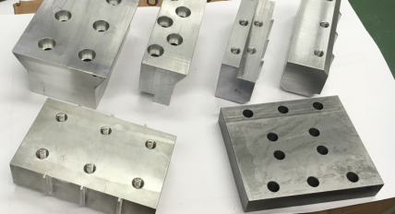
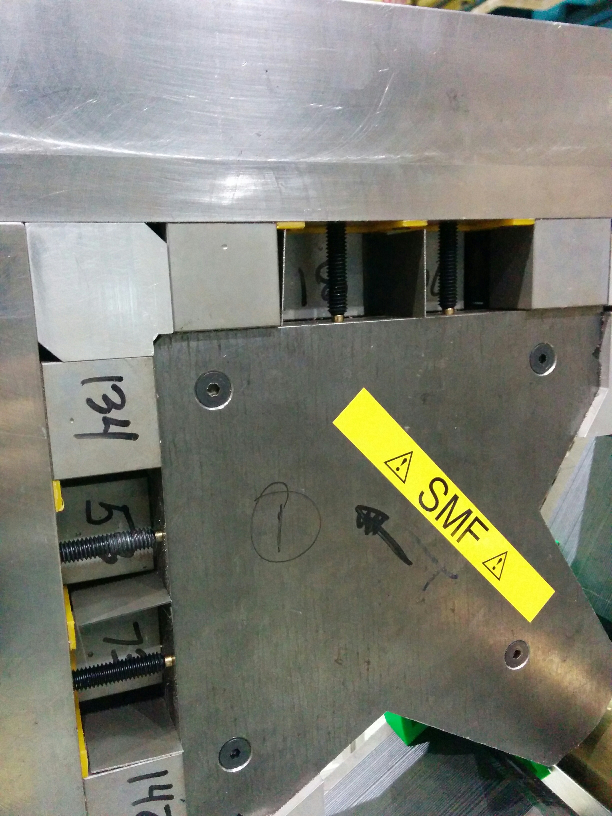
Issue
Worst problem encountered was the inconsistencies in size of aluminum spacers.
Use of permanent magnet jacking screws.
Re-measuring all components prior to assembly is essential.
Remediation

Slide 8
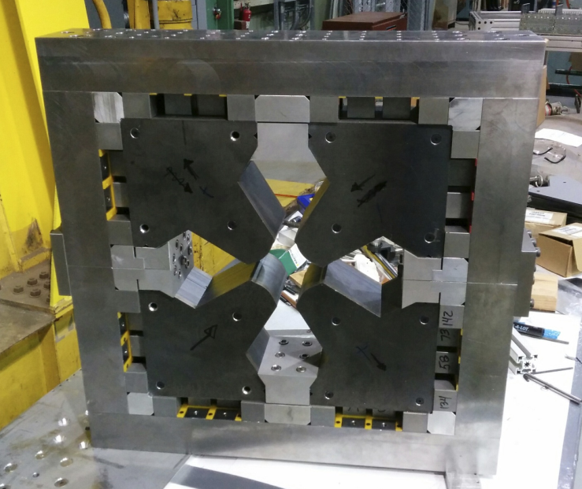
Issue
Tightening these screws problematic.
Remediation
Ordered non magnetic tools.

