Slide 1
Hybrid Magnets: Design and Status
(with contributions from the CBETA team)

Slide 2
Outline
Lattice and Magnet Requirements
General Concept
Prototype Magnet
Tolerances
Correctors
Path to Prototype Girder

Slide 3
Cell
Qf/Qd: identical gradient / aperture (different length)
Beam excursion: +/- 31mm
Design: tracking with 3D field maps

Slide 4
Requirements
Magnet to magnet variation
Permanent magnet tolerances (harmonics / gradient strength)
Temperature variation (harmonics, gradient strength)
Geometric tolerances (harmonics)
(Vibration – prefer no water cooling)
Correctors
Risk sheet: all risks can be reduced with sufficient corrector strength
In practice: corrector strength limited
Avoid using correctors for errors which can be addressed by magnet design
Systematic effects: not that critical
Need magnet design which can satisfy this

Slide 5
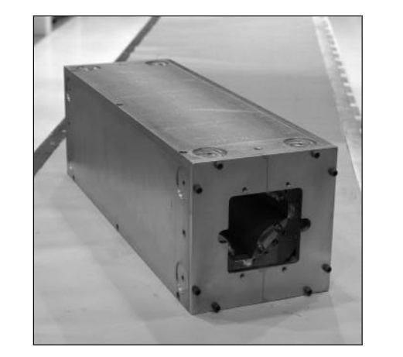
Magnet Concept: Hybrid
Demonstrated to work (Fermilab recycler)
Advantages
(Largely) conventional approach
Field quality determined by pole
Can only drive harmonics which are allowed by geometry
Tolerances
Laminations: shuffle
Small magnet to magnet variation
Permanent magnets: reduced to 1D problem
easy to deal with remaining tolerance
Passive scheme for temperature compensation

Slide 6
2D Geometry Qf/Qd
M
80% PM (N49M)
M
Size of magnets: driven by beam pipe requirements

Slide 7
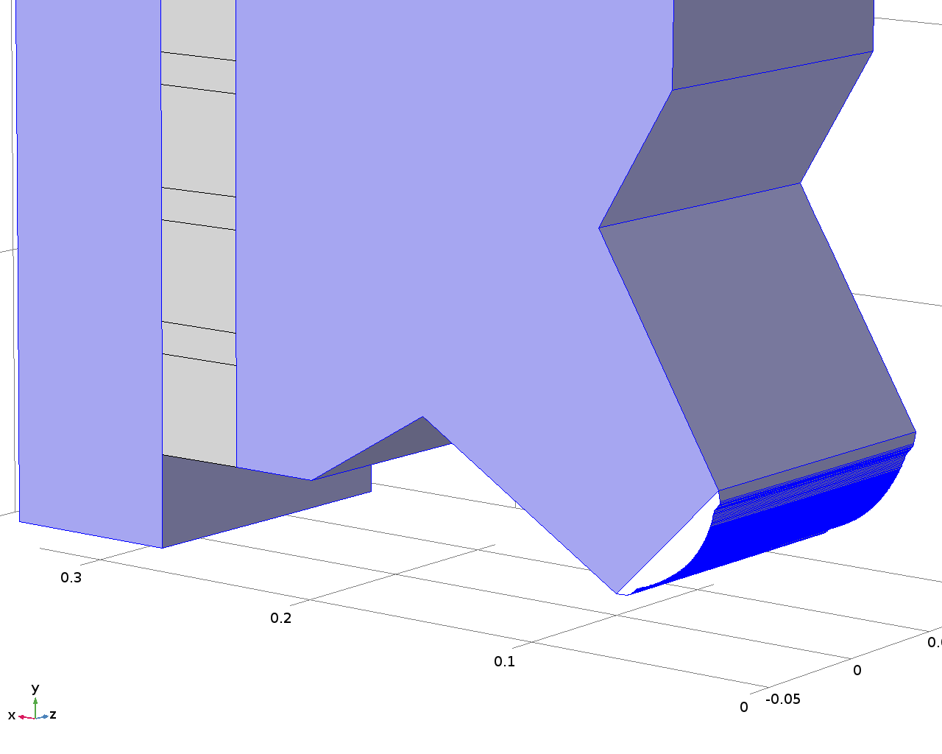
Higher Order Harmonics
Can be corrected with pole chamfer 30° reduces 12-pole to 6 units…
… but would trigger lattice re-design
Systematic effect – no problem for CBETA
R=36mm

Slide 8
Prototype Magnet
Fast track: SiFe poles
Reduced gradient to avoid saturation
Concept:
Use precision Al-spacers (red arrows)
Laminations rest on precision spacers
Design tolerance on spacers: +/-20um
After assembly
Tolerance spacers: 300um
Poles misaligned
Fix: use set screws to align poles
Calipers
Optical level
(not perfect!)

Slide 9
Comparison with Simulation
Real | Simulation | Run 8
b1 | --- | ---
b2 | 10000 | -10000
b3 | 0 | 0.07
b4 | 0 | -1.46
b5 | 0 | 0.06
b6 | -14.866 | 14.29
b7 | 0 | 0.09
b8 | 0 | 0.03
b9 | 0 | 0.01
b10 | -0.14323 | -0.65
b11 | 0 | -0.01
b12 | 0 | 0
b13 | 0 | 0
b14 | -0.0811 | 0.03
b15 | 0 | 0
Skew | Simulation | Run 8
a1 | --- | ---
a2 | 0 | ---
a3 | 0 | 0.13
a4 | 0 | -0.4
a5 | 0 | 0.13
a6 | 0 | 0.18
a7 | 0 | -0.11
a8 | 0 | 0.04
a9 | 0 | 0
a10 | 0 | -0.01
a11 | 0 | 0
a12 | 0 | 0
a13 | 0 | 0
a14 | 0 | 0
a15 | 0 | 0
No geometry
change
R=25mm

Slide 10
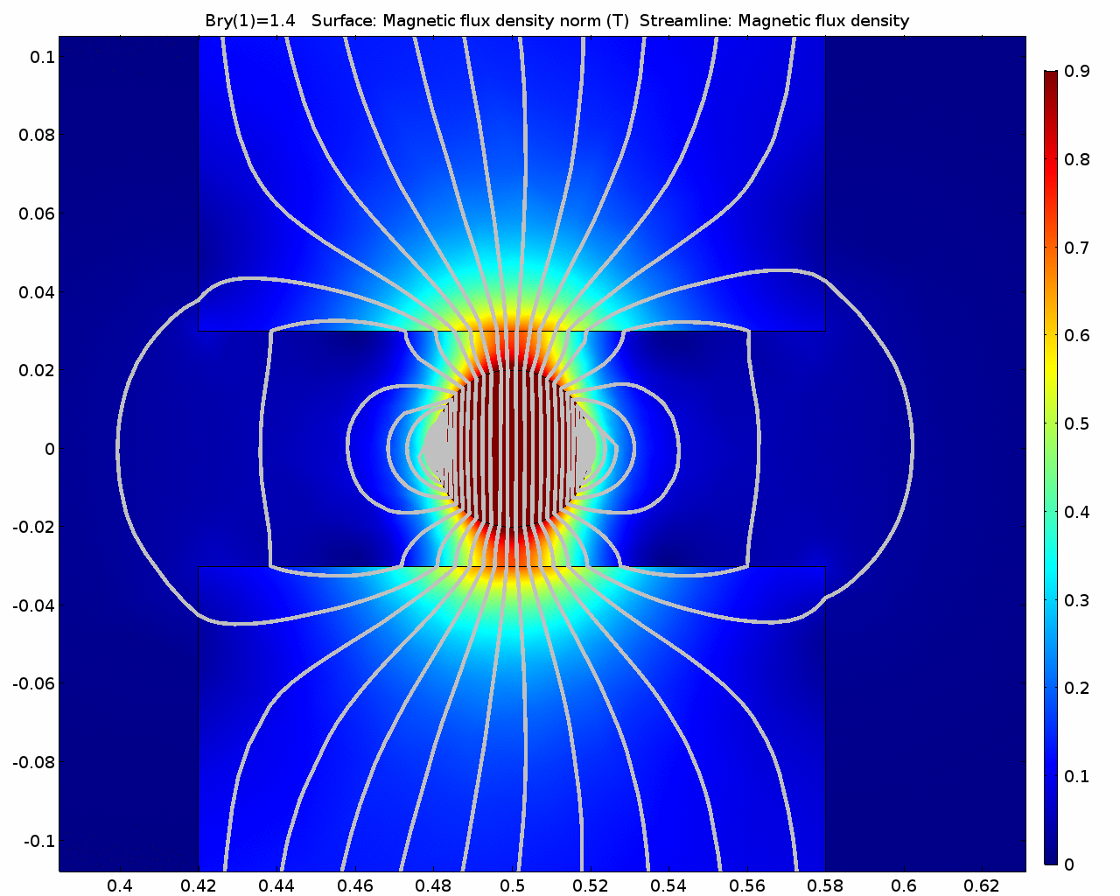
Tolerances: Permanent Magnets
B_{r,y}
Yoke
B_{r}
Largest tolerance: PMs
dx, dy, dz
B_{r,x}, B_{r,y}, B_{r,z}
Permanent Magnets
(from industry)
Magnetization 3-5%
Magnetization angle 1-3º
Hybrid magnet design
Important only flux through surface perpendicular to pole piece (B_{r,y})
Reduced all tolerances of PMs to one
Can be measured and corrected if necessary
d
B_{r,x}
Pole

Slide 11
Tolerances: Permanent Magnets
Statistics
128 permanent magnets per quadrupole
Random drawing: flux difference between poles <0.05%
Measure blocks and sort
Can reduce error to 10⁻⁶ level
(cost associated with this)
Correcting errors: magnetic shunts
Thin iron strip next to PMs
Locally short-circuits some of the flux
PM

Slide 12
Block Measurements
Much smaller spread than expected
B_{r} smaller than expected (but within +/-5% spec)
Blue: Qf
Green: Qd
Qd: +/-0.5%
Qf: +/-1%
Matching (iterative): error < 1x10⁻⁵

Slide 13
Angle of Magnetization
z
M
Angle of magnetization not important for hybrid magnet
y
x
Qf
Qd
Angle: γ

Slide 14
Pole Tolerance
Required pole accuracy?
Start with ideal pole and add error function
Amplitude +/-50um
(easily achievable with stamping)
Benchmarking
3D tracking
Look at orbit distortion
Result: no issue
Choose worst error function
Increase amplitude to 150um
Orbit distortion < 0.3mm
Pole shape very robust

Slide 15
Geometry / Field Quality
Pole area
Pole shape
Distances / tilt
Identical to other quadrupoles
Distance pole to back yoke
NdFeB: µ_{r}~1
Adds to air gap

Slide 16
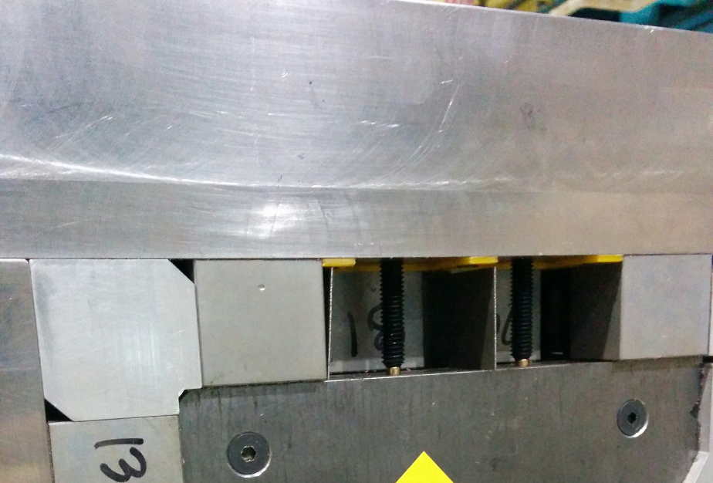
Shunting
Flux imbalance: ‘bad dipole’
(Dipole and sextupole)
difference in PMs
gap difference back-leg steel
Correction: magnetic shunts
thin strip of soft-iron next to PM
Shorts small fraction of the flux
1mm shunt: flux change about 1%
Prototype magnet
Gap changed due to inadequate precision spacers
6 units of sextupole
Corrected with shunts
Perfect agreement with simulations

Slide 17
Elimination of Sextupole
Real | Sim. | Run 1 | Run 8
b1 | --- | --- | ---
b2 | 10000 | -10000 | -10000
b3 | 0 | 6.25 | 0.07
b4 | 0 | -1.48 | -1.46
b5 | 0 | 0.46 | 0.06
b6 | -14.866 | 14.31 | 14.29
b7 | 0 | 0.01 | 0.09
b8 | 0 | 0.02 | 0.03
b9 | 0 | -0.01 | 0.01
b10 | -0.14323 | -0.65 | -0.65
b11 | 0 | 0.01 | -0.01
b12 | 0 | 0 | 0
b13 | 0 | 0 | 0
b14 | -0.0811 | 0.03 | 0.03
b15 | 0 | 0.00 | 0
Skew | Sim. | Run 1 | Run 8
a1 | --- | --- | ---
a2 | 0 | 0 | ---
a3 | 0 | -5.97 | 0.13
a4 | 0 | -0.22 | -0.4
a5 | 0 | 0.52 | 0.13
a6 | 0 | 0.18 | 0.18
a7 | 0 | -0.01 | -0.11
a8 | 0 | 0.04 | 0.04
a9 | 0 | -0.02 | 0
a10 | 0 | -0.01 | -0.01
a11 | 0 | 0 | 0
a12 | 0 | 0 | 0
a13 | 0 | 0 | 0
a14 | 0 | 0 | 0
a15 | 0 | 0 | 0
Run 8:
158mm length
shim to pole 4
R=25mm

Slide 18
Octupole Error (b4/a4)
a=c
b=d
a≠b
c
B
b
A
d
a
Very likely – wouldn’t show up in optical survey (optical level)
CMM survey underway to confirm
Jack Tanabe, Iron Dominated Electromagnets Design, Fabrication, Assembly and Measurements, SLAC 2005.

Slide 19
Temperature Compensation
NdFeB: (∆B/B)/∆T≈-1.1x10⁻³/K
(have two vendors which guarantee this value)
Compensation scheme: 30-32% Ni-Fe
Pioneered by Fermilab
Curie temperature of 60°C
B_{sat}=0.3-0.1 T (20-45°C)
Required Ni-Fe: about 20% of PM
Thermoflux TX65/100
NdFeB
NiFe
Top
Side

Slide 20
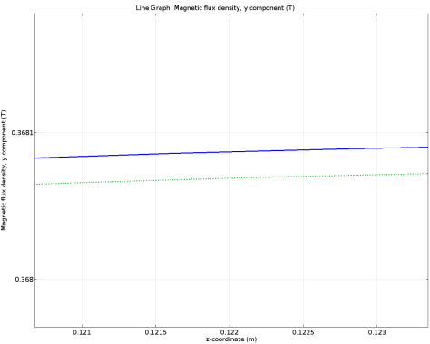
3D NiFe Temperature Compensation
Qf, field at outermost aperture
Not shown: same for Qd / individual magnets
NiFe
0.3681T
20ºC
30ºC
0.368T
z (m)
Demonstrated (exp.) temperature coefficient (%/K):
uncompensated: -0.103
Compensated: <-0.003

Slide 21
Variation of B_{r}
Magnets designed for B_{r} of 1.37T
But B_{r} could also be 1.42T
CBETA: easier to deal with higher gradient
Can reduce gradient, but not increase (easily)
Systematic change
Temperature compensation?
Fill horizontal slots during assembly
Longitudinal space required (width)
Nominal: 8.25mm
B_{r} =1.42T: 8.5mm
Also: μ_{r} of PMs not guaranteed property
Blue: NiFe
Available hor. gap: 12mm
Can correct for 3% gradient difference

Slide 22
Magnet Manufacturing
Vendor C
Permanent
Magnets
Vendor D
Raw Material Iron
Vendor A
Assembly
Vendor B
Laminations
Shunt to cancel unwanted harmonics
Rotating Coil Measurement
Temperature compensation:
PM properties and NiFe specs guaranteed
Can calculate required amount of NiFe
In addition: take samples and verify with c-core magnet (1 PM + NiFe per pole)
Shunting to get gradient identical
Girder

Slide 23
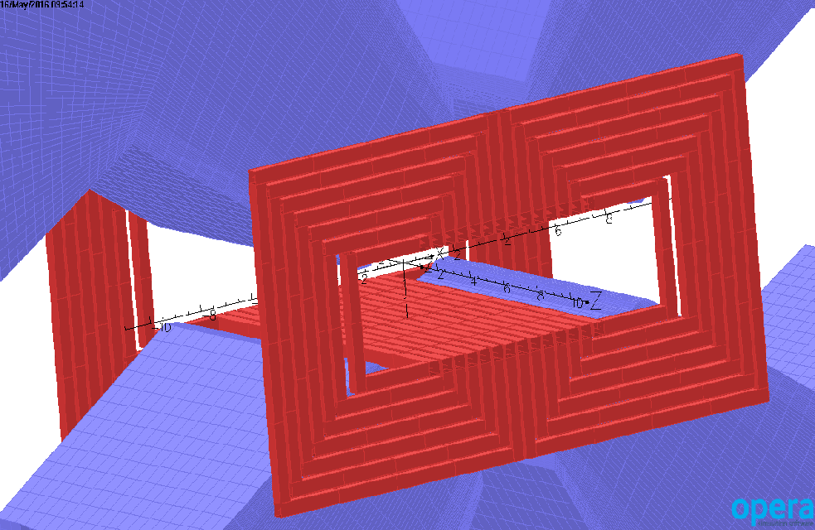
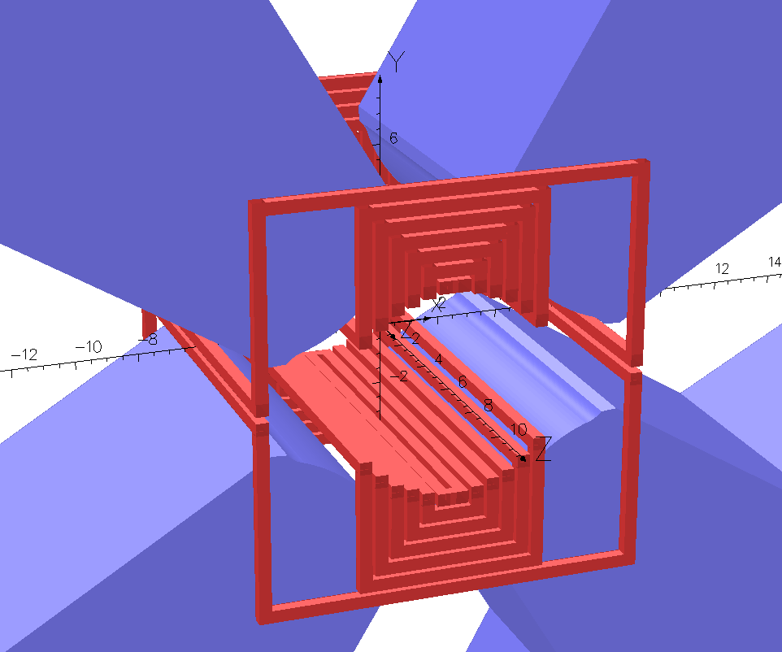
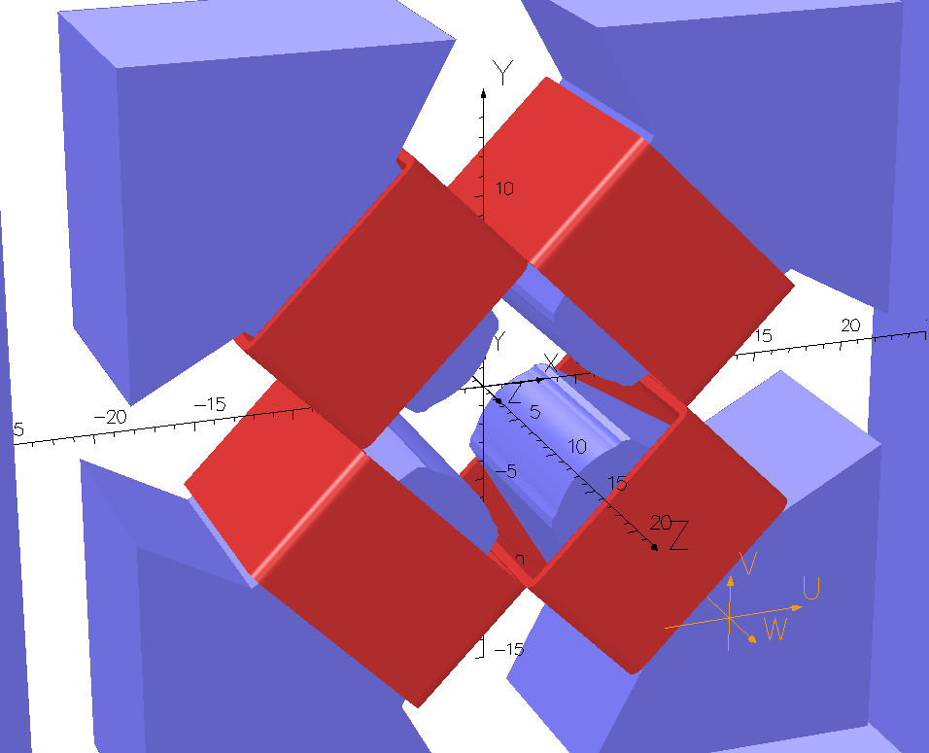
Correctors
Dipole correctors
Normal: 347.26 Gauss.cm (ΔB/B≤~5x10⁻³)
Skew: 590 G.cm (ΔB/B≤~8x10⁻³)
Quad corrector: +/- 4%
Gradient quality unaffected by quad corrector
All air cooled
With engineering at the moment
Manpower limited

Slide 24
Crosstalk
Distance between magnets comparable to aperture
Flux leakage, drives neighbouring magnet
10% effect
Predicted accurately?
Yes, by FEA
Need enough elements
Check solver tolerance
Worst case scenario
Systematic change
Can correct for this by offsetting magnets
Benchmarking: Opera vs Comsol
Will measure this with prototype magnets
Opera Model
F
D
D
F
D
Iron only

Slide 25
Difference Map
Remaining difference caused by coarse mesh
Turnaround times
Opera 2.5d
Comsol: 4h
Not a concern

Slide 26
eRHIC
Solution scales easily
General: eRHIC magnets are easier
CBETA: stretch in terms of gradient / aperture
This are long magnets
No crosstalk
Block sorting quite possibly not required
Larger number of PMs per magnet
Shunting works well
Much easier logistics
Cost savings
Company (SBIR): down-select of different magnet types (incl. Halbach)
This is cost-efficient structure

Slide 27
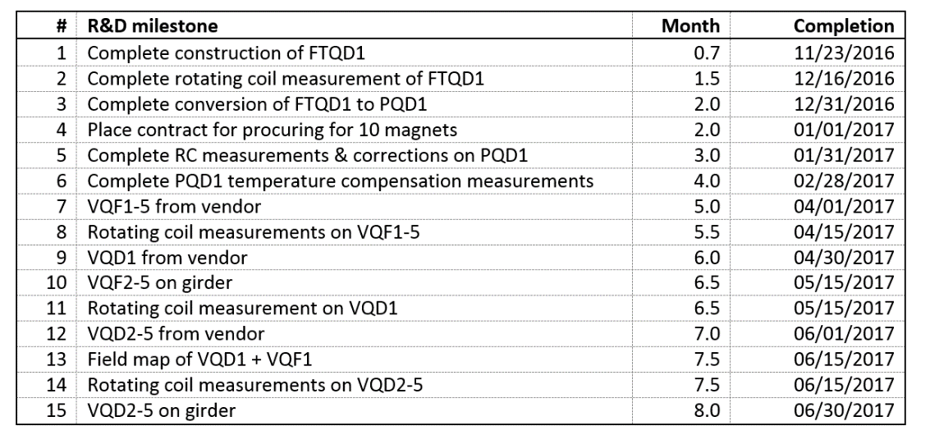
Schedule
Surveying of fast-track prototype magnet
Upgrade to full prototype Qd
Good quality iron
Full strength
Temperature compensation
Prototype Girder options
A: start procurement after full prototype
B: start procurement immediately, prototype in parallel
Option A
Option B

Slide 28
Preferred Route: Option B
Gain: 2.5 months
Confidence in magnet design
No surprises
Prototype shows good agreement with simulation
Octupole due to pole misalignment, should disappear
Shunting works, fast and efficient process
Temperature compensation shown to work in tests at BNL
Minor design modifications can be made after prototype girder

Slide 29
Conclusion
CBETA
Prototyping of essential technology for eRHIC
Chosen design: Iron dominated magnets
Essential: small magnet to magnet variation
Need to keep tolerances under control
Permanent magnets
Large tolerances on magnetic moment / angle
Hybrid magnets: designed to cope with that
Prototype magnet
~2 units out of 10000 (R=25mm, up to 20-pole)
2 units octupole: likely caused by pole misalignment (conformation underway)
Correctors
Normal/skew dipole, quadrupole

Slide 30
Additional Slides

Slide 31
Fast Track Qd Magnet

Slide 32
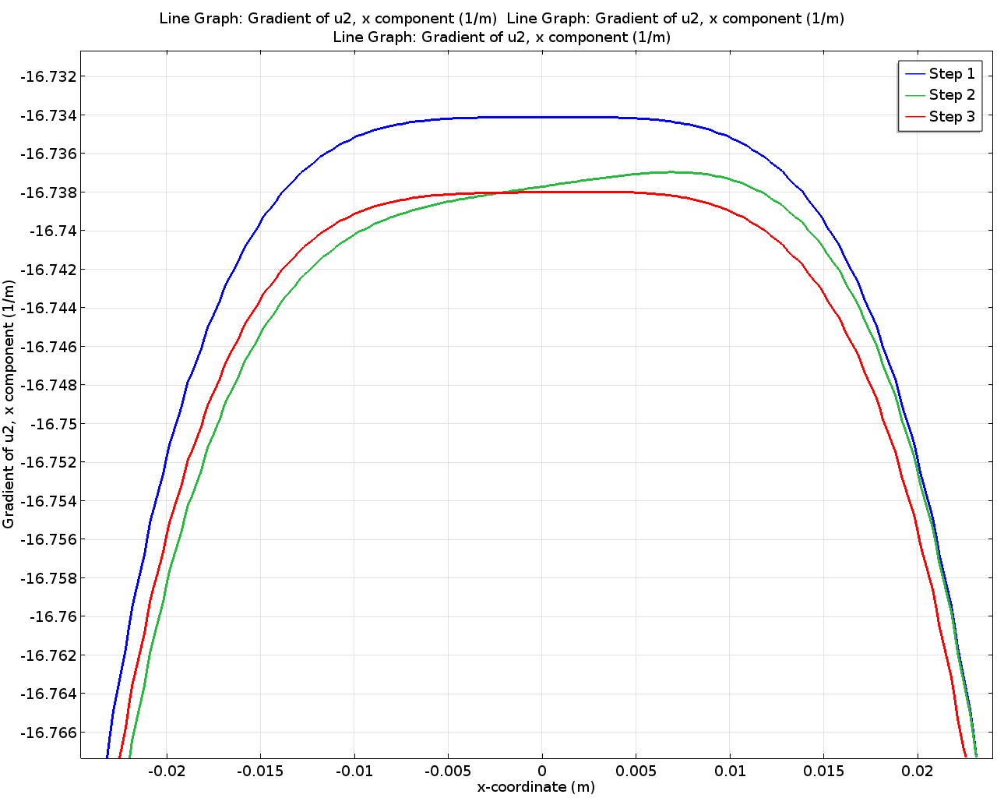
Hysteresis Effects
Assembly error
One quadrant: assembled with wrong polarity
Can be studied with Jiles-Atherton material model
Small effect on gradient
Cure: cycle quad corrector (Step 3)

Slide 33
Quad Corrector
Can be air-cooled
+/-4%
G/G_{0,nominal}
0.96
1.0
1.04
x (m)
Coil: 8x10mm²
J = 1A/mm²
Gradient quality unaffected by quad corrector

Slide 34
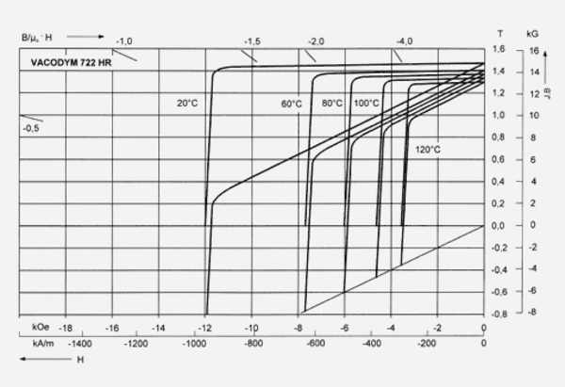
Materials
Iron
Low carbon steel
JFE-EFE: procured recently for large magnetic shielding project
BH curves for as delivered, machined, machined+annealed
(SiFe no change in gradient or quality)
Permanent Magnet
Grade: N49

Slide 35
Magnetization
200 MeV
150 MeV
1.8T
1.4T
Less stringent requirements on iron

Slide 36
Helmholtz Coil
Variation in permanent magnets: Match PMs to deliver same amount of flux to each pole
Thanks to Toshiya Tanabe & Chris Eng (BNL Insertion Devices Group)
Mike Anerella, Jesse, Ray + Mike

Slide 37
Geometry Errors
Back-yoke
Introduces sextupole
Same as imbalanced poles
Pole (100um)
Changes:
 | Bn | An | Bn | An
1 | 0 | 0 | 0 | 0
2 | 0 | 0 | 0 | 0
3 | -1.6 | 1.6 | -1.7 | 0.8
4 | 0 | 0.5 | 0.5 | 0.4
5 | -0.6 | -0.6 | -0.5 | -0.4
6 | 0.5 | 0 | 0.4 | 0
Shifted Shifted+rotation
Poles will be aligned to 25um

Slide 38
Assembly
PM: 35x37.3x28.5 mm³
Holding force: >30kg
Adjacent PMs repel….
Grid
… unless they have iron on both sides
53/58 laminations (2mm thick)
8mm end lamination
Courtesy of George Mahler

Slide 39
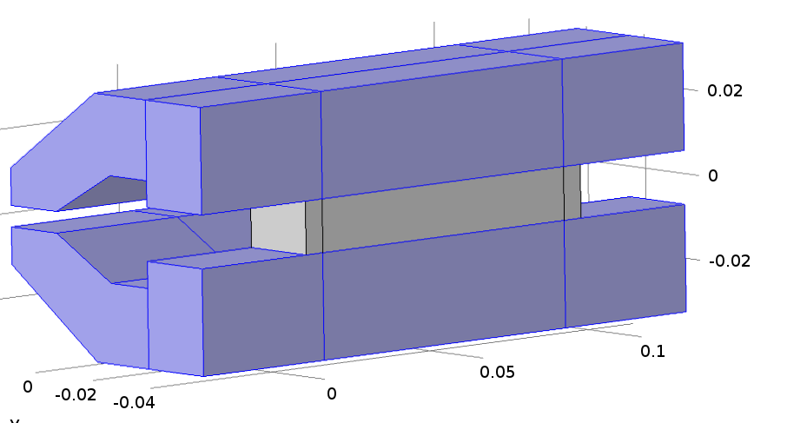
Variation of Temperature Coefficient
NdFeB: (∆B/B)/∆T≈-1.1x10⁻³/K
Not guaranteed property
So far: Thermoflux 65/100G
Alternative: 45/100S?
Advantage:
B_{sat} larger slope
Smaller saturation field
Need less material for same effect
Example: c-core magnet
5.5 mm vs 8 mm
Disadvantage: smaller temperature range
15-30°C (vs. >10-40°C)

Slide 40
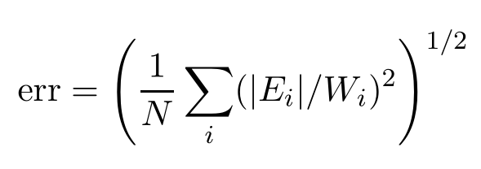
Opera DFDFD Model
N: DOF
E: Estimated error
W: Scaling factor (1)

Slide 41
Gradient quality (2D)
Requested: 1%
Hump: orbit compression
ΔG/G₀
Beam excursion: 31mm

Slide 42
3D Integrated Gradient Quality
Caused by end effects of magnets
(N.b. This works!)

Slide 43
Grid Concept
PM sizes
Qd: 35x37.3x31.2 mm³
Qf: 35x37.3x28.5 mm³
Small PMs vs. big PMs
Matching (statistics)
Holding force (60 lbs)
Space in between PMs
Temperature compensation
Shunting
NiFe

Slide 44
Bench Test
Material: VAC 745TP
Temperature coefficient (%/K)
uncompensated: -0.103
Compensated: <-0.003
NiFe

Slide 45
Discrepancy in Quad Strength
Quad strength within 2%
Good, but not great
(Demonstrator was closer)
Likely reason: set screws
Ferro-magnetic
Will act as shunt
Number of options
Wait for ‘full’ prototype
Worst case: systematic error

