Slide 1
Test of a Permanent Magnet Quadrupole Placed in a Dipole Field
Animesh Jain
April 13, 2016

Slide 2
Magnet Details
Halbach type permanent magnet quadrupole assembly
  Two 60 mm long permanent magnet quadrupoles
  (PMQ_0001 and PMQ_0002) separated by a 60 mm spacer.
  Integrated gradient of assembly = 3.775 Tesla
Window frame dipole corrector
  Horizontal and vertical dipole field coils
  Integrated dipole ~ 5.74 x 10^{–3} T.m at 10 A (measured).
  Yoke length ~ 0.23 m; Central field ~ 20 mT at 10 A.
  Harmonic errors ~ 10^{–3} of dipole field at 10 mm radius
The goal is to study whether field superposition is valid for a permanent magnet quadrupole inside a dipole, as expected from Opera simulation results.

Slide 3
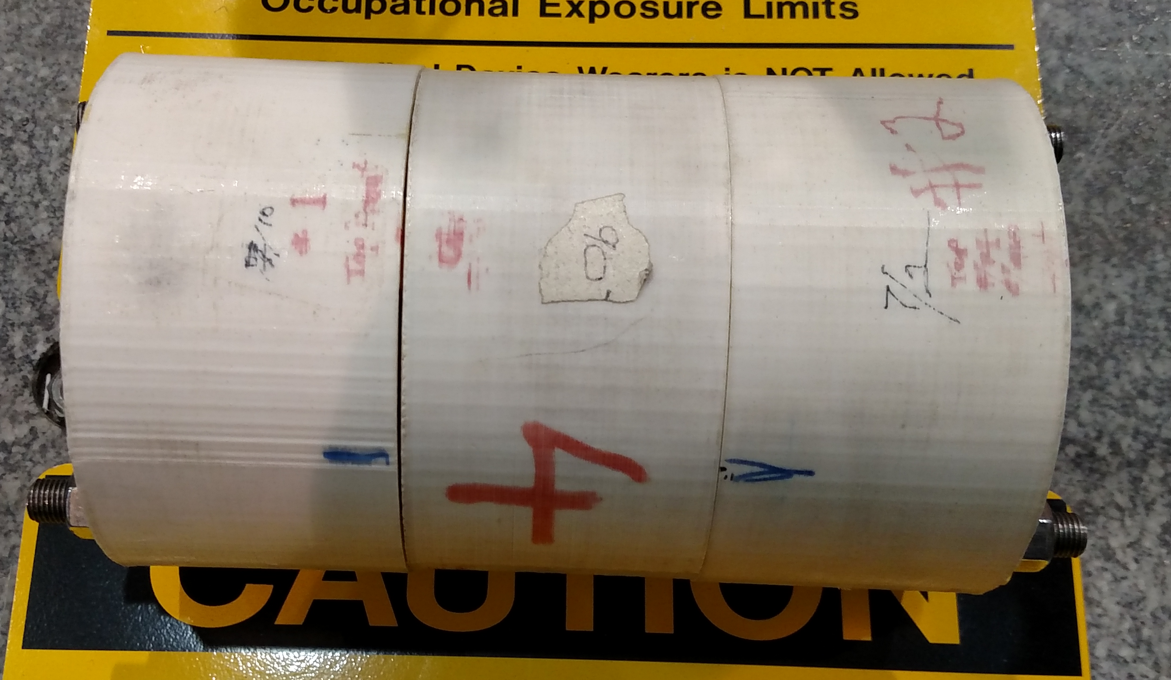
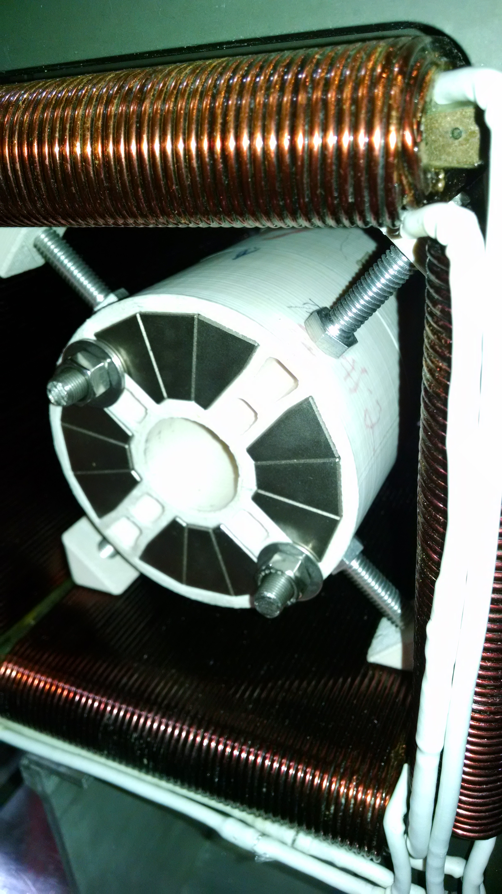
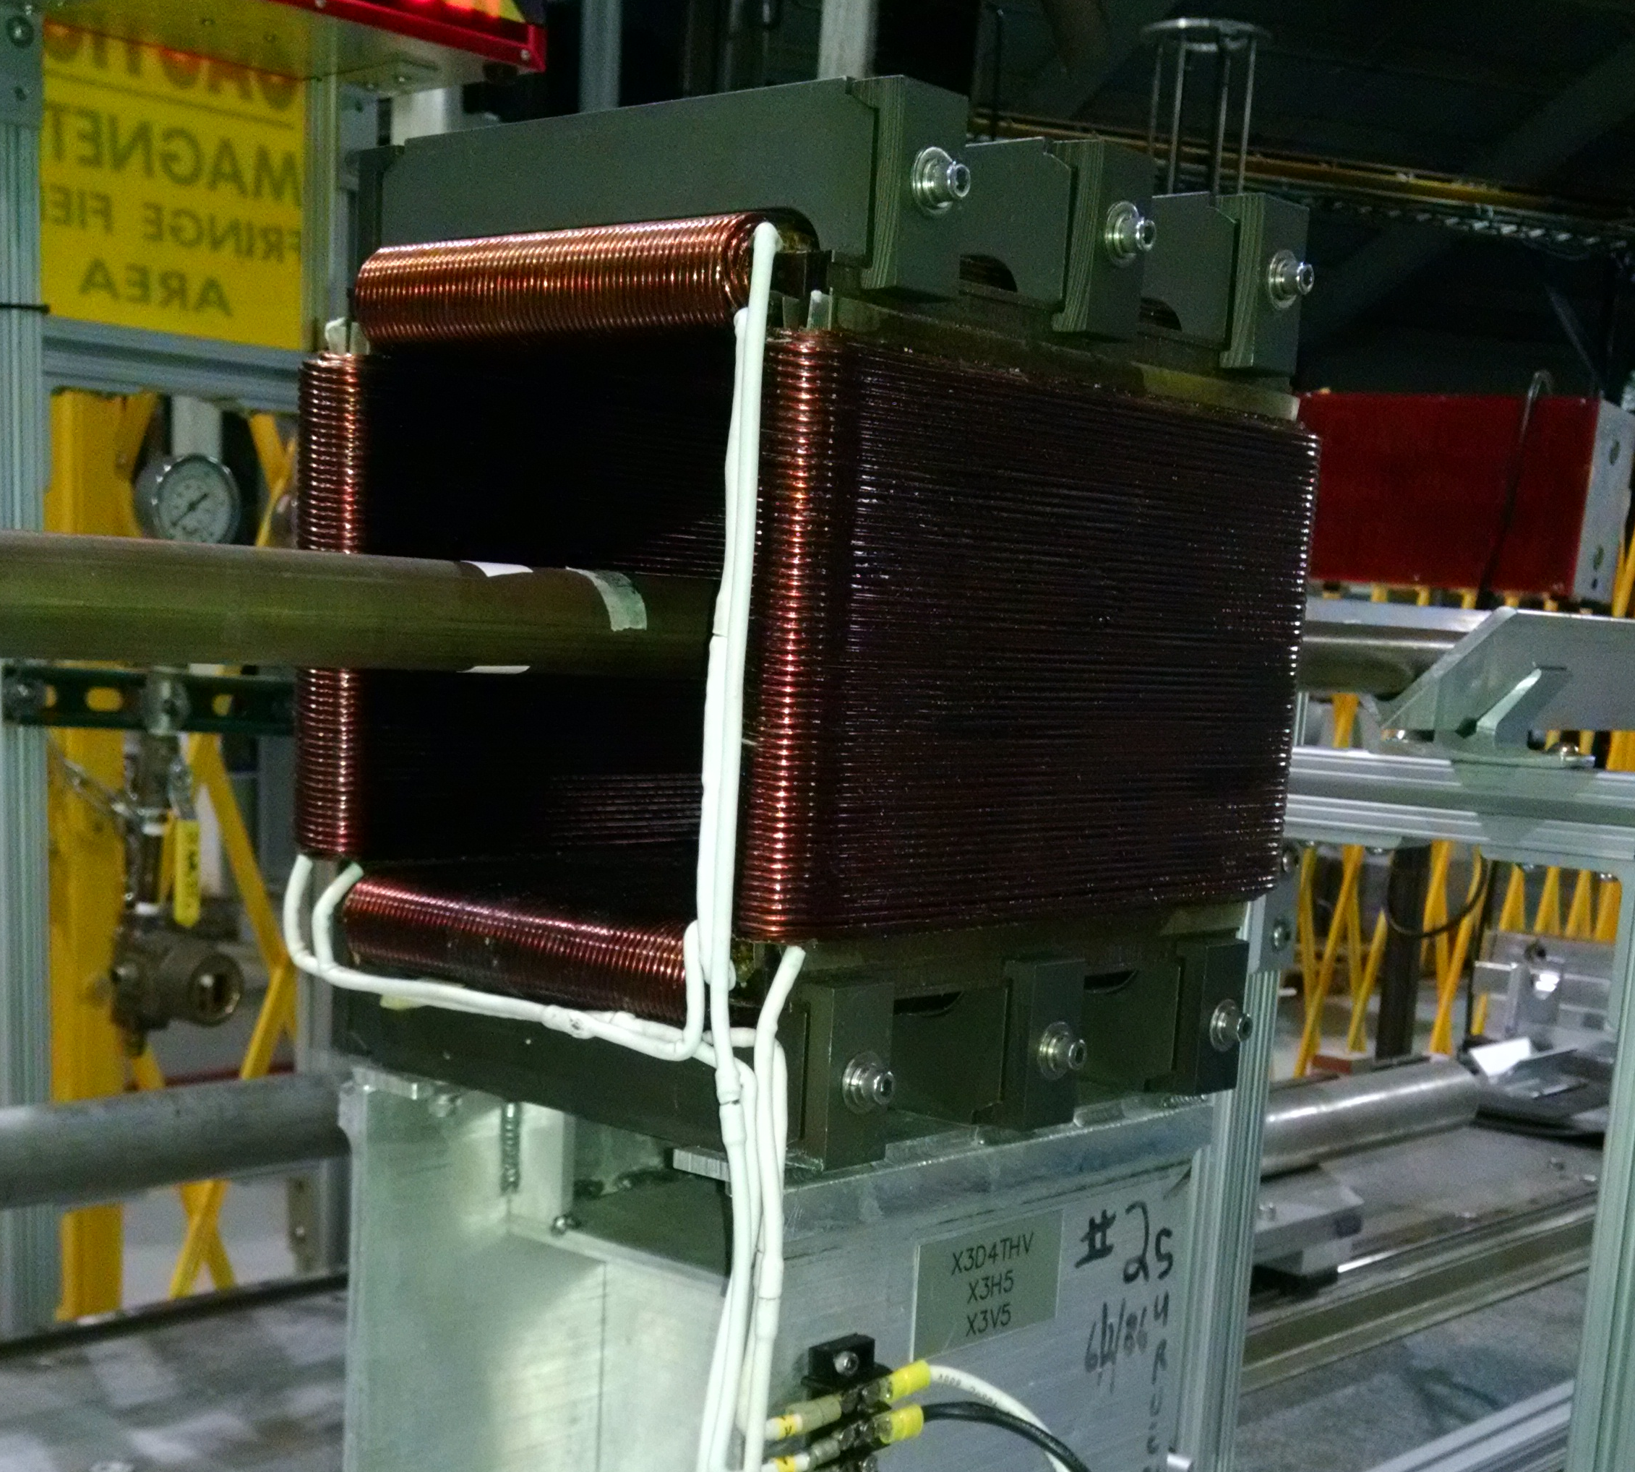
Magnets
PMQ #1
Spacer
PMQ #2
Window frame dipole
Quad assembly inside dipole
(Approximately centered)

Slide 4
Measurement details
All measurements were made with a 1 m long rotating coil. The harmonics are expressed at a radius of 10 mm.
The following configurations were measured:
  Permanent magnet quadrupole by itself ()
  The dipole magnet by itself, powered at 10 A (,Ž,)
    (horizontal field, vertical field, horizontal + vertical field)
  Permanent magnet quadrupole inside the dipole
    Dipole unpowered (baseline field) ()
    Horizontal field coils at 10 A (‘)
    Vertical field coils at 10 A (’)
    Both horizontal and vertical field coils at 10 A (“)
Check: + = ‘; +Ž = ’; + = “
Some error due to background fields counted twice.

Slide 5
Effect of Window Frame Yoke Only



Slide 6
Effect of Window Frame Yoke Only



Slide 7
Superposition for Horizontal Field Dipole


‘

Slide 8
Superposition for Horizontal Field Dipole


‘

Slide 9
Superposition for Vertical Field Dipole

Ž
’

Slide 10
Superposition for Vertical Field Dipole

Ž
’

Slide 11
Superposition for (Hor+Vert) Field Dipole


“

Slide 12
Superposition for (Hor+Vert) Field Dipole


“

Slide 13
Summary
Field superposition was tested for a permanent magnet quadrupole in horizontal and vertical dipole fields of
~20 mT each.
Presence of iron yoke of the window frame dipole enhances the quadrupole field by ~ 0.5%.
Use of a 1 m long rotating coil causes some error in the analysis due to double counting of background fields.
For higher harmonics, the deviation from a perfect superposition is less than 5 units (0.05% of the quadrupole field) at a reference radius of 10 mm.
Error in the dipole and quadrupole terms can be much more, up to ~30 units (normalized to quadrupole field.)

