Slide 1
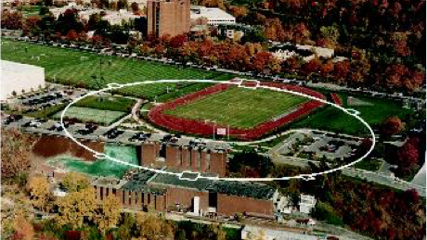
The Bmad Toolkit:
From Lattice Design to Online Modeling of Charged Particles & X-rays
David Sagan
Cornell Laboratory for Accelerator Based Sciences and Education
Notes:
Good afternoon. I’m here to talk about the Bmad toolkit and how it can be used for charged particle and x-ray modeling both offline and online within a control system

Slide 2
History & Introduction

Slide 3

In the Beginning…
Brief History:
  Bmad is a software toolkit for the simulation of charged particles and X-rays.
  Born at Cornell in mid 1990’s
  Started life as modest project: Just wanted to calculate Twiss functions and closed orbits.
  Initially Bmad used a subset of the MAD lattice syntax. Hence the name: “Baby MAD” or “Bmad” for short.

Slide 4
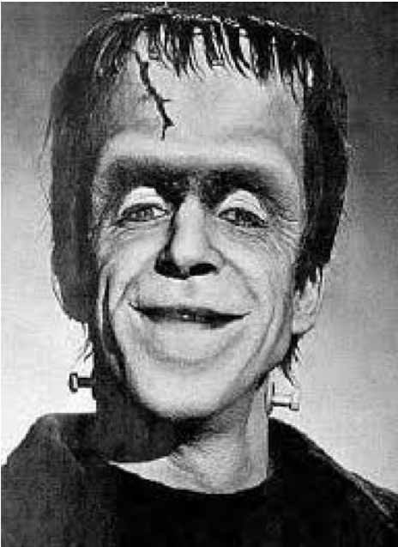
And Baby Grows Up...
Currently:
    >100,000 lines of code
    ~1,000 routines

Slide 5
And Bmad can do Much More:
    Lattice design
    X-ray simulations
    Spin tracking
    Wakefields and HOMs
    Beam breakup (BBU) simulations in ERLs
    Intra-beam scattering (IBS) simulations
    Coherent Synchrotron Radiation (CSR)
    Touschek Simulations
    Frequency map analysis
    Dark current tracking
    Etc., etc.

Slide 6
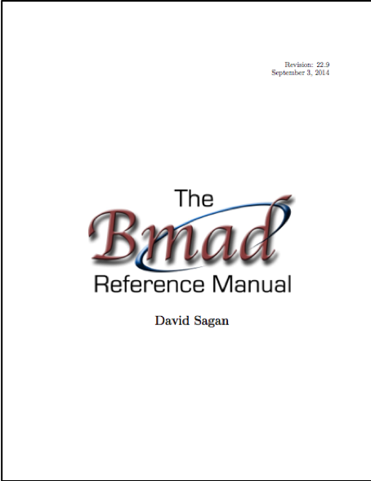
Overview
Written in Fortran 2008.
Object oriented from the ground up.
Has structure translation code for interfacing with C++.
With certain restrictions, Bmad can be run multi-threaded.
Lattice files use a MAD like syntax.
Well documented (Manual is >500 pages).
  Open Source:
  http://www.classe.cornell.edu/bmad/

Slide 7
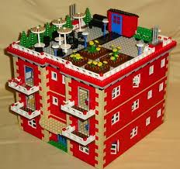
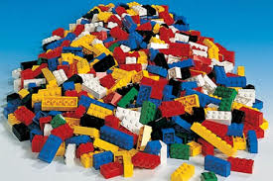
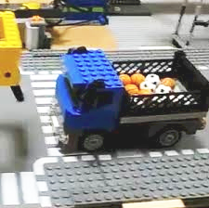
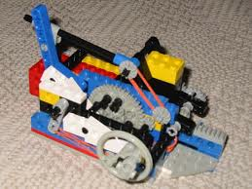
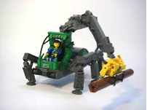
Bmad Philosophy
Lattice Design Program
Bmad
Dynamic Aperture Program
Advantages of a toolkit:
  Cuts down on the time needed to develop programs.
  Cuts down on programming errors (via code reuse).
  Provides a simple mechanism for lattice function calculations from within control system programs.
  Standardizes sharing of lattice information between programs.
Control System Programs
IBS Simulation Programs
Etc.

Slide 8
Programming with Bmad
There are two types of Bmad users:
  The majority are non-programmers who use Bmad based programs.
  A minority are programmers who develop Bmad based programs.
For programmers, to maximize Bmad’s usefulness, Bmad is designed to be modular and object oriented from the ground up:
type (lat_struct) lat
call bmad_parser (‘lat.bmad’, lat)
Notes:
In this example lat is an instance of a lat_struct.
A lat_struct is a structure that holds all the information about a lattice.
Including a list of the lattice elements, magnet strengths, etc.
The call to bmad_parser takes a lattice file name
and bmad_parser will fill the lat instance with the parsed information

Slide 9
Bmad Based Programs

Slide 10
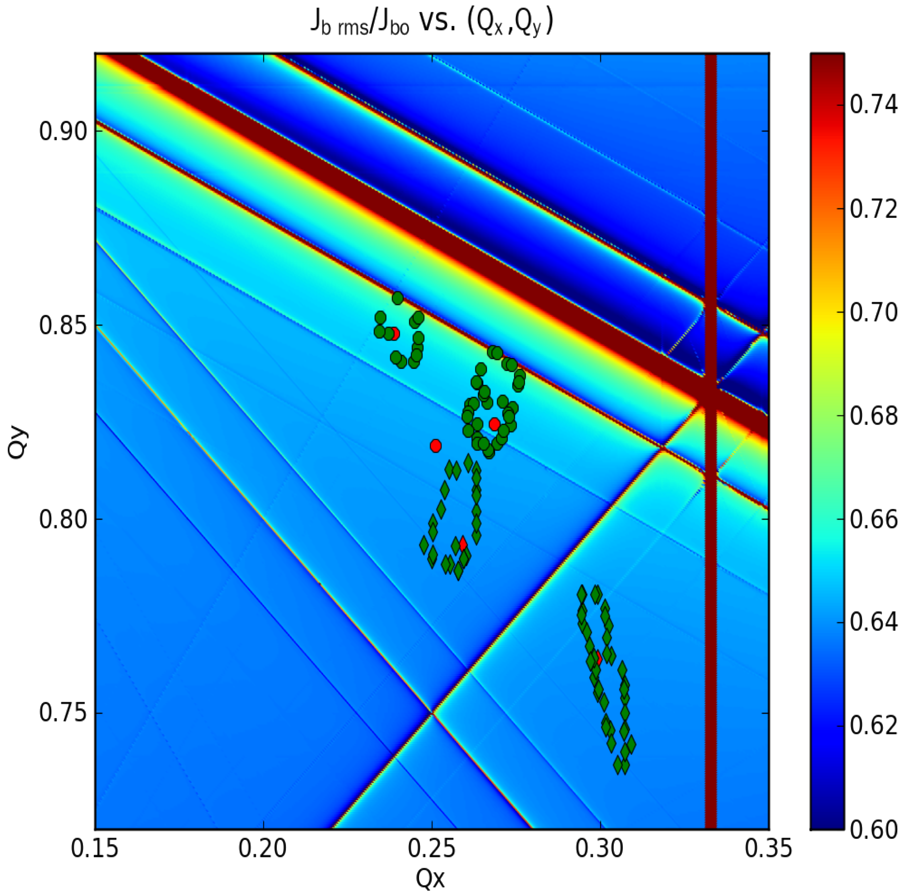
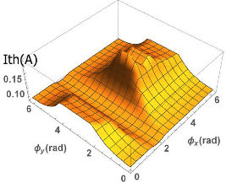
Bmad Ecosystem
Due to its flexibility, Bmad has been used in a number of programs including:
  tao: General purpose design and simulation.
  synrad3d: 3D tracking of synch photons, including reflections, within the beam chamber walls.
  bbu: Beam breakup instability simulations.
  dark_current_tracker: Dark current electron simulation.
  freq_map: Frequency map analysis.
  ibs_sim: Analytic intra-beam scattering (IBS) calculation.
  touschek_track: Tracking of Touschek particles.
  MOGA: Multi Objective Genetic Algorithm optimization.
  Lux: Photon tracking in X-ray beam lines.
  etc...
Code reuse: Modules developed for one program can, via Bmad, be used in other programs.
Tune Scan for CESR Ring Upgrade
Circles = design tunes,
Diamonds = current tunes.
BBU threshold current for CBETA as a function of the phase advance between cavities.

Slide 11
Tao: Tool for Accelerator Optics
Problem: Bmad is not a program so it cannot be used
“out of the box.” for simple calculations.
Solution: Develop Tao - a general purpose simulation & design program
  Twiss and orbit calculations.
  Nonlinear optimization.
  Lattice design.
  Etc.
Additionally: Tao’s object oriented coding makes it relatively easy to extend it.
For example: Can add custom commands to interface Tao with a control system.

Slide 12
Tao Examples
Orbits w/ misalignment
Orbits after correction
Example: Element misalignment in CBETA followed by steering correction.
Bmad with Tao gives the flexibility of a library with the convenience of a program.
Example: Designing or modifying a machine to be/stay within an existing building.

Slide 13
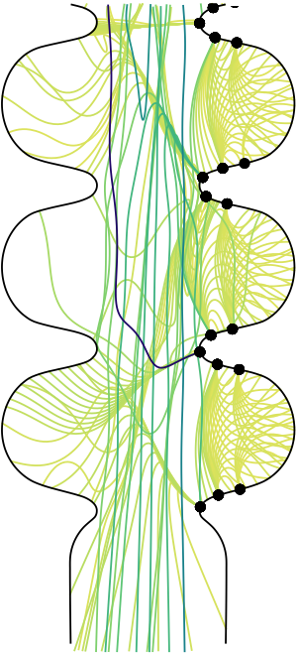
Dark Current Tracker Program
Problem: Simulate in 3D dark current electrons generated at the walls of the beam chamber.
Challenges:
  Define the beam chamber walls.
  Be able to track particles that could reverse direction longitudinally.
Solutions: Develop in Bmad:
  Extended code for modeling the wall of X-ray capillaries for modeling beam chamber walls.
  Time based tracker module that could handle bi-directional tracking (Chris Mayes).
Result: A useful program was developed and Bmad gets extended capabilities which have been used in other programs.

Slide 14
Lux: X-Ray Simulation Program
Problem: Simulate X-rays in X-ray beam lines.
beginning[e_tot] = 8.955e3 ! Reference photon energy
parameter[particle] = photon
r_rowland = 0.5 ! Rowland circle radius
source: photon_init, sig_x = 5e-5, sig_y = 5e-5, spatial_distribution = uniform,
E_center_relative_to_ref = T, sig_E = 2, energy_distribution = gaussian,
velocity_distribution = spherical
drift1: drift
cryst: crystal, crystal_type = "Si(553)", b_param = -1, aperture = 0.050,
spherical_curvature = (1+err) / (2 * r_rowland), aperture_type = elliptical
drift2: drift
det: detector, surface = {grid = {ix_bounds = (-97, 97),
iy_bounds = (-243, 243), dr = (172e-6, 172e-6)}}
daves_line: line = (source, drift1, cryst, drift2, det)
use, daves_line
Photon distribution at detector

Slide 15

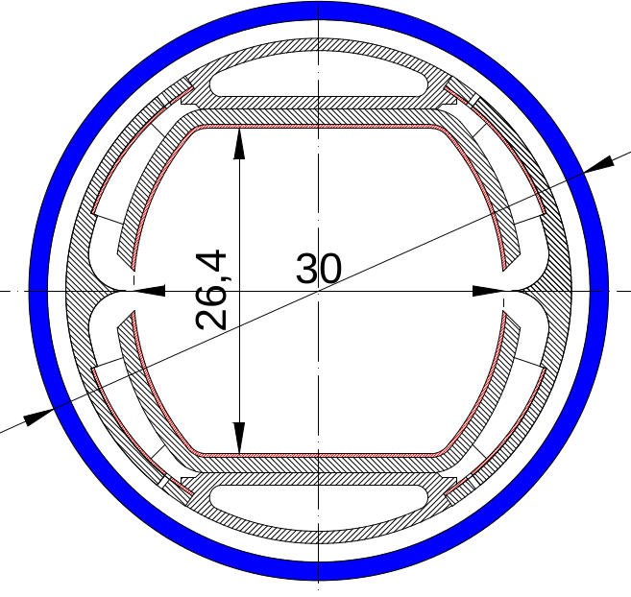
Synrad3D
Synrad3D: Program to simulate in three dimensions:
  Emission of photons from the beam
  3D tracking of photons to the vacuum chamber wall
  Scattering or absorption at the chamber wall
  If not absorbed, further tracking until photon is absorbed
Synrad3D was created to calculate the initial distribution of photoelectrons for electron cloud studies. It has also been used for studying the efficiency of beam masks.
  At the start of development, Bmad provided code for:
    Calculation of the closed orbit
    Photon generation
    Defining the vacuum chamber wall
Synrad3d development involved:
  Tracking of photons.
  Reflection/absorption at the chamber wall.
  ➔ The use of Bmad saved considerable development time.
15
David Sagan LBL February 22, 2019

Slide 16
Synrad3d: SuperKEKB Simulation
Simulations by Jim Crittenden
SuperKEKB wall profile courtesy Takuya Ishibashi
Problem: Photoelectrons can be trapped in the field of a quadrupole. The electrons will react with the beam and if the density is high enough, this can cause problems.
Simulation to determine the number of photons absorbed near a particular quadrupole
Photon number
Energy Spectrum
# Reflections
Angular distribution
16
David Sagan LBL February 22, 2019

Slide 17
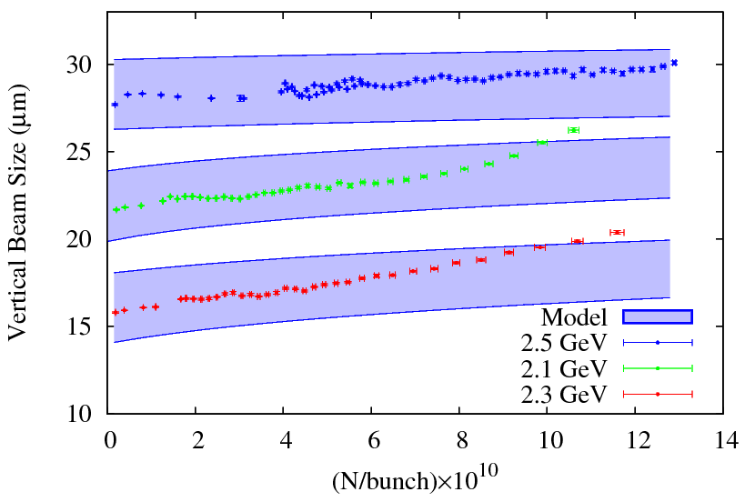
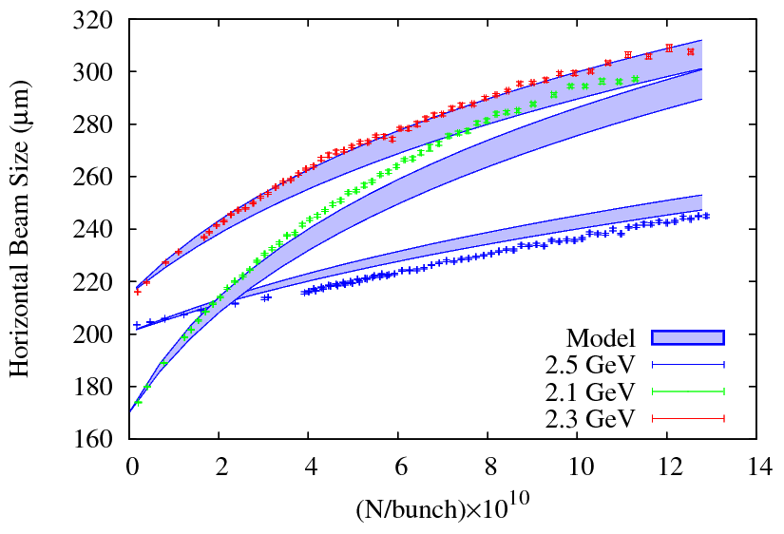
Intra Beam Scattering
Code developed by Michael Ehrlichman
IBS in simulation can be calculated using several different algorithms:
  Modified Piwinski formula
  Bjorken & Mtingwa
  Kubo & Oide
Data from CESR storage ring
17
David Sagan LBL February 22, 2019
Slide courtesy Michael Ehrlichman

Slide 18
BMAD Features

Slide 19
Bmad Features
Bmad has a number of features that over the years have proven useful.
Among these are:
Superposition – Define overlapping elements.
Controller elements – Elements controlling attributes of other elements.
Multiple lines in one lattice – Example: X-ray line attached to a ring.
Multipass lines – Beamlines sharing common elements.
Interface to Etienne Forest’s FPP/PTC code.
Element-by-element selection of how tracking is done through an element.
Custom elements and custom particle tracking.
Define beam chamber walls.

Slide 20
Bmad Lattice Elements
For use with Charged-Particles
For use with X-rays
AB_Multipole
AC_Kicker
BeamBeam
Bend_Sol_Quad
Custom
Drift
E_Gun
Ecollimator
ElSeparator
EM_Field
Fiducial
Floor_Shift
Fork
HKicker
Hybrid
Instrument
Kicker
Lcavity
Marker
Mask
Match
Monitor
Multipole
Octupole
Patch
Photon_Fork
Pipe
Quadrupole
Rbend
Rcollimator
RFcavity
Sad_Mult
Sbend
Sextupole
Sol_Quad
Solenoid
Taylor
Undulator
VKicker
Wiggler
Capillary Mask
Crystal Monitor
Custom Mirror
Detector Multilayer_Mirror
Diffraction_Plate Patch
Drift Photon_Fork
Ecollimator Photon_Init
Fiducial Pipe
Floor_Shift Rcollimator
Fork Sample
Instrument
Controller Elements
Group Overlay
Girder

Slide 21
Tracking Method Selection
Can set how each element is tracked on an element-by-element basis:
bmad_standard Fast, thick element formulas (not necessarily symplectic)
symp_lie_ptc Symplectic Lee integration tracking using PTC
taylor Taylor map (generated via PTC)
linear Linear tracking
custom Tracking with custom code
runge_kutta Track through fields.
etc.
Example:
inflector: em_field, tracking_method = runge_kutta, field_calc = custom, ...
Advantages:
Enables simulation of unique element types via custom tracking.
Can compare different tracking methods.
Can optimize simulations for speed and/or accuracy.
Notes:
End: The bottom line is that tracking method selection adds to the flexibility of simulations

Slide 22
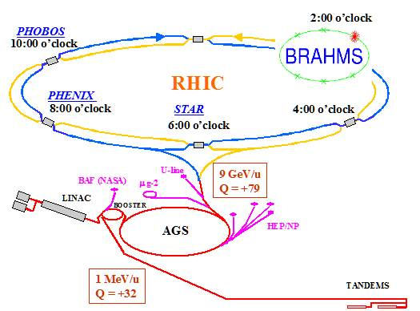
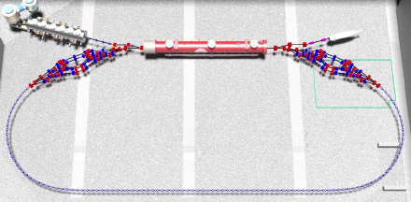
Multipass Lines
Consider the following situation: In a dual ring colliding beam machine, the colliding beams go through a common set of Interaction Region magnets. And in opposite directions!
Problem: If the machine is represented in a simulation program as two separate rings, misaligning an IR magnet in one ring will not affect the corresponding magnet in the other ring.
Note: Also have the same problem in an ERL machine.
Solution: With Bmad this is solved using multipass lines.
Cornell-BNL FFAG-ERL CBETA Machine

Slide 23
Multipass: Simulating Electron/Au Colliding Beams
q1: quadrupole, ... ! IR magnet
IR_line: line[multipass] = (..., q1, ...)
pa_in; patch, ... ; pa_out; patch, ...
pb_in; patch, ... ; pb_out; patch, ...
...
A: line = (arc_a, pa_in, IR_line, pa_out)
A[particle] = electron
B_rev: line = (arc_b_rev, pb_in, IR_line, pb_out)
B: line = (- -B_rev)
B[particle] = Au+79
use, A, B
With multipass a single element is created in a simulation for each physical element.
➔ Can easily vary the parameters of a single physical element.

Slide 24
Forking
Bmad can connect together various parts of a machine. Can join Linacs to injection lines to storage rings to X-ray beam lines, etc. ➔ One lattice can hold the description of the entire accelerator complex.
Example: Injection into the BNL eRHIC RCS (Rapid Cycling Synchrotron). [Thanks: Nick Tsoupas]
to_rcs: fork, to_line = rcs, to_element = from_inj
from_inj: marker
hqtoes: patch, ...
hqf4_inj: quadrupole, ...
hqf4_line: line[multipass] = (hqf4_inj)
lin_to_rcs: line = (..., hqtoes, hqf4_line, ..., to_rcs)
rcs: line = (...,hqf4_line, ..., from_inj, ...)
use, lin_to_rcs
Notes:
EG Can simulate a storage ring with x-ray lines so that, for example, one can calculate the effect of misalignments on the position of x-rays in the experimental end stations.
Run Tao

Slide 25
Forking
A more complicated example: Closeup of the CBETA merger region.

Slide 26
Etienne Forest’s FPP/PTC
Etienne Forest’s FPP/PTC simulation toolkit:
  Can construct Taylor series maps, including spin, to arbitrary order via symplectic integration through elements.
  The maps can be analyzed using Normal form analysis to extract such things such as resonance strengths, the amplitude dependent spin tune and the invariant spin field.
  Besides Bmad, PTC Is used in MAD-X & PTC_ORBIT.
Integration of PTC with Bmad:
  Interface routines between Bmad and PTC to allow tracking of individual elements.
  PTC lattices can be constructed for analysis.

Slide 27
Controller Elements
In a Bmad lattice file, can define controller elements [called overlay and group elements] that control the parameters of other elements.
Example: Power supply powering two steering magnets
Example: Machine energy ramp
Advantage of controller elements: Once defined in a lattice file, any program can read in the lattice and simulate the effect of the controller.
H38W: overlay = {B38W[hkick]: 0.7*v+0.1*v^2, B39W[hkick]: 1.3*v)}, v
ramp: overlay = {beginning[E_tot]}, var = {t}, x_knots = {...}, y_knots = {...}
Notes:
Example: Once steerings are defined a program can design orbit bumps without

Slide 28
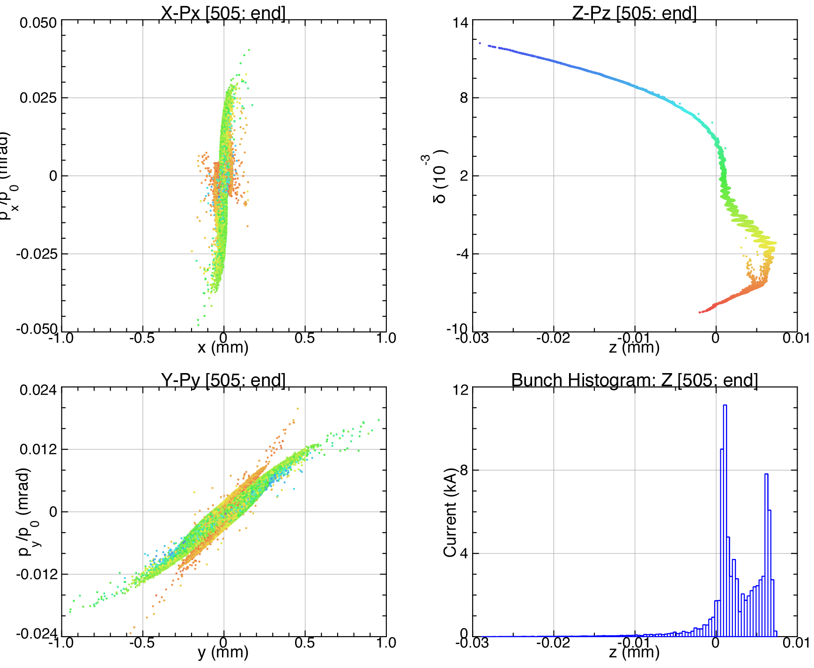
Low Energy Simulations
Have lattice elements to handle low energy tracking:
e_gun Gun cathode region element.
em_field General field element.
Status:
1D/3D Coherent Synchrotron Radiation (CSR) model implemented in Bmad.
Low energy space charge: Integration with existing SC codes:
OPAL (Andreas Adelmann)
ASTRA
GPT
Example: Coherent Synchrotron Radiation (CSR) simulation.

Slide 29
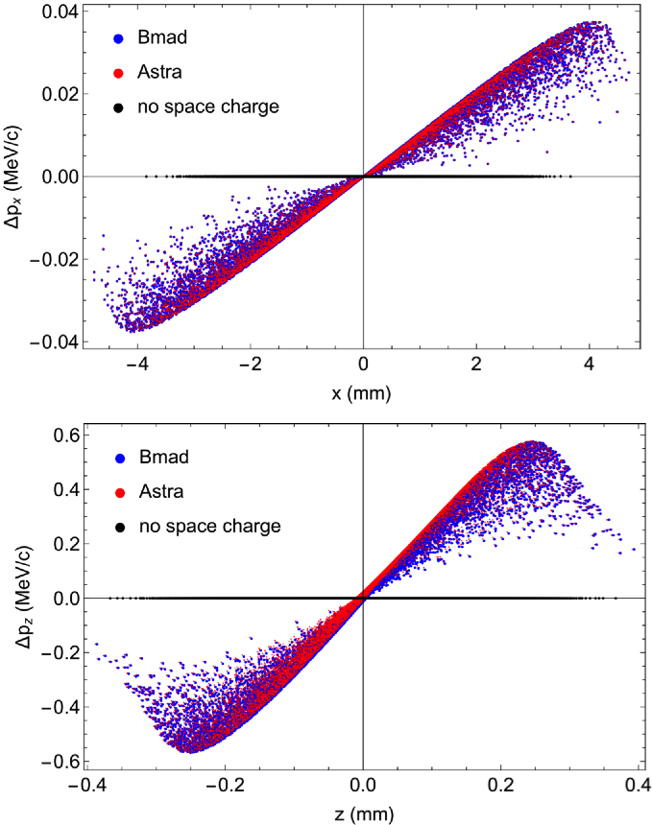
Low Energy Simulations: In Development
With Chris Mayes (SLAC) and Robert Ryne (LBNL) there is a collaboration to add low energy space charge effects directly into Bmad so that tracking, including spin, can be simulated starting at an electron gun.
Status:
  Initial tests show good agreement with Astra and ImpactZ.
  Work is ongoing to include the effect of image charges due to the cathode.

Slide 30
Spin Tracking
Out Coef Exponents Order
-----------------------------------------------------
1: -0.600000000000 0 0 0 0 0 0 0
1: 1.000000000000 1 0 0 0 0 0 1
1: 0.145000000000 2 0 0 0 0 0 2
-----------------------------------------------------
2: -0.185000000000 0 0 0 0 0 0 0
2: 1.300000000000 0 1 0 0 0 0 1
2: 3.800000000000 2 0 0 0 0 1 3
-----------------------------------------------------
3: 1.000000000000 0 0 1 0 0 0 1
3: 1.600000000000 0 0 0 1 0 0 1
3: -11.138187077310 1 0 1 0 0 0 2
-----------------------------------------------------
4: 1.000000000000 0 0 0 1 0 0 1
-----------------------------------------------------
5: 0.000000000000 0 0 0 0 0 0 0
5: 0.000001480008 0 1 0 0 0 0 1
5: 1.000000000000 0 0 0 0 1 0 1
5: 0.000000000003 0 0 0 0 0 1 1
-----------------------------------------------------
6: 1.000000000000 0 0 0 0 0 1 1
x:
p_{x}:
Phase Space Map
y:
p_{y}:
Bmad and PTC can track a particle’s spin including EDM and including fringe fields.
Bmad can track through arbitrary fields.
PTC Can produce transfer maps which include spin.
z:
p_{z}:
Out Coef_Sx Coef_Sy Coef_Sz Exponents Order
-------------------------------------------------------------------------------
Sx: 0.99757886 -0.02372254 -0.06537314 0 0 0 0 0 0 0
Sx: 0.04802411 0.22401654 0.65154583 1 0 0 0 0 0 1
Sx: 0.07391383 3.77338795 -0.24137562 0 1 0 0 0 0 1
Sx: 0.00008802 -0.17584738 0.06515458 0 0 1 0 0 0 1
Sx: 0.01148244 -0.20322945 0.24896717 0 0 0 1 0 0 1
-------------------------------------------------------------------------------
Sy: -0.02460178 0.75885811 -0.65079114 0 0 0 0 0 0 0
Sy: 0.25039365 -0.04801091 -0.06544895 1 0 0 0 0 0 1
Sy: -3.02631629 -0.07739091 0.02416143 0 1 0 0 0 0 1
Sy: 0.17584738 0.00008802 -0.00654489 0 0 1 0 0 0 1
Sy: 0.47579058 1.59361755 1.84025908 0 0 0 1 0 0 1
-------------------------------------------------------------------------------
Sz: 0.06504736 0.65082378 0.75643719 0 0 0 0 0 0 0
Sz: -0.64180483 0.06414595 0.00000000 1 0 0 0 0 0 1
Sz: -2.27815007 0.22777762 -0.00007328 0 1 0 0 0 0 1
Sz: 0.06515785 -0.00651227 0.00000000 0 0 1 0 0 0 1
Sz: 0.00385332 -1.86555986 1.60475990 0 0 0 1 0 0 1
Spin Map

Slide 31
G-2 Simulation Program
Polarized Muons
Dave Rubin at Cornell has been developing a simulation program to simulate the Muon g-2 experiment at Fermilab.
Need to track the polarized muons with:
  Injection line into a storage ring.
  Three dimensional field of the injection line.
  Scattering of muons as they cross the inflector wall
  Electrostatic quadrupoles
  Muon decay
  Tracking of electron decay product

Slide 32
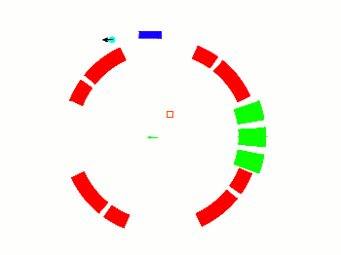
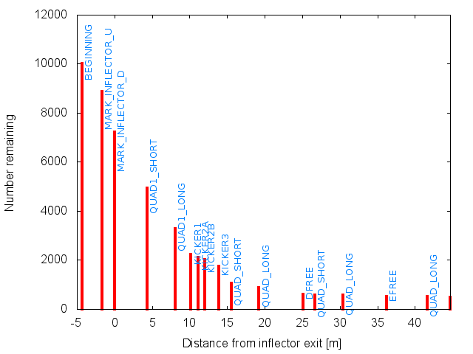
G-2 Simulation
At the start of program development
Bmad provided:
  Ability to define the geometry of the injection line and storage ring.
  Ability to define the geometry of the inflector wall
  Ability to define custom fields for the injection line and the ability to simulate electrostatic quadrupoles
Needed to develop for the program:
  Scattering of muons through the inflector wall
  muon decay.
  etc.
➔ Bmad reduced the development time for creating the program and provides a flexible framework for future program modifications.

Slide 33
ON-LINE MODELING

Slide 34
Cornell CESR Ring Modeling
Bmad has been used for CESR on-line and off-line modeling for over 20 years.
Offline modeling includes:
  Lattice design
  Injection studies
  Control room knob (EG orbit bumps) design
  Misalignment studies.
  Etc., etc.
Online modeling includes:
  Orbit Correction
  Twiss/Coupling Correction
  Dispersion Correction
  Steering/Quadrupole/Sextupole Calibration
  Identifying Steering/Quadrupole/Skew Quadrupole errors.
The standard CESR lattice file includes both control room knobs and x-ray lines simplifying online and offline analysis.
CESR ring section with one X-ray line

Slide 35
Cam Mover Controller Example
Controllers can control other controllers ad infinitum.
Example: Cam movers supporting a superconducting cryostat which contains 4 spatially overlapping superconducting quadrupoles
cam_1w: overlay = {tee_1w_x[x_offset]:cc_x, tee_1w_y[y_offset]:cc_y}, rho
tee_1w_x: overlay = {q01w[x_pitch]:ds1, q01w[x_offset]:dq1, q01w[tilt]:dt1,
q02w[x_pitch]:ds1, q02w[x_offset]:dq2, q02w[tilt]:dt1, ...}, x_offset
tee_1w_y: overlay = {q01w[y_pitch]:ds1, q01w[y_offset]:dq1_t1, q02w[y_pitch]:ds1,
q02w[y_offset]:dq2_t1, ...}, y_offset
35
David Sagan LBL February 22, 2019
Notes:
Note: Solenoid is superimposed upon the quadrupoles
quadrupoles are superimposed upon other quadrupoles

Slide 36
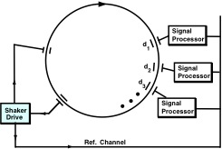
Twiss and Coupling Measurement
Shake simultaneously both “a”-mode (horizontal like) and “b”-mode (vertical like) betatron resonance frequencies.
About 100 detectors in CESR
Average over 40K turns
Each detector has its own signal processor.
Parallel measurement => Takes about 10 seconds.
Measurement setup
Beam response at a detector due to “A”-mode (Horizontal like) shaking
36
David Sagan LBL February 22, 2019

Slide 37
Twiss and Coupling Correction
Can measure:
β_{Α}, β_{Β}, ϕ_{A,} ϕ_{Β}, C₁₁, C₁₂, and C₂₂
Measurement time
~ 10 seconds.
In practice, cleanest is to use:
ϕ_{A,} ϕ_{Β}, C₁₂
Correction calculation takes seconds.
Before correction
After correction
37
David Sagan LBL February 22, 2019

Slide 38
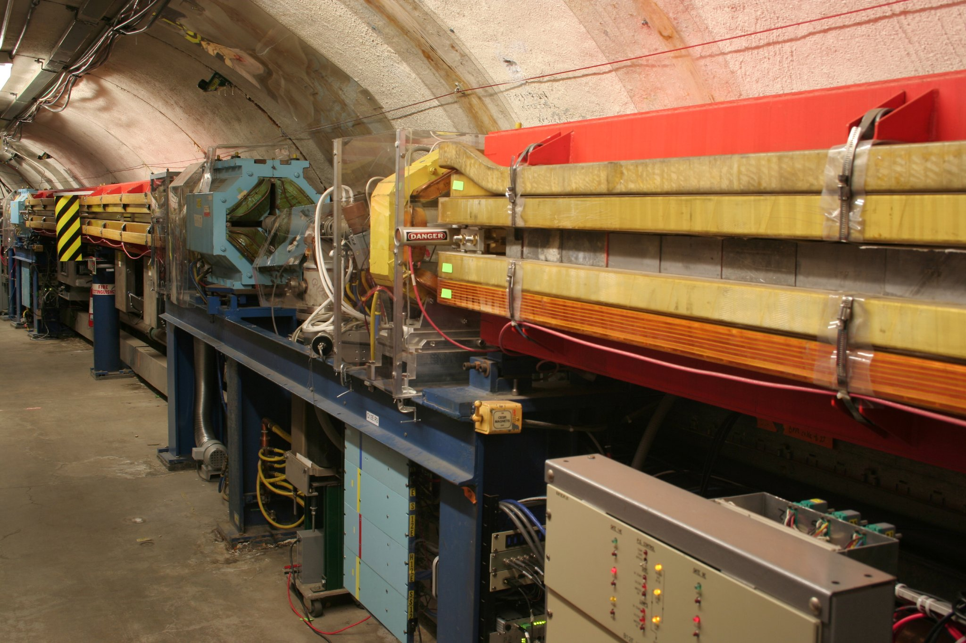
Locating a Skew Quadrupole Error
Data
Data – A-region fit
Data – B-region fit
38
David Sagan LBL February 22, 2019

Slide 39
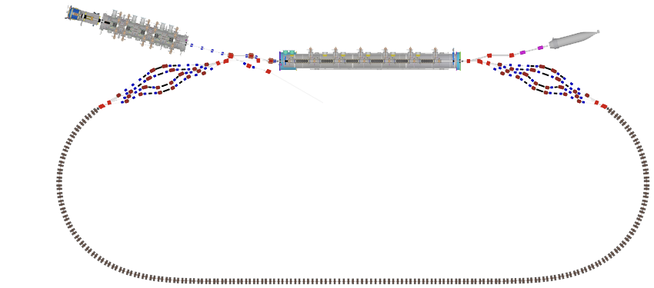
CBETA Control System Flow Chart
CBETA
EPICS measurements
EPICS
controls
CBETA: Cornell – Brookhaven ERL under development at Cornell.
CBETA-V: Customized version of Tao for online modeling of CBETA.
CBETA-V/Tao is used for:
  Online modeling.
  Offline modeling of online system.
  Lattice design.
Python
Python
Lattice
File Storage
CBETA-V
Calibration
Constants
GPT
EPICS beam properties
Data Storage
[Orbits, etc.]
Bottom Line: Using Tao as a starting point for CBETA-V enabled the development of a flexible online modeling program in less time and with fewer bugs.
Matlab, python, EDM, etc.
[*For illustrative purposes only. Don’t take this too seriously!]
Implementors: Colwyn Gulliford, Adam Bartnik, Scott Berg, David Sagan
EPICS = Experimental Physics and Industrial Control System
Notes:
CBETA-V: demonstrating its usefulness as a tool for not only displaying useful physics data to operators in real time, but also for debugging and testing measurement procedures before putting them to use in the real machine.

Slide 40
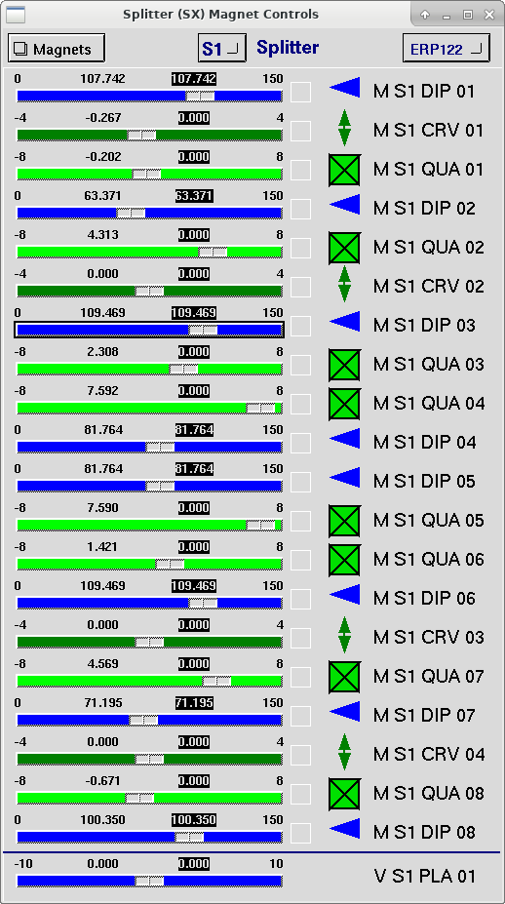
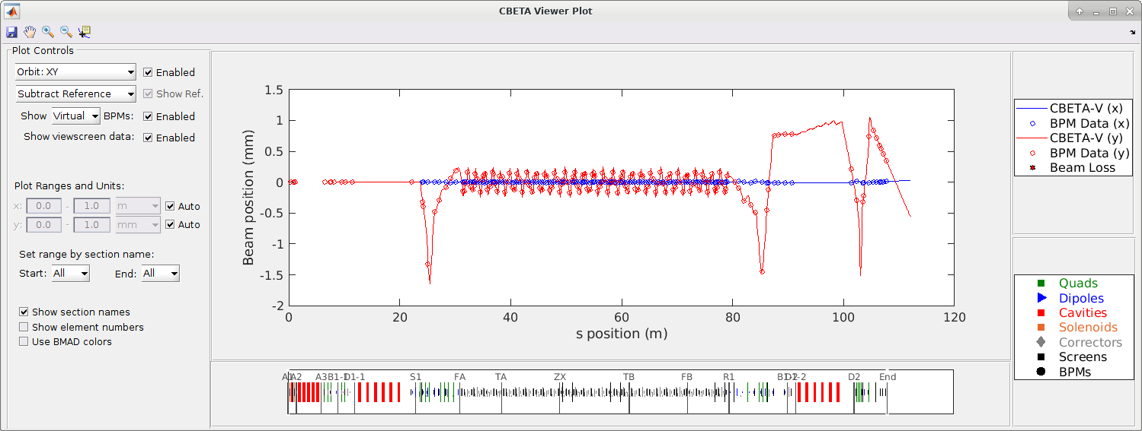
EPICS/CBETA-V

Slide 41
Conclusions

Slide 42
Some Highlights
Bmad is an open source software library for simulating both charged particle beams and X-rays.
Has been used at Cornell, CERN, KEK, DESY, ANL, BNL, Cockcroft Institute, for simulating CESR, ILC, ATF2, SuperKEK-B, Cornell ERL, Fermilab g-2 muon project, etc.
Bmad has been successful due to it’s modular, object-oriented design which allows it to be adapted to ever changing simulation needs.
Bmad is always in continual development with about 1.5 FTEs. Supported by Cornell Laboratory for Accelerator-based Sciences and Education (CLASSE).
With multipass lines, and fork and patch elements, Bmad is able to model an entire accelerator complex including X-ray lines.
Bmad is evolving towards being able to do “complete” start-to-end simulations.
Ongoing work involves
  Spin simulations.
  Low energy space charge tracking.
  Light/Beam interactions (optical stochastic cooling).
Collaborations welcome.

Slide 43
Thanks
Dan Abell
Ivan Bazarov
Moritz Beckmann
Martin Berz
Joel Brock
Desmond Barber
Sarah Buchan
Avishek Chatterjee
Jing Yee Chee
Christie Chiu
Joseph Choi
Robert Cope
Jim Crittenden
Attilio De Falco
Gerry Dugan
Michael Ehrlichman
Ken Finkelstein
Etienne Forest
Mike Forster
Hans Grote
Richard Helms
Georg Hoffstaetter
Chris Mayes
Karthik Narayan
Katsunobu Oide
Mark Palmer
Tia Plautz
Matt Randazzo
Matt Rendina
Dave Rubin
Michael Saelim
Frank Schmidt
Jim Shanks
Jeff Smith
Jeremy Urban
Mark Woodley
Demin Zhou

Slide 44
END

Slide 45

Talk Outline
History & Introduction
Bmad Based Programs
General Features
Online Modeling
Conclusions

