Slide 1
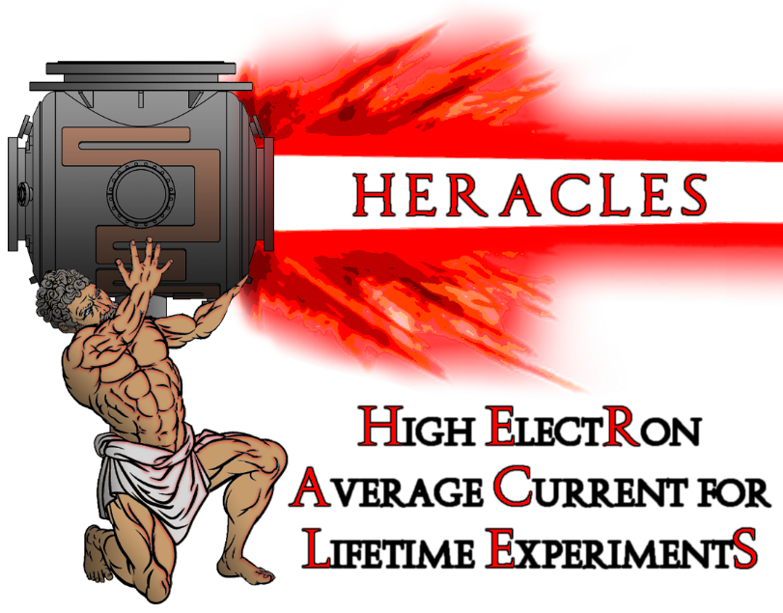
Electron beam generation and cathode R&D at the HERACLES facility
Matthew Andorf, CLASSE

Slide 2
HERACLES TEAM
In collaboration with
Jai Kwan Bae (Former student)
Luca Cultrera (now @ BNL)
Jared Maxson
Ivan Bazarov
Adam Bartnik
Alice Galdi (now @U. of Salerno)
Sam Levenson (Graduate student)

Slide 3
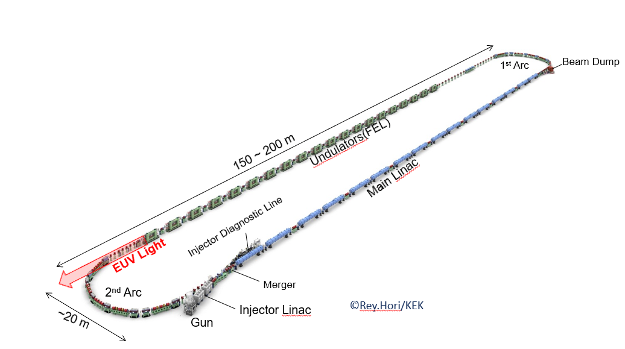
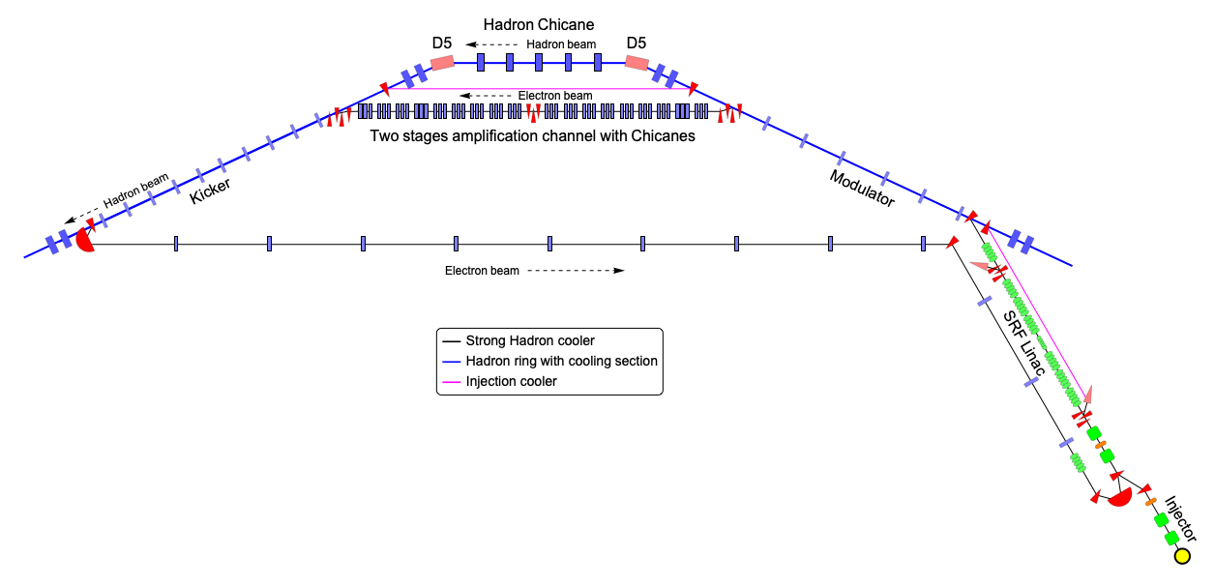
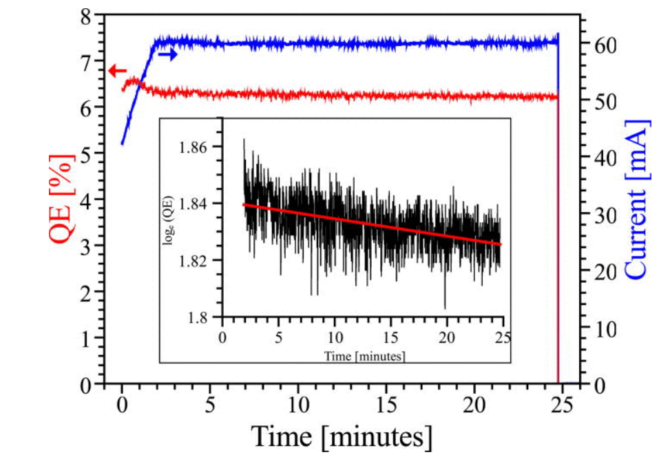
Photocathodes for High Current applications
For high brightness, photocathodes are ideal. They provide low transverse and longitudinal energy spreads
Low emittance beams enable the FEL-lasing process
SHC requires, a high charge bright beam with low energy spread
ERL-FEL based UV lithography~ 10 mA average current
For high current operation, we require a relatively high Quantum Efficiency
For visible light photons, a 1% QE cathode yields ~4 mA per 1 W of laser power
Metal cathodes provide QE’s several orders of magnitude too small. Must use semiconductor-based cathodes!
Cornell has a long history of high current photocathode development. Current record holder for highest average current from a photoinjector, 65 ma!
Electron based, strong hadron cooling with an ERL needs 100 mA!
Alkali-antimonides are great for these applications

Slide 4
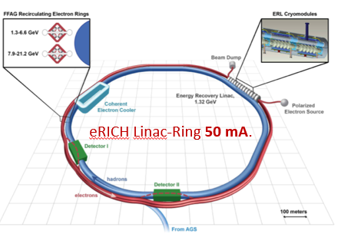
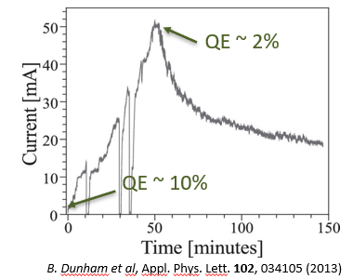
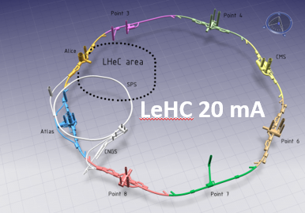
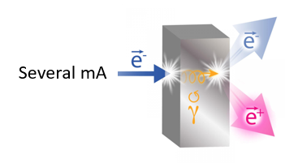
Photocathodes for High Current Spin-Polarized electrons
Many future facilities want spin-polarized electrons at high average currents
Only candidate cathode for the job: GaAs!
Charge lifetime: The amount of current extracted before the QE degrades by 1/e
1000 C is state of the art→6 hours at 50 ma!
PEPPo

Slide 5
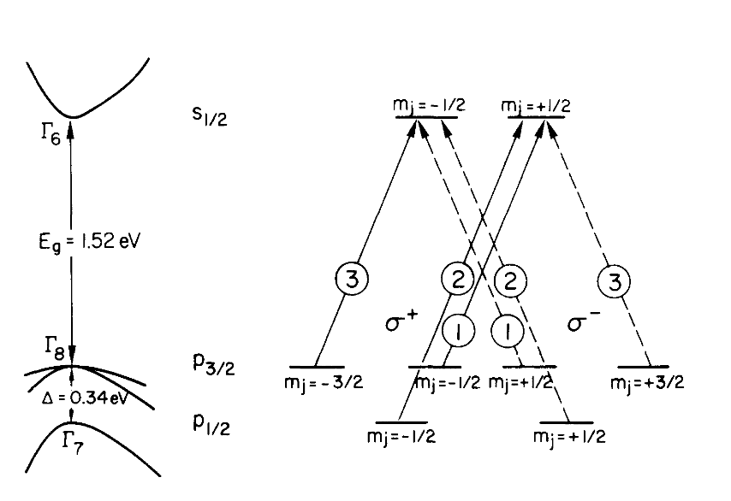
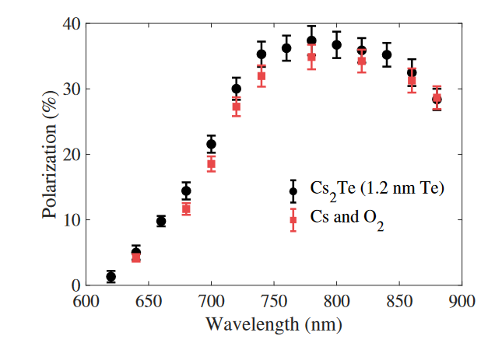
GaAs photocathodes for spin-polarized electron beams
Pierce et al, The GaAs Spin Polarized Electron Source (1980)
0.34 eV spin-orbit splitting in the valance band:
4-fold degeneracy in p_{3/2}
2-fold degeneracy in p_{1/2}
Optical selection rules require Δm=+/-1 for right/left-handed circularly polarized light
Max polarization occurs with excitation at the bandgap where emission from p_{3/2} >> emission from p_{1/2}
Theoretical max value of 50% for Bulk GaAs
Straining GaAs breaks the p_{3/2} degeneracy theoretically allowing 100% polarization
Bae et al, Rugged Spin Polarized Electron Source Based on Negative Electron Affinity GaAs photocathode with Robust Cs2Te coating (2018)

Slide 6
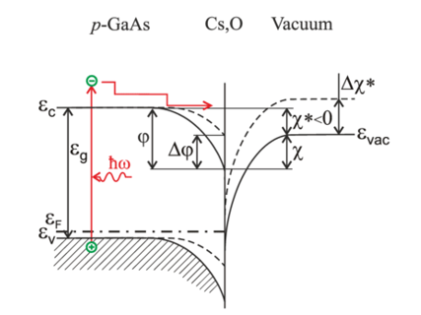
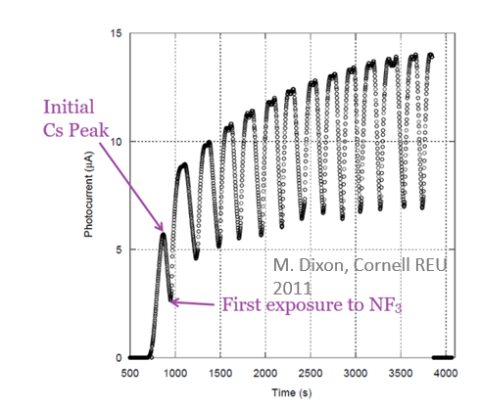
Negative Electron Affinity activation
For the highest QE, GaAs are “activated” to Negative Electron Affinity (NEA)
NEA means the bulk conduction band minimum is larger than the vacuum level
NEA is typically achieved by depositing a monolayer of Cs-Oxidant onto the GaAs surface can be done by:
Co-deposition: Cs is deposited until QE peaks, at which point an oxidant is leaked while Cs source remains on
Yo-yo method: the cathode is over cesiated at which point the cesium source turns off. It is then exposed to an oxidant until the QE peaks, the oxidant is then turned off and cesium source back on. The cycle is repeated numerous times.
Either O₂ and NF₃ can be used for an oxidant
Problem: A monolayer is a fragile thing!
Chemical poisoning: Interaction with residual gas
Ion back bombardment: residual gas is ionized and accelerated towards the cathode

Slide 7
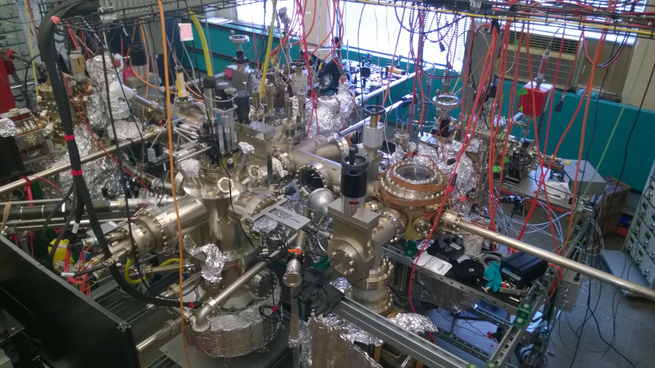
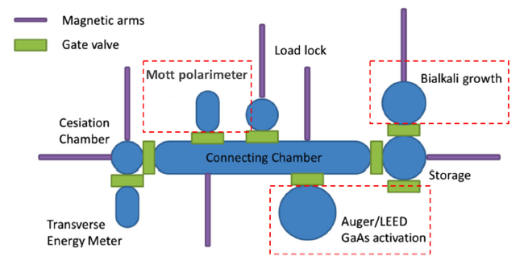
The Mother Chamber
“Mom, your love is a mystery: How can you do it all? You’re always there with the perfect fix For my problems, big and small…..”

Slide 8
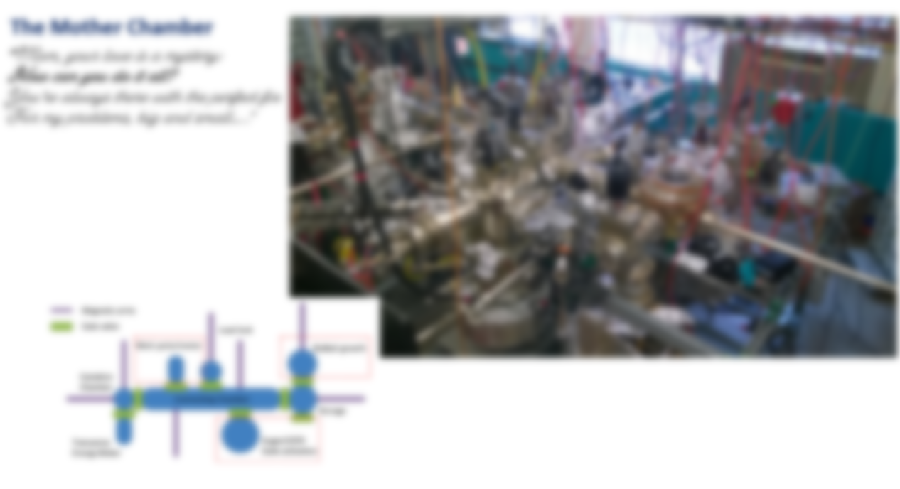
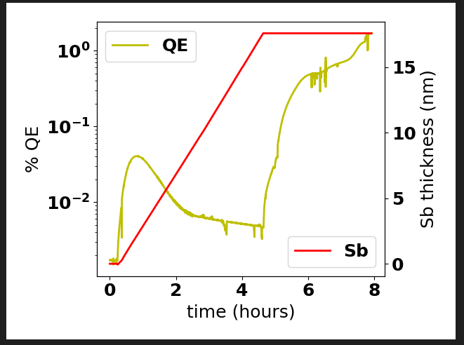
The growth chamber
Cs,Sb,Te,Rb sources+O₂ leak valve, thermally regulated with pneumatic valve control
Quartz microbalance (QMB) for deposition monitoring
Substrate heater

Slide 9
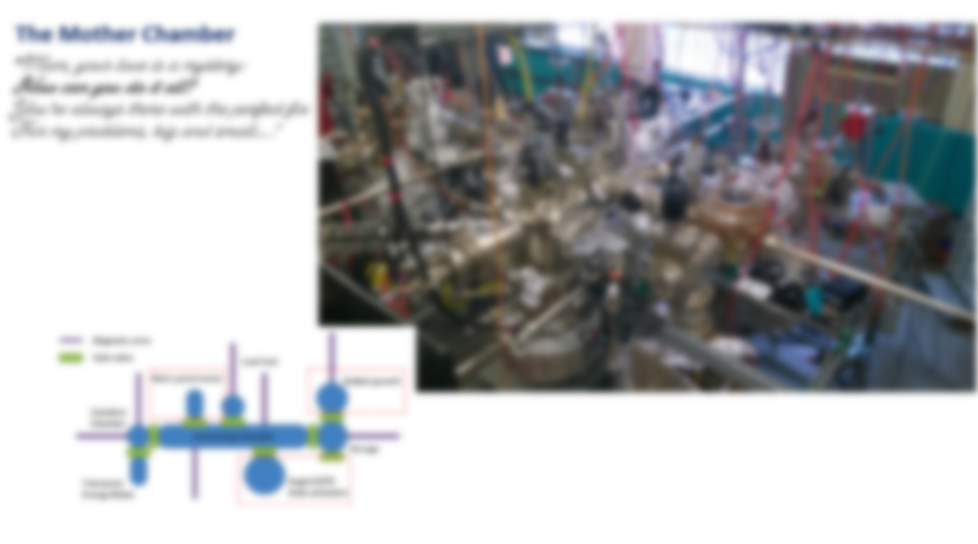
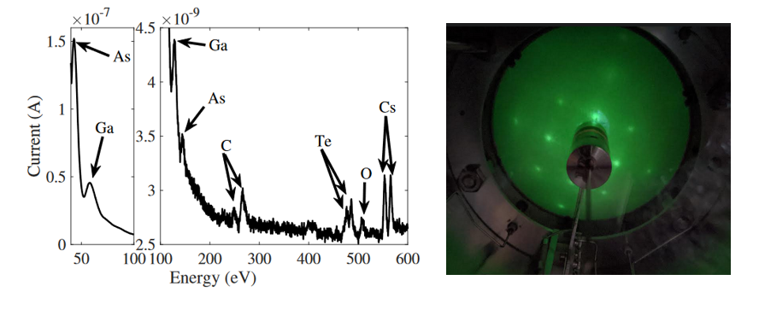
The Auger chamber
Auger Electron Spectroscopy-To characterize surface chemistry
Low Energy Electron Diffraction-Chararacterize surface crystallinity
Cs, O₂ leak valve.
Insulated, bias-able cathode holder

Slide 10
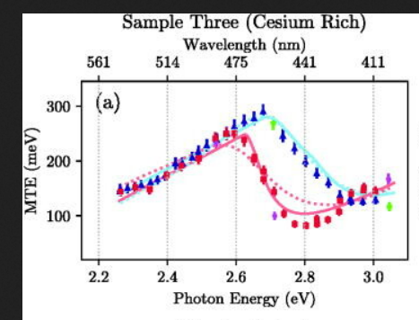
The TE meter
10 kV electron gun
Microchannel plate for beam imaging
Measure Mean Transverse Energy (MTE)

Slide 11
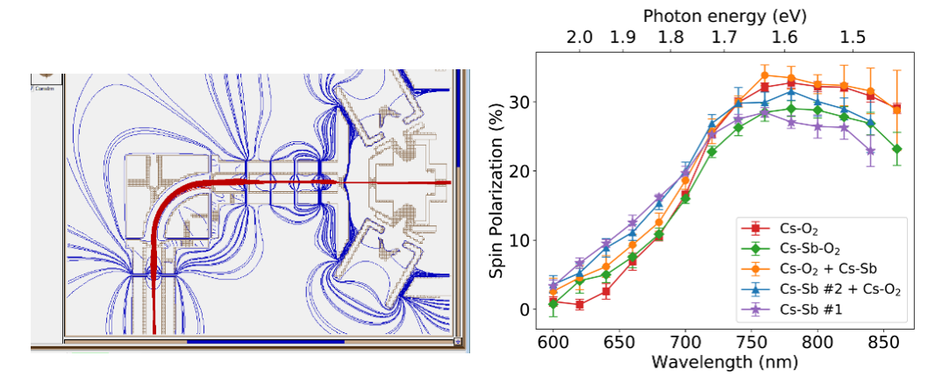
Mott polarimeter
20 keV gun + einzel lens beamline
Tungsten scattering target
Measure spin-polarization

Slide 12
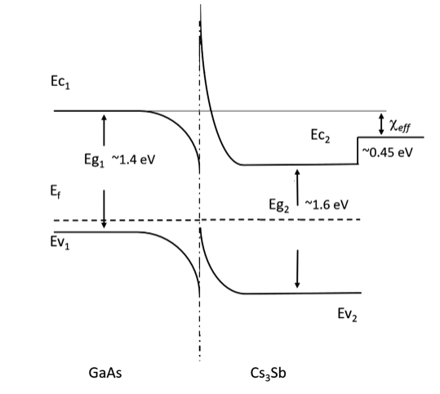
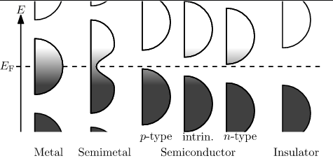
GaAs with Cs₃Sb as a robust NEA activation layer
NEA GaAs can be generated by forming a heterojunction at the surface with another semiconductor (activation layer) subject to two criteria:
In the activation layer, the gap from the fermi level to vacuum should be smaller than GaAs’s bandgap (~1.4 eV).
So that photoemission does not occur from activation layer, its bandgap should be larger than GaAs’s.
This criteria can be violated if the activation layer is sufficiently thin
The above suggest using p-doped GaAs with an intrinsic semiconductor with a small electron affinity for the activation layer
Cs₃Sb fits this description
Known to be less sensitive to chemical poisoning
As a photoemitter, it can sustain 10’s of mA beam current for weeks (alkali-antimonide!)
This indicates Cs₃Sb may be a very robust activation layer!
p-type
intrinsic?

Slide 13
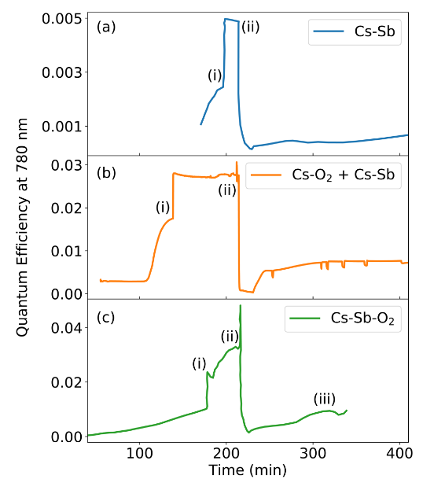
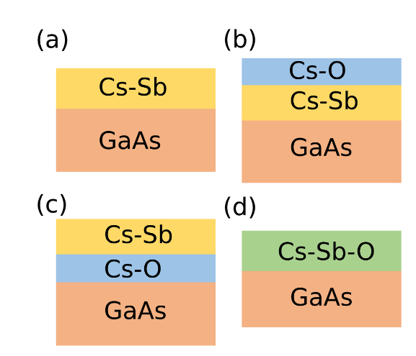
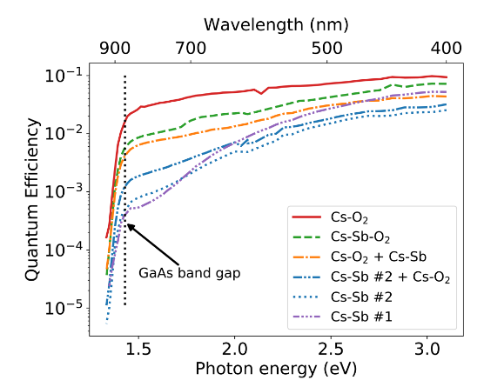
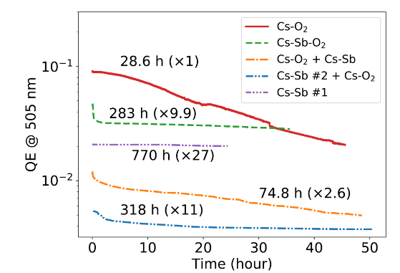
GaAs with Cs₃Sb as a robust NEA activation layer (recipes)
Various activation recipes were tried and compared with Cs-O₂ activation:
All methods achieved NEA
Overall, Cs-O₂ produced the highest QE while Cs-Sb had the worse
Including O₂ in the activation improved QE of Sb containing recipes
The QE was monitored over time to determine robustness
All Sb activations outperformed pure Cs-O₂ and pure Cs-Sb had the longest lifetime.
Co-deposition of Cs-Sb-O finds a happy middle ground
10x Improved lifetime over Cs-O activation.
10x improved QE over Cs-Sb activation
Bae et al, “Improved lifetime of a high spin polarization superlattice photocathode (2020)”

Slide 14
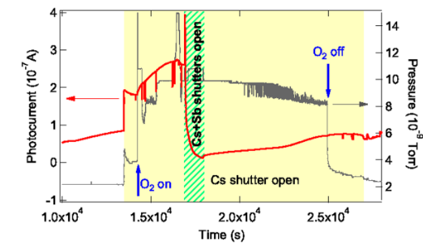
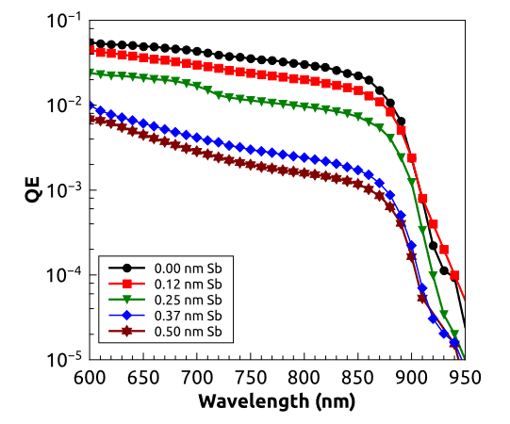
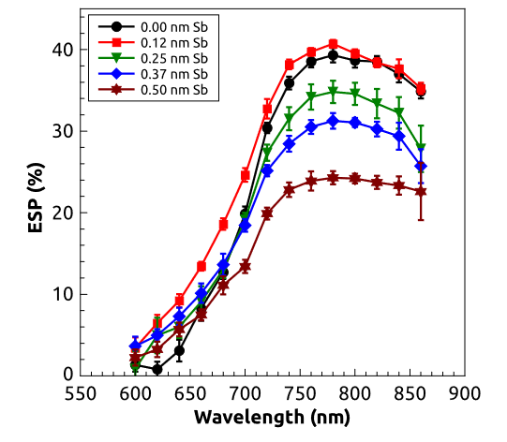
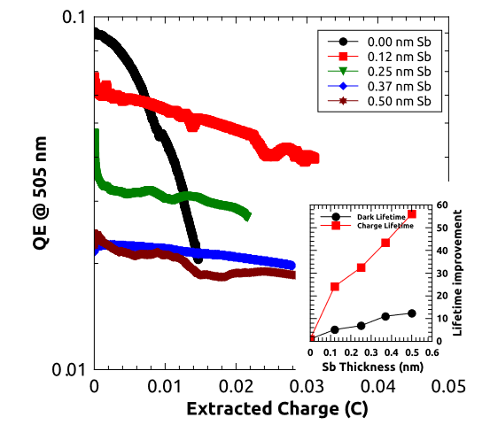
GaAs with Cs₃Sb as a robust NEA activation layer—Trade offs
Cs-O-Sb co-deposition recipe was further refined through scanning the Sb layer thickness:
QE and electron spin-polarization decrease with Sb layer thickness
0.12 nm layer results in only a small QE decrease while preserving max spin-polarization!
Cultrera et al, “Long lifetime polarized electron beam production from negative electron affinity GaAs activated with Sb-Cs-O: Trade-offs between efficiency, spin polarization, and lifetime (2020)”

Slide 15
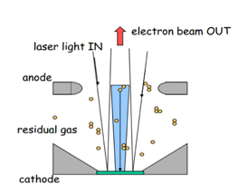
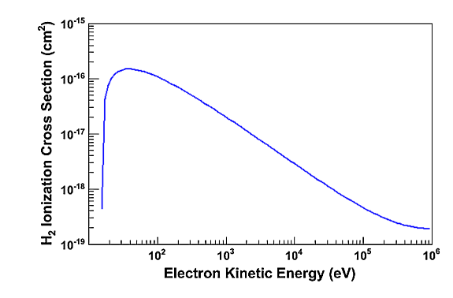
Ion back bombardment
An electron beam can ionize residual gas which will be positively charged
Ions will be accelerated towards the cathode and cause damage
So far, results have been in growth chamber
Low current (1-100 nA)
Low voltage (-18 V)
Main source of degradation comes from vacuum poisoning
In a high voltage DC gun, induced damage from ion back bombardment is more severe
Lower energy ions can sputter off activation layer
High energy ions damage GaAs crystal structure
Operation at high voltage and current is critical to testing efficacy of alternative activation layers!

Slide 16
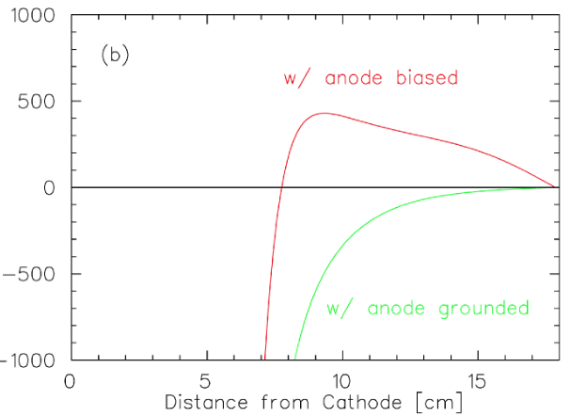
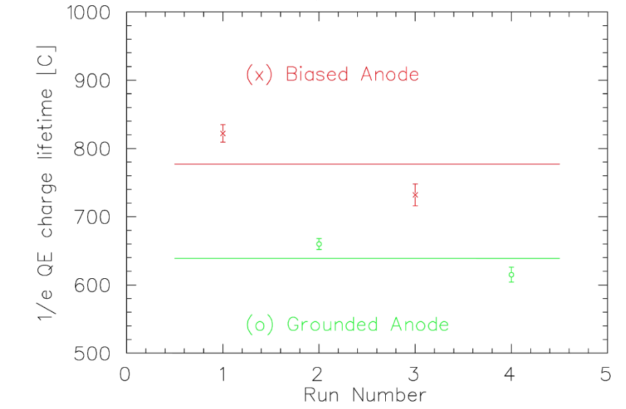
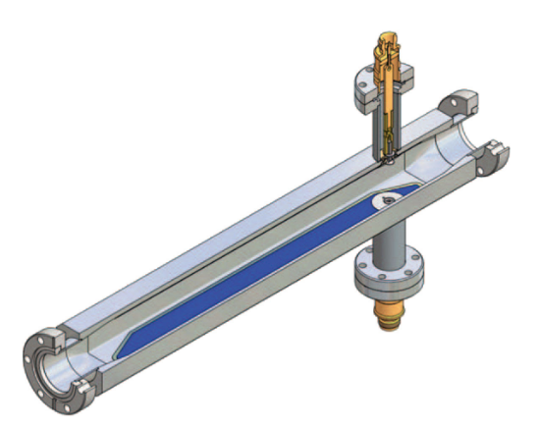
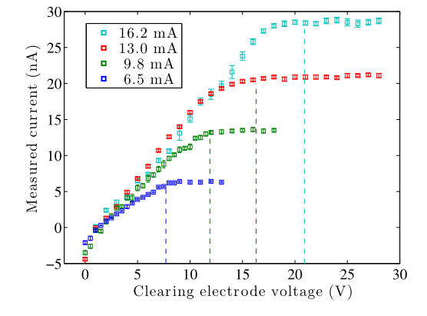
Reducing beamline ions
Although ionization cross-section at high energy (>100 keV) is small, a significant number of ions are generated outside the gun:
Vacuum tends to be poorer in the beamlines
Out gassing from beam loss
Beamline is much longer than cathode/anode gap
Ions can migrate from beamline into cathode/anode gap and be accelerated
Biased anode can reduce migration
JLAB, 2 kV bias, 22% increase in charge lifetime for GaAs
Cornell developed clearing electrodes for high current running
Required voltage predicted by electron beam size
No reported lifetime changes but substantial reduction in beam trips

Slide 17
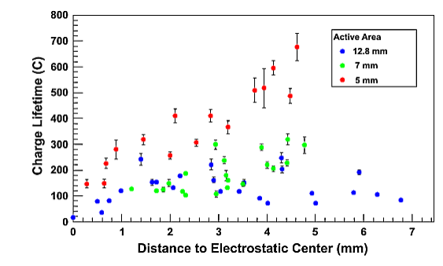
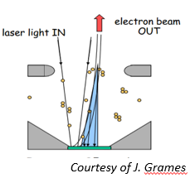
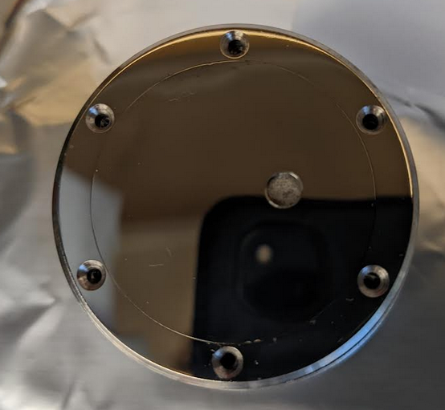
Off centered cathode
Grames et al. “Charge and fluence lifetime measurements of a dc high voltage GaAs photogun at high average current(2011)”
Transverse electric field inside the gun provides focusing towards the electrostatic center (EC)
If the cathode active area is positioned off axis, away from the EC, the total number of ions striking the cathode is reduced, increasing operational lifetime.
Can not eliminate ion back bombardment completely
Ions generated near the cathode will still strike the active area.
Smaller active reduces stray beam, further increasing lifetime.
Puck used in HERACLES for GaAs running

Slide 18
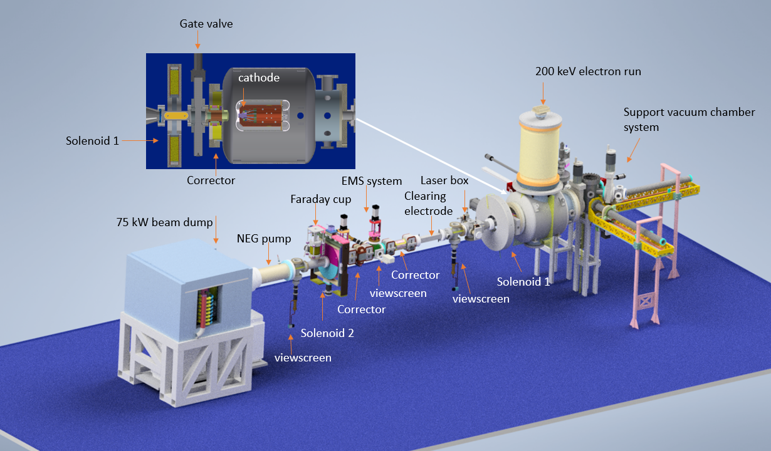
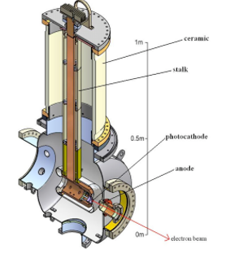
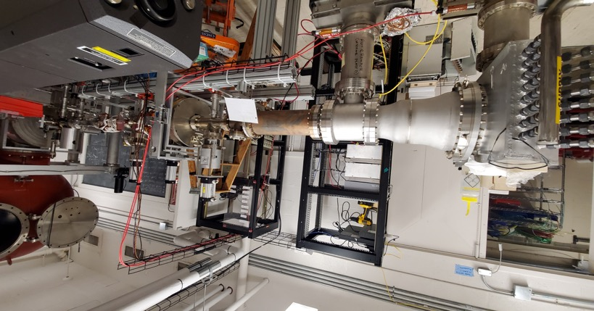
The HERACLES beamline
A beamline dedicated to the study of high current beam running:
Former CU-ERL gun 200kV @ 10 mA
Ion clearing electrodes
75 kW beam dump
EPICS based control system
Attached storage system: QE mapping, Cs-O activation

Slide 19
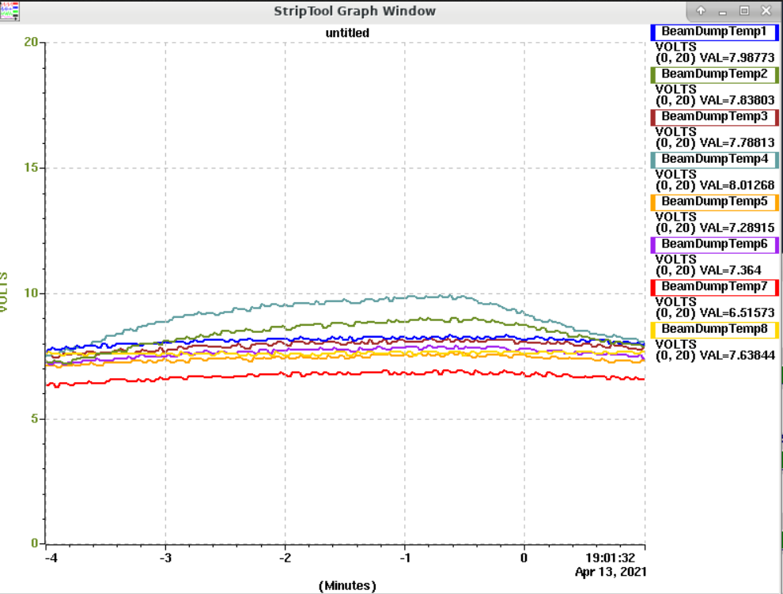
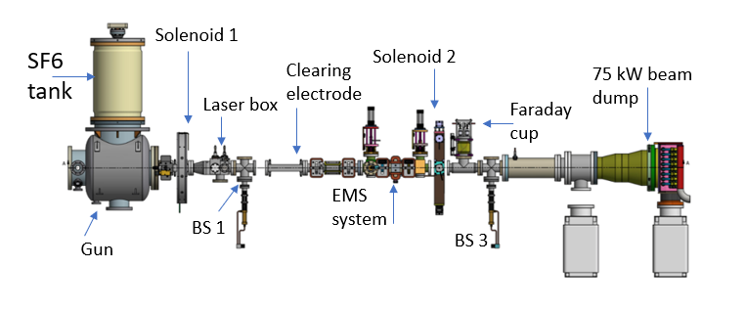
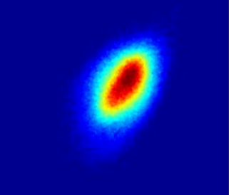
Beamline and Diagnostic details
Solenoid scan characterizes cathode MTE
Thermal couples register beam induced temperature rise at the dump
Beamline
2 Solenoids, 3 corrector pairs (hor/vert)
2 clearing electrodes
3 screens, 1 quad detector
1 Faraday cup
EMS system not implemented
3 Beam screens ensure clean beam transport from cathode to dump

Slide 20
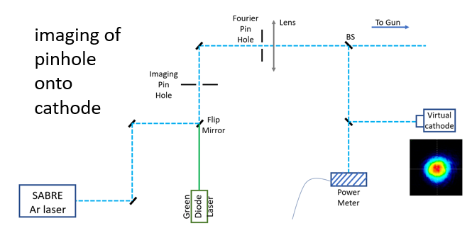
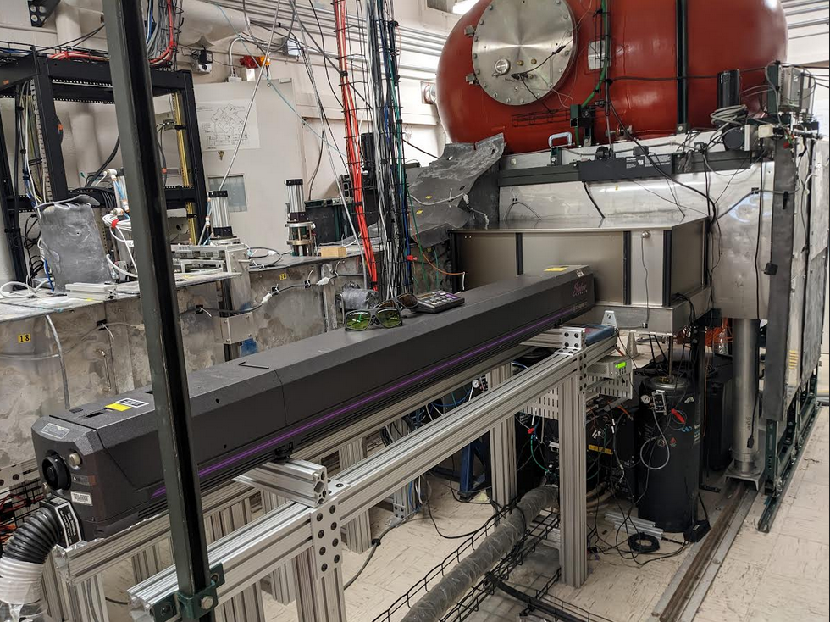
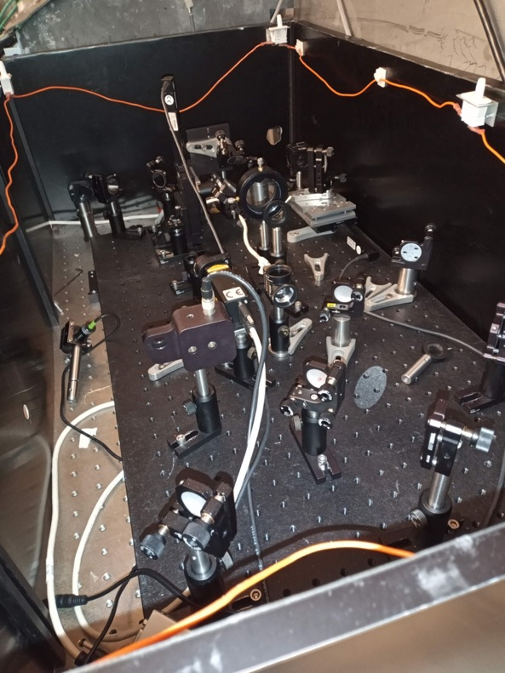
Laser Setup
The Ar ion laser has been refurbished and now can operated with tunable wavelength in the visible and UV.
5 W in the visible (ML)
2 W in the UV (ML)

Slide 21
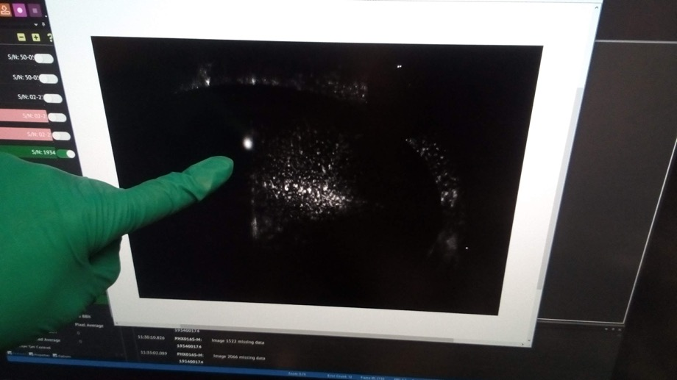
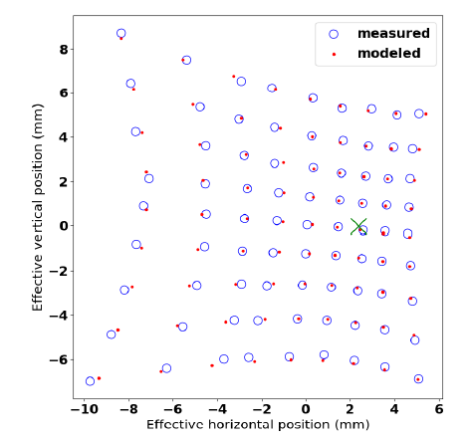
HERACLES commissioning low current
July 17th, 2020
First beam in the summer of 2020
Gun processed up to 200 keV
Beam-based alignment of
Electrostatic center to solenoid 1
Clean transport of beam from cathode to final view screen
Mu metal, degaussing…
Magnet calibrations
Angular kick vs current
Larmor rotation

Slide 22
HERACLES high current demonstration
Cs₃Sb cathode on stainless steel puck
10 mA max current, limited by radiation trips
8 mA constant current for 3 + hours with no significant change in cathode QE
Ready for cathode lifetime studies!

Slide 23
Cs-Sb-O activated GaAs cathode in HERACLES
Goal
Compare the charge lifetimes of Cs-Sb-O vs Cs-O activated GaAs.
Sample Preparation:
Cs-O:GaAs
activated with co-deposition in a chamber attached to the rear of HERACLES.
Lifetime measurements performed within hours of activation
Cs-O-Sb:GaAs
Activated in Mother chamber and transported via a vacuum suitcase to HERACLES
~24 hours between activation and lifetime measurement
Run Conditions
1 mA beam current held constant for 2-3 hours
488 nm drive laser. QE map at 532 and 780 nm
Typical vacuum pressure in the low e-10’s during run

Slide 24
Cs-Sb-O activated GaAs cathode in HERACLES (results)
We did not see an improvement in the charge lifetime at 488 nm
Pre/post run comparisons of QE indicate lifetime at 780 nm may have improved.
Relative QE change smaller for Cs-Sb-O samples
Cs-Sb-O had lower QE’s
We observed roughly a factor of 3 reduction in the QE between activation in the Mother chamber and beginning the run.
Required laser power a factor of 4-10 higher
The story is not over!
New growth chamber on HERACLES to support Cs-Sb-O activation
780 nm drive laser
Cs-O
Cs-Sb-O

Slide 25
Summary
GaAs is currently the only viable candidate for high current spin polarized production
NEA activation is fragile, making the charge lifetime low compared to alkali-antimonides
Cs-Sb-O activation improves GaAs lifetime in growth chambers
No improvement of lifetime was observed with operation at 488 nm
Some indirect evidence for improved lifetime at 780 nm
Future work
Lifetime studies performed at the 780 nm
Upgraded growth chamber on HERACLES to allow for Cs-Sb-O testing with transporting

Slide 26
BACKUP SLIDES

Slide 27
Analysis of QE degradation at high current
Damage is caused by ion back bombardment, but how exactly? The ions can either:
Sputter off the NEA activation layer
Damage the bulk crystal structure
Multiple GaAs samples ran in the CEBAF and IR-VUV FEL guns (JLAB) were studied after operation¹
On two bulk GaAs samples:
Rutherford Backscattering Spectrometry (RBS) showed no evidence of crystal damage.
Secondary Ion Mass Spectrometry (SIMS) did not indicate hydrogen ion implantation
On SL samples:
SIMS did show ion implantation that correlated with use AND location on the sample
¹V. Shutthanandan et al. PRAB 15, 063501 (2012)

Slide 28
Analysis of QE degradation at high current
Damage is caused by ion back bombardment, but how exactly? The ions can either:
Sputter off the NEA activation layer
Damage the bulk crystal structure
Multiple GaAs samples ran in the CEBAF and IR-VUV FEL guns (JLAB) were studied after operation¹
On two bulk GaAs samples:
Rutherford Backscattering Spectrometry (RBS) showed no evidence of crystal damage.
Secondary Ion Mass Spectrometry (SIMS) did not indicate hydrogen ion implantation
On SL samples:
SIMS did show ion implantation that correlated with use AND location on the sample
¹V. Shutthanandan et al. PRAB 15, 063501 (2012)

Slide 29
Analysis of QE degradation at high current
Damage is caused by ion back bombardment, but how exactly? The ions can either:
Sputter off the NEA activation layer
Damage the bulk crystal structure
Multiple GaAs samples ran in the CEBAF and IR-VUV FEL guns (JLAB) were studied after operation¹
On two bulk GaAs samples:
Rutherford Backscattering Spectrometry (RBS) showed no evidence of crystal damage.
Secondary Ion Mass Spectrometry (SIMS) did not indicate hydrogen ion implantation
On SL samples:
SIMS did show ion implantation that correlated with use AND location on the sample
¹V. Shutthanandan et al. PRAB 15, 063501 (2012)

Slide 30
Ion Implantation into GaAs
Hydrogen ions implanted at 100 and 10000 eV for 3 different cleave planes
Hypothesized 110’s smaller atomic density would support the most channeling and thus, be less damaged.
QE measured as a function of heat cycles
Low energy implantation resulted in QE loss that was recoverable
Interstitial defects
High energy resulted in some permanent loss
Knock out vacancy
W. Liu et al, PRAB 19, 103402 (2016)

Slide 31
Ion Back Bombardment in RF guns
Ions are heavy enough such that over one period of acceleration, they do not travel the length of a cavity cell
The ponderomotive effect causes the ions to move from strong field regions to weaker field regions→ In general away from the cathode
Eliminates high energy bombardment (<9 keV for 700 keV gun)
¹ J.W. Lewellen “Ion tracking in photocathode RF guns”
² Ji Qiang “Particle in Cell Monte Carlo simulation of ion back bombardment in a high average current RF photo-gun”

Slide 32
Ion bombardment reduction with an off-set anode

