Slide 1
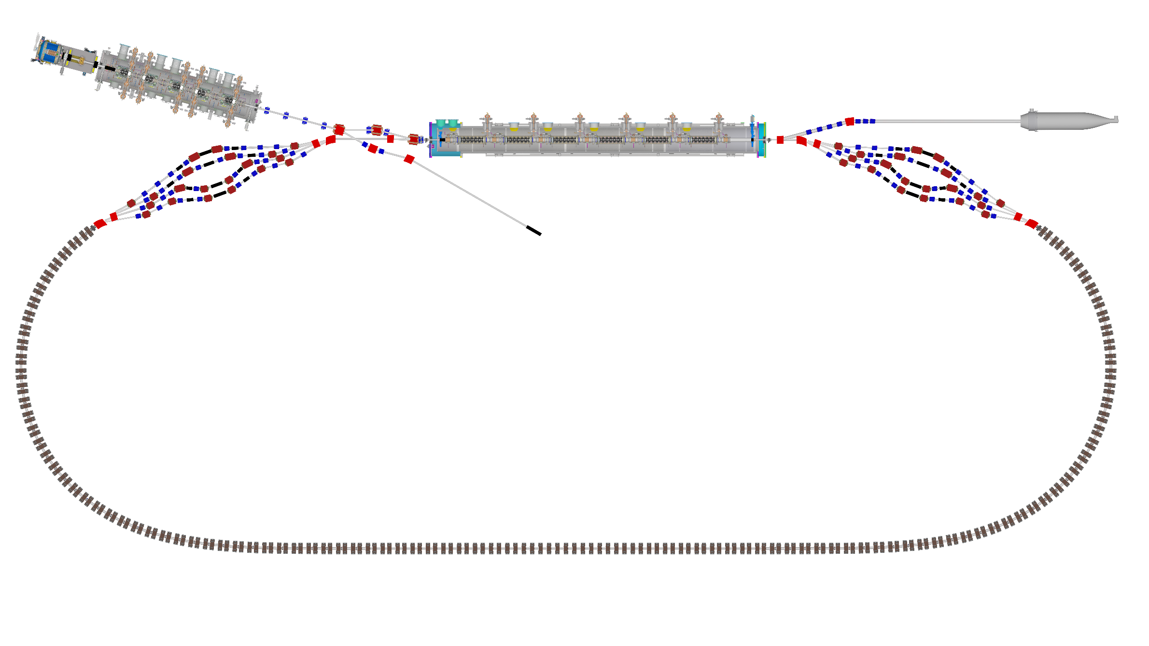

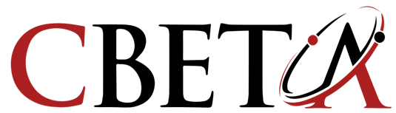

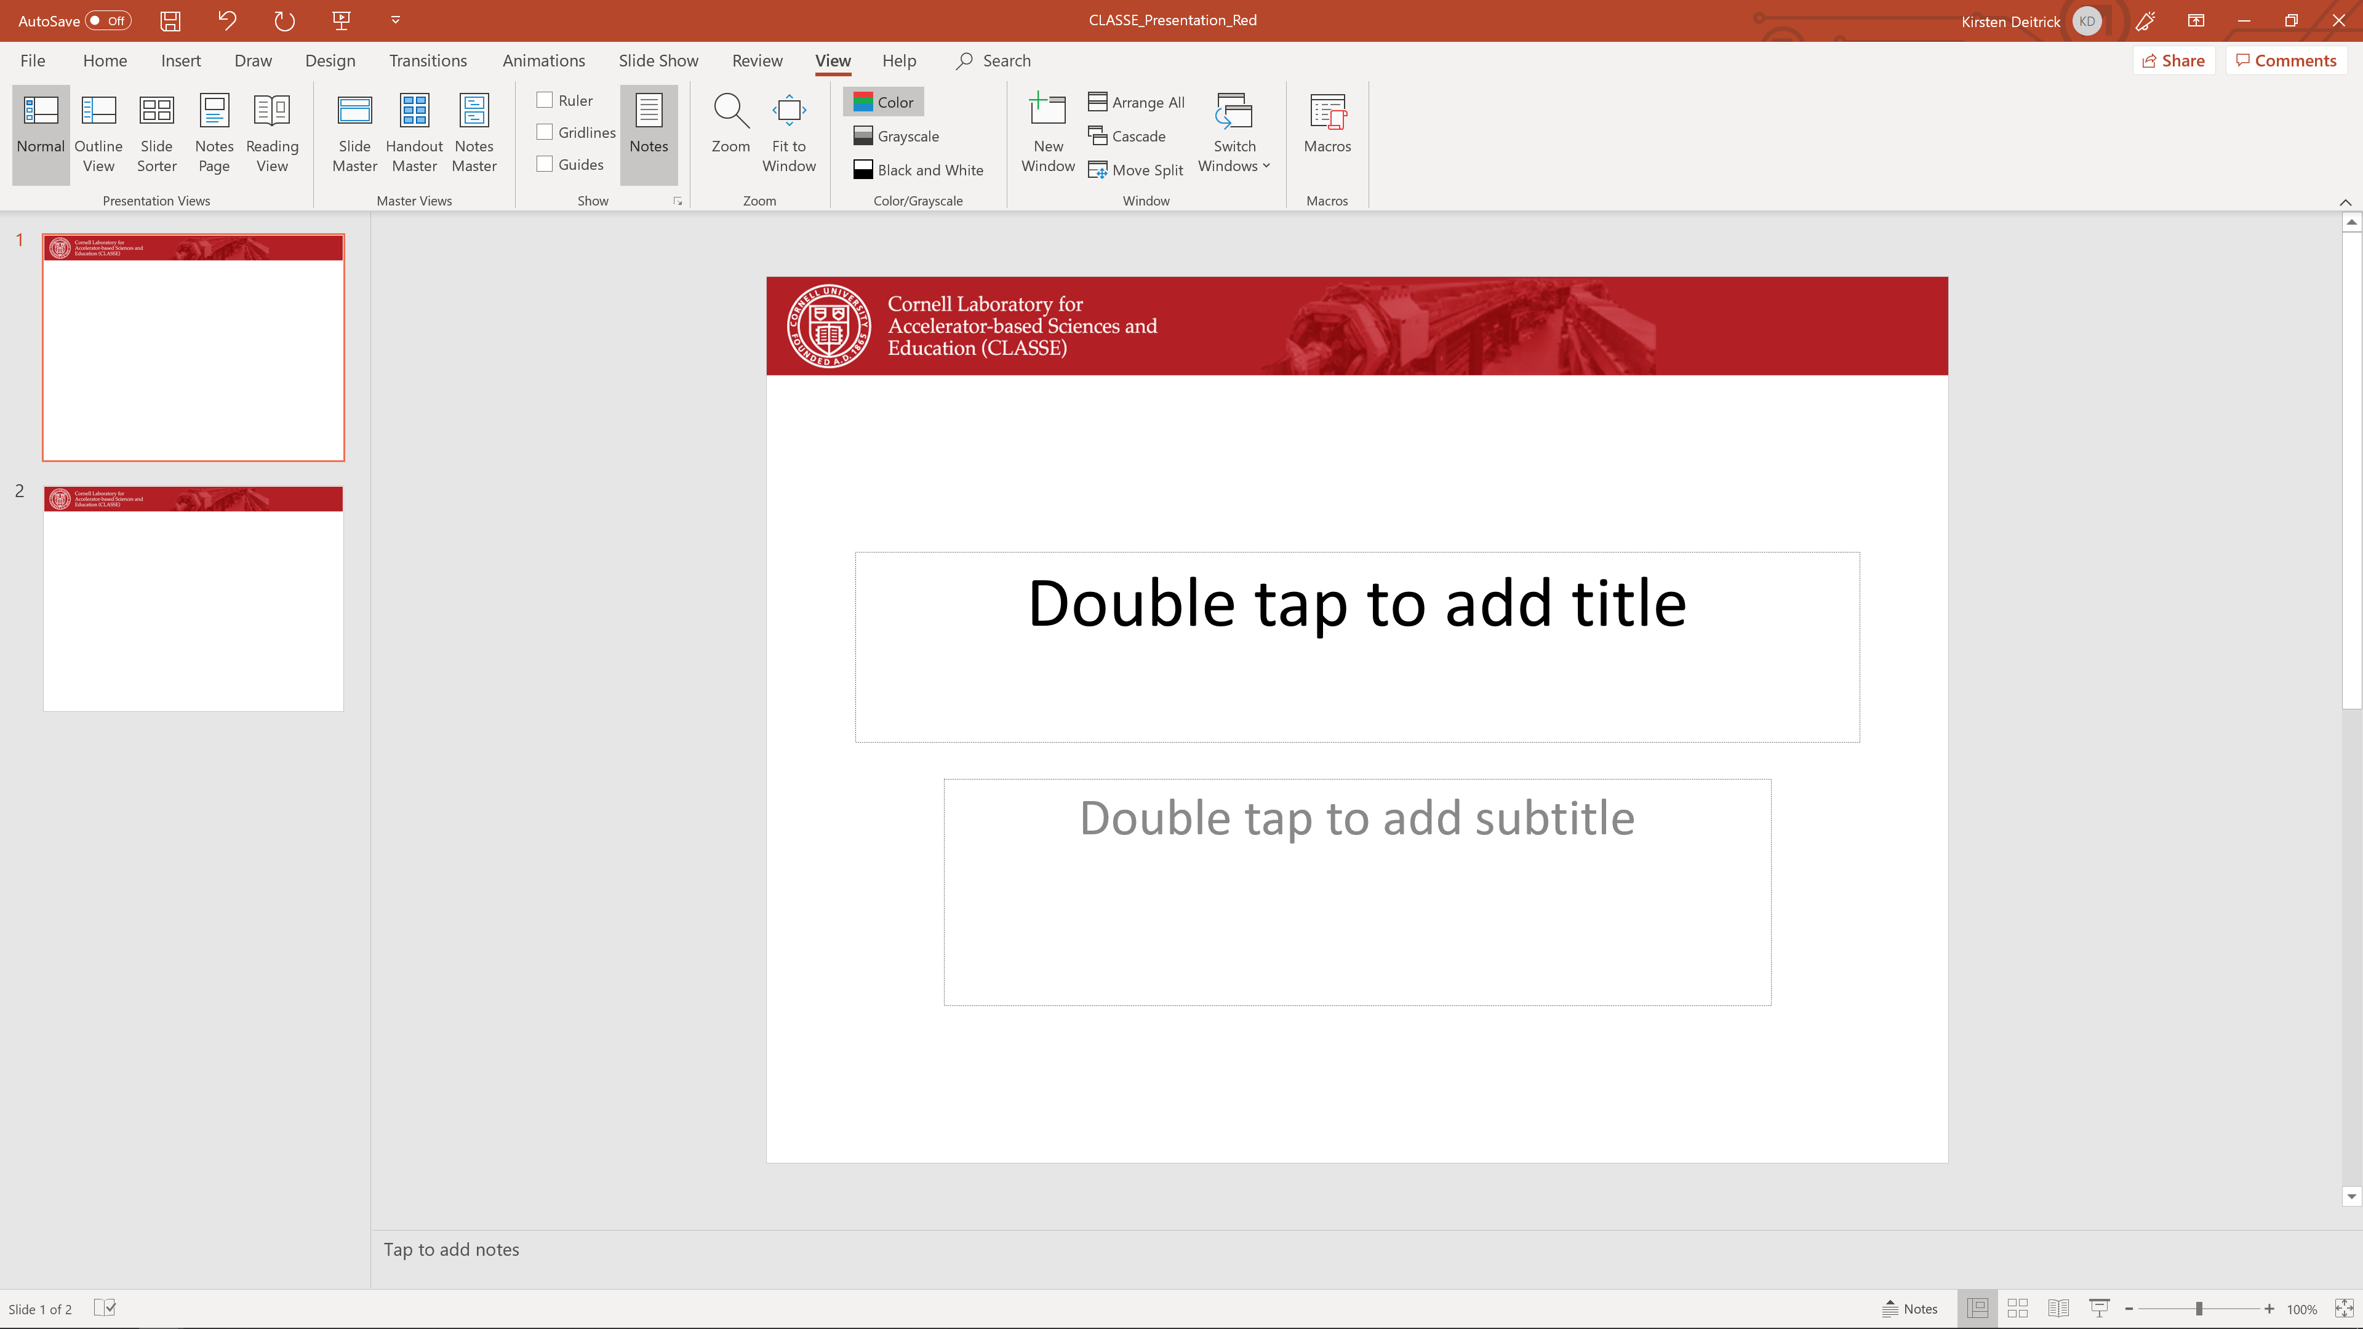
Challenges and Lessons Learned
Adam Bartnik

Slide 2
Background
CBETA: Cornell-BNL ERL Test Accelerator
What is it?
SRF Energy Recovery Linac (ERL)
  Why is it interesting?
Multi-pass ERL, with single return loop
  7 beams of 4 energies in 1 pipe: 42, 78, 114, 150, 114, 78, 42 MeV
  Uses the wide energy acceptance of Fixed Field Alternating-gradient (FFA) permanent magnets

Slide 3
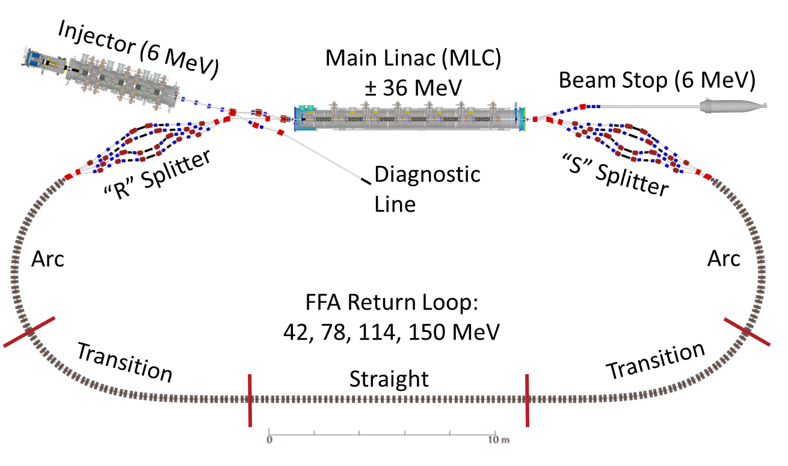
Layout

Slide 4
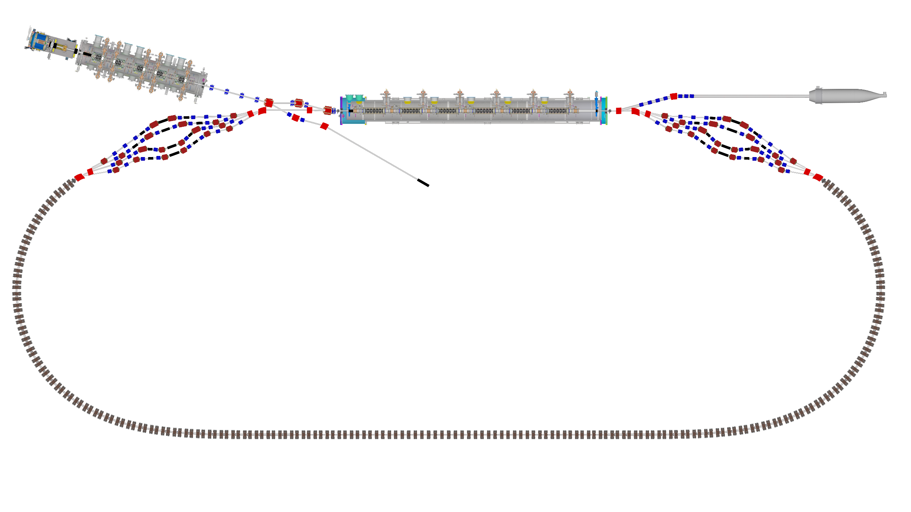
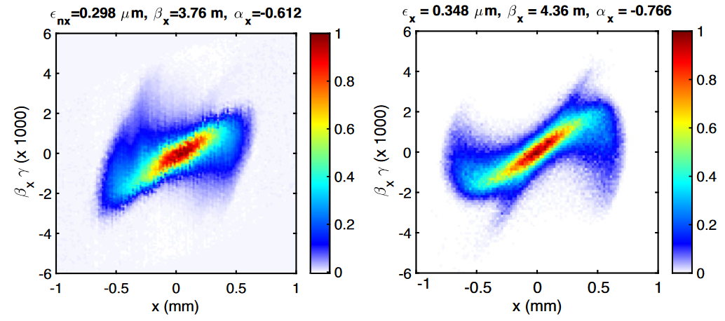
Injector
Design
350 kV dc gun, NC buncher
5 two-cell SRF cavities
4 quadrupole optics matching section
Merger and “Mirror merger” sections with phase space diagnostics
Goals
Produce beam with desired twiss parameters at MLC entrance
Measured “good enough”
GPT Simulation Goal

Slide 5
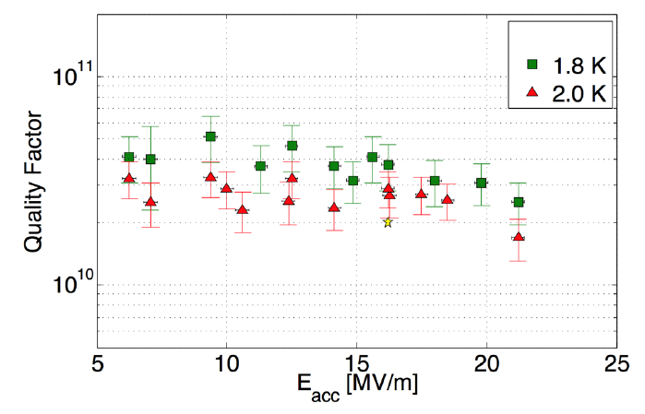

Main Linac Cryomodule (MLC)
Design
Originally designed for CU ERL lightsource
Q₀ = 2x10¹⁰ @ 16 MV/m, 1.8 K
Q_{L} = 6x10⁷
Microphonics low enough for 5-10 kW amplifier / cavity
Goals
Reach design energy gain of 6 MeV/cavity
Field stability of 10⁻⁴
Phase stability of 0.05 deg
MLC (going for a drive)

Slide 6
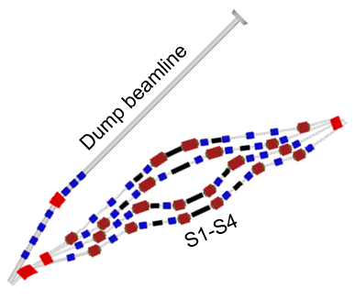
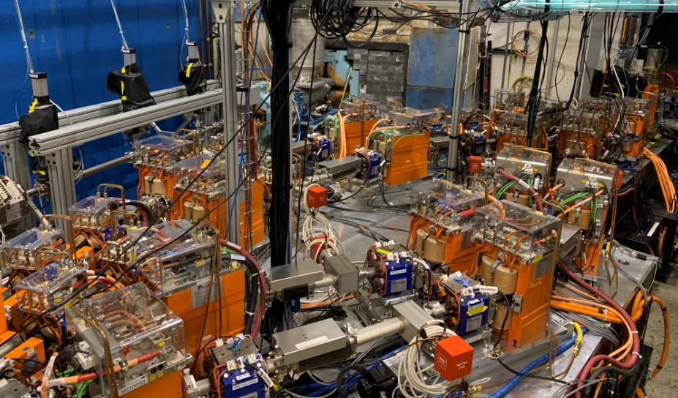
Splitters
Design
4 beamlines to separate and recombine each beam energy
8 quadrupoles per line
Goals
Path length adjustment for energy recovery
Twiss parameters / dispersion / dispersion prime/ R₅₆ / orbit
FFA
Blue: quadrupole
Red: dipole
Black: bellows
MLC

Slide 7
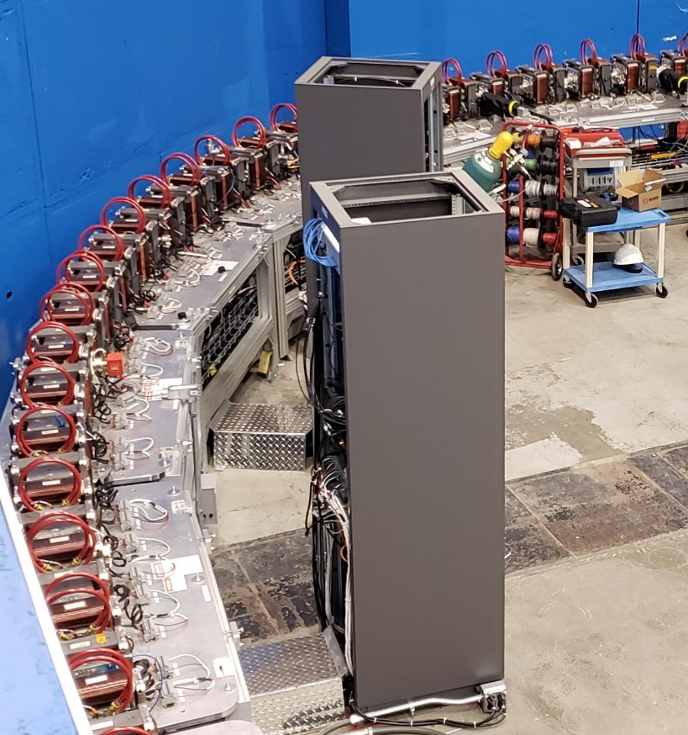
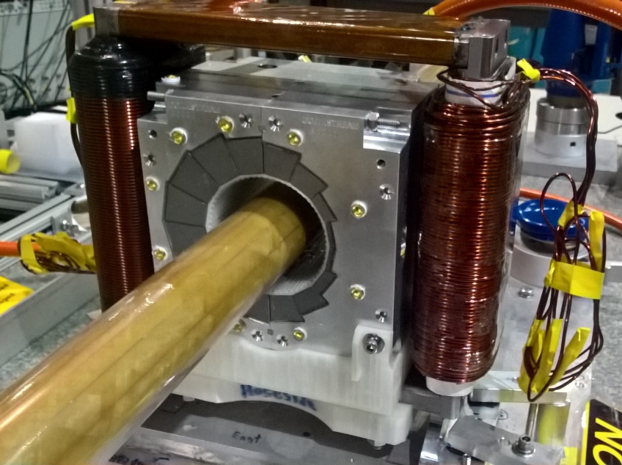
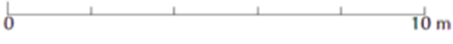
FFA Return Loop
Design
Non-scaling, linear gradient FFA made of permanent Halbach magnets
Alternating H and V dipole correctors, allowing for ~0.1 mm alignment errors
BPMs placed at periodic locations around ring
Goals
Just don’t ruin the beam along the way

Slide 8
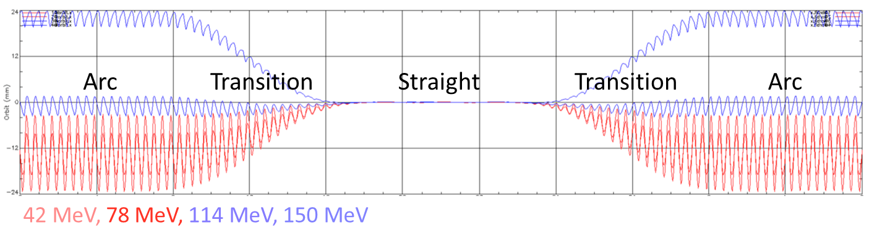
FFA Return Loop
Design
Arc type of FFA cell transitioning to straight and back to a second arc
A pure arc would be desirable, but impossible due to building walls

Slide 9
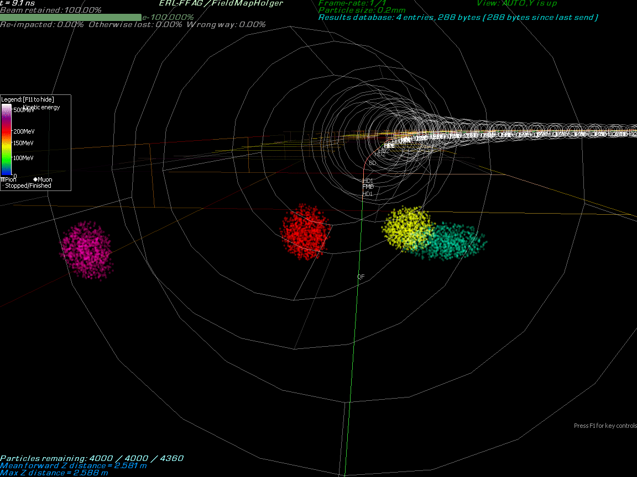
Design Concepts

Slide 10
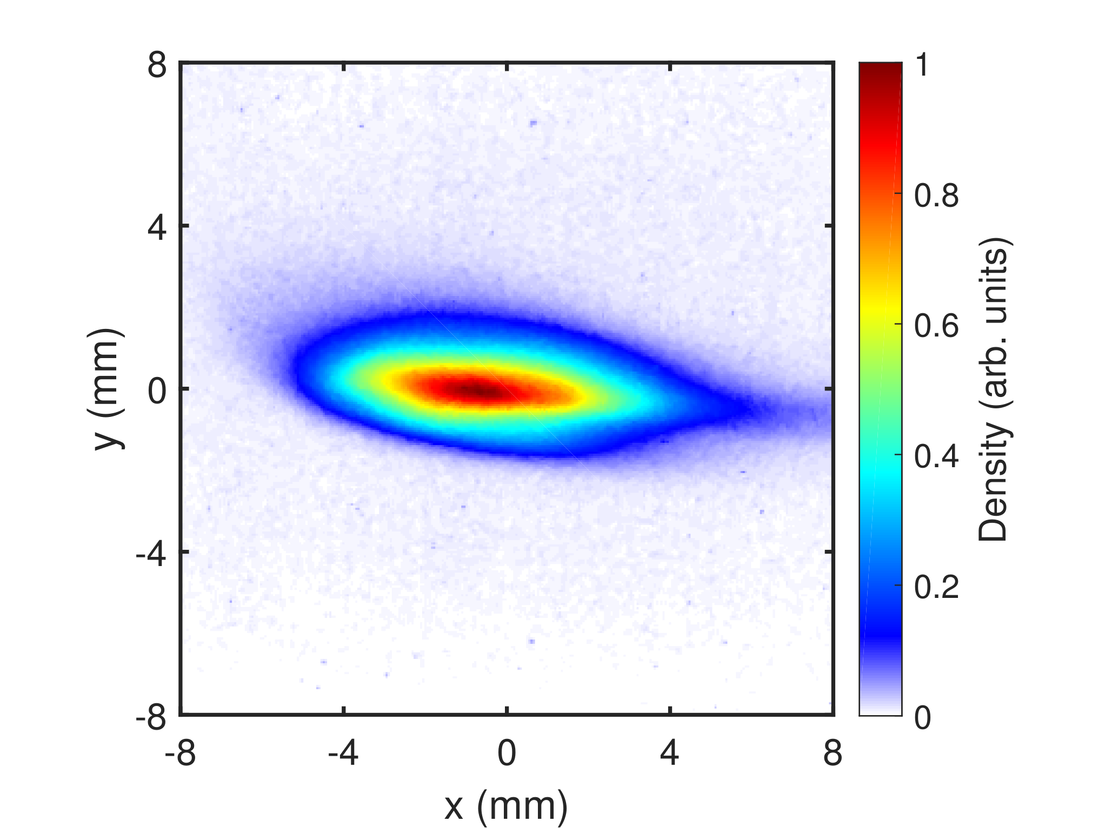
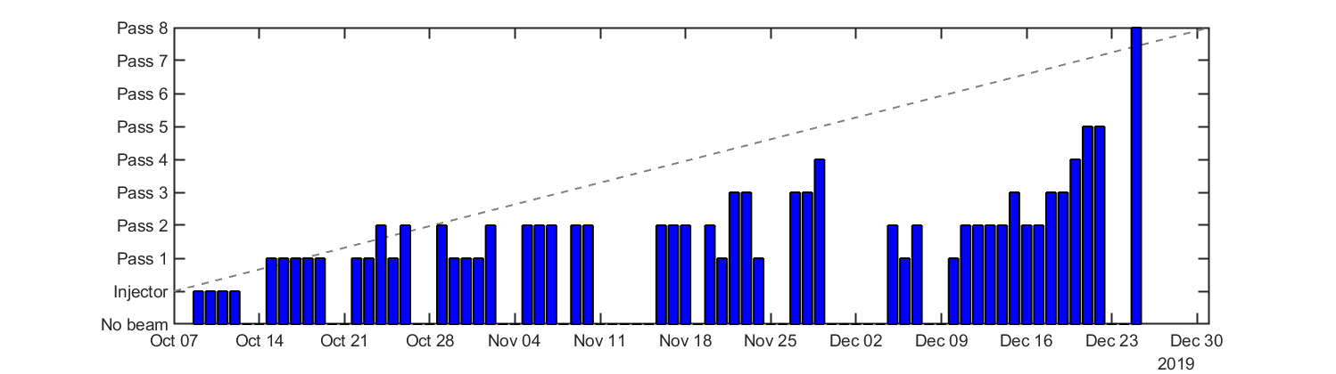
Four-Turn Commissioning
October-December 2019
  Max current: 1 nA (magnet safety)
  12 weeks of operation
  8 passes through the linac
Average required progress: 1.5 weeks / pass
Actual achieved progress was much slower, punctuated with problem solving
First ER beam on Dec. 24th!
Commissioning Timeline

Slide 11
Problems and Solutions
Expected challenges
Microphonics
BPM design for many beams
Multi-beam orbit correction
Stray fields
Dispersion/R56 correction
Laser leakage current
Machine reproducibility, degaussing
Unexpected challenges
Buncher / SSA / magnet failures
Magnet power supply instability
Path length adjustment
MLC slow energy drift
Beam arrival phase drift
Matching lattice optics
Microbunching instability
Light grey font = Moved to extra slides to save time

Slide 12
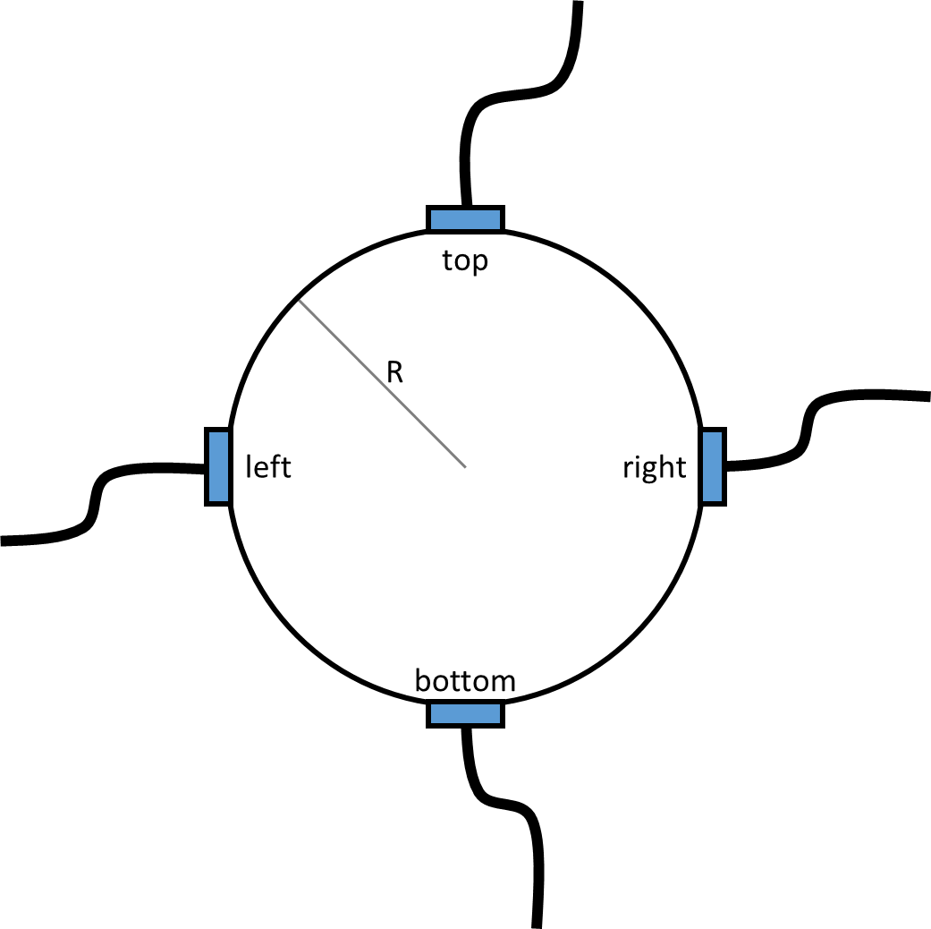
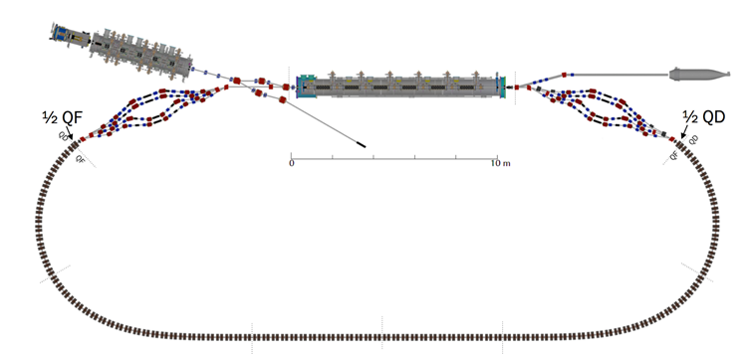
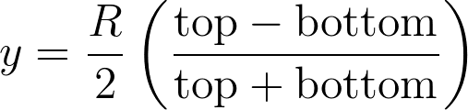
BPMs for Many Beams
Challenge: Measure up to 8 beams at a single location
Bunches are emitted at 1300/31 = 41.9 MHz
  All 100% duty factor (every bunch is emitted) the method is very complicated, remains untested
  At low current, we can instead emit trains of 8 bunches, which only fills one pass through the ring at time
    5 pC * 8 bunches * 25 Hz = 1 nA
Two kinds of BPMs
“Time domain BPMs”: Position only
“RF BPMs”: Position and phase (arrival time)
BPM
= RF BPM
= Bunch location

Slide 13
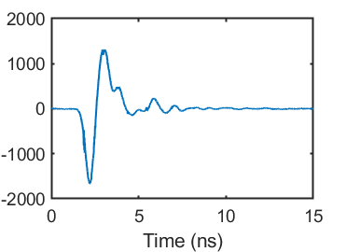
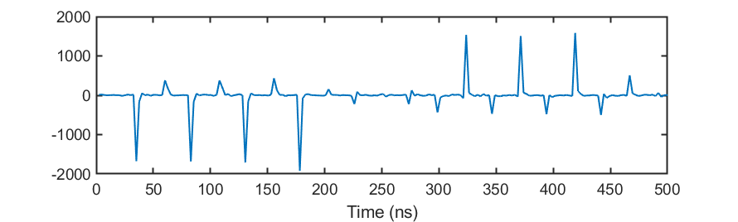
Time domain BPMs
Digitize BPM response
Single bunch response: ∼3 ns
ADC rate: 2.5 ns
Original plan: Synchronize BPMs to (every other) peak
Problems:
Time-consuming to set up
Each pass has different timing
Laser hiccups cause timing to be lost (extra slides)
Single bunch response
= ADC sampled points
Bunch spacing = 23.8 ns
8 bunches passing by BPM twice
Round-trip time = 264 ns

Slide 14
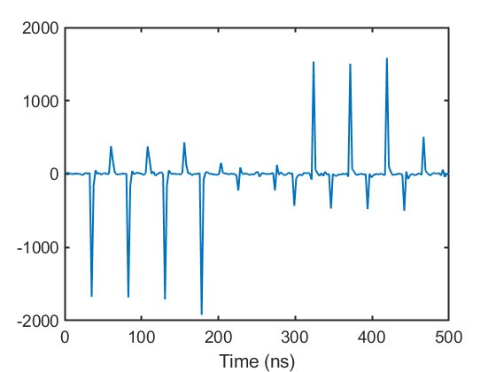
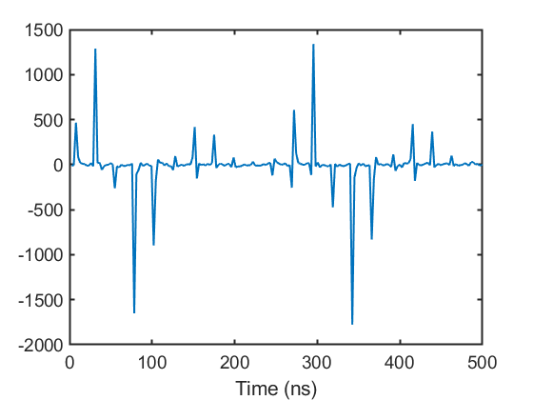
Time domain BPMs
Solution: Asynchronous timing : Sample random part of a bunch response
Synchronous BPM ADC: (1300/31)x(76/2)/4 = 398.4 MHz
Asynchronous BPM ADC: (1300/31)x(73/2)/4 = 382.6 MHz
Synchronous
Asynchronous
Bad: Lose about a factor of 5 in signal
Good: Simple, stable, details of timing no longer matter

Slide 15
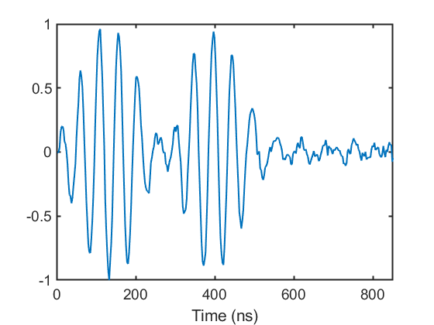
Phase (RF) BPMs
Timing information is produced by RF frequency mixing
Raw BPM signal is mixed with a (1.3 + Δf) GHz clock signal, low pass filtered
Remaining signal has the form: A(t) sin(2π Δf t + φ₀)
  A(t) : Envelope from when the beam was there
  Δf : Low frequency that is capable of being digitized
  φ₀ : Relative phase between beam and 1.3 GHz RF clock
Typically accurate to ∼500 fs at 1 nA beam current
1st pass
2nd pass

Slide 16
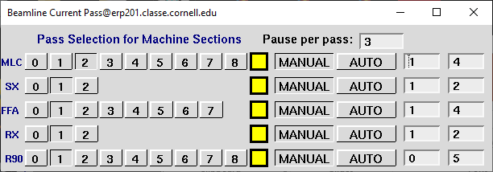
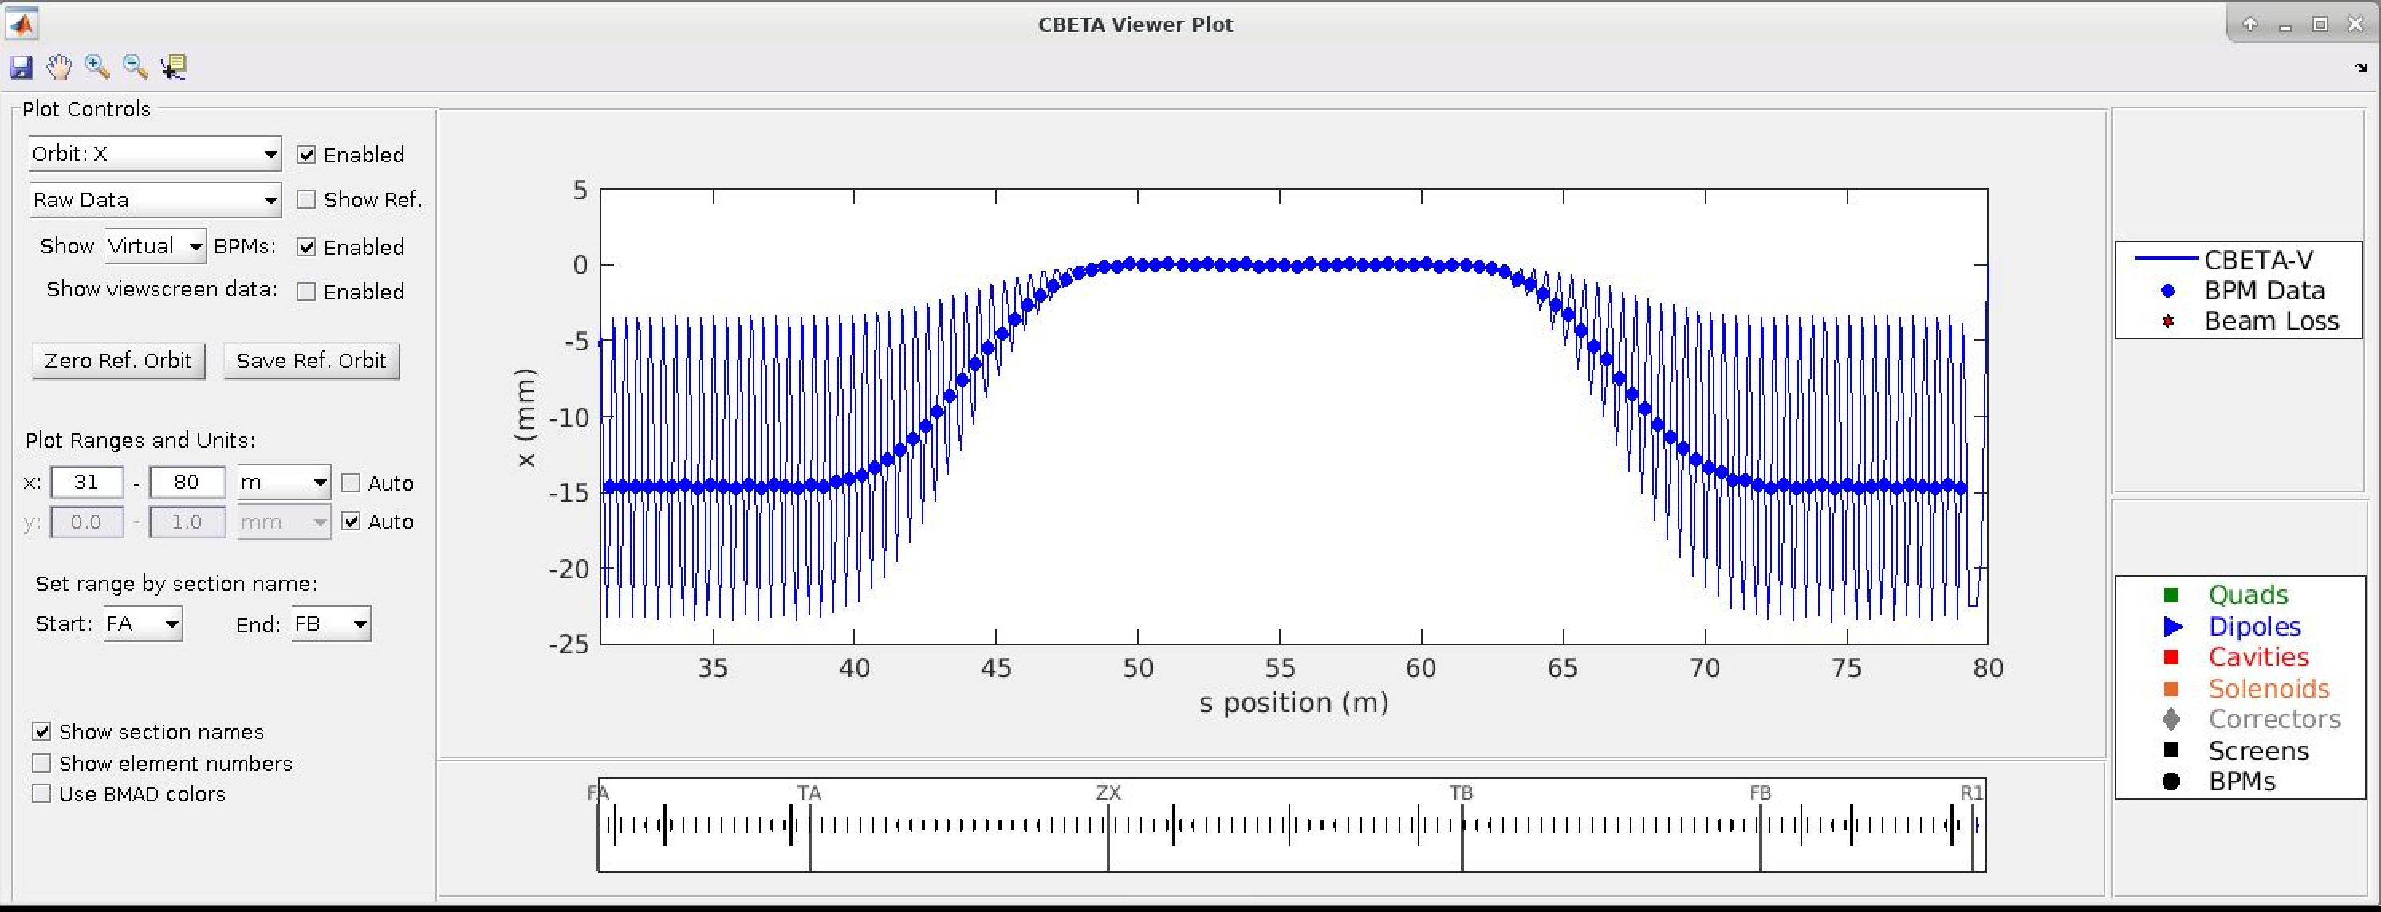
BPM Windows
Data is averaged in hardware in a window centered on a given pass
  BPM positions only update in currently selected pass
Operators select pass manually, or choose “auto” to have it cycle through all passes
  Can choose by BPM, by section, or in groups of sections
Timing window
Operator BPM Display Screen

Slide 17
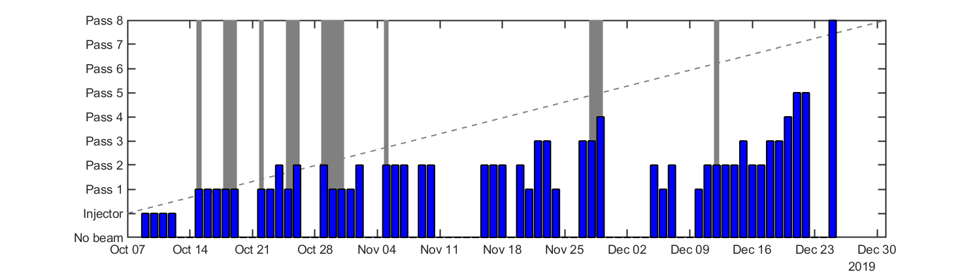
BPMs for Many Beams
Firmware upgraded 10/22
Plan was in progress before operation began, but:
Major FPGA firmware upgrades on 10/22
Hardware swaps, wiring, software changes continued intermittently throughout run period (grey areas above)
Remaining issues:
5 pC, our operating charge, was near the lower measurable limit

Slide 18
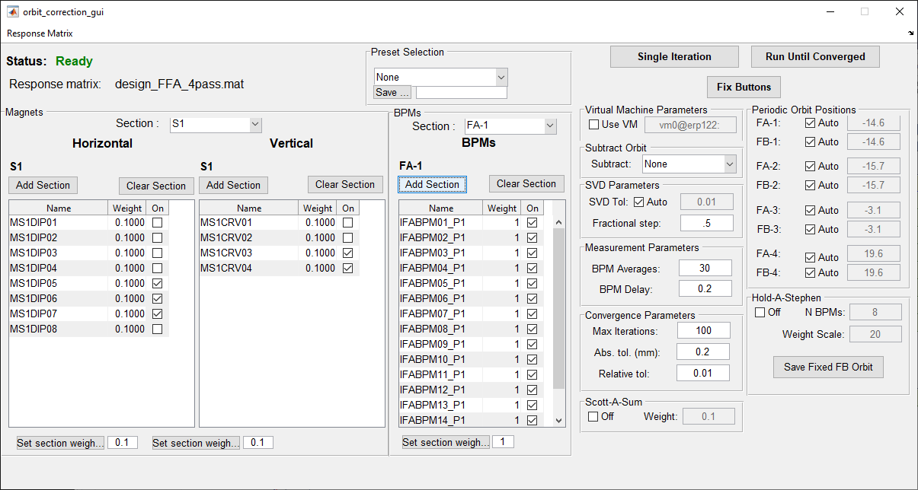
Multi-beam orbit correction
SVD-based method ready well before operation began
Can modify weight factors for BPMs and magnets
Can include/exclude BPMs or magnets
Can solve for best off-axis periodic orbit in FFA
Just needs a response matrix…
Auto/manual periodicity
Convergence criteria
BPM selection, weights
Magnet selection, weights

Slide 19
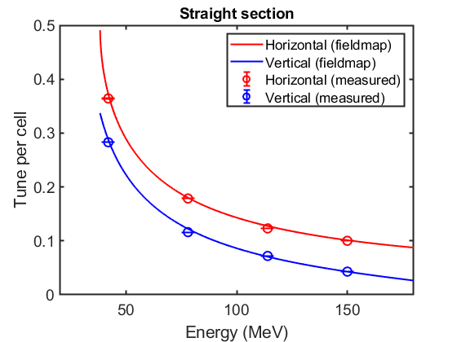
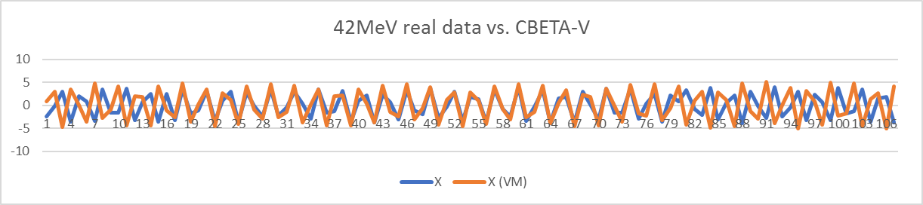
Multi-beam orbit correction
Problems:
FFA Lattice has large chromaticity (by design)
    Machine has unexplained slow energy drift (~0.1 MeV)
Simulation:
Simulation and measurement go in and out of phase
Phase advance across FFA deviates by more than 1 cycle
Measured:
Very time consuming
Typically lose beam in splitters before reaching next pass

Slide 20
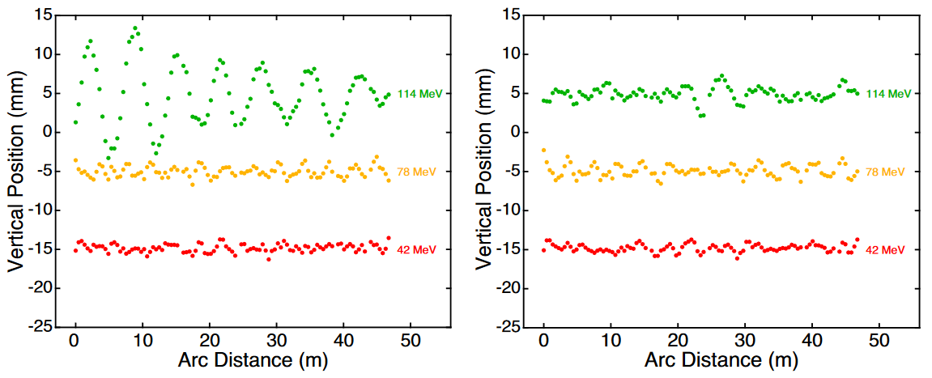
Multi-beam orbit correction
Idea 1: Tune-based empirical response matrix
Measure experimental tunes for each energy
Create response in periodic sections
Decouple passes by holding orbit constant on last N FFA BPMs
1
3
Before 3rd pass correction
After 3rd pass correction
2
Orbit held constant here (with large weight factor)
Beam position (offset for clarity)

Slide 21
Multi-beam orbit correction
Ideas for orbit correction
Idea 2: Matrix refinement in closed-bump subspace
Measure 1st pass matrix with single magnets
Predict next pass closed-bump subspace
Re-measure and refine matrix in that subspace, iterate
Correct exit FFA orbit / injection into splitter
Correct vertical dispersion growth in FFA

Slide 22
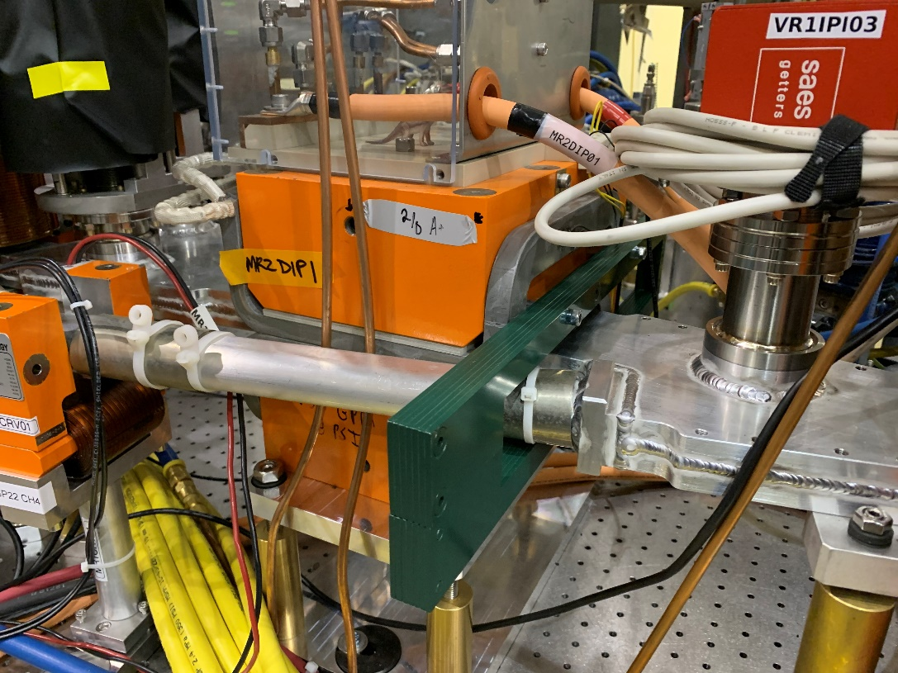
Stray fields
Splitter magnet density was expected to be a significant problem
Largest expected problems: septa magnets
  Field clamps from detailed modeling, engineering
  Reduced stray field effect by factor of 40
No time for engineering, nor space for clamps around other magnets…
Field clamp

Slide 23
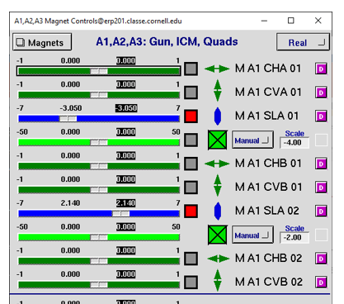
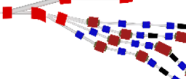
Stray fields
Use linear combinations of magnets in prior lines to best cancel stray fields
“Real” : actual magnet controls
“Corrected” : stray-field corrected
“VM” : online simulation (virtual machine)
e.g. this magnet is felt in adjacent (prior) beamline. Fix automatically using other nearby magnets.

Slide 24
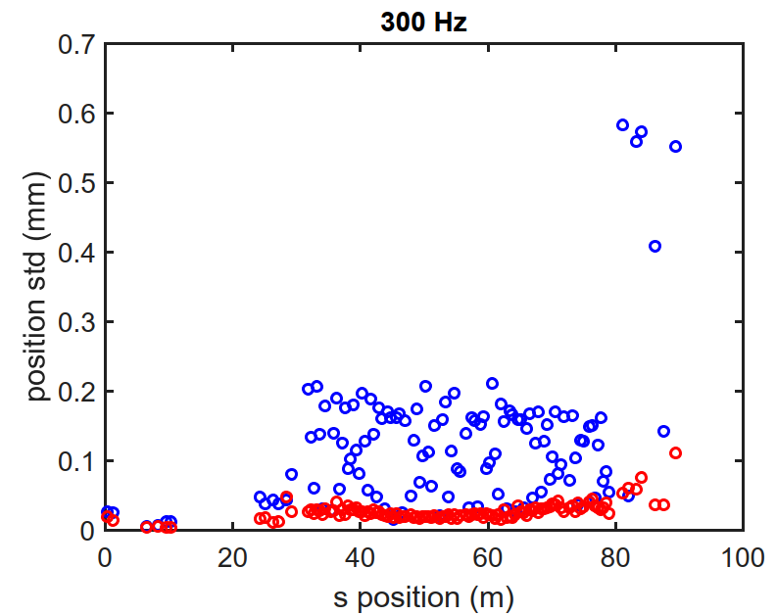
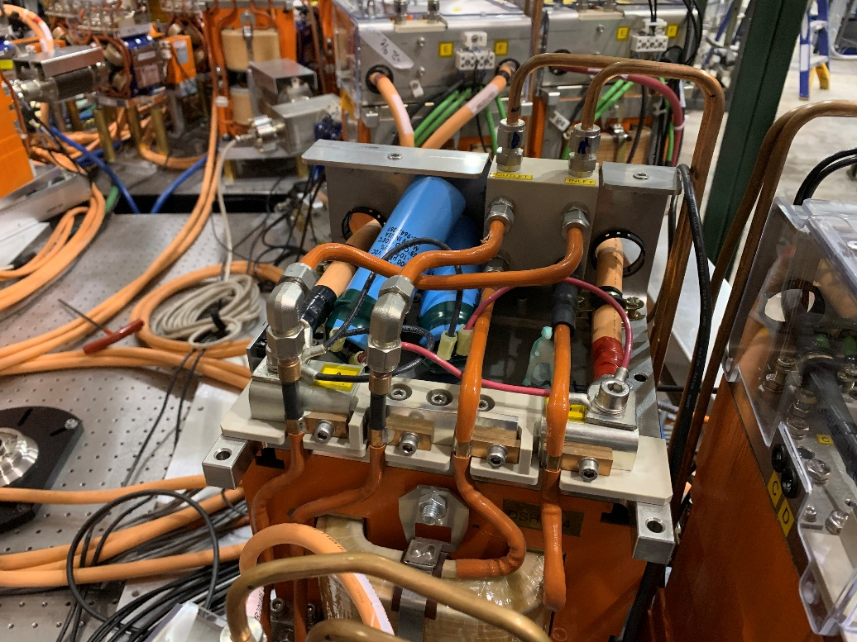
Power supply instability
Some Genesys power supplies had an instability above ∼120 A
  ±10% oscillations!
  Initially beam was moving in S1 purely from oscillating stray field in S2
Two hallmarks to distinguish from other sources of jitter
  18 Hz, sinusoidal
  Does not follow trend of dispersion
Solved by adding one (or two) 3 mF capacitors in parallel with magnet
S1, R1 have roughly equal dispersion (η∼1 m)
FFA has η < 0.02 m

Slide 25
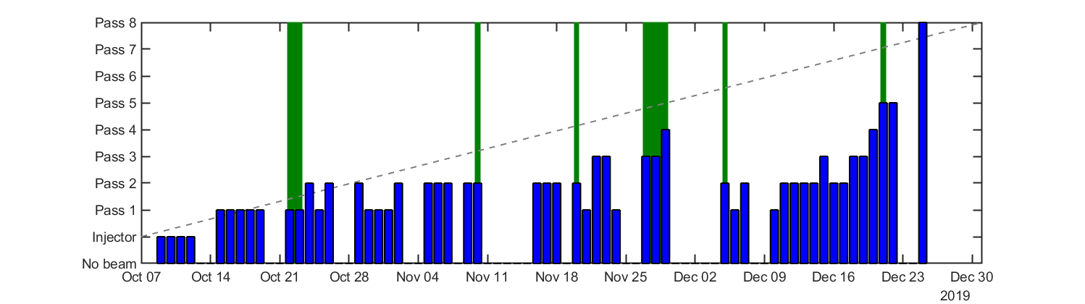
Power supply instability
Proved difficult to fully solve in one access
  Single capacitor on each power supply wasn’t enough
    Cannot directly measure residual problem field pickups / ammeter
  Difficult to notice until well after bad supply
    e.g., we narrow it down to “maybe in R3, or S3?”
  Stray fields complicate diagnosis
    e.g., effect in R3 actually caused by magnet in R4
Not a coincidence that new passes achieved shortly after capacitor additions (green, above)

Slide 26
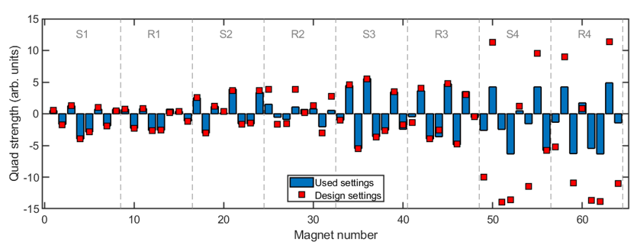
Beam Optics Matching
Primarily in R2 (2nd pass, 2nd splitter), we had optics problems.
Could not reach design quadrupole setpoints, without losing (most of the) beam
Beam appearance typically “odd” after R2.
  For fun, here are some images taken after the R2 section, with a comparison to what I think it looked like…
R2: could not reach design
S4,R4: No real attempt to reach design

Slide 27
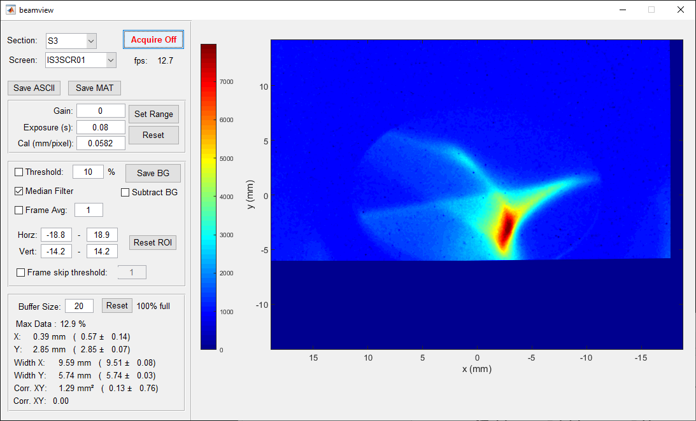

Peacock

Slide 28
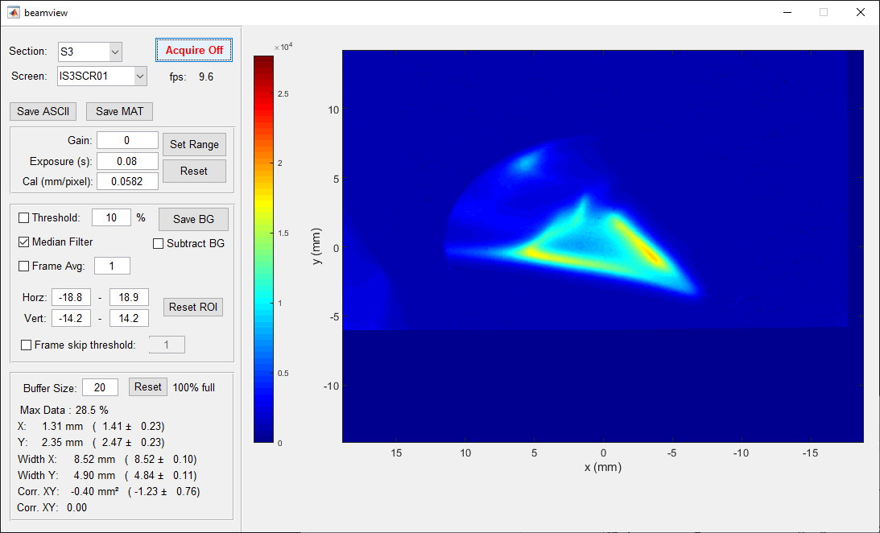
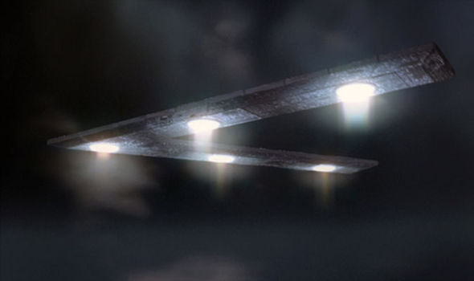
Spaceship

Slide 29
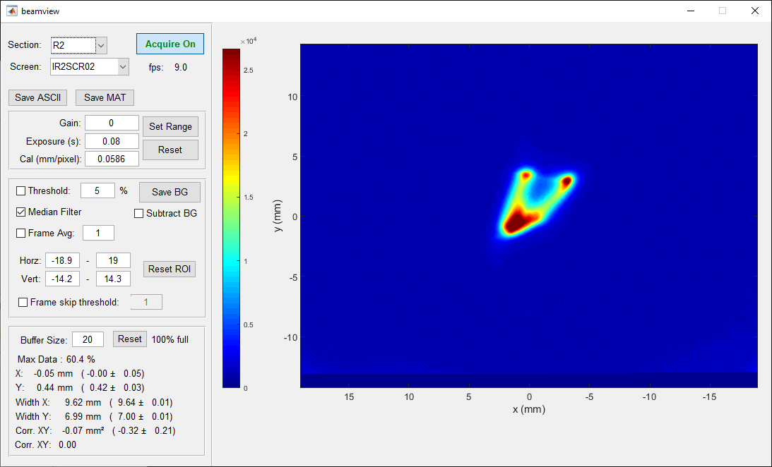

Happy Alien

Slide 30
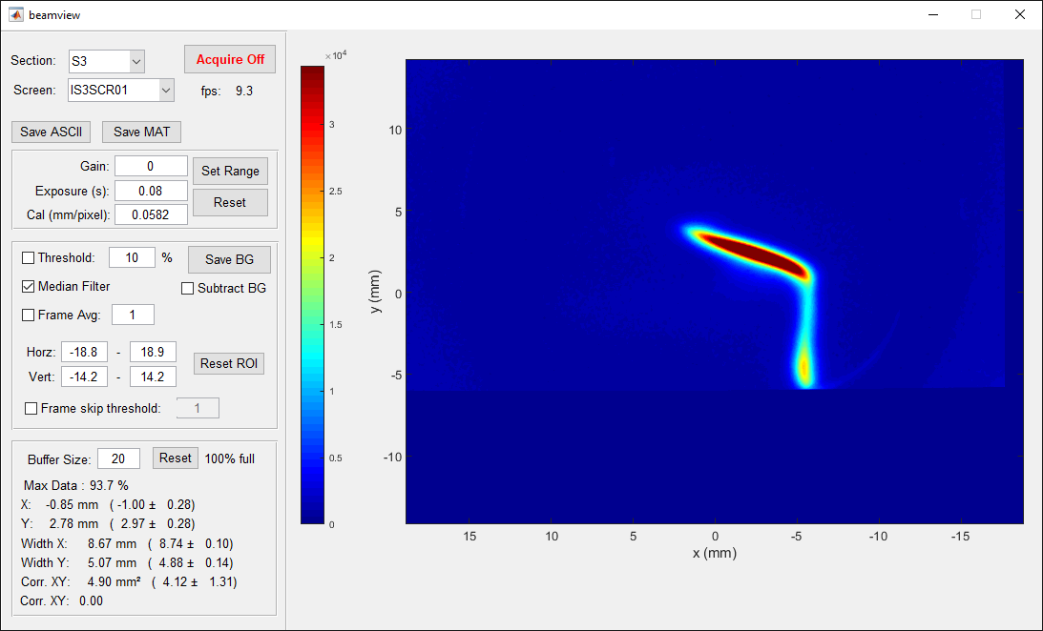

Salvador Dali Painting

Slide 31
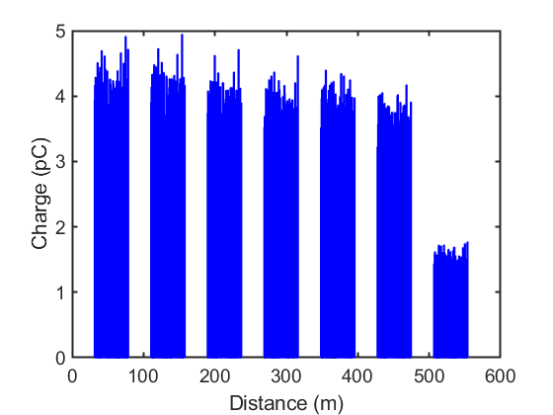
R2 optics matching
It is no coincidence that we were often stuck after the second pass (red line, above)
Second pass through R2 section remained primary source of transmission loss
Source of the problem remains unsolved
10% loss
60% loss

Slide 32
Conclusions
Path towards higher current
Many challenges solved during 12 week operation period
Significant challenges remain for improved 4-pass ER
Primary problem: unexplained optics in R2 section
Expected challenges
Microphonics
BPMs for many beams
Multi-beam orbit correction
Stray fields
Dispersion/R56 correction
Laser leakage current
Machine reproducibility, degaussing
Unexpected challenges
Component failures
Magnet power supply instability
Path length adjustment
MLC slow energy drift
Beam arrival phase drift
Matching lattice optics
Microbunching instability

Slide 33
Acknowledgements
Thank you to everyone on the CBETA team, including:
D. Trbojevic¹, G. Hoffstaetter², R. Michnoff¹, N. Banerjee², J. Barley², A. Bartnik², I. Bazarov², J.S. Berg¹, L. Borak¹, S. Brooks¹, D. Burke², J. Crittenden², J. Crone³, L. Cultrera², K. Deitrick², J. Dobbins², C. Franck², R. Gallagher², C. Gulliford², B. Heltsley², R. Hulsart¹, J. Jones³,
D. Jusic², R. Kaplan², D. J. Kelliher³, G. Mahler¹, F. Meot¹, V. Kostroun², B. Kuske⁴, Y. Li²,
M. Liepe², W. Lou², M. McAteer⁴, T. Miyajima⁵, K. Ming⁵, B. Muratori³, S. Peggs¹, P. Quigley²,
J. Renta¹, T. Roser¹, D. Sabol², D. Sagan², J. Sears², C. Shore², E. Smith², K. Smolenski²,
C. Stoll¹, S. Thomas¹, S. Trabocchi¹, N. Tsoupas¹, J. Tuozzollo¹, V. Veshcherevich², J. Völker⁴, D. Widger², H. Witte¹
BNL (2) Cornell University (3) STFC (4) HZB (5) KEK
This project was supported by NSF award DMR0807731, DOE grant DE-AC02-76F00515, and NYSERDA agreement number 102192

Slide 34
References
  A. Bartnik et al., “CBETA: First Multipass Superconducting Linear Accelerator with Energy Recovery”
  https://journals.aps.org/prl/abstract/10.1103/PhysRevLett.125.044803
  C. Gulliford et al., “Measurement of the per cavity energy recovery efficiency in the single turn Cornell-Brookhaven ERL Test Accelerator configuration” https://journals.aps.org/prab/abstract/10.1103/PhysRevAccelBeams.24.010101
  G. Hoffstaetter et al., “CBETA Design Report, Cornell-BNL ERL Test Accelerator”
  https://arxiv.org/abs/1706.04245

Slide 35
Backup Slides

Slide 36
Results from 4-pass operation

Slide 37
Transmission
10% loss
60% loss
Gradual 10% loss
Additional 60% loss after 2nd pass through R2
Percentages improve with lower initial charge (not shown)

Slide 38
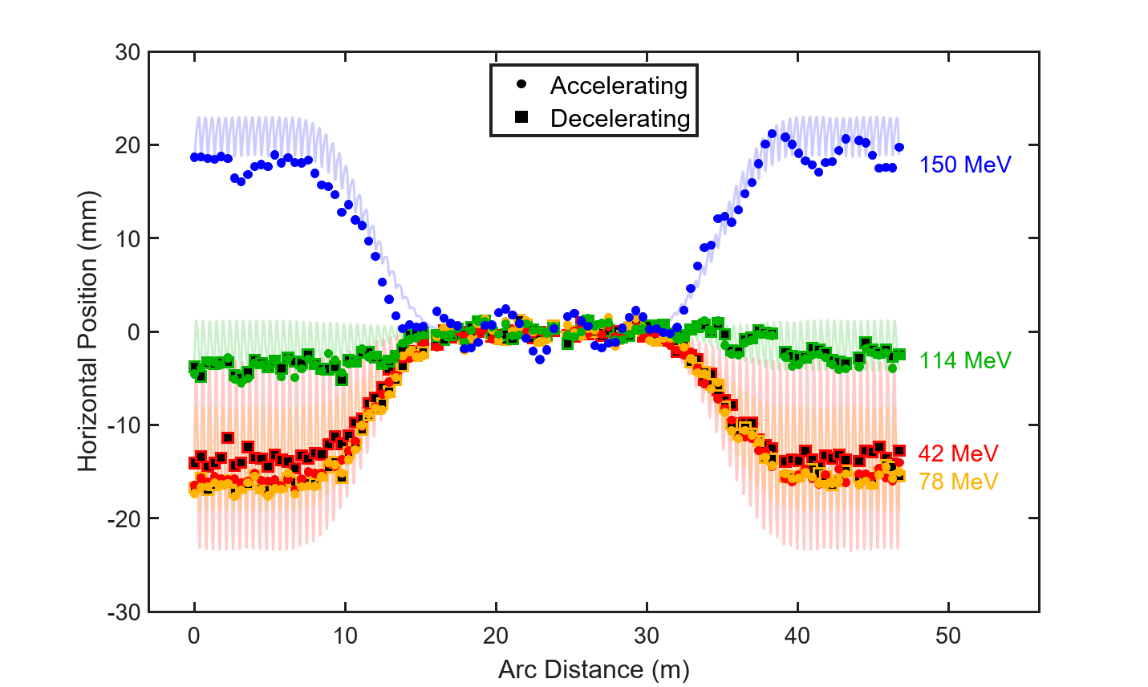
Horizontal Orbits
Note: Final 42 MeV orbit (red) has systematic error due to poor transmission

Slide 39
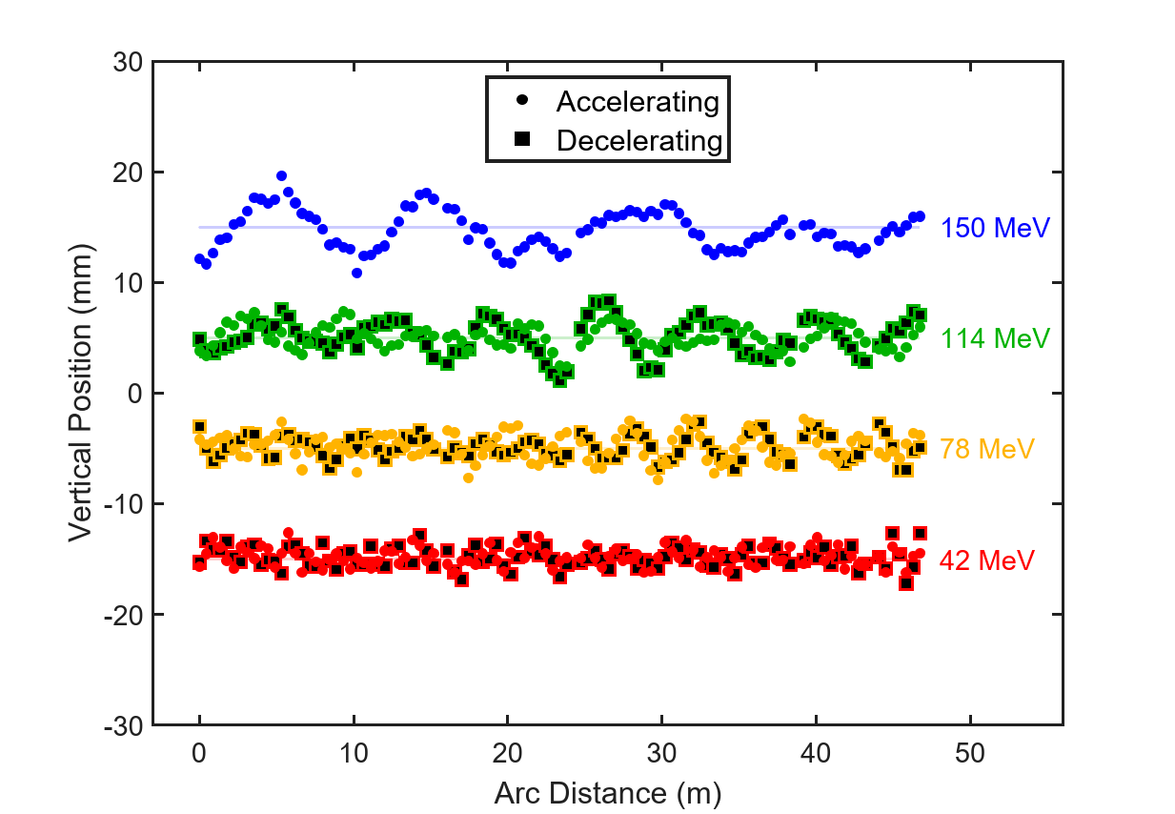
Vertical orbits
Offset Vertical Position (mm)

Slide 40
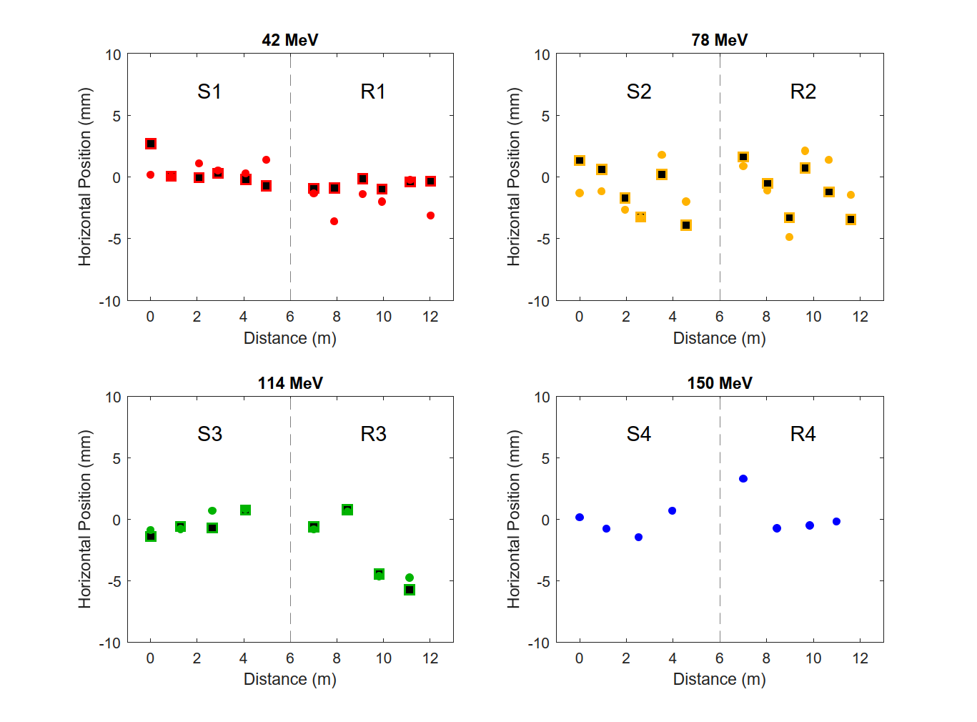
4-pass Splitter Orbits (Horizontal)

Slide 41
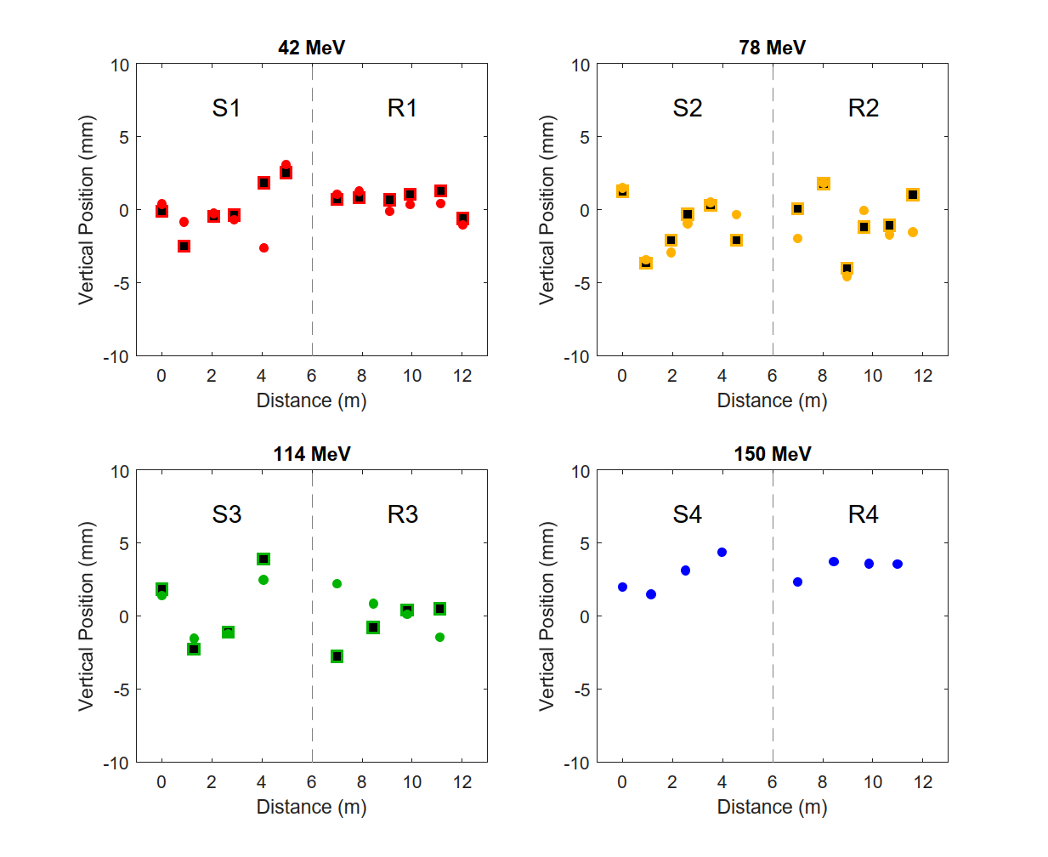
4-pass Splitter Orbits (Vertical)

Slide 42
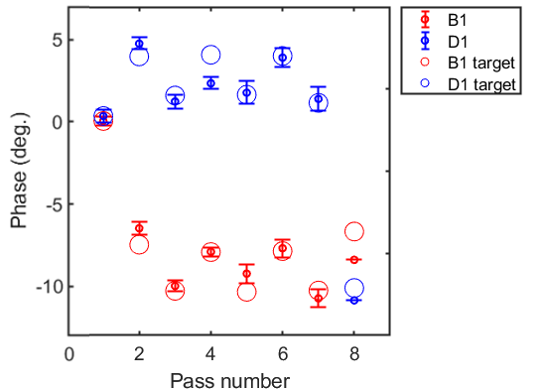
MLC arrival phase
Red = Before MLC
Blue = After MLC
Phases are shown relative to 1st pass for pass 1-4, and offset by 180º for pass 5-8
Circles are target values from an optimized BMAD simulation
Transmission seemed to require accuracy better than 2 degrees
    Success would have been impossible without this diagnostic

Slide 43
Other challenges / omitted slides

Slide 44
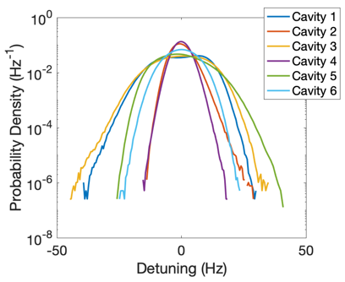


Microphonics
MLC stability was a concern during 1-pass operation
MLC waveguide support reinforced
  Sorbothane used to absorb vibrations
Improved microphonics by a factor of 2
Before
After
Note the different scale

Slide 45
Microphonics
Ready before operation began
MLC Operation
Before: delicate, requires an on-hand expert staff 100% of the time
After: routine, requires only occasional expert staff

Slide 46
MLC Slow Energy Drift
MLC energy drifts ∼0.5-1% over first ∼30 minutes
  Begins high, drifts lower
  Drift occurs in fast, discontinuous jumps
Manual “fix” button added which finds orbit deviations in S1 along direction of dispersion, predicts energy change
  Reproducible to few kV level, but not foolproof
Origin of problem never understood, remained occasional source of confusion throughout run

Slide 47

Laser Leakage Current
During single pass, laser “off” produced a worrisome amount of current
Leakage current ∼0.3-3 nA
FFA trip threshold: ∼1 nA
Added Acousto-optic modulator to further reduce leakage current
EOM: fast, leaves leakage current
AOM: slow, improves leakage
5x10⁵:1
5x10⁸:1
Time
Intended beam
Leakage beam

Slide 48
Laser AOM
Ready before operation began
Laser extinction ratio improved from 500,000 to 500,000,000
Leakage current now in pA

Slide 49

Path length adjustment
Bellows would not reliably hold their position after they de-powered
Vibrations during bellows movement sometimes cause MLC to quench
  Must turn off MLC to adjust path length, then wait for MLC to stabilize.
  Very time-consuming!
No work-around. We tried to adjust phase as few times as possible.
25 minute duration

Slide 50
Stray fields
IOC ready for use
“Linear Combinations” IOC ready by 12/12
Magnet linear combinations added to list throughout rest of run period
Remaining concerns
Combinations occasionally needed significant changes
  Depend on bellows positions? Optics changes? Energy dependent? Nonlinearity?
Confusing hysteresis, not clear how best to degauss

Slide 51

MLC arrival phase drift
Beam MLC arrival phase drifted many 10s of degrees
  A static beam was never seen to change
  During a shift, phase would seem to have sudden unexplained jumps.
Spent days investigating, looking for problems with BPM hardware / software
Sudden 15º change over 20 minutes

Slide 52
MLC arrival phase drift
Phases are real
Discovered that the readings were real, and causes by splitter orbit changes
Manual S2/R2 splitter orbit changes produced up to 50º of path length adjustment!
Red path longer than green due to arc length

Slide 53


Dispersion R₅₆ Correction
Measured dispersion/R₅₆ response to splitter quads
Worked well for horizontal dispersion, R₅₆… except when it didn’t
  Discovered subtle problem in method in last week of operation
Vertical dispersion cannot be corrected using splitter quadrupoles, requires correction within FFA
  Method tested in last week of operation, seemed promising

Slide 54
Dispersion R56 Correction
Dispersion, R₅₆ GUI
GUI ready at the beginning of the run period
Ideas for vertical dispersion correction occasionally throughout run period, successful correction only at the end of January

Slide 55
MLC arrival phase drift
Beam MLC arrival phase drifted many 10s of degrees
  A static beam was never seen to change
  During a shift, phase would seem to have sudden unexplained jumps.
Spent days investigating, looking for problems with BPM hardware / software
Sudden 15º change over 20 minutes

Slide 56
MLC arrival phase drift
Phases are real
Discovered that the readings were real, and caused by splitter orbit changes
Manual splitter orbit changes produced up to 50º of path length adjustment!
Red path longer than green due to arc length

Slide 57

Buncher failure
Switch to ICM bunching
The buncher RF power supply (IOT), rarely a source of previous trouble, was down for significant periods of time (red areas)
Initially, we stopped operation for repairs
In the end, we re-tuned the injector in a novel way to bunch using the ICM instead

Slide 58


ICM bunching
In simulation, using the ICM to bunch leads to higher peak current and longer longitudinal tails
Not ideal, but good enough for the milestone
Baseline, with buncher
ICM bunching, no buncher

Slide 59
Dipole power supply failure
Power supply failure
R2 dipole 4: Power supply failed on 12/10, no spare
Power supply with similar specs found on shelf at BNL
Ready for beam in 2 days!
  Transport to CU
  Wiring
  Control system changes for analog voltage control

Slide 60
MLC Cavity SSA Failure
SSA DC power supply failure
SSA #1 has an internal DC power supply failure, no spare
Ready for beam in 3 days!
  During the wait, retuned MLC for 5 cavity operation
Achieved 4-pass ER milestone the next day

Slide 61


Microbunching Instability?
Occasionally, we would see a charge-dependent structure on the beam profile
As early as the beginning of the second pass
Charge dependent
Single bunch effect
Optics dependent
  causing the instability or just accidentally letting us see it?

Slide 62

Microbunching Instability?
Entrance to S2: 1.3 pC

Slide 63

Microbunching Instability?
Entrance to S2: 1.9 pC

Slide 64

Microbunching Instability?
Entrance to S2: 2.5 pC

Slide 65

Microbunching Instability?
Entrance to S2: 5.0 pC

Slide 66

Laser loses BPM timing
Laser is only locked to 1300 MHz (RF rate), not 41.94 MHz (Bunch rate)
  If laser loses lock, will come back in random 41.94 MHz “bucket”
  Occasional timing error within 23.8 ns window
  Synchronous BPM timing is ruined by this error
Laser picks random 1.3 GHz bucket

Slide 67


Two-frequency RF BPMs
Preliminary test from 1-pass operation: Two beams on BPM before MLC
Problem: Too many coupled adjustable parameters
Single frequency BPMs with single beam
  2 adjustable scales
  4 adjustable phase offsets
  Position and phase are decoupled
Two frequency BPMs with two beams
  8 adjustable scales
  8 adjustable phase offsets
  All parameters are coupled
Here, a vertical kick produces an unphysical phase change.
Promising, but unreliable. Cannot use this method!

