Slide 1
Low-Energy Space Charge in Bmad
Accelerator Journal Club
2023/04/13
Ningdong Wang

Slide 2
Outline
Space charge in Bmad
  Integrated Green Functions
  Implementation and validation
  Adaptive step size control
Applications
  EIC cooler design
  Longitudinal laser shaping

Slide 3
Space Charge
Space charge describes the interaction of electric charges in a charge particle bunch.
The space charge forces vanish as 1/γ² due to cancellation of electric and magnetic forces.
It is especially important in high brightness beams and at low energy.

Slide 4
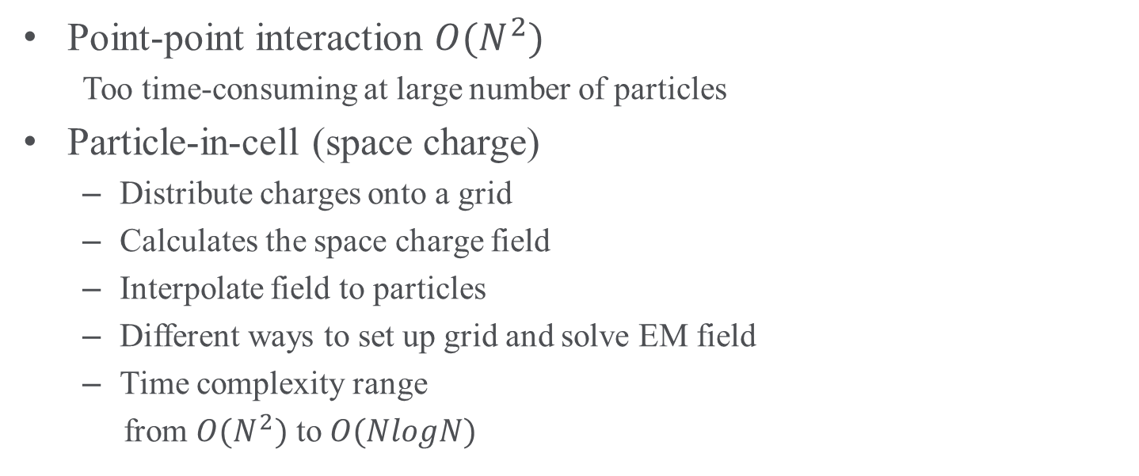
Space Charge Algorithms
Point-point interaction $O(N^{2})$
  Too time-consuming at large number of particles
Particle-in-cell (space charge)
  Distribute charges onto a grid
  Calculates the space charge field
  Interpolate field to particles
  Different ways to set up grid and solve EM field
  Time complexity range
  from $O(N^{2})$ to $O(NlogN)$

Slide 5

Integrated Green Functions
Once particles are deposited onto a grid, the space charge field are calculated in the local rest frame using integrated Green functions (IGFs).

Slide 6
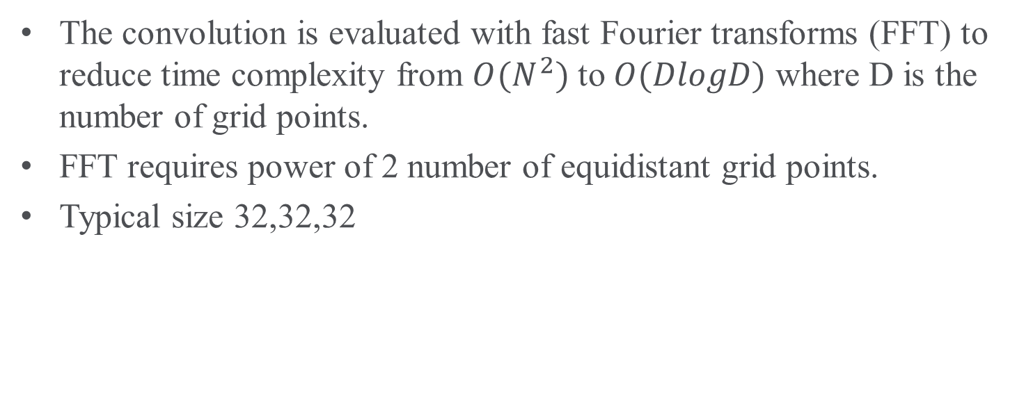
Integrated Green Functions
The convolution is evaluated with fast Fourier transforms (FFT) to reduce time complexity from $O(N^{2})$ to $O(DlogD)$ where D is the number of grid points.
FFT requires power of 2 number of equidistant grid points.
Typical size 32,32,32

Slide 7
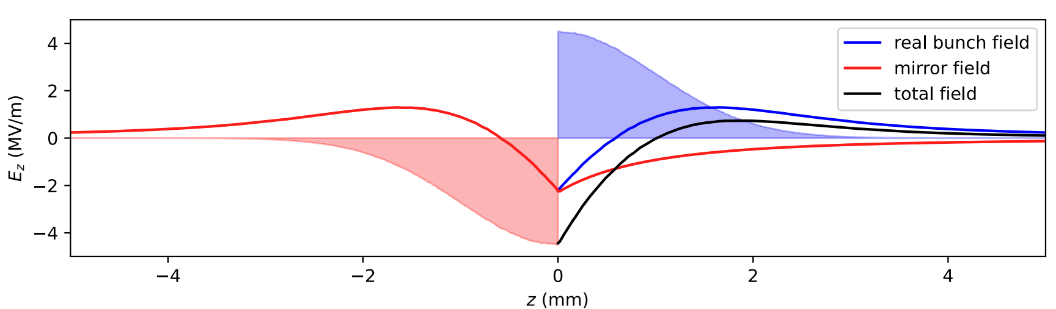
Space Charge
Open Space Charge (OpenSC) by Robert Ryne, Christopher Mayes implements the IGFs FFT method to calculate space charge field.
  Calculate the field due to particles on a 3D grid
  Interpolate the field to the particle locations
The space charge field is computed in the local rest frame.
The cathode field can be easily added using image charges.

Slide 8
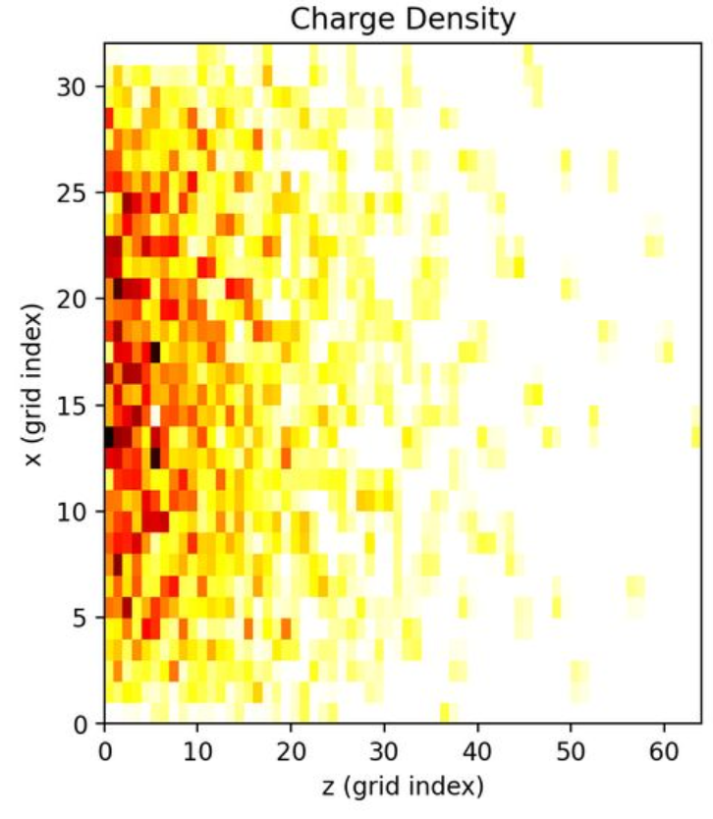
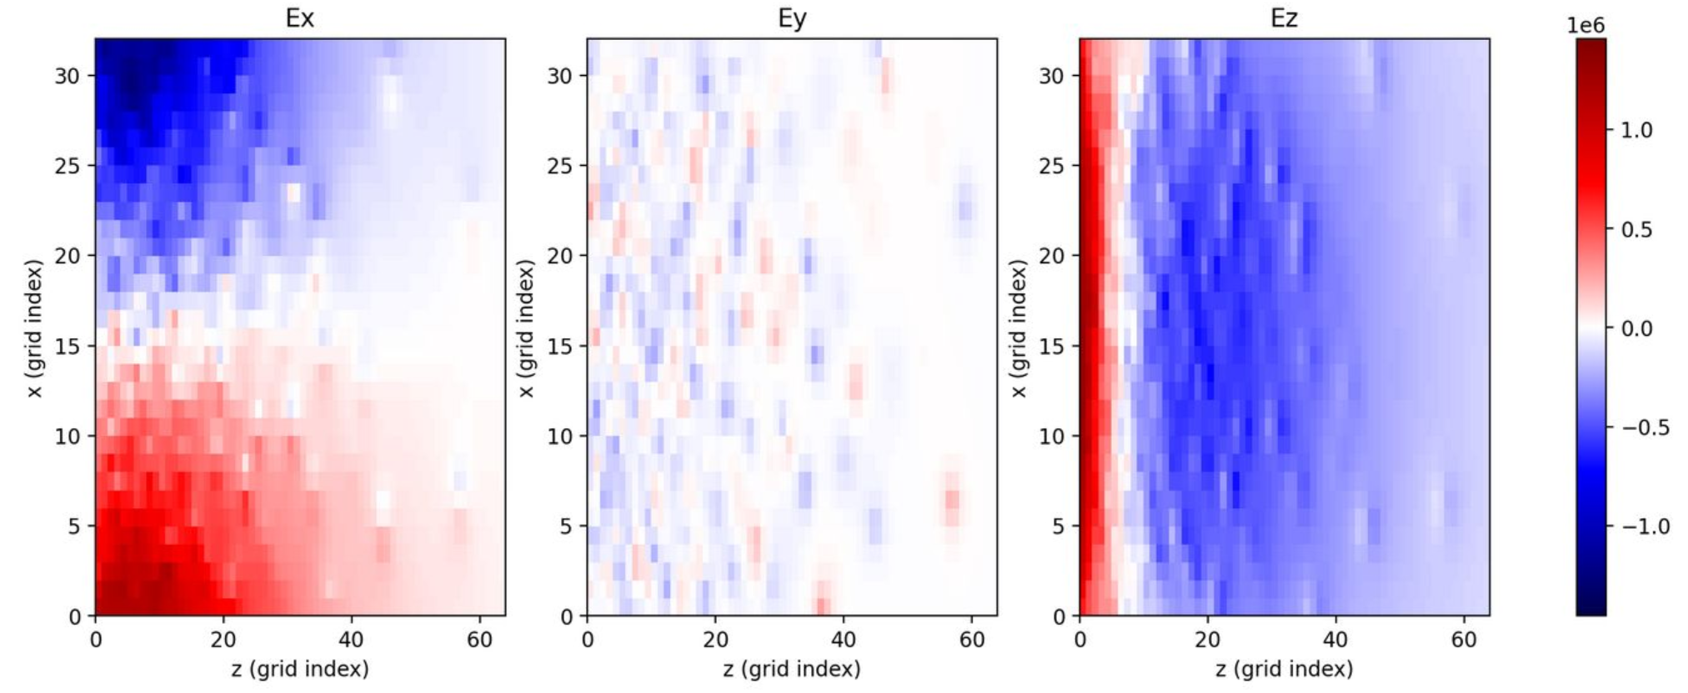
Space Charge at Cathode
Example charge density and electric field at the cathode
x-z plane along the center of the bunch

Slide 9
Particle tracking with space charge in Bmad
Time-based tracking:
Particles are tracked individually without interaction through a time step Δt_sc (with a higher order – multi step Runge Kutta cycle).
Compute the SC field in the local rest frame and add the SC field in the following Runge Kutta cycles.
Single particle tracking
Time Runge Kutta
P1
P2
P3
t
Δt_sc
Calculate space charge field

Slide 10
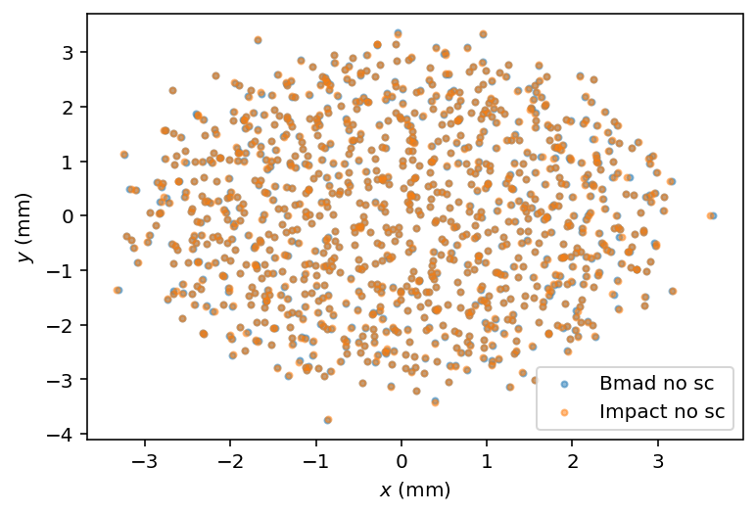
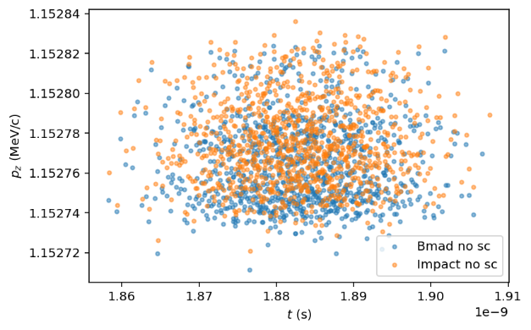
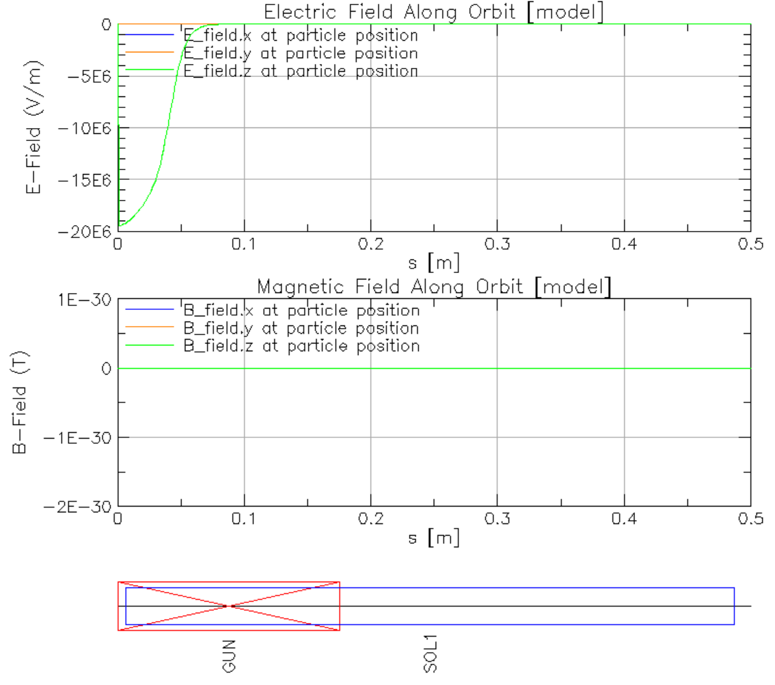
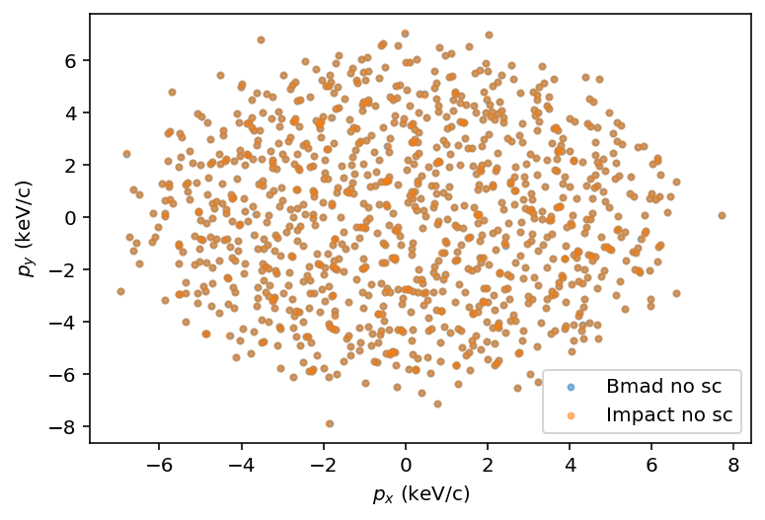
Validation – no space charge
AC gun, 750 kV, solenoid off
1k particles, 0.5 mm, 8.5 ps, 20 pC

Slide 11
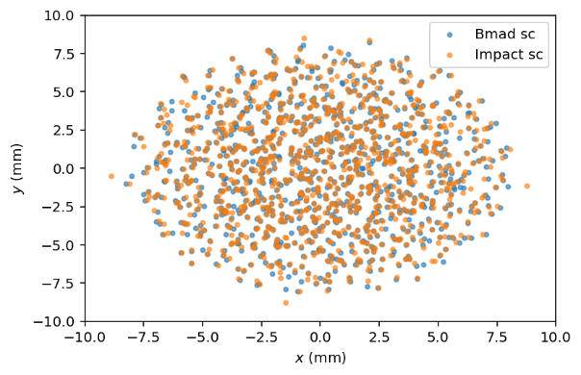
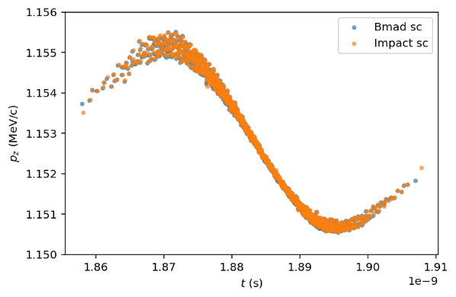
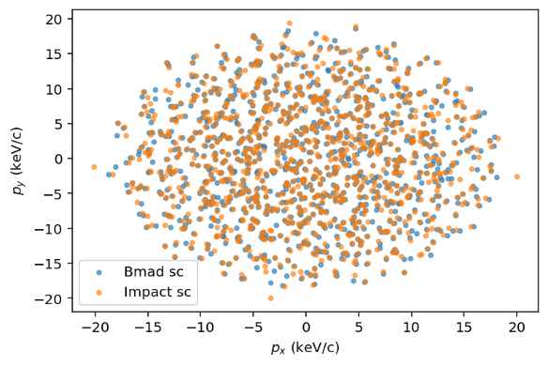
Validation – with space charge
AC gun, 750 kV, solenoid off
1k particles, 0.5 mm, 8.5 ps, 20 pC

Slide 12
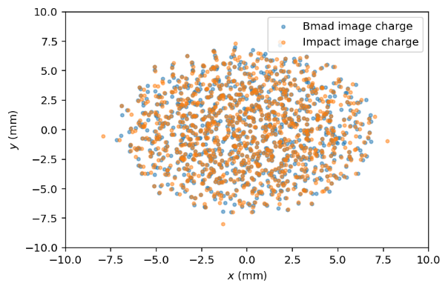
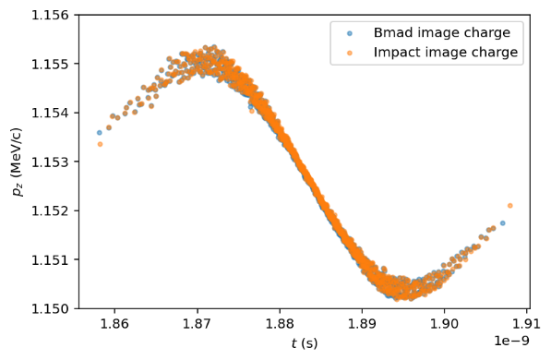
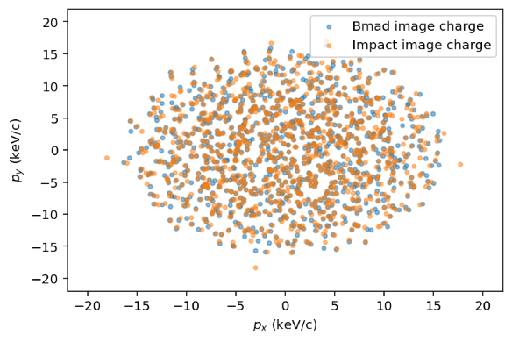
Validation – with image charge
AC gun, 750 kV, solenoid off
image charge cut off when image field < 1% bunch field
1k particles, 0.5 mm, 8.5 ps, 20 pC

Slide 13
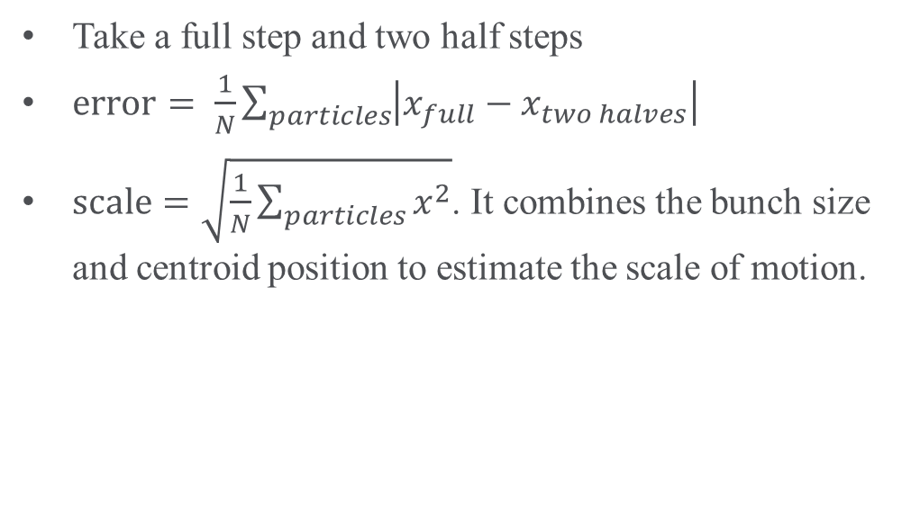
Adaptive step size control
Take a full step and two half steps
$\text{error}= \frac{1}{N}\sum_{particles}{\left|x_{full}−x_{two halves}\right|}$
$\text{scale}=\sqrt{\frac{1}{N}\sum_{particles}{x^{2}}}$. It combines the bunch size and centroid position to estimate the scale of motion.
t
Δt_sc
t
Δt_sc/2
Δt_sc/2

Slide 14
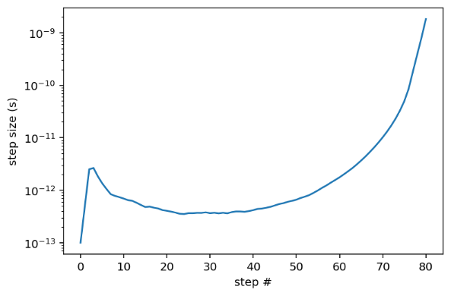
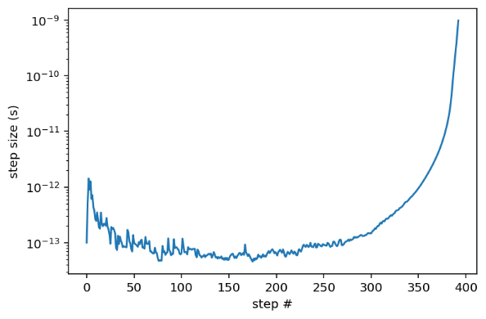
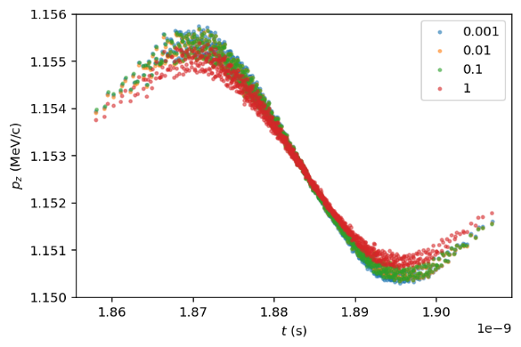

Adaptive step size control
The tolerance is controlled by two parameters, rel_tol and abs_tol.
The error is bound by $err<\text{rel}\text{_}\text{tol}\text{ ∗ }\text{scale}\text{ + }\text{abs}\text{_}\text{tol}$.
rel_tol = 0.1, abs_tol =1e-6
Runtime = 47 s
rel_tol = 0.01, abs_tol =1e-6
Runtime = 181 s
Reduce tolerance until convergence around rel_tol = 0.1

Slide 15
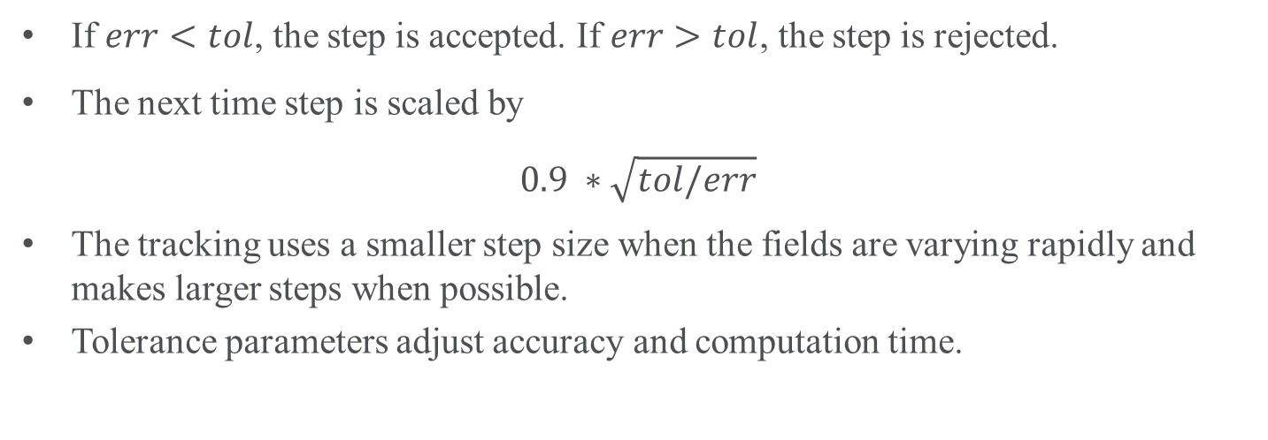
Adaptive step size control
If $err<tol$, the step is accepted. If $err>tol$, the step is rejected.
The next time step is scaled by
$$0.9 ∗\sqrt{tol/err}$$
The tracking uses a smaller step size when the fields are varying rapidly and makes larger steps when possible.
Tolerance parameters adjust accuracy and computation time.

Slide 16
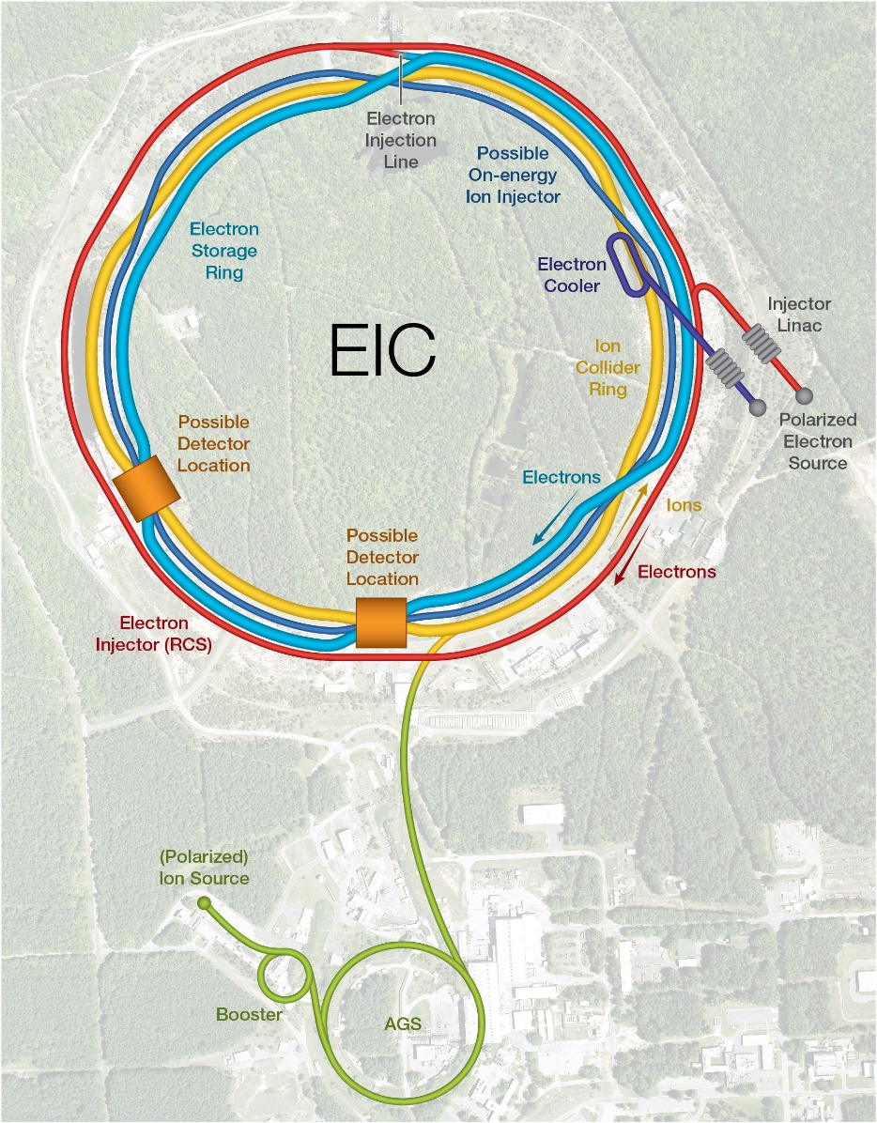
Application
EIC electron cooler design, optimization and simulation

Slide 17
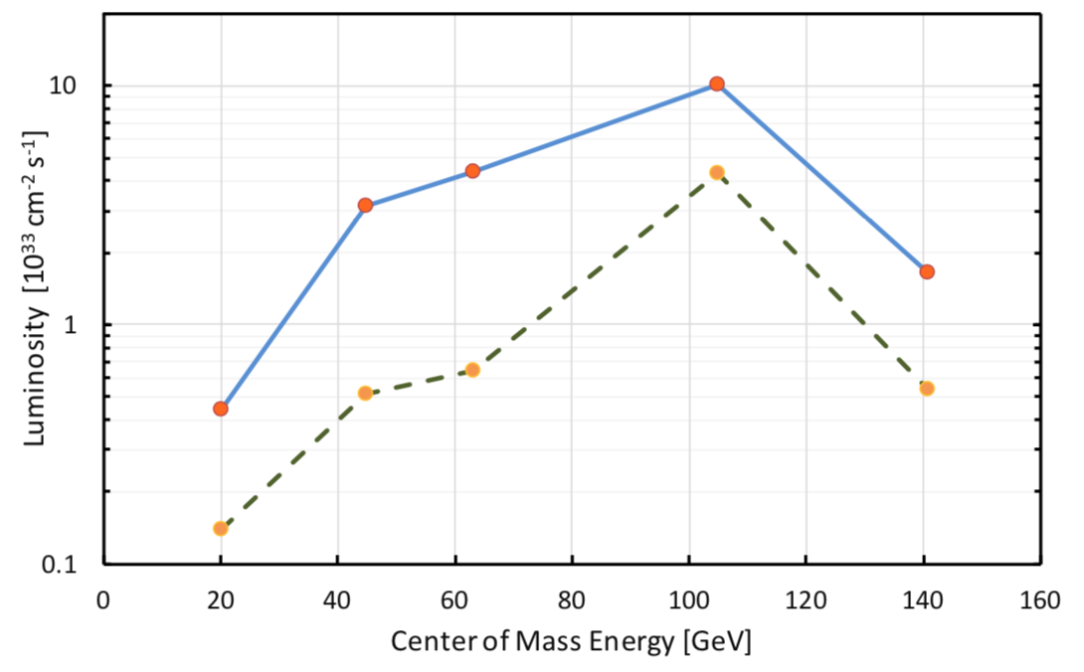
EIC Strong Hadron Cooling
Luminosity of the EIC benefits strongly from cooling the transverse and longitudinal hadron beam emittance.
Using a new scheme called Strong Hadron Cooling
Cool the hadron beam at 275 GeV, 100 GeV, and 41 GeV
with SHC
w/o SHC

Slide 18
EIC SHC ERL
SHC needs a high-quality electron beam with a high current, small energy spread, and small noise.
Case | 100 GeV | 275 GeV
Electron Energy (MeV) | 55 | 150
Norm. Emit. (mm-mrad) | 2.8 | 2.8
Repetition Rate (MHz) | 98.5 | 98.5
Bunch Charge (nC) | 1 | 1
Peak Current (A) | 8.5 | 17
Bunch Length (mm) | 14 | 7
Slice 𝜎_{𝛿} | 10⁻⁴ | 10⁻⁴

Slide 19
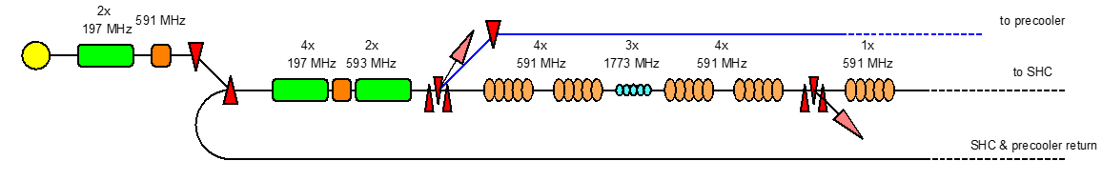
Simulating EIC cooler injector
The cooler ERL lattice is modeled in Bmad, GPT, and Impact-T.
Validate simulations against each other
Injector
https://www.youtube.com/watch?v=eKwfPmaF3rk

Slide 20
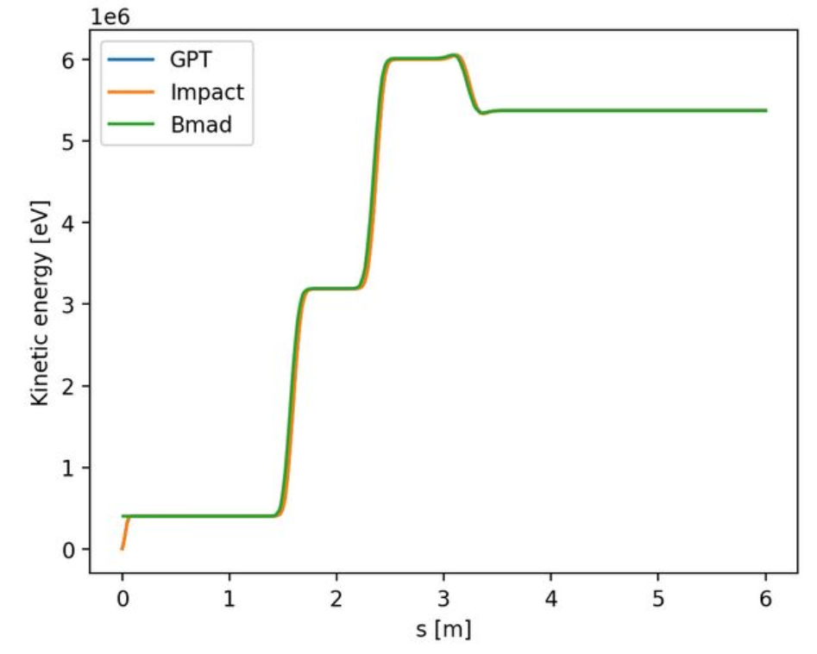
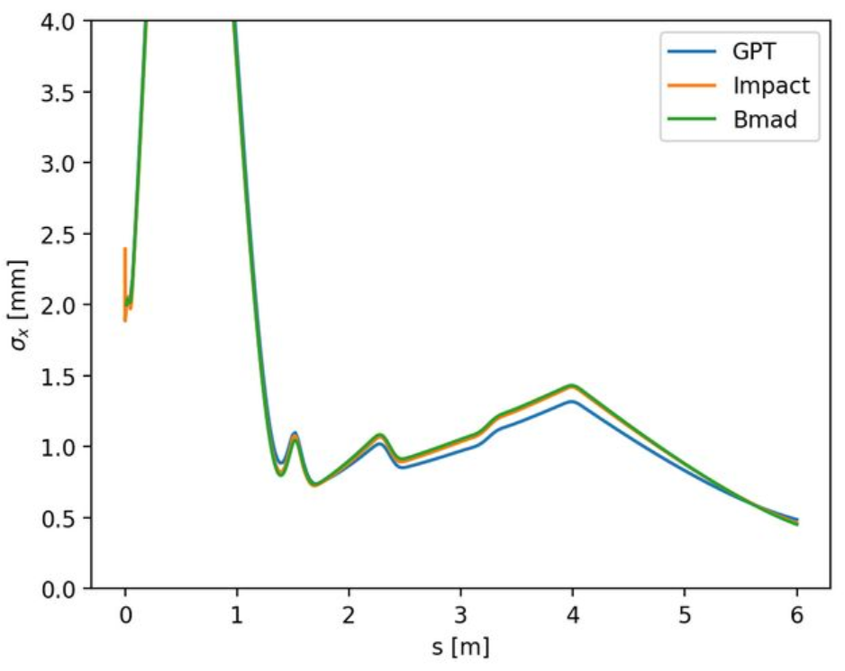
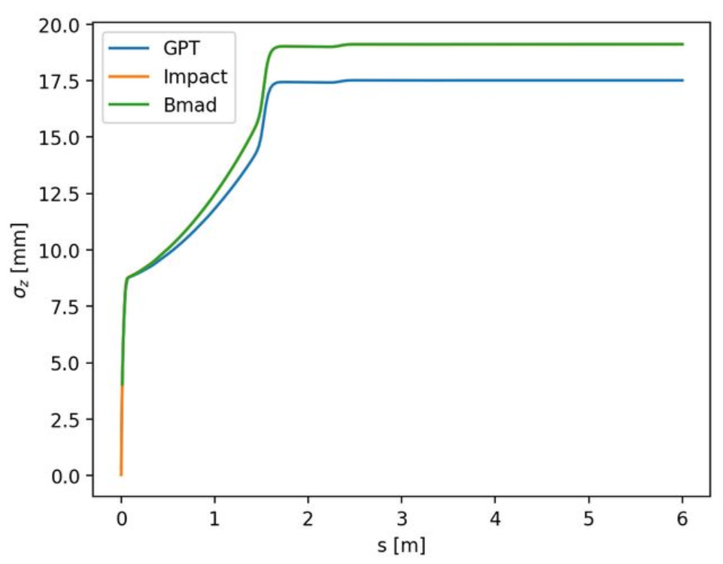
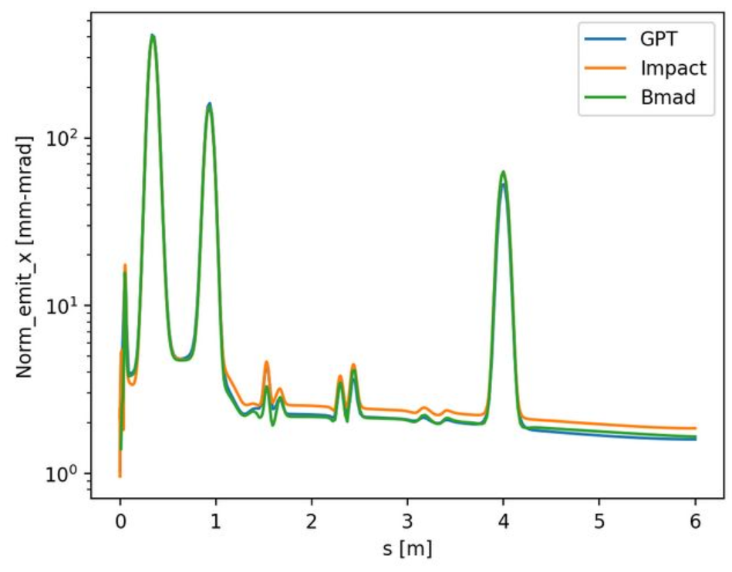
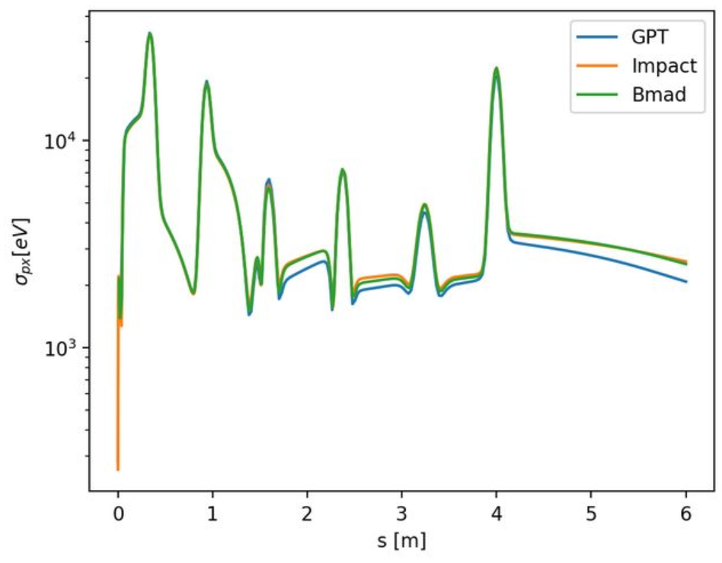
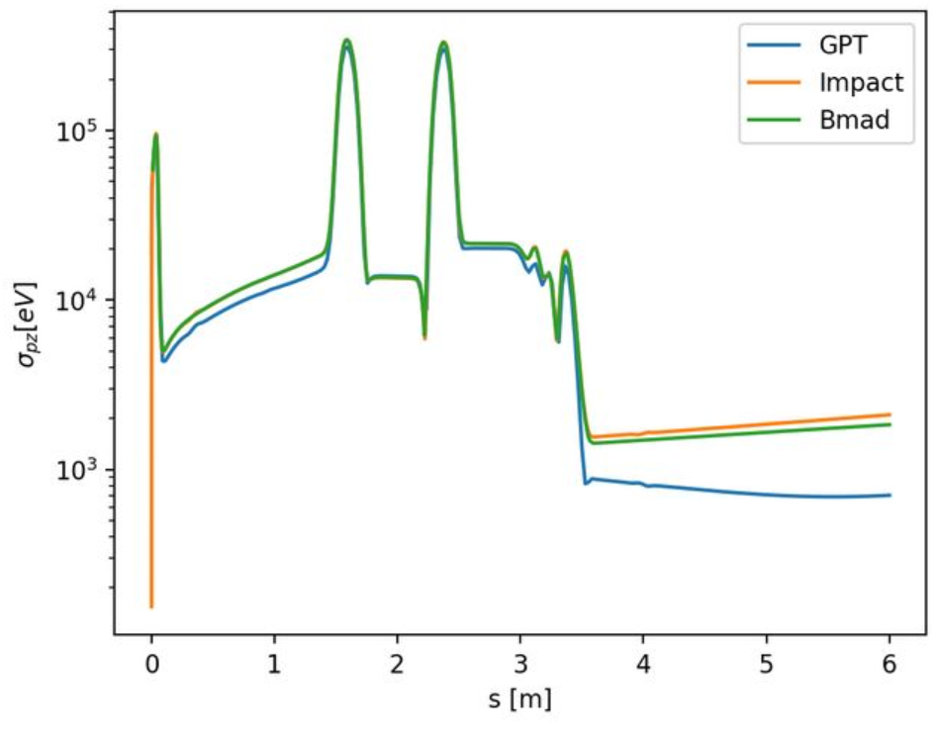
Simulating EIC cooler injector
GPT bunch length is 10% shorter

Slide 21
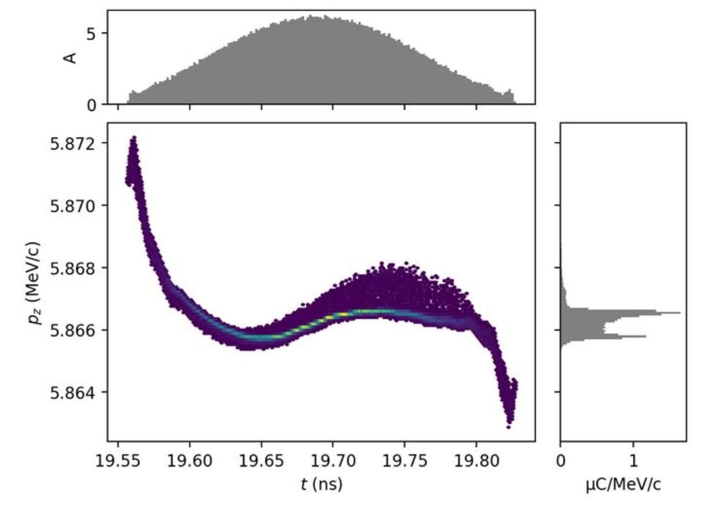
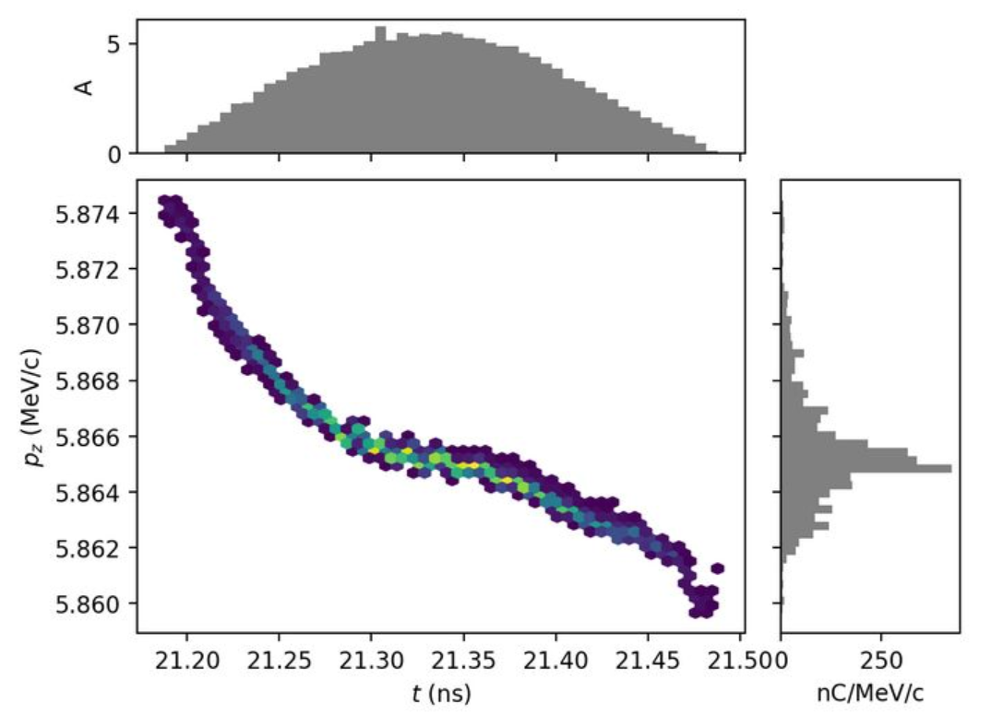
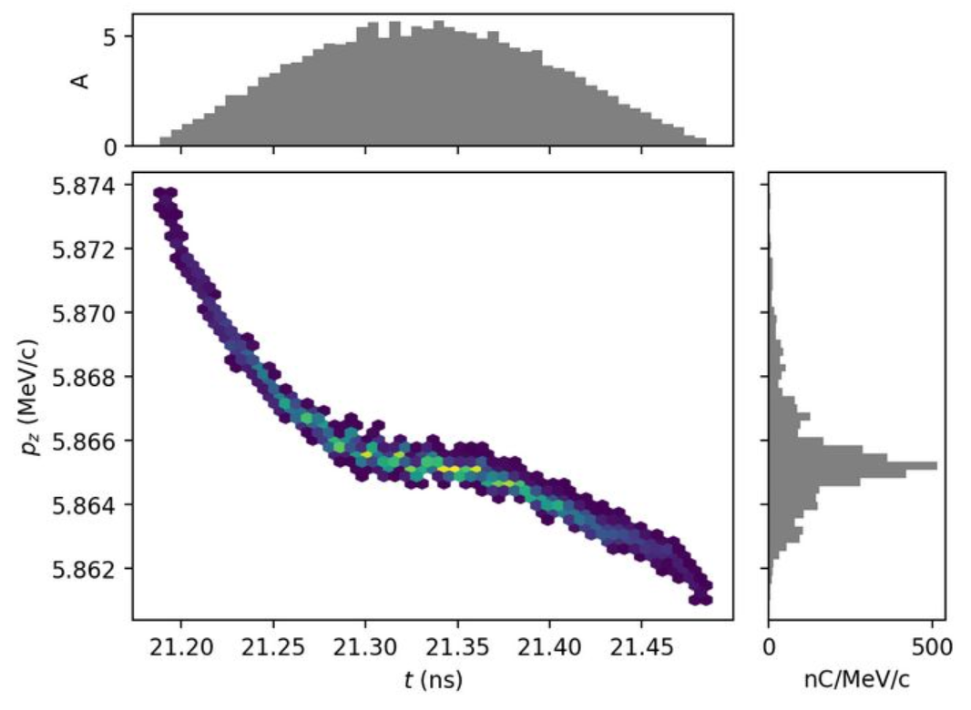
Simulating EIC cooler injector
The longitudinal phase space looks different in GPT.
GPT
Impact-T
Bmad

Slide 22
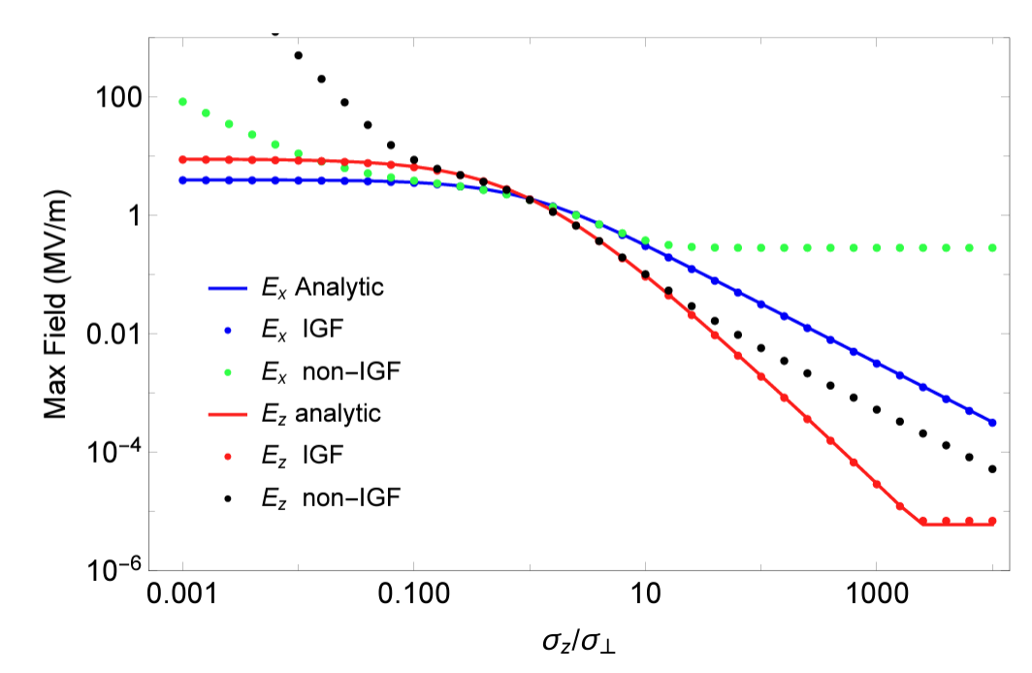
Space Charge Model Is Important
The space charge model in GPT may be inaccurate near the cathode due to small aspect ratio.
IGF method agrees with analytical formula even for extreme aspect ratios.

Slide 23
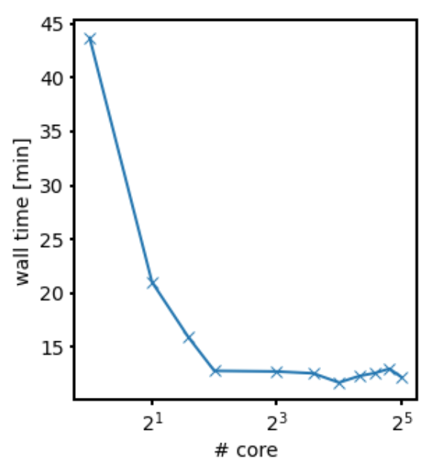
Performance
With adaptive step size control, Bmad performs at least as good as Impact-T.
Bmad SC is parallelized with OpenMP to improve runtime. It can utilize multi-cores on a single machine. Future work can parallelize with MPI to run on high-performance clusters.
Space charge field calculation makes up 70% of the runtime!
Program | Single core performance
GPT | 25 min
Bmad | 44 min
Impact-T | 40 min

Slide 24
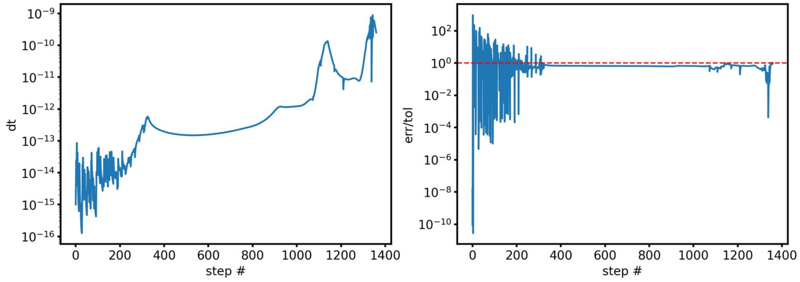
Adaptive step size control
The adaptive stepper spends some time during emission, then saves time tremendously away from the cathode.
Users don’t have to guess a good step size.

Slide 25
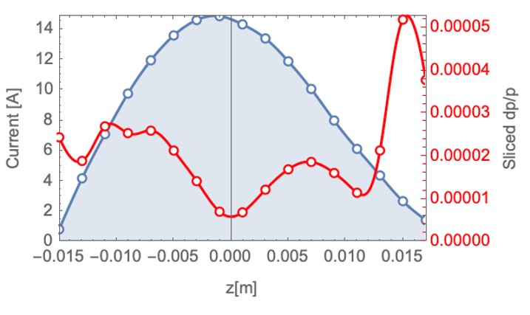
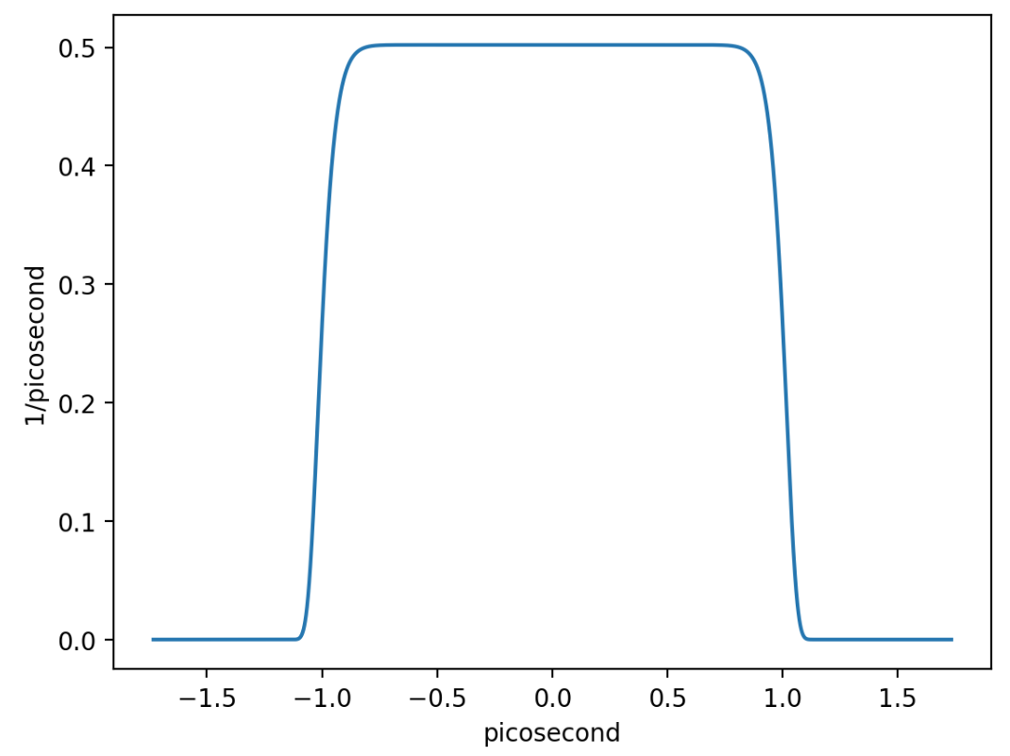
Longitudinal Laser Shaping (ongoing)
The electron beam needs to have a uniform current profile in the cooling section to achieve optimal cooling rate.
We can control the initial longitudinal distribution by changing laser intensity → laser shaping
A Gaussian bunch from the cathode evolves into
What initial distribution gives us this in the end?

Slide 26
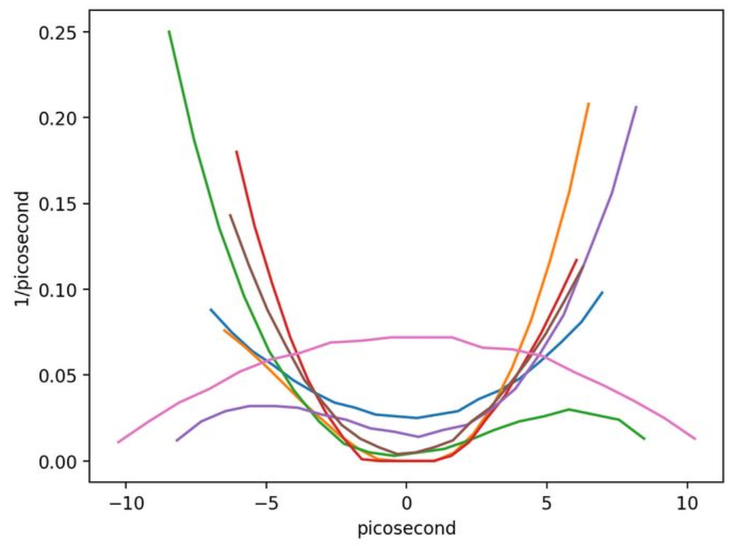
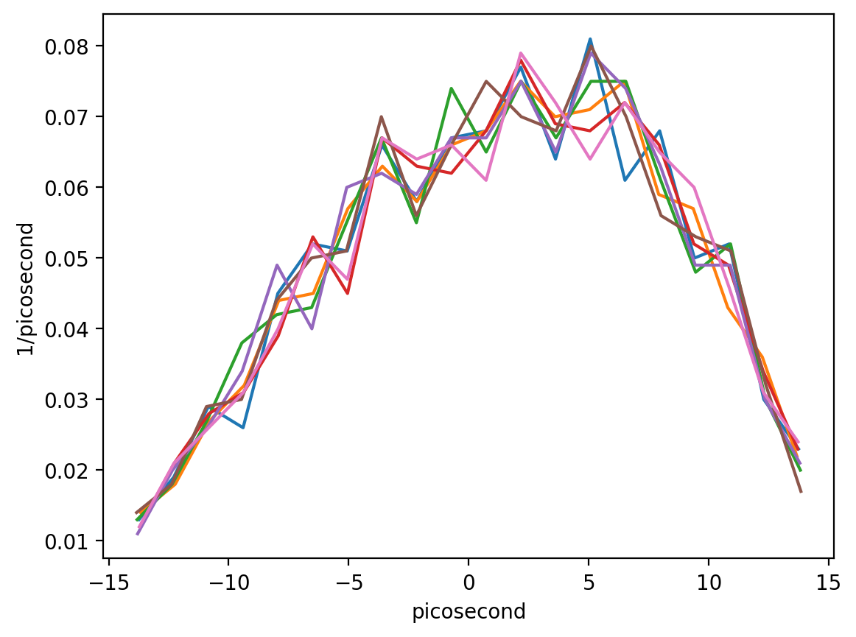
Longitudinal Laser Shaping
We parametrize the initial longitudinal distribution by specifying N points of the PDF. The generator will interpolate them into a smooth distribution.
The final distribution is compared to a target super Gaussian distribution.
Tested optimizer on
AC gun lattice
Initial distributions
Final distributions

Slide 27
Questions?

