Slide 1

Effects on the Dynamic Aperture of the EIC
Jonathan Unger
Cornell ERL/EIC Group
2/23/2023

Slide 2
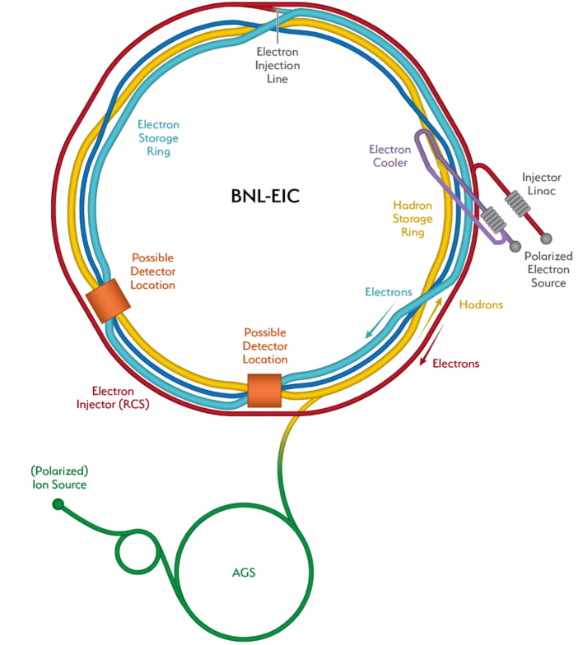
Electron-Ion Collider
To be constructed at Brookhaven National Laboratory
Collides electrons and hadrons
2 rings: Hadron Storage Ring (HSR) Electron Storage Ring (ESR)
Large energy range: (30GeV-140GeV)
Polarized beams

Slide 3
Electron Storage Ring
Focus on 18 GeV
2 Possible interaction points (IP)
Beam size at IP h/v [μm]: 119/11
Electrons only Collide at one IP

Slide 4
What is Dynamic Aperture?
Physical Aperture
Like physical aperture, a particle is lost if it does not stay inside (stable phase space)
Non-linearities reduce dynamic aperture
Dynamic Aperture

Slide 5
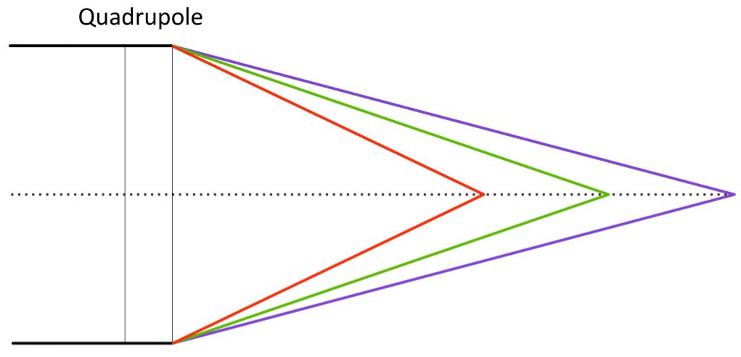



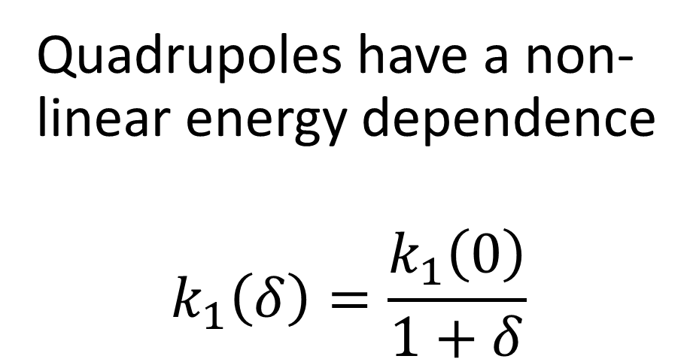
Example Non-Linearities
Sextupole gives a non-linear kick: $∆x^{′}=−\frac{1}{2}k_{2}L(x^{2}−y^{2})$
Quadrupoles have a non-linear energy dependence
$$k_{1}\left(δ\right)=\frac{k_{1}\left(0\right)}{1+δ}$$
$$δ<0$$
$$δ>0$$
$$δ=0$$

Slide 6
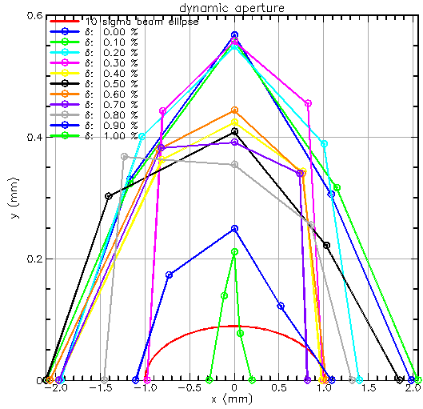
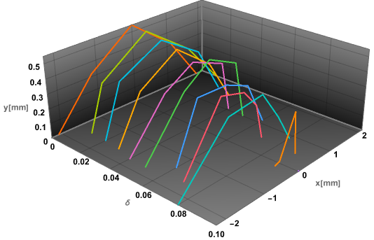
Looking at Dynamic Aperture

Slide 7
Optimizing Dynamic Aperture
Energy Dependent Tune
W-Function
Second Order Dispersion

Slide 8
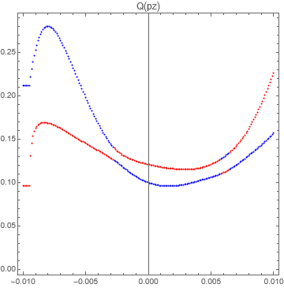
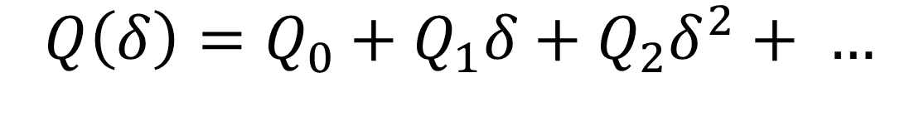
Energy Dependent Tune
Second order chromaticity
Design tune
$$Q\left(δ\right)=Q_{0}+Q_{1}δ+Q_{2}δ^{2}+ …$$
Higher order chromaticity
“Chromaticity”
Flatter tune gives more stability

Slide 9
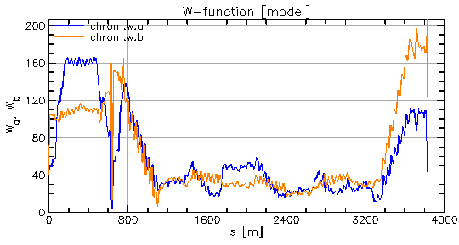
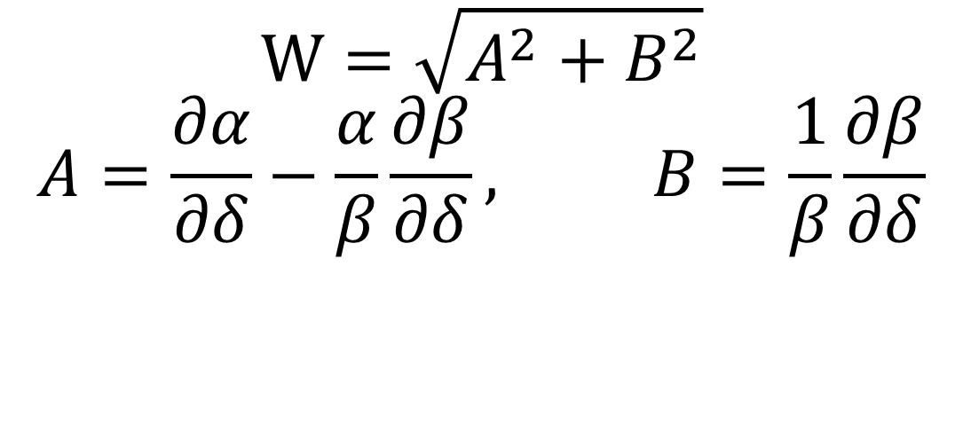
W-function
$$W=\sqrt{A^{2}+B^{2}}$$
$$A=\frac{∂α}{∂δ}−\frac{α}{β}\frac{∂β}{∂δ}, B=\frac{1}{β}\frac{∂β}{∂δ}$$
$$\int_{S_{0}}^{S_{0}+C}{ds\left[k_{1}\left(s\right)−k_{2}\left(s\right)D_{x}\left(s\right)\right]β_{x,y}(s)e^{2j\left[μ_{x,y}\left(s\right)−μ_{x,y}(s_{0})\right]}}$$
Modulus is W-function

Slide 10

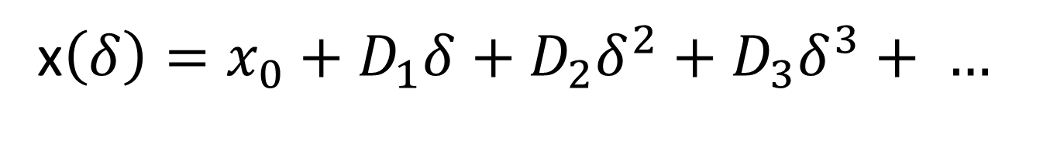
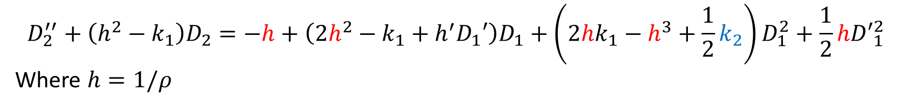
“Second Order Dispersion”
Second order dispersion
Also:
x$\left(δ\right)=x_{0}+D_{0}δ+D_{1}δ^{2}+D_{2}δ^{3}+ …$
x$\left(δ\right)=x_{0}+D_{1}δ+D_{2}δ^{2}+D_{3}δ^{3}+ …$
Second order dispersion
$$D_{2}^{′′}+\left(h^{2}−k_{1}\right)D_{2}=−h+\left(2h^{2}−k_{1}+h^{′}D_{1}′\right)D_{1}+\left(2hk_{1}−h^{3}+\frac{1}{2}k_{2}\right)D_{1}^{2}+\frac{1}{2}h{D′}_{1}^{2}$$
Where $h=1/ρ$
Caused by bending
Corrected with sextupoles

Slide 11
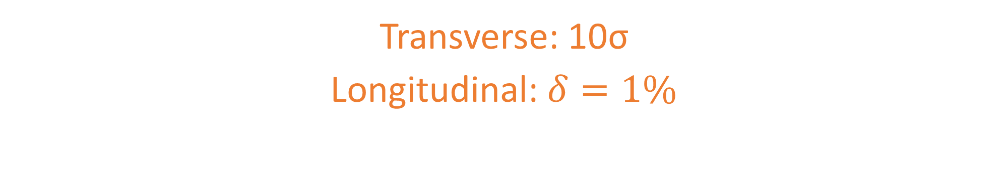
DA Goals for ESR
Transverse: 10σ
Longitudinal: $δ=1\%$

Slide 12
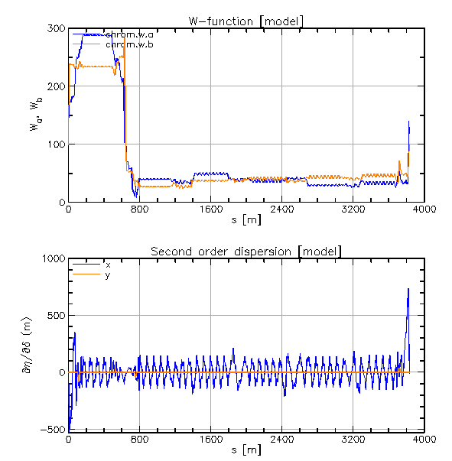
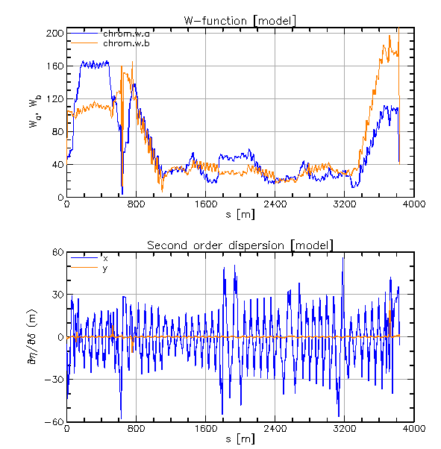
Baseline Lattice Correction
Single sextupoles for second order dispersion
Sextupoles in each arc are grouped into families to control W-function and chromaticity
Optimization by Yunhai Cai (SLAC)
Sextupoles off
Sextupoles on

Slide 13
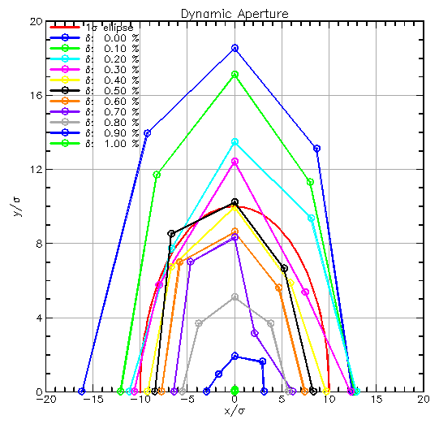
Baseline Lattice Results
Optimization is just shy on momentum aperture
Transverse aperture is large with room for errors
Optimized without all features

Slide 14
Need to Include
Crab Cavities
Beam-Beam
Detector Solenoid and Correction

Slide 15
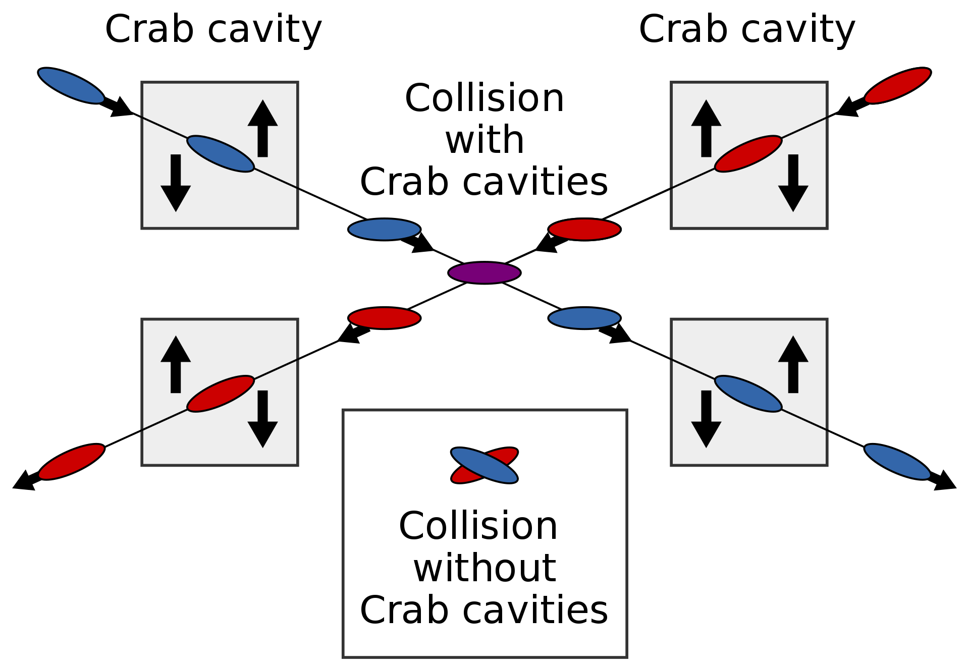
Crab Cavities
EIC will collide with a 25mrad crossing angle due to many bunches
The crossing angle reduces collisions per bunch
Crab cavities are used to keep head on collisions
Luckily, no noticeable impact to DA

Slide 16
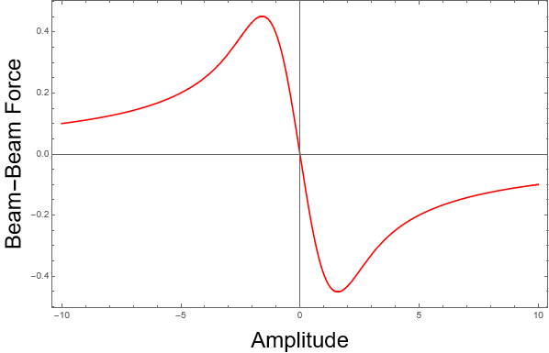
Beam-Beam Modelling
Beam-Beam represented as a thin lens
Weak-Strong model
Beam-Beam parameter h/v: 0.093/0.10

Slide 17
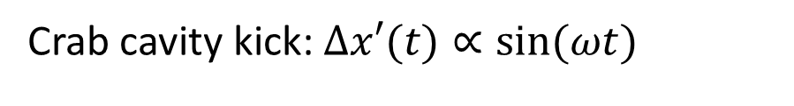
Crab Cavities with beam-beam
Particles in the beam tails will be kicked slightly off
Thin lens beam-beam does not pick this up
Assemble many thin lens beam-beam interactions along centroid
Crab cavity kick: $∆x′(t)∝\sin{(ωt)}$
Zero from sine kick
Left over term
Main crabbing
$$x_{c}\left(z\right)={\text{crab}}_{x1}z+{\text{crab}}_{x2}z^{2}+{\text{crab}}_{x3}z^{3}+{\text{crab}}_{x4}z^{4}+{\text{crab}}_{x5}z^{5}$$
Corrected by second crab cavity

Slide 18
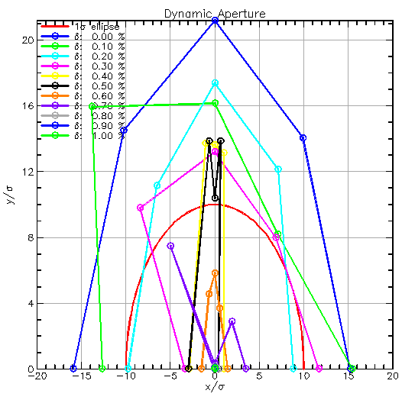
Results with Beam-Beam and Crabbing
Transverse aperture remains acceptable
Momentum aperture drops to 0.6%

Slide 19
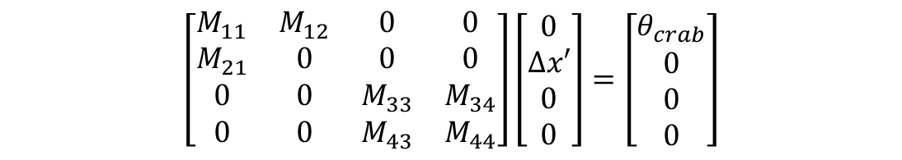
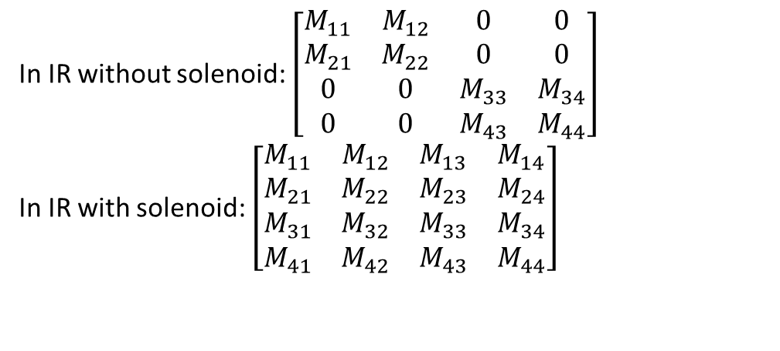
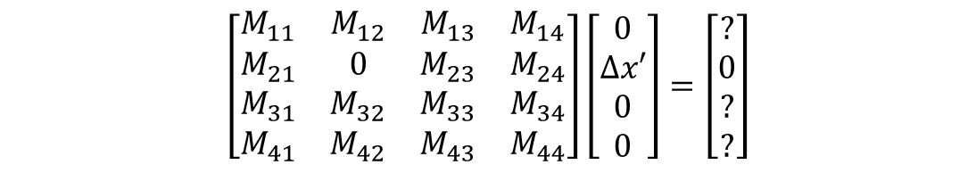
Detector Solenoid
Detector solenoid introduces coupling in the IR
Coupling messes with crabbing
In IR without solenoid: $\left[\begin{matrix}M_{11} & M_{12} & 0 & 0 \\ M_{21} & M_{22} & 0 & 0 \\ 0 & 0 & M_{33} & M_{34} \\ 0 & 0 & M_{43} & M_{44}\end{matrix}\right]$
In IR with solenoid: $\left[\begin{matrix}M_{11} & M_{12} & M_{13} & M_{14} \\ M_{21} & M_{22} & M_{23} & M_{24} \\ M_{31} & M_{32} & M_{33} & M_{34} \\ M_{41} & M_{42} & M_{43} & M_{44}\end{matrix}\right]$
$$\left[\begin{matrix}M_{11} & M_{12} & 0 & 0 \\ M_{21} & 0 & 0 & 0 \\ 0 & 0 & M_{33} & M_{34} \\ 0 & 0 & M_{43} & M_{44}\end{matrix}\right]\left[\begin{matrix}0 \\ ∆x′ \\ 0 \\ 0\end{matrix}\right]=\left[\begin{matrix}θ_{crab} \\ 0 \\ 0 \\ 0\end{matrix}\right]$$
$$\left[\begin{matrix}M_{11} & M_{12} & M_{13} & M_{14} \\ M_{21} & 0 & M_{23} & M_{24} \\ M_{31} & M_{32} & M_{33} & M_{34} \\ M_{41} & M_{42} & M_{43} & M_{44}\end{matrix}\right]\left[\begin{matrix}0 \\ ∆x′ \\ 0 \\ 0\end{matrix}\right]=\left[\begin{matrix}? \\ 0 \\ ? \\ ?\end{matrix}\right]$$

Slide 20
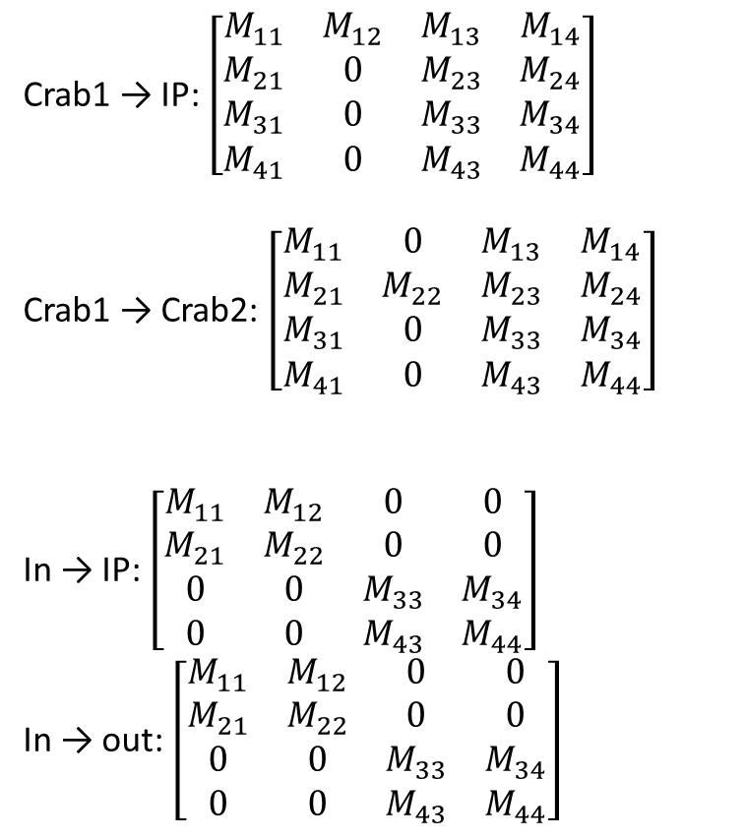
Detector Solenoid correction
Vasiliy Morozov (Oak Ridge National Laboratory)
Derong Xu (Brookhaven National Laboratory)
Crab1 → IP: $\left[\begin{matrix}M_{11} & M_{12} & M_{13} & M_{14} \\ M_{21} & 0 & M_{23} & M_{24} \\ M_{31} & 0 & M_{33} & M_{34} \\ M_{41} & 0 & M_{43} & M_{44}\end{matrix}\right]$
Crab1 → Crab2: $\left[\begin{matrix}M_{11} & 0 & M_{13} & M_{14} \\ M_{21} & M_{22} & M_{23} & M_{24} \\ M_{31} & 0 & M_{33} & M_{34} \\ M_{41} & 0 & M_{43} & M_{44}\end{matrix}\right]$
In → IP: $\left[\begin{matrix}M_{11} & M_{12} & 0 & 0 \\ M_{21} & M_{22} & 0 & 0 \\ 0 & 0 & M_{33} & M_{34} \\ 0 & 0 & M_{43} & M_{44}\end{matrix}\right]$
In → out: $\left[\begin{matrix}M_{11} & M_{12} & 0 & 0 \\ M_{21} & M_{22} & 0 & 0 \\ 0 & 0 & M_{33} & M_{34} \\ 0 & 0 & M_{43} & M_{44}\end{matrix}\right]$
Need to correct the crabbing plane
Need to correct coupling in the region
Skew quadrupoles added for correction
No room between the crab cavities and IP to fully correct coupling

Slide 21
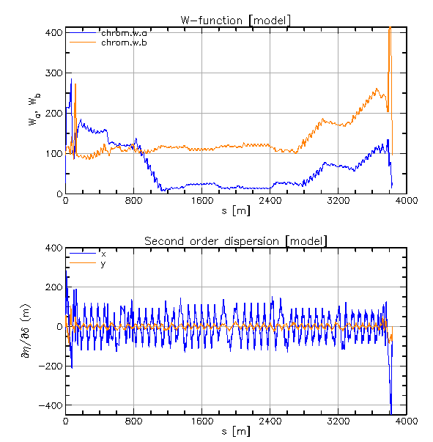
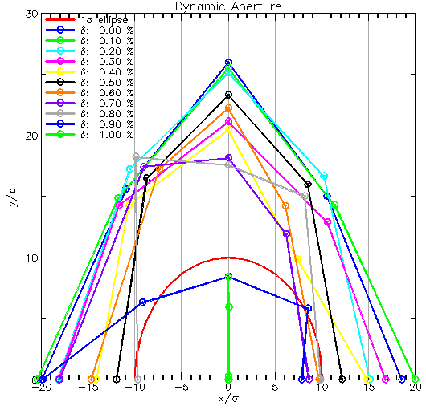
Results with Detector Solenoid (1-IP)
Great Results. Including crabbing and beam-beam

Slide 22
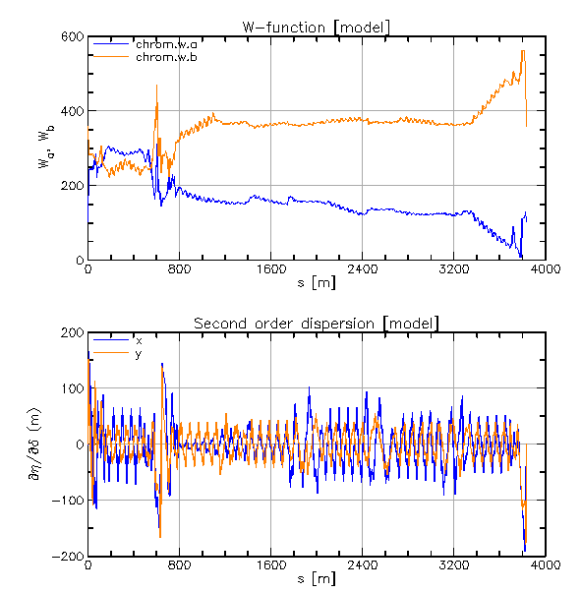
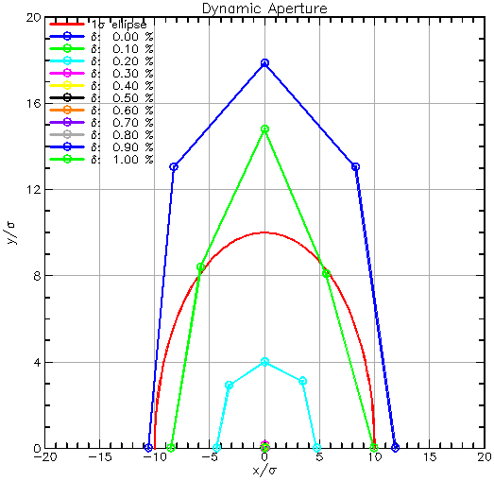
Results with Detector Solenoid (2-IP)
Large W-function and second order dispersion
Dynamic aperture is quite poor

Slide 23
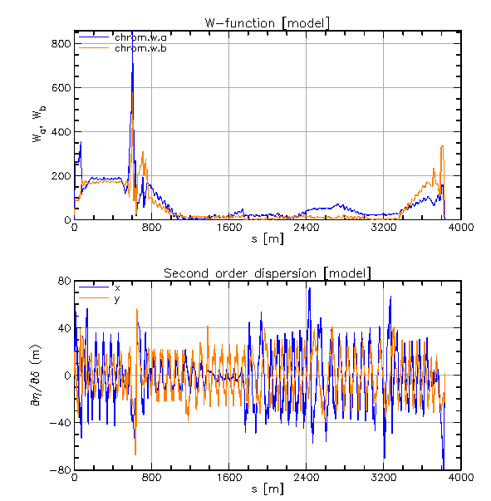
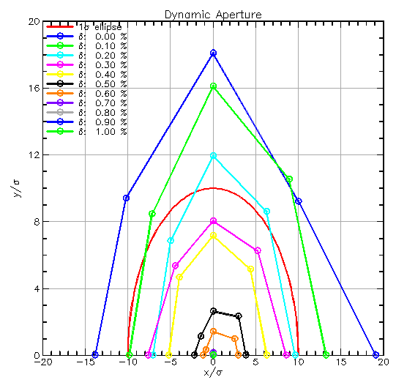
Reoptimizing the 2-IP case
Needs to go,
Still under optimization
Still falls short,
needs more optimization

Slide 24
Conclusion
Dynamic aperture is the phase space with stable particle motion
Baseline ESR lattice has good DA
Crab-cavities, beam-beam, and detector solenoid must be added
This works for the 1-IP configuration
But additional work needed for the 2-IP configuration

