Slide 1
Elastic Finite Element Modeling of X-ray Measured Microstructures
Sarah Bonestell
Dalton Shadle

Slide 2
Overview of Project
Motivation:
Developing a better understanding of fatigue failure on the microscopic level
Overall goal:
Analyze elastic stress/strain on the microstructure of a metal superalloy (Inconel-718) by using Finite Element Modeling (FEM) and measurements captured through X-rays
Process:
Experiment/Measurements
Meshing
Modeling
Analysis

Slide 3
Background
$$σ=Eε$$
Optics
Sample
700 MPa
Near-Field Detector
400 MPa
Far-Field Detector
Figure 1. Forming and Shaping Technology (FAST) Beamline at CHESS
Figure 2. Stress/Strain curve for Inconel-718

Slide 4
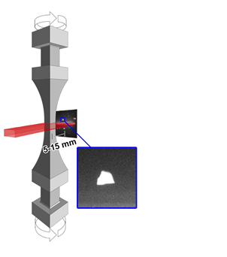
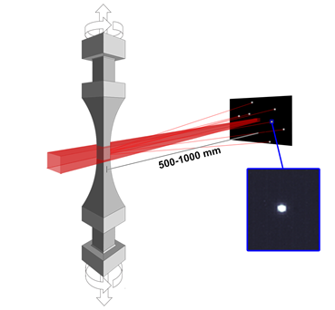
Experiment/Measurements
HEDM- High energy X-ray diffraction
Near-Field and Far-Field measurements
Obtain map, orientation, elastic strain, and centroid of grains
Figure 1. Near-Field and Far-Field data collection

Slide 5
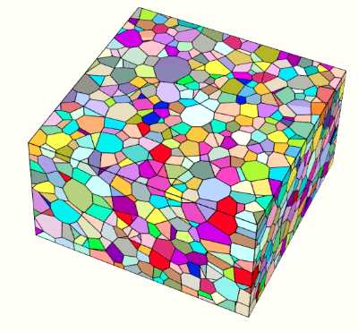
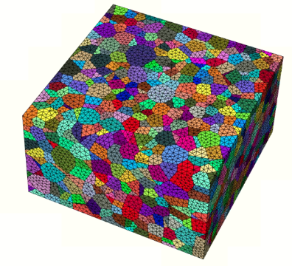
Meshing
Python script converts NF and FF data into tessellation file of microstructure grains
Neper creates a mesh on the microstructure
Neper output transformed into files readable by MechMet
Grain map
Tessellation
Mesh

Slide 6
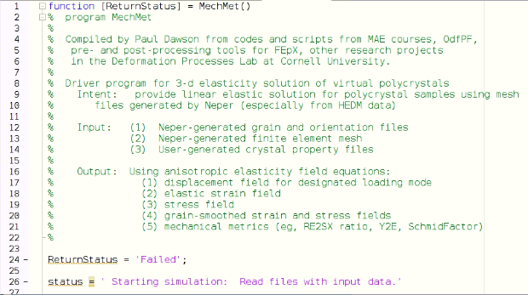
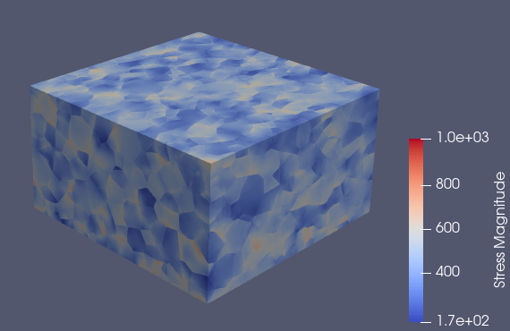
Modeling
Run MechMet.m script
Performs FEA
Software that mathematically predicts stress/strain on a structure by using stiffness matrix, boundaries and forces as input
Outputs
vtk file for visual analysis in ParaView
Files for further data analysis (stress, strain, stiffness, strength-to-stiffness)
Figure 2. MechMet MATLAB script
Figure 3. Microstructure visualized in Paraview

Slide 7
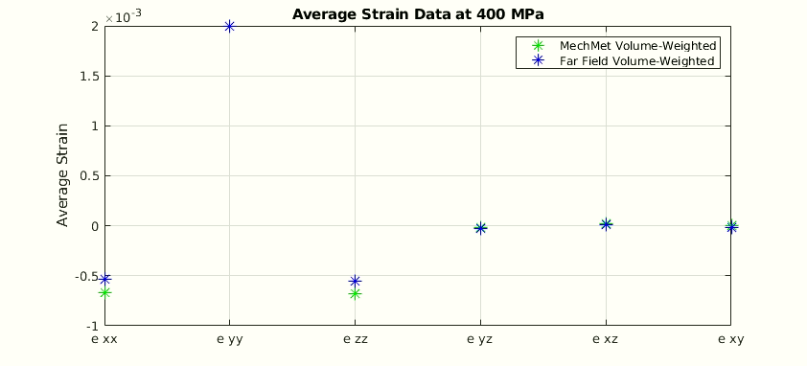
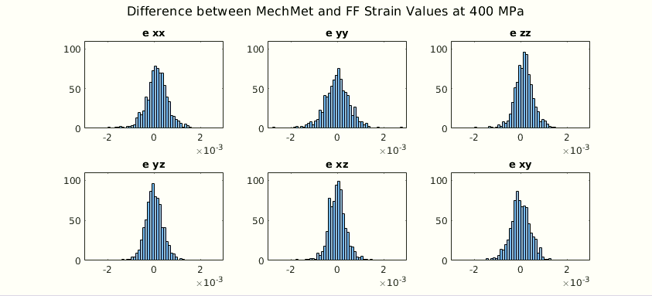
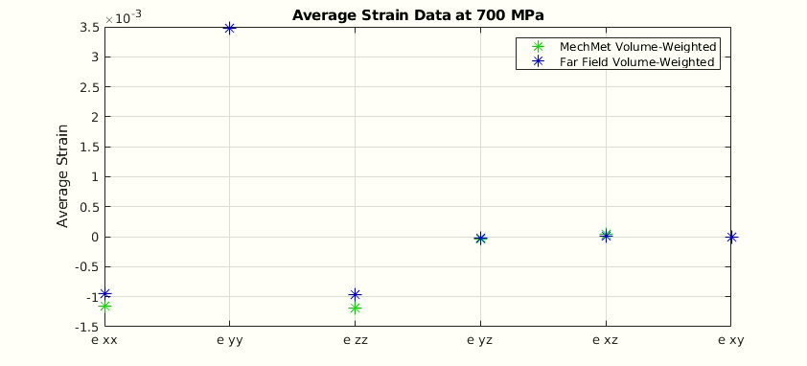
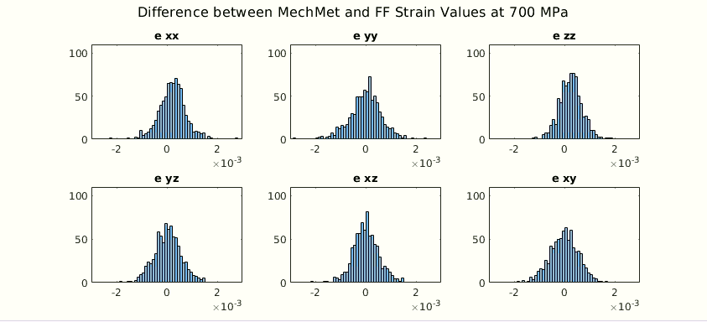
Analysis
400 MPa Stress:
700 MPa Stress:

Slide 8
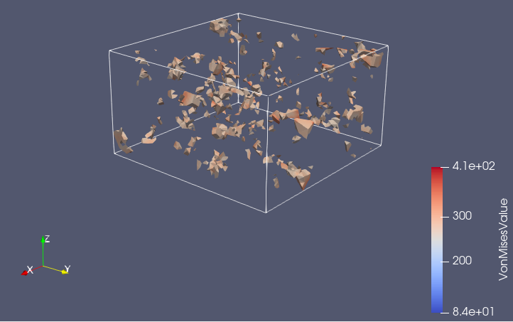
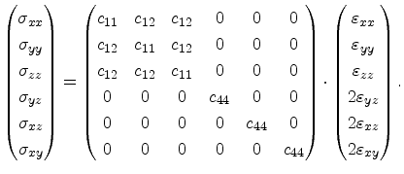
Future Work
SXM Optimization
MATLAB script finds optimal C11, C12, C44 values
Use optimal values to find grains experiencing high stress
Need good model agreement, reliable SXM
Will give better understanding of fatigue/crack initiation
Generalized Hooke’s Law:
Figure 4. Microstructure depicting grains with highest Von Mises stress

Slide 9
Questions?

