Slide 1


Design Projects for the Structural Materials Beamline @ CHESS
Jacob Frazey
July 26, 2021
Mentor: Kelly Nygren

Slide 2
MSN-C & Structural Materials Beamline
We use two beamlines to perform x-ray diffraction imaging. The beamlines are the Forming and Shaping Technology (FAST) and the Structural Materials Beamline (SMB).
The x-ray imaging techniques include high energy x-ray diffraction microscopy, transmission powder diffraction and energy dispersive diffraction.
Materials Solutions Network @ CHESS (MSN-C) offers beamline capabilities optimized to tackle the most pressing materials problems facing the Department of Defense researchers and their OEMs
SMB: Primary focus is based around the performance of different materials.

Slide 3
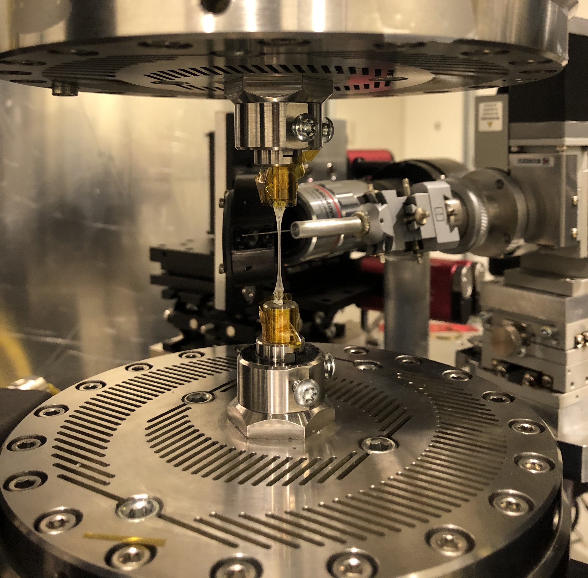
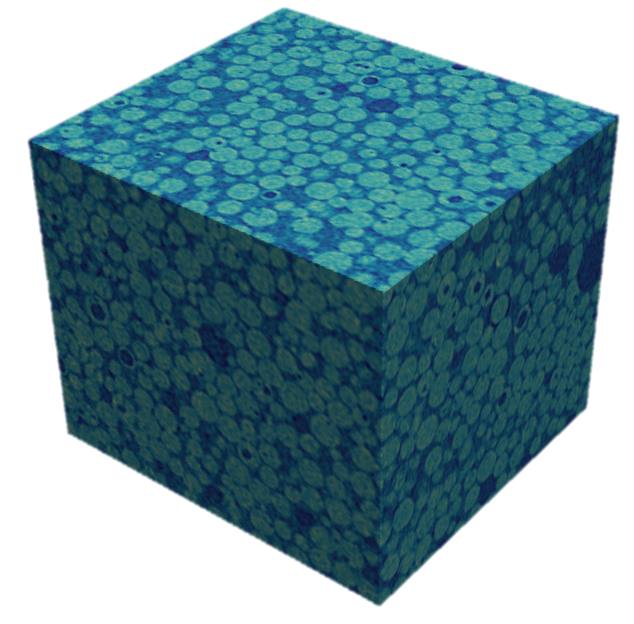
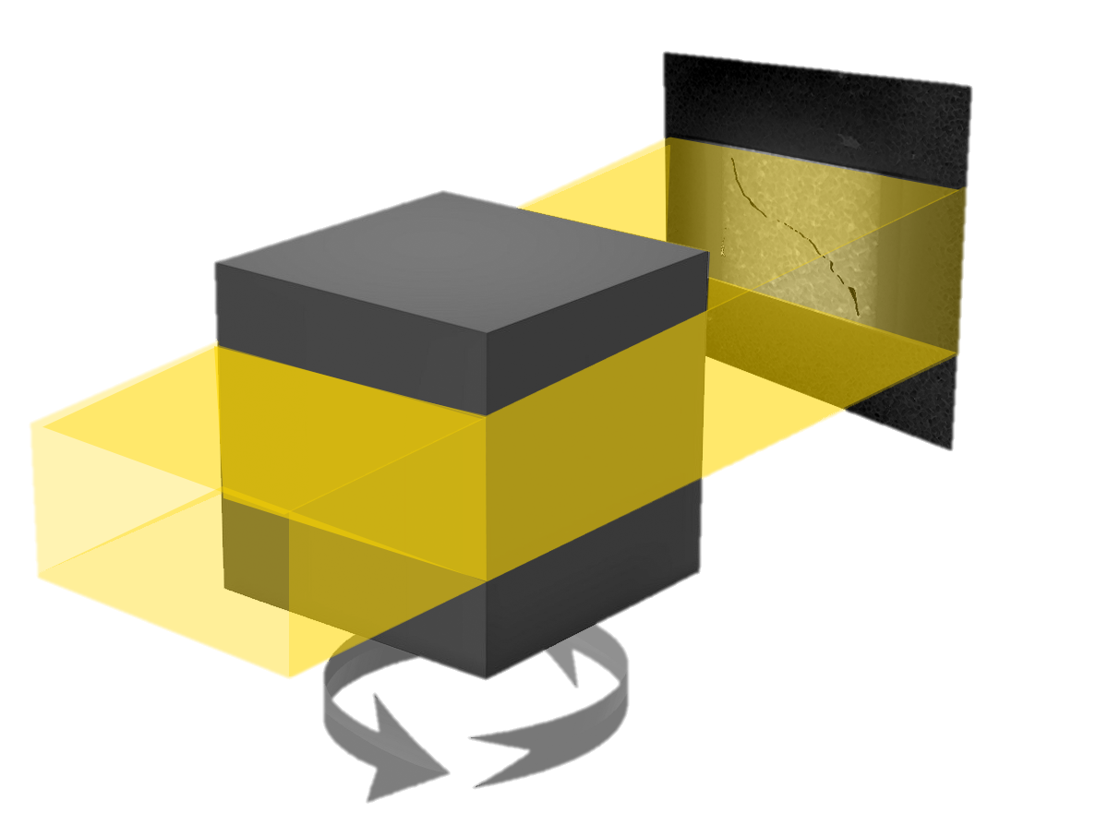
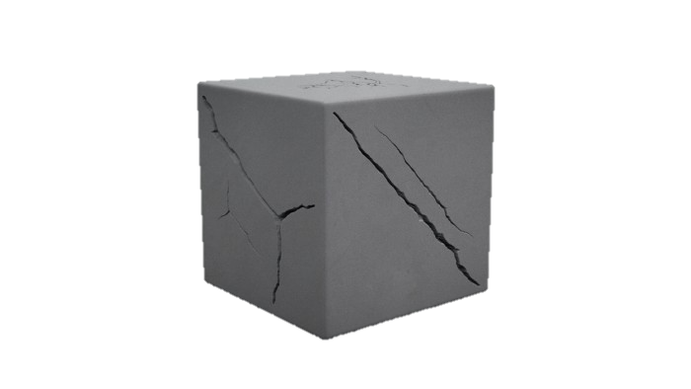
In-Situ Tensile Testing of Polymers
Experiment:
To look at the behavior of a polymer composite during in-situ loading using x-ray tomography
The same test that would take months on a lab-CT we can perform in hours at a synchrotron
Use a specialized load frame RAMSII/RAMSIV which can rotate 360˚ while applying a mechanical load to the sample
Absorption Tomography
. . . With in situ Loading
PROVIDES:
Variation of porosity/cracks
Variations in phase
Sample is rotated 180° and a series of projection images are obtained

Slide 4
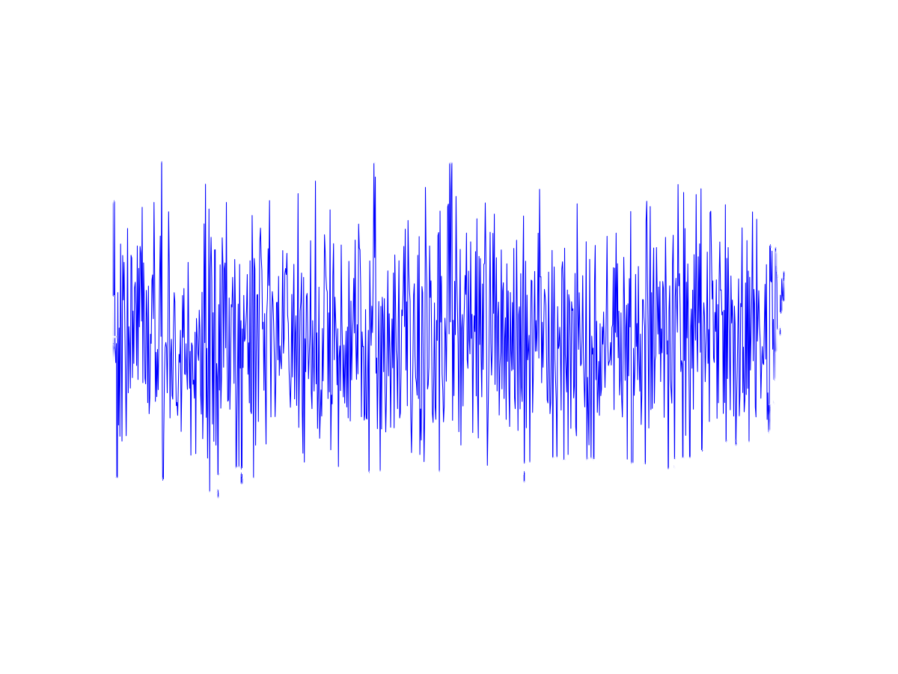
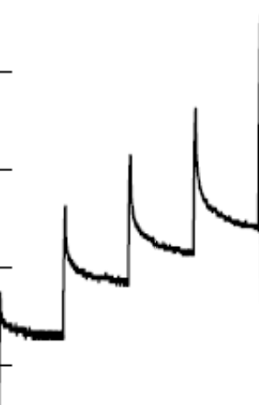
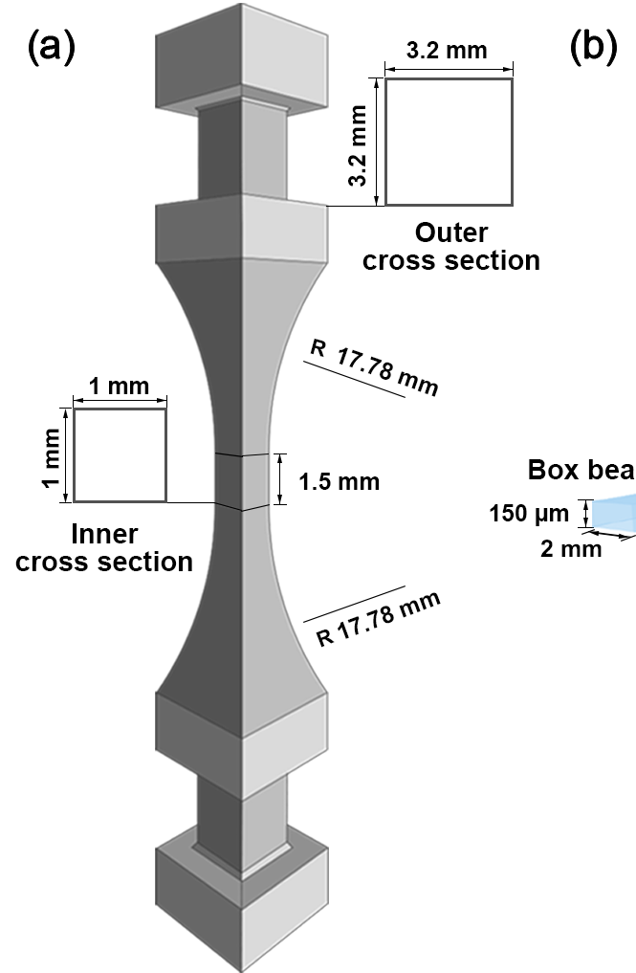
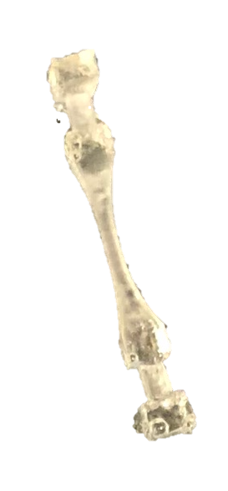
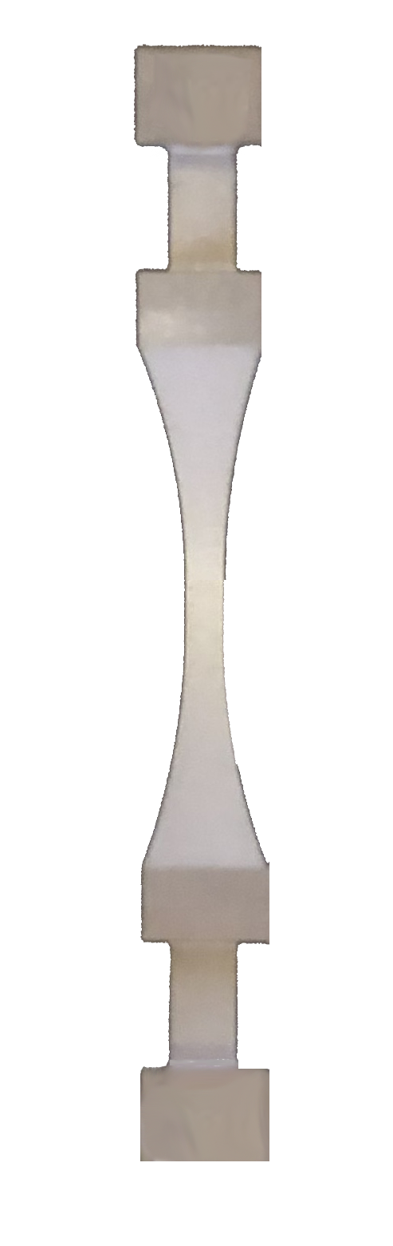
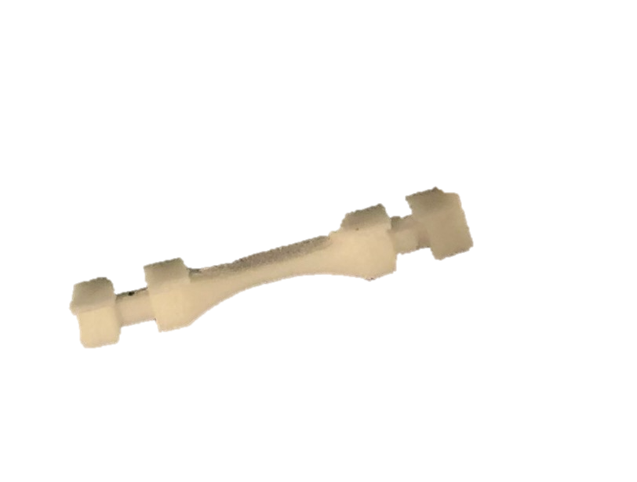
In-Situ Tensile Testing of Polymers
CHALLENGE: RAMSII/RAMSIV are optimized to study “structural materials” = Engineering Alloys
  Forces on the polymer are in the noise of this load cell
  -Load frame has a 2.5 kN loadcell
  -Load cell cannot be removed/exchanged
  Specimen design assumes material is a metal
    -Nearly impossible to fabricate to correct tolerances on a polymer
    -Grip design too weak for polymer sample
    -Not enough travel for sample rupture
What we need to see
What we currently see
Metal
Polymers
6 N
6 N

Slide 5
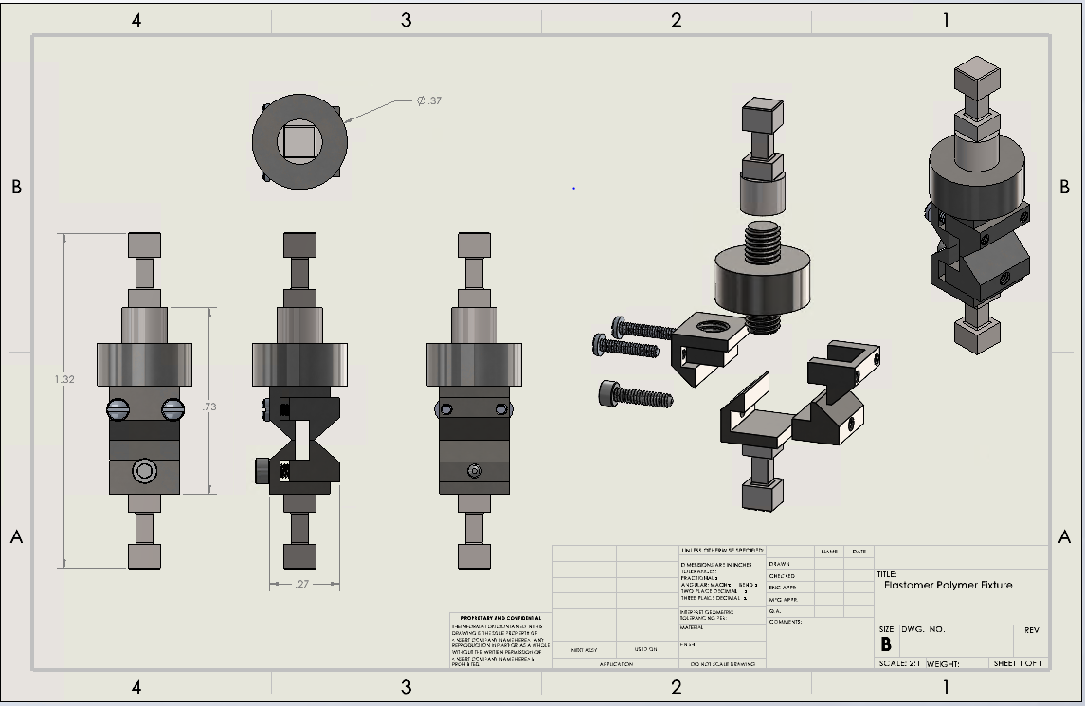
Elastomer Polymer Fixture Solution
The solution we produced was a custom fixture that could be mounted inside the jaws of RAMSII and RAMSIV.
This fixture contains two major components: a sensitive inline loadcell and sample grips.
For this fixture, a new elastomer polymer sample was designed. The new dimensions were a 1mmx1mm cross-section with a 6mm length.
This fixture will now allow us to take accurate readings of the forces required to rupture our samples.
The main challenge with this project was to stay within the size parameters. The maximum opening of the RAMSII was 36mm.
This fixture had to accommodate a sample that could stretch 7.5 times it’s original length, a loadcell sensitive enough to get accurate readings, and sample grips.

Slide 6
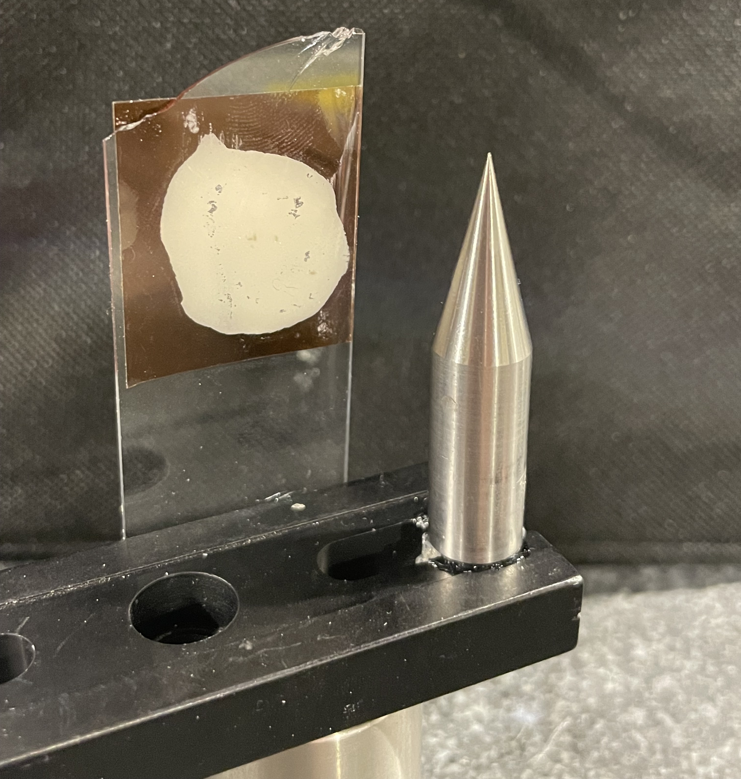
Mounts for Alignment & Calibrations
CHALLENGE: Need better mounting system for Calibration and Alignment samples
Rotation Center of staging/assembly:
  Precision pin in Stainless
  Past solutions: hold pin with collet holder
Laser-zeroing sample:
  Square cross-section sample on the order of 1 mm²
  Past solution: old tension sample in collet (works mediocre)
Detector Calibration:
  Sample: 10-500 um thick Ce0₂ powder sample
  Past solutions: CeO₂ washer, Ce0₂ glass slide with Kapton tape
Sample Calibration square:
  Would like universal mount option for adding a sample for measuring or deciding detector distances
  Never existed before.

Slide 7
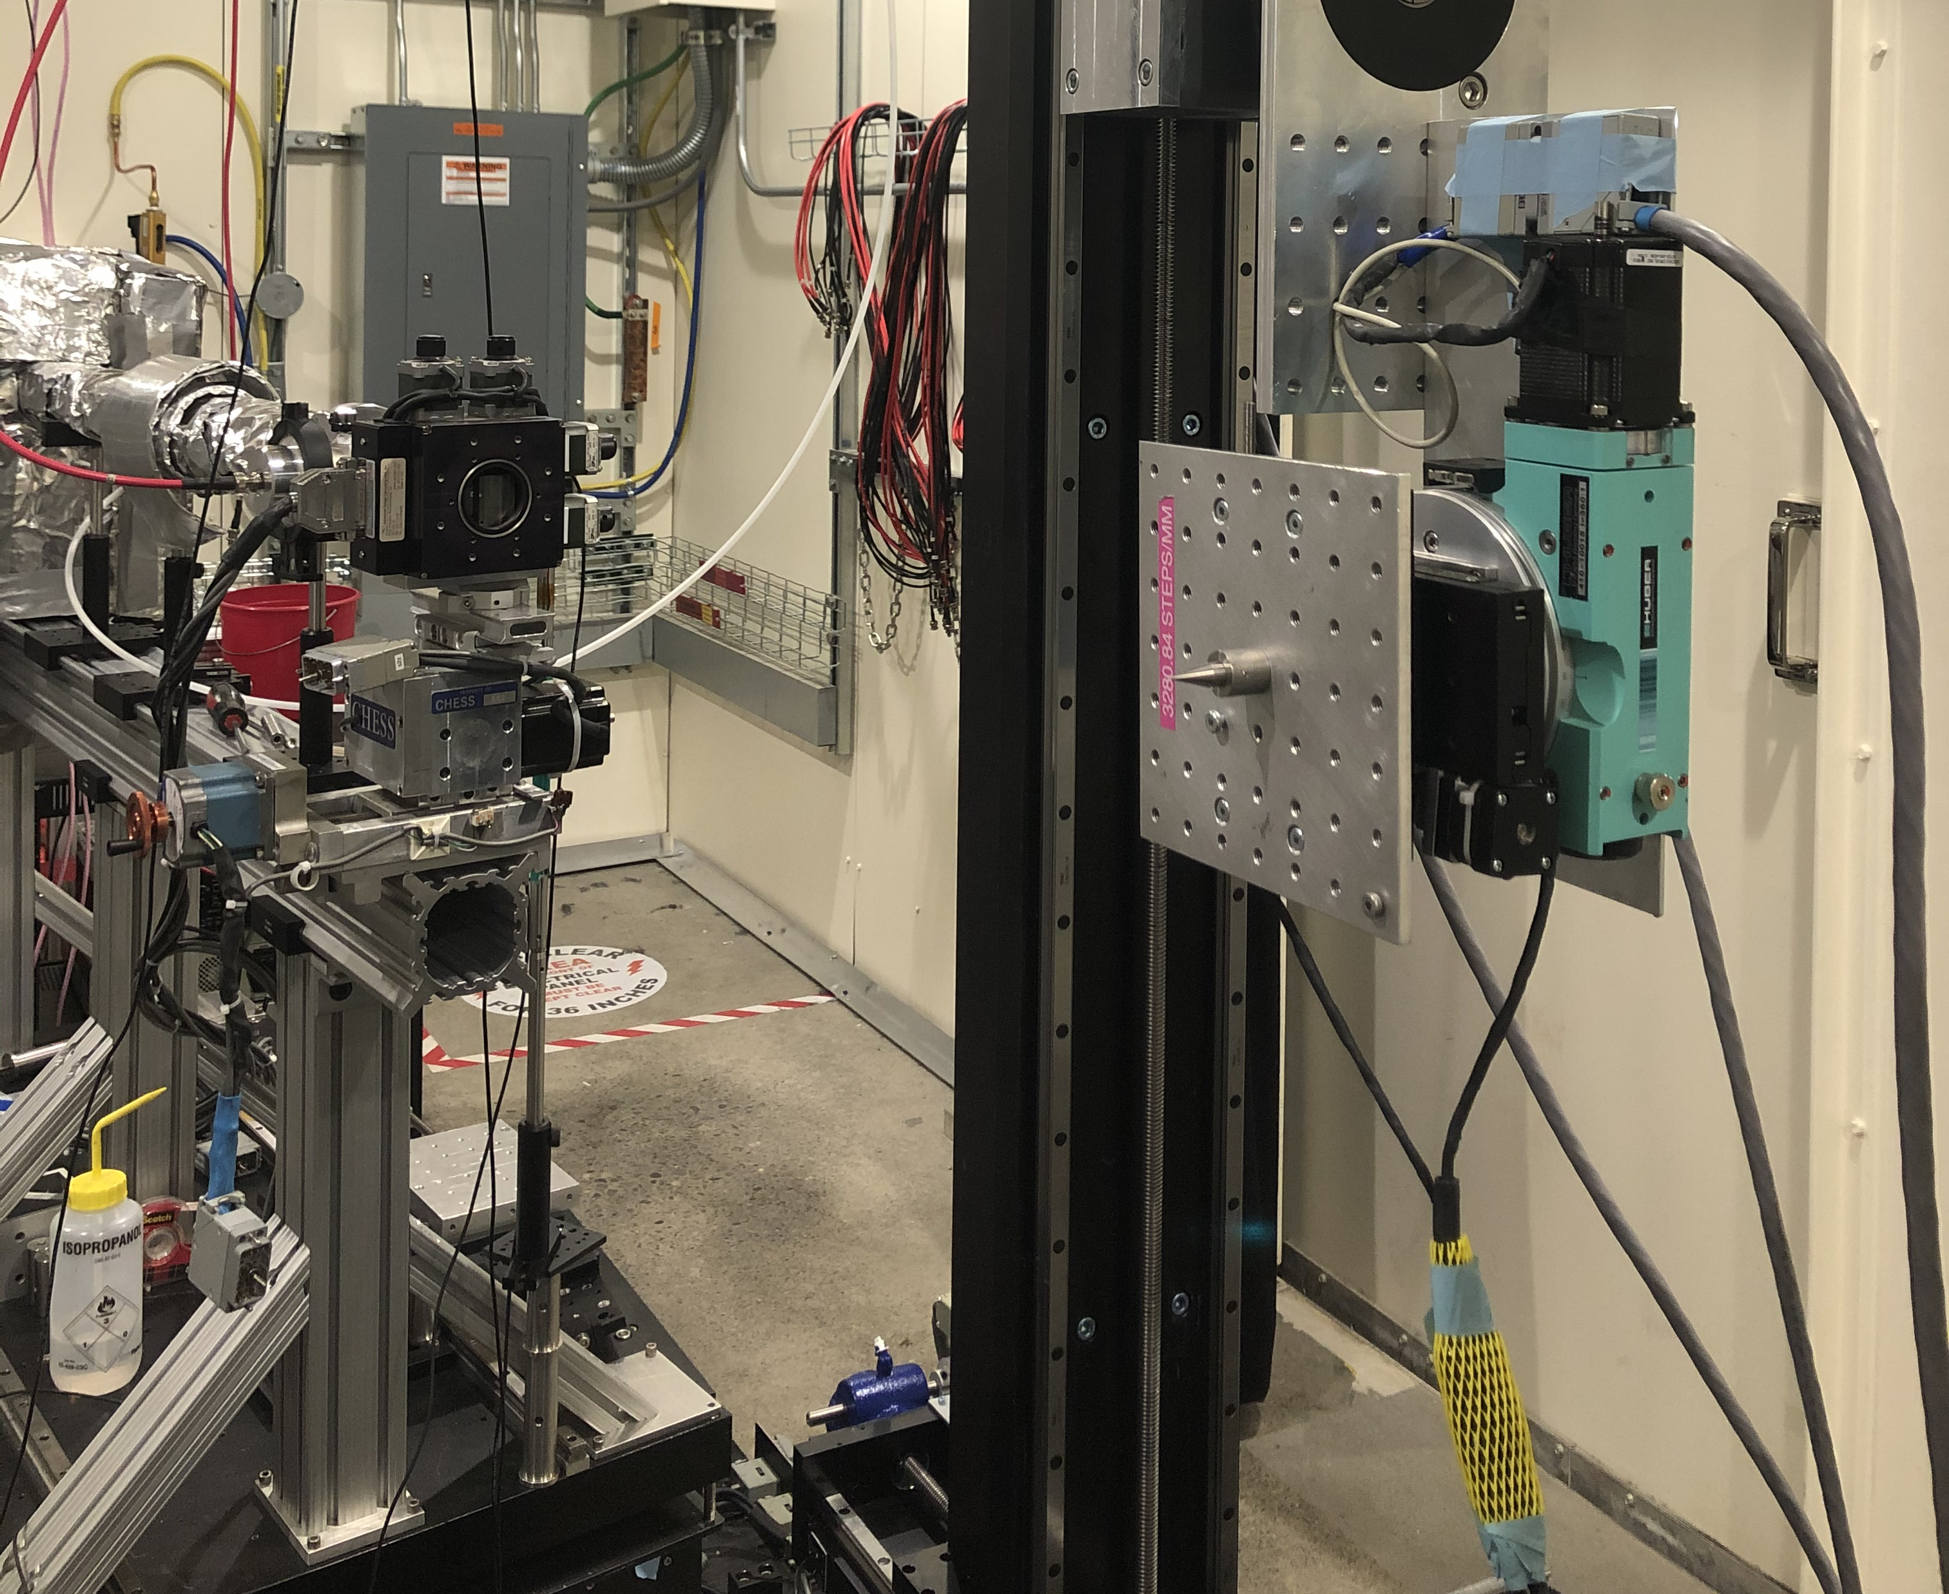
Mounts for Alignment & Calibrations
CHALLENGE: Need better mounting system for Calibration and Alignment samples
  We don’t want to place one at a time
  We want all samples to co-exist on same assembly!

Slide 8
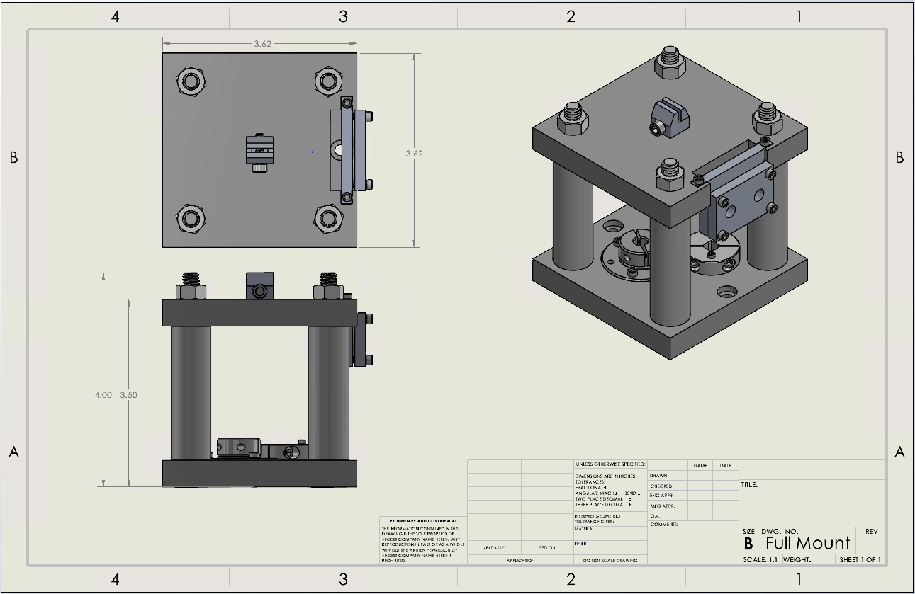
Calibration Mount Solution
The solution we produced was a universal mount that could contain all the calibration samples.
This mount has individual sample holders for each of the 4 unique calibration sample.
These samples include a rotation calibration sample, a laser zeroing sample, a detector calibration sample, and a piece of the material being analyzed.
After each sample is placed on the mount it can then be staged in front of the SBM.
The challenge with this project was that multiple samples needed be accessed from 0, 90, 180, and 270 degrees. So, it was important that the design allow for this.

Slide 9
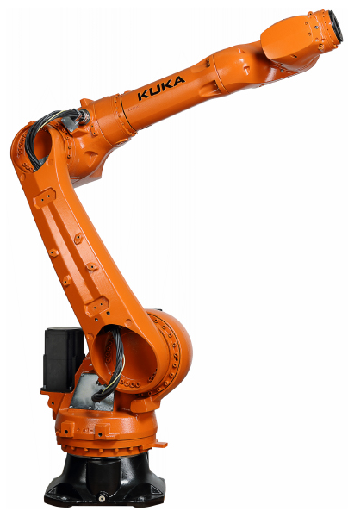
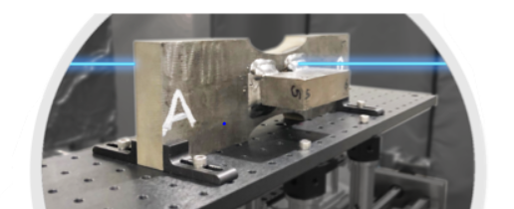
Robotic Arm
MSN-C is getting a new robotic arm to stage samples.
Currently there is no procedure for how this arm should interact with these samples.
We would like to develop a workflow, along with a script, that will tell the robot how it should align samples for beamline analysis.
This programming would take place in python.
Figure 4. Robotic arm that will be used and will replace old staging
Figure 5. Probing of a sample in strain for three separate planes
Images provided by Dr. Kelly Nygren

