Slide 1





PHOTOELECTROCATALYTIC ACTIVITY
OF MnZnO
Genesis L. García Machado
Dr. Mitk’El Santiago
Dr. Hector Abruña

Slide 2
Outline
Introduction
  Dye-sensitized solar cells
  MnZnO
Photoelectrochemistry of MnZnO
Future work
References
Acknowledgements

Slide 3


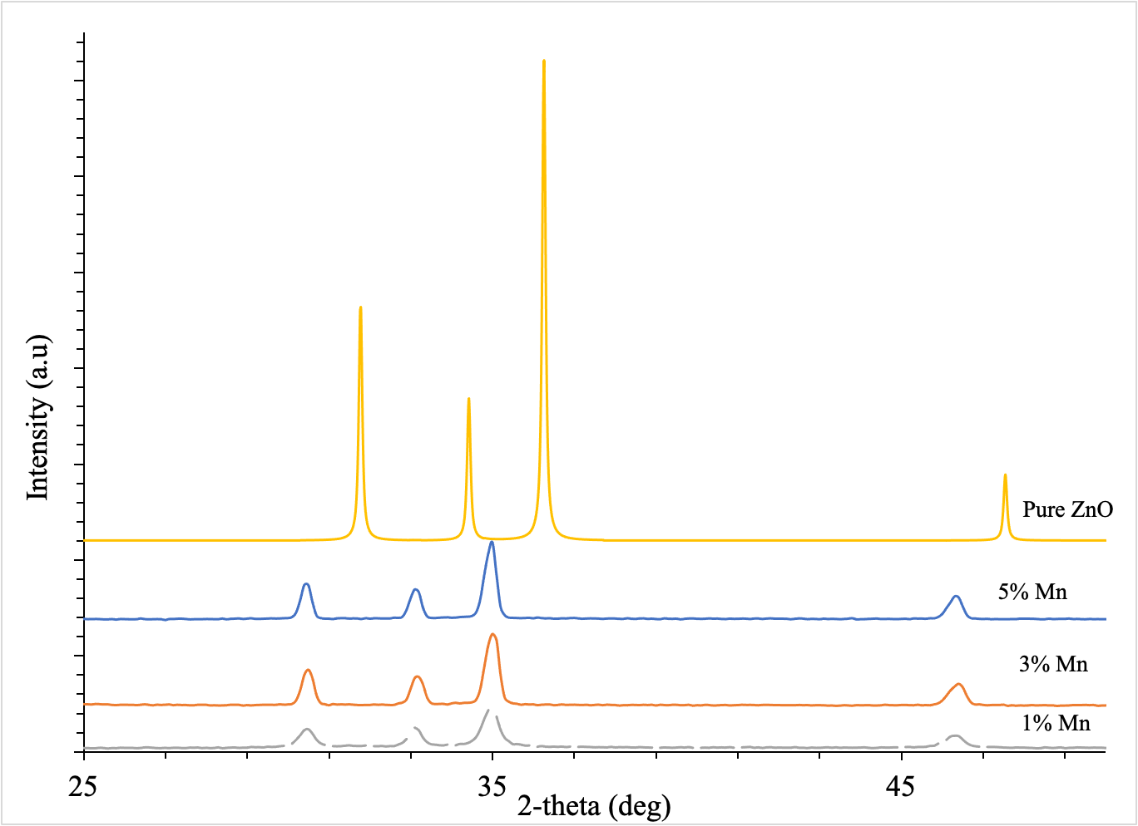
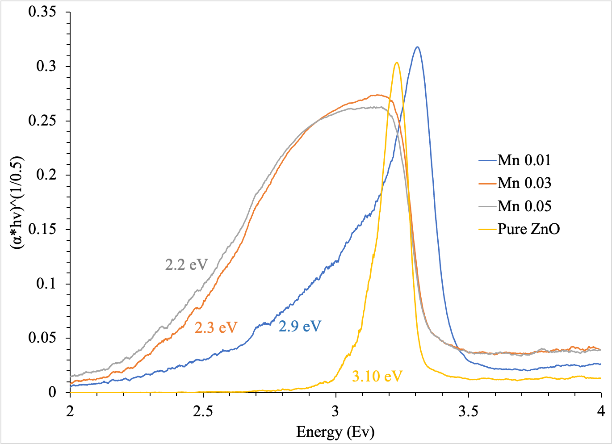
XRPD Diffractograms of Mn_{x}Zn_{1-x}O Materials
XANES of Mn_{x}Zn_{1-x}O Materials at the Mn K-edge
Tauc- Plot of Mn_{x}Zn_{1-x}O Materials
Electrochemistry of Mn_{x}Zn_{1-x}O Materials
Dopant agent | Ionic radii, pm
Zn²⁺ | 88
Mn²⁺ | 81 (low spin)
Mn³⁺ | 72 (low spin)

Slide 4
Dye-Sensitized Solar Cells (DSSCS)
DSSC are photoelectrochemical cells which involves complex reactions.
To achieve high efficiency and reduce energy loss in the DSSC the interfacial energetics and kinetics at the electrode surface are very important.
DSSC has four main components:
  Photoanode Semiconductor
  Dye
  Electrolyte
  Counter electrode

Slide 5
Methodology for the construction of Dye-Sensitized Solar Cells
Used MnZnO and Triton to create the semiconductor paste.
Applied a generous amount of the paste to the anode (FTO glass) until it dried.
We heated the paste at 400 ºC to form a film at the surface of FTO glass.
Carbon was deposited in another FTO glass and used as the cathode.
As the electrolyte we use an iodolyte (I⁻/I₃⁻) solution.
We performed linear sweep voltammetry in dark and under UV light saturation.

Slide 6
Linear sweep voltammetry of a DSSC in the presence and absence of UV light

Slide 7

Future work
  Complete characterization of a DSSC using MnZnO as photoanode.
  Perform in-situ X-ray Spectroscopy to monitor the reaction that occurs at the interface of the semiconductor and electrolyte.
  Since MnZnO can be used for two different applications, attempt the construction of an hybrid device.

Slide 8
References
Hsu, C.-H., Lai, C.-C., Chen, L.-C., and Chan, P.-S. (2014, June 9) Enhanced Performance of Dye-Sensitized Solar Cells with Graphene/ZnO Nanoparticles Bilayer Structure. Journal of Nanomaterials. Hindawi.
Iwata, S., Shibakawa, S.-ichiro, Imawaka, N., and Yoshino, K. (2017, December 29) Stability of the current characteristics of dye-sensitized solar cells in the second quadrant of the current–voltage characteristics. Energy Reports. Elsevier.
Zheng, D., Ye, M., Wen, X., Zhang, N., and Lin, C. (2016, December 23) Electrochemical methods for the characterization and interfacial study of dye-sensitized solar cell. Science Bulletin. Elsevier.

Slide 9
Acknowledgements
Cornell University
Dr. Mitk’El Santiago
Dr. Hector Abruña

Slide 10
THE END

