Slide 1
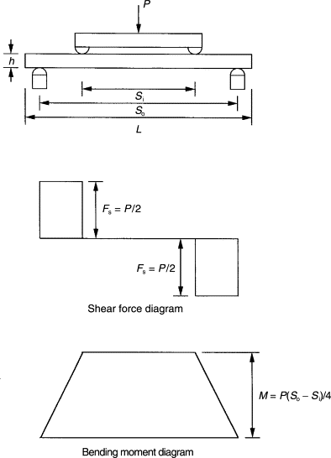
Design of Test Fixture for X-ray Diffraction Measurement of Thermoplastic Carbon Composites in Bending at MSN-C
By: Ian Hahn
Mentors: Arthur Woll, Armand Beaudoin
Guidance from: Joe Crum, Basil Blank
Overview
Carbon fiber composites have been used for a long time but sparsely for structural applications due to brittleness
Thermoplastic carbon composites are more promising as they have a higher stiffness to weight ratio and provide a more crystalline structure than epoxy cured composites
The crystalline structure of the thermoplastic allows X-ray diffraction techniques to more accurately measure the stress and strain states within the composites
Design Process
Refamiliarize with 4-point bending
Pure bending
Clear strain profile
ASTM 7264 – Standard for testing flexural properties of polymer composites
Provided aspect ratio
Discussions with other scientists helped to set specimen and fixture dimensions
Figure 1: Four-point bending diagram with shear and moment diagrams

Slide 2
Design of Test Fixture for X-ray Diffraction Measurement of Thermoplastic Carbon Composites in Bending at MSN-C
Practical Considerations
Alignment of top and bottom housing with pillow blocks and linear bearings
Addition of c-flex bearing to accommodate for specimen imperfections
Reconfiguration of the support and load spans to accommodate different bending configurations as well as varying span dimensions
100 lb. in-line compression load cell

Slide 3
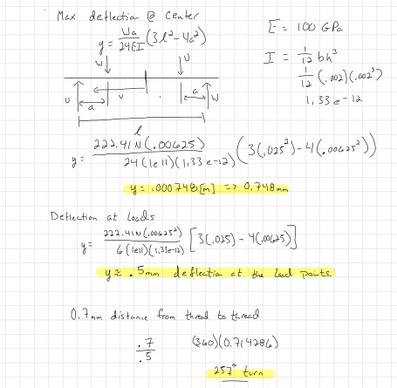
Design of Test Fixture for X-ray Diffraction Measurement of Thermoplastic Carbon Composites in Bending at MSN-C
Deflection Calculations
Maximum deflection at beam center
$y=\frac{Wa}{24EI}\left(3l^{2}−4a^{2}\right)$
.75 mm
Deflection at load points
$y=\frac{Wa^{2}}{6EI}(3l−4a)$
.50 mm
Using M4 x 0.7 load screw
Load point deflection correlates to 257 degree turn of screw
E – Elastic modulus
I – Moment of inertia of the cross-section of the specimen

