Slide 1




Onion-like Carbon, Iron, Cobalt, Nitrogen
XAS Data Analysis
Kelvin J. Vicente-Ramos*, Brenda L. Vargas-Pérez*, Lisandro Cunci-Pérez*, Chris Pollock**, Louise M. Debefve**
*School of Natural Sciences & Technology, Universidad Ana G. Mendez – Gurabo, PR
**Cornell High Energy Synchrotron Source, Cornell University, Ithaca, NY

Slide 2
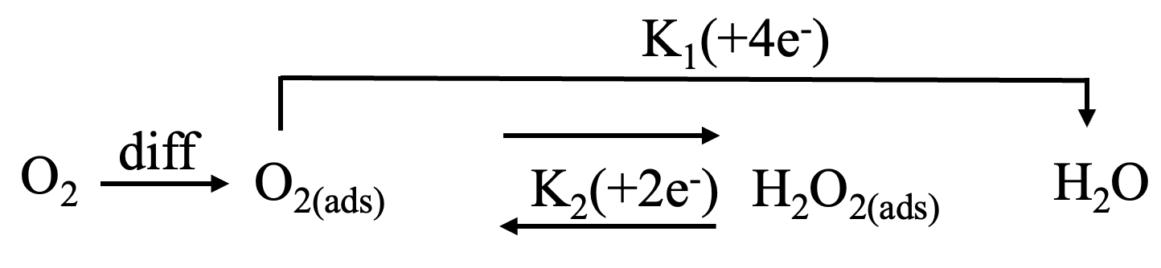
Green House Gases (GHS) and Oxygen Reduction Reaction (ORR)
Notes:
First of all, is necessary to know that over the years there have been an increase in the GHS and that’s something that can be seen in the graph
To reduce the GHS there are methods like the non-precious electrocatalysis in the ORR
Reaction used in the energy-converting systems such as fuel cells and metal-air batteries.
ORR in aqueous solutions have 2 different pathways:
You can either produce hydrogen peroxide by a 2-electron pathway or water by a 4 electron pathways

Slide 3
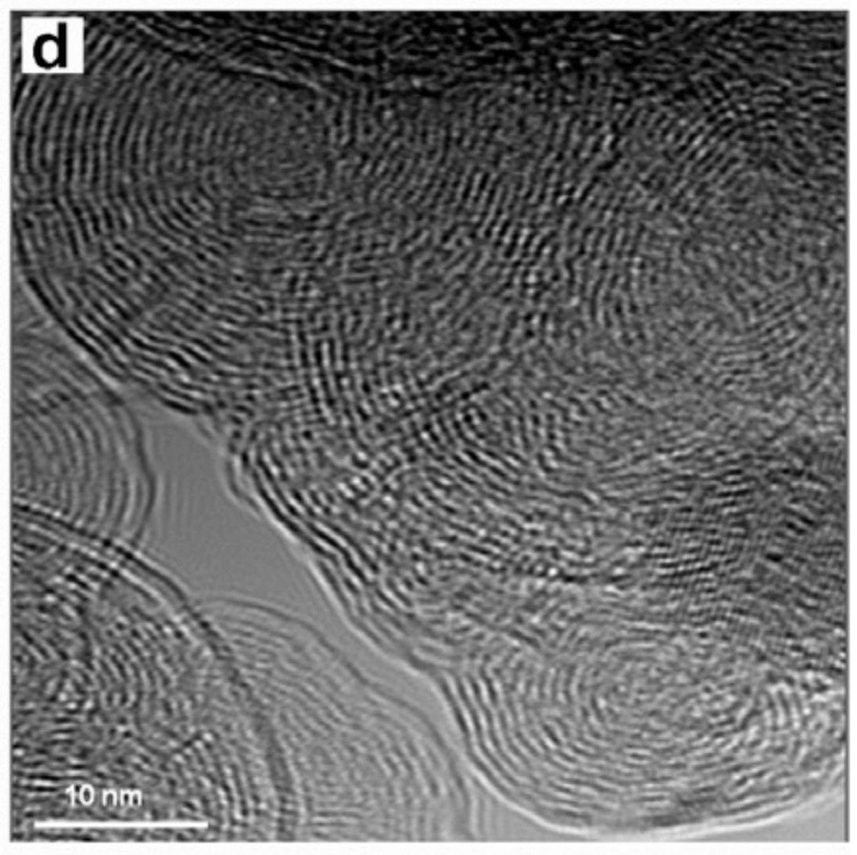
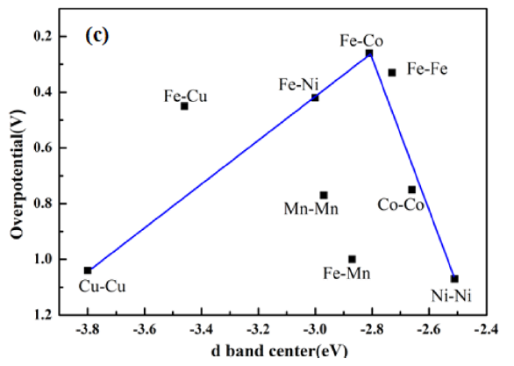
Non-precious Metals and Onion-like Carbon
Mykhailiv, O., Imierska, M., Petelczyc, M., Echegoyen, L., & Plonska-Brzezinska, M. E. (2015). Chemical versus Electrochemical Synthesis of Carbon Nano-onion/Polypyrrole Composites for Supercapacitor Electrodes. Chemistry - A European Journal, 21(15), 5783–5793.
2. Wu, G., Nelson, M., Ma, S., Meng, H., Cui, G., & Shen, P. K. (2011). Synthesis of nitrogen-doped onion-like carbon and its use in carbon-based CoFe binary non-precious-metal catalysts for oxygen-reduction. Carbon, 49(12), 3972–3982.
Notes:
CNO’s have unique chemical and physical properties
If you combing CNO + conducting polymers = materials with potential practical applications which can be used as supercapacitor electrodes that can provide
Potential electronic (2) ionic conductivity (3) improve charge storage and delivery
Onion-like carbon are used as a catalytic support for fuel cell application
CNO’s as catalytic supports increase the effective utilization of the active materials and the electrical conductivity
The Transmission electron microscopy (TEM) is a representative onion-like carbon structure
What is a supercapacitor?
Is an electrochemical energy storage with a large amount of energy, typically 10 to 100 times more energy per unit mass or volume compared to electrolytic capacitors. ... A supercapacitor is also known as ultracapacitor or double-layer electrolytic capacitor.
The polymers that we use are polyaniline and polypyrrole.

Slide 4
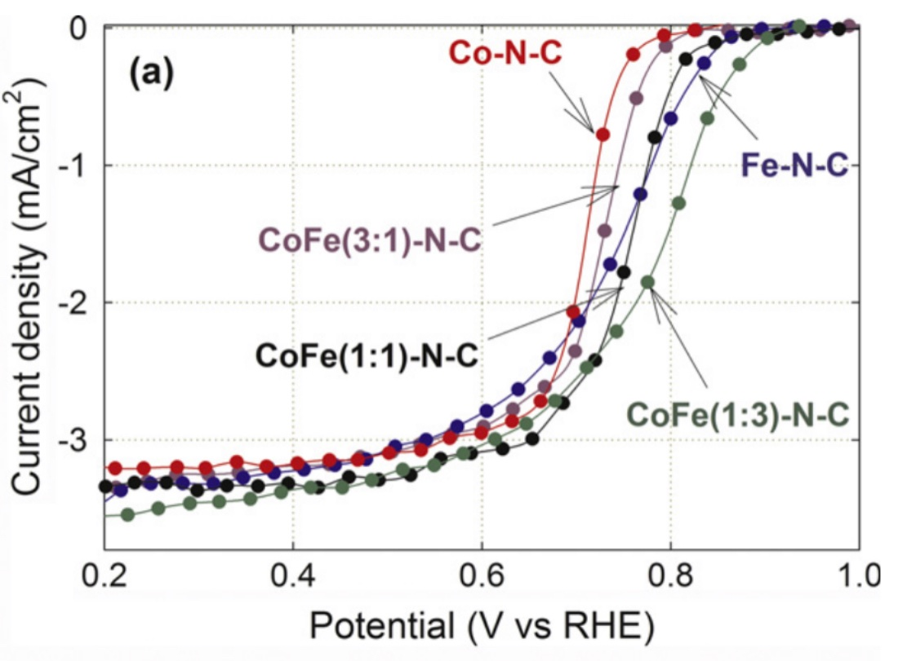
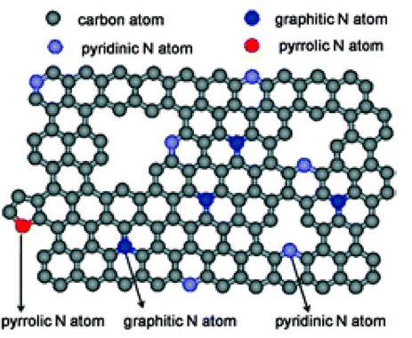
Nitrogen-Doped Onion-like Carbon
Higher catalytic activity
Facilitates oxygen reduction
Low cost
Nitrogen atoms can be incorporate into the
graphene layers to replace carbon different
sites
Notes:
Larger N-OLC molecules generate higher activity and stability
FeCo are the most efficient transition metals in inducing nitrogen atoms doping into carbo structures
Modify onion-like carbon nanoparticles using nitrogen-based conductive polymers for the oxygen reduction reaction.
RRDE is used to the electrochemical characterization – there we can evaluate the activity and 4-electron electivity for ORR
In the lower figure we can observe that Nitrogen atoms can incorporate into the graphene layers to replace carbon ay different sites
Pyridinic form – N atoms doped at the edges of the graphitic carbon layers
Quaternary form – N atoms doped inside the graphitic carbon plane (this is the best)
Pyrrolic form – N atoms in a pentagonal structure, indistinguishabe from pyridone (pyrridinic-N next to an OH group)
More Fe leads to more N atoms doping into the interior of graphitized carbon plane, and generate more intrinsically active ORR sited
Pyrridinic N facilitates the oxygen reduction
The upper indicates the current density of binary compounds at different concentration, there we can observe when the Co-Fe ratio is 1:3 we have a better catalyst, which means that more Fe leads to more N atoms doping into the interior of graphitized carbon plane, and generate more intrinsically active ORR sited

Slide 5
Objectives
Differences in:
  Oxidation state
  Geometry
  Fe-Co bonds
  Structures

Slide 6
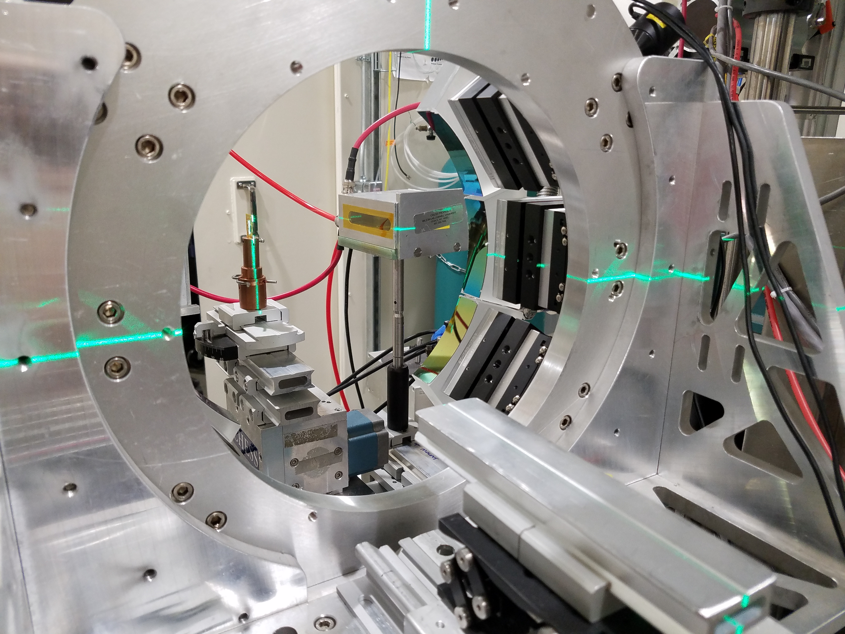
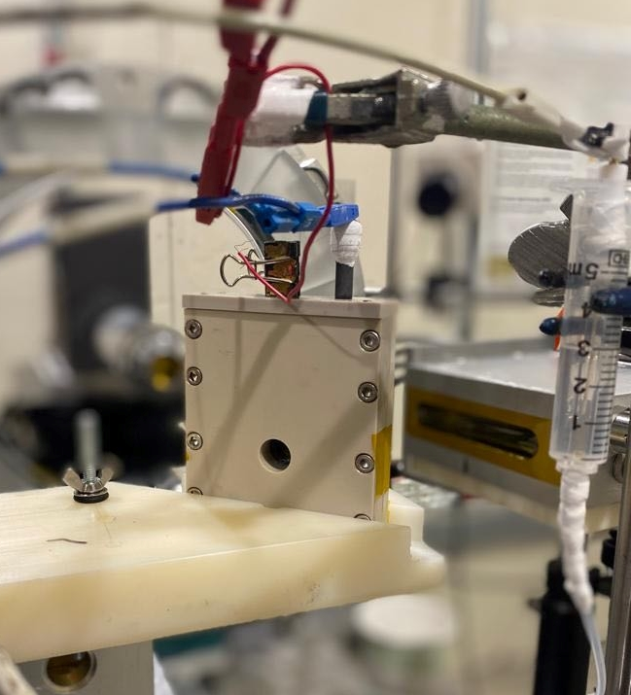
Experimental Set Up

Slide 7
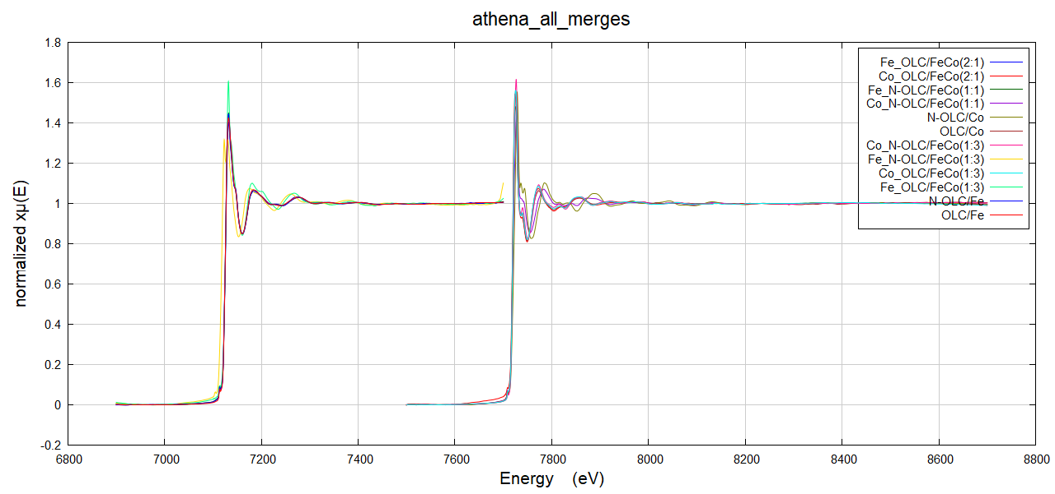
Athena
Notes:
This is what we have after we merge the scans of each samle and after the parameters are set up to remove the background and normalized everything.
The data that is near the y-axis are from Iron and the other samples are from Cobalt.

Slide 8
Fitted Samples?
Group A
  N-OLC/FeCo(1:3)
  OLC/FeCo(1:3)
Group B
  N-OLC/Fe
  OLC/Fe
Group C
  N-OLC/Co
  OLC/Co
Group D
  N-OLC/FeCo(1:1)
  OLC/FeCo(1:1)
Group E
  N-OLC/FeCo(2:1)
  OLC/FeCo(2:1)
8
Notes:
For know I’m just working with the cobalt because the FEFF file is of a cobalt (II) complex and of course I’m still learnig how to use all the artemis program

Slide 9
Example: Excel N-OLC/Co
Notes:
This spreadsheets from some of the fittings that I did when I was learning how to use the Artemis FEFF Calculations to fit our N-OLC/Co sample
S02 0.7 – 1.0 Global correction factor (+)
sigma^2 0.001 – 0.01 Debye-Waller factor that accounts for disorder in the sample (+)
e0 -10 to +10 Controls where the EXAFS begins
Delr
Reff
R -0.1 to + 0.1 This is the difference between the starting distance and the fit distance
R-factor How good is the fit (small values are better?)
Notes:
High e0
Some -sigma^2
R-factor goes from 0.14054 to 0.17344

Slide 10
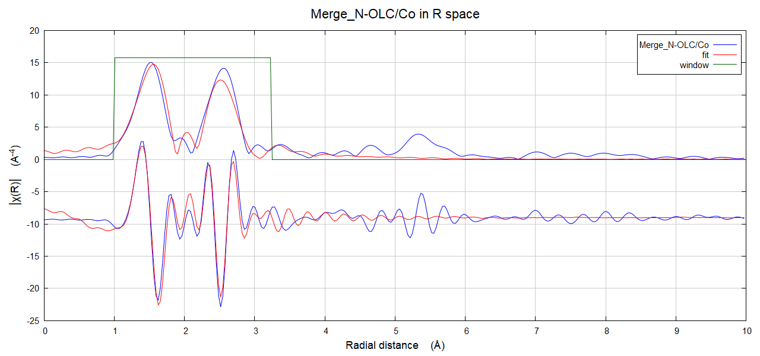
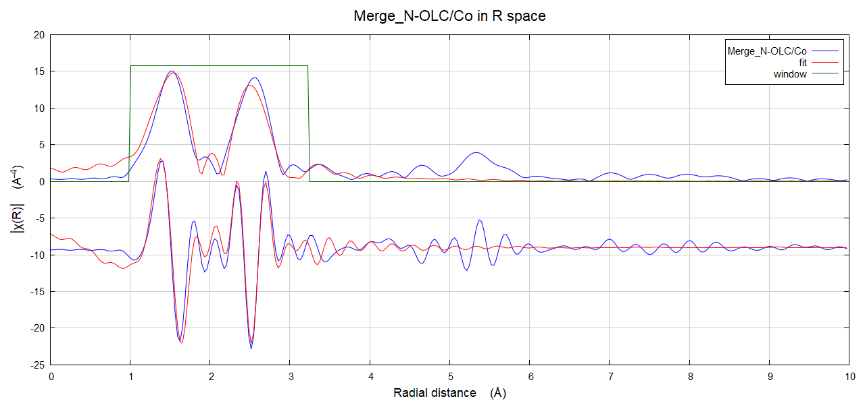
Example: Fitting with FEFF File (Fit 5 vs 25)
Notes:
Fit 5 – better 1st peak
Fit 25 – better second peak
Why the 2nd peak doesn’t looks that great?
A possible explanation can be that in that region (2nd shell) the interactions of bonding atoms are not from Cobalt to Oxygen and maybe they can be from Cobalt to Cobalt
That is an hypothesis and to prove that we need to try a new fit with a FEFF File from a molecule or coplex that have cobalts bonded to other cobalts

Slide 11
Acknowledgments
This work was supported by the National Science Foundation NSF-PREM: Center for Interfacial Electrochemistry of Energy Materials (Grant No.1827622).

