Slide 1
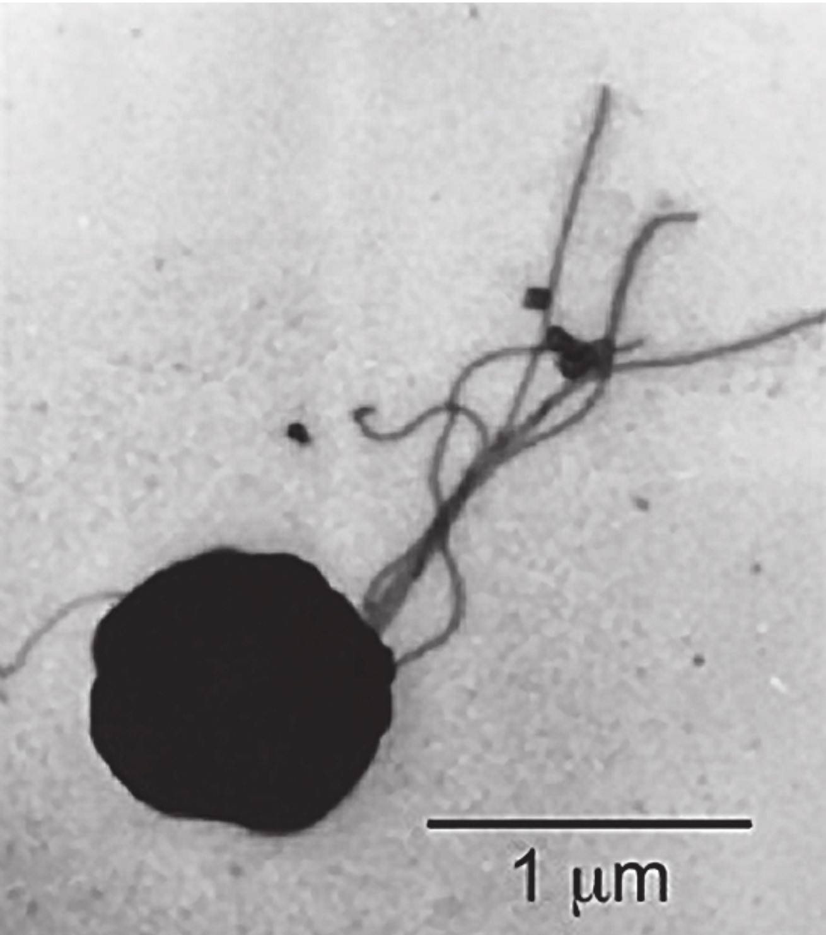
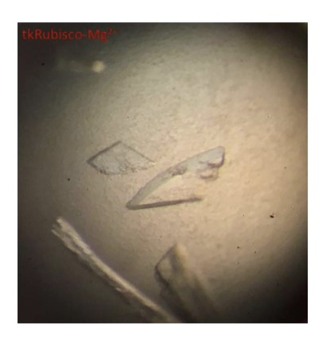
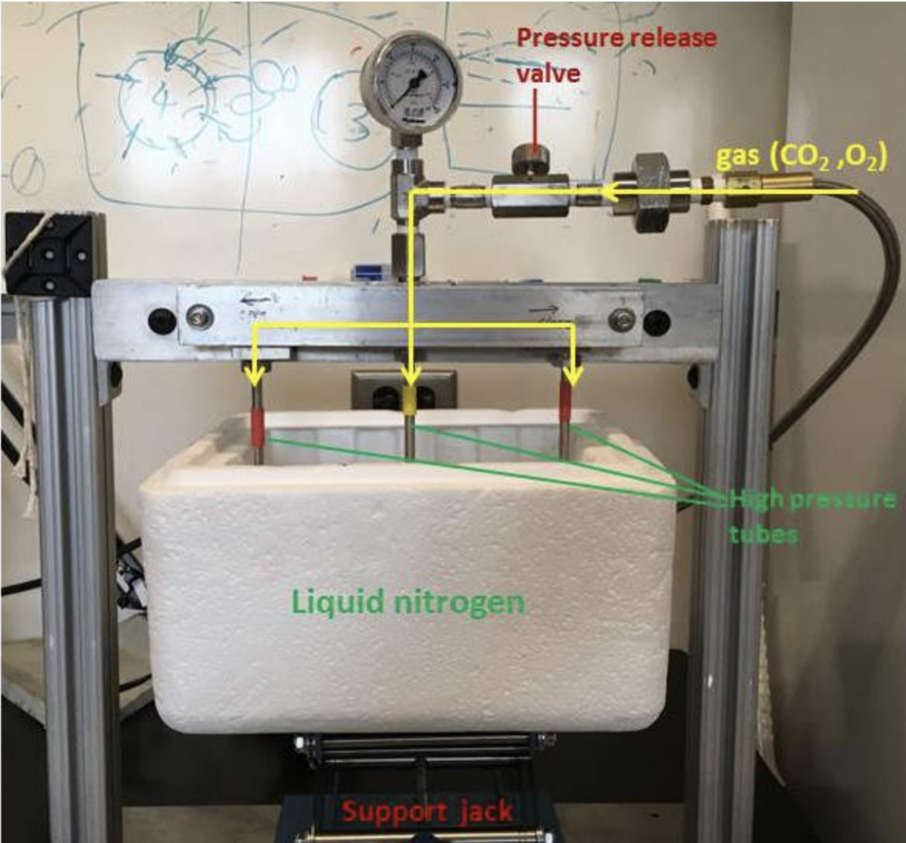
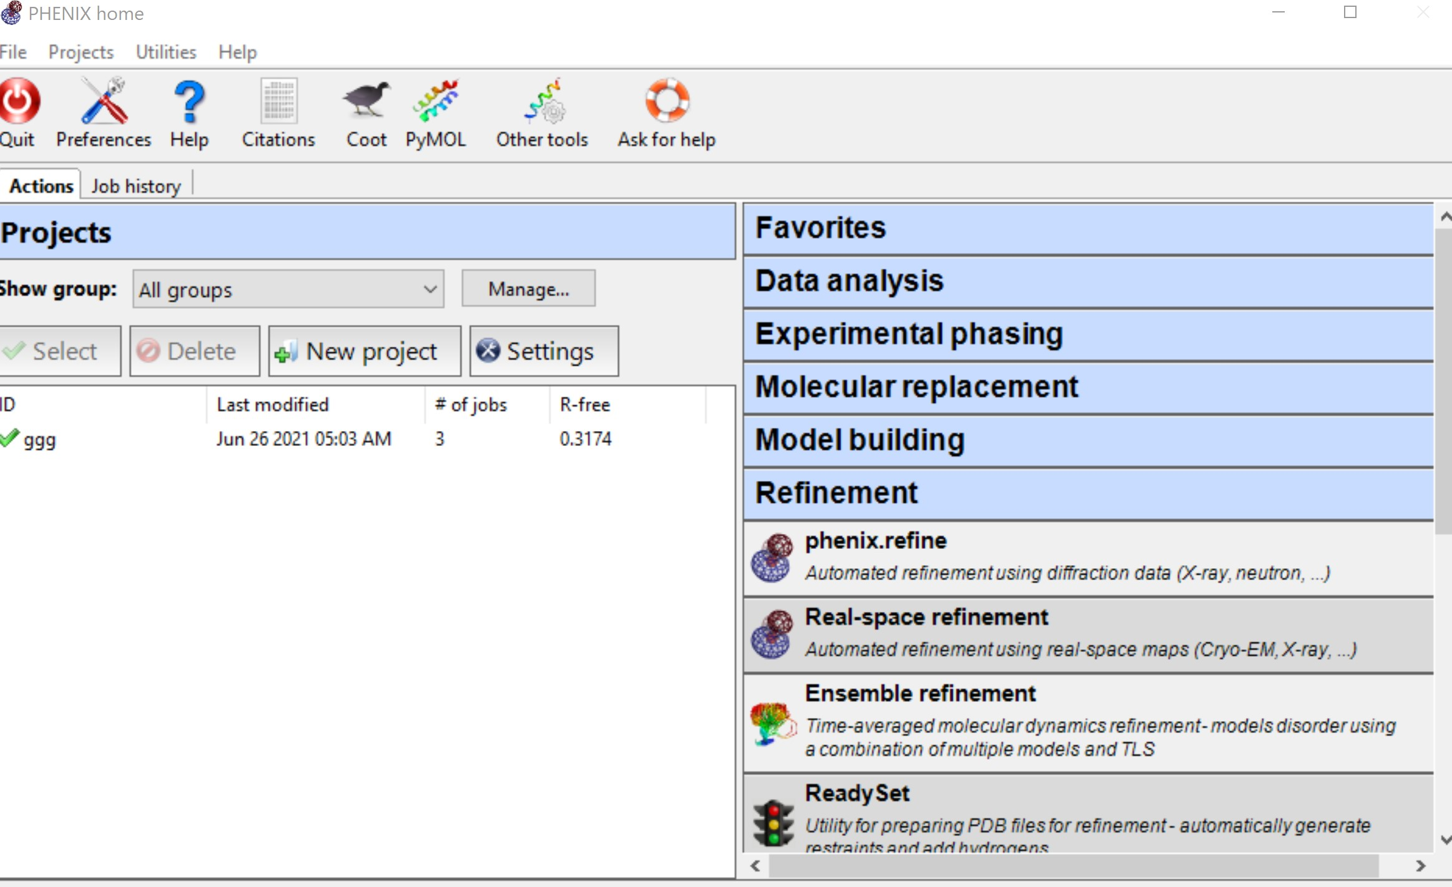
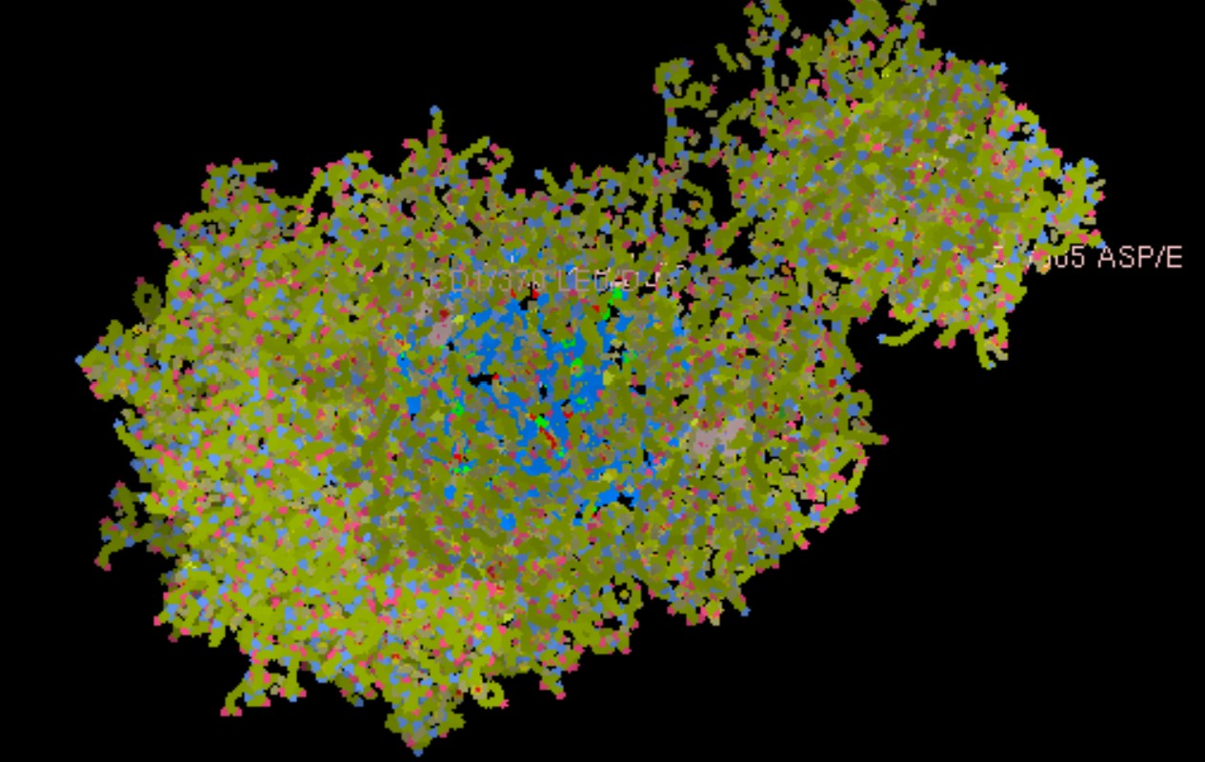
Rubisco project – Dr. Qingqiu Huang
Experimental process
Express and purify protein
Grow the crystal
Pressurize the crystals with CO2
Collect diffraction data
Solve and analyze the crystal structure
Atomi, H. et al. (2004). Description ofThermococcus kodakaraensissp. nov., a well studied hyperthermophilic archaeon previously reported asPyrococcussp. KOD1. Archaea, 1(4), 263–267. https://doi.org/10.1155/2004/204953
Protein Crystal of Tkrubisco
Crystal structure of TkRubisco - Mg²⁺
My project
Solve structure with Phenix
Visualize structure with Coot

Slide 2
