Slide 1
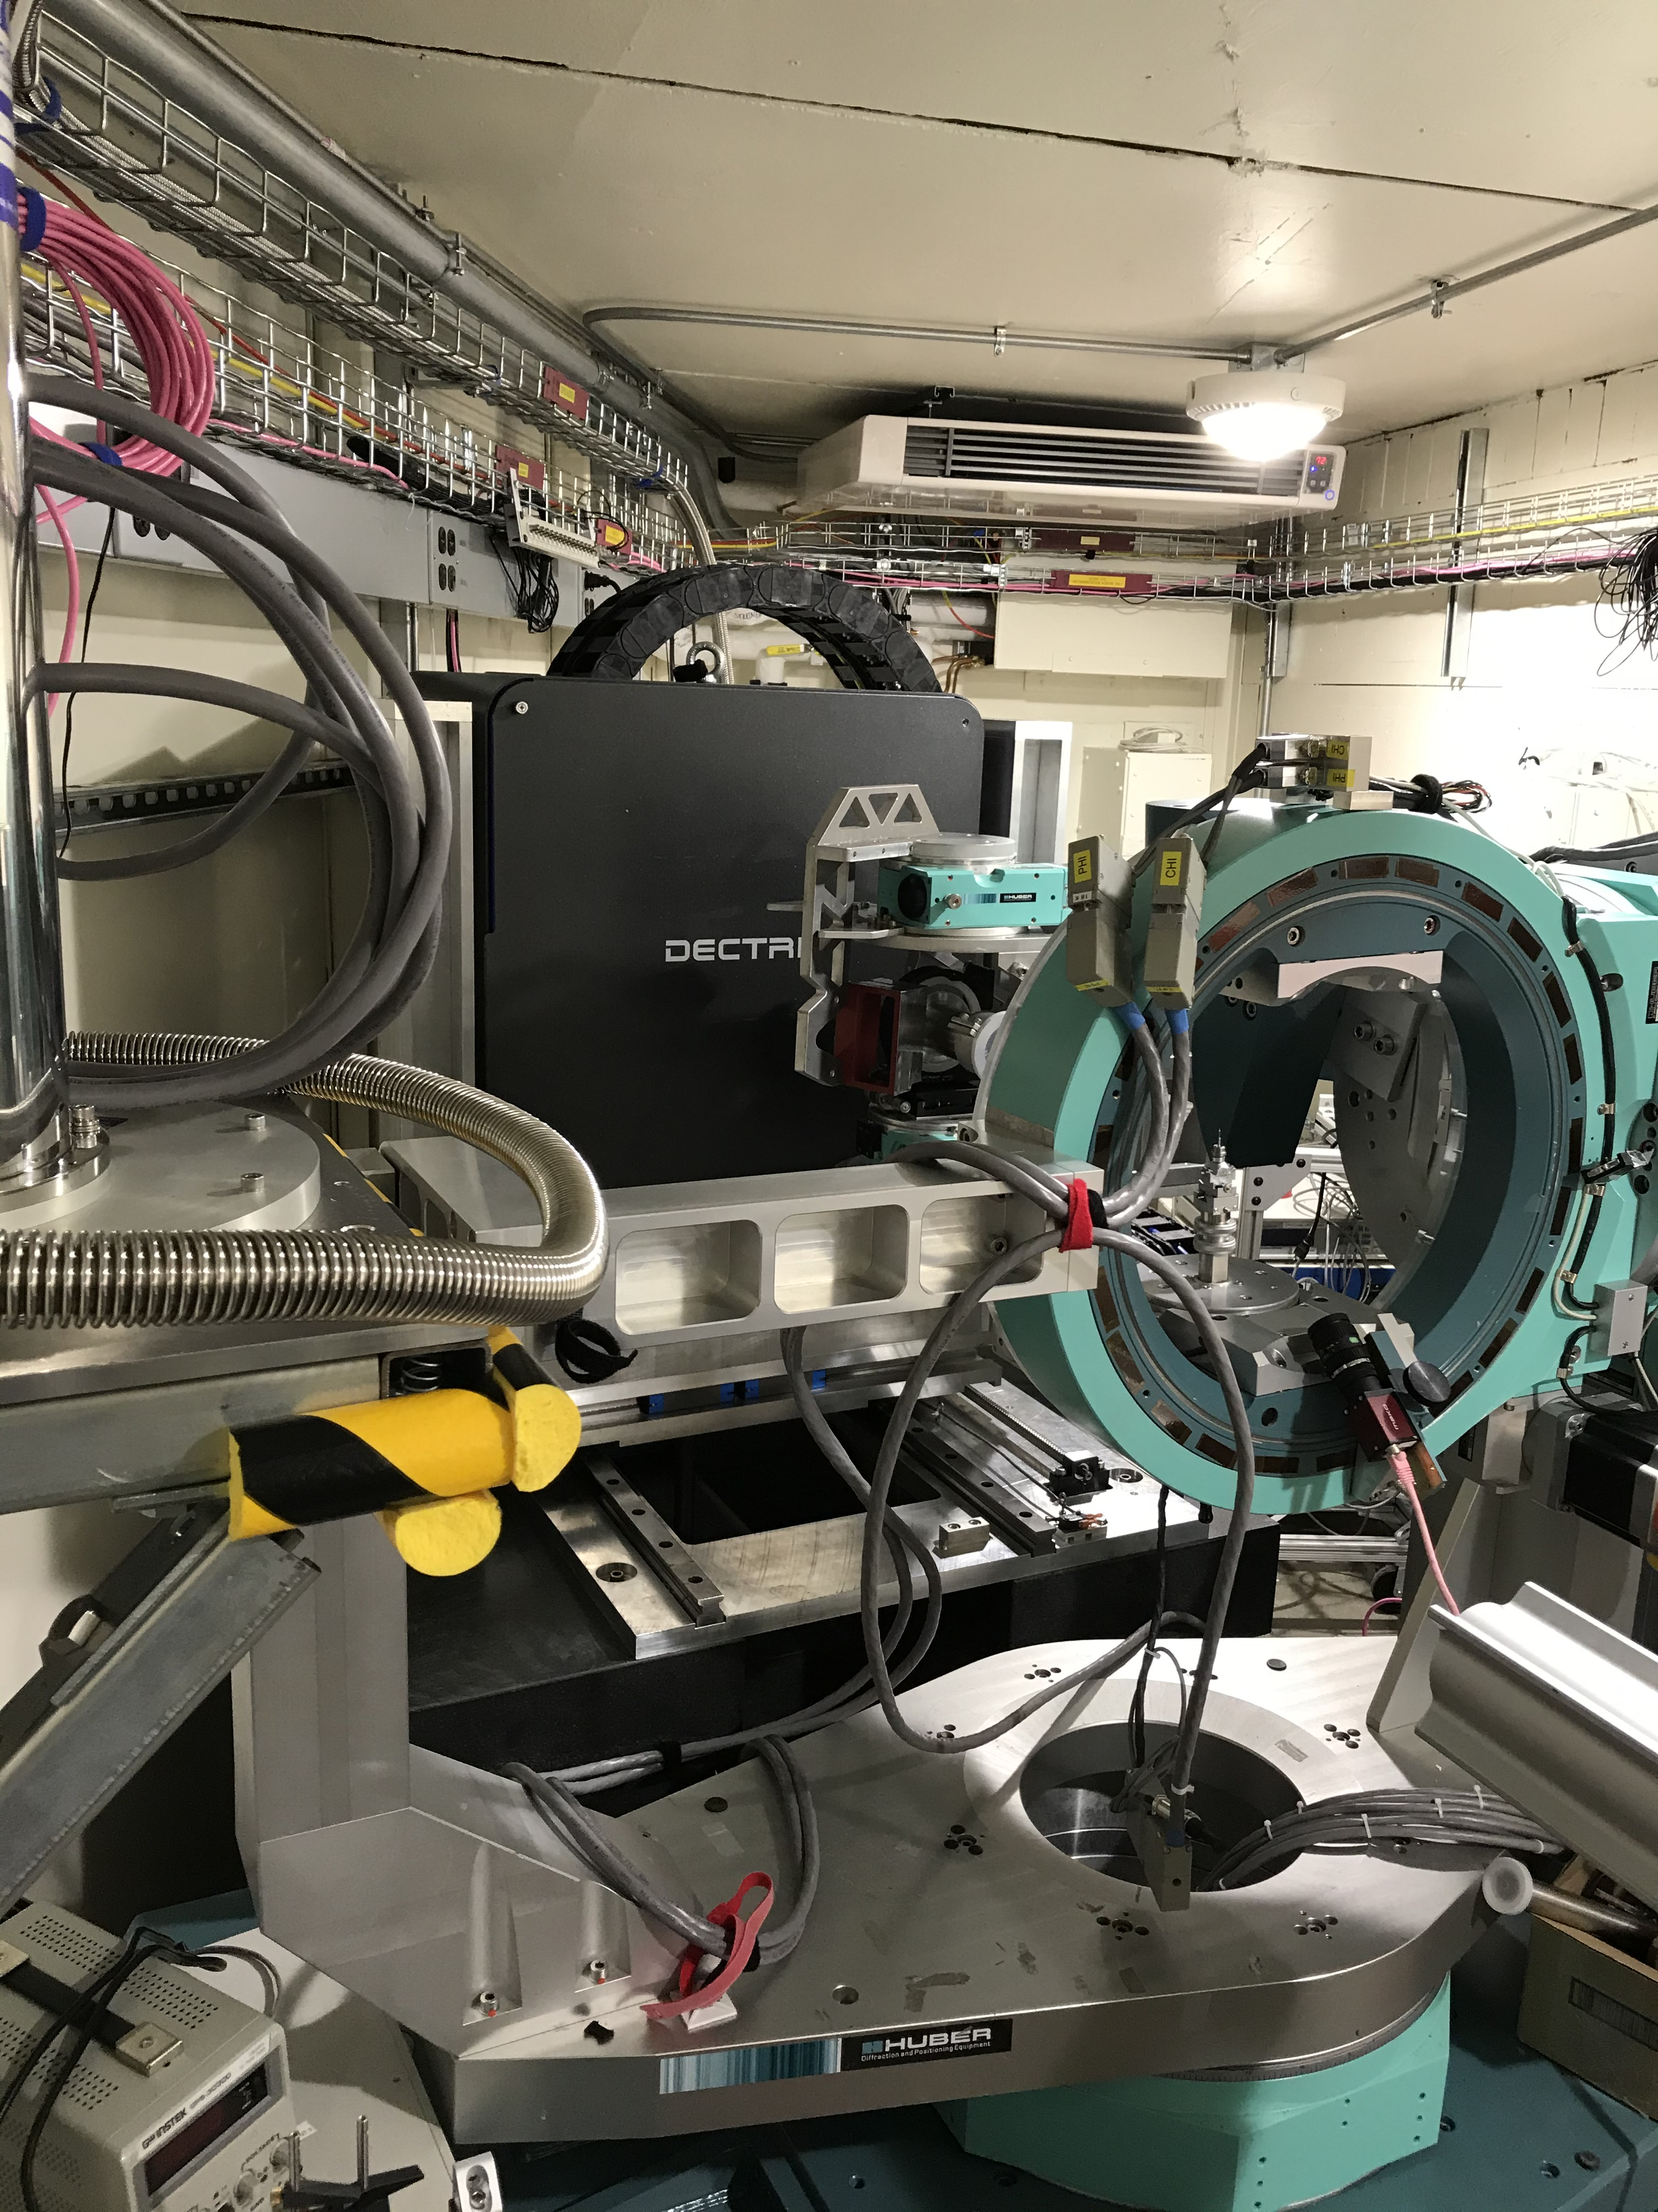
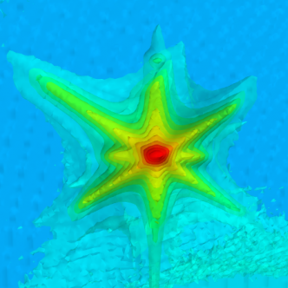
CLASSE Student Visit
“Buddy Talk” Cristian Pompey | Steven Brandon | Jacob Ruff

Slide 2
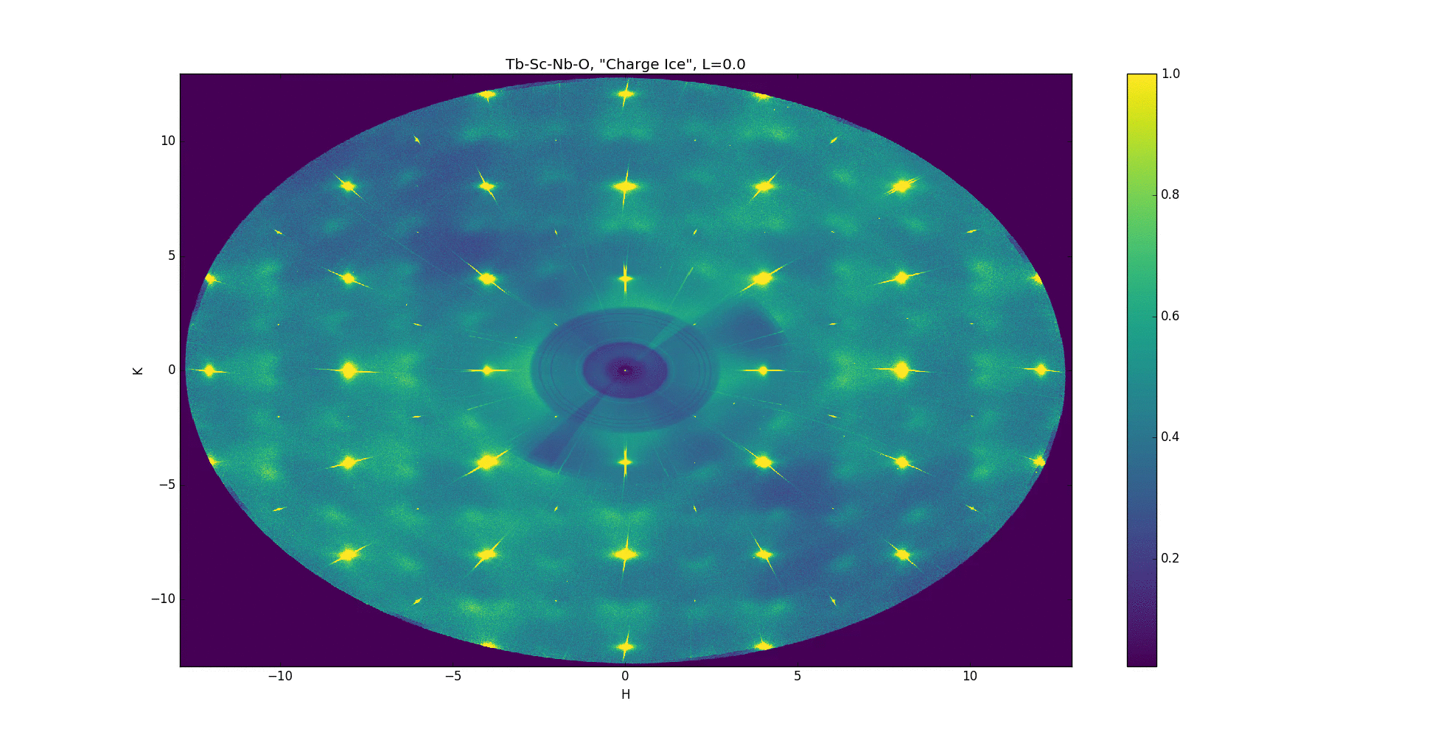
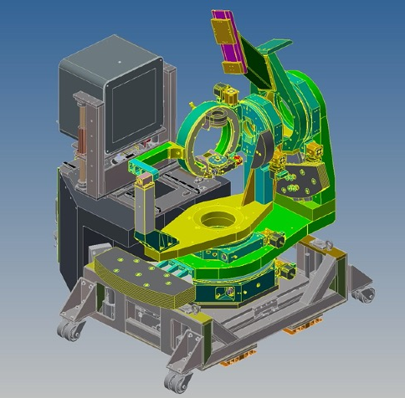
Uncover intertwined quantum correlations of spins, charges, and orbitals, at low temperatures and spanning entire phase diagrams
Science Mission |
Core Capabilities |
High-throughput characterization of quantum materials in reciprocal space (“Q-space”), via both resonant and non-resonant scattering
What is QM2?

Slide 3
Core Capabilities | Mapping extensive regions of reciprocal space for single crystals and thin films |
<QM>² makes about 30 million distinct Q-measurements per second, with simultaneous sensitivity to strong and weak scattering features.
Thousands of 2D images are collected during 360º sample rotations. ~2x10¹⁰ Q measurements in a single temperature point.
We can study weak superstructures, local distortions, phonons, density waves, etc, at temperatures as low as T~3.5K.
Data challenges are significant, but information content is unprecedented.
HDRM @ ID4B – High Dynamic Range Mapping with Pilatus6M
What can QM2 do?
Notes:
What can HP-Bio do?

Slide 4
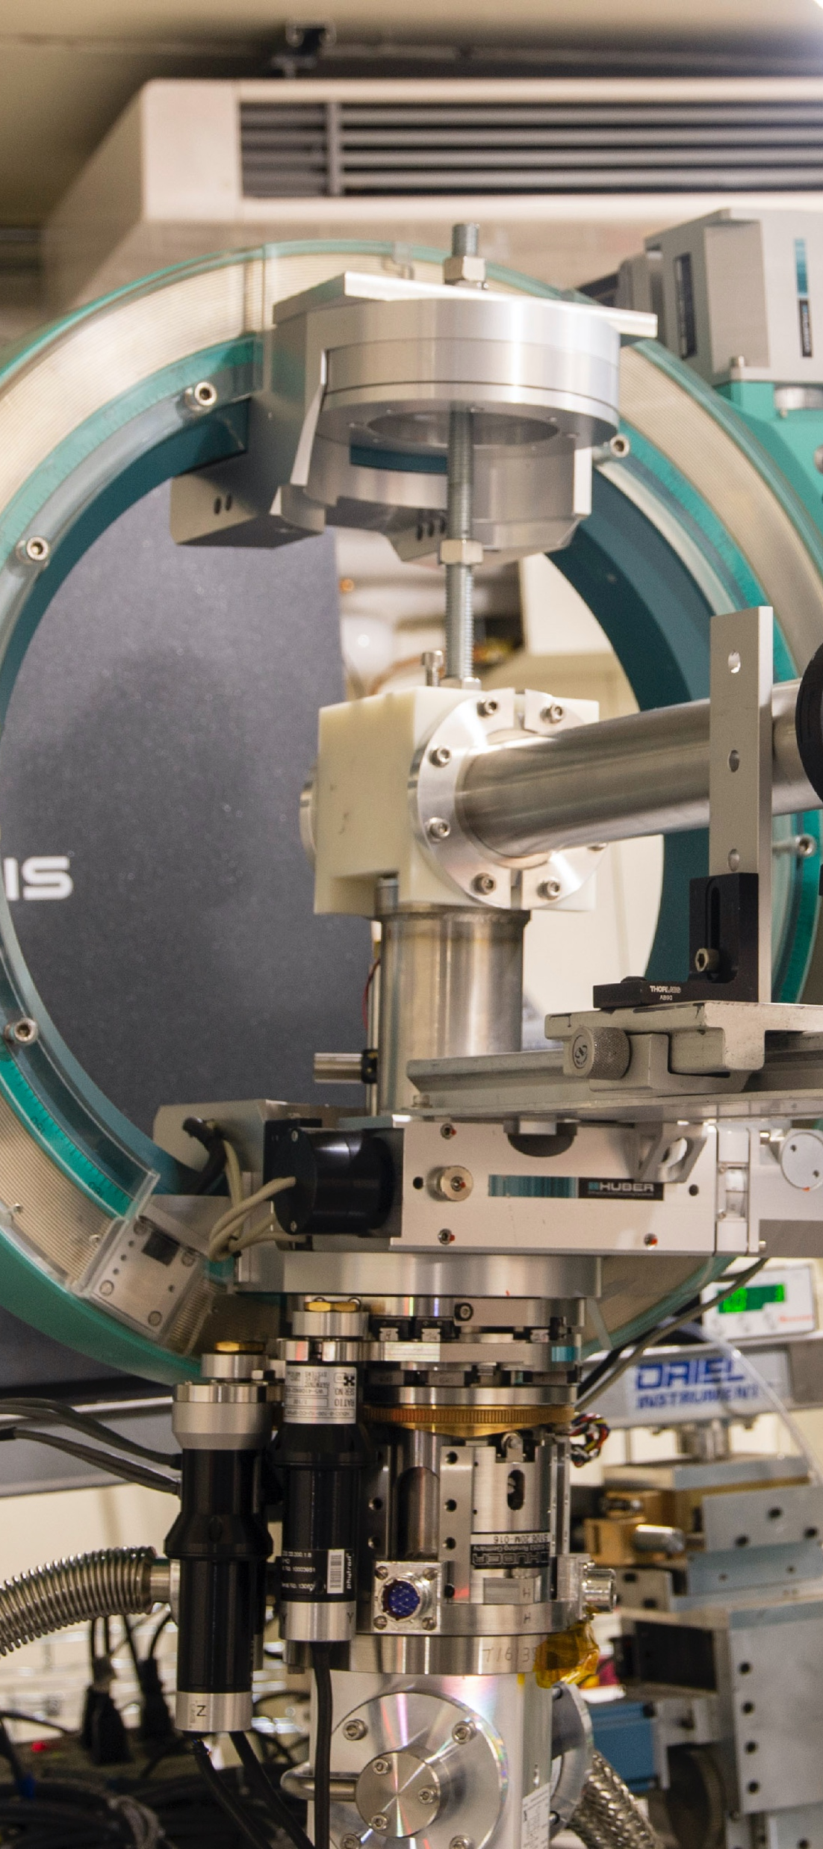
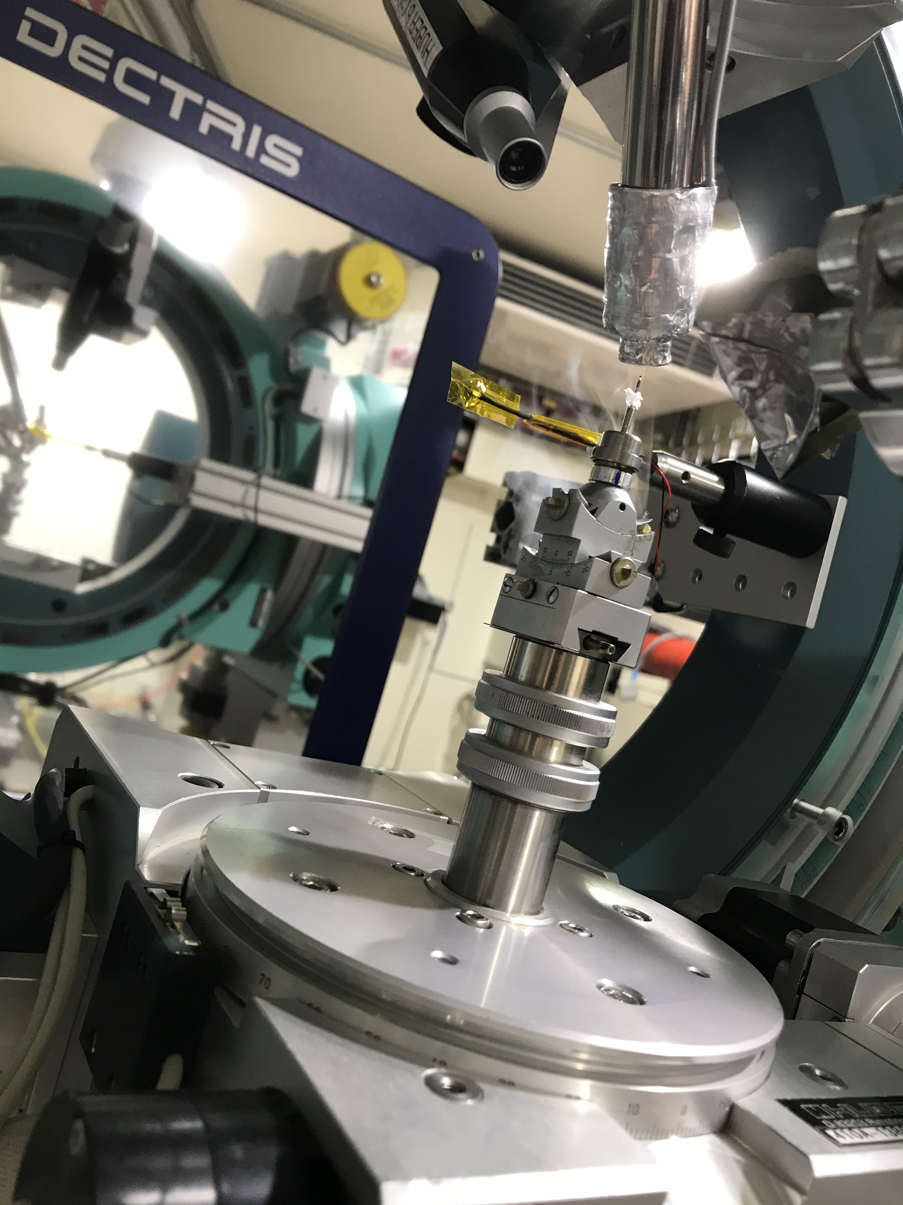
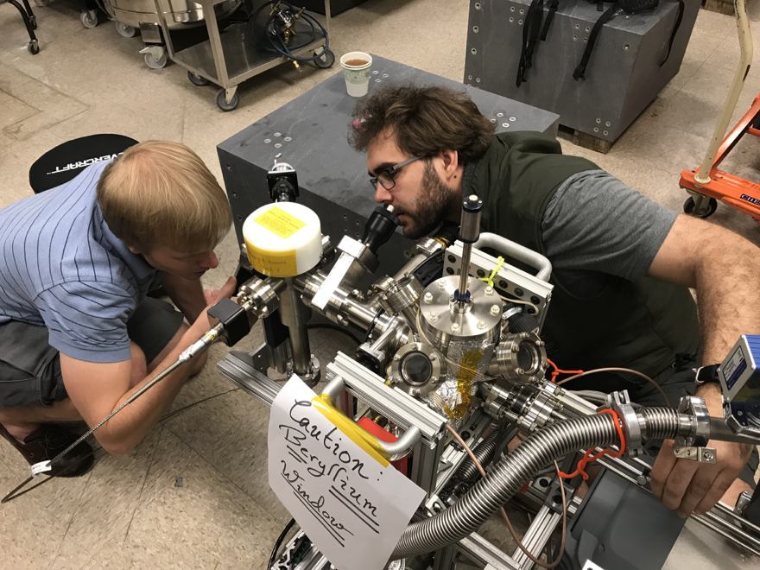
3.5K-300K Cryostat
11K-500K Cryostream
UHV X-ray Chamber
What can QM2 do?
Notes:
What can HP-Bio do?

Slide 5
Challenges | Need tools to predict coverage before scanning, and tools to monitor digitized signals |
Challenge (1) Users want to know how to choose a range of crystal angles to scan that will cover the range of “reciprocal space” they are interested in. The planning code has to run much faster than the conversion code (takes ~ 3 hours).
Challenge (2) Many of the signals we care about during rapid “fly-scanning” are digitized signals from the particle accelerator or other experimental equipment (temperatures, pressures, etc.) We don’t have a way to monitor these digital signals (known as EPICS PVs) during flyscans.
Notes:
What can HP-Bio do?

Slide 6
Challenges | Need tools to predict coverage before scanning, and tools to monitor digitized signals |
Challenge (1) Users want to know how to choose a range of crystal angles to scan that will cover the range of “reciprocal space” they are interested in. The planning code has to run much faster than the conversion code (takes ~ 3 hours).
Cristian’s Project
Notes:
What can HP-Bio do?

Slide 7
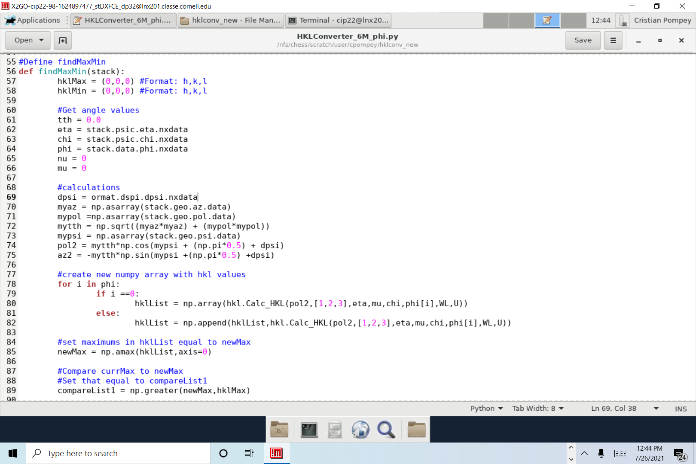
A lot of my experience has been understanding the concepts behind the code I will have to write
The way that I am currently coding the planning tool is as a function within the conversion code
As of right now it takes in a stack file that holds the data points of the angle orientations including phi
For each of these phi angle points, it tracks the range of the HKL values
With this, users can now have confidence before hand that the detector will cover the entire range of reciprocal space that they will need

Slide 8
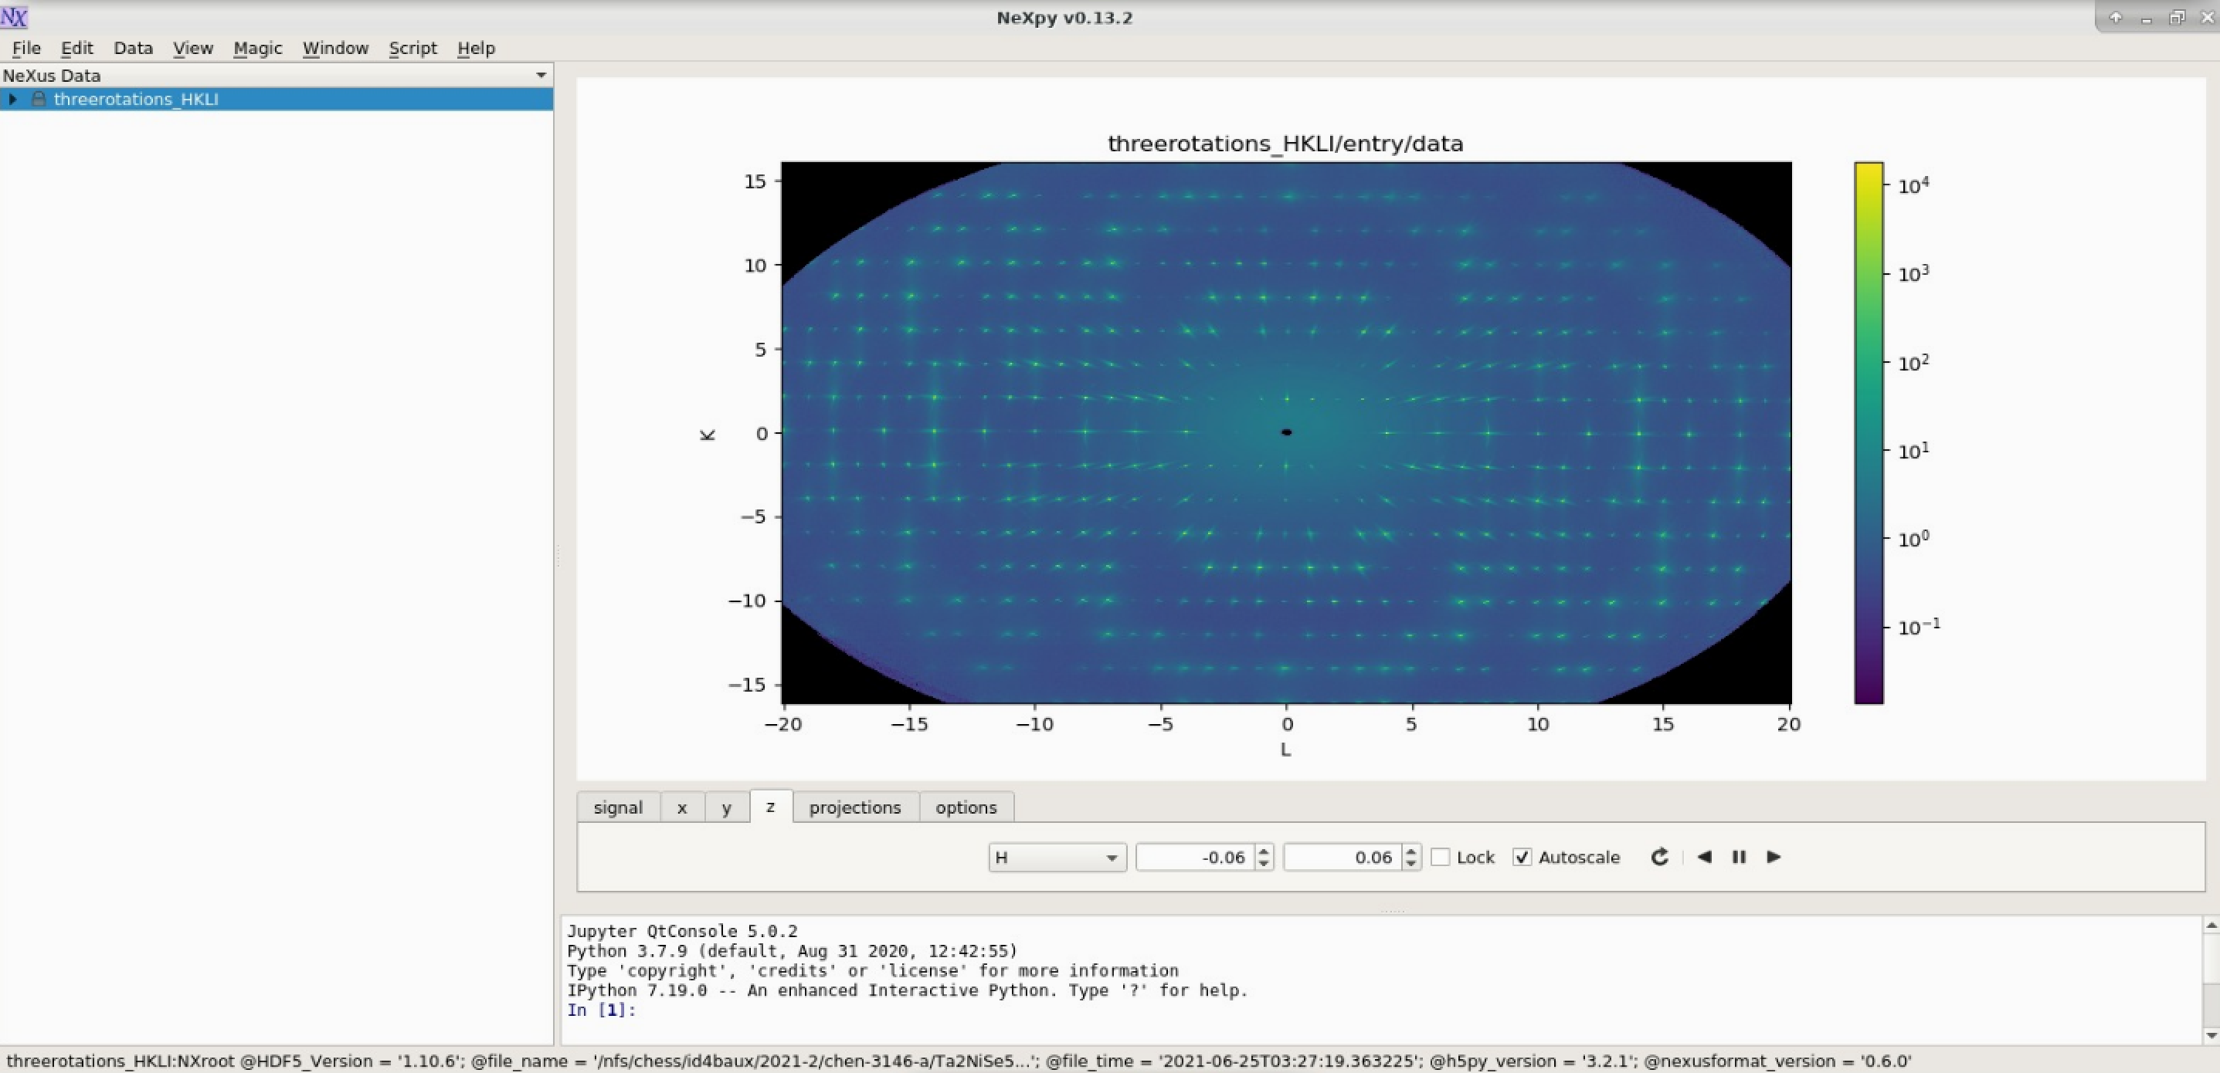

Slide 9
Challenges | Need tools to predict coverage before scanning, and tools to monitor digitized signals |
Steve’s Project
Challenge (2) Many of the signals we care about during rapid “fly-scanning” are digitized signals from the particle accelerator or other experimental equipment (temperatures, pressures, etc.) We don’t have a way to monitor these digital signals (known as EPICS PVs) during flyscans.
Notes:
What can HP-Bio do?

Slide 10
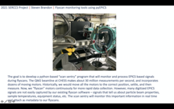
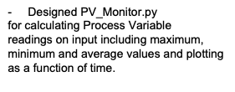
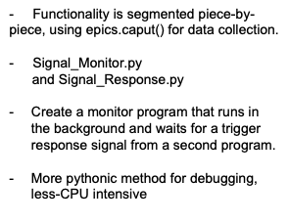
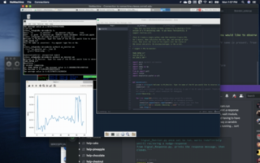
Notes:
What can HP-Bio do?

Slide 11
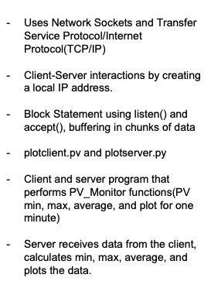
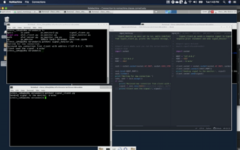
Notes:
What can HP-Bio do?

Slide 12
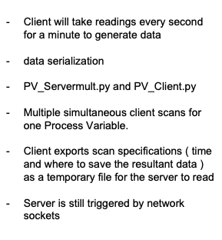
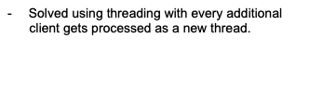
Notes:
What can HP-Bio do?

Slide 13
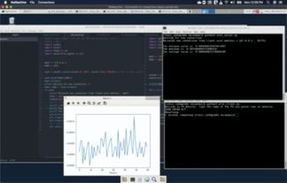
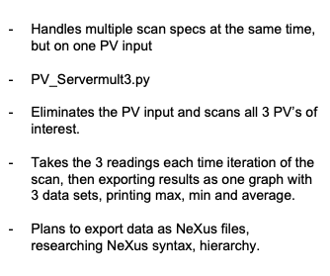
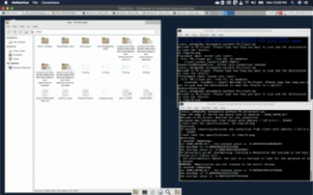
Notes:
What can HP-Bio do?

