Slide 1

Using FLUKA to study Radiation Fields in ERL Components
Jason E. Andrews,
University of Washington
Vaclav Kostroun, Mentor

Slide 2
Previously established…
Ionizing radiation
Electrons, photons, and neutrons
Cascades
Analytic analysis prohibitively complex
Need to use the Monte Carlo method
γ
γ
e⁺
e⁺
γ
e–
e–
e–
γ
e–
e–
e–
e–
γ
e⁺

Slide 3
“A calculation using the Monte Carlo method probes a physical system by tracking the history of a single primary particle and all generated secondaries, using probability density functions to randomly determine the outcome of particle-matter interactions. This process is repeated for many primaries, and from the statistics of this repeated sampling, the simulation results converge to the average behavior of the system.”
Does this mean we can just define a problem, run the software, and get the answer?

Slide 4
Yes, but only if we have infinite computing time.
Geometric increase in number of particles tracked
Regions of interest in phase space may be rarely probed by the simulation at hand
Rare events may contribute significantly to quantities we want to measure
How long does it take for a calculation to converge to the average behavior of the system?

Slide 5
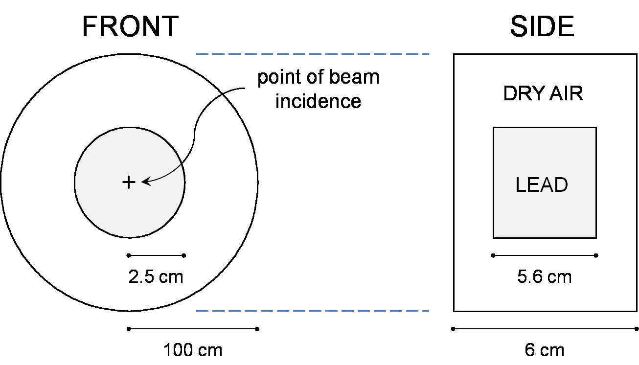
2 GeV electron beam on a lead target
Geometry of the simulation
Leptons and photons of energy less than 6.737 MeV are not transported (E_{c} ≈ 9.6 MeV for lead)
5 cycles are run with 10⁵ primaries per cycle

Slide 6
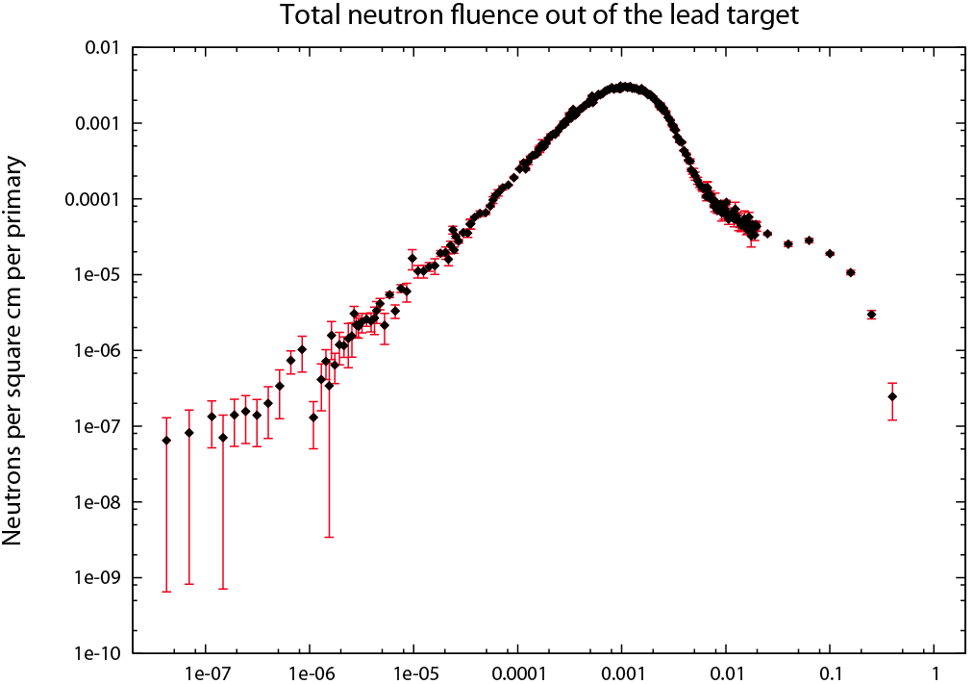
N
GeV
Computation time: 155 minutes

Slide 7
155 minutes is a problem.
Realistic geometries will be more complex
A greater fraction of the energy of the primaries will be deposited in the ‘targets’
Primaries will have greater energies
We need to cheat by changing the simulation, and cheating in Monte Carlo calculations is called “biasing.”
An un-biased simulation samples from ‘true’ probability distributions, resulting in histories that are meant to represent actual histories of real particles.
A biased simulation samples from distributions which are either biased in favor of rare events or which simplify particle transport.

Slide 8
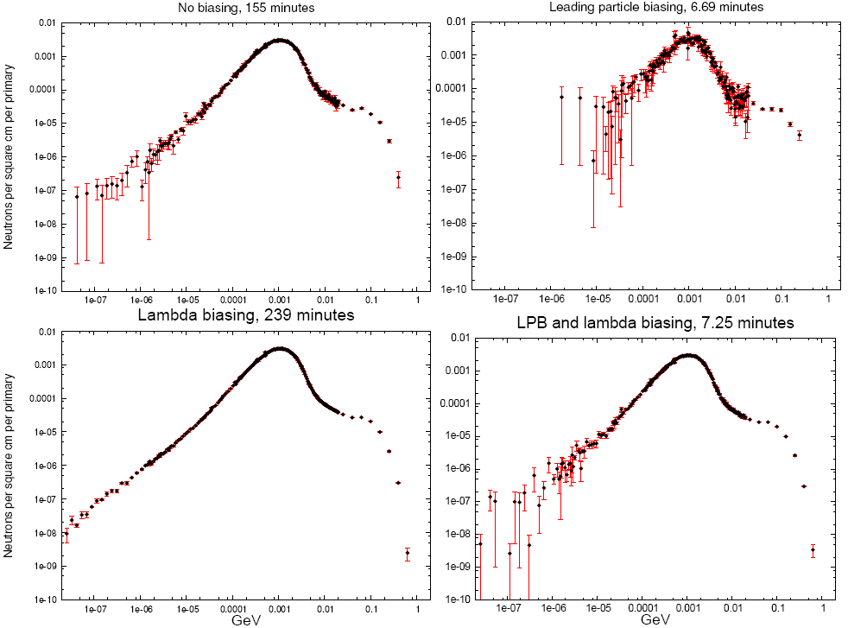

Slide 9
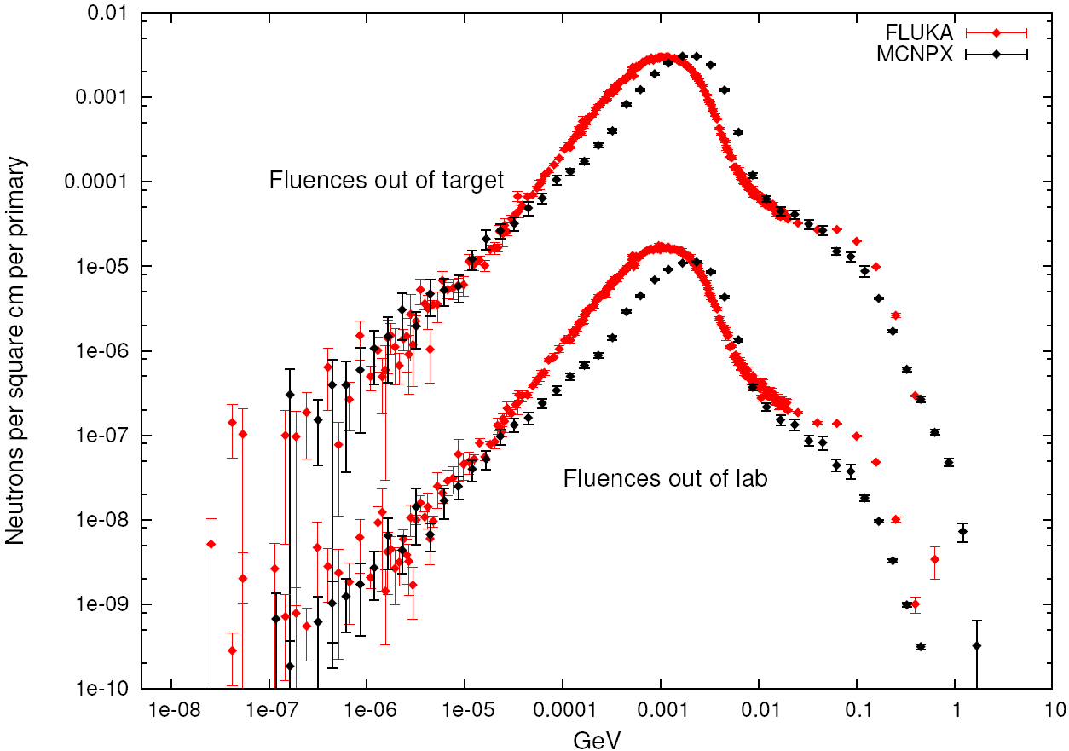
Comparison of FLUKA and MCNPX simulation data

Slide 10
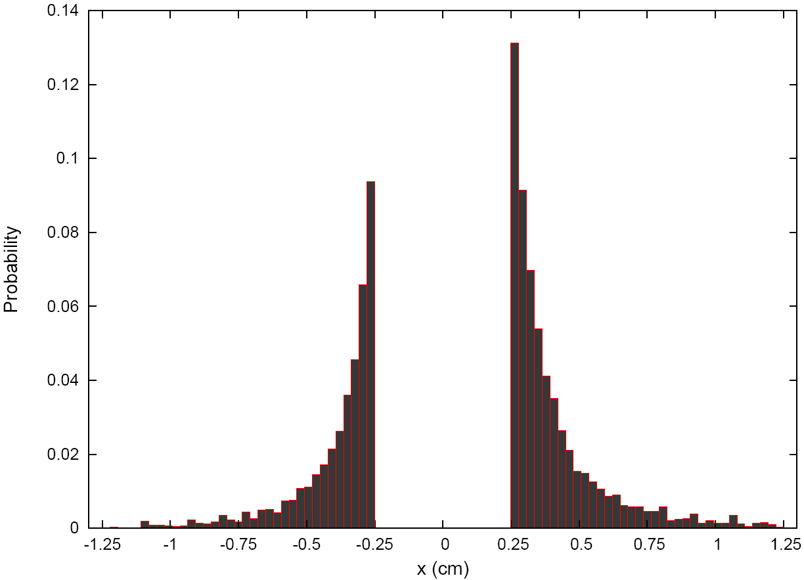
M7 Touschek collimation calculation
Touschek scattering is the collision of beam particles with one another, which results in beam loss.
Probability distribution of Touschek particles
This inevitable loss is controlled by collimating the particles at strategic locations.

Slide 11
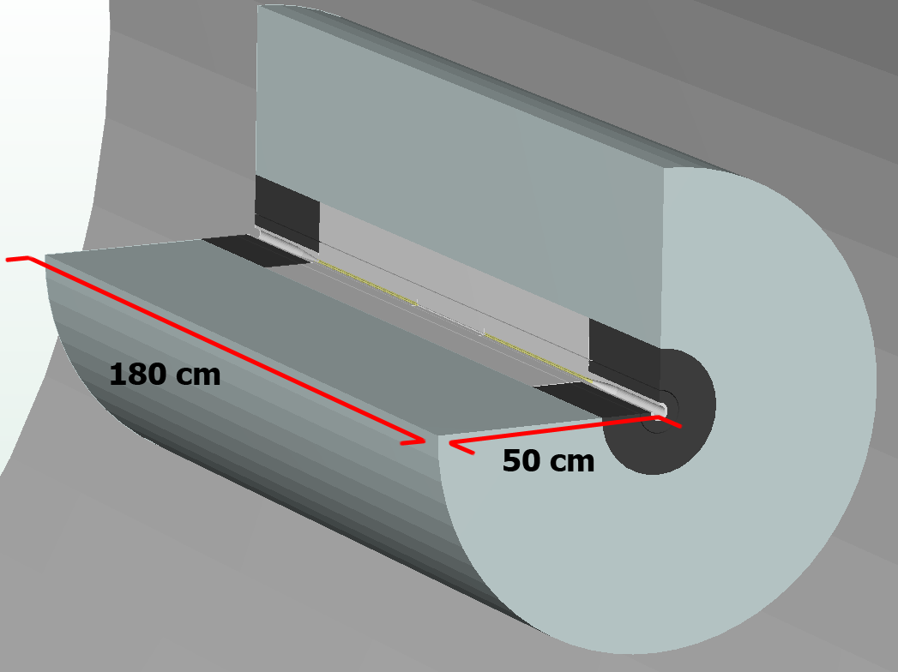

Slide 12
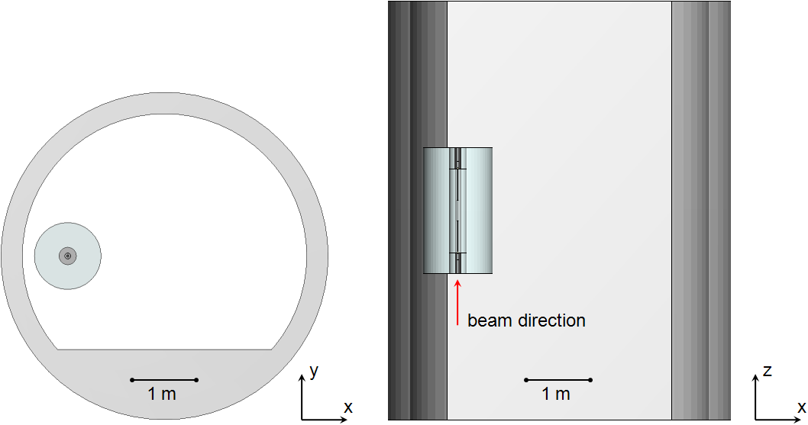
Geometry of the simulation
Both LPB and lambda biasing are implemented
7 cycles are run with 2.5·10⁵ primaries per cycle
Primary particles are initialized at 5 GeV

Slide 13
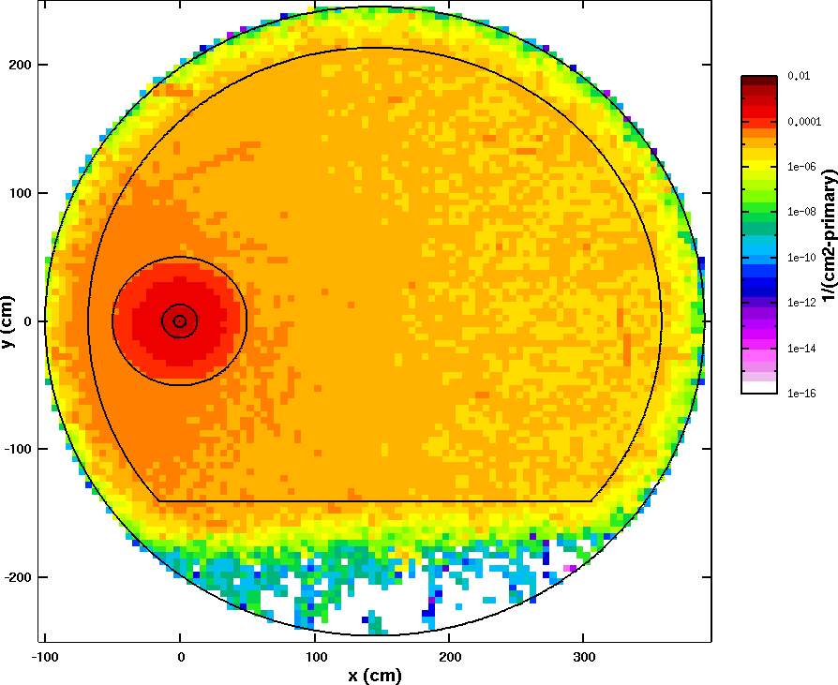
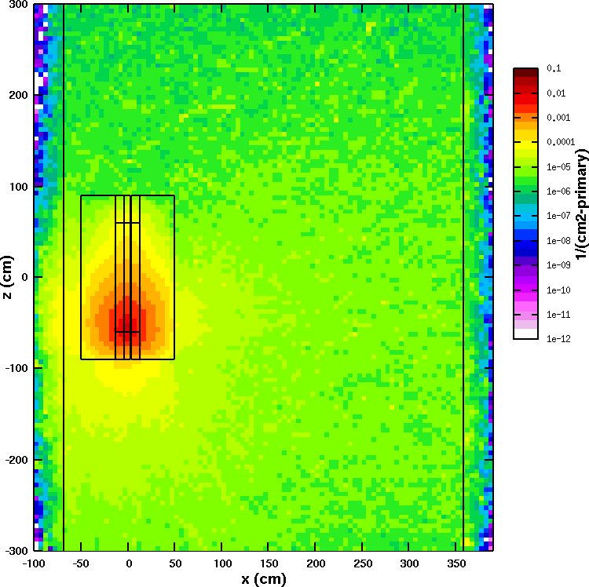
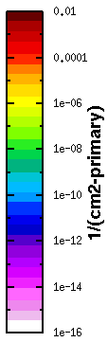
Neutrons per cm² per primary
xy-plane: z=0
xz-plane: y=0 (the plane of the beam)

Slide 14
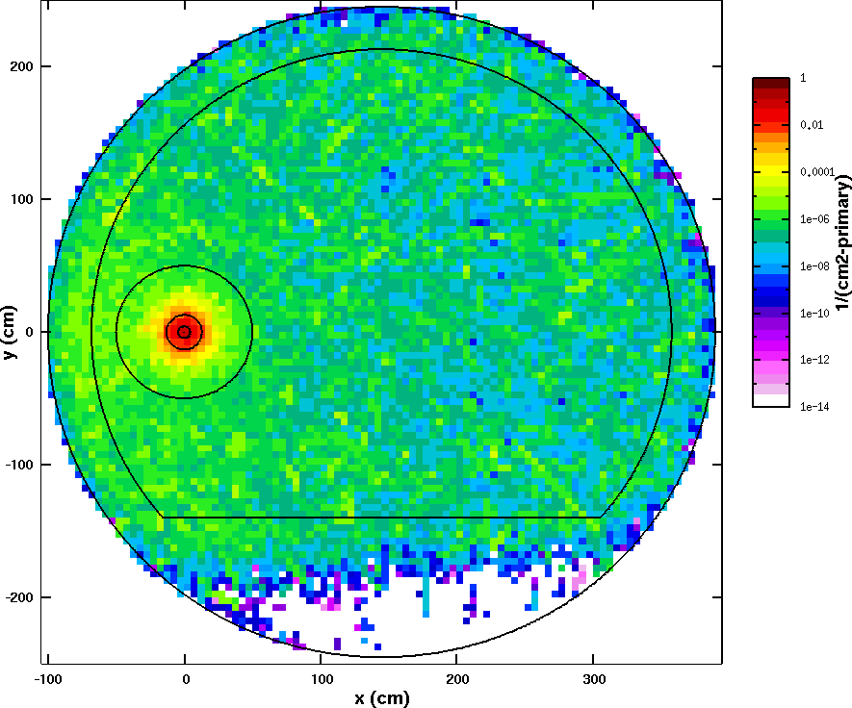
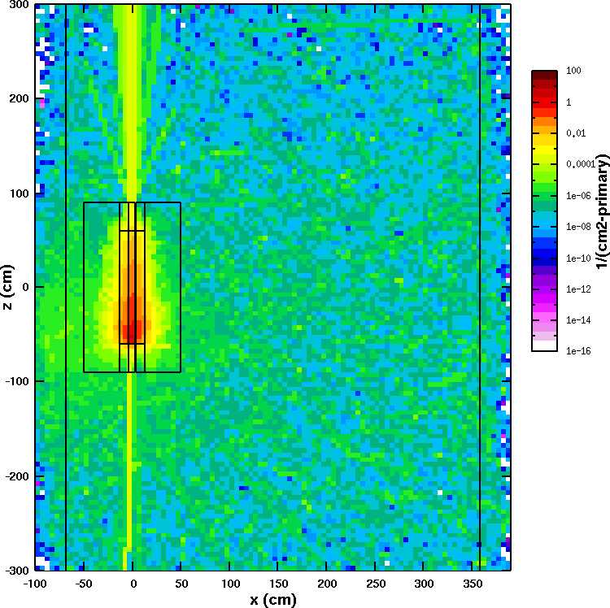
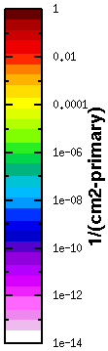
Photons per cm² per primary
xy-plane: z=0
xz-plane: y=0 (the plane of the beam)

Slide 15
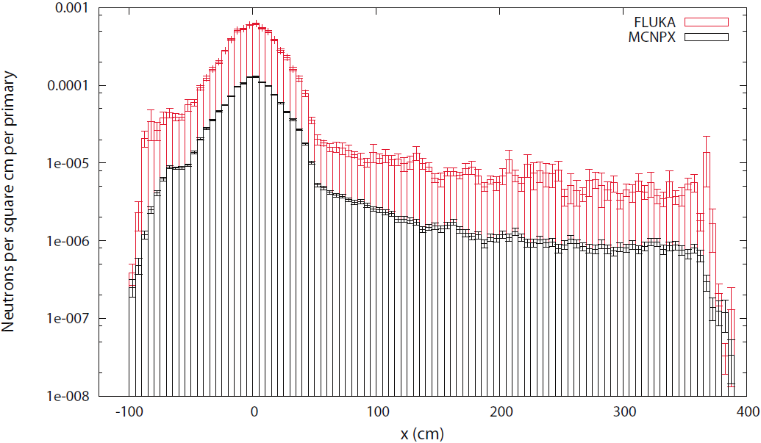
Neutrons per cm² per primary along the x-axis at y=z=0.

Slide 16
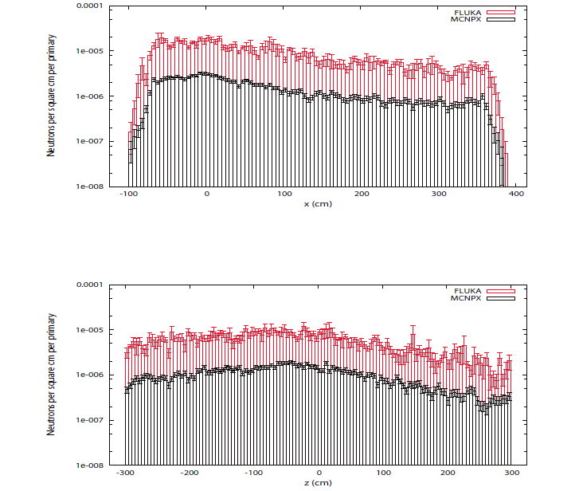
Neutrons per cm² per primary along the x-axis , one meter upstream from the back face of the collimator.
Neutrons per cm² per primary along the x-axis , one meter downstream from the front face of the collimator.

Slide 17
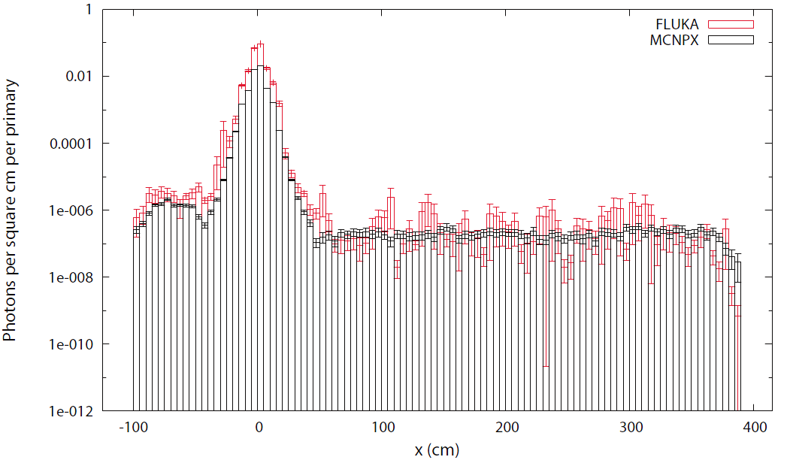
Photons per cm² per primary along the x-axis at y=z=0.

Slide 18
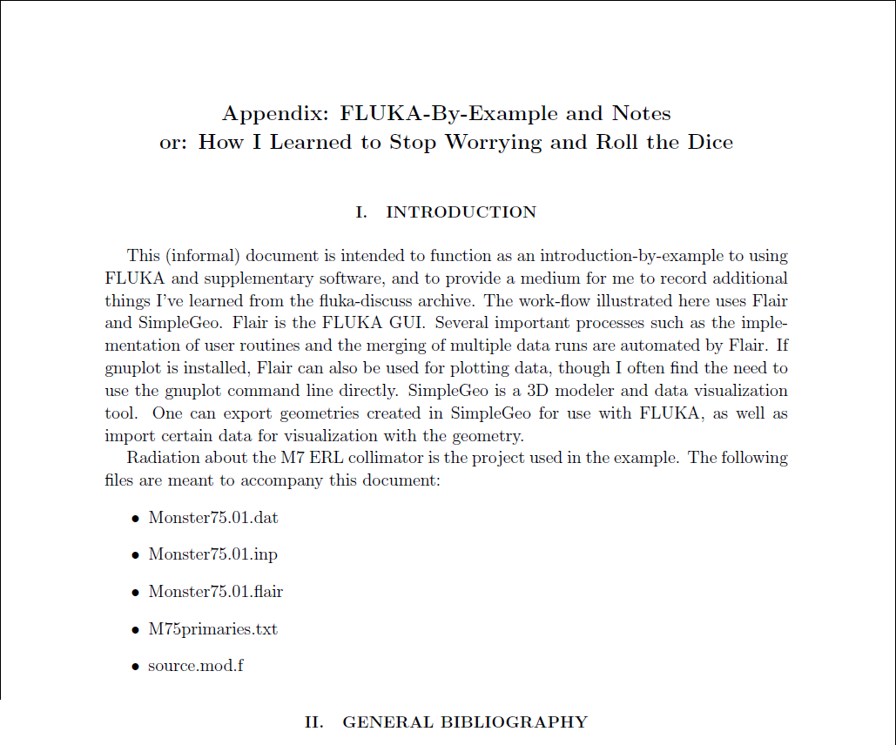
Future work: Determine the nature of the difference in neutron fluences.
There are several models in use for neutron transport at energies above 100MeV , so investigating how each code transports neutrons above this energy would be a good place to start.

Slide 19
Many thanks to Val Kostroun for teaching me much about nuclear physics, guiding me through the research, providing MCNPX data and inputs, and for letting me take my final exams in his office when I first arrived here at Cornell.
Many thanks as well to Georg Hoffstaetter, Ivan Bazarov, Lora Hine, Monica Wesley, and everyone else involved in the CLASSE REU this year.

