Slide 1
Analysis and Optimization of Orbit Correction Schemes
Arman Ballado

Slide 2
Project Description
Brief Introduction
Many sources of errors along the beam line
Loss of particle beam
Place BPMs and CMs to monitor and correct orbits
Goals
Evaluate the performance of a given configuration of BPMs and CMs
Optimize
Apply to a model of the Cornell ERL

Slide 3
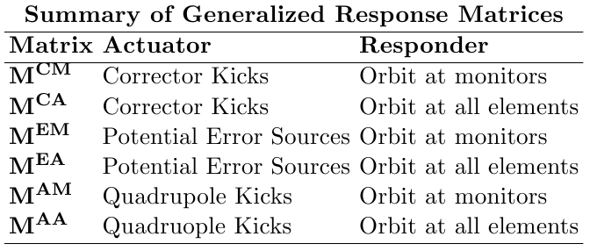
Generalized Response Matrix

Slide 4
Singular Value Decomposition

Slide 5
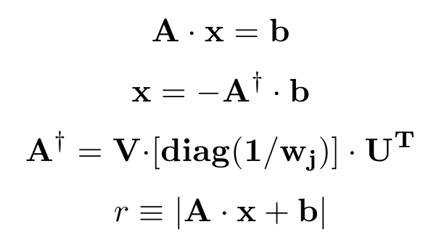

Slide 6
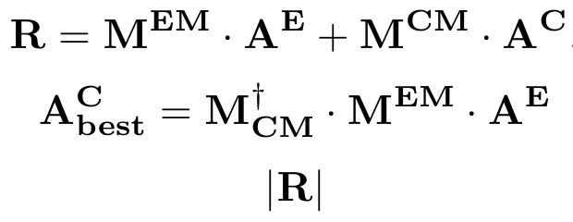
SVD Orbit Correction

Slide 7
Monitor Deficiency

Slide 8
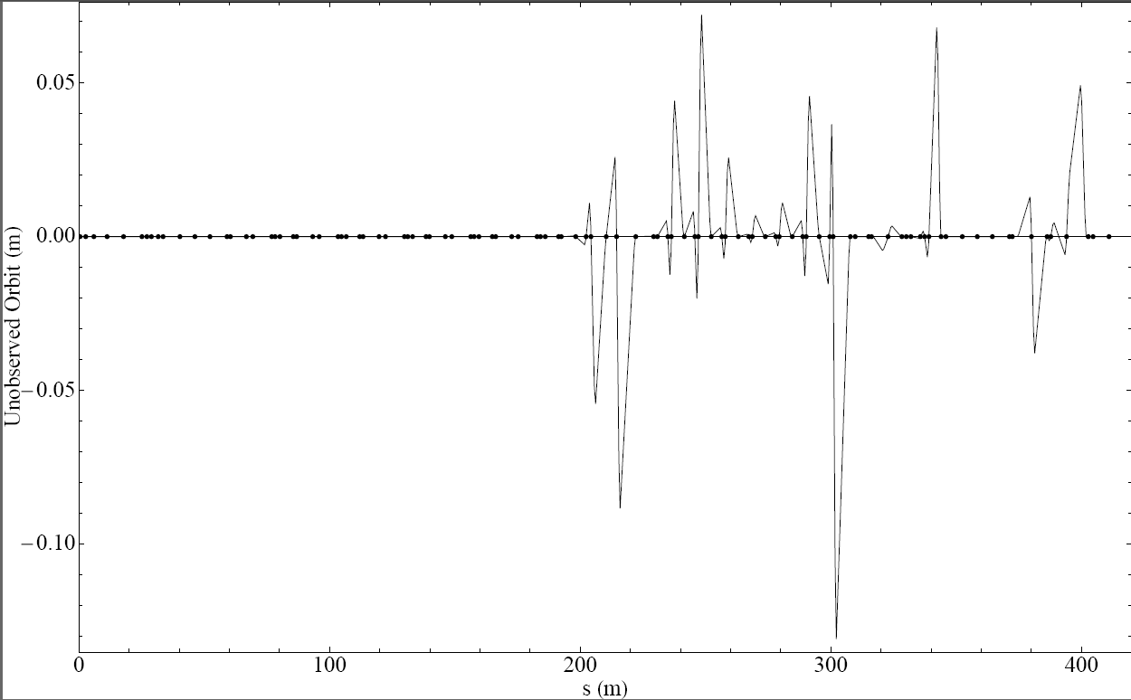
Large Unobservable Orbit

Slide 9
Monitor Redundancy

Slide 10
Monitor Redundancy

Slide 11
Corrector Deficiency I

Slide 12
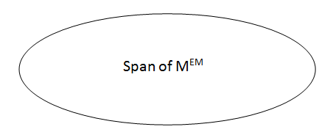
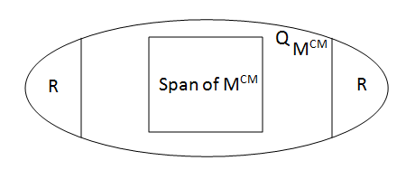
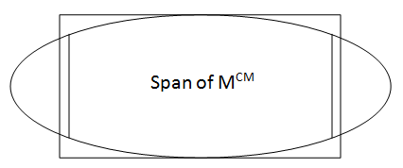
Corrector Deficiency II
Span of M^{EM}

Slide 13
Corrector Deficiency III

Slide 14
Corrector Redundancy

Slide 15
Sample Section: South Arc

Slide 16
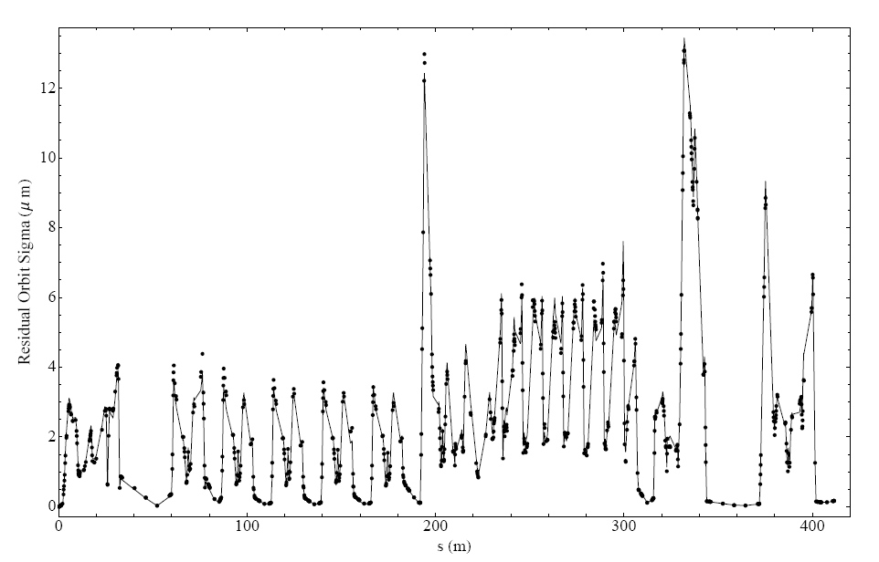
South Arc before Optimization
BPMs: 103 Correctors: 62 Error source: Quadrupole x-offset  of10m

Slide 17
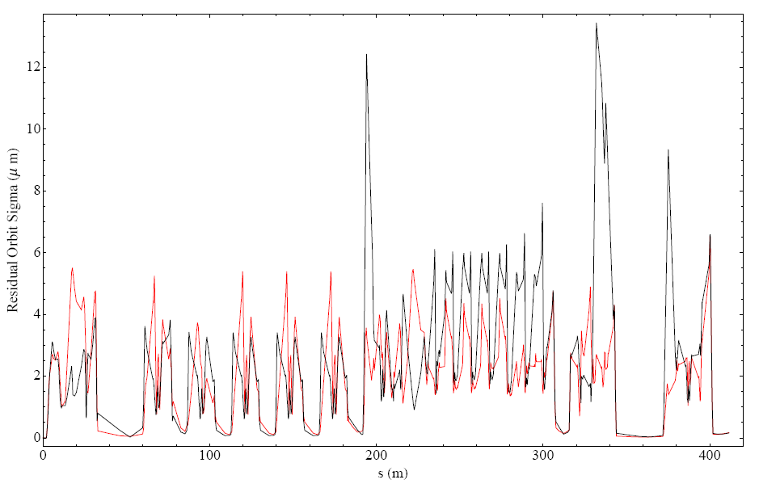
South Arc after Optimization
BPMs: 103 Correctors: 58 Error source: Quadrupole x-offset  of10m

Slide 18
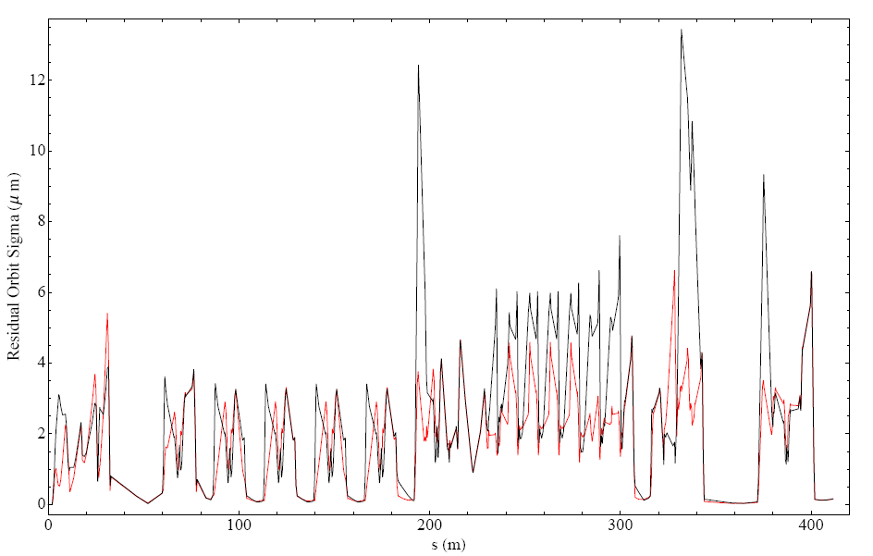
Corrector Optimization Only
BPMs: 103 Correctors: 53 Error source: Quadrupole x-offset  of10m

Slide 19
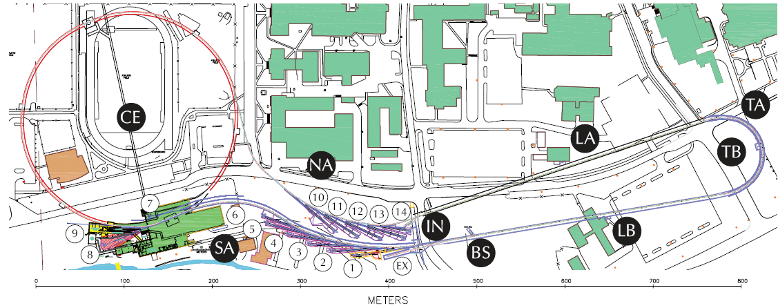
Full ERL Lattice . . .
Simply generate the response matrices . . .

