Slide 1
Effects of reflections on TE-wave measurements of electron cloud density
Kenneth Hammond
Mentors: John Sikora and Kiran Sonnad

Slide 2
Overview
Need to measure electron cloud (EC) density
TE-wave transmission method
Wave transmitted and received by BPM buttons
EC acts as a dielectric
Modulations in EC affect wave speed and thus the phase at the receiver

Slide 3
Overview
Determines spatial average EC density
Data interpretation
Fourier transform of transmitted wave is analyzed
Modulations in phase appear as frequency sidebands

Slide 4
Overview
Challenges
Irregular beam pipe geometry
Cross-section makes theoretical modeling difficult
Numerical simulation is necessary
Amplitude modulation
Can occur in the presence of constant magnetic fields
Reflections
Primarily due to changes in cross-sectional geometry
Can greatly affect average phase advance

Slide 5
Overview
Tasks
Use physical waveguide to confirm accuracy of simulation
Simulate beam pipe with CESR geometry
Measure changes in phase advance brought about by changes EC density and reflections

Slide 6
The Physics of Waveguides
Resonance
In practice, reflection will occur
Waveguide exhibits properties of a resonant cavity
Standing waves form at wavelengths harmonic with waveguide length

Slide 7
The Physics of Waveguides
f ² = an² + b²
a = (c/2L)²
b = f_{c}

Slide 8
The Physics of Waveguides
Phase advance and ΔΦ
Dispersion relation:
Phase velocity:
Phase advance:
“Phase shift”:

Slide 9
Simulation
VORPAL software models waveguide system numerically
Input boundary conditions
Conductor walls
Transmitting antenna
Solve Maxwell’s Equations

Slide 10
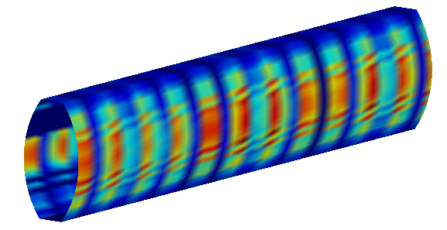
Simulation
Special features
Grid boundaries
Automatically ascribes perfect-conductor boundary conditions to specified surfaces
Cubic cells may be “cut” diagonally

Slide 11
Simulation
Special features
Particles
Distribution can be controlled
Simulation accounts for positions, velocities, and forces

Slide 12
Simulation
Special features
PML (perfectly matched layer) boundaries
Absorb all incident waves
Allows simulation of a segment of an infinite pipe with no reflections

Slide 13
Simulation
Differences with physical measurements
Time scale
Most simulations modeled the system for 70ns
Longer simulations exhibit roundoff error
Frequency sweeps are not practical

Slide 14
Experiments
#1: Phase shifts without reflection
Multiple trials at different electron densities
PML
PML
ρ
measure voltage

Slide 15
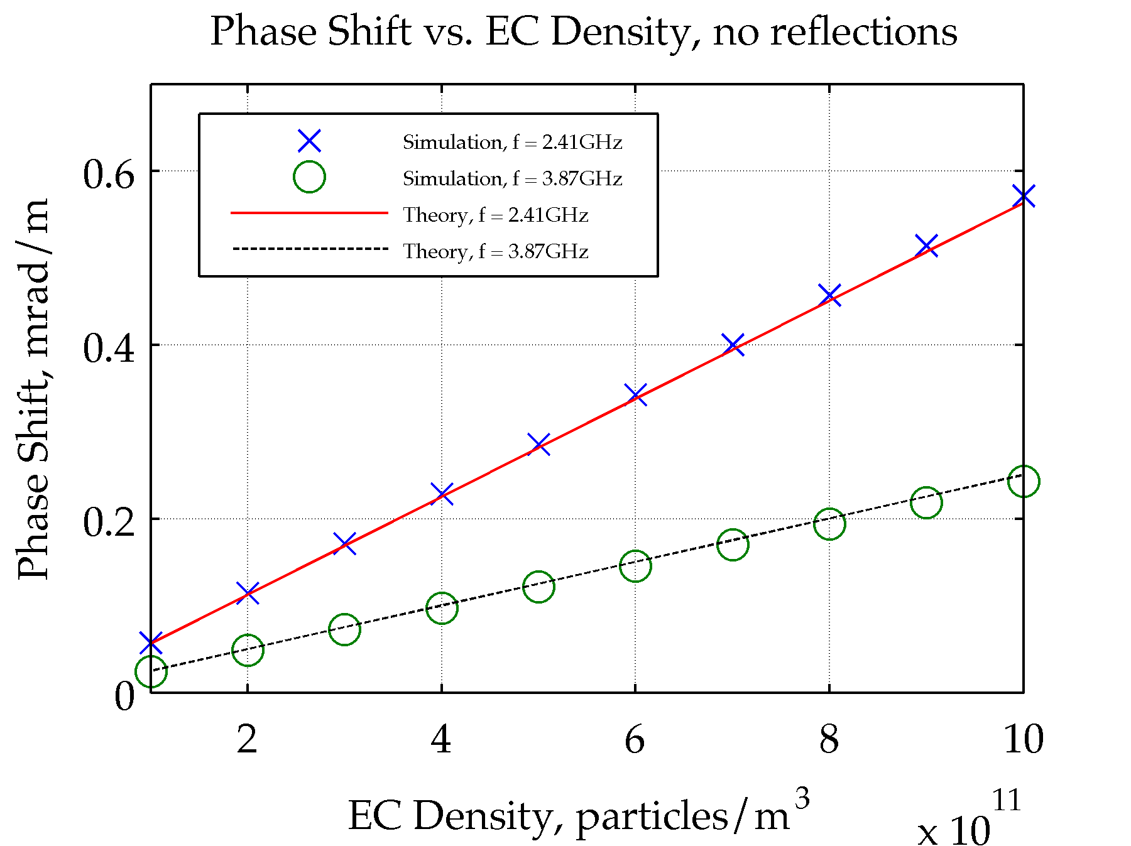
Results
#1: Phase shifts without reflection

Slide 16
Experiments
#2: Phase shifts with reflection
Add conducting protrusions
Transmit waves at resonant frequencies to maximize reflection
PML
PML
ρ
measure voltage

Slide 17
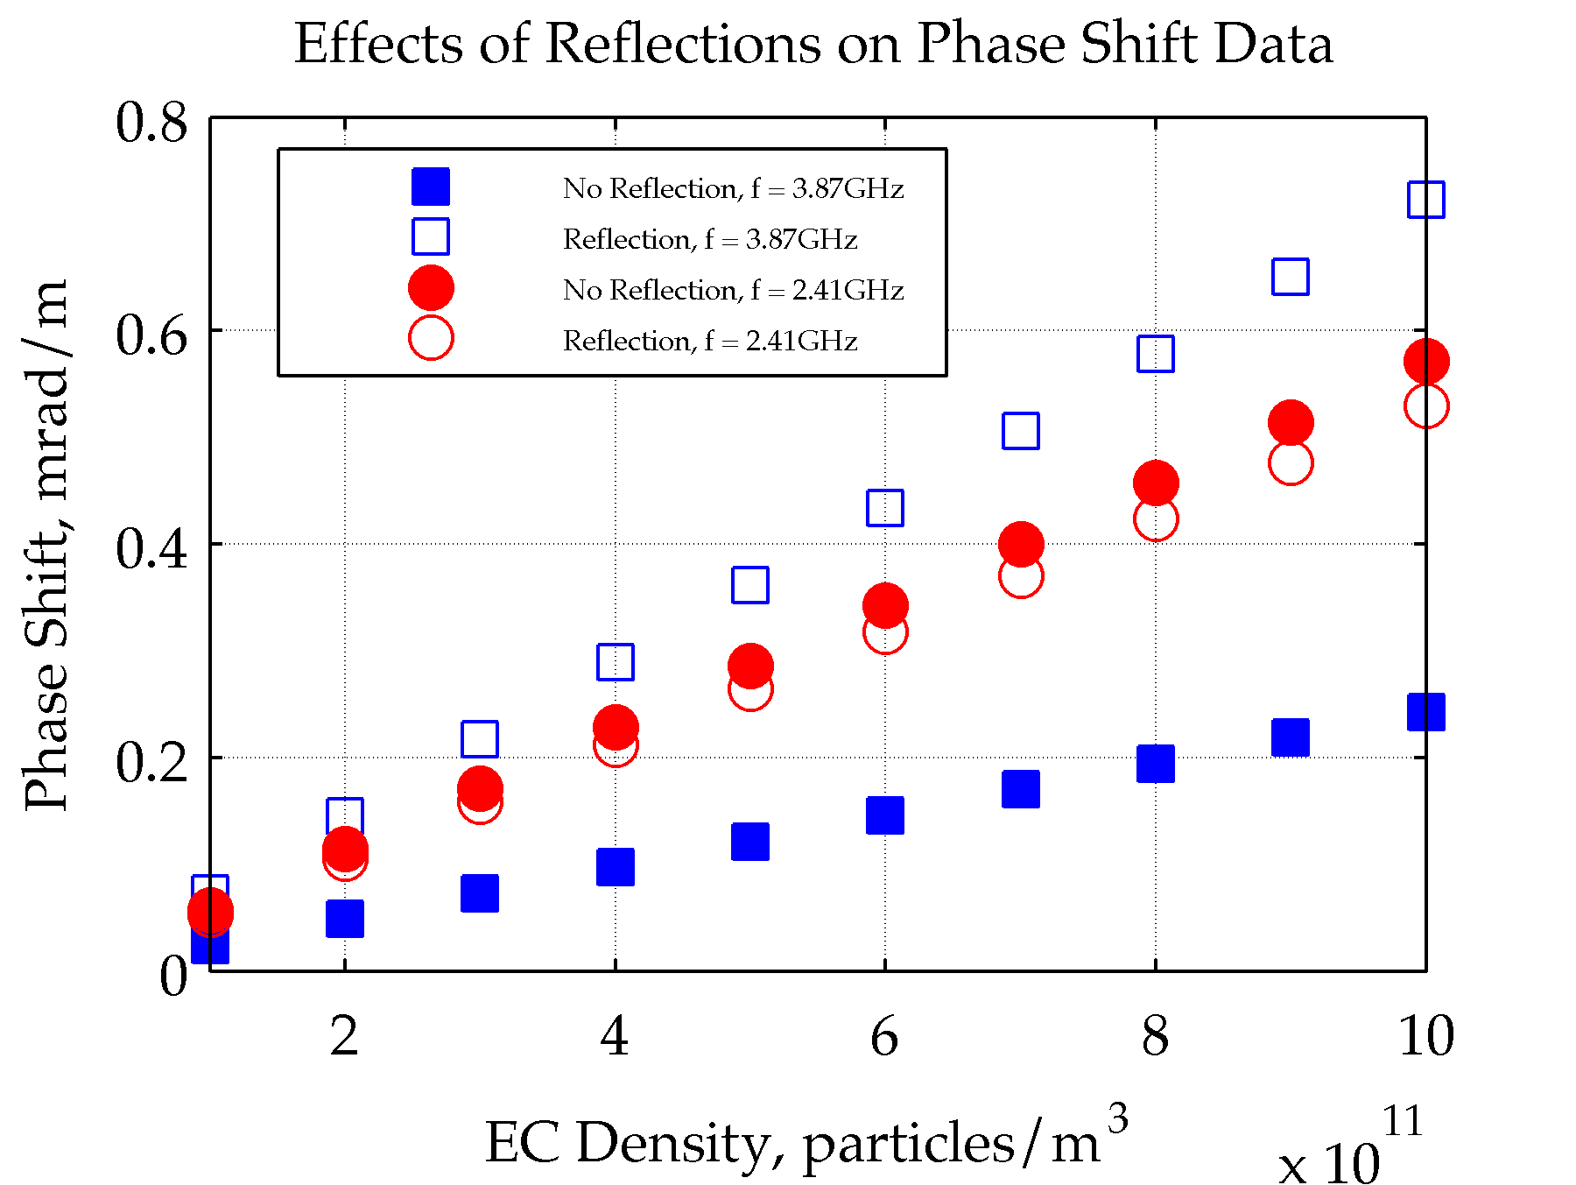
Results
#2: Phase shifts with reflection

Slide 18
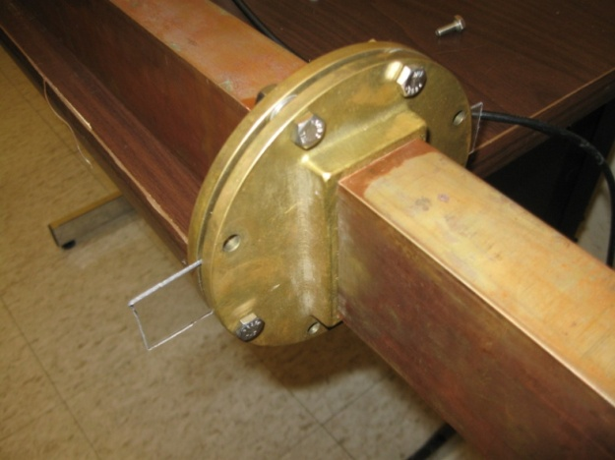
Results
Physical evidence in support of inconsistent phase shifts
Transmission through a plastic dielectric

Slide 19
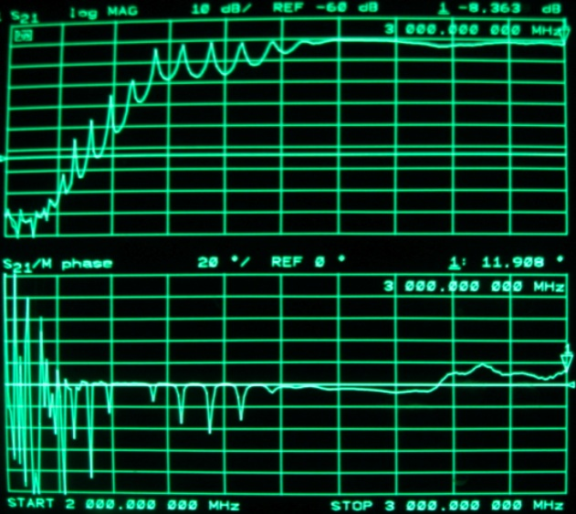
Results

Slide 20
So, what next?
Simulate phase shifts at more frequencies
Streamline the method for extracting phase shift
Study phase shifts for different electron cloud distributions

Slide 21
Acknowledgments
Special thanks to
John Sikora
Kiran Sonnad
Seth Veitzer

Slide 22
Effects of reflections on TE-wave measurements of electron cloud density
Kenneth Hammond
Mentors: John Sikora and Kiran Sonnad

Slide 23
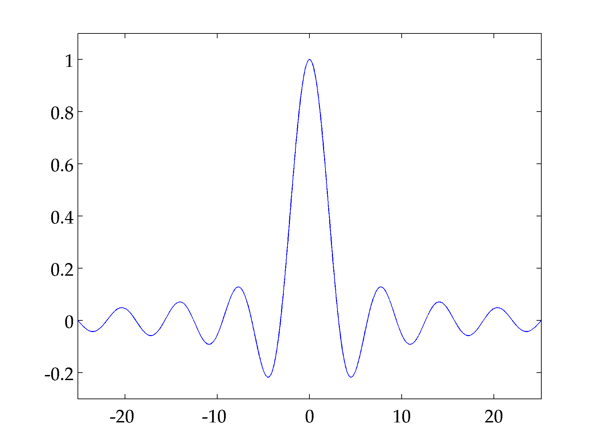
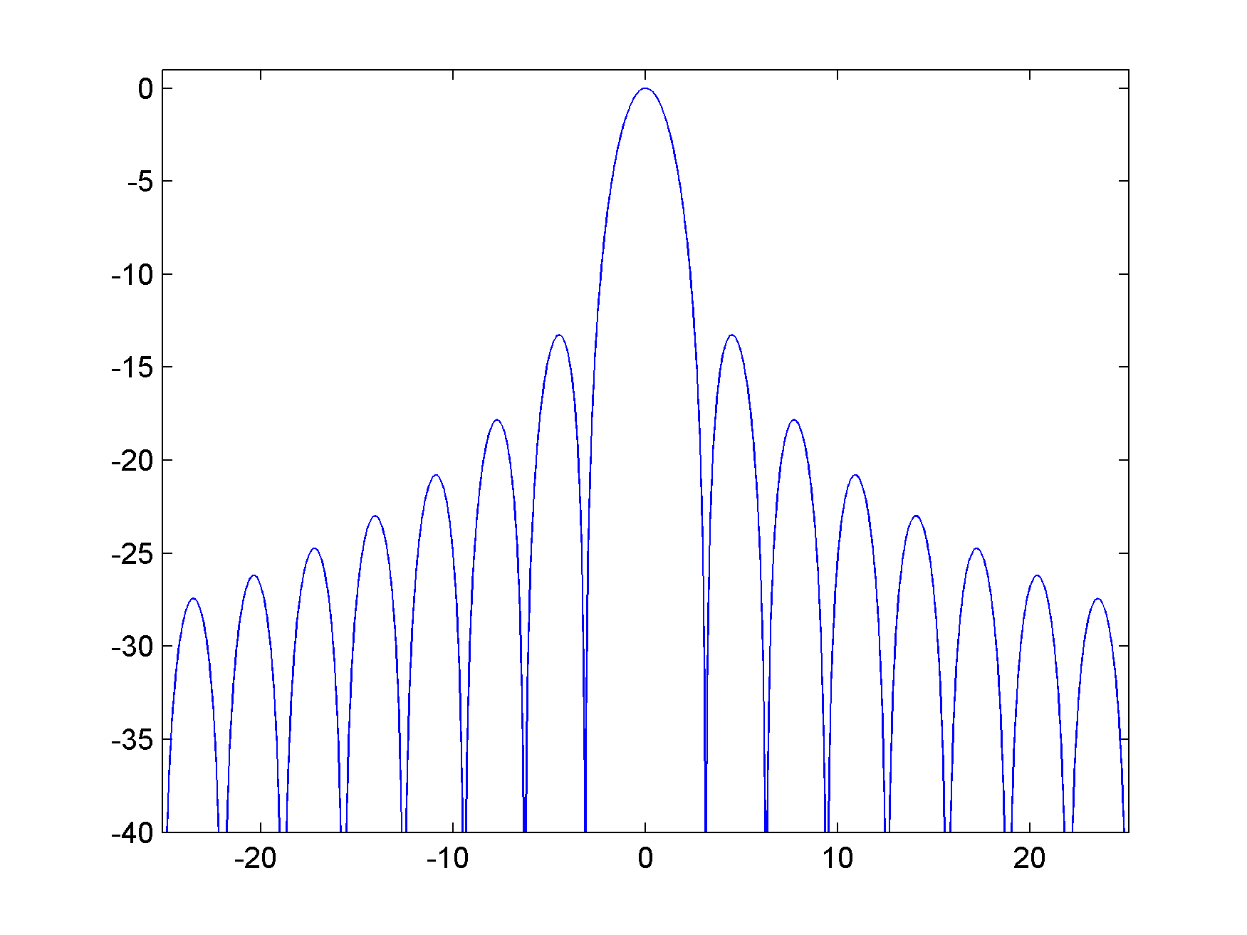
Simulation
Differences with physical measurements
Transfer function
A 70ns signal is essentially a square pulse
carrier frequency

Slide 24
Experiments
Calculating ΔΦ
Record voltage over time for two simulations
Normalize voltage functions
Subtract one set of data from the other

Slide 25
Physical model
Pipe length: l = 1.219m
Flange walls: l = 1.329m
Optimized length: 1.281m

Slide 26
Physical model

Slide 27
Physical model

Slide 28
Physical model

Slide 29
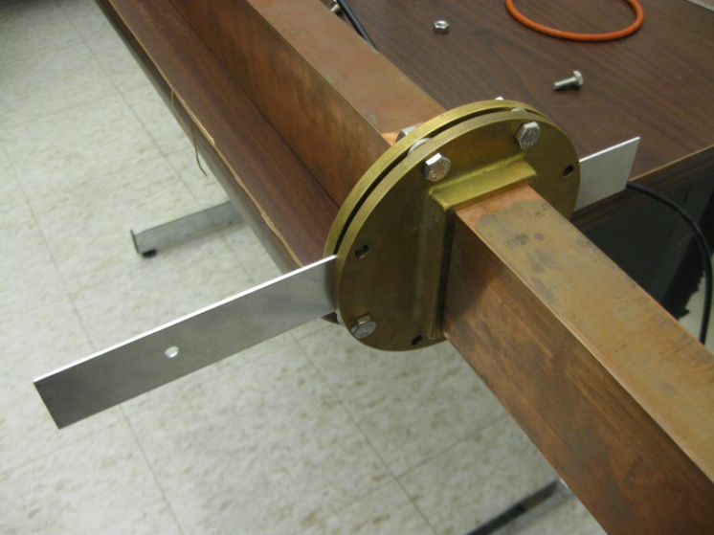
Physical model

Slide 30
Physical model

Slide 31
Physical model

Slide 32
Physical model

Slide 33
Physical model

Slide 34
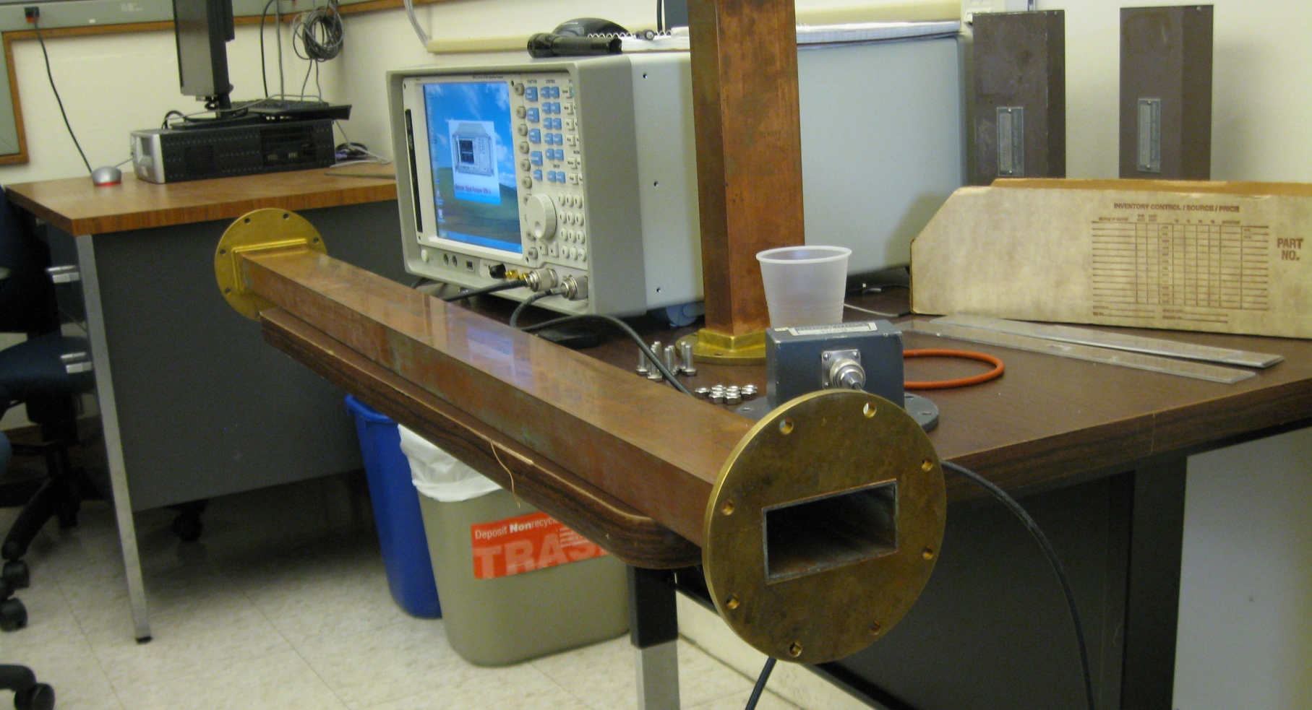
Physical model
Rectangular copper pipe

Slide 35
The Physics of Waveguides
Waveguide: a hollow metal pipe
Facilitates efficient RF energy transfer
Cutoff frequency: minimum frequency required for transmission
Determined by cross-sectional geometry

