Slide 1
Spectral Brightness of Synchrotron Radiation
Evan Walsh
Mentors: Ivan Bazarov
and David Sagan
August 13, 2010

Slide 2
Basics
Accelerating charges emit electromagnetic radiation
For synchrotron radiation, the radiation is usually X-rays
One of the main goals of the new ERL at Cornell is to create one of the brightest X-ray sources in the world

Slide 3
What is Spectral Brightness?
In geometric optics, spectral brightness is defined as photon flux density in phase space about a certain frequency:
This means the number of photons per unit time per unit area per unit solid angle

Slide 4
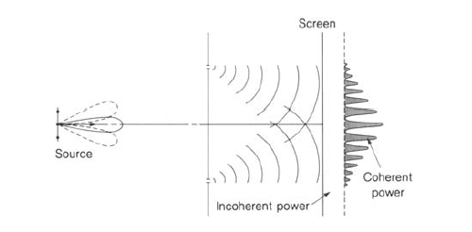
Coherence
In the definition of spectral brightness, light is treated as a particle (a photon at some point in phase space) but what about the wave nature of light?
Coherence is a measure of how sharp the interference pattern formed by the light will be when passing through a slit

Slide 5
Geometric Optics vs. Wave Optics
Geometric optics is an easier way to treat light in that the propagation of photons is reduced to multiplying matrices
Geometric optics, however, does not account for wave phenomena such as diffraction and interference
To include wave properties, electric fields must be used

Slide 6
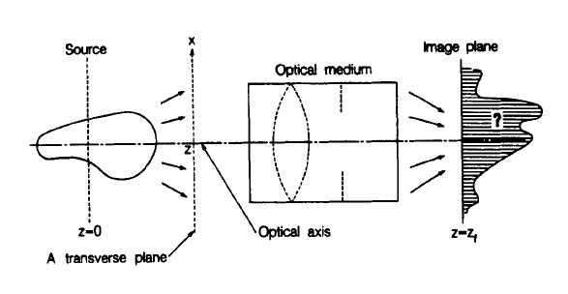
Some Geometry

Slide 7
The Formula: The Wigner Distribution Function (WDF)
Spectral brightness for a single electron
Treats the electric field as a scalar
ω is the frequency at which the spectral brightness is being calculated
T is the time duration of the electric field
E is the electric field in the frequency domain
Brackets indicate taking an average in case of fluctuations
x is a vector containing the two transverse position coordinates in phase space
φ is a vector containing the two transverse direction coordinates in phase space
z is the longitudinal position along the optical axis

Slide 8
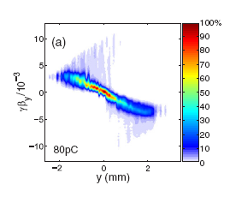
Eventual Goal
Calculate the Electric Field
Convolve the Electric Field with the Electron Phase Space
Calculate the Brightness of the Convolved Fields using the WDF

Slide 9
Step One: Electric Field of a Point Charge in the Time Domain
The equation for the electric field from a moving charged particle:
R is the vector from the particle to the observer
β is the ratio of the velocity of the particle to the speed of light
The dot signifies the time derivative of β (the acceleration divided by the speed of light)
u is a vector given by:

Slide 10
What does the ret stand for?
Light takes time to travel from the particle to the observer
By the time the observer sees the light, the particle is in a new position
The position at which the particle is when it emits the light is known as the retarded position and the particle is at this point at the retarded time

Slide 11
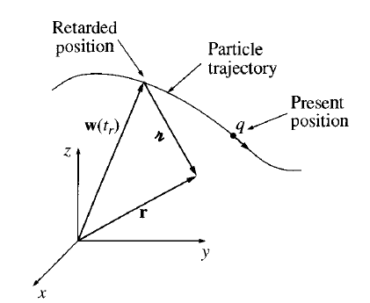
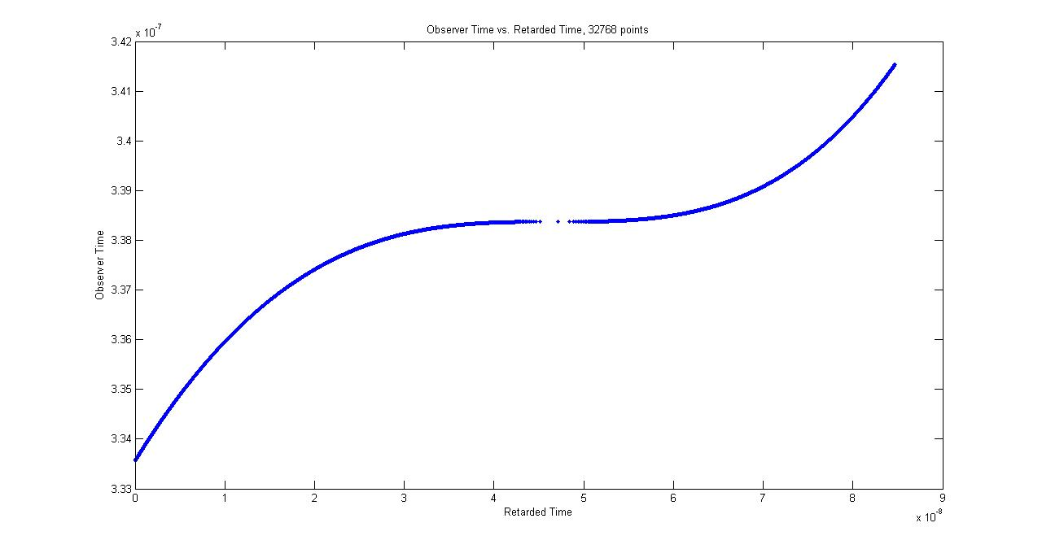
Retarded time
Use BMAD to find particle trajectory
Use root finding methods to solve:

Slide 12
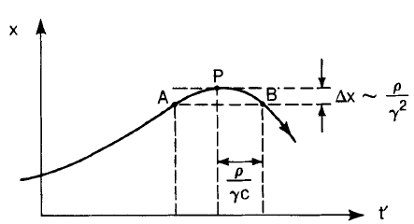
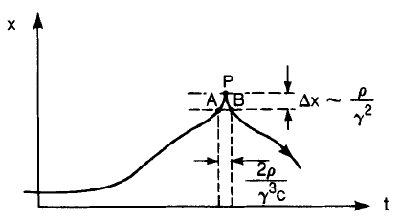
Example: Bending Magnet
Electron trajectory plotted against retarded time
Electron trajectory plotted against observer time

Slide 13
Step Two: Calculate the Electric Field in the Frequency Domain
Spectral Brightness requires the electric field in the frequency domain
To get this quantity, take a Fourier transform of the electric field in the time domain:
Numerically this is done with a Fast Fourier Transform (FFT)

Slide 14
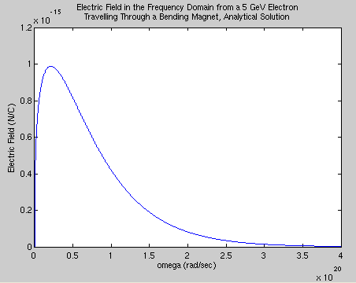
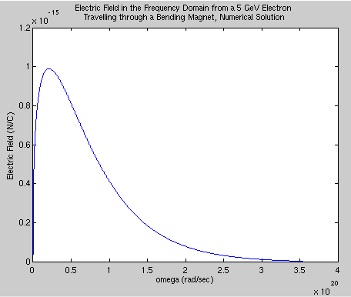
Example: Bending Magnet
Frequency Spectrum of an Electron Travelling through a Bending Magnet

Slide 15
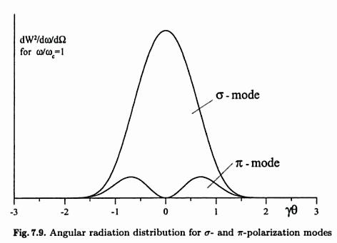
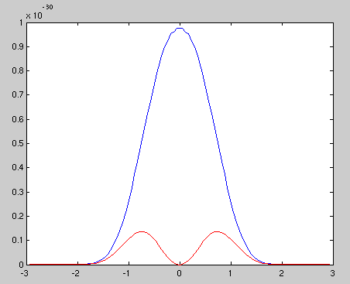
Example: Bending Magnet
Angular Radiation Distribution for an Electron Travelling through a Bending Magnet

Slide 16
Step Three: Plug in the Electric Field
This is known as a Wigner Distribution Function (WDF)
First introduced in 1932 by Eugene Wigner for use in quantum mechanics
First suggested for use in optics in 1968 by A. Walther
The above was suggested for synchrotron radiation by K.J. Kim in 1985

Slide 17
Polarization
Kim’s definition for spectral brightness treats the electric field as a scalar but in reality it is a vector
Polarization describes the way in which the direction of this vector changes
Types: Linear (horizontal, vertical, ±45º), right and left circular, elliptical

Slide 18
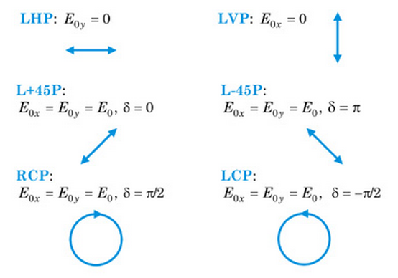
Polarization

Slide 19
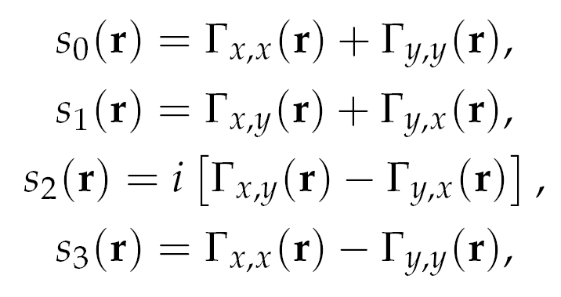
Stokes Polarization Parameters
where
s₀ is the total intensity
s₁ is the amount of ±45º polarization
s₂ is the amount of circular polarization (positive for right circular, negative for left circular)
s₃ is the amount of horizontal and vertical polarization (positive for horizontal, negative for vertical)

Slide 20
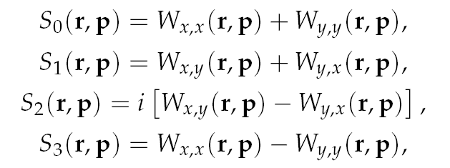
Ray Stokes Parameters
Introduced by Alfredo Luis in 2004:
where

Slide 21
Properties of the Ray Stokes Parameters: Dark & Fictitious Rays
S₀ may take on negative values even though there cannot be negative intensity ; rays with S₀ less then zero are called “dark rays”
Rays are not necessarily produced at a source; these rays are called “fictitious rays”
Dark rays and fictitious rays are essential to capture the wave nature of light

Slide 22
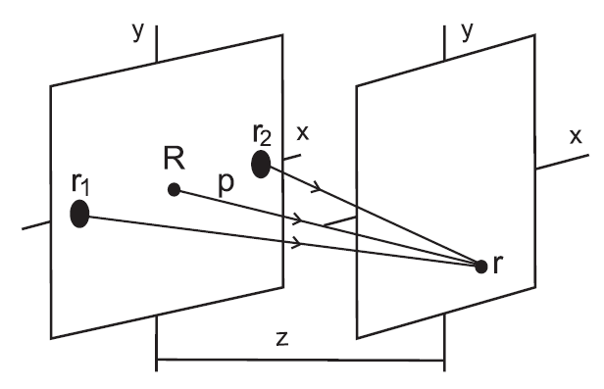
Properties of the Ray Stokes Parameters: Dark & Fictitious Rays
Example: Young Interferometer

Slide 23
Properties of the Ray Stokes Parameters: Conversion
The usual Stokes parameters can be obtained from the ray Stokes parameters by:
To get usual phase space distributions, integrate out one position and its corresponding angle (i.e. x and p_{x} or y and p_{y})

Slide 24
Measuring the Stokes Parameters
It is impossible to directly measure the ray Stokes parameters but the usual Stokes parameters are obtainable empirically
To measure the Stokes parameters:
Send light through a retarder that adds a phase difference of φ between the x and y components of the electric field
Send the light from the retarder through a polarizer that only allows the electric field components at an angle of θ to be transmitted
The intensity of the light from the polarizer in terms of the Stokes parameters of the incident light is:
I(θ,φ) = ½[s₀+s₁cos(2θ) +s₂cos(φ)sin(2θ)+s₃sin(φ)sin(2θ)

Slide 25
Properties of the Ray Stokes Parameters: Propagation
S stays constant along paraxial rays in free space
Huygen’s Principle:
Each point acts as a secondary source of rays
Rays are superimposed incoherently regardless of the state of coherence of the light
For propagation through homogeneous optical media, the incident Stokes parameters are multiplied by a Mueller matrix
For propagation through inhomogeneous optical media, the incident Stokes parameters are convolved with the WDF of the transmission coefficients

Slide 26
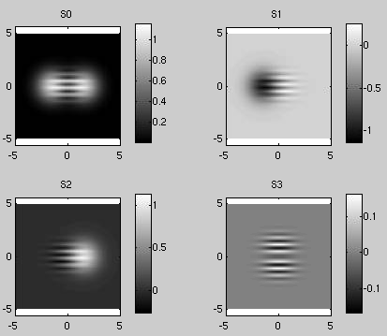
Example: Gaussian Beam Interference
Stokes parameters calculated from fields

Slide 27
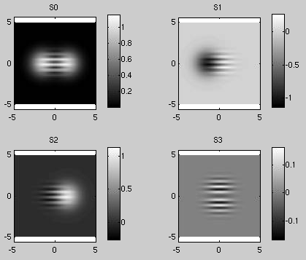
Example: Gaussian Beam Interference
Stokes parameters calculated from WDF

Slide 28
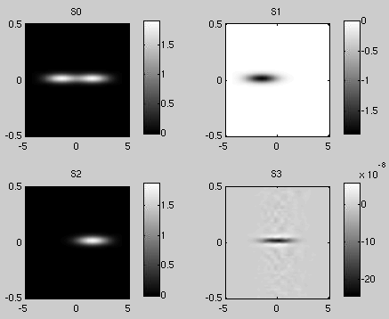
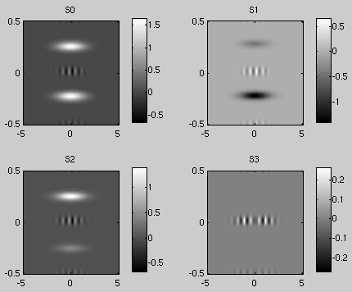
Example: Gaussian Beam Interference
Phase space distribution
x-p_{x} y-p_{y}

Slide 29
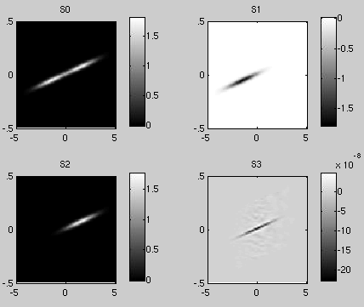
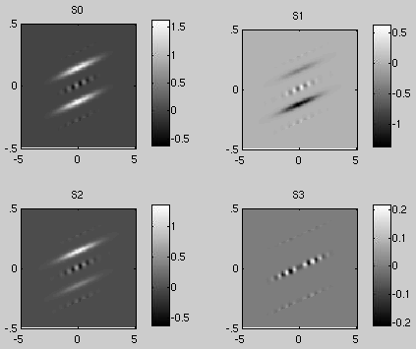
Example: Gaussian Beam Interference
Phase space distribution propagated in free space
x-p_{x} y-p_{y}

Slide 30
Current Issues
It is hard to work with 4 dimensions in general so it would be preferable to use projections into the Stokes parameters or the x and y phase spaces separately
Propagation through optical media may not be as straightforward in this case and some information may be lost
A 4D array takes a large amount of memory
Possible Solution: Split the xy plane into sections and calculate the brightness in each separately – will use less memory but will take longer

Slide 31
Step Four: Spectral Brightness of Many Particles
Brightness Convolution Theorem:
The superscript zero means the brightness of the reference electron
The subscript e denotes the phase space coordinates of the reference electron
N_{e} is the total number of electrons
f is the distribution of electrons in phase space (a probability distribution function)
Works for a Gaussian distribution but not necessarily for an arbitrary distribution

Slide 32
Other Ideas to Calculate Ray Stokes Parameters for Many Particles
The electric fields from each particle need to be added together but it would take far too long to calculate these separately
Instead, find the field from a reference particle and either:
Taylor expand for particles at other positions and orientations
Include the change in position and orientation as a perturbation
Convolve the fields with the electron distribution and then calculate the WDF

