Slide 1

LCLS-II Touschek Tracking
Lattice: May 2, 2014
Notes:
Cleanup:
Fix all titles

Slide 2
LCLS2sc (May 2, 2014)
http://www.slac.stanford.edu/~mdw/LCLS2sc/MAD/

Slide 3
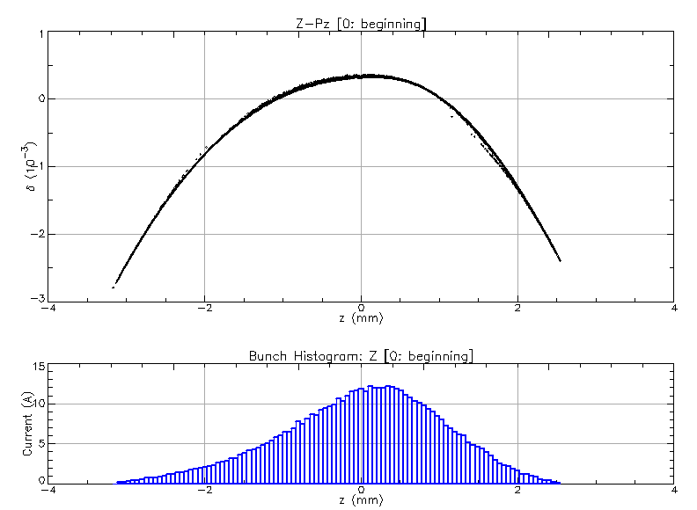
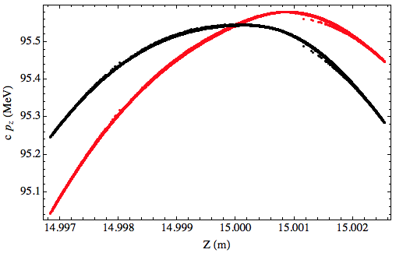
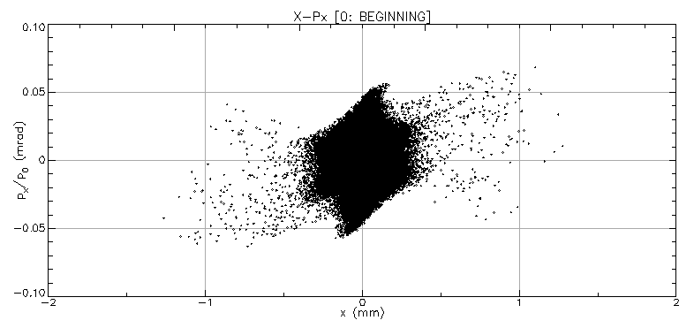
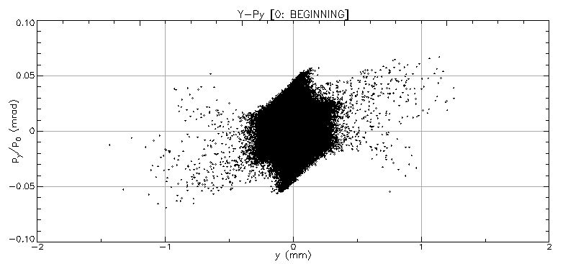
Initial Astra bunch
From Lanfa Wang: GUN2013_10_08v3_1500.001
Dechirped: ,

Slide 4
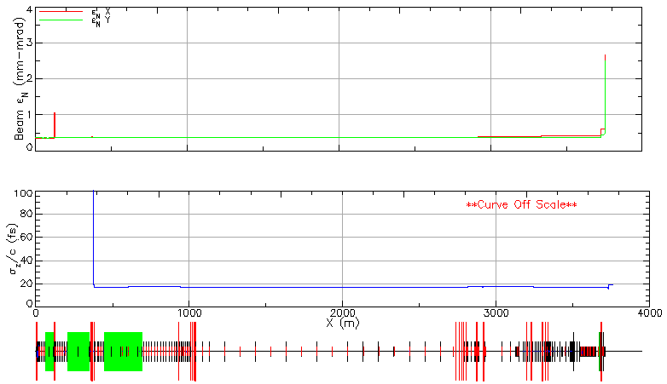
Bunch tracking
100k particles, CSR off

Slide 5
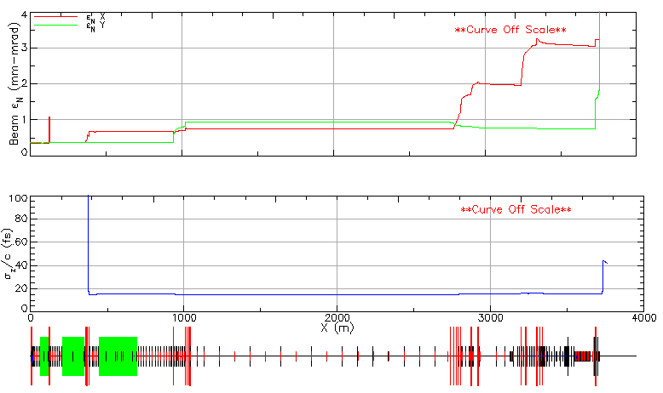
Bunch tracking
100k particles, CSR ON

Slide 6
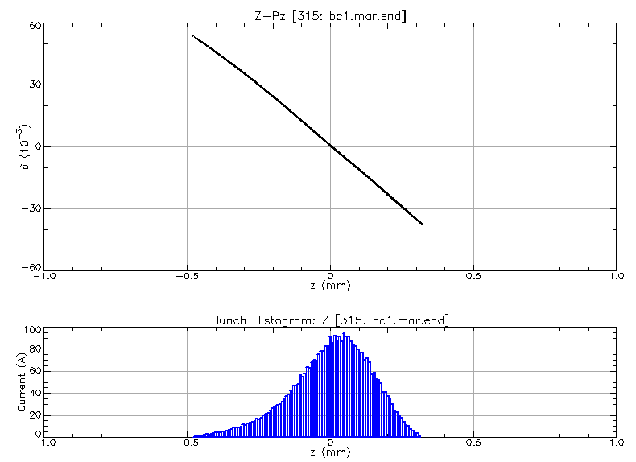
Tracking with CSR

Slide 7
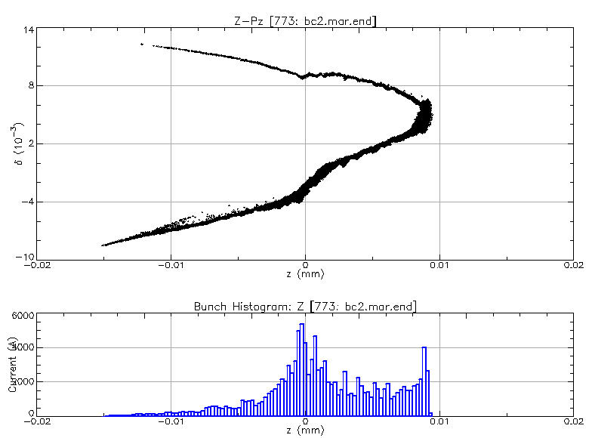
Tracking with CSR

Slide 8
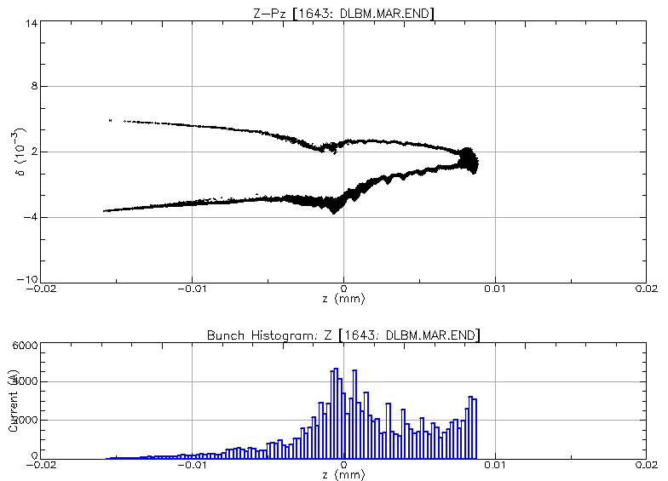
Tracking with CSR

Slide 9
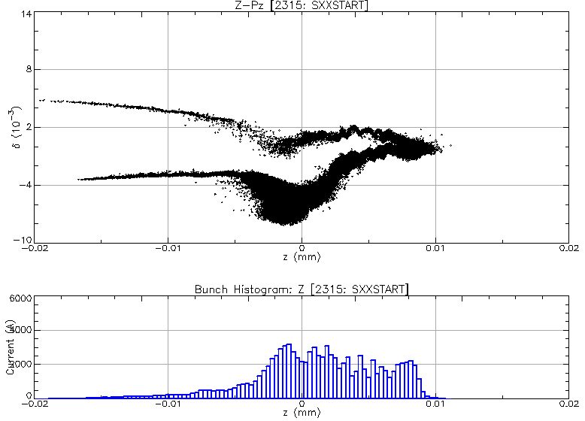
Tracking with CSR

Slide 10
Optics and bunch for tracking
CSR OFF
SXR

Slide 11
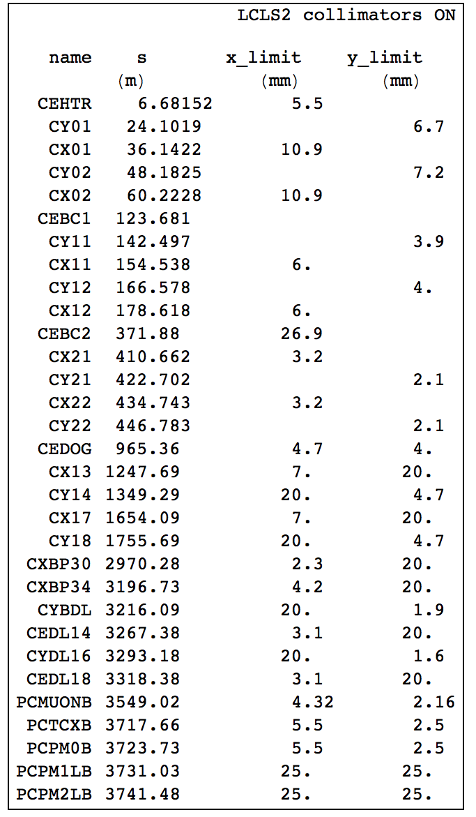
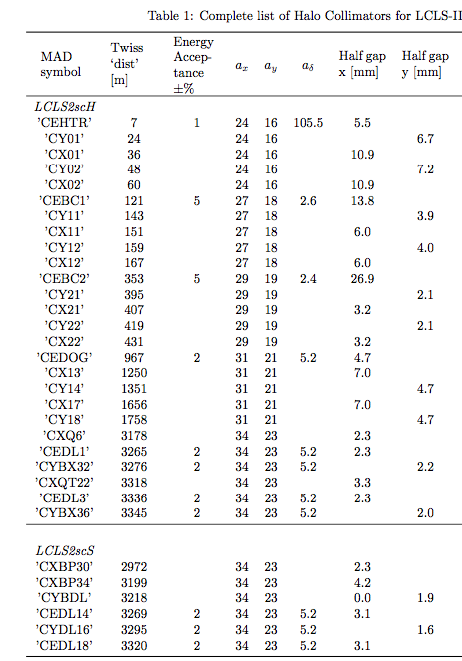
Collimators
Lattice
From Jim
CEBC1 clips the beam, so I turned it off

Slide 12
Physical aperture
Collimators ON
Collimators OFF

Slide 13
Bmad’s Touschek tracking program
Parallelized with MPI
The lattice is sliced in 10 cm intervals
Particles outside the momentum aperture are tracked from every slice, with weights representing the Touschek distribution.
Halo: F
Number of data points: 8
Number of test particles: 100
Total Integrated current (#e-): 734.7671
Beam Pipe Collisions: 734.7671
Zero Energy in Linac: 0.0000
Energy deposited into beam pipe (eV): 2.93741E+12
Number of test particles: 1373000
Number lost to beam pipe: 1276888
Number lost to zero energy: 0
real 187m43.516s
user 645m38.994s (11 hours)
sys 0m15.235s
734 * e_charge * 1 MHz = 118 pA

Slide 14
Momentum aperture
Collimators ON
Collimators OFF

Slide 15
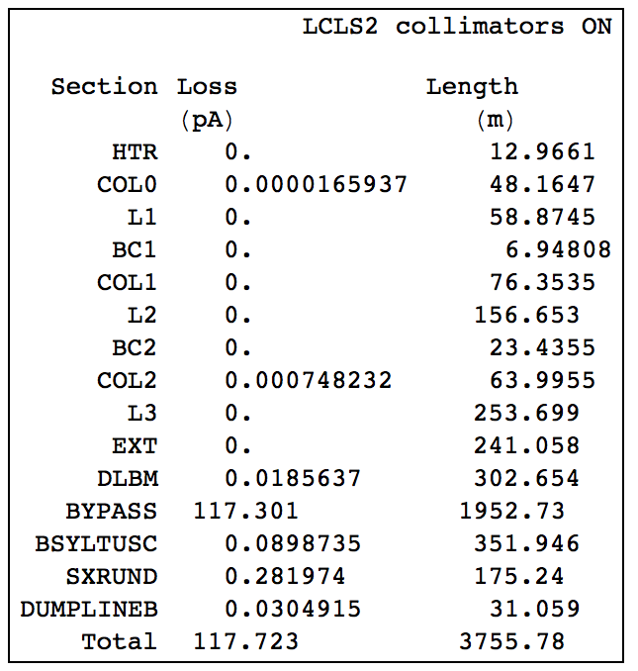
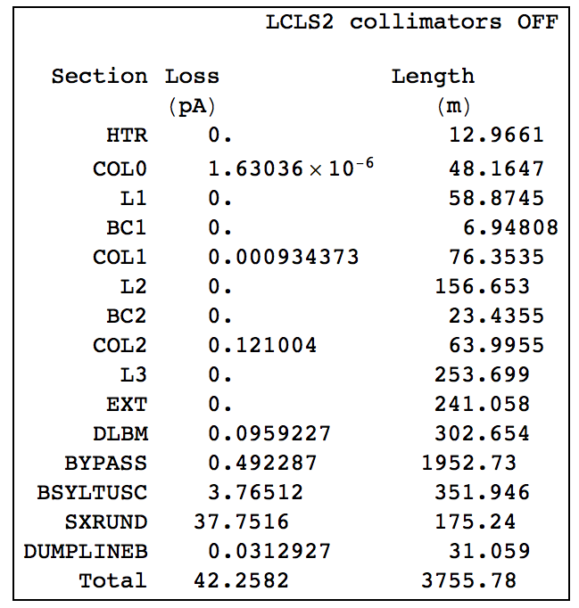
Touschek losses
Calculated assuming 1 Mhz, 100 pC bunches

Slide 16
Touschek losses
Collimators ON
Collimators OFF

Slide 17
Cumulative Touschek generation/loss
Collimators ON
Collimators OFF

Slide 18
Touschek particle generation detail
Collimators ON

Slide 19
Touschek particle generation detail
Collimators ON

Slide 20
Touschek particle loss detail
Collimators OFF

