Slide 1

LCLS-II dark current tracks
from cathode edge and
possible collimation
Notes:
Cleanup:
Fix all titles

Slide 2
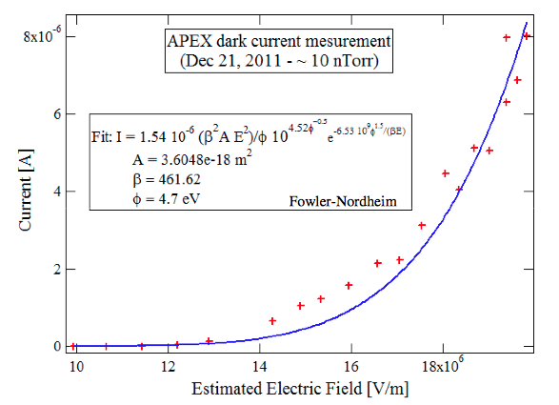
Charge assignment from FN parameters
Used the parameters from measurement to assign charges to the dark current particles based on their initial longitudinal E-field.
Particles are uniformly distributed in time and at radius 5mm (the edge of the cathode puck)
The sum of all charges is normalized to 1(Coulomb)
http://www-physics.lbl.gov/seminars/old/Sannibale.pdf

Slide 3
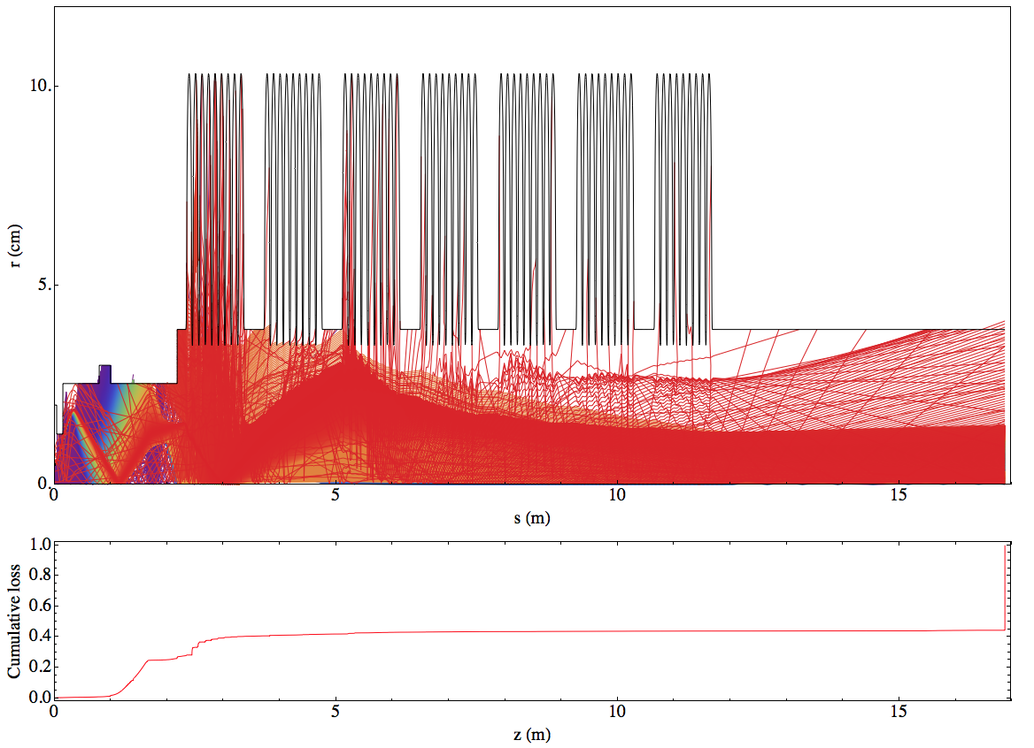
Particles from r = 5 mm on cathode colored by charge
(red is higher charge)

Slide 4
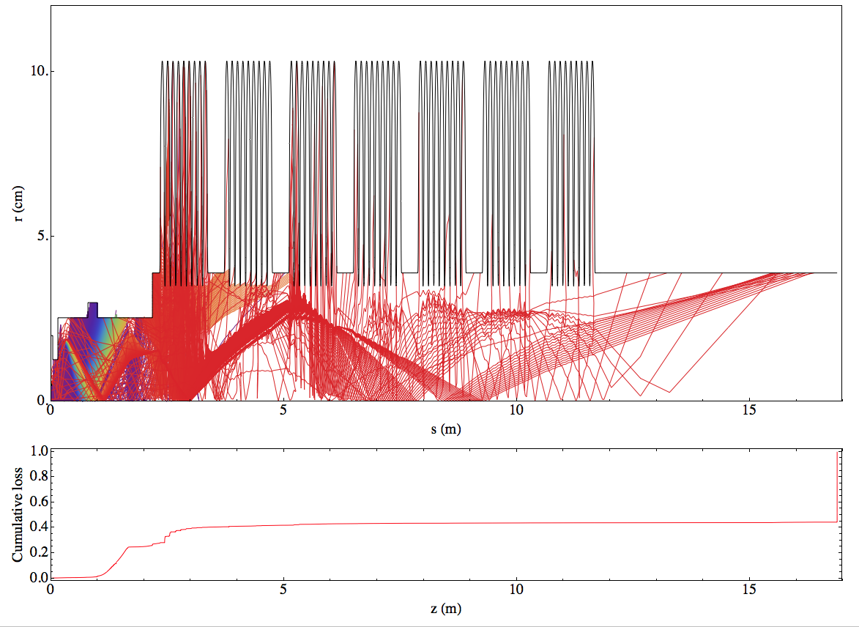
Particles lost colored by charge (red is higher)

Slide 5
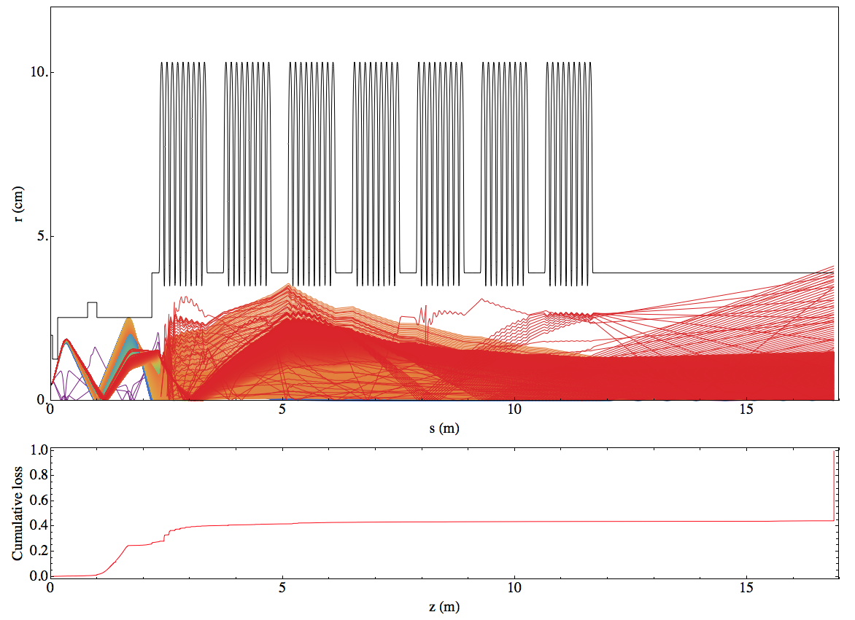
Particles escaping colored by charge (red is higher)

Slide 6
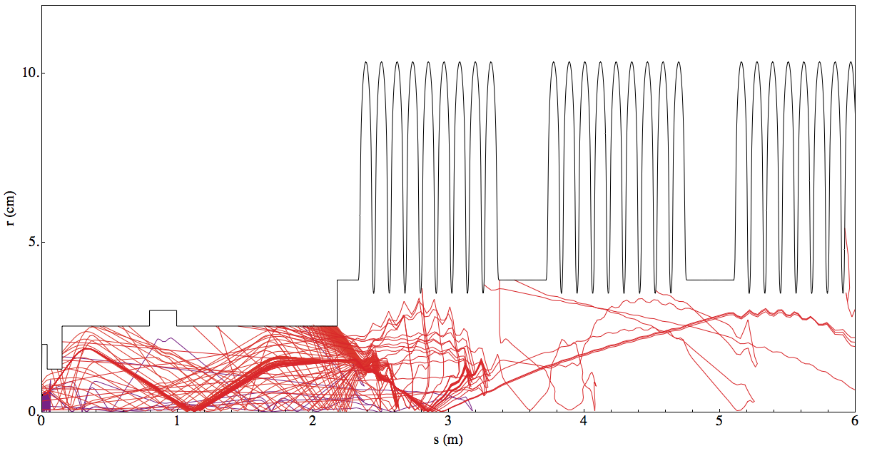
Particles lost backwards
0.25% of the current turns around and hits the cathode

Slide 7
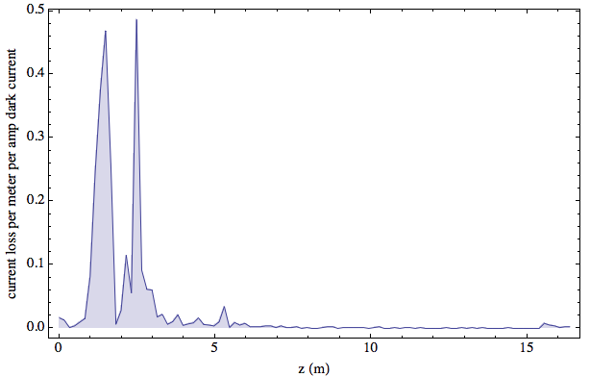
Current lost per meter

Slide 8
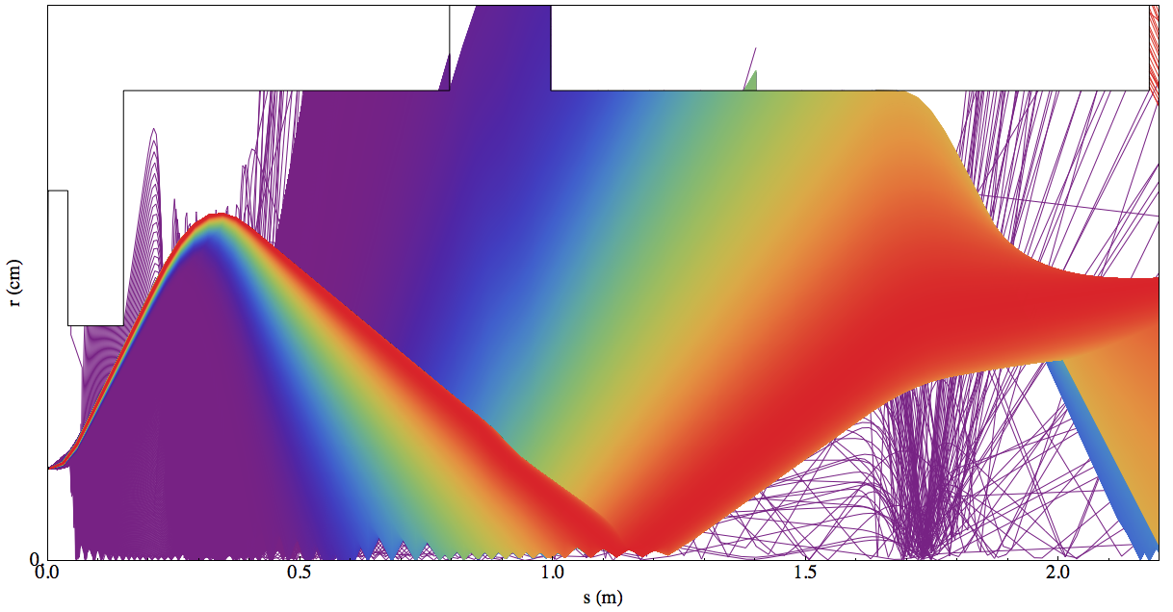
Forward moving particles in frontend

Slide 9
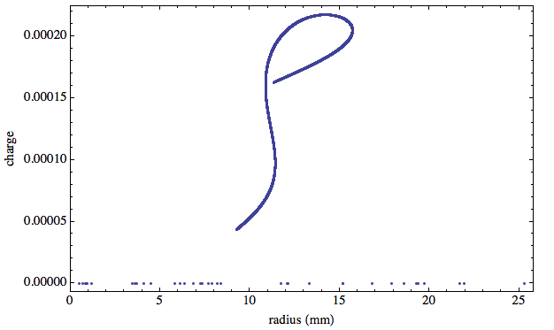
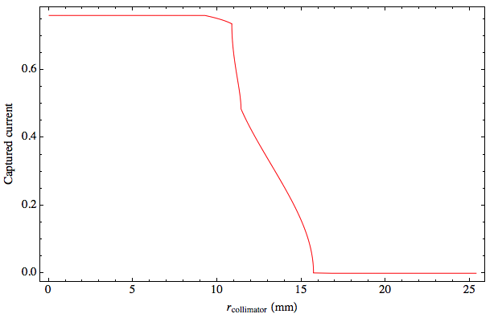
Collimator at z = 2 m
These are the particles passing z=2m in the forward direction.
The fraction captured current for a given collimator radius. Note that some current was already lost prior to this location

Slide 10
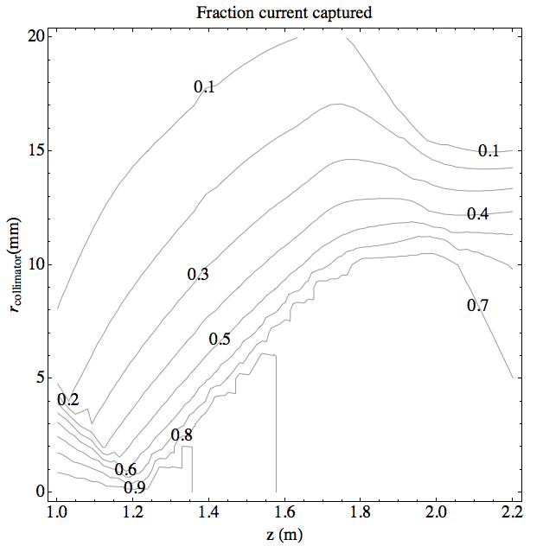
Collimator placement after buncher summary
This extends the previous plot to all possible z locations for collimation.
For example:
A collimator with radius 5 mm placed at z=1.5 m would capture 80% of the dark current
A collimator with radius 10 mm placed at z = 2.0 m would capture 70% of the dark current

Slide 11
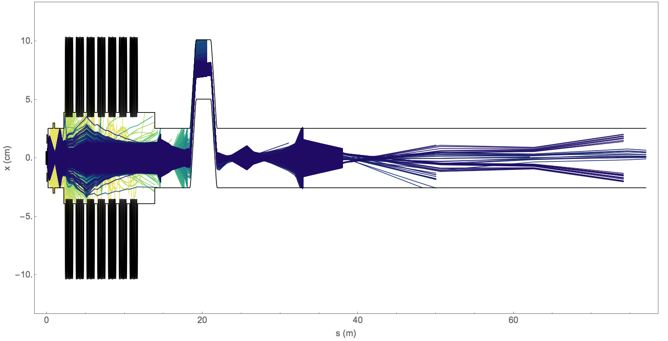
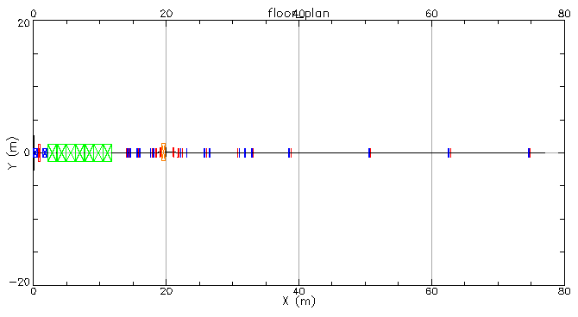
Tracks including HTR, Col0 sections

Slide 12
Tracks including HTR, Col0 sections
.02% survive

Slide 13
Tracks including HTR, Col0 sections

