Slide 1

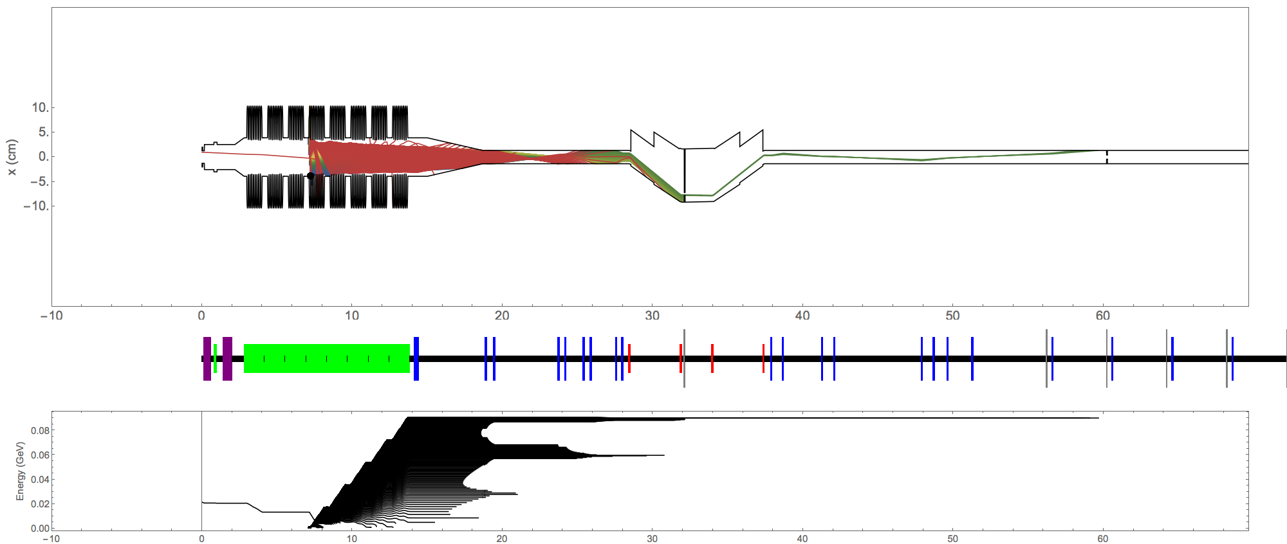
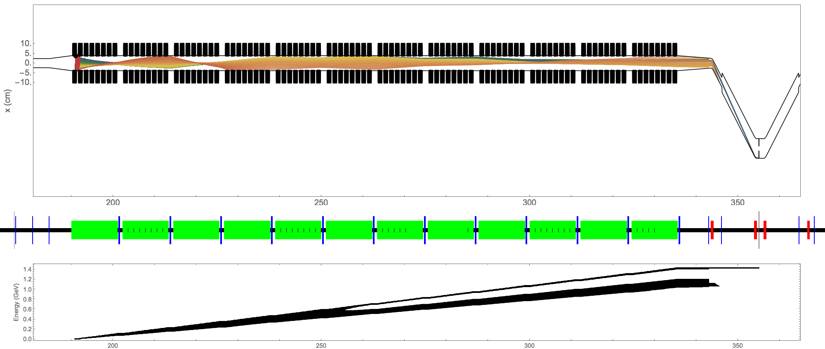
LCLS-II Dark Current
Notes:
Cleanup:
Fix all titles

Slide 2

Bmad Overview
Born at Cornell in mid 90’s by David Sagan
  Initially used a subset of the MAD lattice syntax. Hence the name: “Baby MAD” or “Bmad” for short.
Written in Fortran. Object oriented from the ground up:
Has structure translation code for interfacing with C++
MAD like lattice syntax
Well documented:
  400 page manual
  Code
Under continuous development
Open source:
type (lat_struct) lat
call bmad_parser ('lat.bmad', lat)
  http://www.lepp.cornell.edu/~dcs/bmad/

Slide 3
Bmad
Library currently has:
    ~1,000 routines
    ~100,000 lines of code
Routines can do:
    Spin tracking
    Tracking with coherent synchrotron radiation (CSR) with shielding
    Wakefields and HOMs
    Taylor maps
    Intra-beam scattering (IBS)
    Touschek scattering
    Frequency map analysis
    Dark current tracking
    X-ray tracking
    ...
Lattice features
  Superposition – Define overlapping elements
  Controllers – Elements controlling attributes of other elements
  Forking – Joining lines together
  Multipass – Beamlines sharing common elements
  Element-by-element selection of the tracking method
  Custom elements and custom particle tracking
  Chamber walls
Lattice transcription
    Lattice translation between Bmad, XSIF, MAD, and SAD
    One way translation to: Astra, OPAL, GPT

Slide 4
SLAC MAD to Bmad translation
2015 June 19 model

Slide 5
…Refitting
The discrepancies are due to different cavity focusing models.
Adjusting 5 quads (< 20% levels) at the ends of L1, L2, and L3 resolves this.
All other element strengths/values are unchanged
Dispersion (not shown) agree perfectly

Slide 6
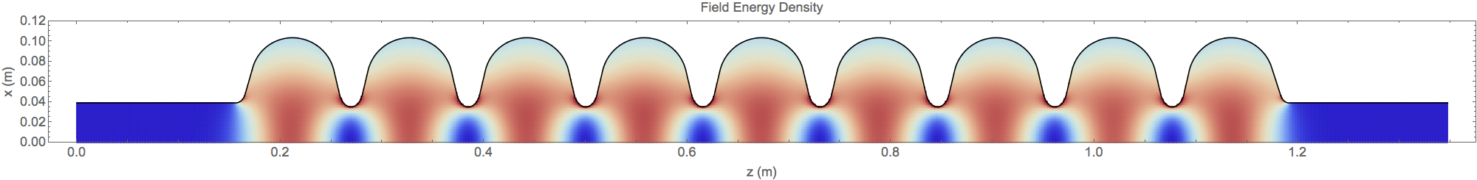
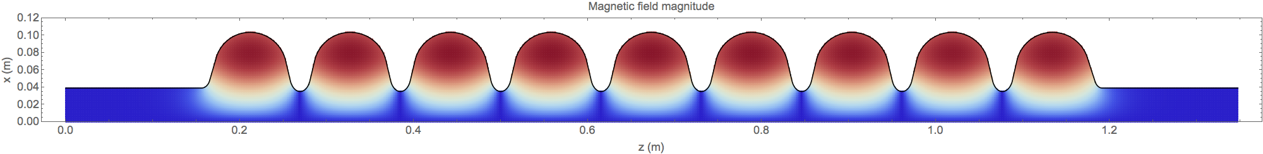
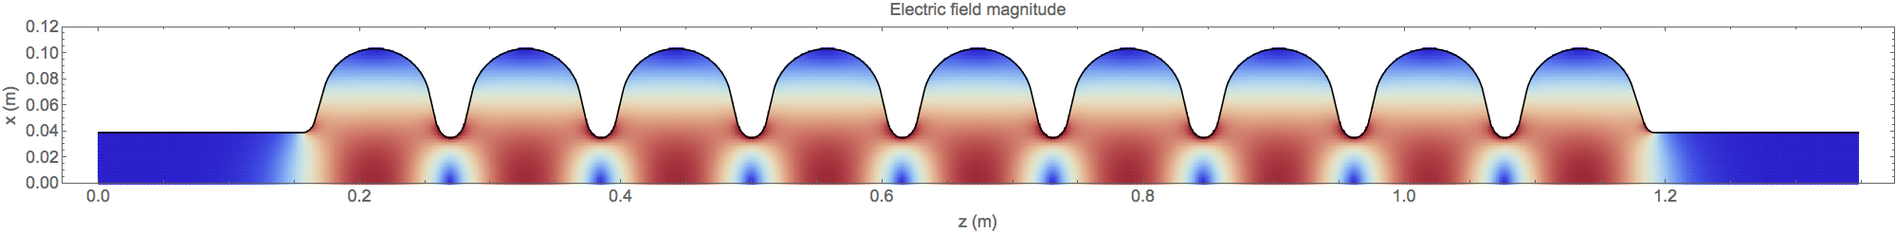
9-cell cavity fields
Cylindrically symmetric data on 1 mm x 1 mm grid
Wall shape
[data from Valery Shemlin using CLANS]

Slide 7
Bmad time tracking
time_runge_kutta tracking method
3D wall shape

Slide 8
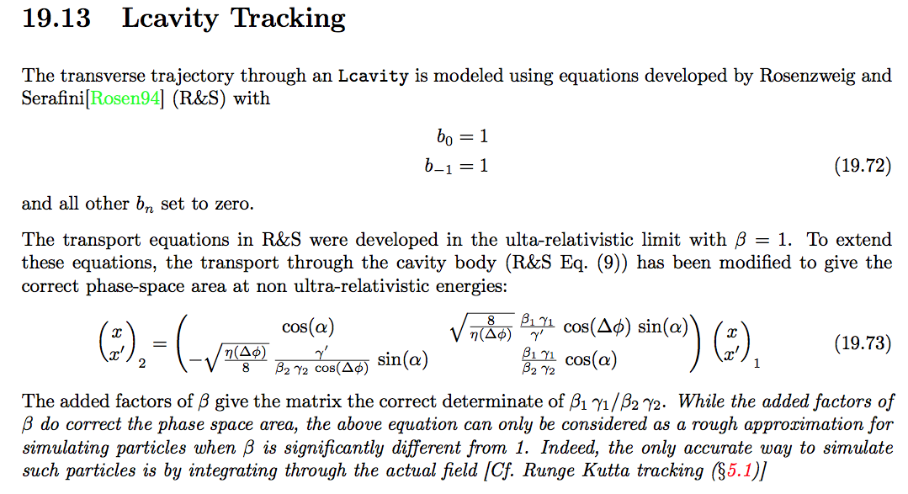
Bmad standard vs. field integration matrix
Bmad manual
Bmad standard vs. runge kutta tracking matrix computation are practically identical (<1% difference).
No refitting was necessary.
SLAC should consider using this.

Slide 9
Injector (INJ) model
The reference model is the optimized ASTRA 300 pC injector, ‘newbaseline300.in’, courtesy of Feng Zhou
All field maps were converted to Bmad’s format. An equivalent Bmad model was written.
Bmad has a Bmad->Astra conversion program. This is used to verify that the two models are the same.
Quads before HTR are tweaked to accept the space charge dominated beam out of the injector, so that the start-to-end LCLS2 model is realistic

Slide 10
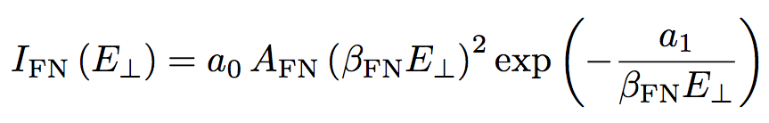
Field emitter current
200
The instantaneous current is given by the Fowler-Nordheim equation:
For Niobium,
The field enhancement factor
is determined empirically. We use a value of 100 in these simulations.
sets the total average current
150
100
50
[H. Padamsee, RF Superconductivity, p. 94]

Slide 11
Field emitter tracking
Locate a position on the cavity wall
Sample the field normal at even intervals over 1 rf period
Create particles at this position at these times, with weights determined by the Fowler-Norheim equation.
Only accept particles where
For simplicity, normalize weights to sum to 1
Track each particle until lost at the wall

Slide 12

Field emitter iris scan
Total cavity voltage: 15 MV.
Fowler-Nordheim field enhancement factor (beta): 100.
Each track represents charge from 1 degree of the rf period.
Red is more charge.
https://www.youtube.com/watch?v=xjRR7xE6MXc

Slide 13
Danger Zones
Only very small regions on the cavity wall can harbor field emitters that produce particles that can escape the cavity.

Slide 14
Danger Zones
Only very small regions on the cavity wall can harbor field emitters that produce particles that can escape the cavity.
All irises exhibit roughly this same pattern.
We save time, we only track from danger zone field emitters.

Slide 15
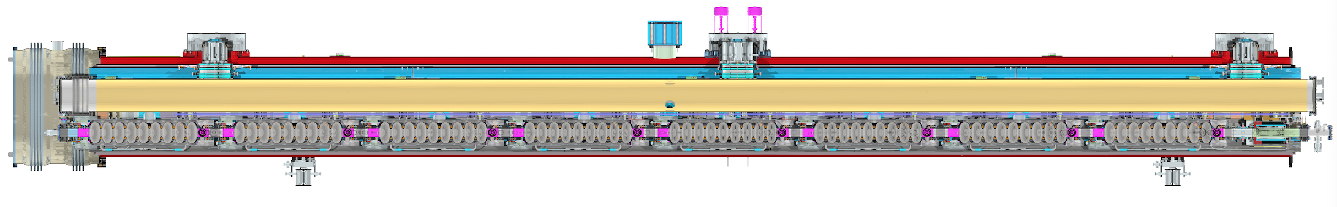
LCLS2 Cryomodule

Slide 16
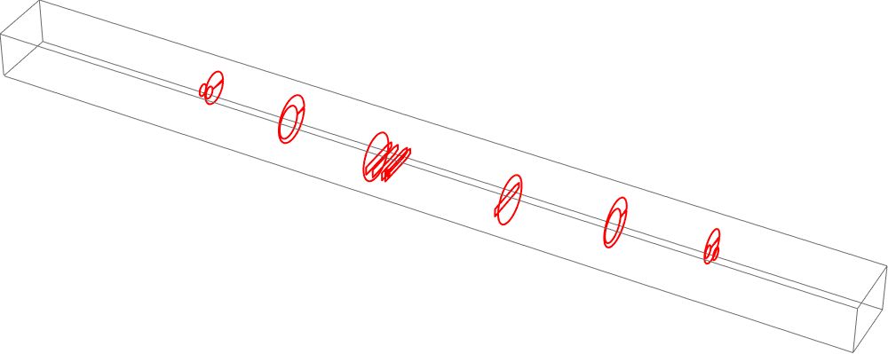
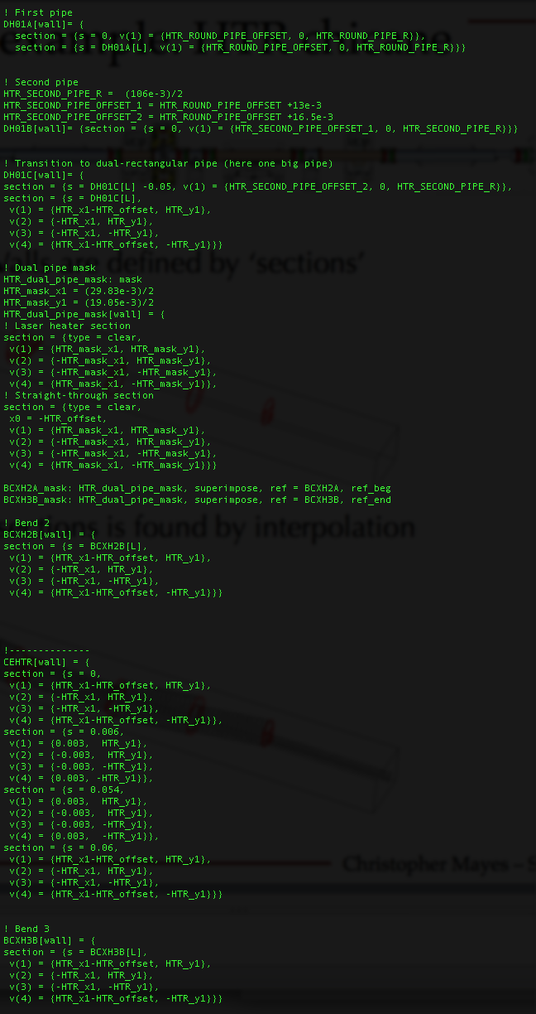
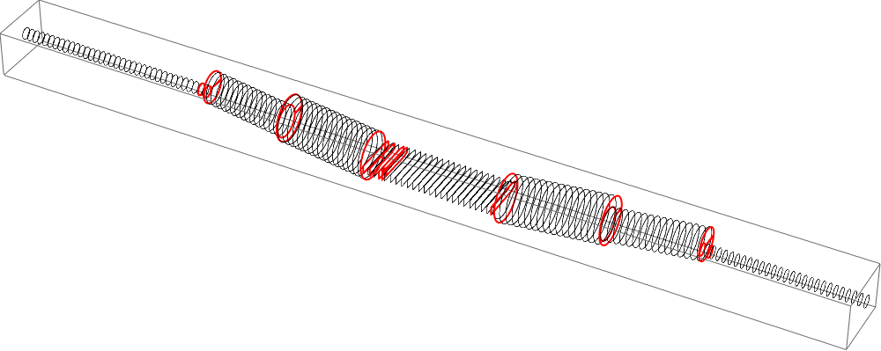
Bmad wall example: HTR chicane
Walls are defined by ‘sections’
wall definition file
The wall between sections is found by interpolation
‘mask’ elements are placed to simulate this special case of two pipes

Slide 17
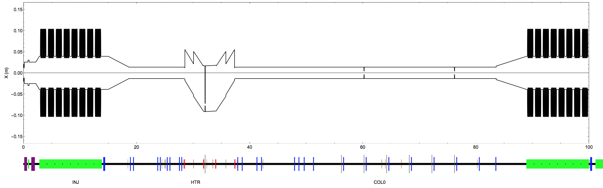
Cathode to L1 wall
INJ
HTR
COL0
L1
instruments
collimators
cavities
dipoles
quads
solenoids

Slide 18
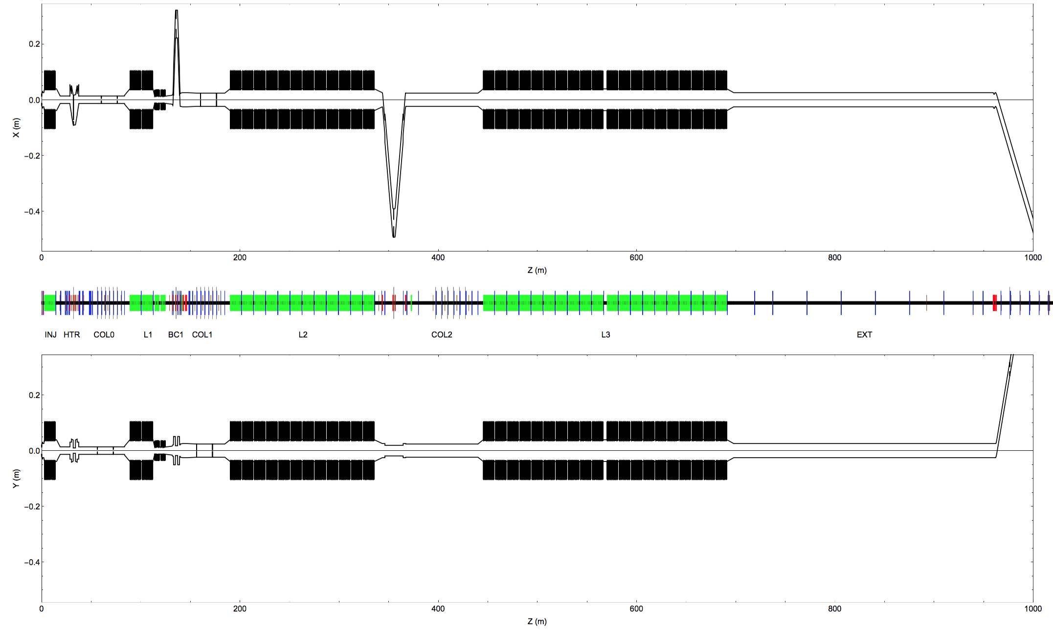
LCLS2scH 2015 June 19
Top view
Side view

Slide 19
Cryomodule field emission tracking
Field emitters are placed in danger zones, at random angles (~5000 emitters)
For each emitter, particles are created and tracked (~1000 per emitter)
Weights for particles escaping the crypmodule are renormalized to sum to 10 nA
Power and current deposition are tallied per element
INJ
HTR
COL0

Slide 20
CM01 powers
Worst case power deposition due to a field emitter in CM01, per element.
Losses inside CM01 are not plotted.
The plot represents the full range of particles tracked. Here, no particle made it past 70 m.
INJ
HTR
COL0

Slide 21
CM02 powers
A few lucky field emitters in CM02 can make it all the way to the dogleg.
Backwards particles can’t make it past the laser heater (HTR)
Almost no possibility to cause loss in L2, L3
L0
L1
L2
L3
CM02

Slide 22
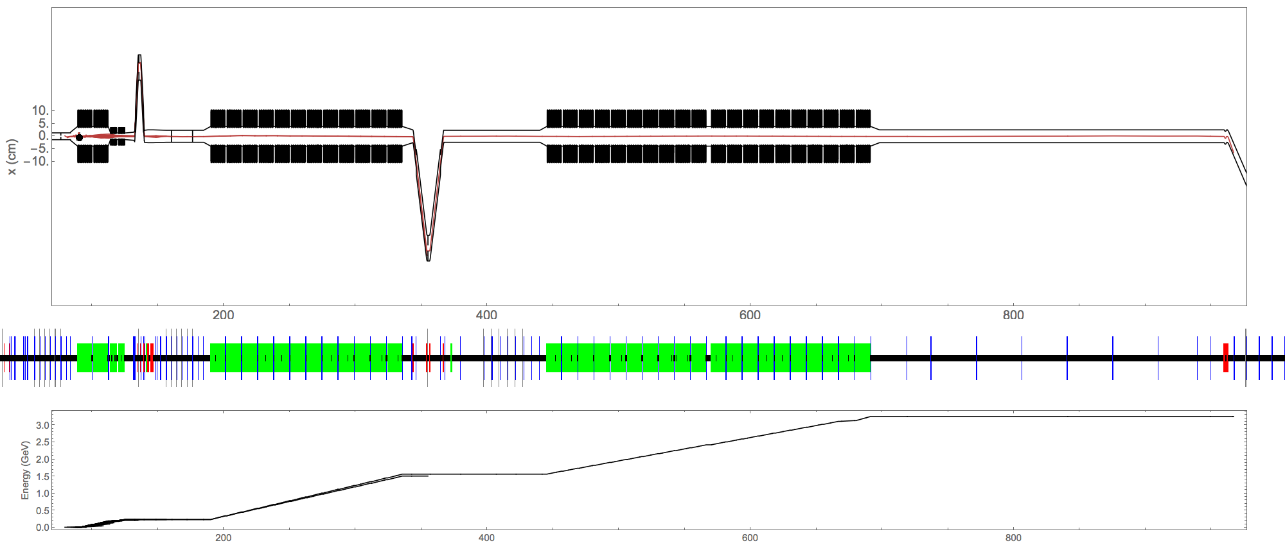
CM02 example field emitter 796

Slide 23
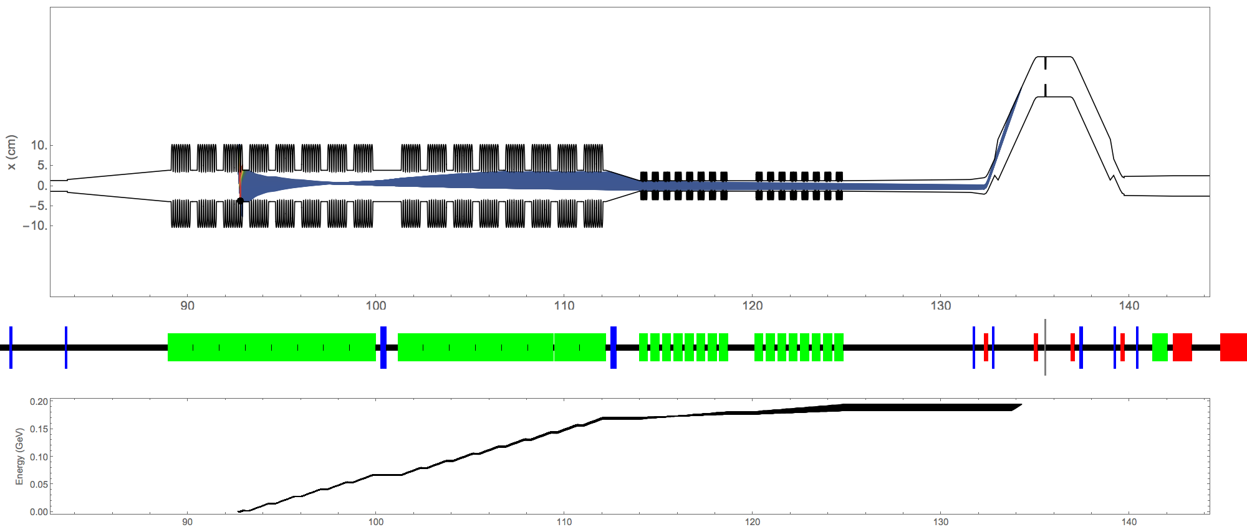
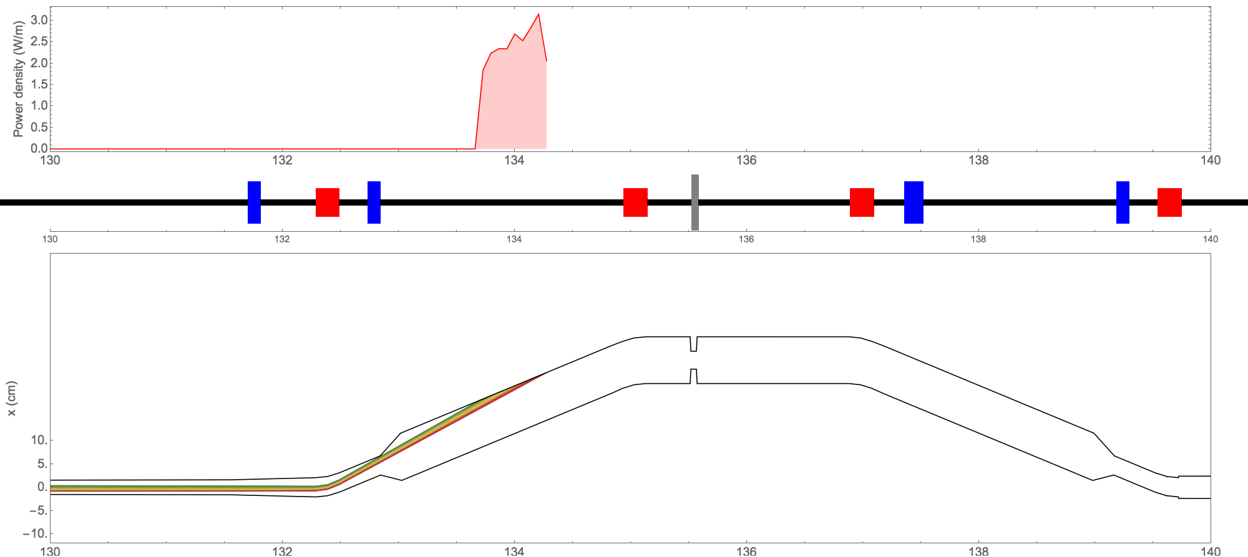
CM02 example field emitter 2087
Power density in BC1 wall

Slide 24
CM04 powers
CM04 losses are always between BC1 and BC2
The plot represents the full range of particles tracked. Here, no particle made it past 70 m.
BC1
L2
BC2
CM04

Slide 25
CM04 example field emitter 628
L2
BC2

Slide 26
Worst case summary
Worst case power experienced per element from a field emitter in one cryomodule, with emission exiting the cryomodule totaling 10 nA.
No particle due to field emission can make it past the dogleg.
L0
L1
L2
L3

Slide 27
Worst Worst case summary
Worst Worst case power experienced per element, assuming that all cryomodules have a field emitter with 10 nA exiting.
L0
L1
L2
L3

Slide 28
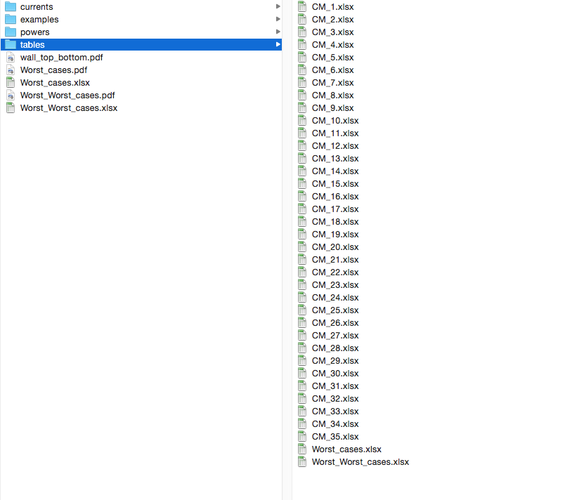
Summary Data
Summary particle loss plots and data can be found at:
http://www.lepp.cornell.edu/~cem52/LCLS2/data/

Slide 29
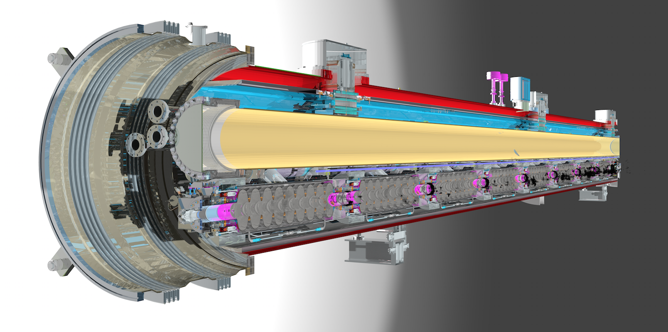
End

