Slide 1
LCLS Virtual Accelerator:
Online Model
Christopher Mayes
August 31, 2017

Slide 2
LCLS Virtual Accelerator
    We would like to build:
  Detailed computer model and simulation framework of the machine
  Fully start-to-end, from laser shape on the cathode to X-ray production to X-ray tracking to the sample
  Seamless or simple translation from code to code without the need of an expert
  Utilizes HPC resources without the need of a parallel computing expert
  This would enable:
  High-fidelity, comprehensive beam physics simulations
  Virtual beam experiments
  Discovery of optimal, robust machine settings

Slide 3
LCLS Online Model
  Subset of the virtual accelerator
  Fast
  Update continuously as the machine is running
  Adjusts automatically to reflect known measurements (wire-scan, BPM data)
  High-level `knobs’ for rapid tuning
  Scriptable
  Reliable save/load machine state

Slide 4
Plan
Choose a backbone simulation framework that:
  Captures the most physics effects
  Well-supported and documented by the developers
  Mature
  Produces inputs to other programs
  Customizable

Slide 5
Physics features of various accelerator codes
Physics features | MAD8 | Elegant | Bmad/Tao | SLAC-Matlab | Impact | OPAL | Astra | GPT | Ocelot
design tool | X | X | X
Linear optics | X | X | X | X |  | X |  |  | X
Nonlinear optics | X | X | X
Taylor maps, symplectic tracking, analysis |  |  | X
Wakefields |  | X | X |  | X | X |  |  | X
low energy space charge |  |  |  |  | X | X | X | X | X
high energy space charge |  |  | X |  | X | X | X | X | X
Inchoherent synchrotron radiation |  | X | x |  | X | X
coherent synchrotron radiation (CSR) |  | X | X |  | X | X |  | X | X
CSR with shielding |  |  | X
Field map tracking |  | partial | X |  | X | X | X | X
x-ray tracking |  |  | X
spin tracking |  |  | X |  | ?
Touschek scattering |  | X | X
intrabeam scattering |  | X | X |  | X
Cavity higher-order modes (HOMs) |  |  | X
Dark current tracking |  |  | X |  |  | X | X | X

Slide 6
Practical features of various accelerator codes
Code features | MAD8 | Elegant | Bmad/Tao | SLAC-Matlab | Impact | OPAL | Astra | GPT | Ocelot
SLAC specific developer support |  | partial | X | X | X | partial
Active development |  | X | X | X | X | X |  |  | X
Documented | X | X | X |  |  | X | X | X
customizable as a software library |  |  | X | X |  |  |  | X
open source | X | X | X | X |  | X |  |  | X
Used as online model at other laboratories |  | X | X | X |  |  |  |  | X
Parallel |  | X | partial |  | X | X |  | $$$
GPU support |  | X
Free | X | X | X | X | X | X | X |  | X
MAD-like lattice syntax | X | X | X | X |  | X
Lattice control structures |  |  | X | somewhat
Birthdate |  | 1988 | 1996 |  |  |  |  | 2002 | 2014
User base (small, medium, large) | L | L | M | S | S | M | L | M | S

Slide 7
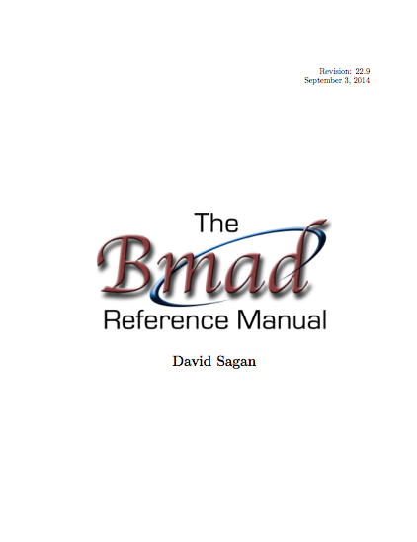
Bmad Overview
Written in Fortran 2008.
Object-oriented from the ground up.
Has structure translation code for interfacing with C++.
With certain restrictions, Bmad can be run multi-threaded.
Lattice files use a MAD like syntax.
Well documented (Manual is ~500 pages).
  Open Source:
  http://www.lepp.cornell.edu/~dcs/bmad/
type (lat_struct) lat
call bmad_parser (‘lat.bmad’, lat)
Notes:
In this example lat is an instance of a lat_struct.
A lat_struct is a structure that holds all the information about a lattice.
Including a list of the lattice elements, magnet strengths, etc.
The call to bmad_parser takes a lattice file name
and bmad_parser will fill the lat instance with the parsed information

Slide 8

In the Beginning…
Brief History of Bmad:
  Bmad is a software toolkit for the simulation of charged particles and X-rays.
  Born at Cornell in mid 1990s
  Started life as modest project: Just wanted to calculate Twiss functions and closed orbits.
  Initially Bmad used a subset of the MAD lattice syntax. Hence the name: “Baby MAD” or “Bmad” for short.
Over the years Bmad had evolved…
Notes:
And Baby has grown up

Slide 9

And Baby Grows Up...
Currently:
    ~100,000 lines of code
    ~1,000 routines
And it can do much more:
    Lattice design
    X-ray simulations
    Spin tracking
    Wakefields and HOMs
    Beam breakup simulations in ERLs
    Intra-beam scattering (IBS) simulations
    Coherent Synchrotron Radiation (CSR)
    Touschek Simulations
    Frequency map analysis
    Dark current tracking
    Etc., etc.

Slide 10
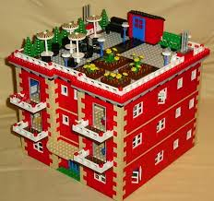
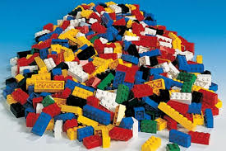
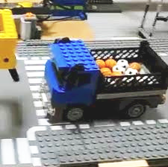
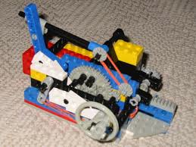
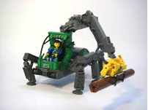
Bmad Philosophy
Lattice Design Program
Bmad
Advantages of a toolkit:
  Cuts down on the time needed to develop programs.
  Cuts down on programming errors (via code reuse).
  Provides a simple mechanism for lattice function calculations from within control system programs.
  Standardizes sharing of lattice information between programs.
Dynamic Aperture Program
Control System Programs
IBS Simulation Programs
Etc.

Slide 11
Superposition
Physical Layout:
Internal lat_struct Representation:
Lords:
Tracking
elements:
Superposition allows element overlap. In the lattice file:
  cesr: line = (... q1e, dft, ip, dft, q1w ...)
  cleo: solenoid, l = 3.5, superimpose, ref = ip
And Bmad does the bookkeeping…
Simplifies life for both user and programmer:
  Simplifies lattice file construction
  Simplifies varying element attributes in a program

Slide 12
Forking
Bmad can join different beam lines using fork elements.
Example: SuperKEKB Low Energy Ring (LER) injection
to_LER: fork, to_line = ler, to_element = injection
inj: line = (..., to_LER) ! injection line
LER: line = (..., injection, ...) ! LER ring
use, inj
Can splice together rings, dump lines, Linacs, X-ray lines, etc. ➔ One lattice can hold the description of the entire accelerator complex.

Slide 13
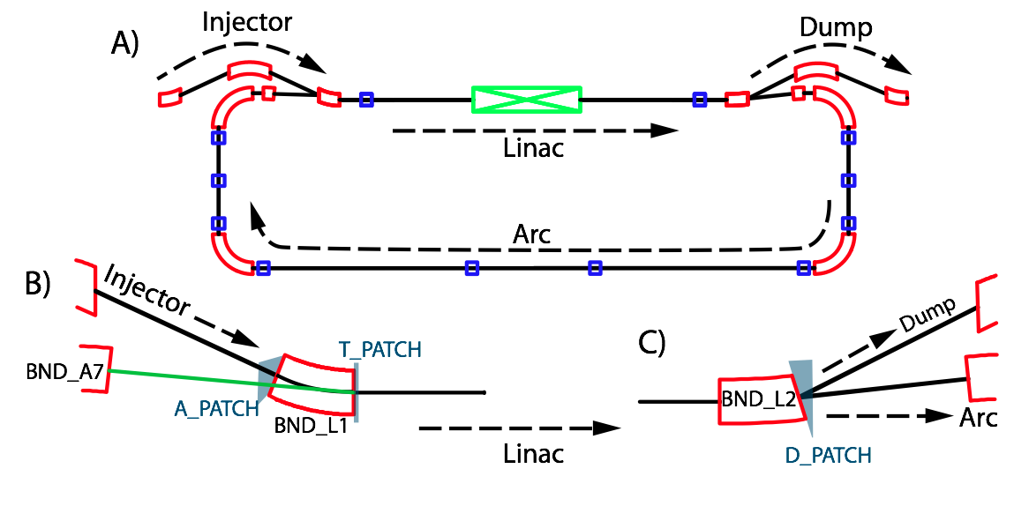
Multipass
Lines having common elements. Example ERL loop:
BEND_L1: sbend, angle = -25*pi/180, l = 0.2, ...
BEND_L2: BEND_L1
A_PATCH: patch, flexible = T
D_PATCH: patch, x_offset = -0.034, x_offset = asin(-0.32)
INJECT: line = (...)
LINAC: line[multipass] = (BEND_L1, ..., BEND_L2)
ARC: line = (..., BEND_A7)
DUMP: line = (...)
ERL: line = (INJECT, LINAC, ARC, A_PATCH, LINAC, D_PATCH, DUMP)

Slide 14
Tracking method selection
Can set how each element is tracked:
  bmad_standard Fast, nonsymplectic
  symp_lie_ptc Symplectic tracking using PTC
  taylor Taylor map tracking using PTC
  linear Linear tracking
  runge_kutta Track through fields.
  custom Tracking with custom code
  …
my_ele: em_field, tracking_method = runge_kutta, field_calc=custom, ...
Advantages:
  Enables simulation of unique element types
  Can compare different tracking methods

Slide 15
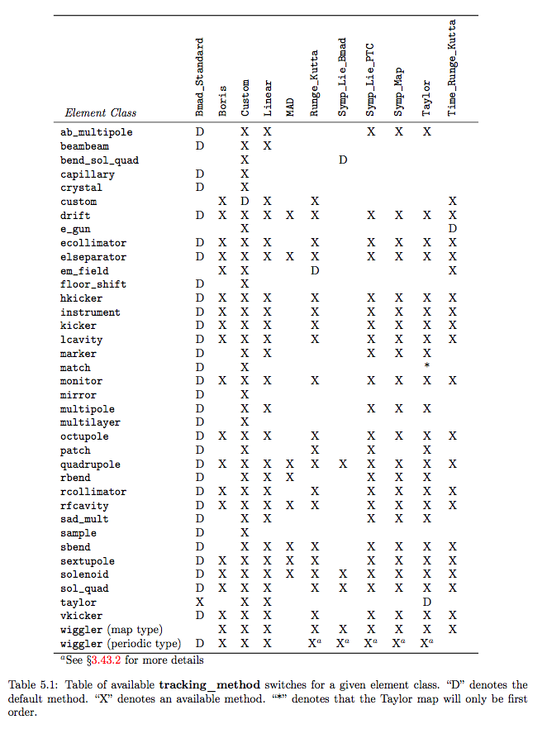
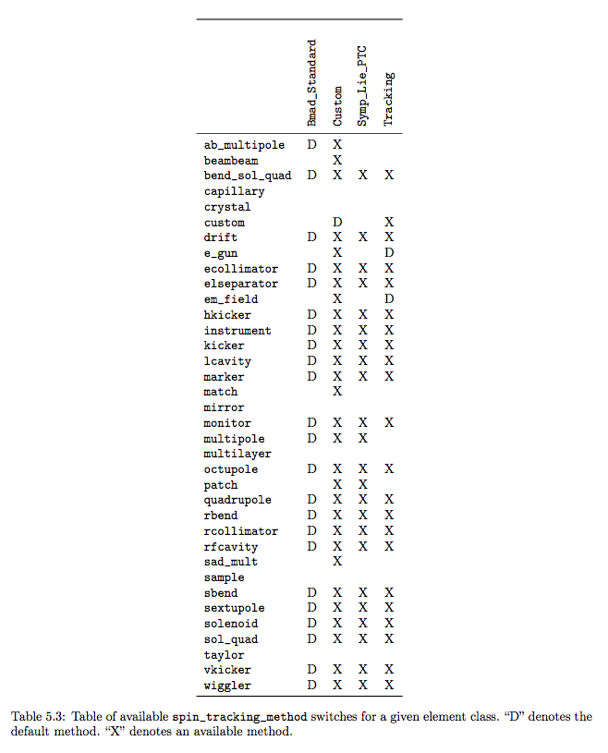
All elements and tracking methods
Spin

Slide 16
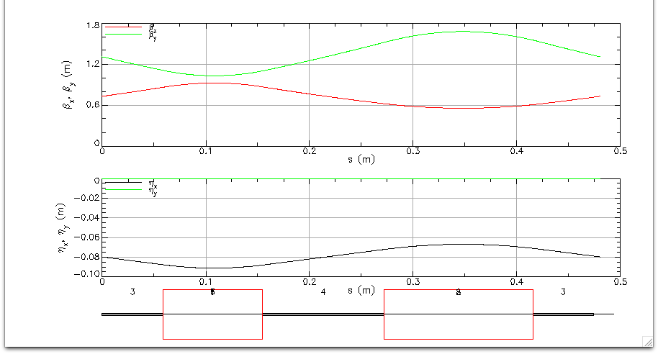
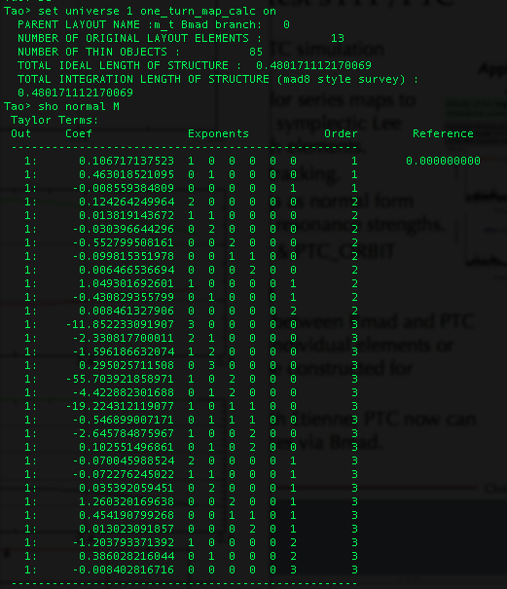
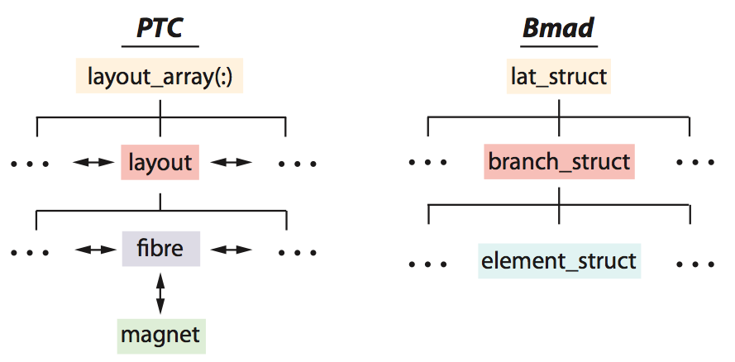
Etienne Forest’s FPP/PTC
Etienne Forest’s FPP/PTC simulation toolkit:
  Taylor maps to arbitrary order via symplectic integration through elements.
  Spin tracking.
  Normal form analysis.
  Amplitude Dependent Spin Tune and Invariant Spin Field calculations.
  Also used in MAD-X & PTC_ORBIT
FFAG cell
Interface routines between Bmad and PTC allow tracking of individual elements or PTC lattices can be constructed for analysis.
One turn map calc in Tao

Slide 17
X-ray simulation
Both incoherent and coherent ray-tracing implemented (but needs more testing).
X-ray tracking elements developed:
  Crystal ! Bragg & Laue diffraction
  Capillary ! Focus X-rays
  Mirror
  Multilayer Mirror
  Diffraction_plate ! Apertures, Zone plates
Bragg crystal diffraction simulation

Slide 18
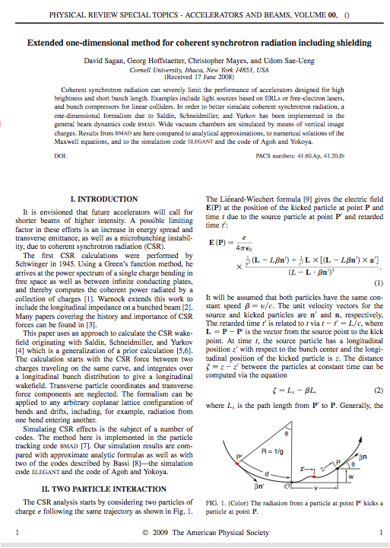
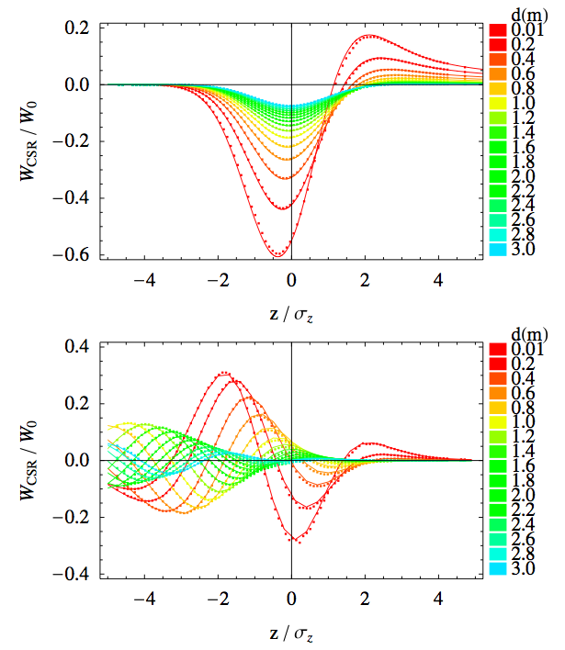
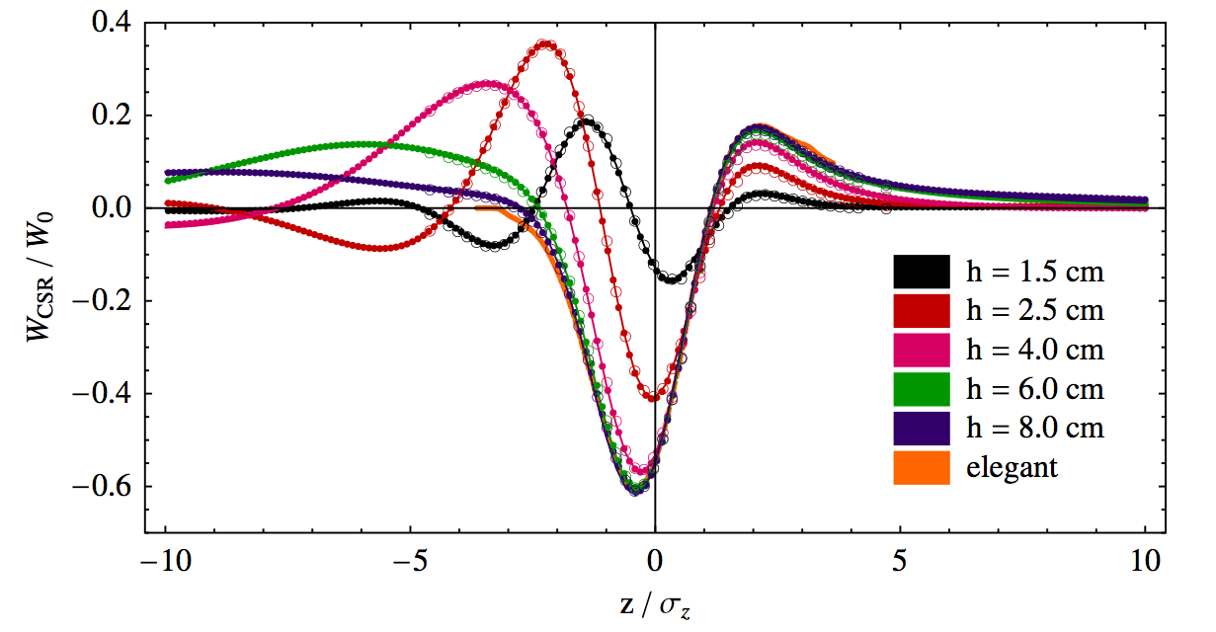
CSR with Shielding
We developed and benchmarked a 1-D CSR simulation technique with shielding by the vacuum chamber in Bmad
[Sagan, Hoffstaetter, Mayes, Sae-Ueng PRST-AB 12, 040703 (2009)]
Exit Transient
Free space
Compared with Agoh & Yokoya
shielding

Slide 19
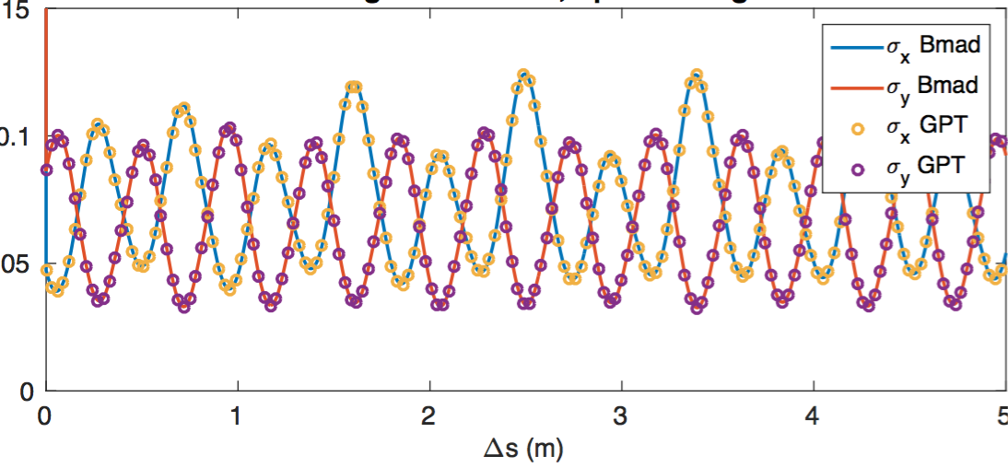
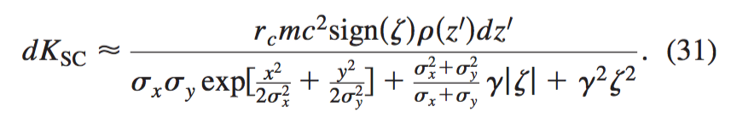
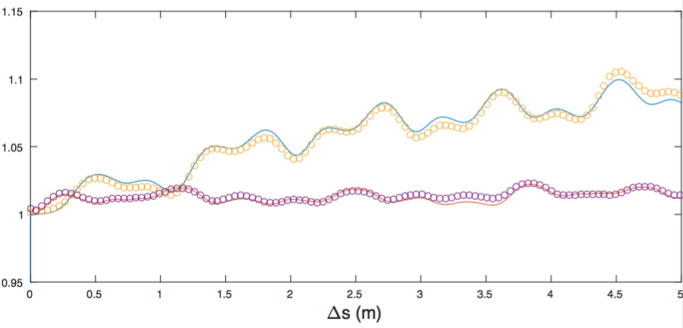
Transverse Space Charge
1 nC bunch through straight FFAG section at 42 MeV
Also in the 2009 paper was an excellent approximation of the space charge kick due to a Gaussian slice
This includes both longitudinal and transverse space charge

Slide 20
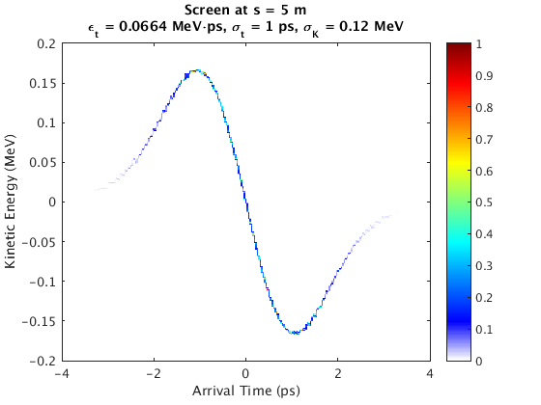
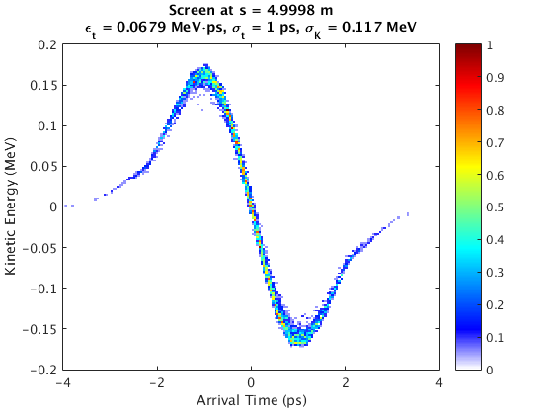
Longitudinal Space Charge
Also in the 2009 paper was an excellent approximation of the space charge kick due to a Gaussian slice
This includes both longitudinal and transverse space charge
Bmad
GPT

Slide 21
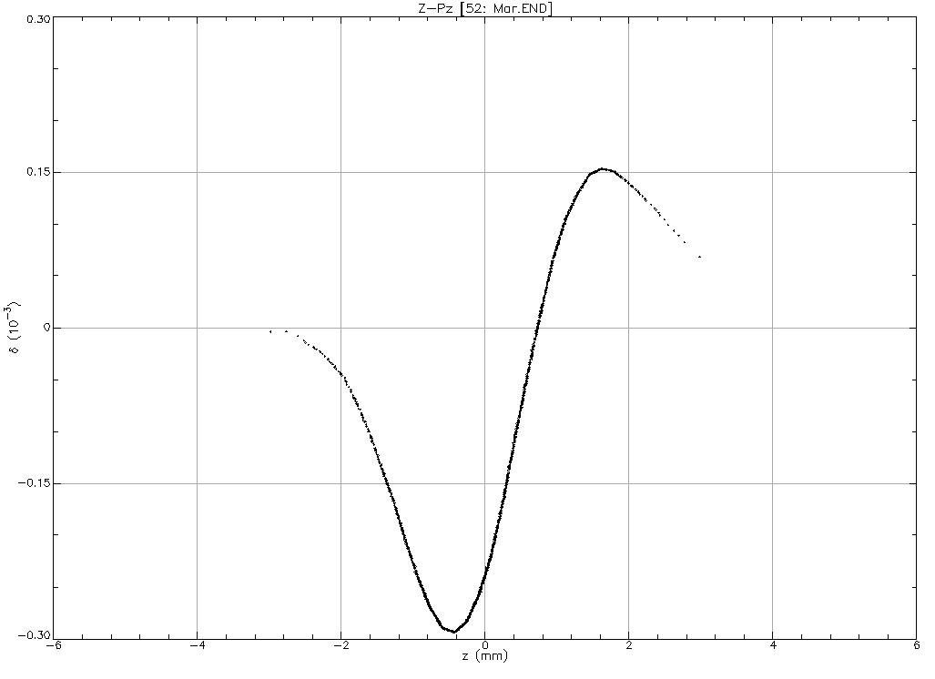
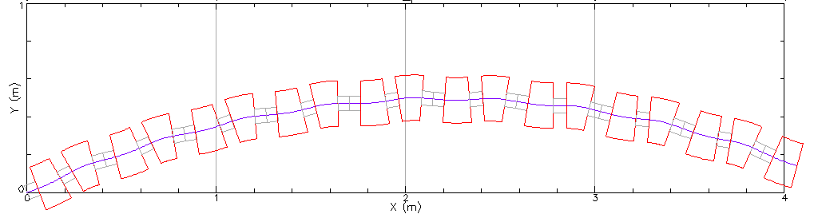
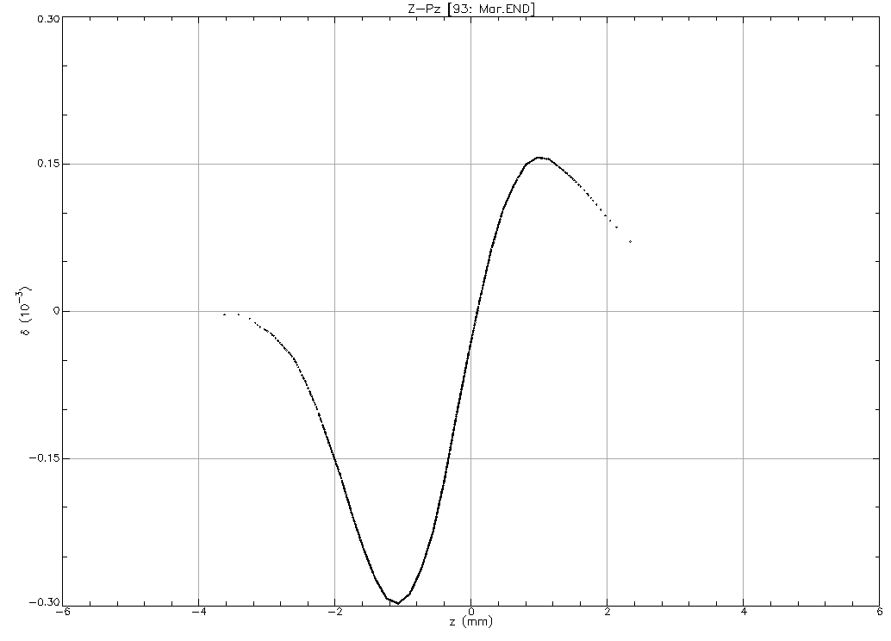
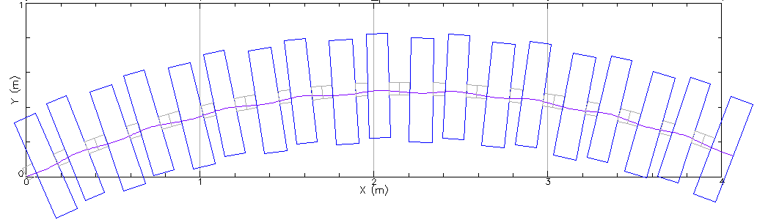
More general 1-D CSR model
Page Headline
The old code and 2009 paper assumed that the beam followed the reference coordinate system
The new code has been generalized to deal with arbitrary orbits and is currently being benchmarked
Beam follows reference (bends with quad moment)
Beam orbit with offset quads

Slide 22
Bmad Ecosystem
Due to its flexibility, Bmad has been used in a number of programs including:
  tao General purpose design and simulation.
  synrad3d 3D tracking of synch photons, including reflections, within the beam chamber.
  cesrv On-line data taking, simulation, and machine correction for CESR.
  dark_current_tracker Dark current electron simulation.
  freq_map Frequency map analysis.
  ibs_sim Analytic intra-beam scattering (IBS) calculation.
  touschek_track Tracking of Touschek particles.
  etc...
  Code reuse: Modules developed for one program can, via Bmad, be used in other programs.

Slide 23
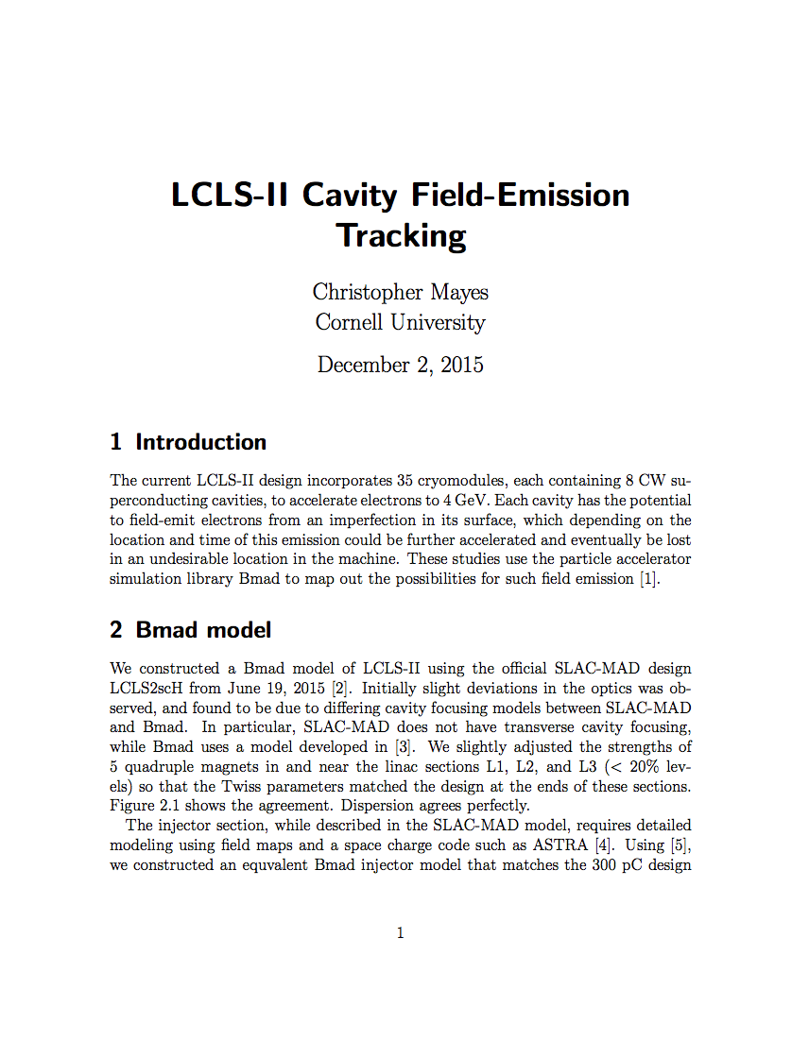
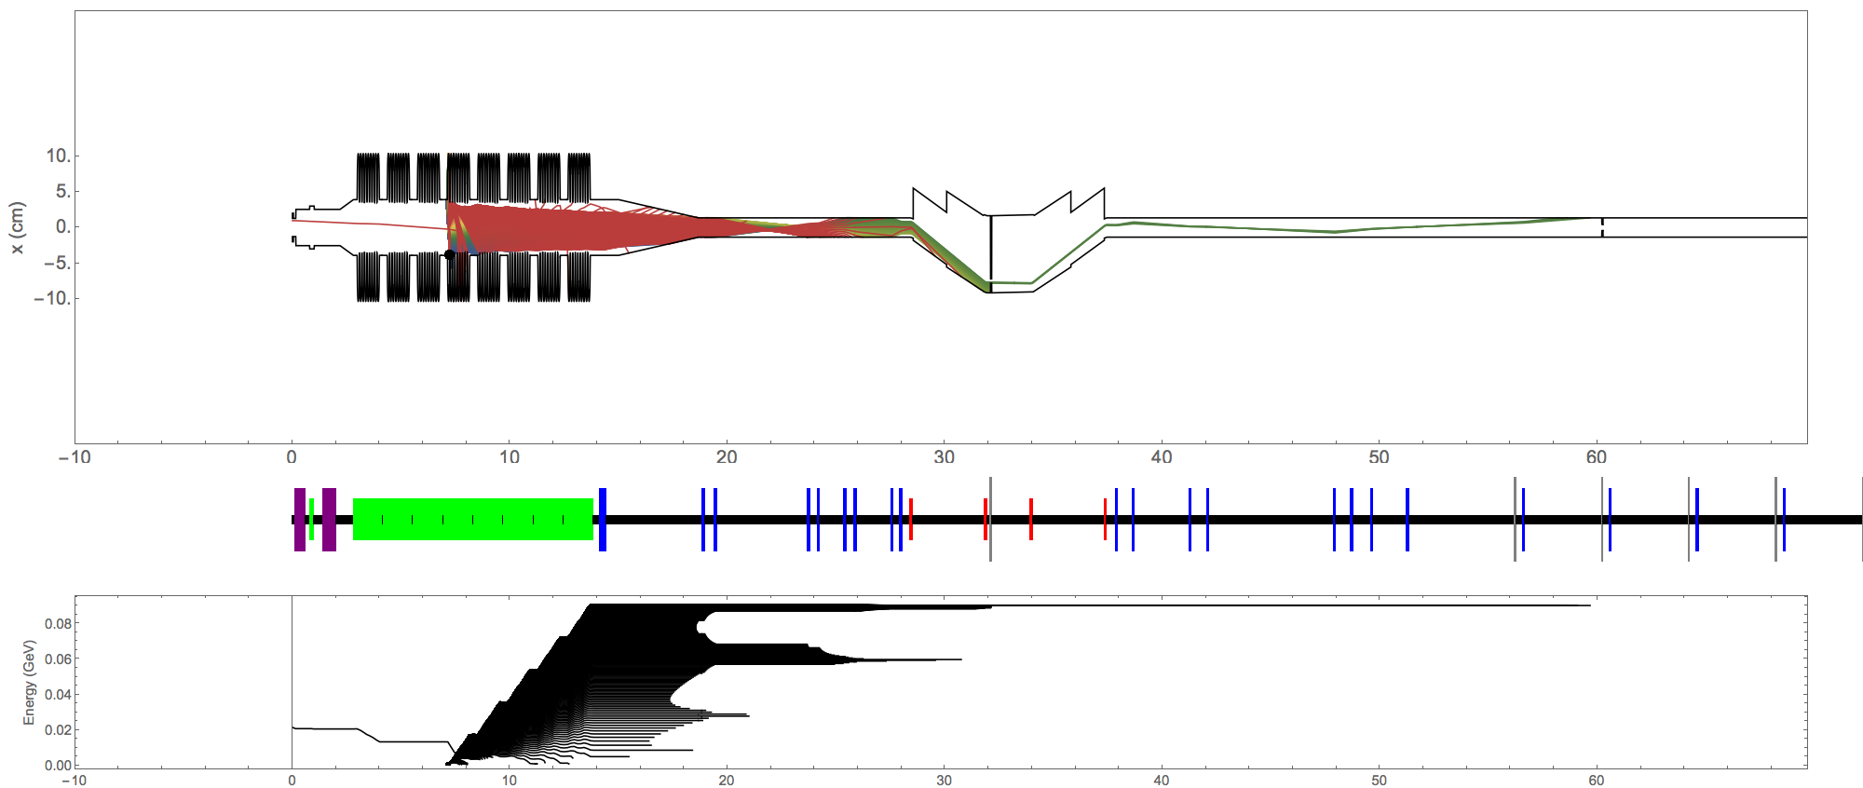
Dark Current Tracking for LCLS2
Field emitters
https://www.classe.cornell.edu/~cem52/LCLS2/2015_09_16-LCLS2_dark_current.pdf

Slide 24
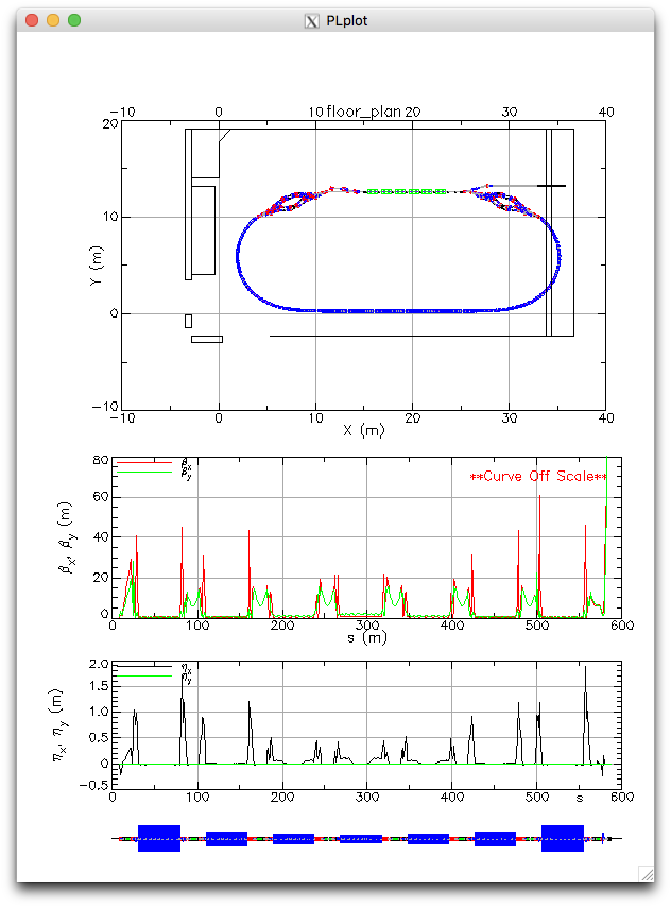
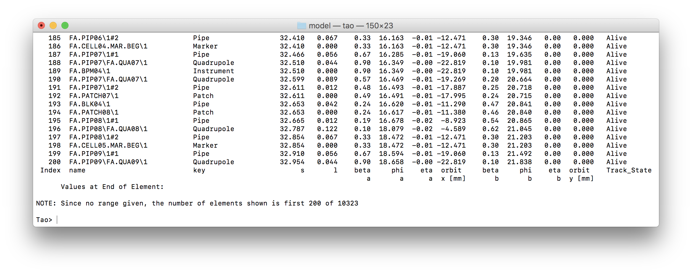
Tao: Tool for Accelerator Optics
Problem: Bmad is not a program so it cannot be used “out of the box” for simple calculations.
Solution: Develop Tao - a general purpose simulation & design program with
  Twiss and orbit calculations.
  Nonlinear optimization.
  Analysis of complicated geometries.
  Etc.
Additionally: Tao’s object oriented coding makes it relatively easy to extend it.
  Can add custom commands to interface Tao with a control system.
  Can be driven by Python
CBETA 4-pass ERL

Slide 25
Tao [continued]
Example: Designing or modifying a machine to be/stay within an existing building:
Tao with Bmad gives the flexibility of a library with the convenience of a program.

Slide 26
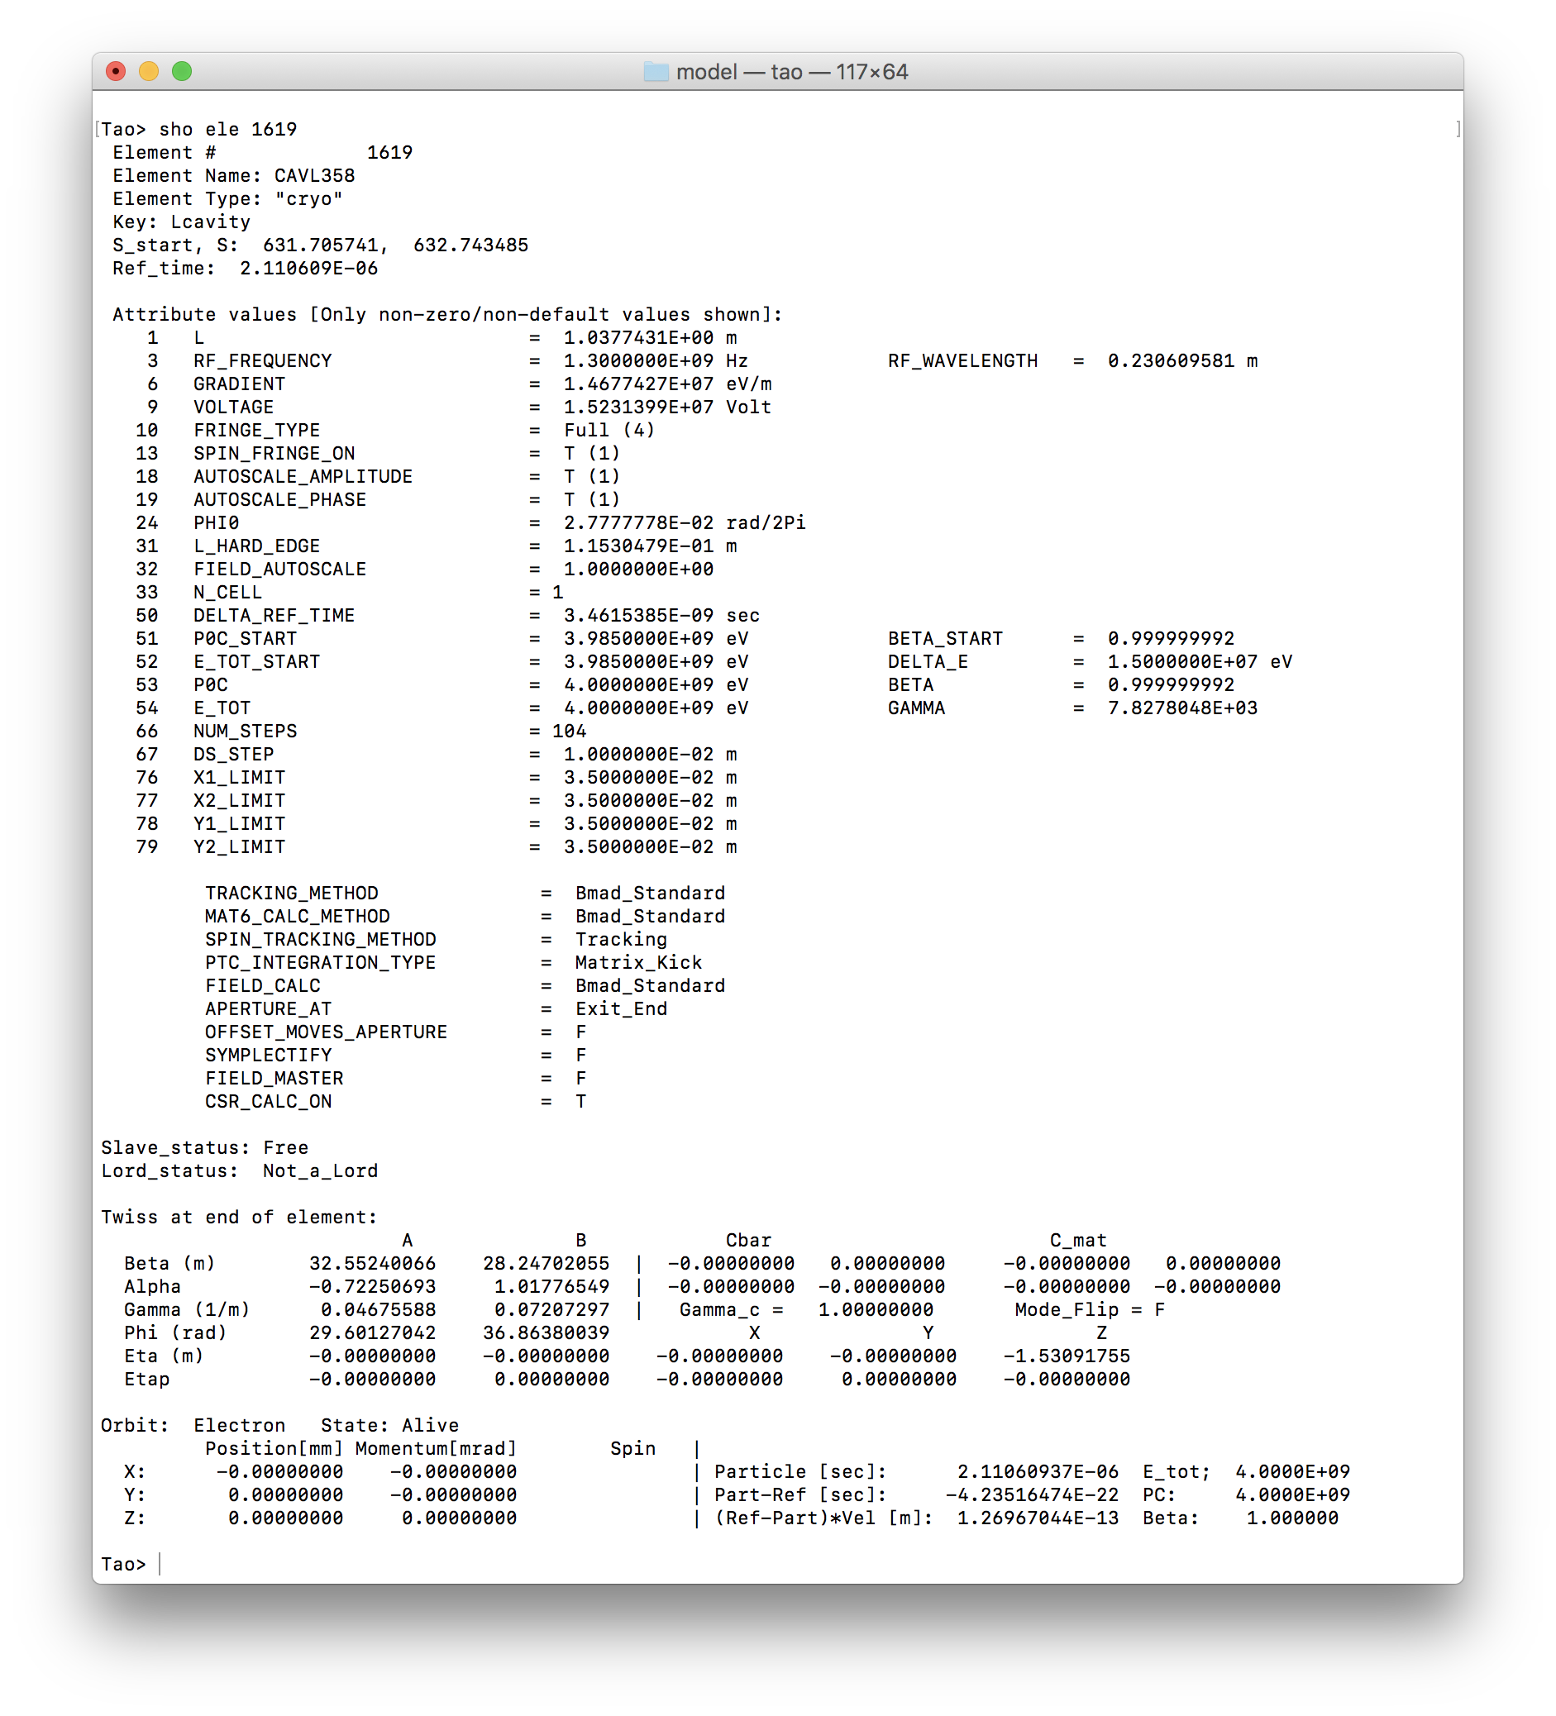
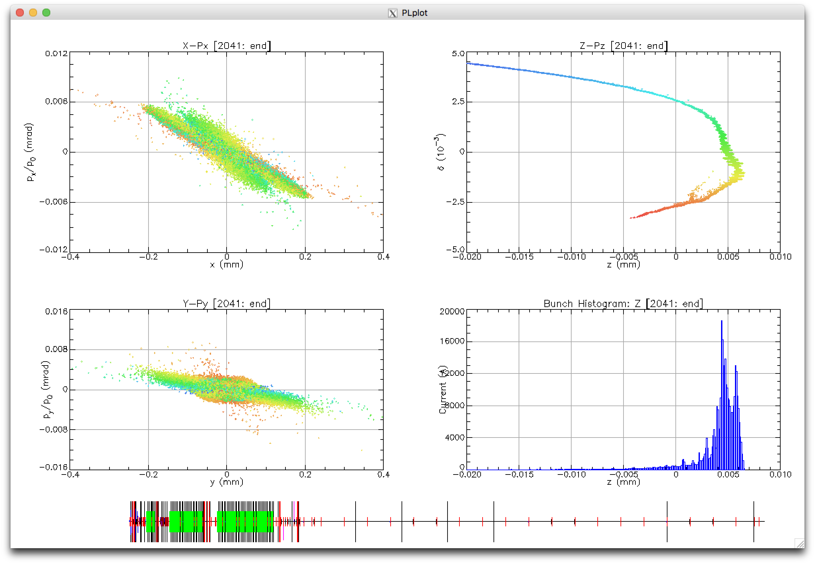
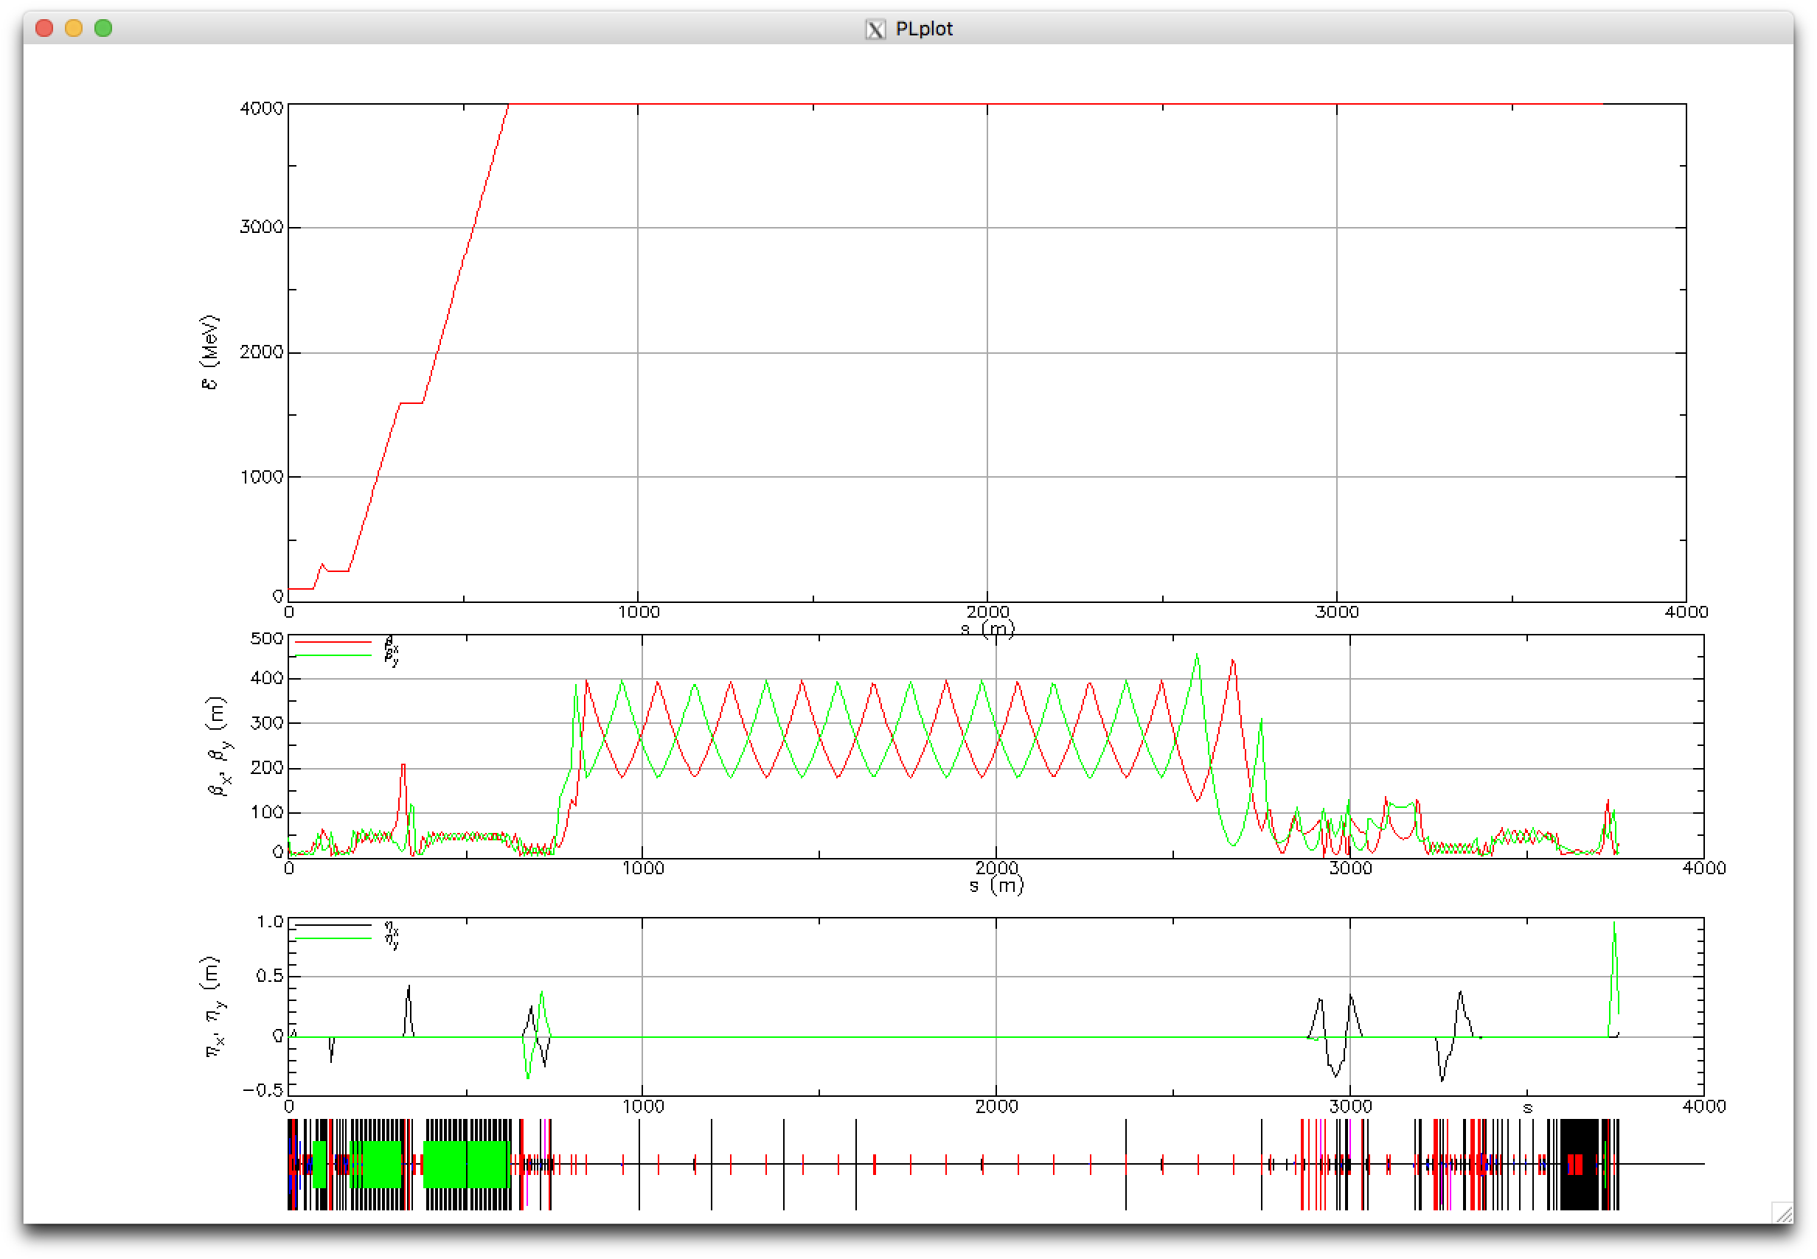
Tao running the LCLS2 lattice

Slide 27
Tao as an online model
Tao Live interactive display
CSR, Space Charge tracking
Tao> call read_EPICS.tao
(repeat)
Tao> call read_EPICS.tao
(repeat)
Tao> call write_data.tao
Discover errors
Python wrapper
Tao> use data bpms
Tao> use variable quad_offsets
Tao> derivative. ! Calculates response of offset quad to BPM
Tao> show derivative
Tao> call read_BPMS_EPICS.tao
Tao> run_optimizer
Python >>>
>>> from pytao.tao import Tao
>>> tao = Tao('-lat my_lat.bmad')
>>> tao.command('use var *')
>>> doutput = tao.capture('show top10')
>>> print(output)

Slide 28
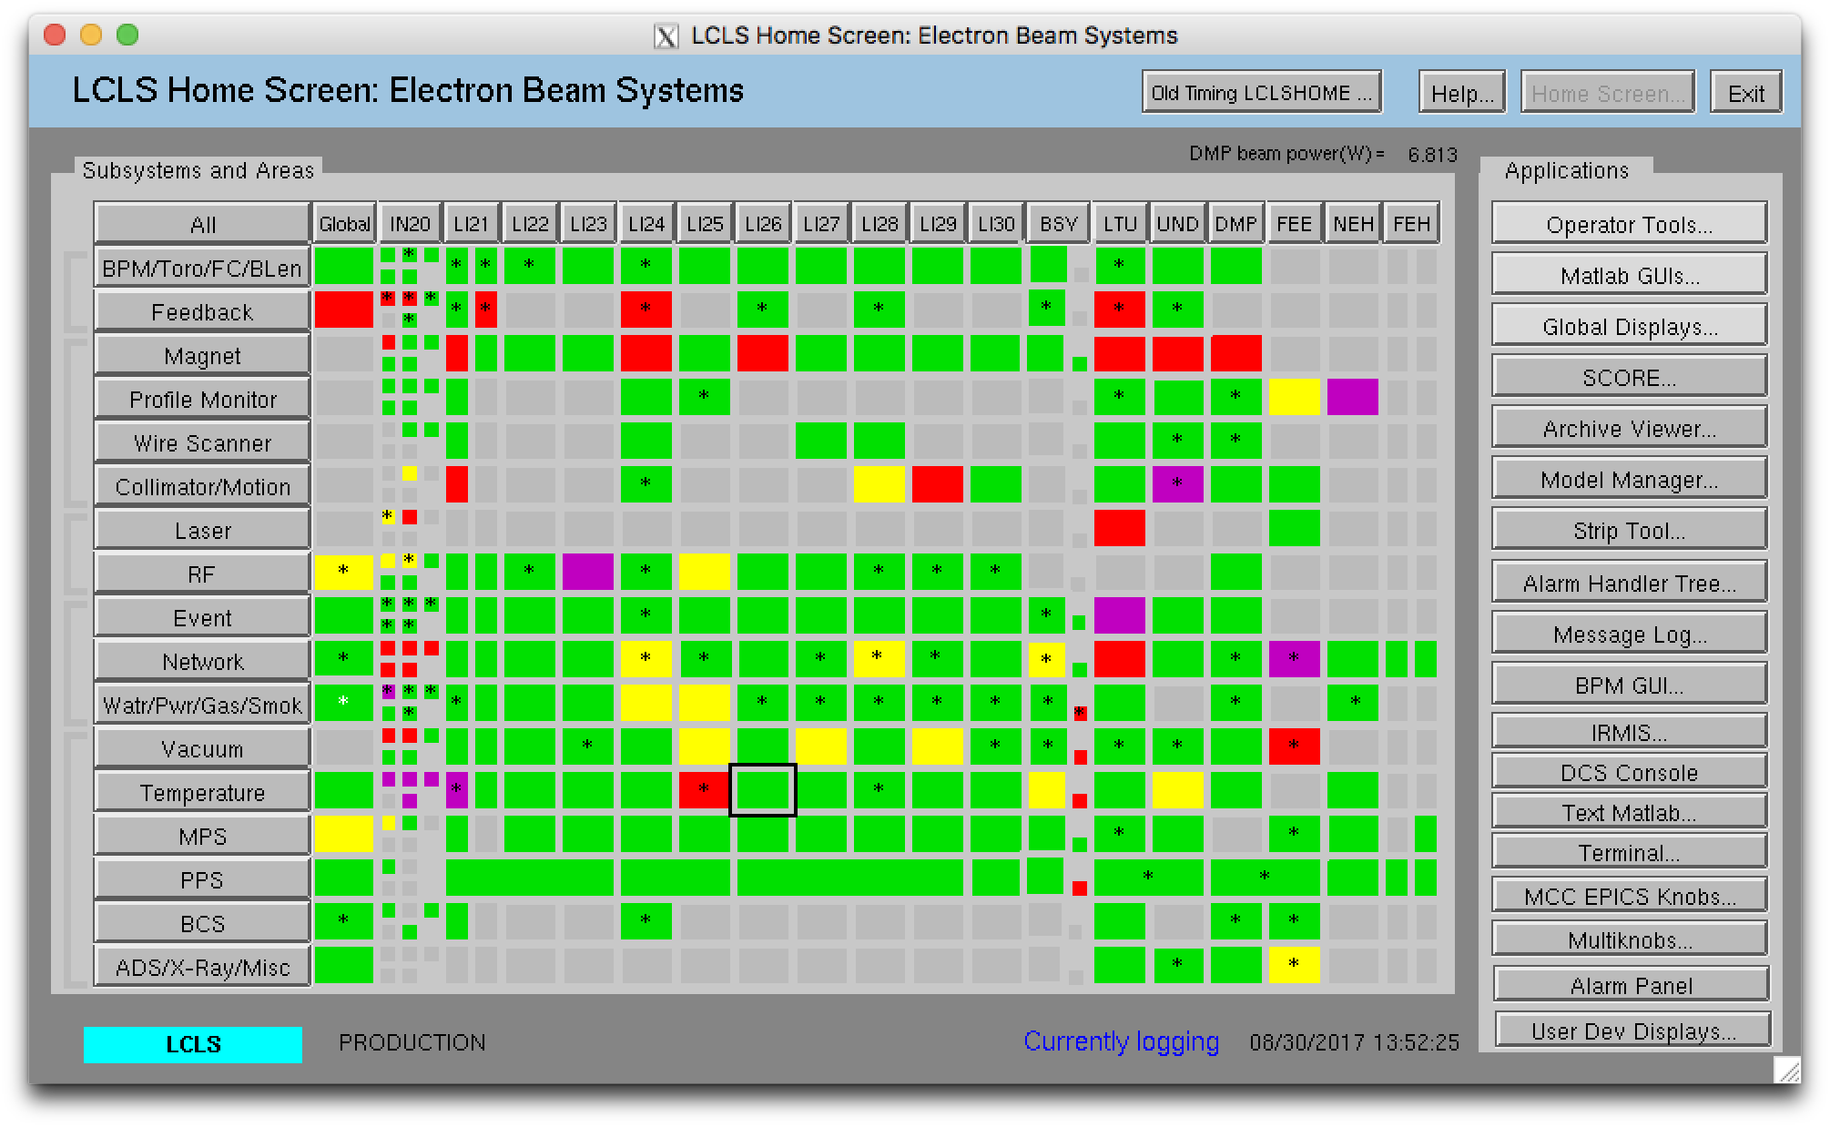
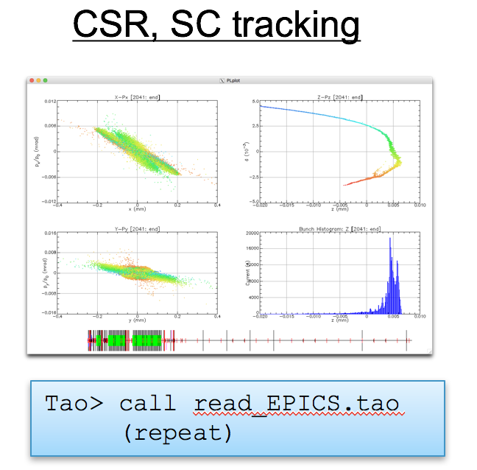
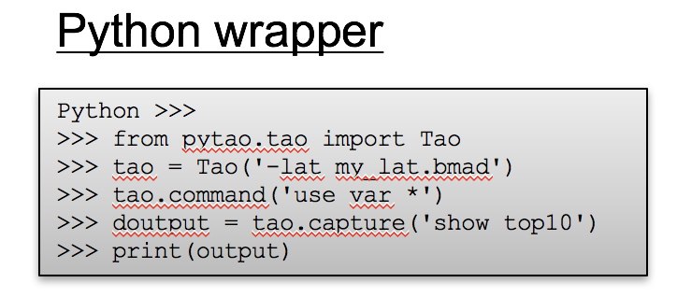
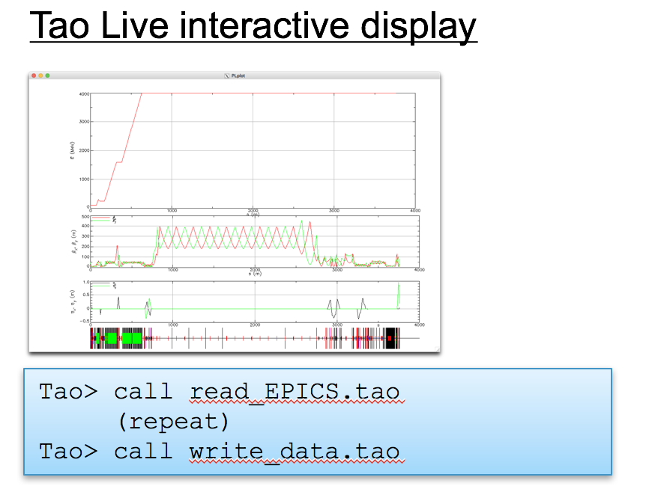
Architecture
Applications
lclshome
Offline (slow) simulations
database
Saved lattices
…
Tao> optics correction
Survey, Magnetic Measurements, etc.
MAD> optics calc
Data servers
Element strengths
BPM data
…
Machine
devices

Slide 29
Summary Bmad advantages
  State-of-the-art tracking methods, fast and slow
  Arbitrary trajectory 1-D CSR model with shielding
  Medium-High energy space charge model
  Field maps for any element, can overlap other elements
  Superposition: Greatly simplifies lattice layout, bookkeeping
  Patch element: Enables arbitrary arrangement of magnets
  Controller elements: define arbitrary knobs
  Continuous beam chamber walls, masks
  Forking: Multiple connected lines
  Reads MAD, XSIF, SAD lattice formats
  Translation routines to Astra, OPAL, MAD, XSIF, SAD, …
  Spin tracking
  X-ray tracking
  Dark current tracking
  Software toolkit: Maximum flexibility for custom programs

Slide 30
Summary Tao advantages
  Design tool
  Fast online optics calculation
  Multiple optimization methods
  Bunch tracking with CSR, Space charge
  Response of anything to anything: discover quad misalignments
  Built-in plotting
  Customizable via hook routines
  Python interface for automation, advanced GUIs

