Slide 1
Modeling LCLS, LCLS-II:
Bmad and Beyond
Christopher Mayes
October 30, 2017

Slide 2
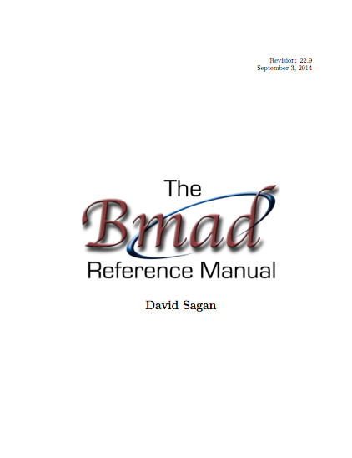
Bmad Overview
Written in Fortran 2008.
Object-oriented from the ground up.
Has structure translation code for interfacing with C++.
With certain restrictions, Bmad can be run multi-threaded.
Lattice files use a MAD like syntax.
Well documented (Manual is ~500 pages).
  Open Source:
  http://www.lepp.cornell.edu/~dcs/bmad/
type (lat_struct) lat
call bmad_parser (‘lat.bmad’, lat)
Notes:
In this example lat is an instance of a lat_struct.
A lat_struct is a structure that holds all the information about a lattice.
Including a list of the lattice elements, magnet strengths, etc.
The call to bmad_parser takes a lattice file name
and bmad_parser will fill the lat instance with the parsed information

Slide 3

In the Beginning…
Brief History of Bmad:
  Bmad is a software toolkit for the simulation of charged particles and X-rays.
  Born at Cornell in mid 1990s
  Started life as modest project: Just wanted to calculate Twiss functions and closed orbits.
  Initially Bmad used a subset of the MAD lattice syntax. Hence the name: “Baby MAD” or “Bmad” for short.
Over the years Bmad had evolved…
Notes:
And Baby has grown up

Slide 4
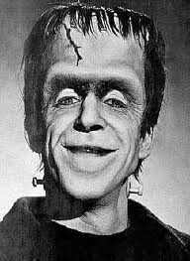
And Baby Grows Up...
Currently:
    ~100,000 lines of code
    ~1,000 routines
And it can do much more:
    Lattice design
    X-ray simulations
    Spin tracking
    Wakefields and HOMs
    Beam breakup simulations in ERLs
    Intra-beam scattering (IBS) simulations
    Coherent Synchrotron Radiation (CSR)
    Touschek Simulations
    Frequency map analysis
    Dark current tracking
    Etc., etc.

Slide 5
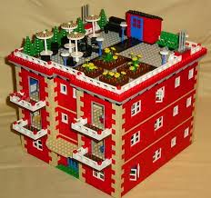
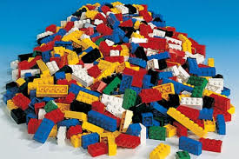
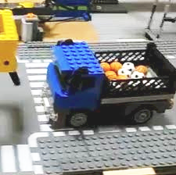
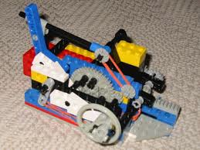
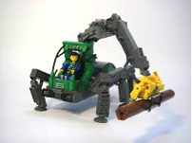
Bmad Philosophy
Lattice Design Program
Bmad
Advantages of a toolkit:
  Cuts down on the time needed to develop programs.
  Cuts down on programming errors (via code reuse).
  Provides a simple mechanism for lattice function calculations from within control system programs.
  Standardizes sharing of lattice information between programs.
Dynamic Aperture Program
Control System Programs
IBS Simulation Programs
Etc.

Slide 6
Superposition
Physical Layout:
Internal lat_struct Representation:
Lords:
Tracking
elements:
Superposition allows element overlap. In the lattice file:
  cesr: line = (... q1e, dft, ip, dft, q1w ...)
  cleo: solenoid, l = 3.5, superimpose, ref = ip
And Bmad does the bookkeeping…
Simplifies life for both user and programmer:
  Simplifies lattice file construction
  Simplifies varying element attributes in a program

Slide 7
Forking
Bmad can join different beam lines using fork elements.
Example: SuperKEKB Low Energy Ring (LER) injection
to_LER: fork, to_line = ler, to_element = injection
inj: line = (..., to_LER) ! injection line
LER: line = (..., injection, ...) ! LER ring
use, inj
Can splice together rings, dump lines, Linacs, X-ray lines, etc. ➔ One lattice can hold the description of the entire accelerator complex.

Slide 8
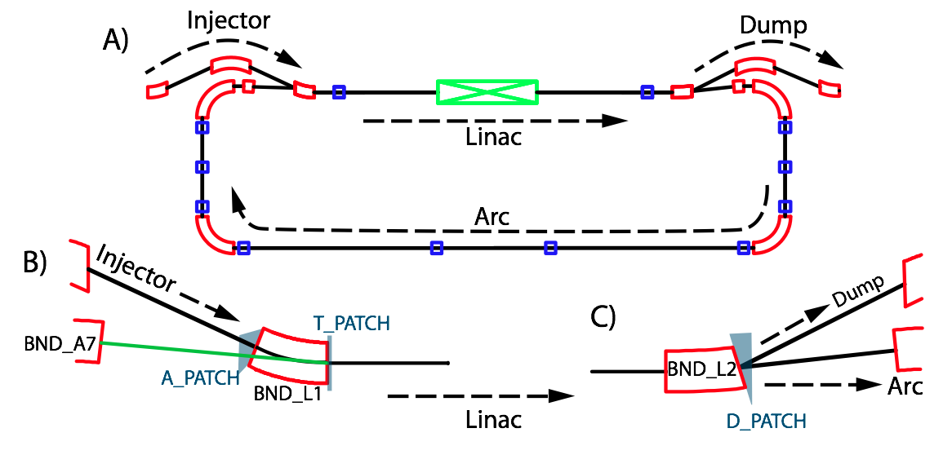
Multipass
Lines having common elements. Example ERL loop:
BEND_L1: sbend, angle = -25*pi/180, l = 0.2, ...
BEND_L2: BEND_L1
A_PATCH: patch, flexible = T
D_PATCH: patch, x_offset = -0.034, x_offset = asin(-0.32)
INJECT: line = (...)
LINAC: line[multipass] = (BEND_L1, ..., BEND_L2)
ARC: line = (..., BEND_A7)
DUMP: line = (...)
ERL: line = (INJECT, LINAC, ARC, A_PATCH, LINAC, D_PATCH, DUMP)

Slide 9
Tracking method selection
Can set how each element is tracked:
  bmad_standard Fast, nonsymplectic
  symp_lie_ptc Symplectic tracking using PTC
  taylor Taylor map tracking using PTC
  linear Linear tracking
  runge_kutta Track through fields.
  custom Tracking with custom code
  …
my_ele: em_field, tracking_method = runge_kutta, field_calc=custom, ...
Advantages:
  Enables simulation of unique element types
  Can compare different tracking methods

Slide 10
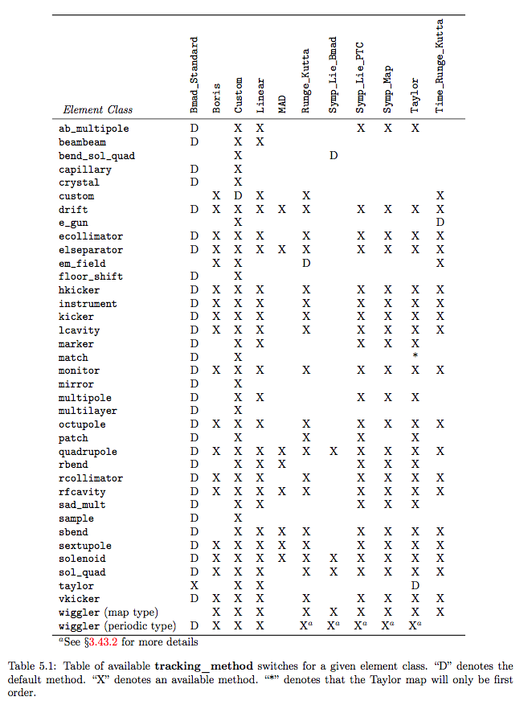
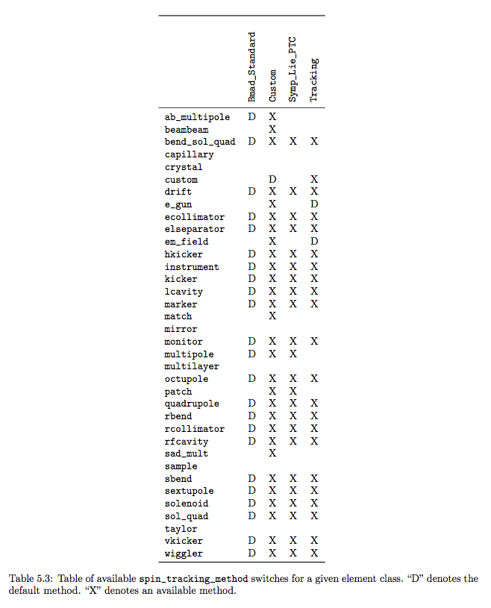
All elements and tracking methods
Spin

Slide 11
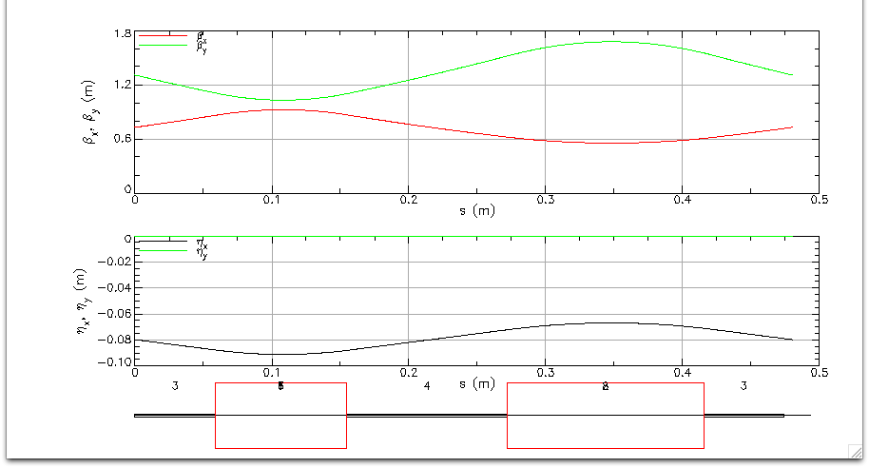
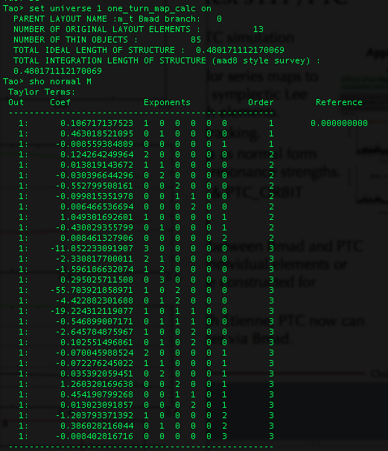
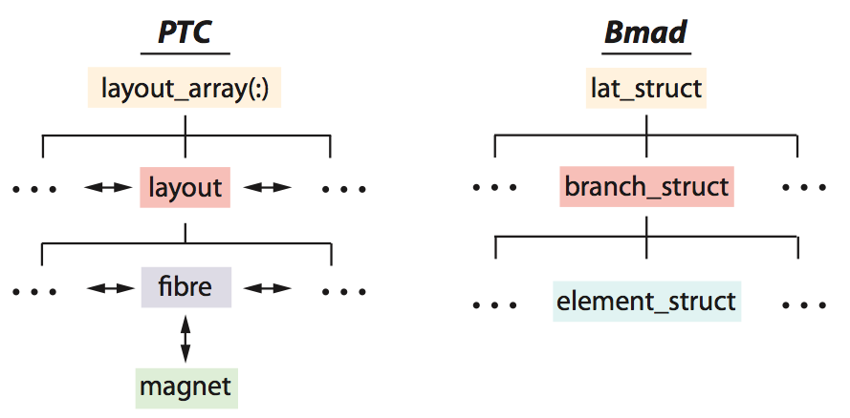
Etienne Forest’s FPP/PTC
Etienne Forest’s FPP/PTC simulation toolkit:
  Taylor maps to arbitrary order via symplectic integration through elements.
  Spin tracking.
  Normal form analysis.
  Amplitude Dependent Spin Tune and Invariant Spin Field calculations.
  Also used in MAD-X & PTC_ORBIT
FFAG cell
Interface routines between Bmad and PTC allow tracking of individual elements or PTC lattices can be constructed for analysis.
One turn map calc in Tao

Slide 12
X-ray simulation
Both incoherent and coherent ray-tracing implemented (but needs more testing).
X-ray tracking elements developed:
  Crystal ! Bragg & Laue diffraction
  Capillary ! Focus X-rays
  Mirror
  Multilayer Mirror
  Diffraction_plate ! Apertures, Zone plates
Bragg crystal diffraction simulation

Slide 13
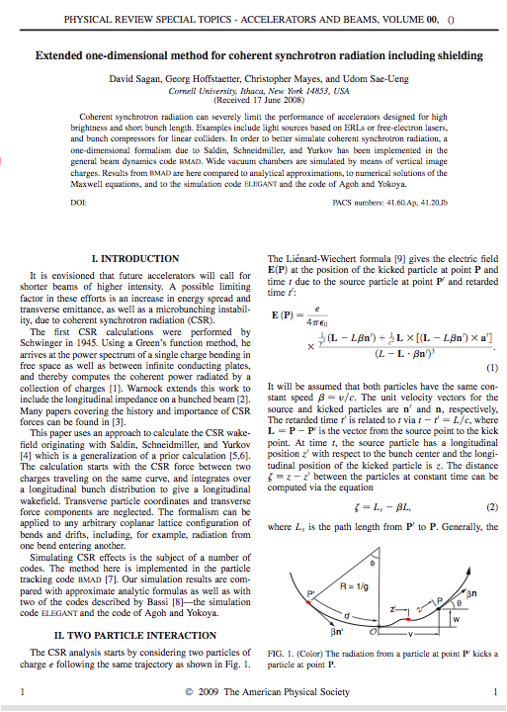
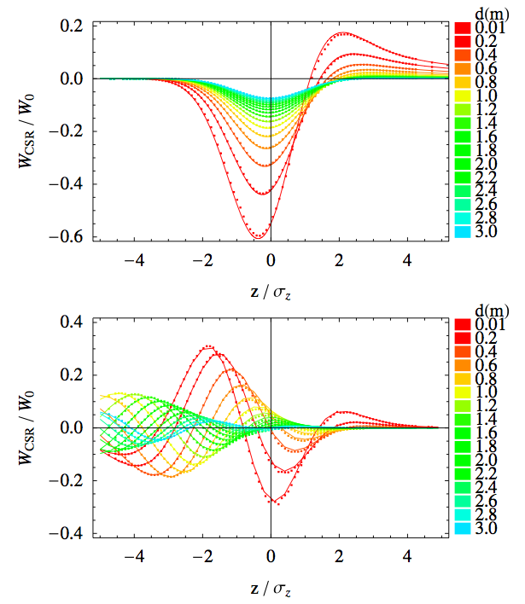
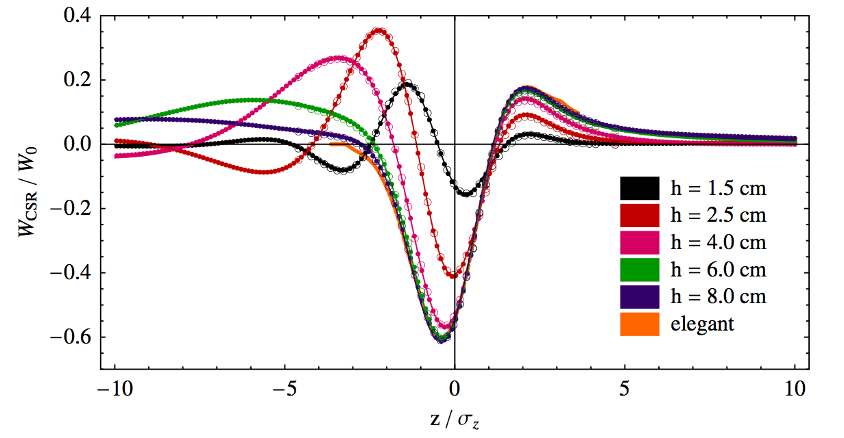
CSR with Shielding
We developed and benchmarked a 1-D CSR simulation technique with shielding by the vacuum chamber in Bmad
[Sagan, Hoffstaetter, Mayes, Sae-Ueng PRST-AB 12, 040703 (2009)]
Exit Transient
Free space
Compared with Agoh & Yokoya
shielding

Slide 14
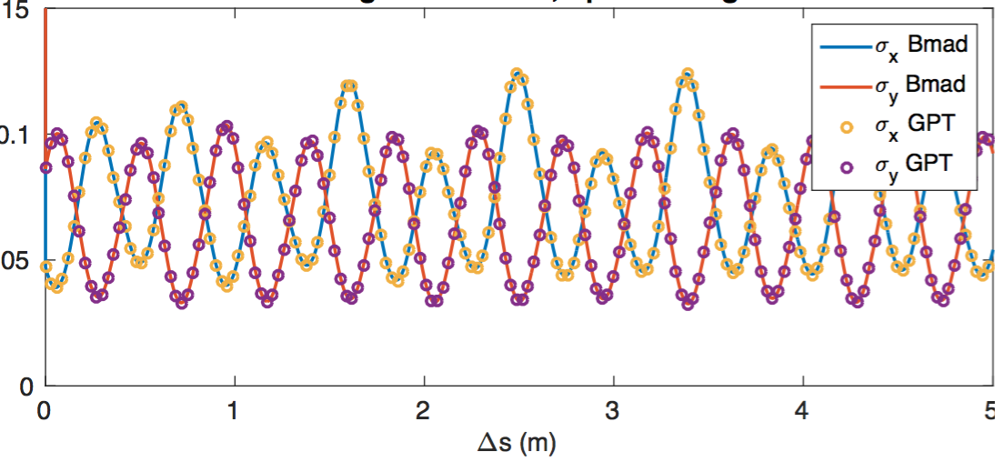
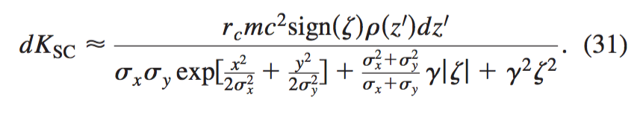
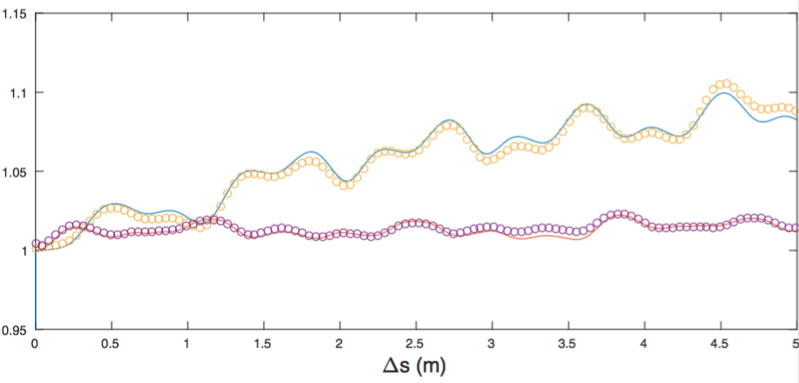
Transverse Space Charge
1 nC bunch through straight FFAG section at 42 MeV
Also in the 2009 paper was an excellent approximation of the space charge kick due to a Gaussian slice
This includes both longitudinal and transverse space charge

Slide 15
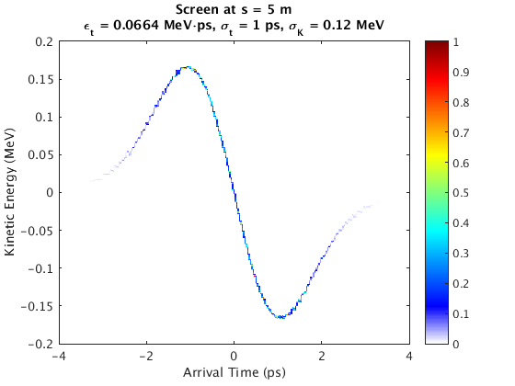
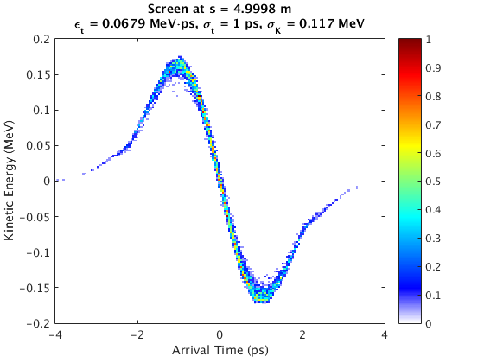
Longitudinal Space Charge
Also in the 2009 paper was an excellent approximation of the space charge kick due to a Gaussian slice
This includes both longitudinal and transverse space charge
Bmad
GPT

Slide 16
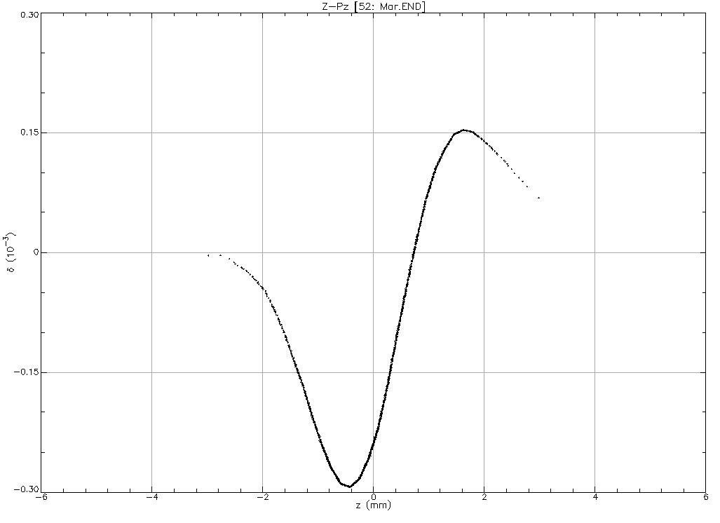
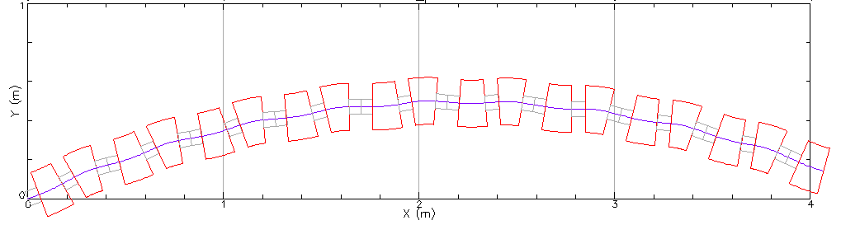
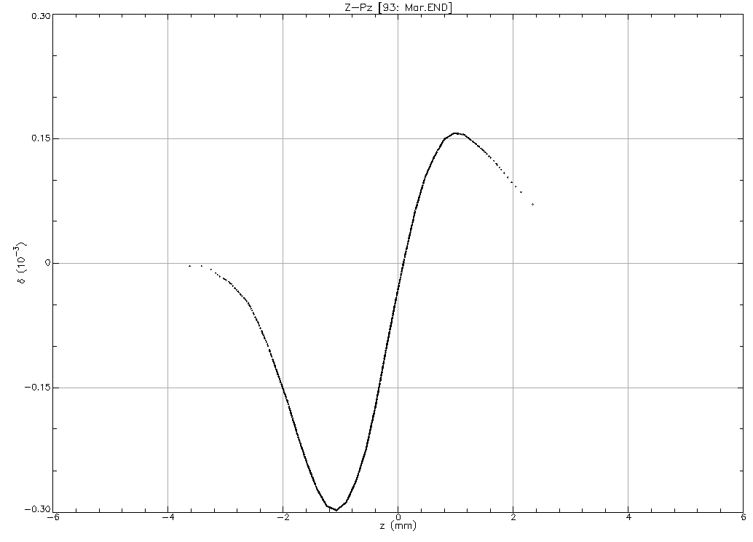
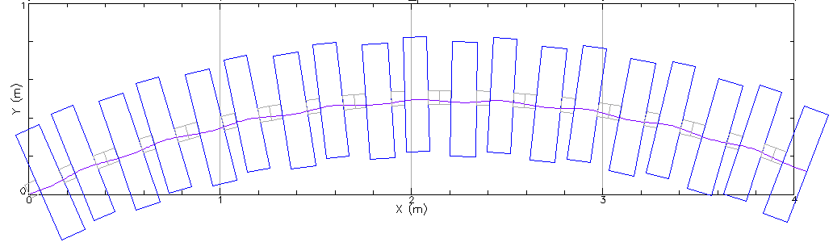
More general 1-D CSR model
Page Headline
The old code and 2009 paper assumed that the beam followed the reference coordinate system
The new code has been generalized to deal with arbitrary orbit.
IPAC17:THPAB076
Beam follows reference (bends with quad moment)
Beam orbit with offset quads

Slide 17
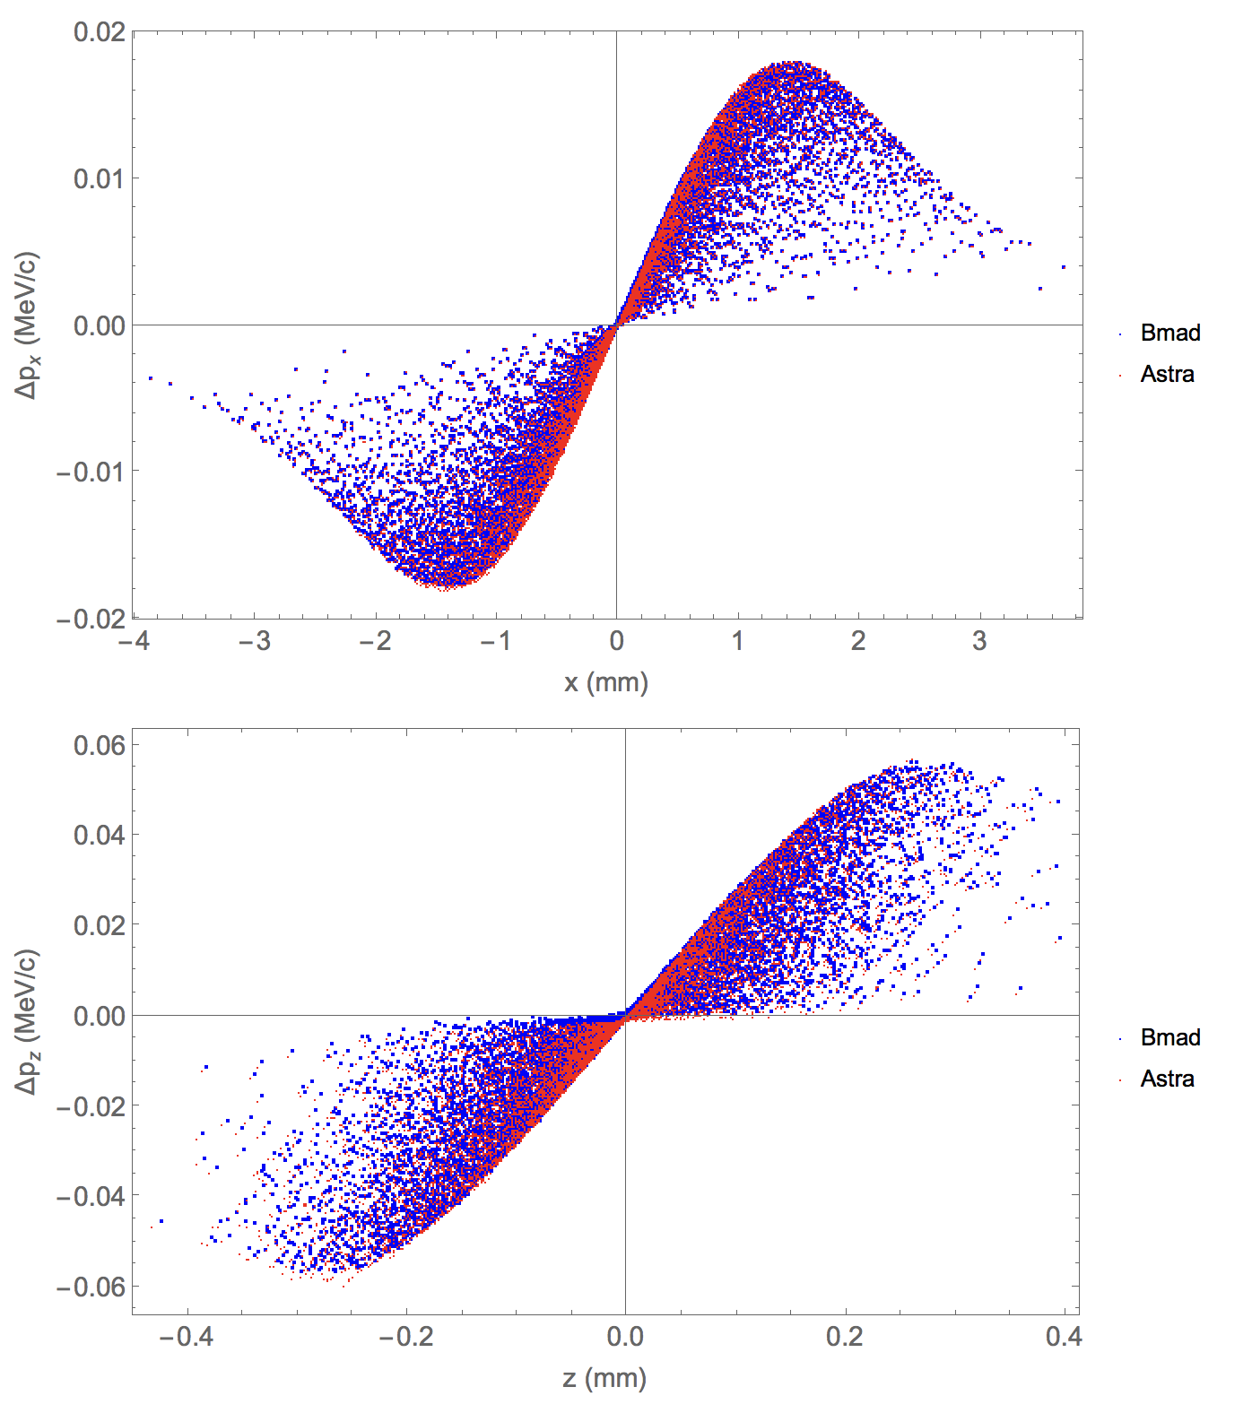
NEW: 3D spacecharge
Page Headline
Robert Ryne (LBNL, original author of IMPACT) has developed a new stand-alone space charge package.
Parallelized via MPI
Open source
New collaboration to generalize its use for easy integration into other codes.
Currently incorporating it into Bmad
Adding OpenMP parallelization.
Benchmarks well with Astra, ImpactZ, MaryLie/IMPACT

Slide 18
Bmad Ecosystem
Due to its flexibility, Bmad has been used in a number of programs including:
  tao General purpose design and simulation.
  synrad3d 3D tracking of synch photons, including reflections, within the beam chamber.
  cesrv On-line data taking, simulation, and machine correction for CESR.
  dark_current_tracker Dark current electron simulation.
  freq_map Frequency map analysis.
  ibs_sim Analytic intra-beam scattering (IBS) calculation.
  touschek_track Tracking of Touschek particles.
  etc...
  Code reuse: Modules developed for one program can, via Bmad, be used in other programs.

Slide 19
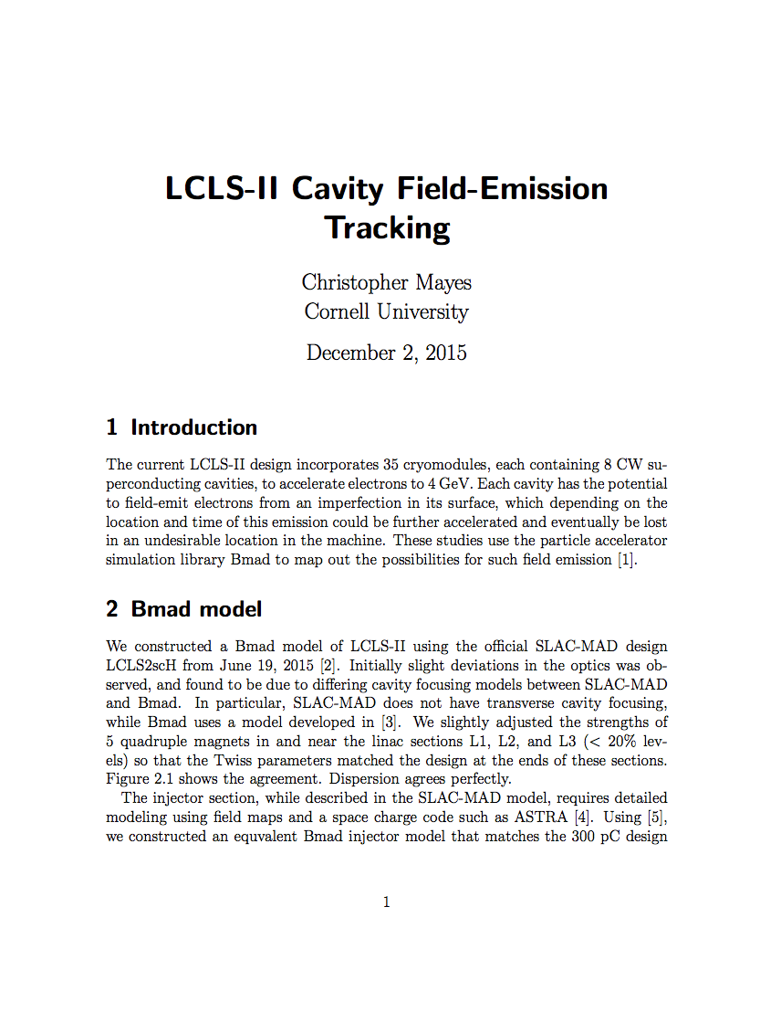
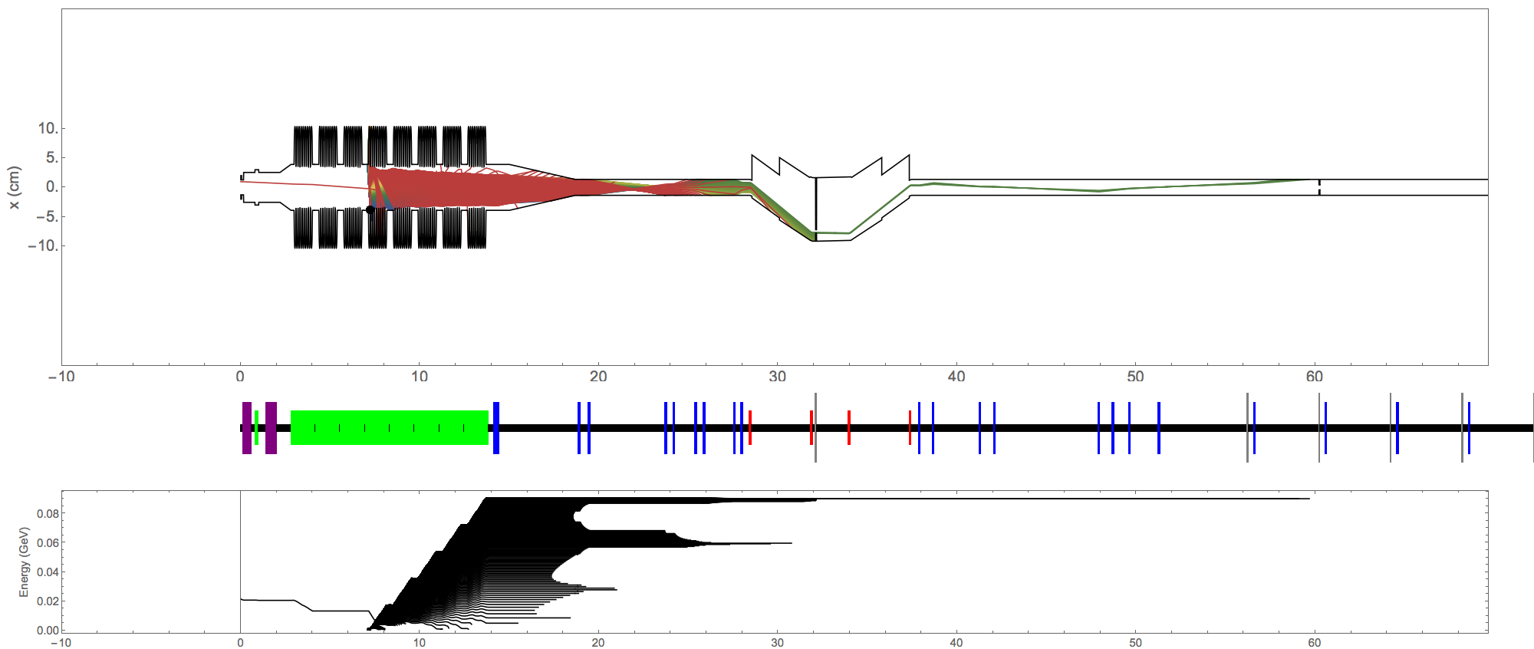
Dark Current Tracking for LCLS2
Field emitters
https://www.classe.cornell.edu/~cem52/LCLS2/2015_09_16-LCLS2_dark_current.pdf

Slide 20
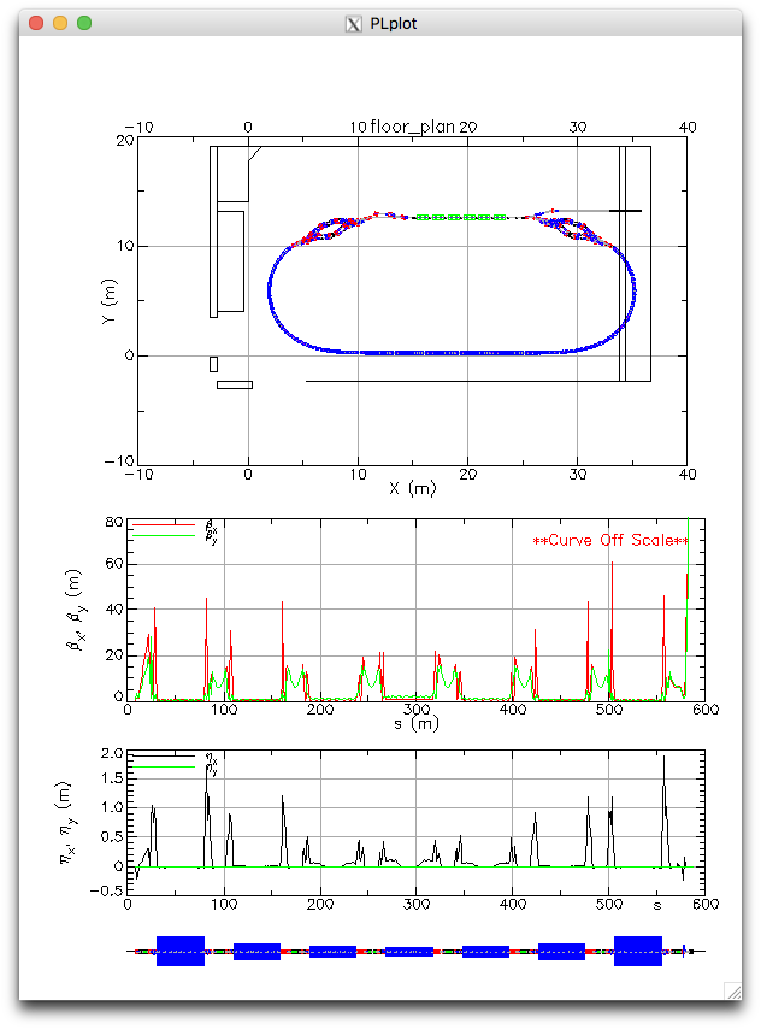
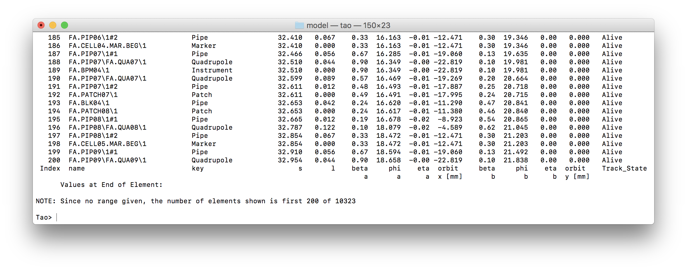
Tao: Tool for Accelerator Optics
Problem: Bmad is not a program so it cannot be used “out of the box” for simple calculations.
Solution: Develop Tao - a general purpose simulation & design program with
  Twiss and orbit calculations.
  Nonlinear optimization.
  Analysis of complicated geometries.
  Etc.
Additionally: Tao’s object oriented coding makes it relatively easy to extend it.
  Can add custom commands to interface Tao with a control system.
  Can be driven by Python
CBETA 4-pass ERL

Slide 21
Tao [continued]
Example: Designing or modifying a machine to be/stay within an existing building:
Tao with Bmad gives the flexibility of a library with the convenience of a program.

Slide 22
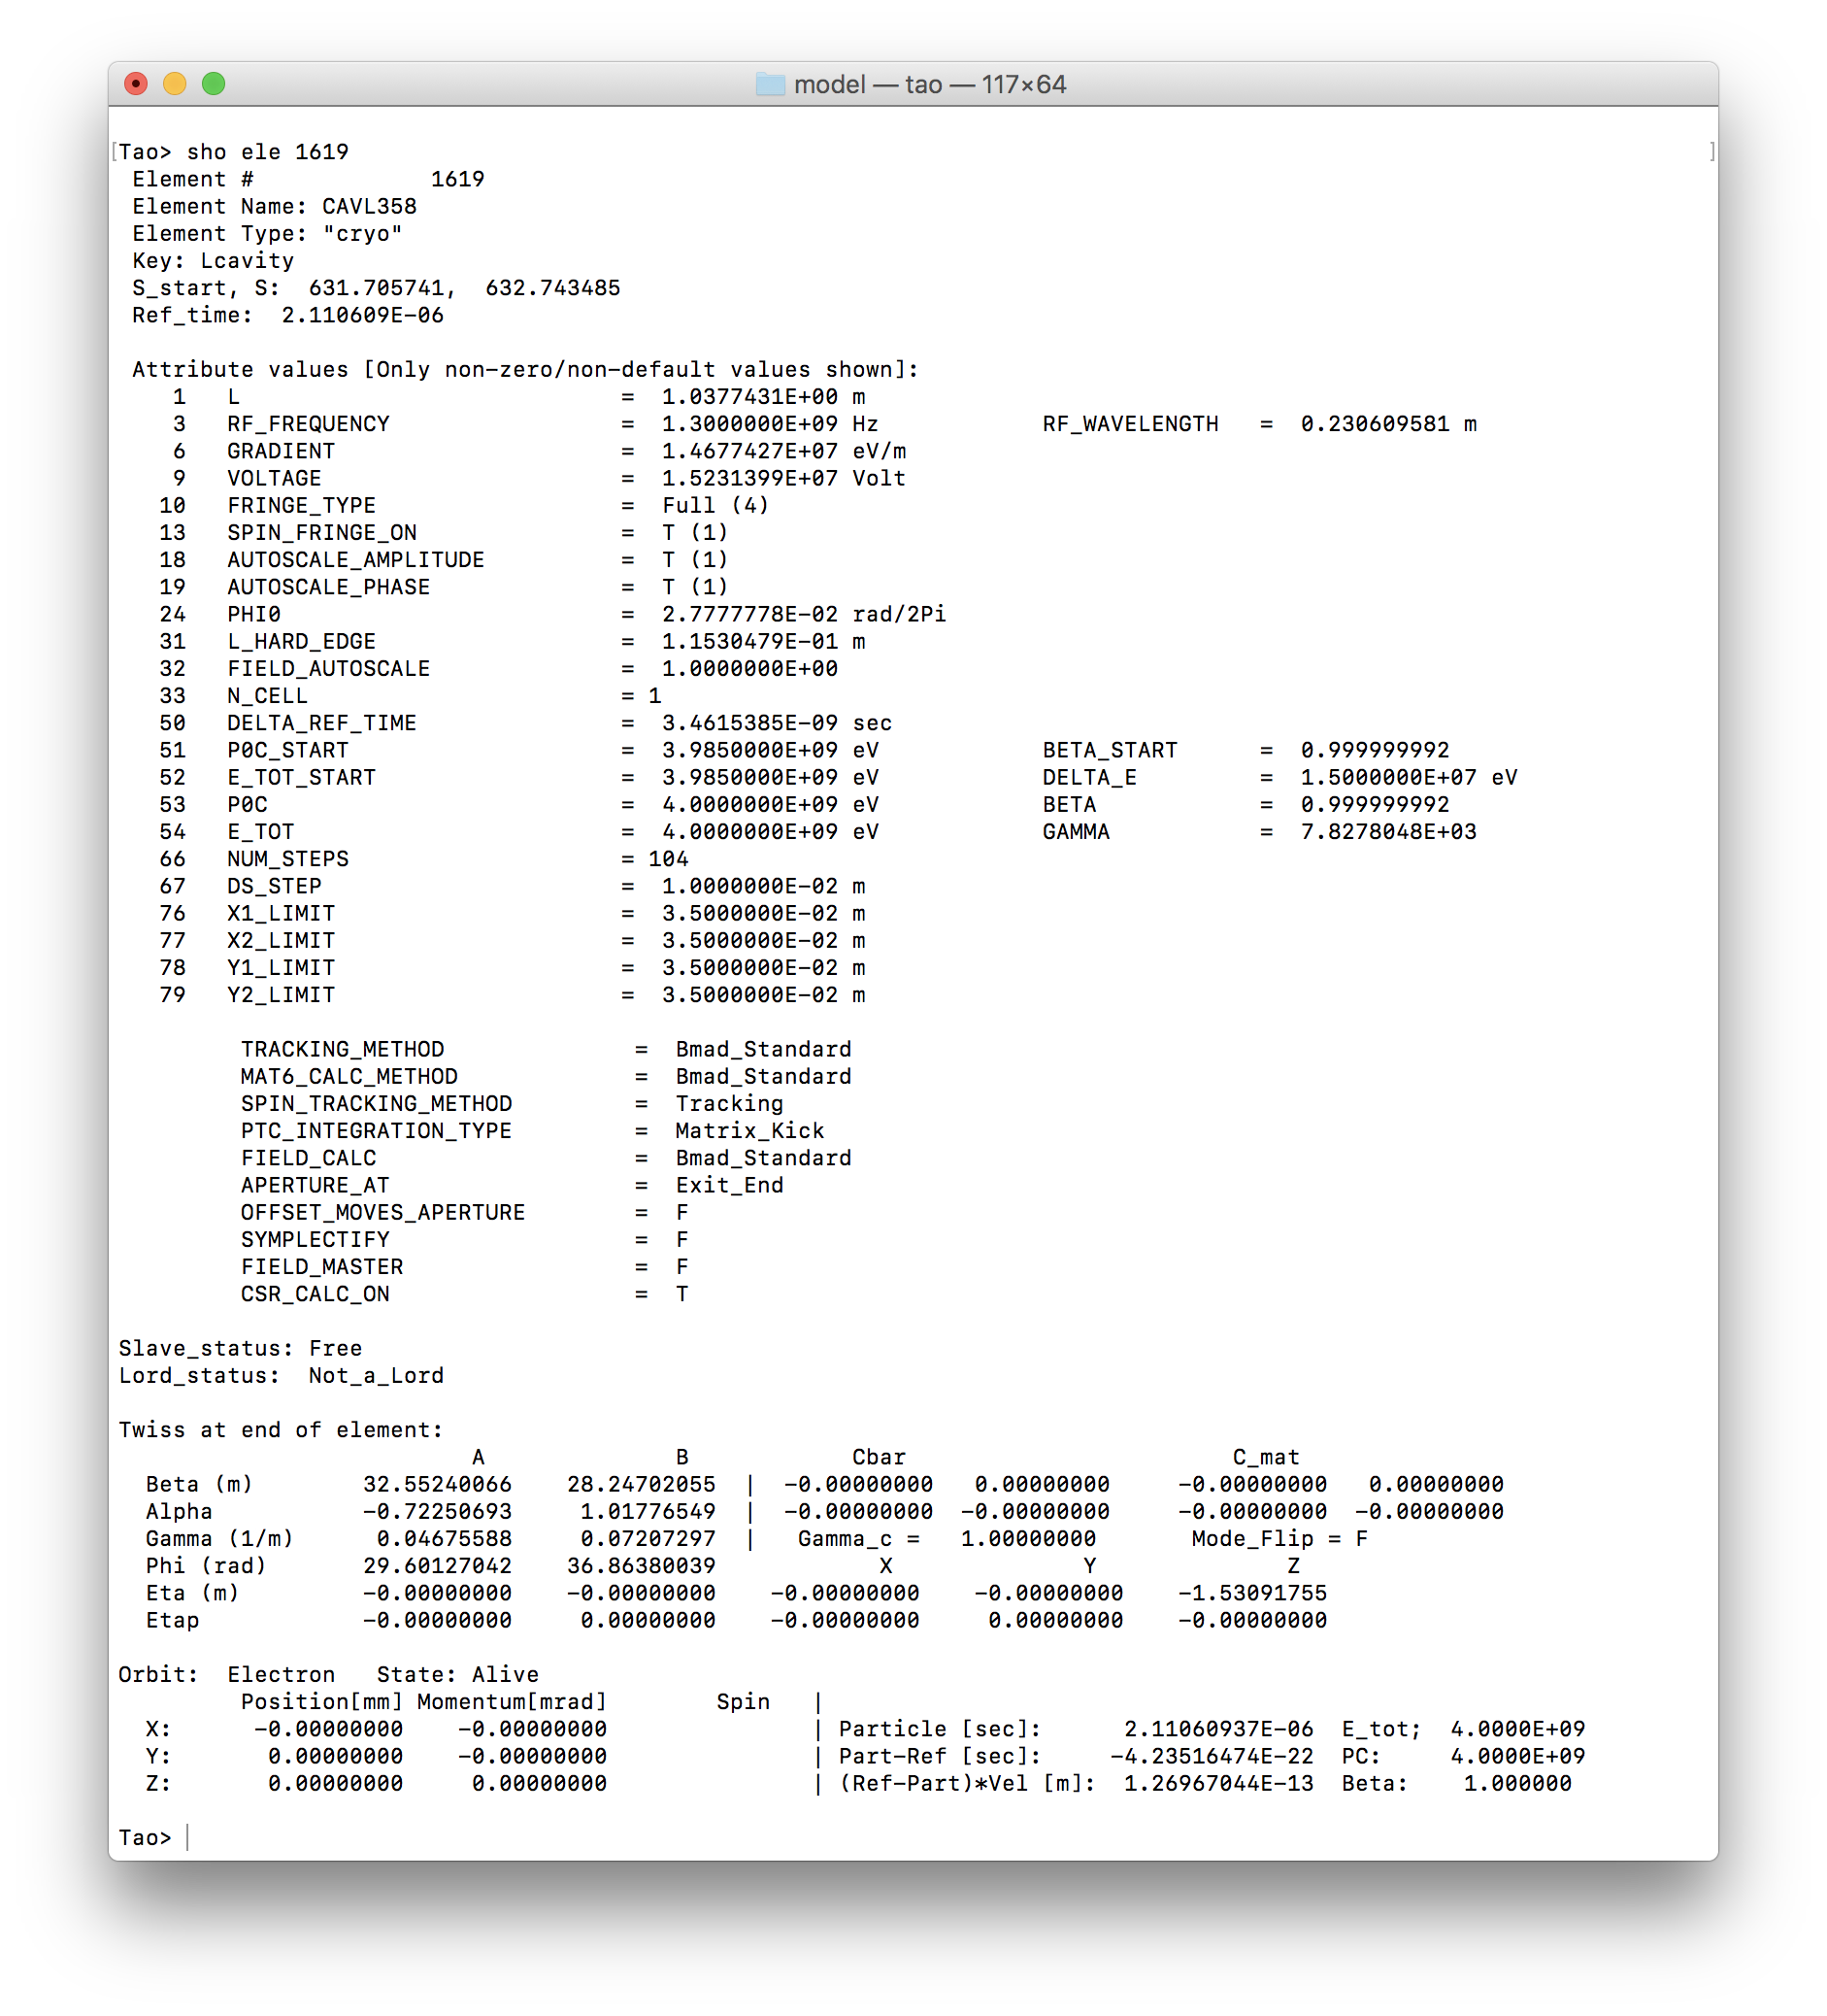
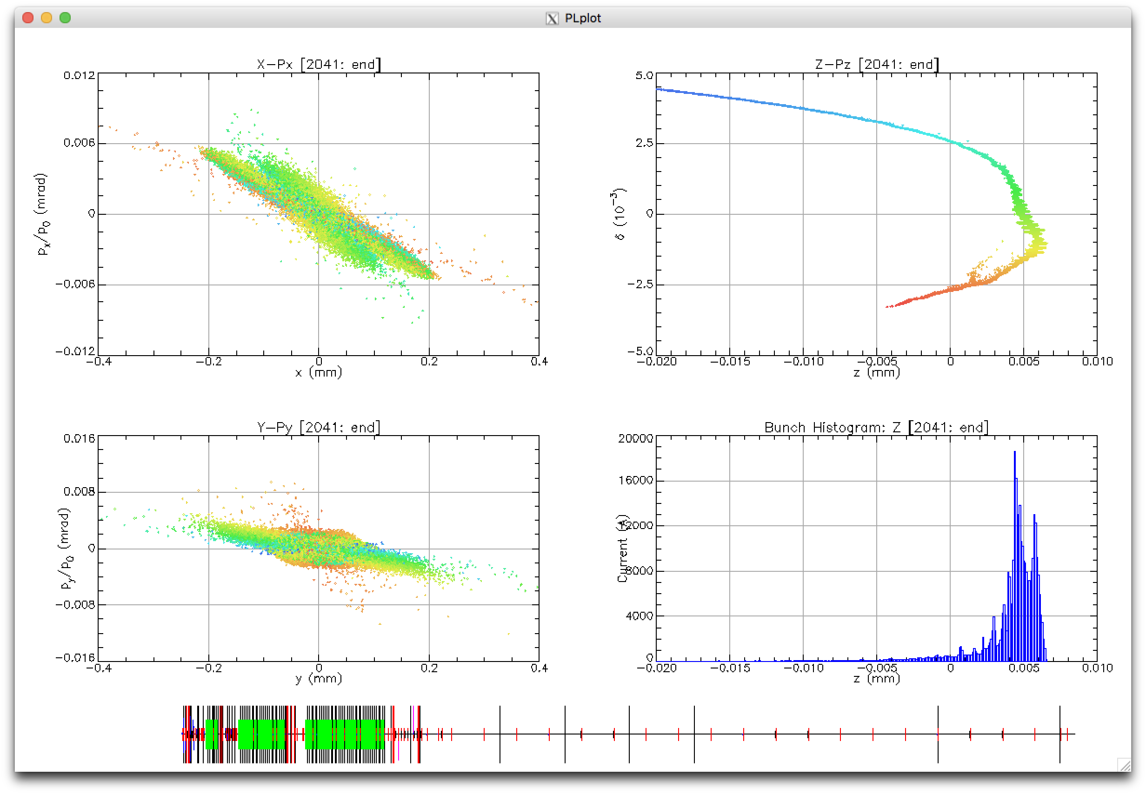
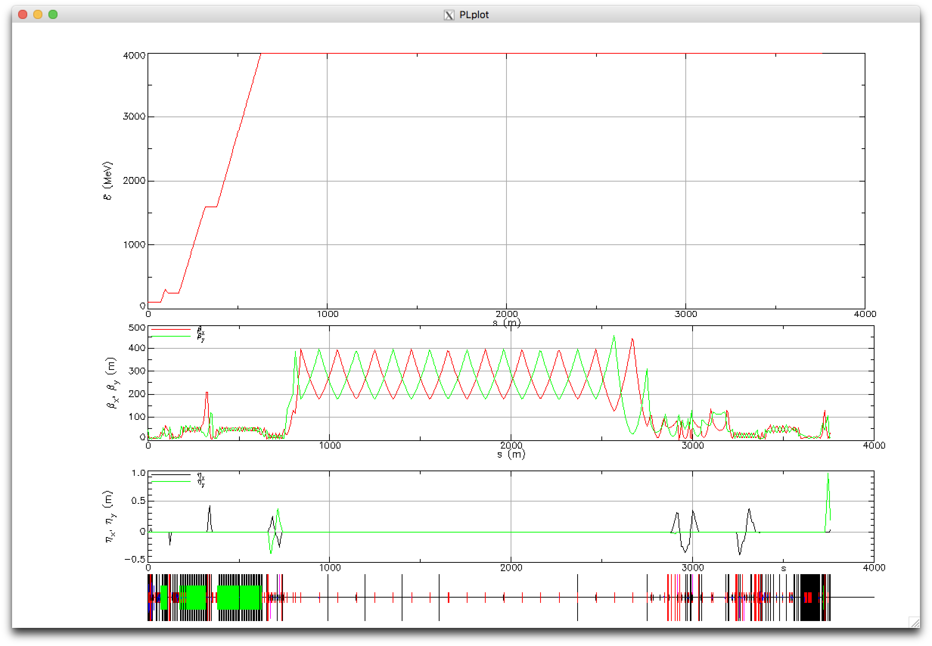
Tao running the LCLS2 lattice

Slide 23
Tao as an online model
Tao Live interactive display
CSR, Space Charge tracking
Tao> call read_EPICS.tao
(repeat)
Tao> call write_data.tao
Discover errors
Python wrapper
Tao> use data bpms
Tao> use variable quad_offsets
Tao> derivative. ! Calculates response of offset quad to BPM
Tao> show derivative
Tao> call read_BPMS_EPICS.tao
Tao> run_optimizer
Python >>>
>>> from pytao.tao import Tao
>>> tao = Tao('-lat my_lat.bmad')
>>> tao.command('use var *')
>>> doutput = tao.capture('show top10')
>>> print(output)

Slide 24
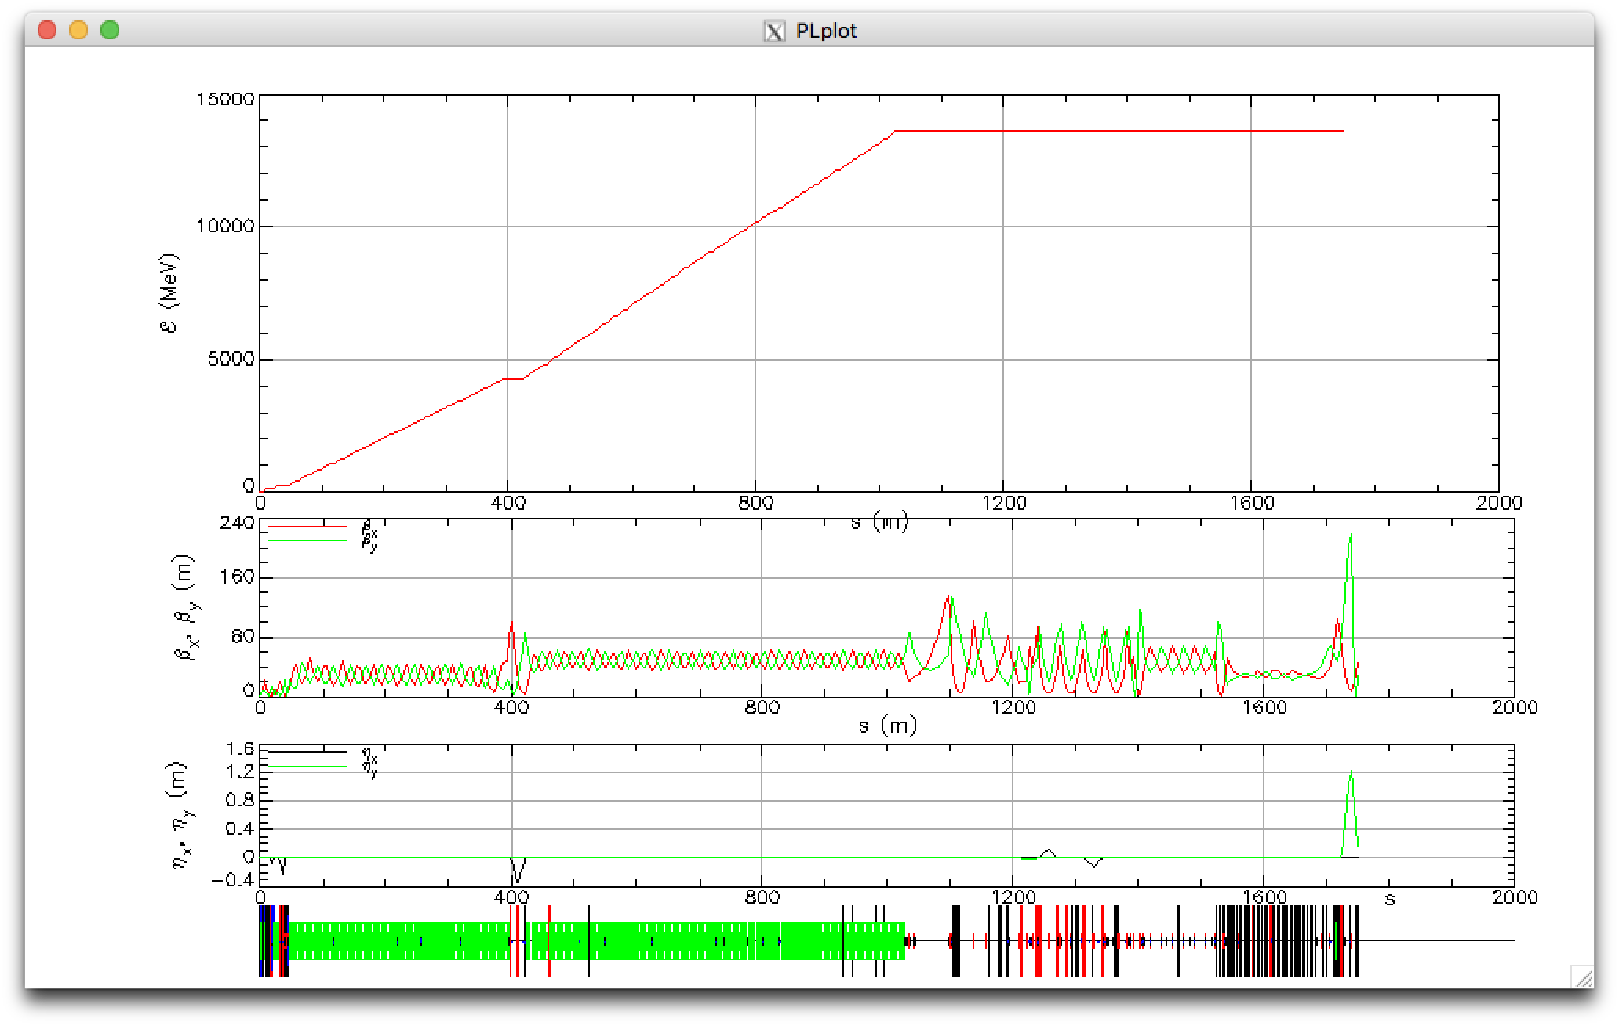
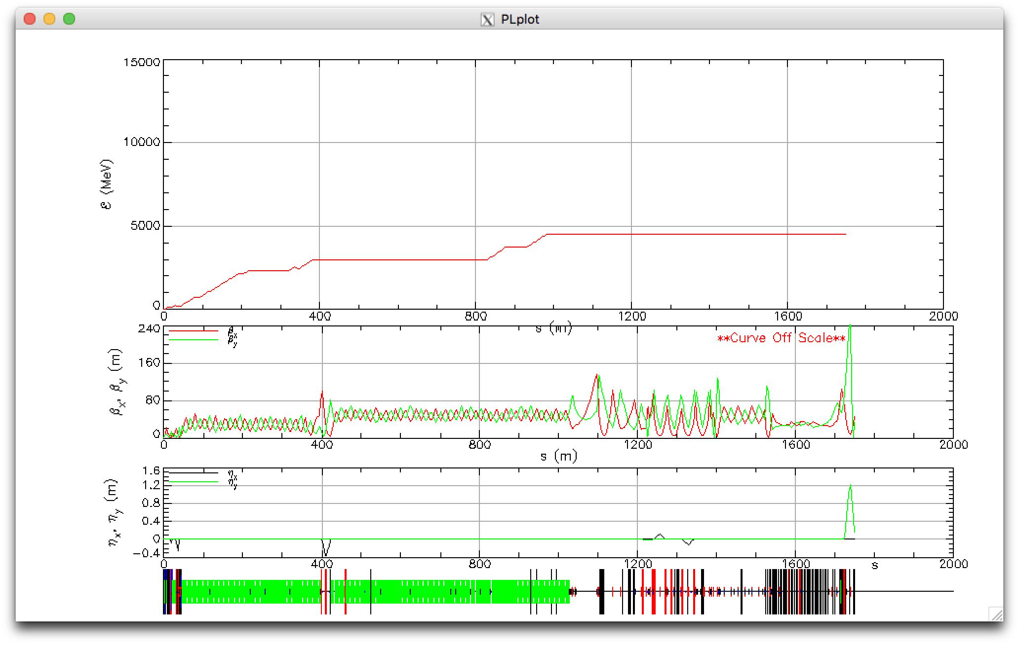
Bmad online model of LCLS (Current State)
Complete translation of the MAD lattice, including comments and structure
Overlays to add functionally for:
  Klystrons [ENLD, PHAS, STAT], including feedback klystrons
  Bunch compressors [angle]
  Linac overall [phase, fudge]
Python scripts read EPICS PV values, write Bmad compatible statements
Tao script for ‘LEMing’ based on energy measurement PVs
October 30, 7 pm
Design lattice in:
/u/ad/cmayes/LCLS/model
Tao> call scripts/live_update.tao

Slide 25
Summary Bmad advantages
  State-of-the-art tracking methods, fast and slow
  Arbitrary trajectory 1-D CSR model with shielding
  Medium-High energy space charge model
  New: 3D Space Charge
  Field maps for any element, can overlap other elements
  Superposition: Greatly simplifies lattice layout, bookkeeping
  Patch element: Enables arbitrary arrangement of magnets
  Controller elements: define arbitrary knobs
  Continuous beam chamber walls, masks
  Forking: Multiple connected lines
  Reads MAD, XSIF, SAD lattice formats
  Translation routines to Astra, OPAL, MAD, XSIF, SAD, …
  Spin tracking
  X-ray tracking
  Dark current tracking
  Software toolkit: Maximum flexibility for custom programs

Slide 26
Summary Tao advantages
  Design tool
  Fast online optics calculation
  Multiple optimization methods
  Bunch tracking with CSR, Space charge
  Response of anything to anything: effect of quad misalignments, etc.
  Wave analysis: discover isolated orbit and focusing errors.
  Built-in plotting
  Customizable via hook routines, e.g. interface with a control system
  Python interface for automation, advanced GUIs, also interface with control systems

Slide 27
SLAC FEL Lightsource Modeling
Goals:
  Maximize FEL performance.
  Minimize downtime (rapid/automated tuneup, diagnose problems).
  Enable advanced beam dynamics studies.
Existing modeling problems:
  LCLS: Measured optics do not match existing model, no collective effects
  LCLS-II: Collective effects and their impact on FEL performance are not fully understood
  LCLS-II-HE: Space charge limits the injected emittance; What bunch qualities are really needed at injection?

Slide 28
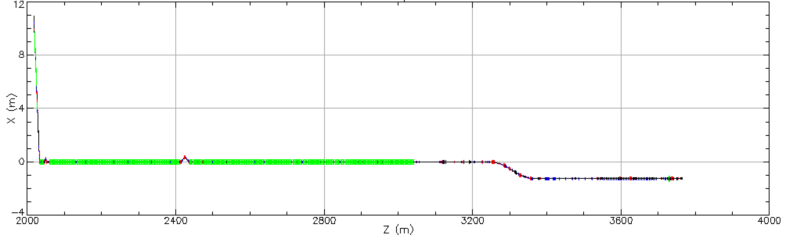
Current state of modeling
electron/photon divide
MAD description
Astra
Simulation codes
Genesis
ImpactT
?
ImpactZ
elegant
SLAC MAD8
SLAC Matlab MAD

Slide 29
SLAC FEL Lightsource Modeling
Proposal:
Construct realistic start-to-end models of the electron machines (LCLS, LCLS-II, LCLS-II-HE).
Develop a simulation pipeline for tracking electrons from the cathode through X-ray production.
Bridge this to X-ray transport simulation pipeline.

Slide 30
Benefits
A realistic start-to-end model and simulation framework will enable holistic optimization, understanding, and performance prediction of SLAC’s lightsources.
For the existing machines (LCLS, soon LCLS-II), this would be used as an operational tool to understand and tune-up the machine.
For future machines (LCLS-II-HE and beyond) it would be used to understand requirements for various components (e.g. electron gun, injector) and sensitivities.
Subtle beam physics effects that limit ultimate performance would be identified early on.
When bridged with X-ray transport, this would be used to predict the success of individualized experiments.
The model could be optimized as a whole (correlate experiment performance with accelerator parameters), or be used to train machine learning algorithms for online control.

Slide 31
Plan
Most of the simulation codes and techniques exist, but are not bridged. We will:
Identify the relevant codes and human expertise for each of the parts of the machine (injector, Linac, beam transport, FEL light production, X-ray optics, X-ray final focus, detector)
  Avoid re-inventing the wheel: Use existing, well-developed codes as much as possible (e.g. Impact, Bmad, Genesis)
Quantify and experimentally validate various beam effects (e.g. space charge, coherent synchrotron radiation, wakefields)
Tune models to match machine measurements (e.g. alignment, field errors)
Develop a software wrapper to enable ‘push button’ start-to-end simulation runs usable by both experts and students.
Collaborate with the X-ray optics group (which is pursuing a parallel effort) for truly start-to-end simulations.

Slide 32
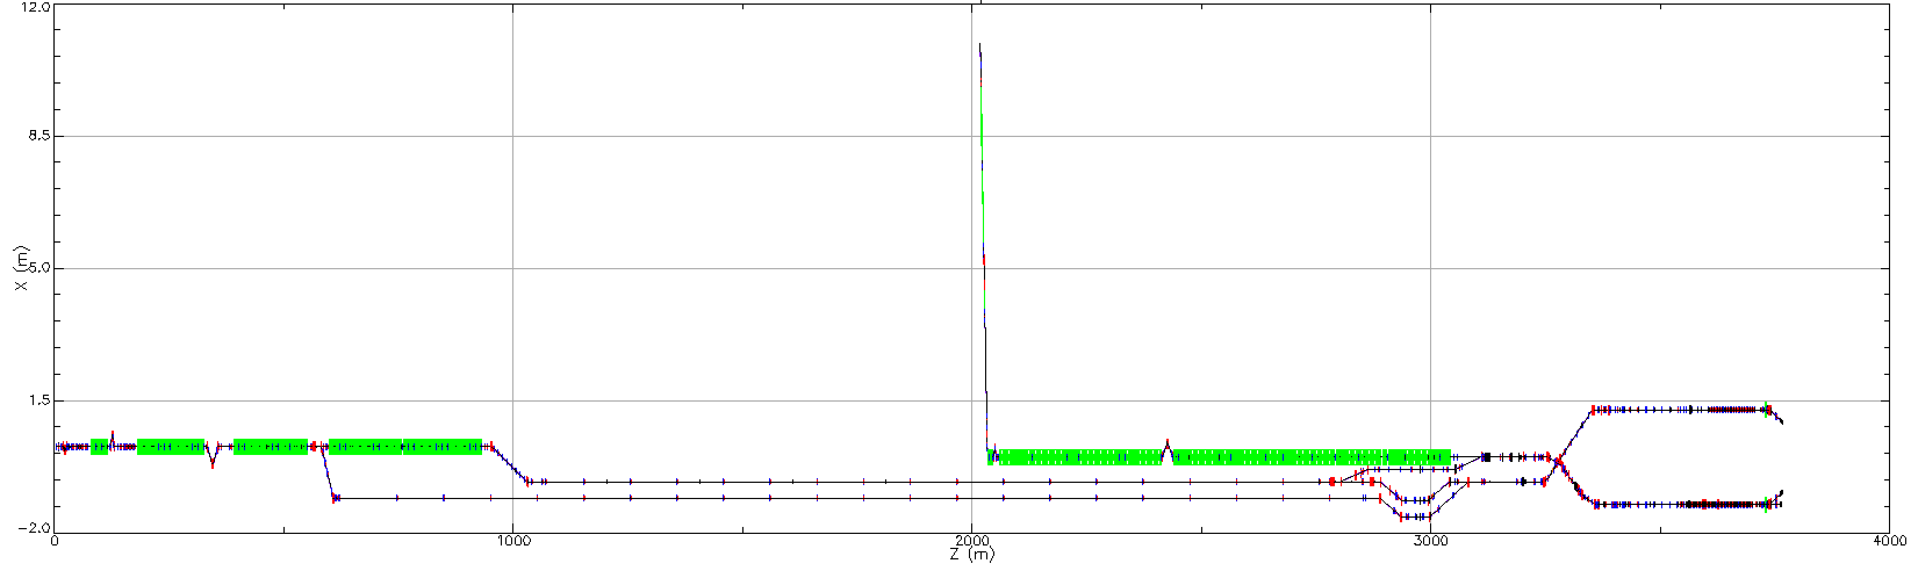
Future: LCLS-I, LCLS-II, LCLS-II-HE, …
Simulation tools
Custom simulation pipeline
Start-to-End simulation

