Slide 1
LUME
Lightsource Unified Modeling Environment
Christopher Mayes, Andrea Dotti, Chuck Yoon, Paul Fuoss.
June 26, 2018

Slide 2
Abstract
Since first light at LCLS, there has been continuous invention of new operating modes, introduction of new optical elements, and rapid improvement in detectors. While these improvements have led to new experiments with much greater scientific impacts, their transfer to user operations has often taken several experimental runs (many months to years). The integration of these technical advances into scientific programs would be greatly accelerated by a modeling tool that allowed for quantitative assessment of the impact on scientific programs of facility improvements.
We propose develop the Lightsource Unified Modeling Environment (LUME) for unified modeling of X-ray free electron laser (XFEL) performance. This modeling tool will be built in several stages with an initial focus on quantitative prediction of critical parameters of the X-ray pulses delivered to experimental stations. This initial development will be followed by incorporation of X-ray−sample interaction and detector performance. This project will take a holistic approach starting with the simulation of the electron beams, to the production of the photon pulses and their transport through the optical components of the beamline, their interaction with the samples and the simulation of the detectors, followed by the analysis of simulated data.
LUME will leverage existing, well-established codes [Astra, Bmad, Elegant, Genesis, Impact for electrons, Genesis 1.3 for FEL simulation, and the “Synchrotron Radiation Workshop” (SRW) for X-ray optics] that will be driven and configured by a coherent high-level framework. The high-level framework will build on the Simex platform being developed by the European Cluster of Advanced Laser Light Sources (EUCALL). The platform will be built with an open, well-documented architecture so that science groups around the world can contribute specific experimental designs and software modules, advancing both their scientific interests and a broader knowledge of the opportunities provided by the exceptional capabilities of X-ray FELs
LUME will be the first platform in the world for unified modeling of XFEL performance. LUME’s optimization capabilities will guide SLAC accelerator physicists in developing world leading XFEL performance. LUME will identify performance bottlenecks, both in the accelerator and photon transport, and enhance operational efficiency and reliability. The complete integration of electron and X-ray processes will allow LCLS scientists to invent instruments that optimally use those unique X-ray beams. Finally and most importantly, the ability to simulate experiments will stimulate the development of new approaches to the scientific and technological challenges facing the country, maximizing the impact of DoE’s investment in cutting-edge X-ray sources.

Slide 3
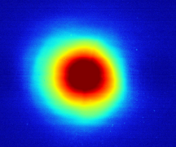
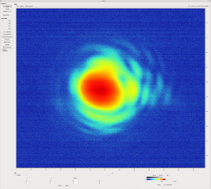
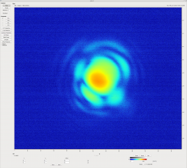
Goal for Start-to-End Simulations
How should the accelerator be configured to produce the “best” pulses?
How do real pulses, instead of idealized pulses, propagating through the instrument interact with the optics and the sample?
Average over 200 shots
What FEL components and configurations degrade, or enhance, the experimental results?
The Lightsource Unified Modeling Environment (LUME) will provide answers to important questions and solutions to design problems.
Single shot monochromatic beam

Slide 4
Value Proposition for LUME
Need
Approach
Benefits
Competition/Alternatives
May 2018 Workshop

Slide 5
Need for Modeling
Since first light at LCLS, there has been continuous invention of new operating modes, introduction of new optical elements, and rapid improvement in detectors.
While these improvements have led to new experiments with much greater scientific impacts, their transfer to user operations has often taken several experimental runs (many months to years).
Within a single experimental shift (12 h), the majority of time can be spent on setup and tuning (even for an established operating mode).
The integration of these technical advances into scientific programs would be greatly accelerated by a modeling tool that allowed for quantitative assessment of the impact on scientific programs of facility improvements.

Slide 6
Approach: Lightsource Unified Modeling Environment (LUME)
LUME will be a simulation platform that glues together simulation modules in an integrated pipeline.
Wrap standard, developed electron/photon simulation codes with a common interface (Python)
Use the newly developed openPMD standard for data exchange (HDF5 files)
Well documented for use by developers, Ph.D. students, users (simulation as a service)
Supporting technologies: Machine database, Simulation Catalogue, Visualization and (G)UI,Optimization hooks, PSANA integration
Expands on the developed SimEx platform (Chuck Yoon)
Will prototype with immediate use cases
Notes:
Psana stands for photon science analysis.

Slide 7
Benefits of LUME
An efficient, high-fidelity and simple-to-use simulation platform will allow:
Prototyping of novel accelerator operation modes without using valuable machine time.
Accelerator and FEL parameters to be optimized with the guidance of simulations, consequently improving the efficiency of data-collection
Determination of corrections and calibrations needed to accurately interpret experimental data.
Early development of analysis algorithms to:
enhance quasi-real time data visualization.
improve the quality of the data collected.
reduce the time needed to obtain scientific results.
Prioritization of facility development by identifying parameters that critically affect scientific success.
Development of stronger science case by testing experimental assumptions.
Goal is to guide experiment design and interpretation of results, not to predict the results of specific experiments.
Notes:
Complicated problems can be hard to solve, but they are addressable with rules and recipes, like the algorithms that place ads on your Twitter feed. They also can be resolved with systems and processes, like the hierarchical structure that most companies use to command and control employees.
The solutions to complicated problems don’t work as well with complex problems, however.
Complex problems involve too many unknowns and too many interrelated factors to reduce to rules and processes. A technological disruption like blockchain is a complex problem. A competitor with an innovative business model — an Uber or an Airbnb — is a complex problem. There’s no algorithm that will tell you how to respond.
https://sloanreview.mit.edu/article/the-critical-difference-between-complex-and-complicated/

Slide 8
Competition/Alternatives
LUME is a medium-scale project (4-8 FTEs, 3-5 years). Nothing of its kind currently exists. Alternatives are:
Hand-stitch (script) start-to-end simulations as needed
- Requires expert(s) for each step
Model-free tuning (direct optimization) of the live machine
  + Time saved on modeling
- Limited to local optimization
- Not necessarily fast
Surrogate modeling (neural network) of the as-built machine
  + Fast switching between established operating modes
  + Time saved on modeling
- Limited by data acquired from a limited set of operating conditions
Only LUME and the first approach could assess new experiments

Slide 9
LUME Initial Projects
Defining requirements, development path, and deployment plan tradeoffs for Wavefront Sensing (WFS) based on a quantitative analysis of the needs of our principal experiments.
Defining requirements, development path and deployment plans for beam conditioning and diagnosis including trade-offs between seeding and monochromator design options to provide moderate-resolution beams to NEH-2.2.
Simulating impact of space charge induced micro-bunching, which develops early in the machine, on X-ray beam quality produced in the FEL process at the end of LCLS-II-HE.
Modeling novel designs for a combined inelastic X-ray scattering and X-ray photon correlation spectroscopy instrument for LCLS-II and LCLS-II-HE.

Slide 10
Use Case: Testing Single Shot Wavefront Sensor
Analysis Workflow
Simulation of FEL Source
Transport of X-rays to Experiment
Focusing X-Rays (e.g. KB mirrors or Be Lens)
Measurement of Wavefront using the Talbot effect
Work done by: Yanwei Liu, Matthew Seaberg, Yuantao Ding, Gabriel Marcus, Daniele Cocco, Anne Sakdinawat

Slide 11
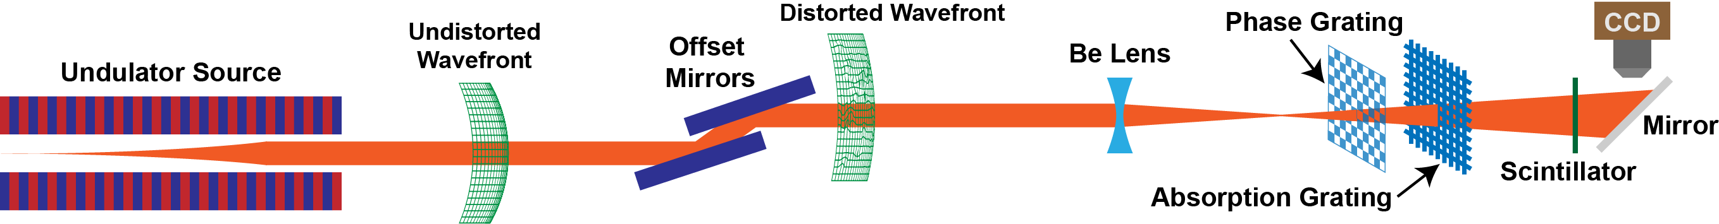
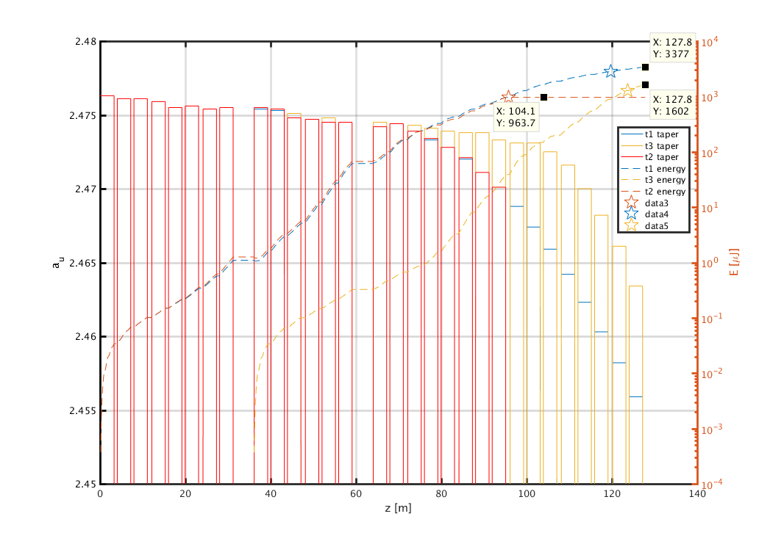
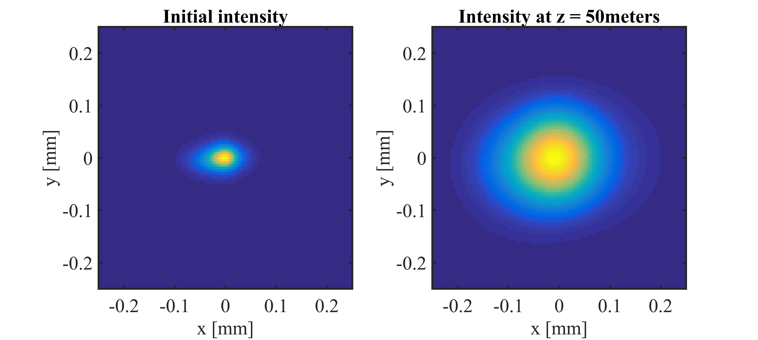
Use Case: Testing Single Shot Wavefront Sensor
FEL Simulation
Beam Transport
Beam Focusing
Wavefront Analysis
Genesis Simulation
Genesis Output to Wave Propagation
Notes:
Light field buildup in FEL undulator is simulated using Genesis software. It takes into account electron beam parameters and undulator magnetic fields. We uses its output at the undulator exit and propagates that output to downstream locations where it meets transport optics.

Slide 12
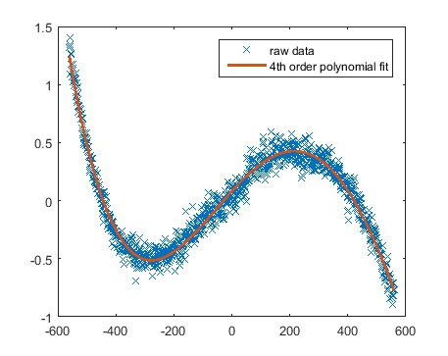
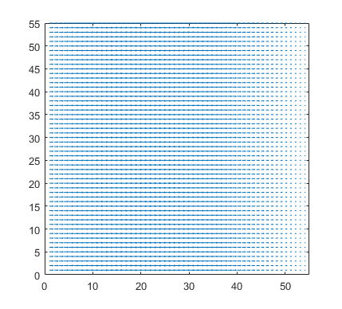
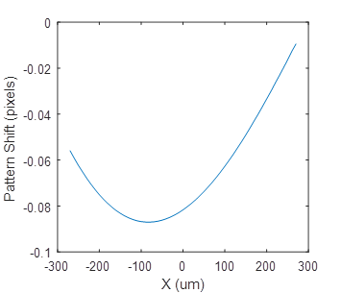
Use Case: Testing Single Shot Wavefront Sensor
FEL Simulation
Beam Transport
Beam Focusing
Wavefront Analysis
HOMS Mirror Phase Error (rad)
Simulated Distorted Wavefront from HOMS Mirror
X (um)
Simulation parameters: phase grating pitch = 20 um, photon energy = 9.5 keV, working distance = 1160 mm (n=3), Detector resolution = 2 um, detector pixel equivalent size = 0.6 um.
Notes:
Transport optics, shown here as HOMS (Hard X-ray Offset Mirror System) for hard x-rays, is used to divert x-ray to endstations. Due to the very short wavelength of x-rays, it is extremely difficult to make sure the mirror surface is perfectly flat. Optical methods were used to measure the surface profile and the mirrors, and we took that measurement data to simulate the distortion on wavefront, and how the images on wavefront sensor will shift as the result of the distortion.

Slide 13
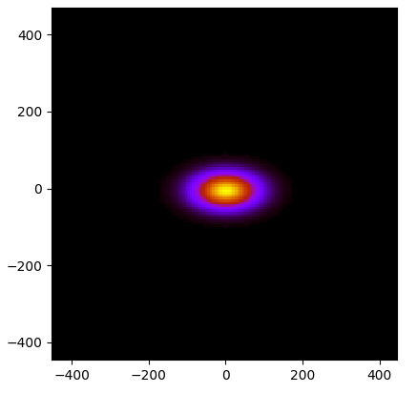
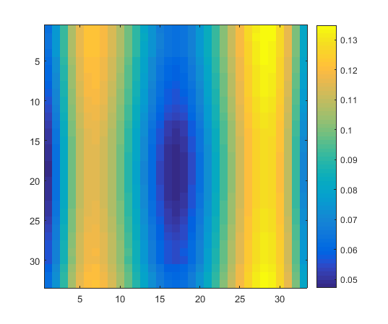
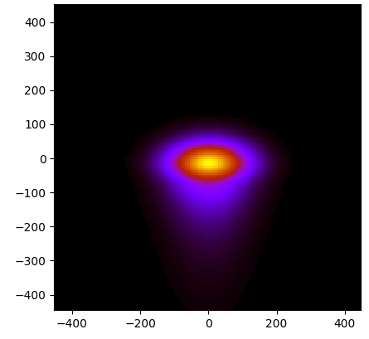
Use Case: Testing Single Shot Wavefront Sensor
FEL Simulation
Beam Transport
Beam Focusing
Wavefront Analysis
Ideal focus
Aberrated focus
Talbot Image Shift (pixels)
y (nm)
x (nm)
x (nm)
To accommodate the divergent focused beam, the phase grating has a pitch of 14um, placed 0.400 meters after the focus. Detection was at the 1st Talbot plane at 0.354 m away from the grating. We assumed an image blur of 2um and pixel size of 0.6um. Photon energy is 9.5 keV.
Notes:
We also simulated how common aberrations on endstation optics, usually KB mirrors or CRL (compound refractive lens), affect the quality of focusing. The aberrated focused beam is further propagated to the wavefront sensor, and we simulate how the images on wavefront sensor respond.

Slide 14
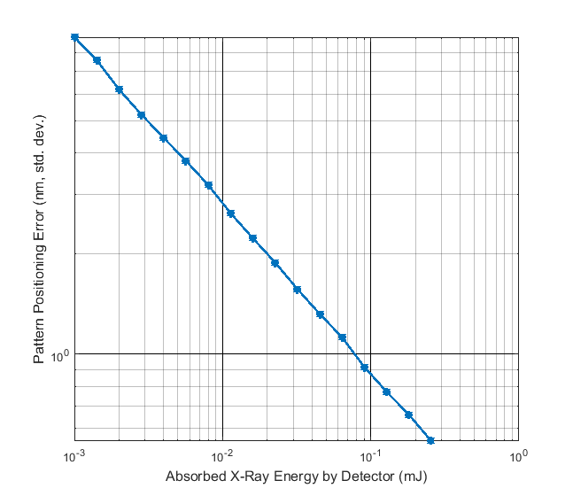
Use Case: Testing Single Shot Wavefront Sensor
FEL Simulation
Beam Transport
Beam Focusing
Wavefront Analysis
Photon Shot Noise
Detector Blur
Image Pixelization
Position Error
Notes:
We also simulate real-world situations for the wavefront sensor, to see how practical limitations impact its performance. For example, the detector has finite pixel size, and the use of scintillator introduces image blur. Both can reduce the sensor’s spatial resolution, and thus the sensitivity to wavefront errors. Simulations like those help us to choose the optimal microscope parameters.

Slide 15
LUME Pipeline
Simulation of electron-beam production.
Modeling of the accelerator with known component performance and errors.
Simulation of X-ray production in undulator including seeding.
Propagation of X-rays through the beamline optics.
Calculation of the photon-matter interaction at the sample.
Selection and propagation of photons and particles to the detector.
Modeling of the detector response.
Test reconstruction and data analysis algorithms with simulated detector signals.

Slide 16
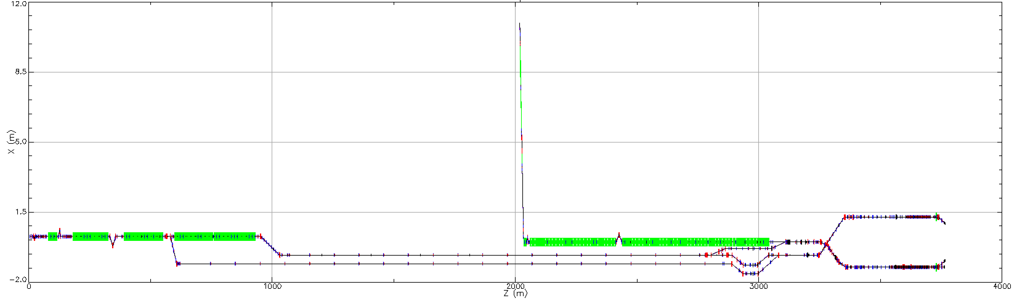
Module Codes
electrons
photons
LCLS-II
-HE
LCLS
We will create common interfaces for module types:
Injector
Accelerator
Undulator
X-ray transport
Photon-Sample
Signal Transport
Detector Response
Analysis
(wide variety)
Astra
IMPACT-T
OPAL
Bmad
elegant
IMPACT-Z
OPAL
Genesis 1.3
GINGER
SRW
Shadow
Notes:
There will be a lot of different codes used on the right hand sides. Currently I think
xscit => Detector simulation code
esther => hydrodynamic code
pysingfel => single crystal x-ray diffraction
are probably the most used in simex.

Slide 17
LUME Scope
LUME will be a simulation platform that glues together simulation modules in an integrated pipeline. This platform will:
Track the creation of the electron bunch at the cathode and follow it through the accelerator.
Create an X-ray pulse from bunched electrons via the FEL interaction in the undulator (including seeding).
Propagate the X-ray wavefront through the X-ray beamline.
Perform atomistic modeling of the photon-material interaction.
Track the resultant diffracted and emitted particles (photons, electrons and ions) to appropriate detectors.
Assemble the simulation results into three dimensional datasets that can be used for algorithm development.
The simulation modules will be reused from existing efforts. New modules will only be developed to fill clear needs where solid benefit can be demonstrated.

Slide 18
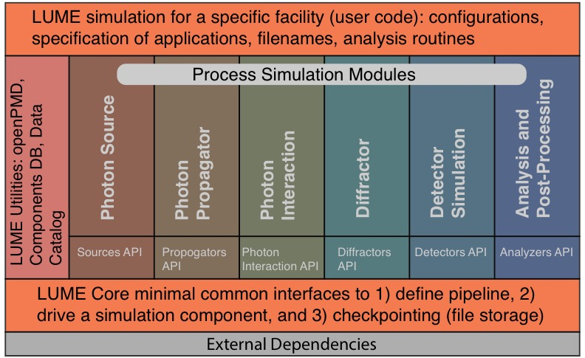
LUME Tasks
Simulation framework
The LUME backbone will be a framework that leverages already well established calculation codes interfaced to each other via standard data formats and APIs. To maximize efficient use of existing resources, we plan to use of existing software solutions (e.g. SimEx from the EUCALL consortium), proactively participating in their development, proposing features and supporting the parts of the code of main interest to SLAC.
Machine Description Database
Simulation Data Catalog
Visualization and (G)UI
Numerical Optimization
Particle File Format
Integration with PSANA
Immediate Use Cases
Documentation

Slide 19
LUME Tasks
Simulation framework
Machine Description Database
In order to efficiently simulate the performance of a given beamline, a database of electron and x-ray optics and associated hardware will be created. In addition to supplying information for simulations, this database should find general applicability for design, installation and maintenance work.
Simulation Data Catalog
Visualization and (G)UI
Numerical Optimization
Particle File Format
Integration with PSANA
Immediate Use Cases
Documentation

Slide 20
LUME Tasks
Simulation framework
Machine Description Database
Simulation Data Catalog
The data catalog provides a repository and for metadata cataloguing of simulation results. The goal is to increase simulation efficiency by capability to reuse, in part or fully, simulation data. The data catalog is independent of the simulation framework but its main client will be simulation workload, and as such it needs to be designed closely with Task A.
Visualization and (G)UI
Numerical Optimization
Particle File Format
Integration with PSANA
Immediate Use Cases
Documentation

Slide 21
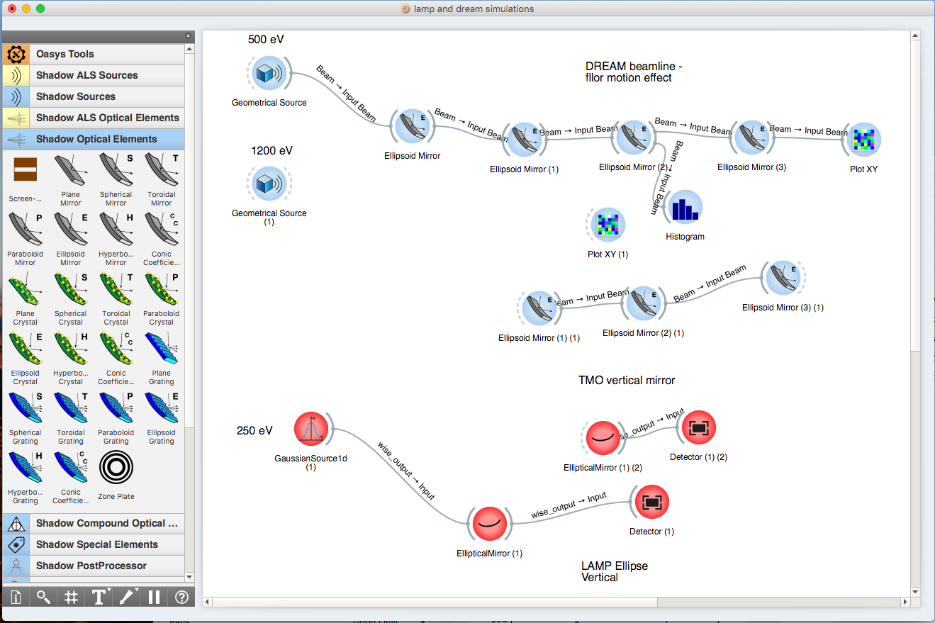
LUME Tasks
Simulation framework
Machine Description Database
Simulation Data Catalog
Visualization and (G)UI
The framework provides a visualization sub-system defining what can be visualized. Visualization is implemented in separate modules via visualization drivers. We prefer web-based approaches that do not require additional software and graphic libraries.
Numerical Optimization
Particle File Format
Integration with PSANA
Immediate Use Cases
Documentation
OASYS - OrAnge SYnchrotron Suite
Notes:
https://www.elettra.trieste.it/oasys.html
OASYS (OrAnge SYnchrotron Suite) is an open-source Graphical Environment for optic simulation softwares used in synchrotron facilities, based on Orange 3.

Slide 22
LUME Tasks
Simulation framework
Machine Description Database
Simulation Data Catalog
Visualization and (G)UI
Numerical Optimization
The goal is to maximize experimental performance, not to deliver beam with intermediate qualities at artificial code transition points. Experiments can subtly depend on properties developed far upstream that are difficult to quantify. With LUME, these artificial interfaces can be removed and the composite system can be optimized as a whole.
Particle File Format
Integration with PSANA
Immediate Use Cases
Documentation

Slide 23
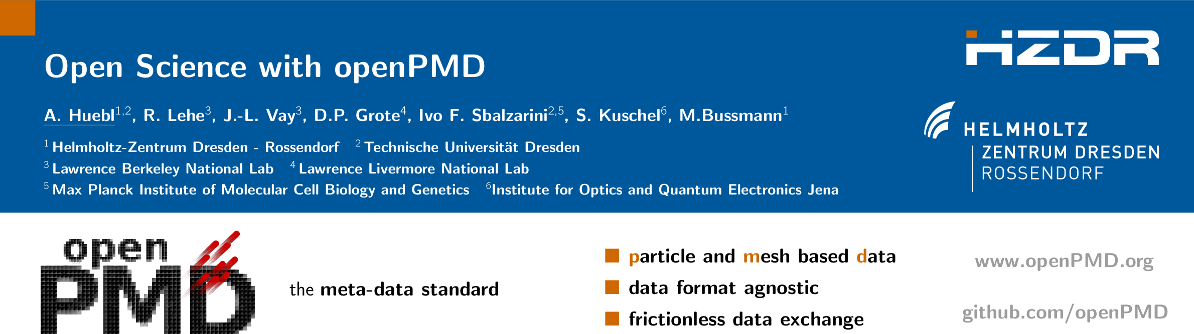
LUME Tasks
Simulation framework
Machine Description Database
Simulation Data Catalog
Visualization and (G)UI
Numerical Optimization
Particle File Format
Use openPMD to describe Particle and Mesh data. Researchers from LBNL, DESY, Cornell University, HZDR, and SLAC are defining an Accelerator and X-ray extension. The LUME task is to develop interface code for simulation tools (e.g. the Astra space charge code), so that the framework can use the format to glue together different codes.
Integration with PSANA
Immediate Use Cases
Documentation
http://www.openpmd.org
Notes:
Particle phase space. Extensions: Beam Physics and Species

Slide 24
LUME Tasks
Simulation framework
Machine Description Database
Simulation Data Catalog
Visualization and (G)UI
Numerical Optimization
Particle File Format
Integration with PSANA
We want to be able to produce data-formats in LUME that are the same as those produced by the LCLS experiments. The challenge is that we cannot put these functionalities inside the “Core” of the simulation platform if we want other facilities to share the same “Core” software.
Immediate Use Cases
Documentation

Slide 25
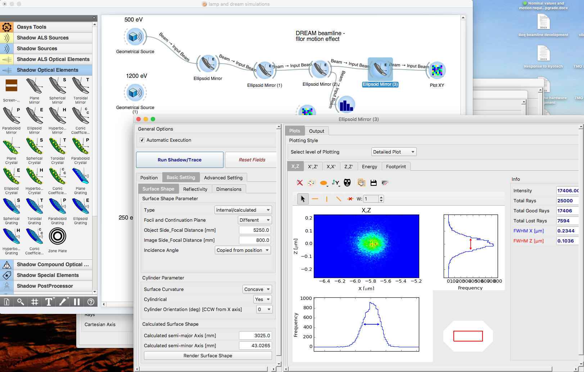
LUME Tasks
Simulation framework
Machine Description Database
Simulation Data Catalog
Visualization and (G)UI
Numerical Optimization
Particle File Format
Integration with PSANA
Immediate Use Cases
LUME will use examine high-impact problems currently facing development projects at LCLS-II, in particular, LCLS and SLAC to drive the development of the modeling capabilities.
Documentation

Slide 26
LUME Tasks
Simulation framework
Machine Description Database
Simulation Data Catalog
Visualization and (G)UI
Numerical Optimization
Particle File Format
Integration with PSANA
Immediate Use Cases
Documentation
LUME must have high quality, complete documentation to be generally usable by our target audience.

Slide 27
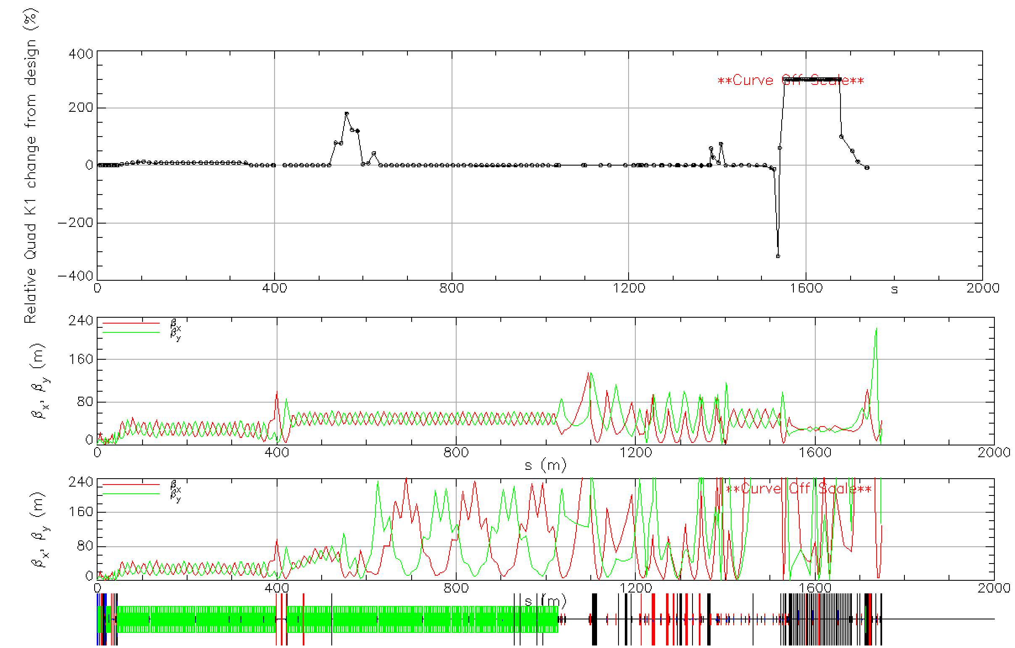
Validation: LCLS Accelerator
LCLS electron optics
  Setting quadrupole focusing (k1) according to design does not give good actual FEL performance.
  Quads are tuned empirically to get good performance.
  The accelerator model then predicts that the beam would be wildly defocused.
  It is not understood why these settings work.
  The model needs to be calibrated against measurements.
Actual quad settings (change from design)
Design optics
Predicted actual optics
Linac
Undulator
Notes:
Green is beta y, red is beta red

Slide 28
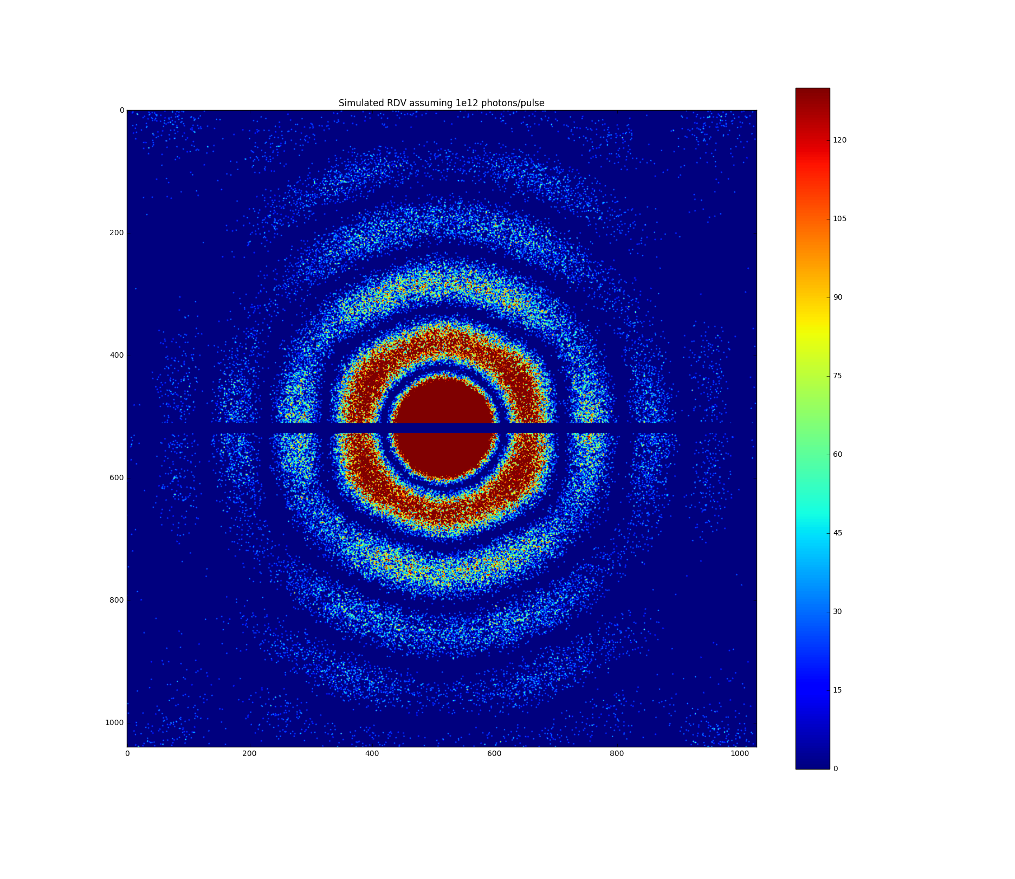
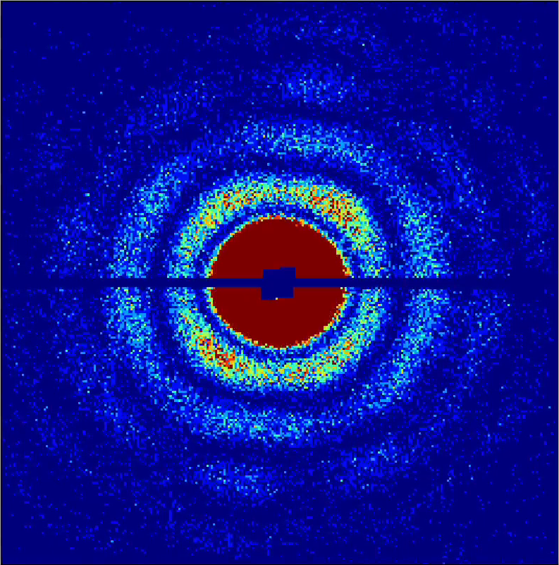
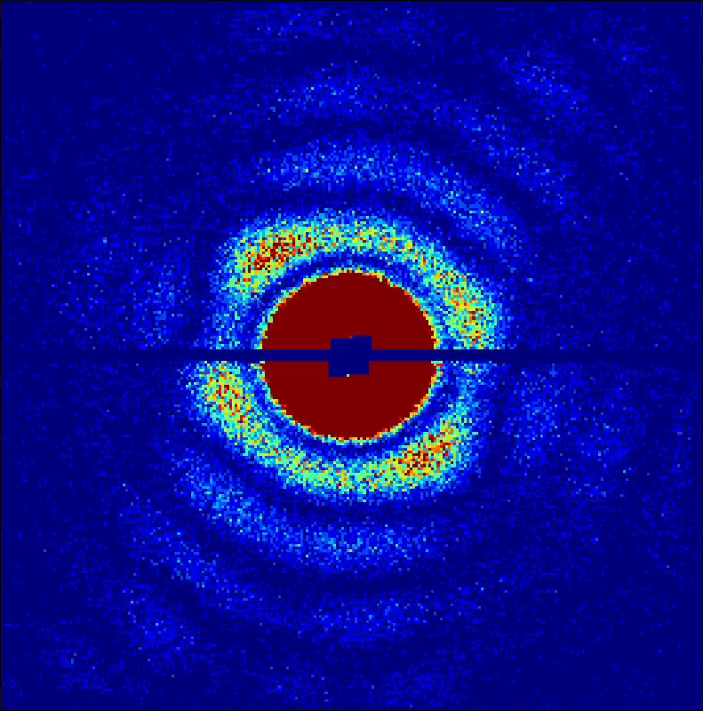
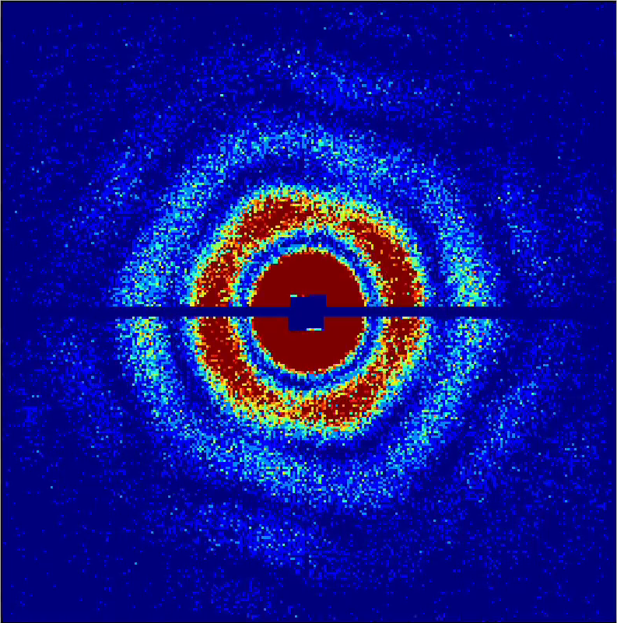
Validation: Development of Single Particle Imaging
A key step in establishing a trusted simulation platform is validating the simulated data with real experimental data from a beamline and understanding how large the errors can be.
Example of simulating a Single Particle Imaging (SPI) experiment at LCLS. Preliminary results from Haoyuan Li, Philip Hart, and Chuck Yoon:
RDV data was collected as part of the SPI initiative in Aug 2015 at AMO beamline on pnCCD cameras.
Simulated diffraction pattern of an RDV from the AMO beamline setup using pysingfel package. The simulation assumes 10¹² photons per pulse in a 1.5 micron focus. Detector noise was added using dark measurements from the experiment. The total number of photons is in the correct ball park (~400K photons per image).
120
60
Measured RDV Data
Simulated Data
0
Notes:
Rice Dwarf Virus (RDV)

Slide 29
Design Philosophy: Overall
Who are the USERS?
FEL Developer
PhD Graduate Student
FEL User (Simulation as a service)

Slide 30
Design Philosophy: Code Base
Pure Python wrappers
Platform independence
Dependencies are scoped
Can simulate FEL without X-ray optics
Can simulate X-ray optics from canned FEL output
Interactive configuration manager (e.g. Conda)
Work with underlying code developers to achieve better portability
Container distribution (e.g. Docker or Singularity) to facilitate cloud and high-performance computing

Slide 31
Development Strategy
LUME needs to be developed in collaboration with other XFEL and related laboratories in order to:
Reduce the total effort required to produce comprehensive simulation capabilities.
Deliver the needed software packages in a timely manner.
Maximize the user base and impact.
Facilitate rapid collaboration and comparisons of machine performance.
LUME must provide interfaces that are convenient and easy to use.
We are surveying current systems (e.g. Oasys) to understand their strengths and weaknesses.
Incorporate principles from other efforts (e.g. Geant4)
The SimEx platform is a promising existing system to build on because:
SimEx incorporates many of the principles identified by our project development team.
There is an active SimEx development effort funded by EUCALL.
SimEx builds on BNL’s Synchrotron Radiation Workshop (SRW) (funded by DOE-BES).

Slide 32
Development Strategy
LUME needs to be developed in collaboration with other XFEL and related laboratories in order to:
Reduce the total effort required to produce comprehensive simulation capabilities.
Deliver the needed software packages in a timely manner.
Maximize the user base and impact.
Facilitate rapid collaboration and comparisons of machine performance.
LUME must provide interfaces that are convenient and easy to use.
We are surveying current systems (e.g. Oasys) to understand their strengths and weaknesses.
Incorporate principles from other efforts (e.g. Geant4)
The SimEx platform is a promising existing system to build on because:
SimEx incorporates many of the principles identified by our project development team.
There is an active SimEx development effort funded by EUCALL.
SimEx builds on BNL’s Synchrotron Radiation Workshop (SRW) (funded by DOE-BES).

Slide 33
Long-term Development and Support
A practical start-to-end simulation program will be useful to the community for years, possibly decades (as demonstrated by other successful scientific simulation and data analysis software solutions). We plan an extensible platform that evolves and can respond to new simulation needs.
After initial development, possible extensions of the project include:
Providing new modules that simulate rapidly evolving X-ray FELS and new scientific missions.
Exploiting new hardware and software technologies (e.g. expanding the use of GPUs or using advanced Machine Learning techniques).
Developing software modules (e.g. increased parallelism) that efficiently incorporate HPC (e.g. NERSC) to accelerate compute intensive simulations (e.g. beam-sample interactions).
Incorporate new software tools and techniques that improve portability (e.g. containers and VM techniques) and broaden usability (e.g. micro-services, distributed applications, and enhanced visualization techniques).
Notes:
Training surrogate models for faster execution of simulation

Slide 34
LUME – Lightsource Unified Modeling Environment
Since 1st light at LCLS, there has been continuous:
Invention of new operating modes
Introduction of new optical elements
Rapid improvement in detectors
A start-to-end model will increase LCLS impact by:
Guiding physicists in developing world leading XFELs
Identifying performance bottlenecks
Enhancing operational efficiency and reliability
Unified modeling of electron and x-ray processes will:
Enable the invention of instruments to fully exploit XFELs
Stimulate new experimental approaches and maximize the impact of DoE investment.
LUME Features
Leverages on existing capabilities, for example:
ASTRA, Bmad, Elegant, and Impact codes for charged particles.
Genesis 1.3 code for the FEL interaction
Synchrotron Radiation Workshop (SRW) (Brookhaven)
SimEx (simulation platform started by EuCALL)
openPMD particle mesh data files (LBNL et al.)
Open source, modular, well documented design
Efficient development with emphasis on code reuse
External science groups can contribute
Capabilities evolve with XFEL capabilities and science
Notes:
Some discussions with Eliane Lessner about accelerator side in October

Slide 35
End
END

