Slide 1
Recent Advances in Electron Cloud Buildup Measurements and Models at CESR (Part 2) Stephen Poprocki & Jim Crittenden
Cornell University
Accelerator Physics Seminar
October 16, 2018
Brookhaven National Laboratory

Slide 2
Overview
(Part 1: Simulations of synchrotron-radiation-induced electron production in the CESR vacuum chamber wall)
Part 2: Measurements and model validation of electron-cloud-induced betatron tune shifts in the CESRTA, CHESS and CHESS-U transition lattices and predictions for CHESS-U operation
Emittance growth measurements
Improved betatron tune shift measurements
Fitting e-cloud model parameters to tune shift measurements in CESRTA and CHESS conditions
Predictions for tune shifts in CHESS-U
Emittance growth simulations

Slide 3
Measurements
Beam:
2.1 GeV positrons or electrons (5.3 GeV for additional tune shifts)
Horizontal emittance: 3.2 nm, fractional energy spread: 8x10⁻⁴, bunch length: 9 mm
30 bunch train, 0.4 mA/b and 0.7 mA/b, 14 ns spacing (2-6 mA/b at 5.3 GeV)
(0.64x10¹⁰ and 1.12x10¹⁰ bunch populations)
1 witness bunch, 0.25 to 1.0 mA, bunch positions 31 to 60
Witness bunch position probes cloud as it decays
Witness bunch current controls strength of pinch effect (cloud pulled in to e+ bunch)
Measure:
Betatron tunes: using digital tune tracker
Drive an individual bunch via a gated kicker that is phase locked to the betatron tune
Vertical bunch size: from X-ray beam size monitor
Bunch-by-bunch, turn-by-turn
Horizontal bunch size: from visible light gated camera
Bunch-by-bunch, single-shot
Bunch-by-bunch feedback on to minimize centroid motion
Disabled for a single bunch when measuring its tunes
…
1
30
witness

Slide 4
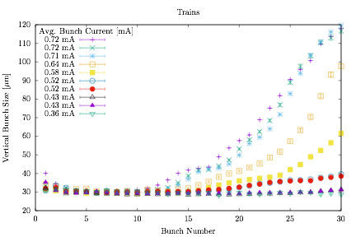
Beam size
Vertical emittance growth along a train of positron bunches above a threshold current of 0.5 mA/b

Slide 5
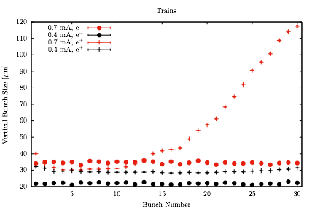
Beam size
Trains of e- bunches do not blow-up
Indicates e+ emittance growth is due to EC, not another effect
0.7 mA/b e+
0.7 mA/b e-
0.4 mA/b e+
0.4 mA/b e-

Slide 6
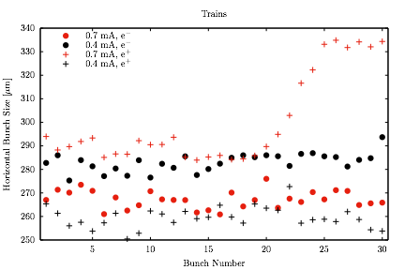
Horizontal beam size
Horizontal beam size also blows-up in 0.7 mA/b e+ train
0.7 mA/b e+
0.7 mA/b e-

Slide 7
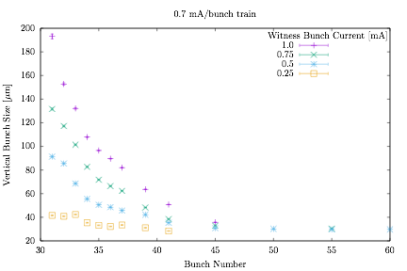
Witness bunch beam size
One witness bunch to a 30 bunch 0.7 mA/b e+ train
Start with witness at bunch #60, vary current, eject bunch, move to #55…
For a given witness bunch #, the cloud it sees is the same
Emittance growth strongly depends on current (pinch effect)

Slide 8
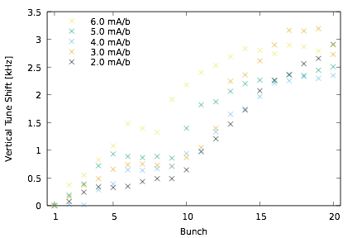
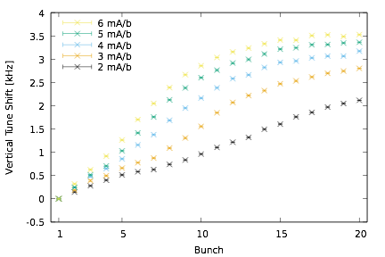
Tune shift measurements
Tune shifts can be measured various ways:
“Pinging”: Coherently kicking entire train once, measuring bunch-by-bunch, turn-by-turn positions, and peak-fitting the FFTs
Fast measurement (whole train at once)
Multiple peaks from coupled-bunch motion contaminate signal
Unable to measure horizontal tune shifts from dipoles (vertical stripe of cloud moves with train)
“Single bunch”: Feedback on all bunches except one. Tune from FFT
Self-excitation enough but cleaner signal if kicking the single bunch with gated kicker
Measures horizontal tune shift
“Digital tune tracker”: Enhancement on above technique, driving the bunch transversely in a phase lock loop with a beam position monitor
Best method; used here
1) Pinged data
(Revolution frequency: 390 kHz)
5.3 GeV
3) Digital tune tracker
5.3 GeV

Slide 9
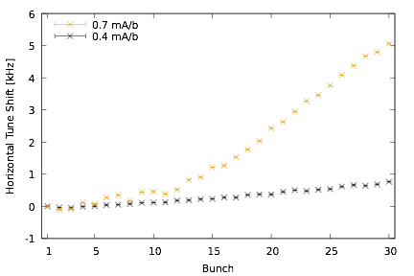
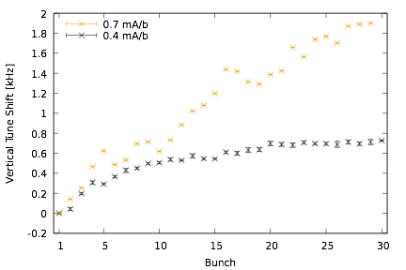
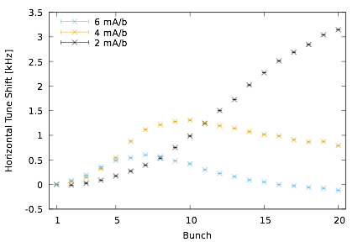
Tune shift measurements
Tune shifts measured at different energies and a wide range of currents
World-wide unique data set
(Revolution frequency: 390 kHz)
2.1 GeV
5.3 GeV

Slide 10
Simulations
Simulations involve four codes which feed into each other
Tracking photons from synchrotron radiation (Synrad3D)
Information on photons absorbed in vacuum chamber
Photo-electron production (Geant4)
Quantum efficiencies
Photo-electron energies
Electron cloud buildup (ECLOUD)
Space-charge electric field maps
Betatron tunes
Tracking of beam through the lattice with EC elements (Bmad)
Equilibrium beam size

Slide 11
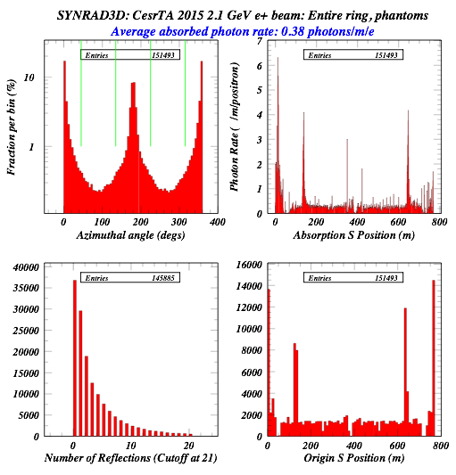
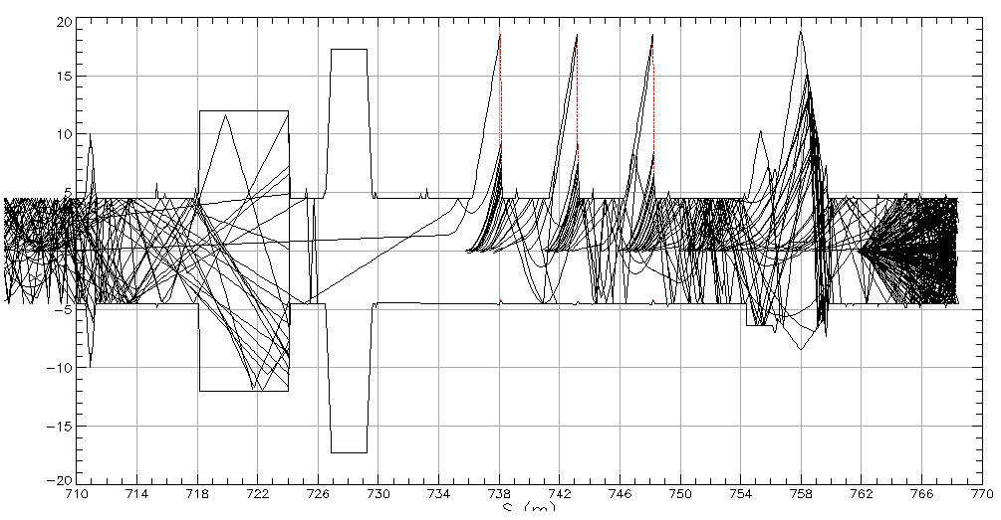
1) Photon tracking
Synrad3D
Simulates photons from synchrotron radiation
Tracks photons through vacuum chamber including specular & diffuse reflections
Input: lattice, 3D vacuum chamber profile, material
Output: information on absorbed photons:
Azimuthal angle
Energy
Grazing angle with vacuum chamber wall
x [cm]
Wigglers
S [m]

Slide 12
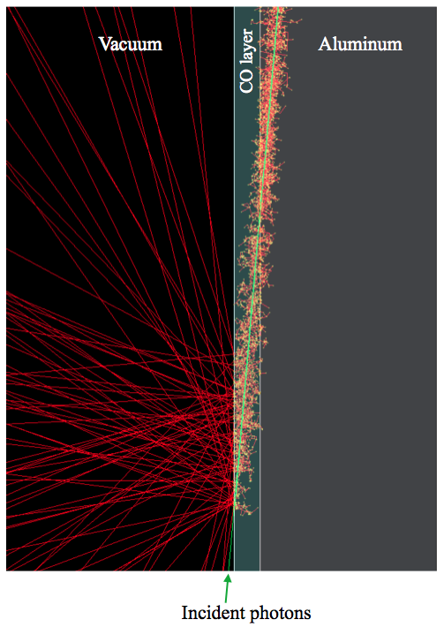
2) Photo-electron production
Geant4
Input: Absorbed photons
Azimuthal angle
Energy
Grazing angle with vacuum chamber wall
Simulates electron production from photo-electric and Auger effects
Vacuum chamber material (Aluminum) and surface layer (5 nm carbon-monoxide)
Output:
Quantum efficiency vs azimuthal angle
Photo-electron energy distributions
QE depends on photon energy & grazing angle which vary azimuthally
Improvement on ECLOUD model
Big improvement to predictive ability
300 eV
5 deg. grazing angle
Refer to Part 1 for details

Slide 13
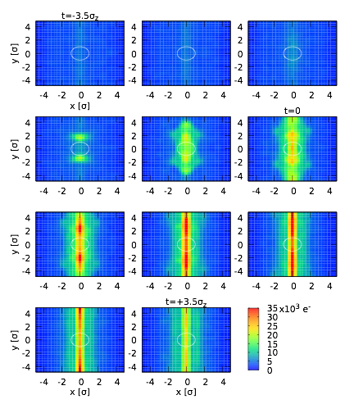
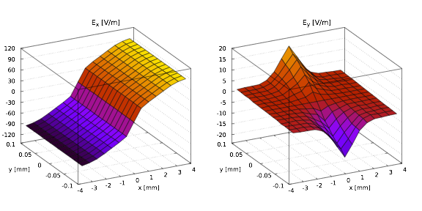
3) EC buildup simulation
EC buildup simulations with ECLOUD in both dipole and field-free regions
Use element-type ring-averaged beam sizes
Dipole: 730 x 20 um
Drift: 830 x 20 um
The large horizontal size is dominated by dispersion
Obtain space-charge electric field maps from the EC for 11 time slices during a single bunch passage, in ±5σ of the transverse beam size
∆t = 20 ps
Only ~0.1% of electrons are within this beam region
Necessary to average over many ECLOUD simulations
Transverse EC charge distributions in an 800 G dipole for bunch 30 of a 0.7 mA/b positron train

Slide 14
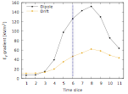
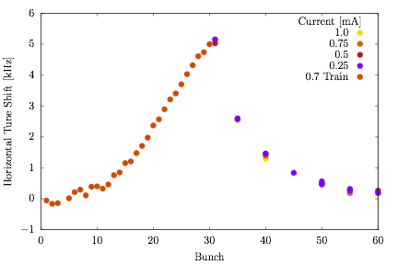
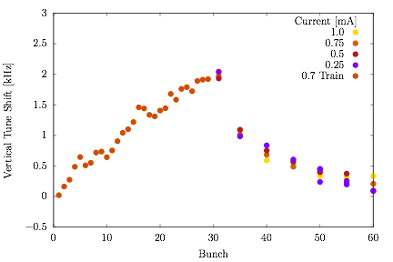
Electric field gradients from cloud space-charge fields
Tune shifts calculated from electric field gradients (dEx/dx, dEy/dy)
Gradient just before a bunch passage ➔ coherent tune shift
Demonstrated in witness bunch tune measurements (left)
Gradient during pinch ➔ incoherent tune spread, emittance growth
Demonstrated in witness bunch size measurements (right)

Slide 15
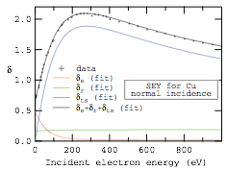
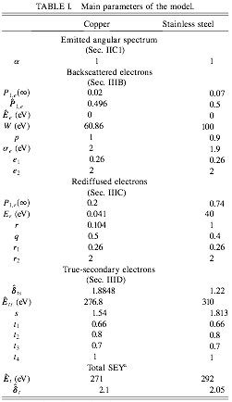
Calibration of model to tune shift measurements
ECLOUD simulations depend strongly on vacuum chamber secondary electron yield (SEY) parameters
Direct SEY measurements provide a good starting point, but it’s hard to accurately determine all the parameters
Still, the condition in the machine may be different
Use results from copper for our aluminum vacuum chamber
To improve agreement between the ECLOUD model and our various measurements:
Use an optimizer to fit the SEY parameters to tune shift data
At each iteration, run ECLOUD simulations in parallel varying each parameter by an adaptive increment
Calculate Jacobian & provide to optimizer
M. Furman & M. Pivi, “Probabilistic Model for the Simulation of Secondary Electron Emission,” Phys. Rev. ST Accel. Beams 5, 124404 (Dec. 2002)

Slide 16
Simulated tune shifts with initial SEY parameters
2.1 GeV (CESRTA)
5.3 GeV (CHESS)
0.4 mA/b
2 mA/b
0.7 mA/b
4 mA/b
6 mA/b
(Revolution frequency: 390 kHz)
Various discrepancies between model & measurements
However, just getting this close required a sophisticated model
Adjusting SEY parameters to better match data is a final calibration

Slide 17
Simulated tune shifts with fit SEY parameters
2.1 GeV (CESRTA)
5.3 GeV (CHESS)
0.4 mA/b
2 mA/b
0.7 mA/b
4 mA/b
6 mA/b
(Revolution frequency: 390 kHz)
Excellent agreement for a range of currents and beam energies!
Seeing the different contributions from dipoles & drifts has taught us about cloud dynamics

Slide 18
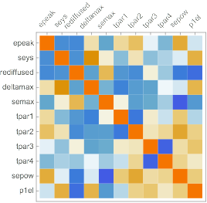
Fit SEY parameters
 | Initial | Fit | Uncertainty
epeak Peak energy of true secondary yield | 277 | 260 | 10
seys True secondary yield 's' parameter | 1.54 | 1.58 | 0.05
rediffused Rediffused secondary yield | 0.2 | 0.39 | 0.01
deltamax True secondary yield | 1.88 | 1.53 | 0.04
semax Energy spread of secondaries | 1.8 | 3.58 | 0.4
tpar1 Angular dependence of true secondary yield | 0.66 | 0.99 | 0.2
tpar2 Power of cosine in angular dependence of true secondary yield | 0.8 | 1.5 | 0.4
tpar3 Angular dependence of peak energy of true secondary yield | 0.7 | 0.77 | 0.5
tpar4 Power of cosine in angular dependence of peak energy of true secondary yield | 1.0 | 1.16 | 1
sepow Power of energy of secondaries | 1.0 | 0.84 | 0.2
p1el Elastic yield at ‘zero’ energy | 0.5 | 0.07 | 0.02
Fit uncertainties come from covariance matrix, estimated from Jacobian
Correlation matrix (right) shows large correlations between parameters (could be removed from the optimizer)
Red is +1
Blue is -1

Slide 19
CHESS-U Transition Lattice
CHESS-U transition and CHESS-U results by summer REU student Keefer Rowan
To gain confidence in this model for predicting tune shifts for CHESS-U, compare with measurements of CHESS-U Transition lattice
Same optics as CHESS-U except in south arc
Tune shift measurements were taken for two bunch configurations (14 ns bunch spacing)
18x5 at 1.0 mA/b (90 mA total)
9x5 (every other train) at 4.4 mA/b (200 mA total)
The 18x5 train was seemingly limited by a horizontal instability, possibly caused by electron cloud
Investigation underway
18x5 at 1.0 mA/b
9x5 at 4.4 mA/b

Slide 20
CHESS-U at 5.3 GeV
CHESS-U transition and CHESS-U results by summer REU student Keefer Rowan
Various bunch configurations, all 200 mA total
Includes contribution from combined function magnets (DQ) and compact undulators (CCU)
18x5 at 2.2 mA/b
1x9, 14ns, 22.2 mA/b
9x5 at 4.4 mA/b
1x9, 4ns, 22.2 mA/b

Slide 21
CHESS-U at 6 GeV
Various bunch configurations, all 200 mA total
Includes contribution from combined function magnets (DQ) and compact undulators (CCU)
Tune shifts at 5.3 GeV very similar, about 5-10% lower
All tune shifts, except for 1x9 with 4ns spacing, are < 2.5 kHz and should not present a problem
We had tune shifts up to 3.5 kHz in the 5.3 GeV measurements
Tune plane of CHESS-U better than CHESS
18x5 at 2.2 mA/b
1x9, 14ns, 22.2 mA/b
9x5 at 4.4 mA/b
1x9, 4ns, 22.2 mA/b

Slide 22
4) Tracking simulations
Use the time-sliced electric field maps in EC elements at the dipole and drifts
Track particles in bunch through the full lattice (using Bmad) for multiple damping times, with radiation excitation and damping
“weak-strong” model: does not take into account effects on the cloud due to changes in the beam
Tracking: Weak: beam; Strong: EC
EC buildup simulations: Weak: EC; Strong: beam
Justification: EC buildup simulations are rather insensitive to vertical beam size
Strong-strong simulations are too computationally intensive to track for enough turns
Damping times at CesrTA are ~20,000 turns
We want equilibrium beam sizes

Slide 23
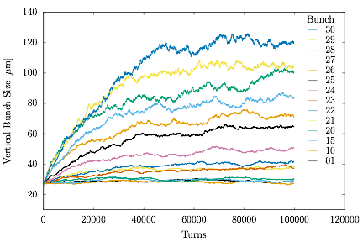
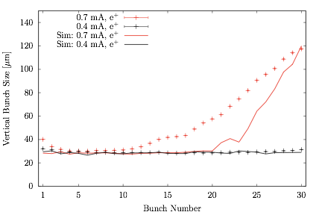
Vertical bunch size growth - train
Bunch size from simulation is the average over last 20k turns (of 100k)
See vertical emittance growth in 0.7 mA/b simulations
0.7 mA/b positron train

Slide 24
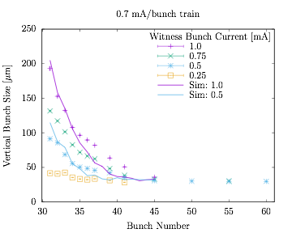
Vertical bunch size growth - witness bunch
More emittance growth with:
shorter distances from train (more cloud)
higher witness bunch current (more pinch)
Simulations show similar behavior

Slide 25
Summary
We have obtained various measurements of tune shifts and emittance growth from electron cloud
Our e-cloud model has been improved with precise modeling of synchrotron radiation photons & generation of primary electrons
The model has been validated with improved tune shift measurements for a range of bunch currents at 2.1 and 5.3 GeV
The validated model was used to predict tune shifts in CHESS-U transition and CHESS-U
All tune shifts (except for 1x9 with 4ns spacing) are < 2.5 kHz; should not present a problem
Disclaimer: We have not ruled out other possible sources of instabilities from EC:
Cloud shape, pinch effect, cloud trapping
The simulations can be used to address problems as they arise
Our model can uncover the largest contributions to tune shifts and emittance growth
EC mitigation methods can be targeted to these regions and tested in simulation
Future work:
Use model to predict EC effects at future accelerators
Use model to understand underlying factors driving emittance growth
New approaches to mitigating emittance growth from EC

Slide 26
Thank you

Slide 27
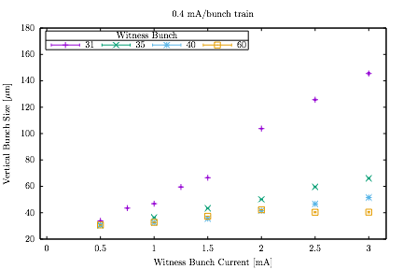
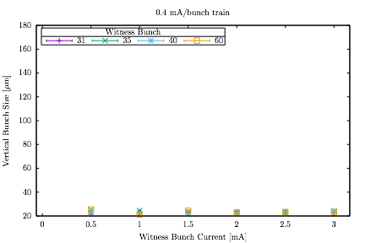
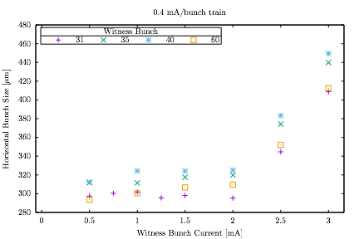
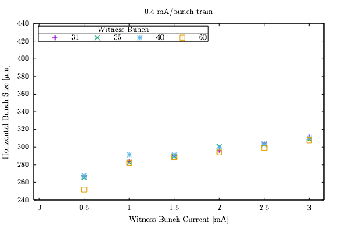
Witness bunch to a 0.4 mA/b train (below threshold)
e+
e-

