Slide 1
Study of Electron Cloud Development in a Solenoidal Magnetic Field Using Time-resolved Measurements from Shielded Pickup Detectors
-- Progress in Modeling with the ECLOUD Program --
Jared Ginsberg
Cornell Laboratory for Accelerator-Based Sciences and Education
Electron Cloud Meeting
25 July 2012

Slide 2
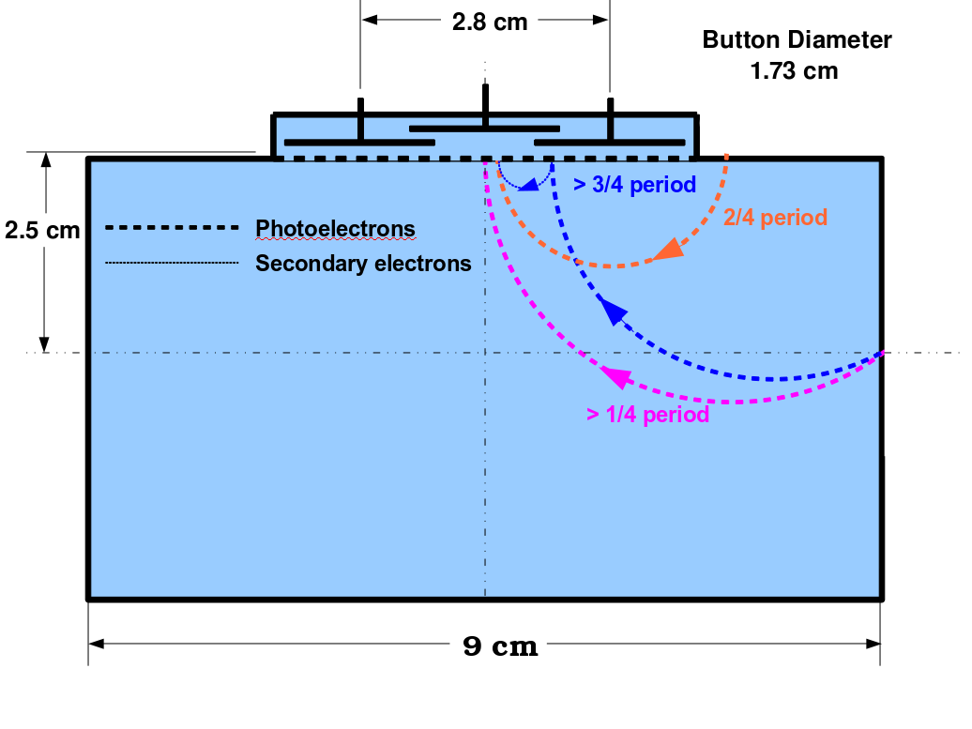
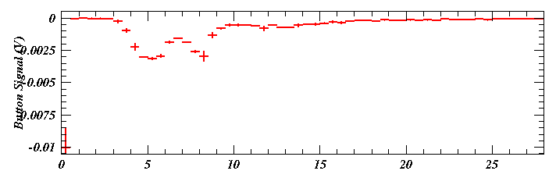
The cyclotron period of the solenoidal magnetic field dictates the timing and shape of the pulse
Understanding the SPU Signal Timing
The cyclotron motion of the photoelectrons determines when electrons sharing a production location contribute to the shielded pickup signal. The cyclotron period is
The earliest signal corresponds to slightly more than one quarter period (>4 ns for a 23 Gauss field). A second pulse signal from photoelectrons produced on the ceiling arrives at about half a period. A third pulse from secondary electrons produced by photoelectrons on the ceiling arrives after about ¾ period. This late pulse is caused by photoelectrons that hit the ceiling, producing secondaries which curl up into the button after traveling an additional semi-circle.
ECLOUD model of SPU signal development
in a rectangular vacuum chamber
B=23 G: ¼ period is 4 ns
3/4
1/4
1/2
The production location and angle of signal-producing photoelectrons depend on their kinetic energy, but the arrival times which determine the signal time structure depend only weakly on the energy.
Time (ns)

Slide 3
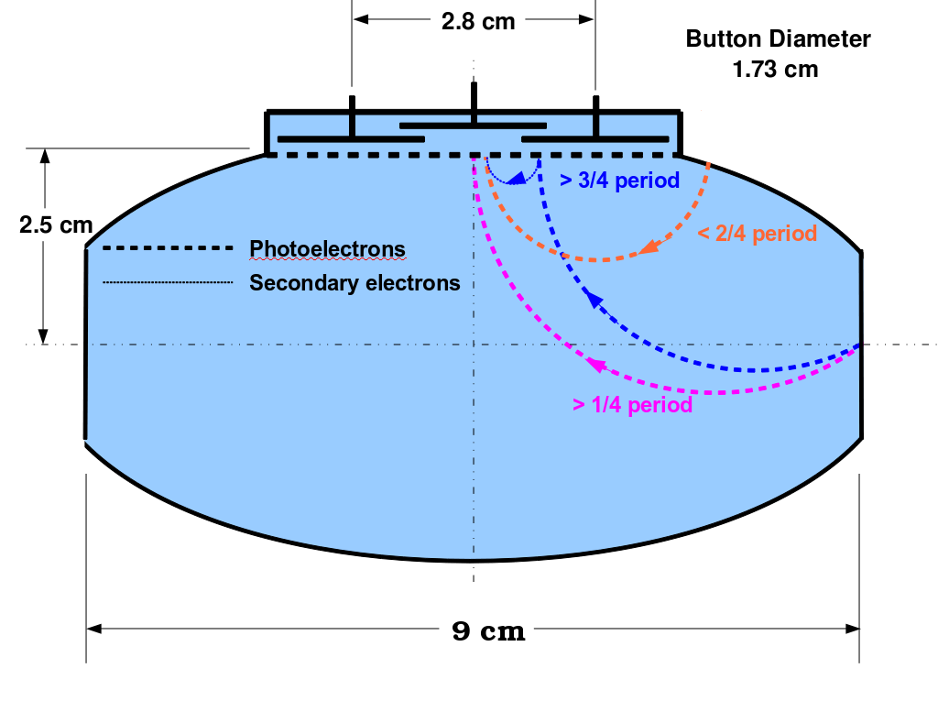
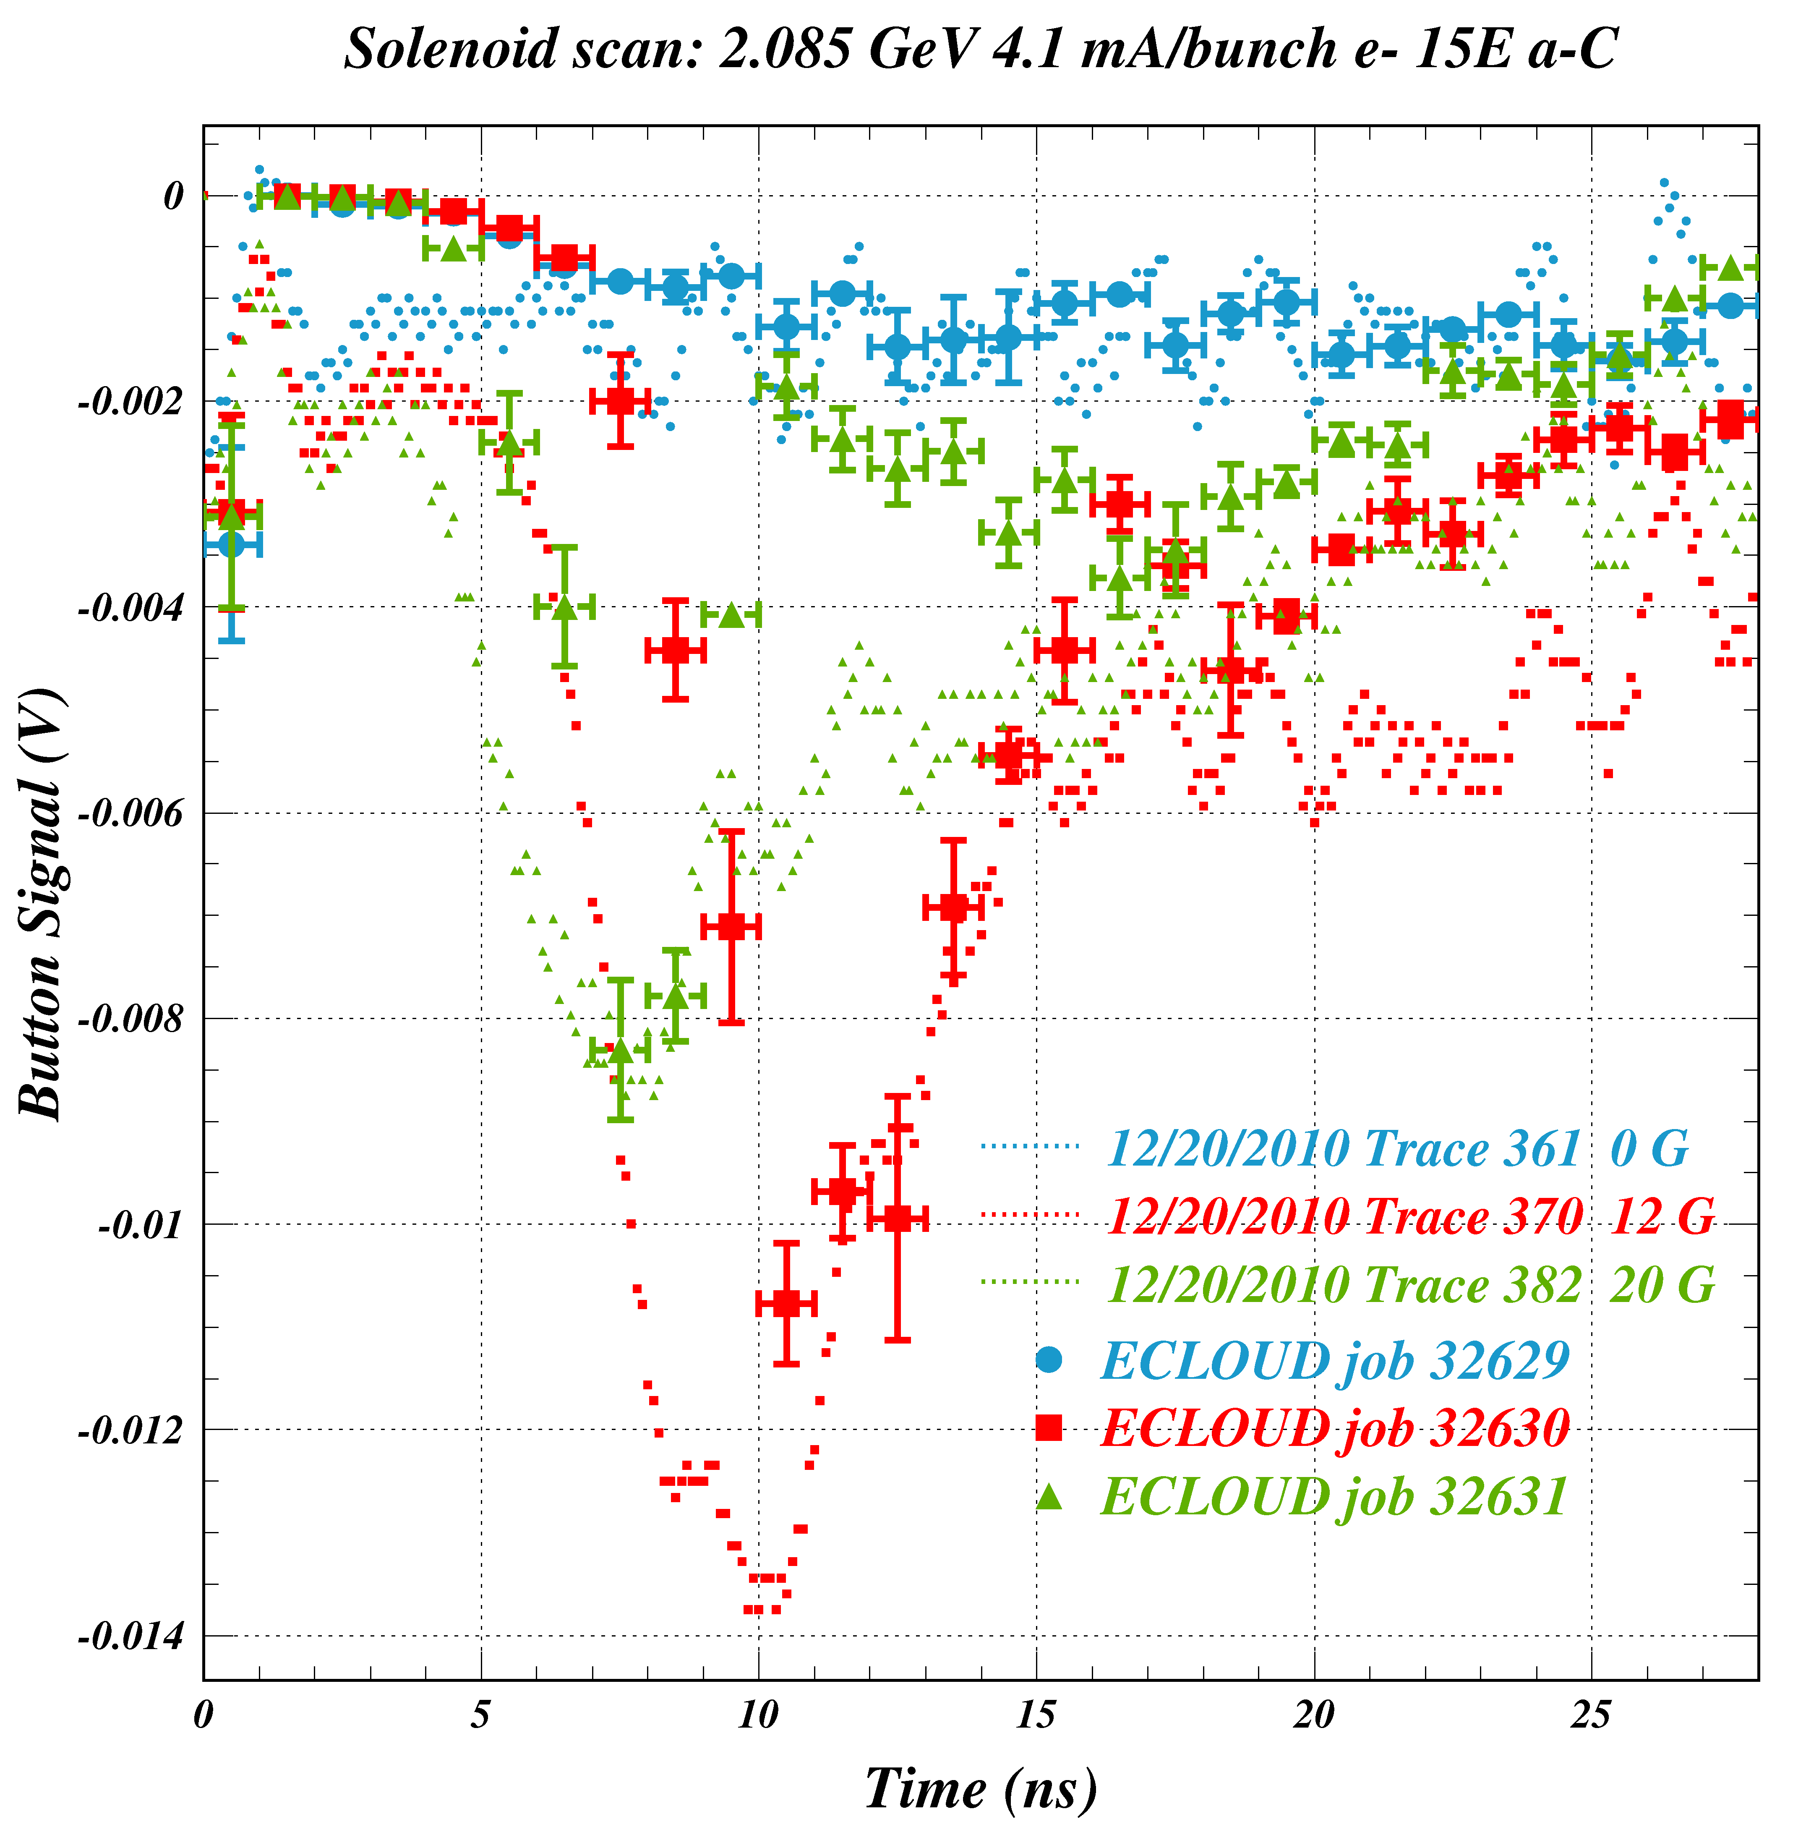
Solenoid-Off vs. Solenoid-On
2.1 GeV e- 4.1 mA/bunch 15E (Button 2) a-Carbon
12/20/2010
Comparison of ECLOUD model to observed signals for the case of the CESRTA vacuum chamber shape
This comparison of modeled and measured SPU signals shows the effects of raising the modeled field strength to 12 G and 20 G in an ECLOUD model which is a good match to the field-free case. This shows how the shape of the CESR beampipe affects the expected signal shape relative to the simple rectangular case.
The 20-G case (green) shows a double-pulse structure for the higher field which is not seen in the SPU signal. The two pulse times correspond approximately to ¼ cyclotron period for photoelectrons from the primary source point and ¾ cyclotron period for secondaries arriving after a single collision with the wall.
NB: One quarter cyclotron period (T=2pm/qB) is 4.5 ns for 20 Gauss and 7.5 ns for 12 Gauss for button 2. For this button, the cyclotron radius for photoelectrons from the primary source point is about 3 cm. Photoelectrons of energy near ~200 eV (125 eV) reach button 2 for a field of 20 (12) Gauss.
The naïve extrapolation of the ECLOUD model to nonzero solenoidal field results in a signal which arrives later than the measured one. Since the width of the button is in the simulation, this example shows that the button width does not suffice to explain the early signal.
Another candidate reason for early arrival times is the photoelectron production angular distribution, which can produce path lengths shorter than a quarter cyclotron period. The next slide addresses this possibility.

Slide 4
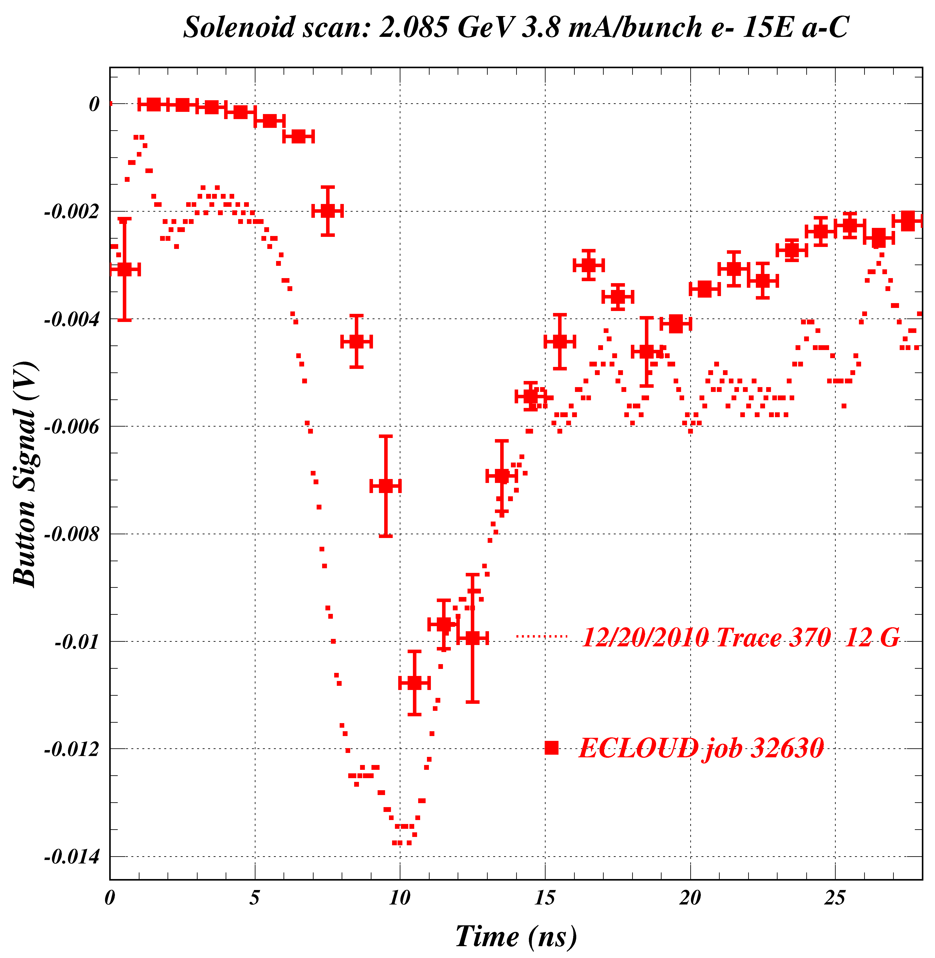
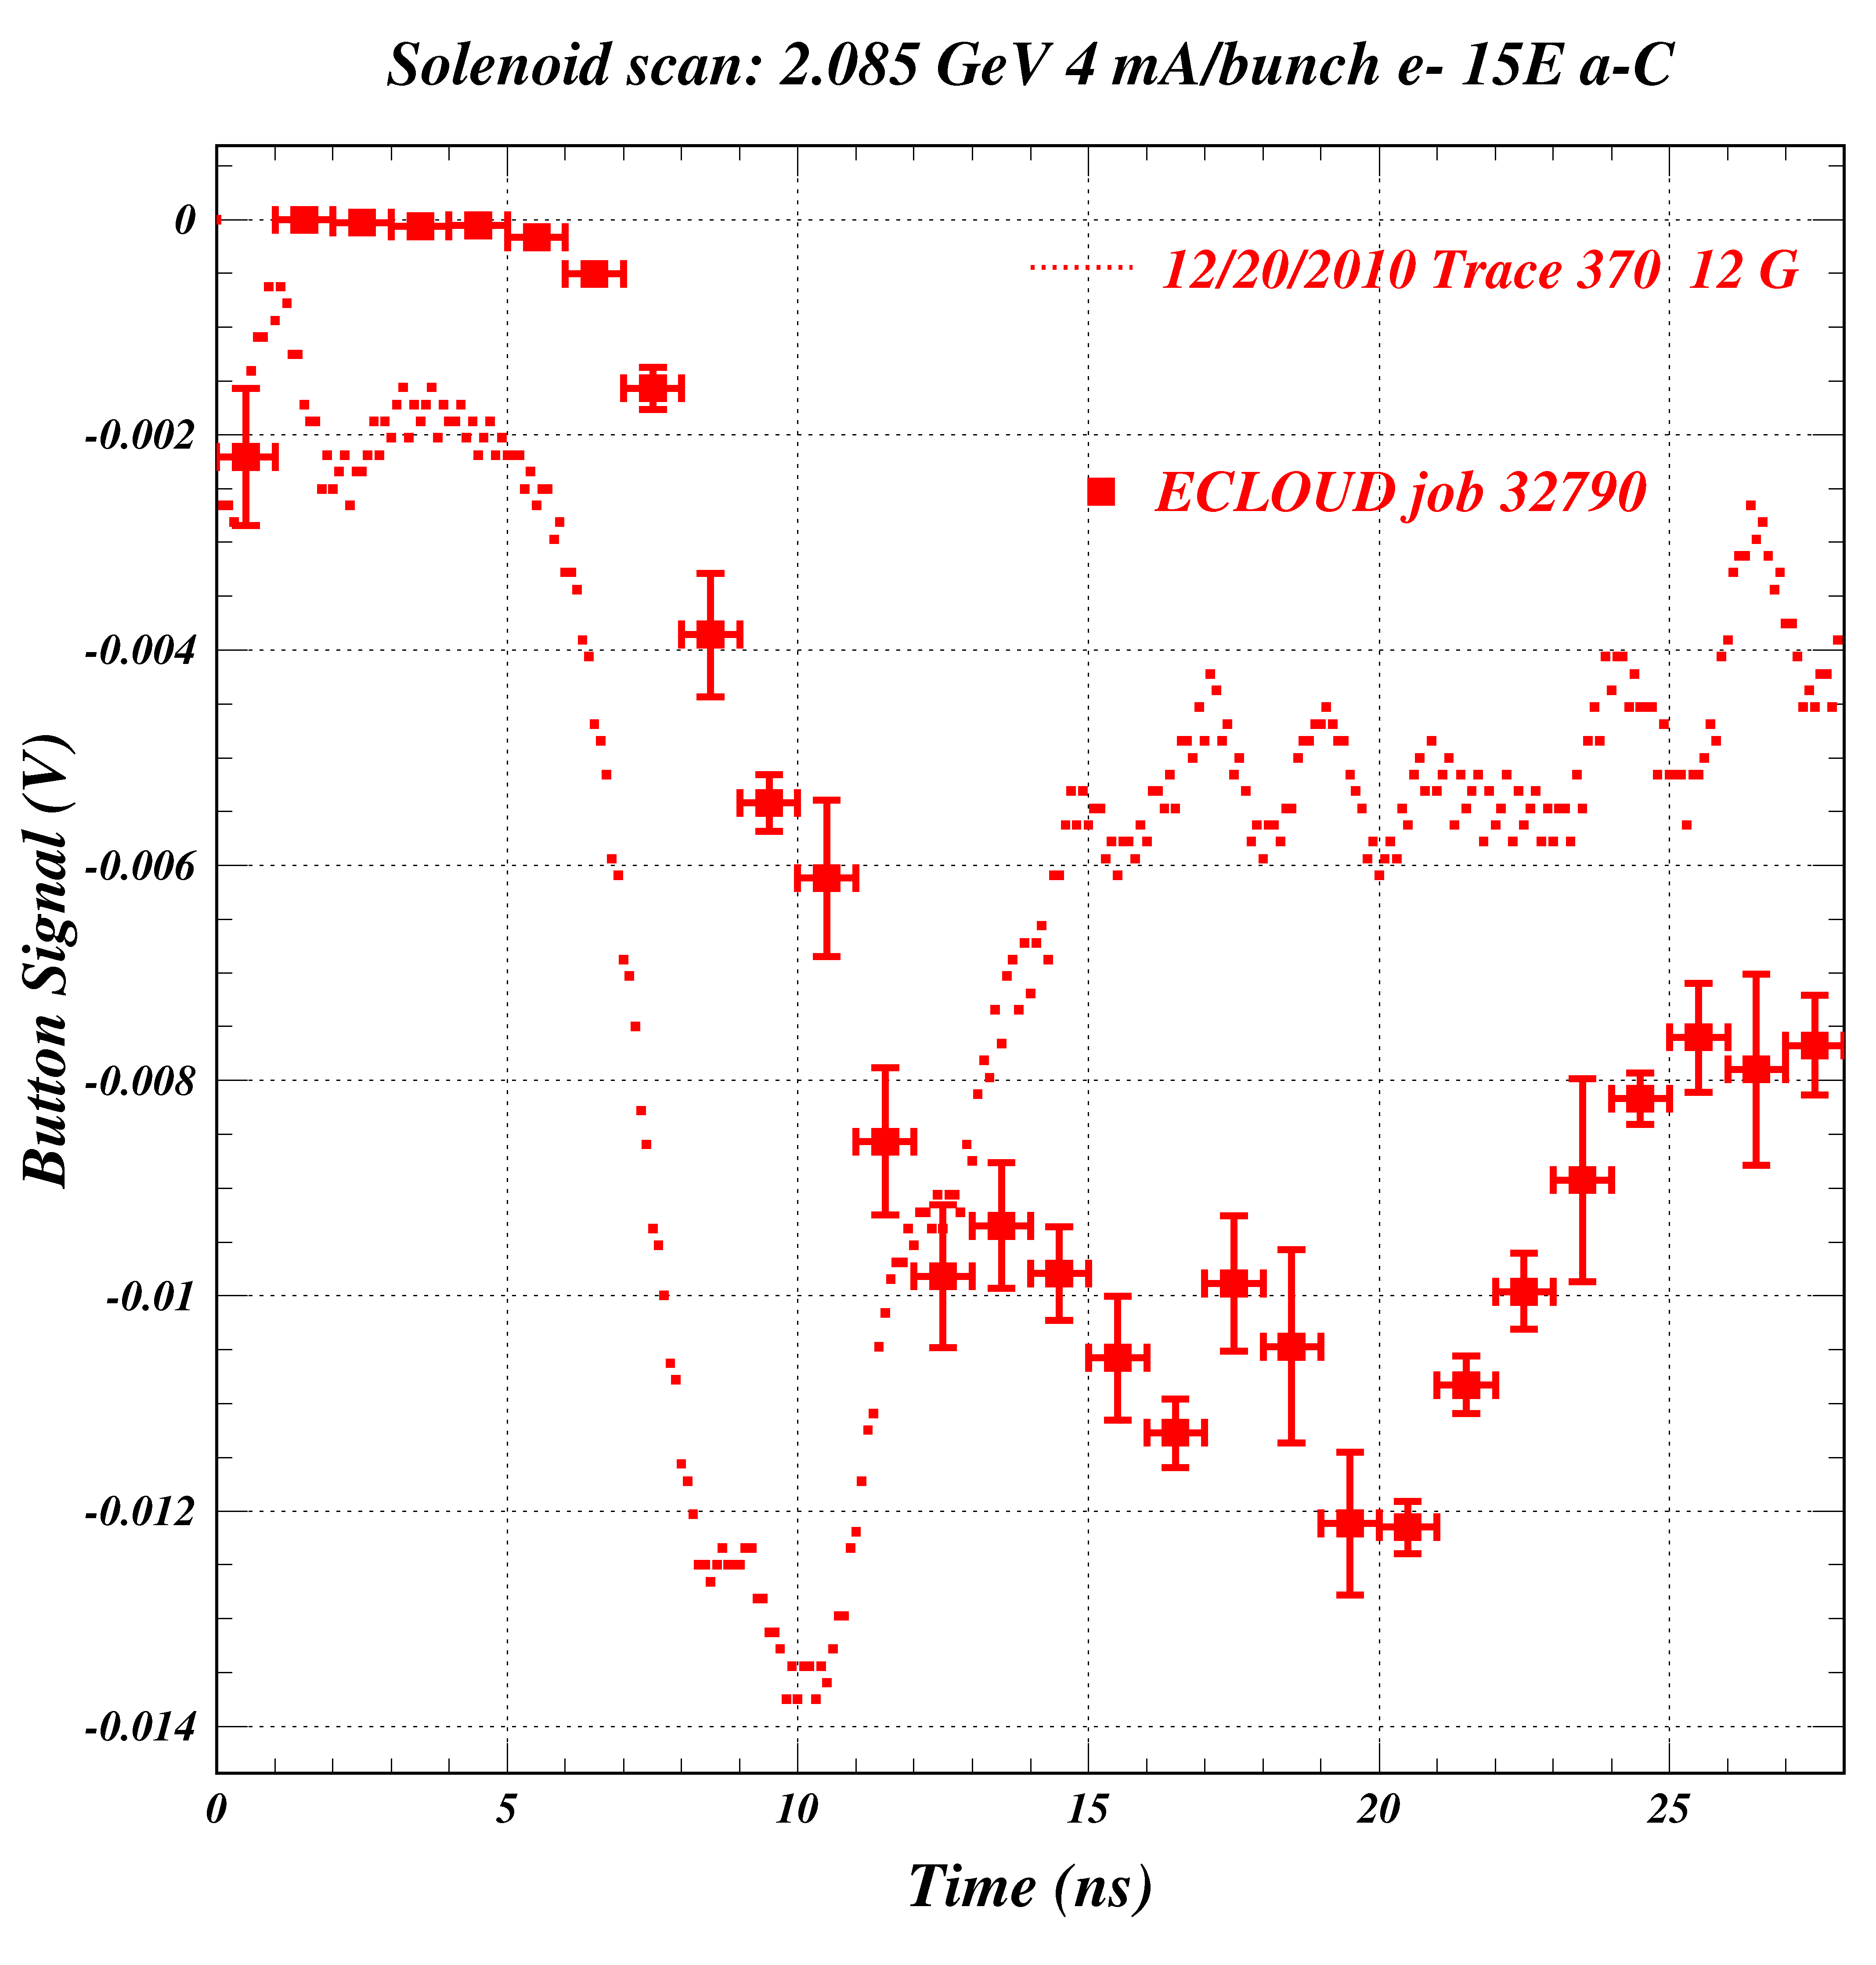
Example of strong production angular distribution dependence
dN/d(cosΘ) ~ cos^{n}Θ
n=1 (Default, Furman-Pivi) n=0 (Isotropic)
n
Can the early signal be explained by making the p.e. production angular distribution less perpendicular?
No! “Aiming” the primary photoelectrons is ineffective.

Slide 5
Model and Measurement Comparison for 12 G and 20 G
The study of different photoelectron energy contributions to the signal which will be described on the next few slides was conducted with 20 Gauss solenoid data, rather than the 12 G data used for the study of angular dependence. This plot simply again shows the comparison of 12 G to 20 G measured signals and models. The modeled pulse for 20 G is late and there is a double peak.

Slide 6
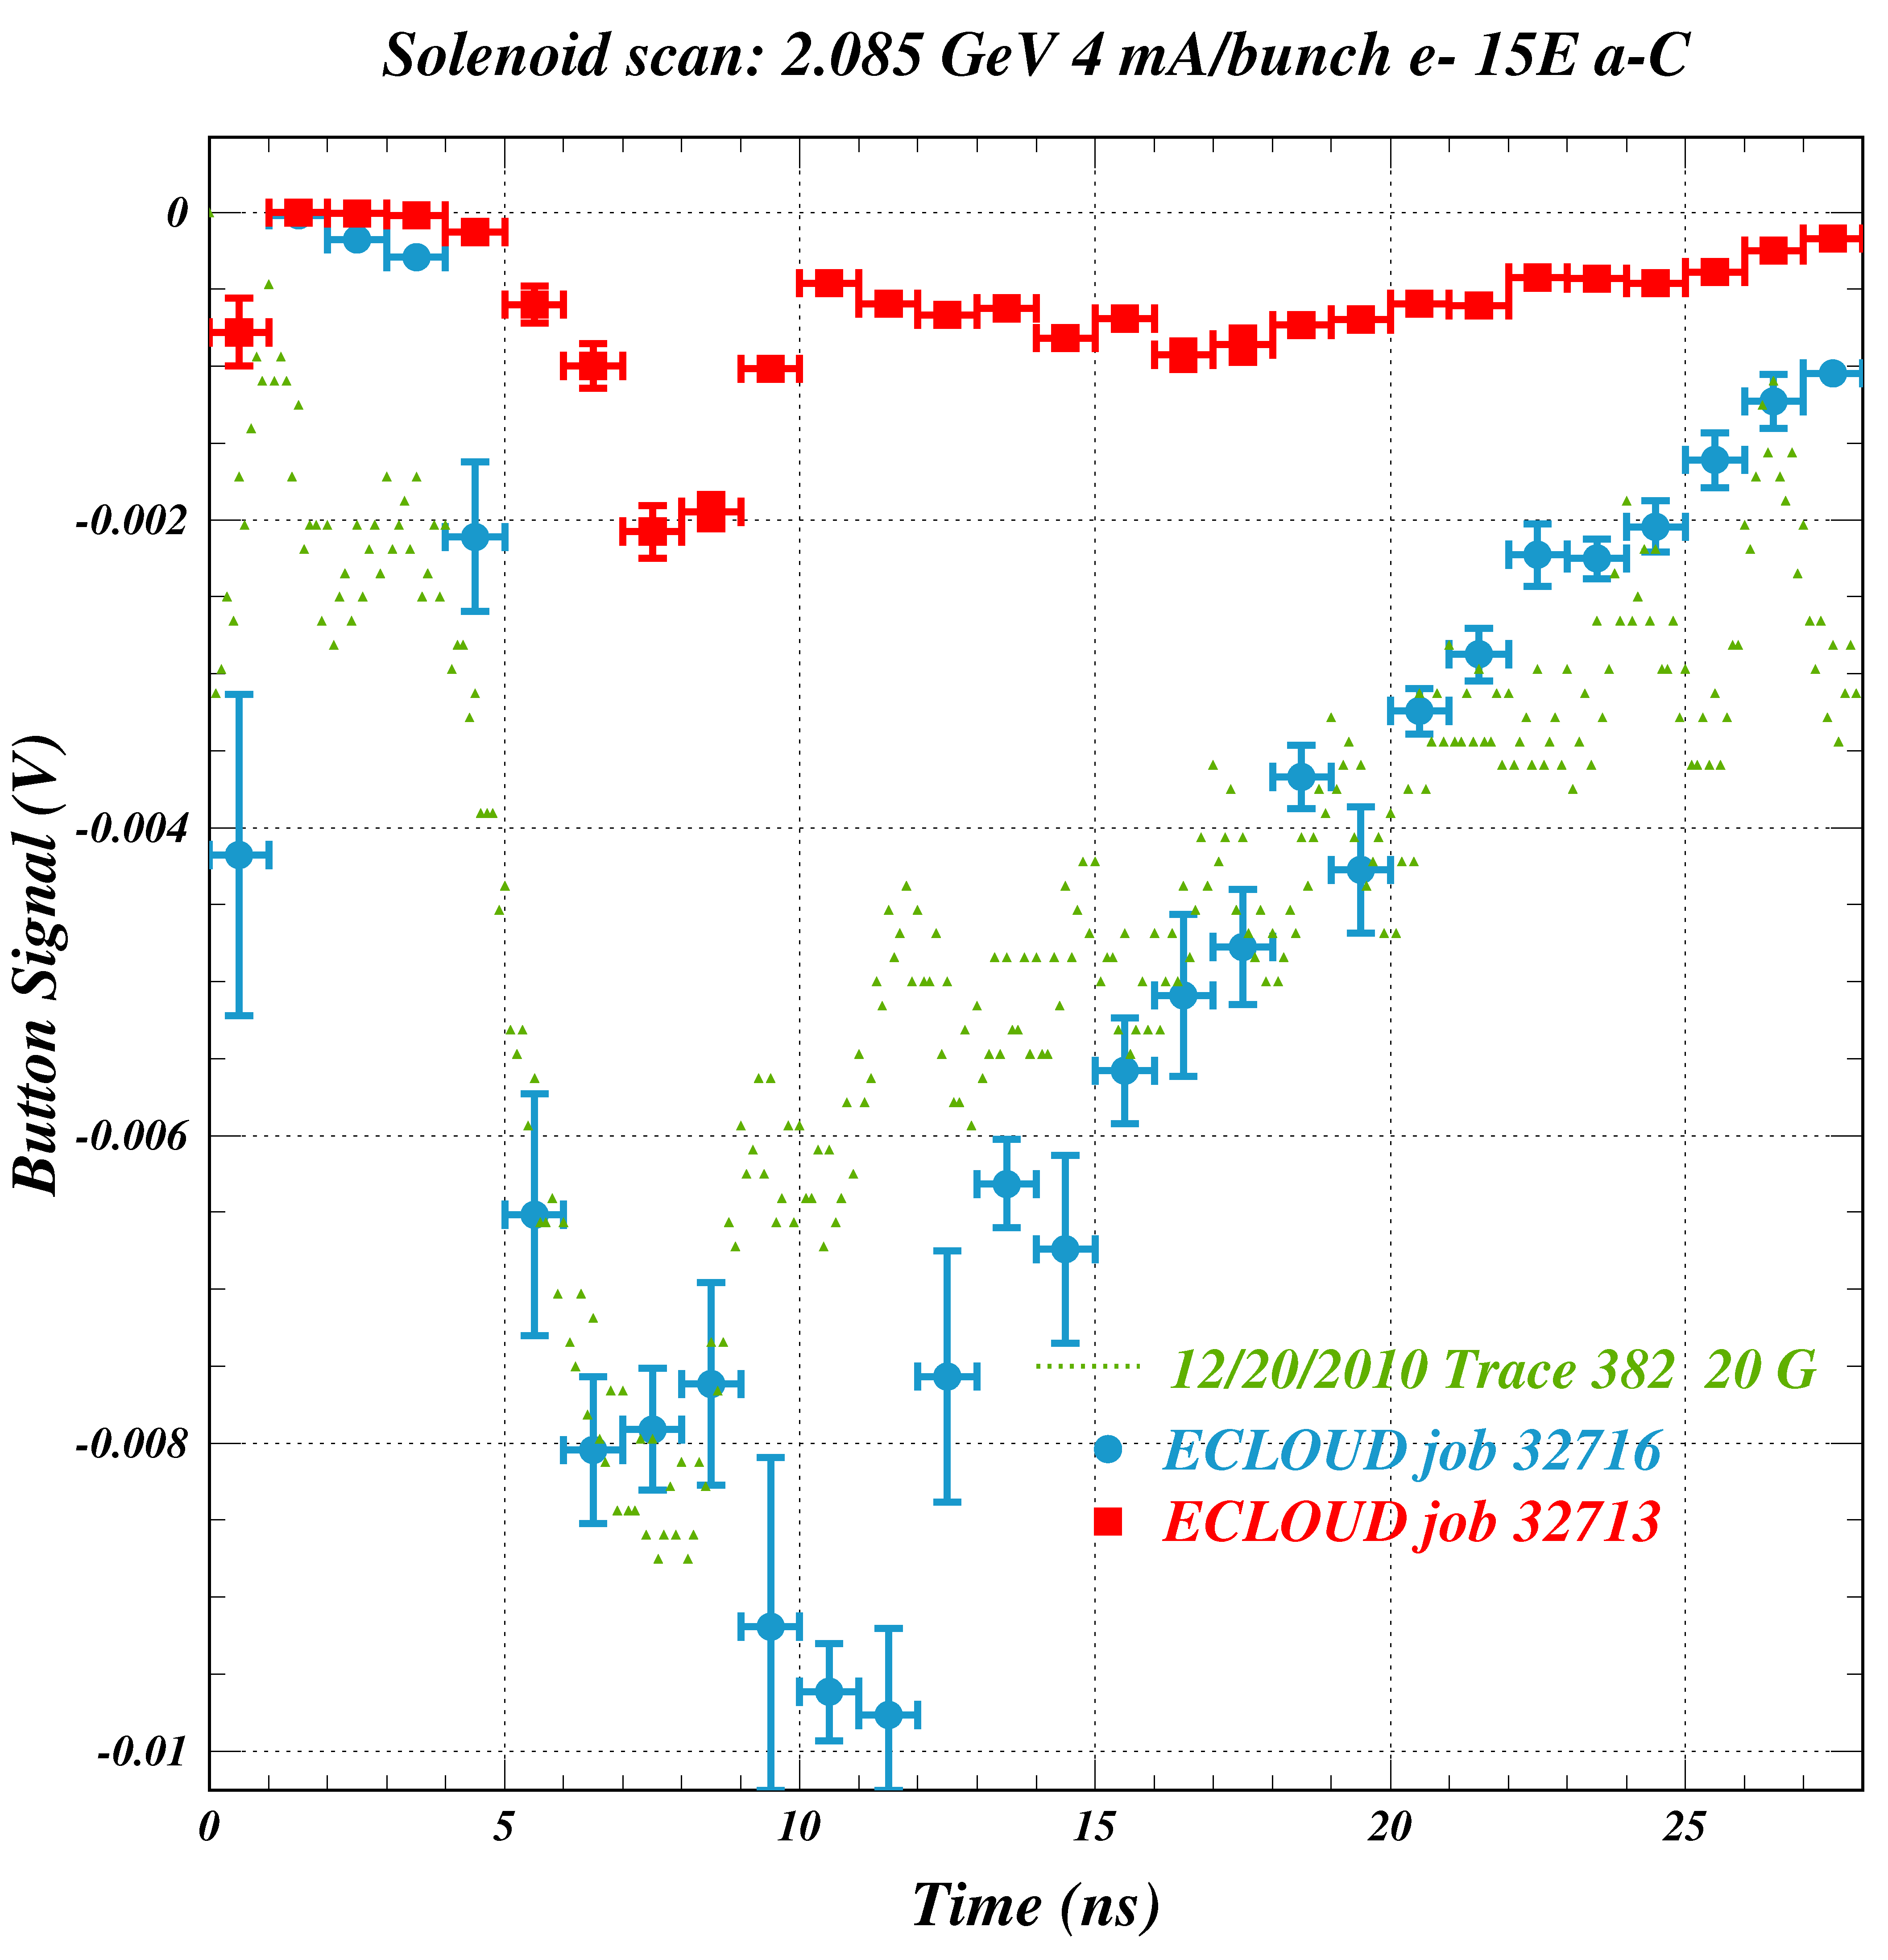
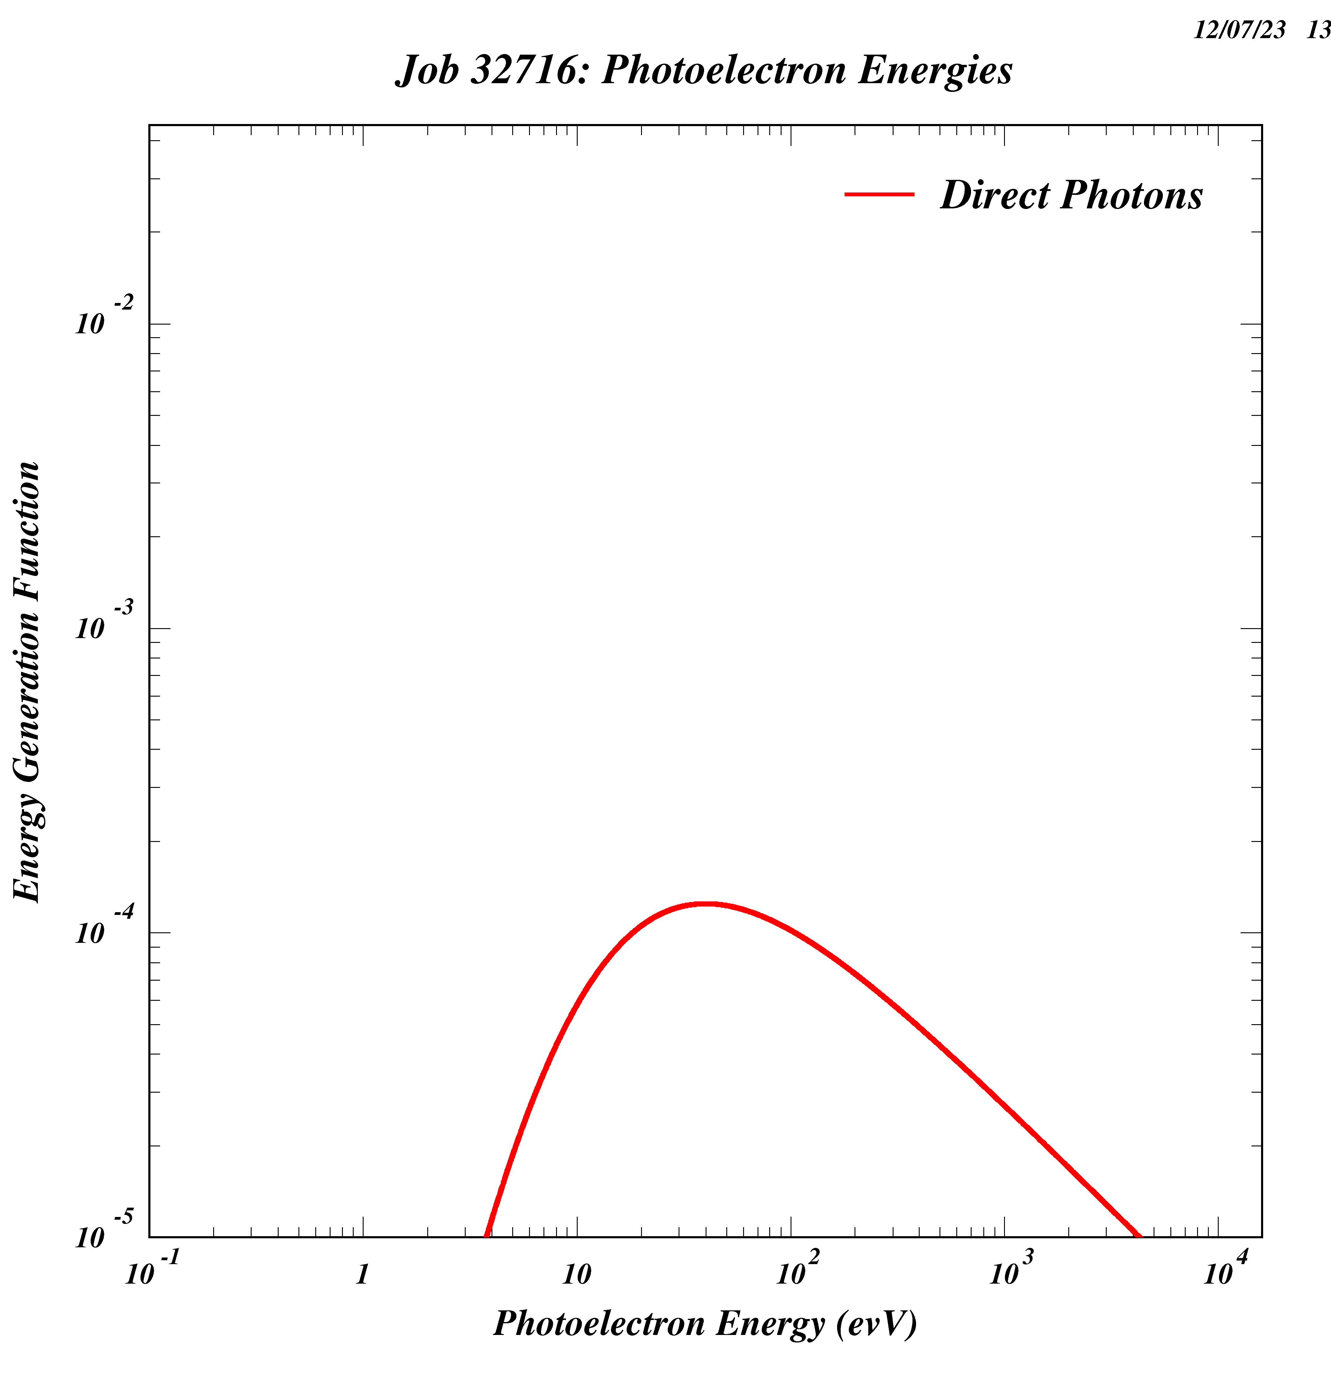
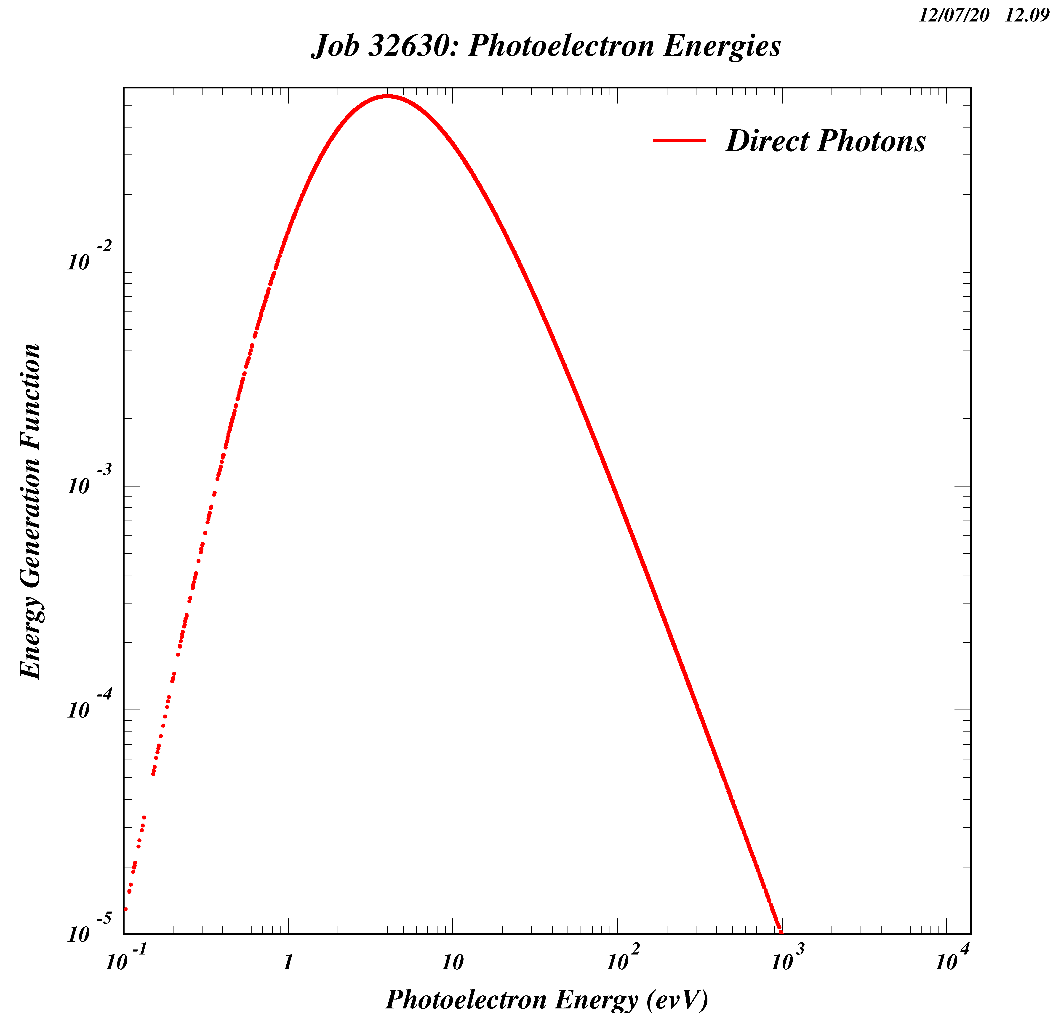
Addition of a second Power Law to improve the overall shape of the signal.
The energy distribution for photoelectrons produced by s.r. photons absorbed at the primary source point used up until this point corresponds to the red points.
We now add a higher-energy component with a weight of 75%.
Two Power-Law Contributions
F(E) = E ^{P1} / ( 1 + E/E0 ) ^{P2}
E0 = Epeak (P2-P1)/P1
Epeak= 40 eV P1= 4 P2= 4.7
The high-energy component (75%) has a peak energy of 40 eV and an asymptotically falling power of 0.7. Its contribution to the signal is shown in light blue.
Epeak= 4 eV P1= 4 P2= 6
The low-energy component (25%) has a peak energy of
4 eV and an asymptotically falling power of 2. Its contribution to the signal is shown in red.
75%
(Blue)
25%
(Red)

Slide 7
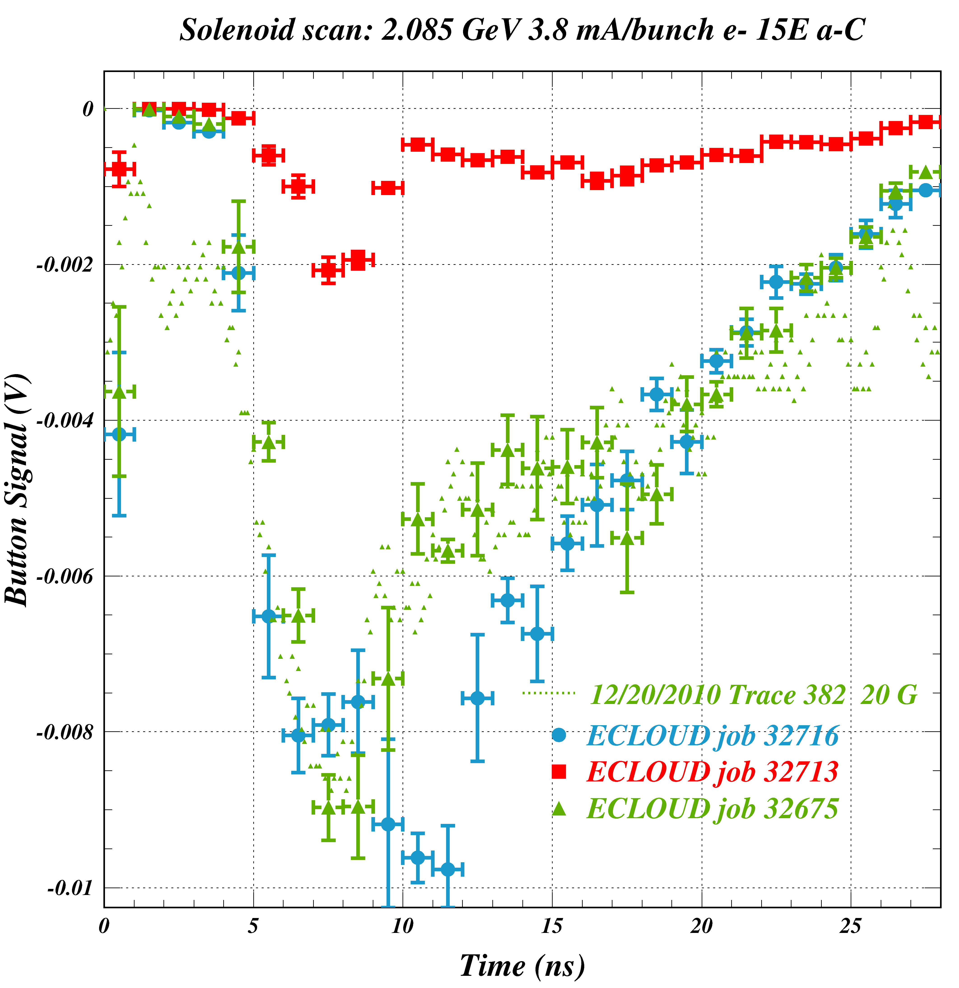
Achieving great agreement by combining the two power-laws
Successes:
After a considerable amount of tweaking, the combination of these two energies gives us the best agreement ever obtained. The leading edge timing of the signal is reproduced by the introduction of a second, higher energy power law contribution to the photoelectron energy distribution.
The shape is very nice overall, and can be improved even more by tampering with the field.
Side note: The interpretation of the model result is complicated by the fact that the low-energy contribution alters the time development of the cloud from the high-energy contribution. The full model evidently differs from the superposition of the clouds from the two photoelectron energy components.
Does this model work for other magnetic field strengths?

Slide 8
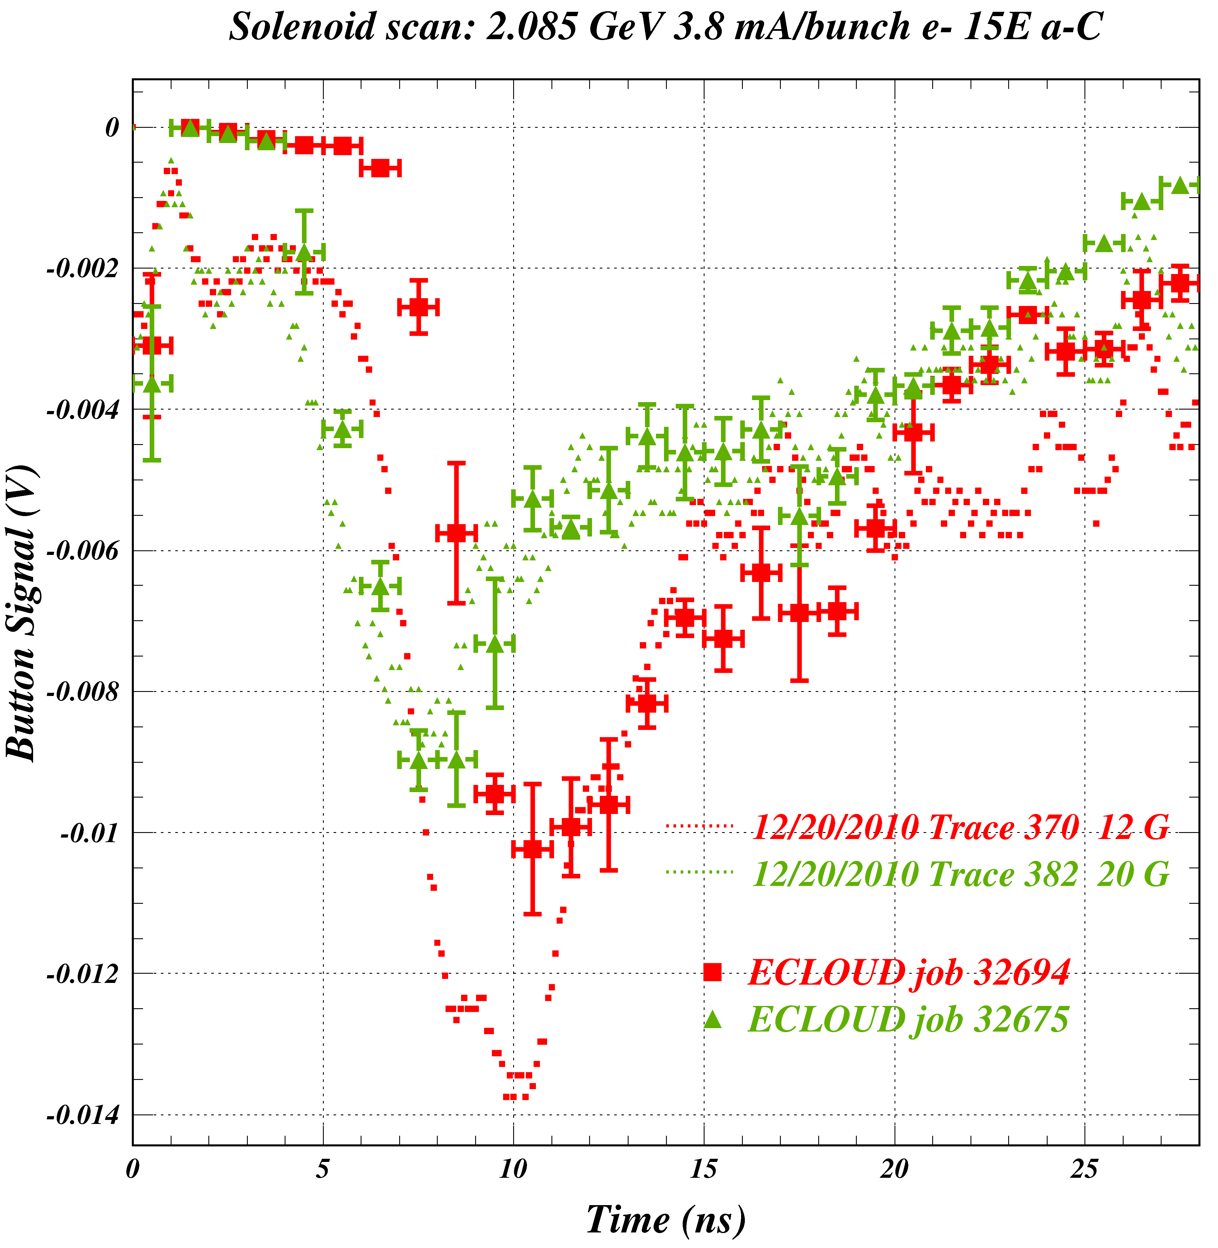
Comparison of 20 Gauss and 12 Gauss simulation plots with identical energies
Here are the 20G (green) and 12G (red) simulations side by side.
What issues have yet to be resolved? First, the modeled signal for 12 Gauss is a bit weak at the peak of the pulse. The model which correctly produces the leading edge timing for 20 G produced a signal for 12 G which is late. Note, that given the difference in cyclotron periods for 12 Gauss and 20 Gauss fields (7.5 ns – 4.5 ns = 3.0 ns) the rising edge of the simulation shows the expected time shift of 3 ns, whereas the data show only a 2 ns separation.
The comparison of the observed signal time shift to the ECLOUD modeling result indicates that the change in field magnitude is much less than expected from the power supply current settings.
What are the modeled field strengths which reproduce the observed signal timings?

Slide 9
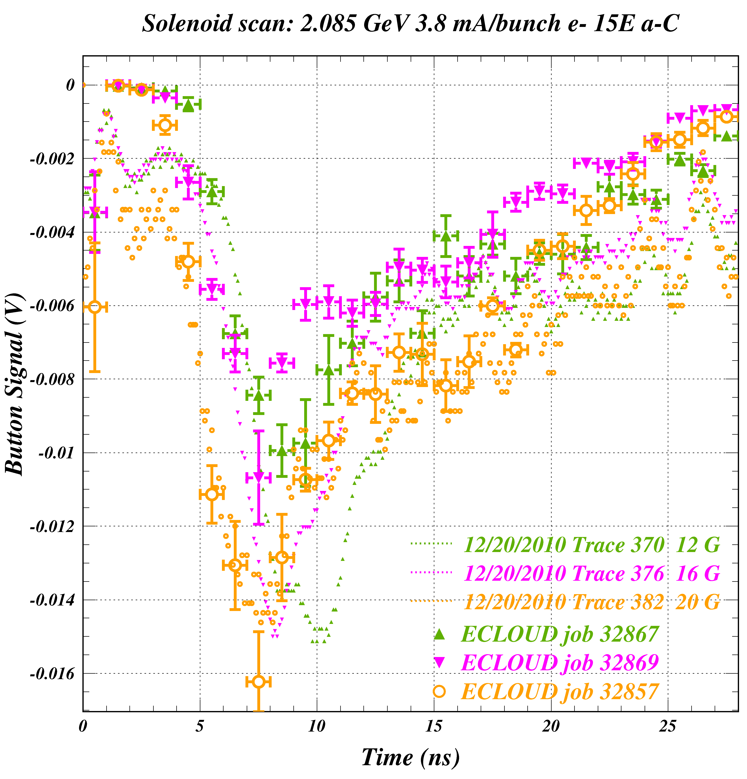
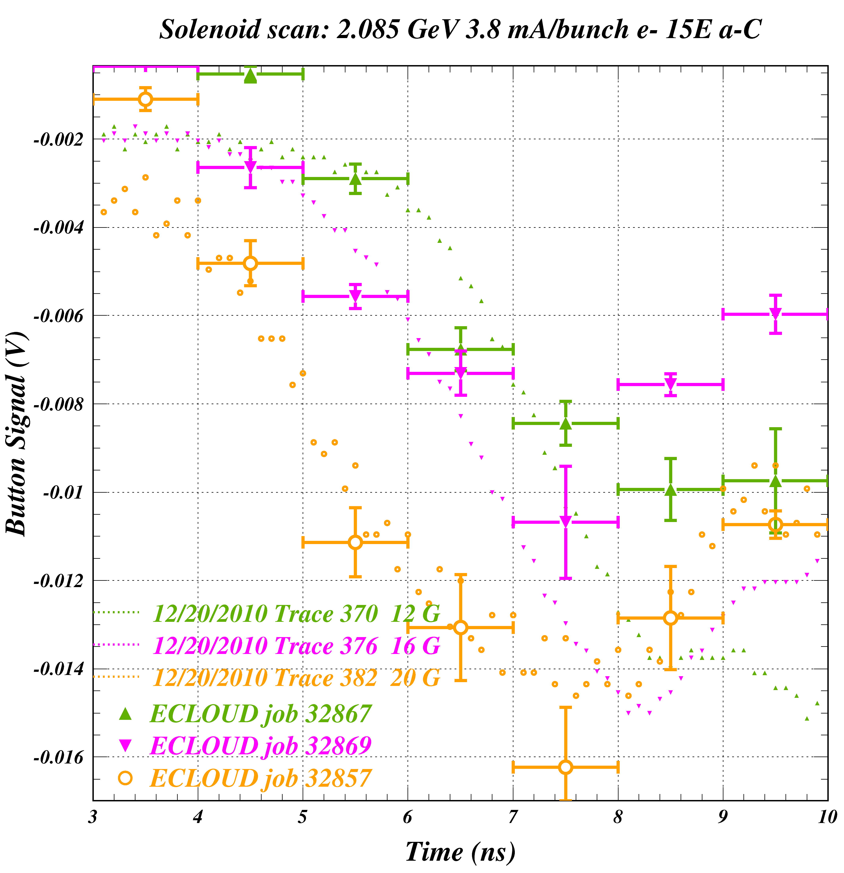
Selecting new field strengths by studying the timing of the signal's leading edge
What the data suggest:
20 Gauss
16 Gauss
12 Gauss
What works in the model:
23 Gauss
22 Gauss
18 Gauss
We've now hit a bit of a bump. Is the issue with the simulation, or can more progress be made by making in situ measurements of the fields produced by the windings?

Slide 10
The Story So Far...
This Summer's Progress in Modeling Electron Cloud Buildup in Solenoidal Magnetic Fields Using Shielded Pickup Measurements
Understanding of the time structure of the SPU signal in a solenoidal field
  The basic structure of the pulse is determined by the cyclotron period. Changing from a rectangular pipe to one with a more rounded shape smears out the signal, but in an understandable way.
  The observation of cloud electrons which contribute to a signal prior to the quarter cyclotron period motvated study of their possible origin. The p.e. production angular distribution was removed as a possible answer. An in-depth study of the relationship between p.e. production energy and signal arrival time succeeded in modeling the early signal via the introduction of a second power-law contribution.
Identifying modeling issues when changing the strength of the solenoid.
  Changing the magnetic field to translate a good shape from one field strength to another raises a brand new issue. The simulation matches the expected time shift well, but the observed signal does not. This may be interpreted as an error in the relationship between the solenoid excitation current and field magnitude. But it may also be that the expectation for the time shift is too naïve, owing to the complicated influence of the photoelectron energy distribution.
Where do we go from here?
  The next steps in this operation should investigate two distinct paths for improvement. First of all, to continue improving the simulation in hopes of finding a photoelectron production energy function that successfully fits all data, and secondly to verify the solenoid excitation calibration.

