Slide 1
Electron Cloud Growth & Mitigation: In-Situ SEY Measurements Retarding Field Analyzer Studies
W. Hartung, J. Calvey, C. Dennett, J. Makita, V. Omanovic for the CESRTA Collaboration
CesrTA Advisory Committee Meeting ● 11 September 2012

Slide 2
In-Situ Secondary Electron Yield Measurements
W. Hartung, C. Dennett, V. Omanovic for the CESRTA Collaboration

Slide 3
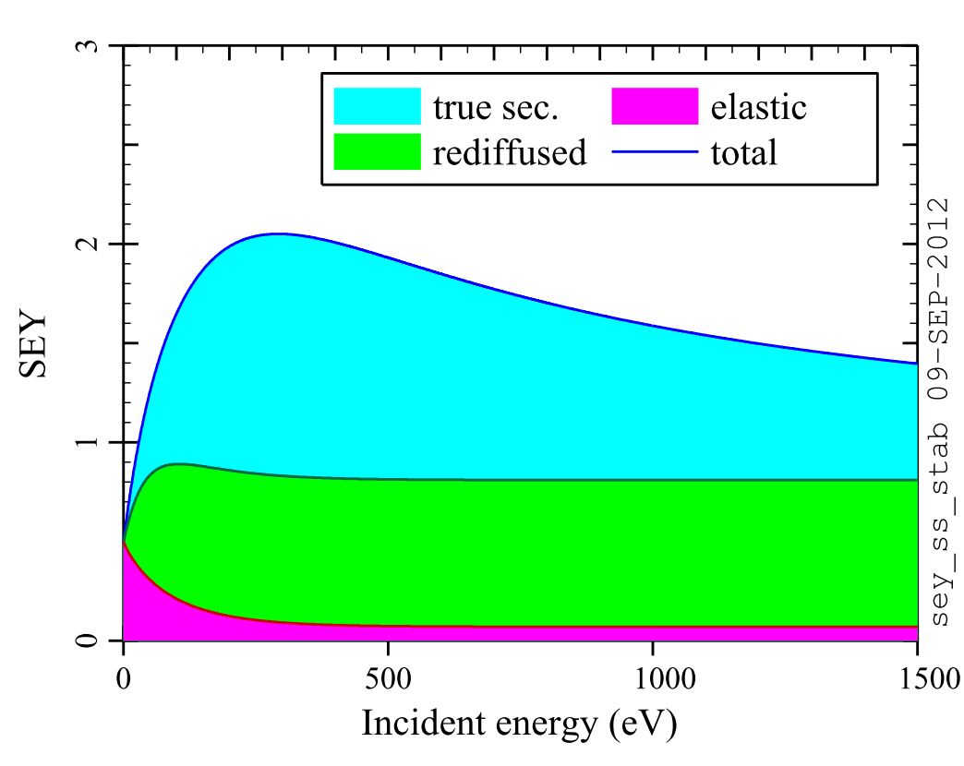
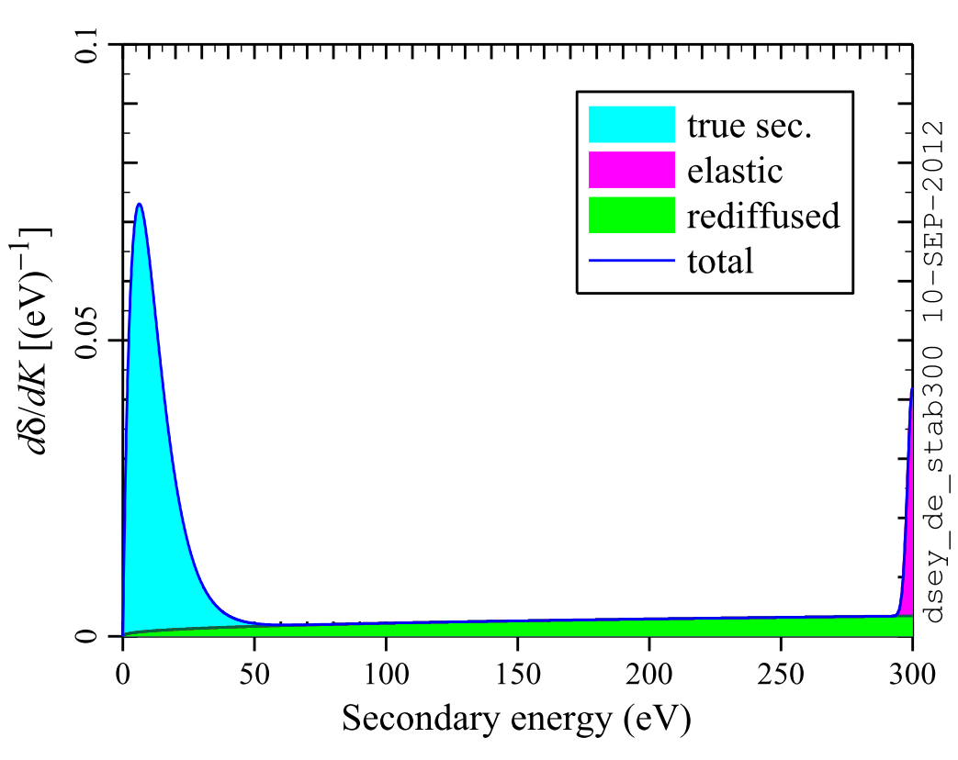
Review: SEY Studies
Secondary emission is important for models of electron cloud build-up
Inc. angle = normal
Inc. energy = 300 eV Inc. angle = normal
SEY depends on energy and angle of incident electron
Secondary electrons have a distribution in energy and angle

Slide 4
Review: SEY Studies
Secondary Electron Yield (SEY) Studies
Measure SEY of surfaces under realistic conditions
Measure effect of beam conditioning
Compare different materials and mitigation coatings
SEY apparatus based on technology developed at SLAC for measurements in PEP-II
SEY measurements being done at CERN and KEK also

Slide 5
Review: SEY Studies
Unique aspects of CesrTA SEY program
In-situ: see beam conditioning vs time, not just before and after; change samples rapidly
Observe deconditioning in a realistic environment
Compare effect of direct SR photons to scattered photons + electrons
Collaborative aspects of CesrTA SEY program
Samples and coatings from SLAC, CERN, KEK
Duplicate systems delivered to Fermilab for future studies in Main Injector
Funding in place for surface texturing R&D with PNNL

Slide 6
In-Situ Measurements
In-Situ SEY Station (ISSS)
Horizontal sample: direct photons in middle
45° sample: scattered photons and cloud electrons
SEY measurements while samples remain under vacuum
Typically measure SEY during weekly tunnel access

Slide 7
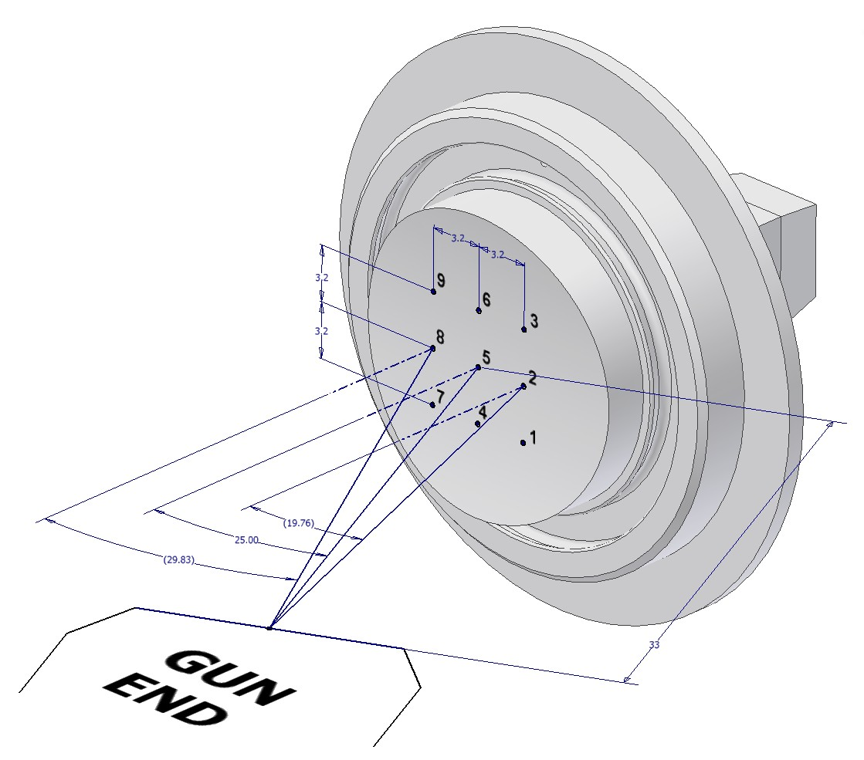
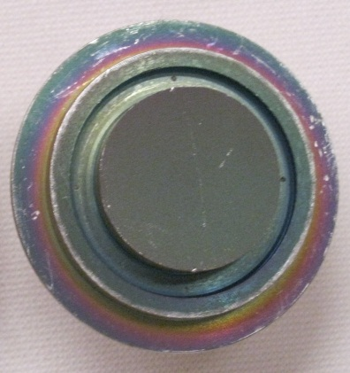
SEY Samples
TiN- coated
30°
25°
20°
TiN- coated
Bare Al
Use DC electron gun and picoammeter for indirect SEY measurement

Slide 8
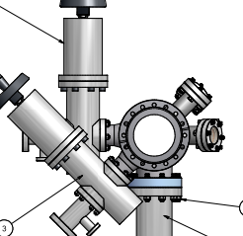
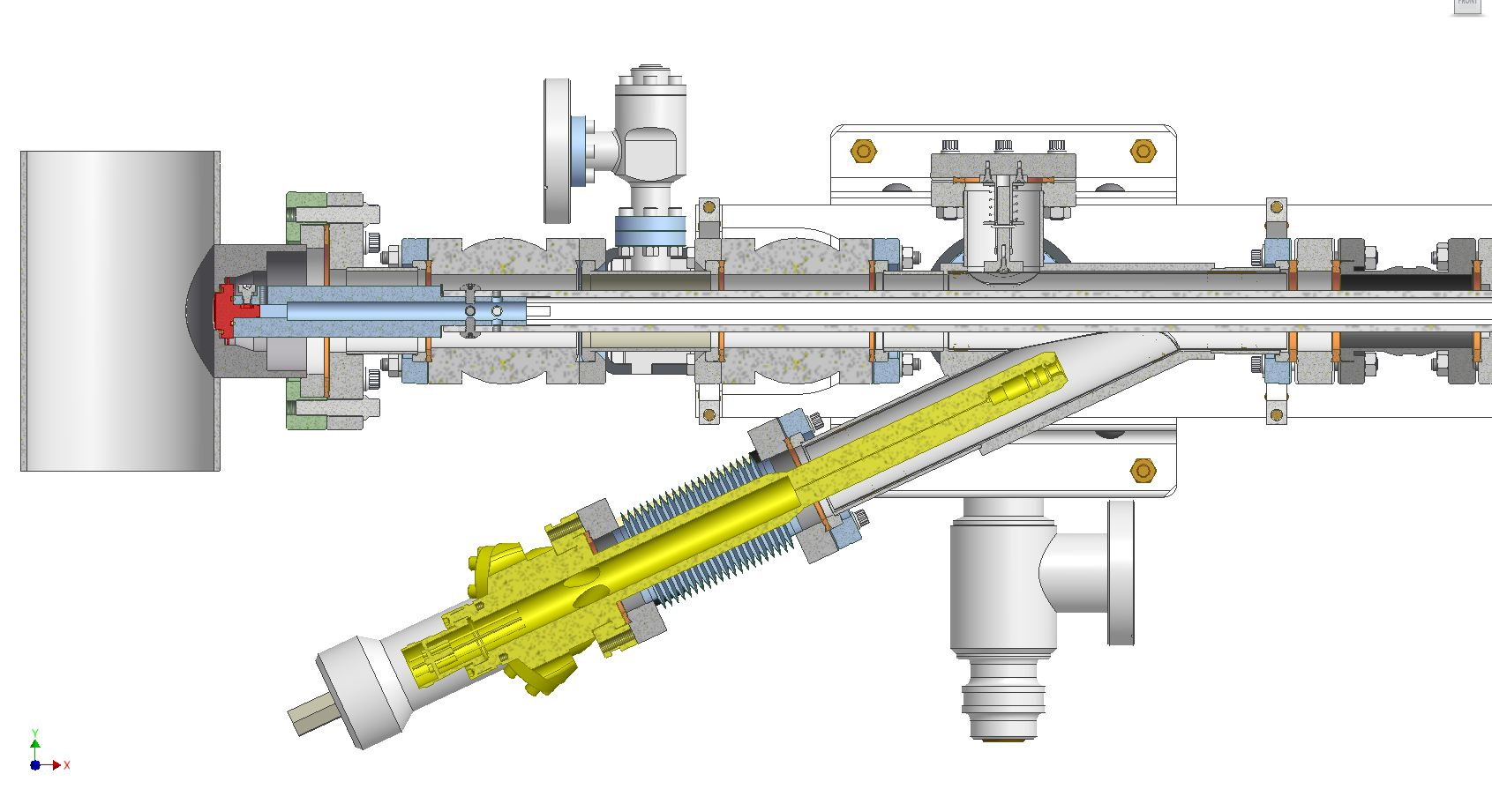
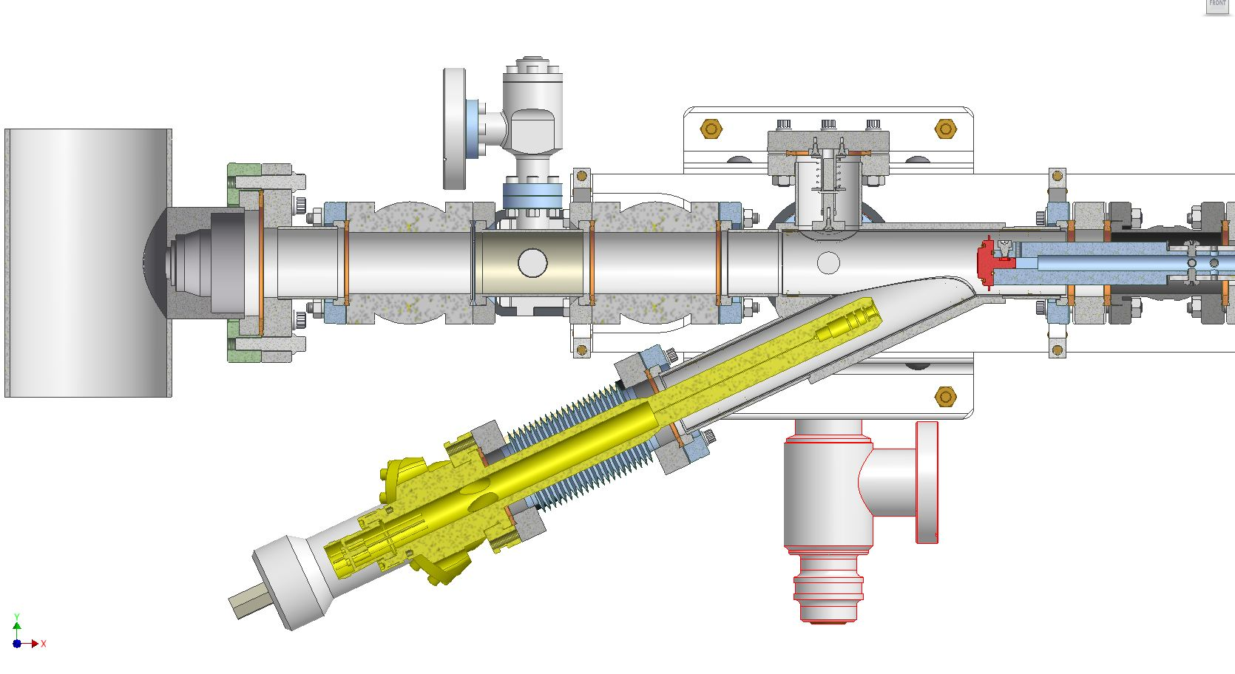
In-Situ Apparatus
Sample
CESR Beam
e-Gun
Expose samples to beam environment
Sample
Beam Pipe
Measure SEY
e-Gun

Slide 9
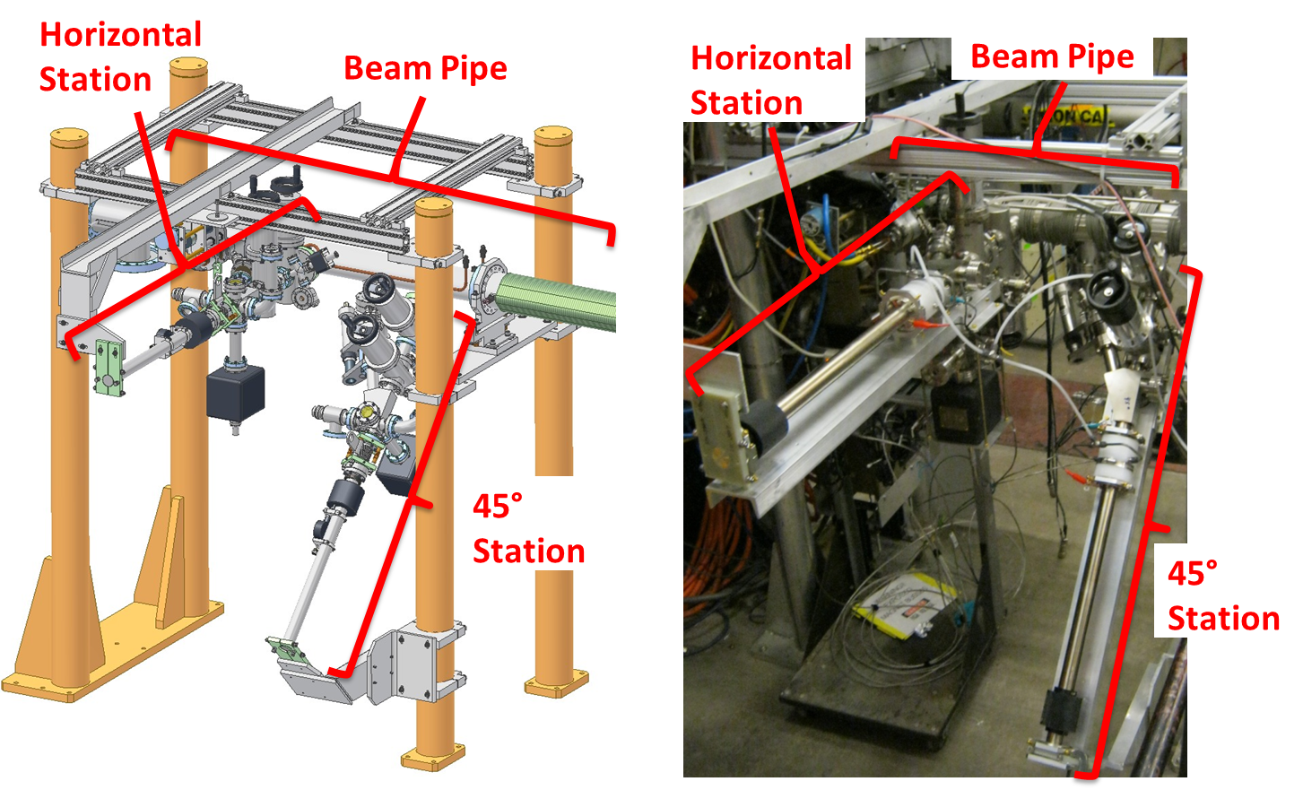
In-Situ Apparatus

Slide 10
SEY Samples
Material | Dates | Comments
TiN | Jan 2010- Aug 2010 | Samples from SLAC
Al | Aug 2010- Nov 2010 | 6061-T6
Amorphous C | Nov 2010- Jan 2011 | Coating by CERN
Diamond-like C | Sep 2011- Nov 2011 | Coating by KEK
TiN | Nov 2011- Mar 2012 | Samples from SLAC
Cu | Mar 2012- Jul 2012 | OFC 101
Stainless steel | Aug 2012- | 316-series

Slide 11
SEY Techniques
Material | Dates | Modifications
TiN | Jan 2010- Aug 2010 | Commission systems
Al | Aug 2010- Nov 2010 | Remove vacuum gauges
Amorphous C | Nov 2010- Jan 2011
 |  | Mitigate leakage current and charging
Diamond-like C | Sep 2011- Nov 2011 | Improve spatial resolution Ensure exposure of samples to direct SR
TiN | Nov 2011- Mar 2012 | More resolution at low energy More height resolution and range
Cu | Mar 2012- Jul 2012 | More angle resolution and range
Stainless steel | Aug 2012- | Reduce cross-talk, improve record-keeping

Slide 12
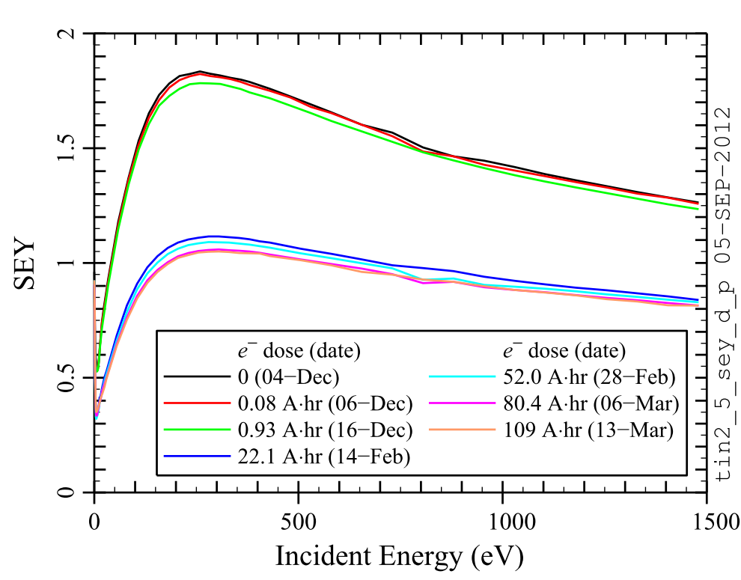
SEY vs Energy: Example
SEY at center of sample: Inc. angle = 25°
Note:
100 Amp·hr
= 3·10²³ photons/meter
Beam conditioning of horizontal TiN sample (2011-2012)

Slide 13
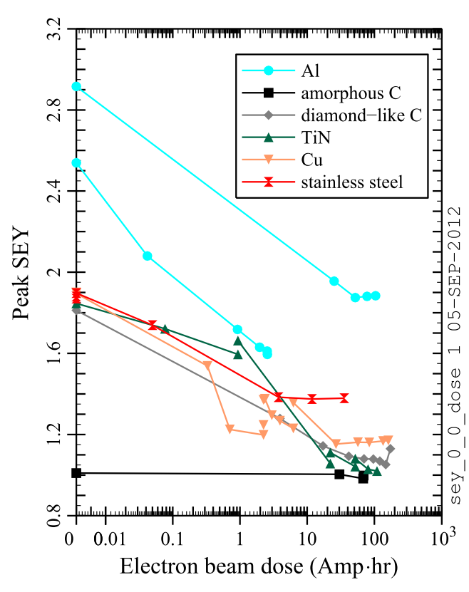
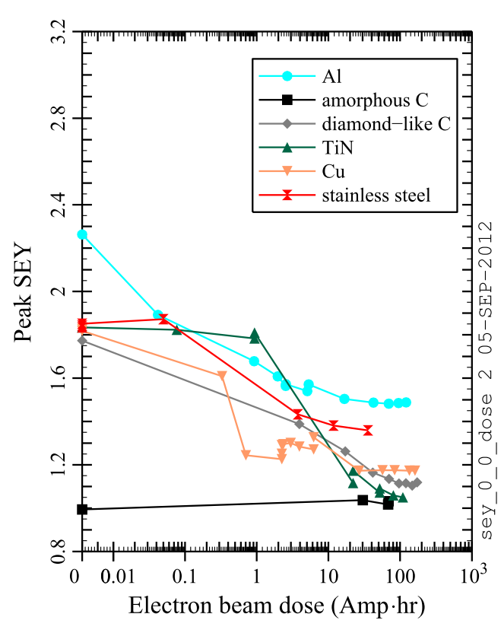
Peak SEY vs Beam Dose
Horiz.
45°
Beam conditioning of SEY samples (center, inc. angle = 25°)

Slide 14
SEY Findings
Direct SR (horizontal sample) vs electrons and scattered photons (45° sample)
Did not observe clear difference with initial samples
Now observing some differences after improvements in techniques
Preliminary Findings
Differences limited to early conditioning for stainless steel and copper
Differences endure longer for TiN

Slide 15
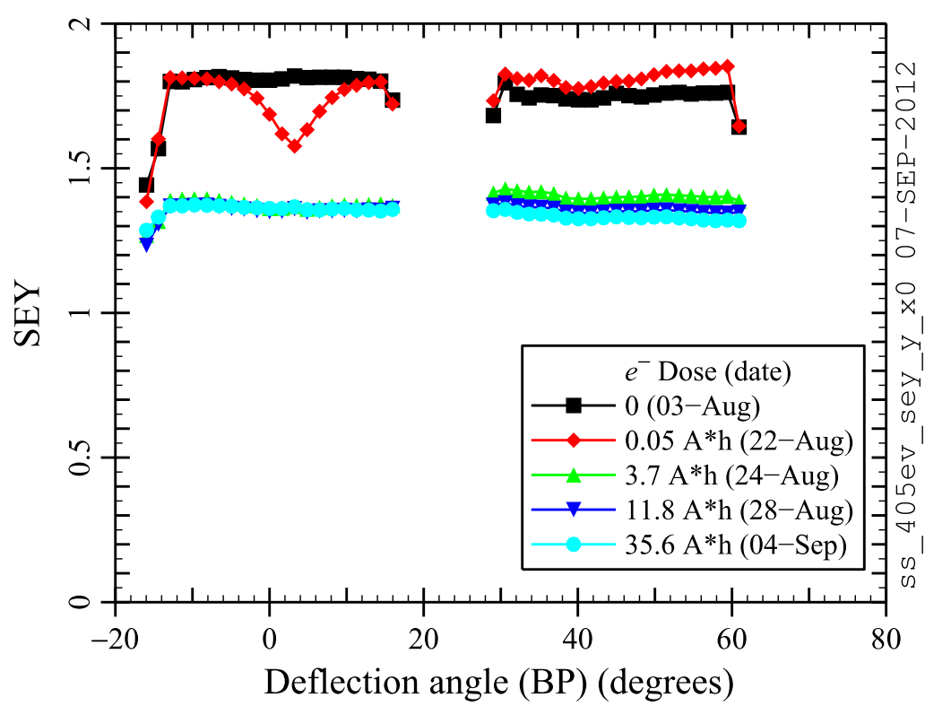
Example: SEY along beam pipe
Direct SR
Horiz.
45°
Inc. angle
≈ 25°
Beam conditioning of stainless steel (at 405 eV)

Slide 16
SEY Work in Progress
SEY dependence on incident angle
More extensive measurements on recent samples
Need to compare with SEY models
SEY at low incident energy
More extensive measurements on recent samples
Need to better quantify systematic errors
Deconditioning
Observe SEY increase with samples in vacuum
Quantified effect for Cu samples during down
Observe SEY increase with exposure to air
More systematic measurements needed

Slide 17
Connection to SEY Models
SEY models for EC build-up
SEY depends on energy and angle of incident e⁻
“True” secondaries: low energy
“Elastic” secondaries: same energy as incident e⁻
“Rediffused” secondaries: energy ≤ incident e⁻
Work in progress/future interests
What parameters of SEY models are constrained by the measurements?
How does the measured SEY differ from the actual SEY?
What can we learn about the energy distribution of secondaries?

Slide 18
Conclusion
CesrTA SEY studies
Measurements on samples of 6 materials/coatings so far
Improvements in techniques have been made
Measured rate of beam conditioning
Measured direct SR vs indirect conditioning
Connecting SEY measurements to SEY models: in progress
Ultimate goals: constrain SEY model parameters as much as possible; use results in EC models

Slide 19
Retarding Field Analyzer Studies
J. Calvey, W. Hartung, J. Makita for the CESRTA Collaboration

Slide 20
Review: Retarding Field Analyzers
Retarding Field Analyzers (RFAs)
Measure flux of electrons from cloud
Average over many turns (basic version)
Modes of operation:
Dedicated measurements with energy resolution
Passive measurements without energy resolution
Use of RFAs for electron cloud studies was pioneered at Argonne/APS
CesrTA RFA program collaborators: APS (K. Harkay et al.), LANL, SLAC, KEK, CERN

Slide 21
Review: Retarding Field Analyzers
CesrTA RFA program: unique features
RFA designs with transverse resolution
RFA designs for insertion in confined spaces
Many RFAs (~30) deployed in a single ring
RFAs in different environments: drift, dipole, quadrupole, wiggler
Dedicated RFA measurements
Under different beam conditions
In vacuum chambers with different mitigations
Over time, to observe beam conditioning
In combination with other EC diagnostics
Large data set already, ~4 years of measurements

Slide 22
Review: Retarding Field Analyzers
+100 V
Collector(s)
V_{grid}
Grid (metal mesh)
Beam pipe
e⁻ cloud
Ideal RFA: measure electrons with energy > −V_{grid}

Slide 23
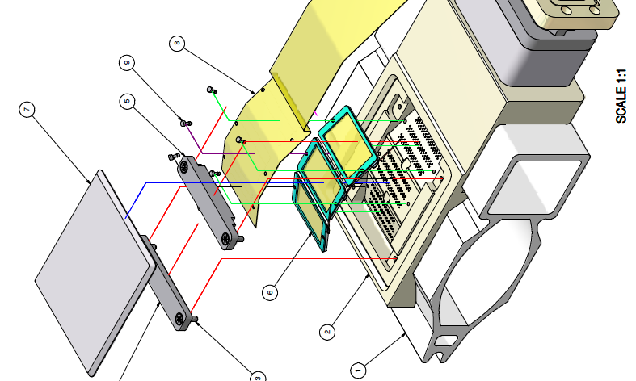
CesrTA thin segmented RFA design
Collectors
Beam pipe holes
Retarding grids
Beam pipe

Slide 24
RFA Measurement Examples
RFA results for segmented collectors in different environments
Show distinctive “fingerprints” depending on local field (type of magnet and location of RFA)
Show good qualitative agreement with predictions of models for electron cloud build-up
Show good quantitative agreement with EC model predictions in drift regions

Slide 25
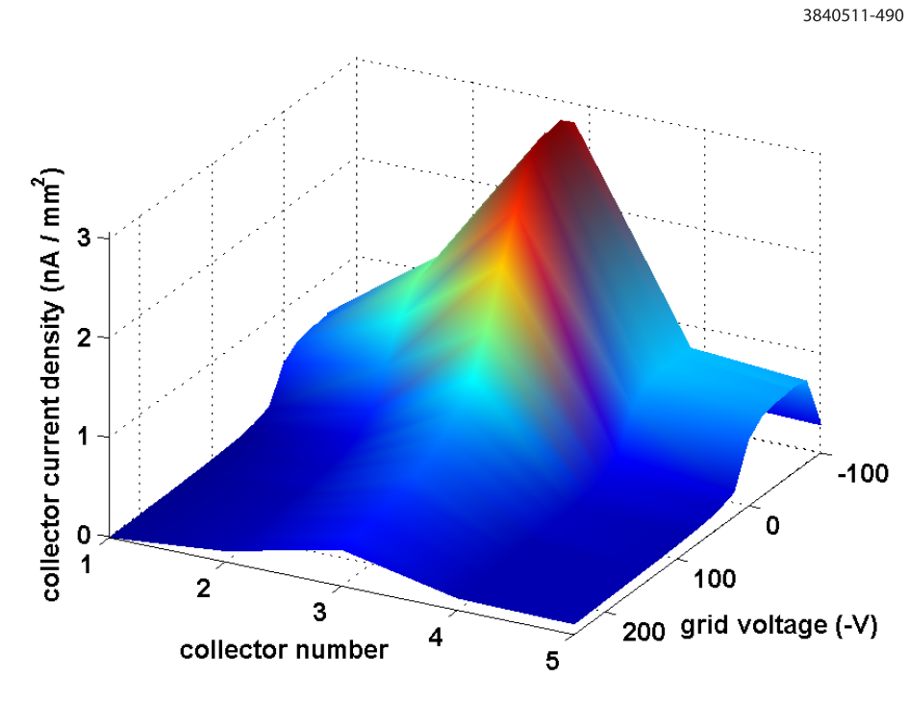
RFA Measurements: Drifts
Broad distribution of electron flux
Peak flux generally aligned with transverse position of passing bunches
High flux of low-energy electrons
Some electrons with KE > 250 eV
Collector current density vs transverse position
vs retarding voltage (Cu chamber, I_{beam} ~ 56 mA)

Slide 26
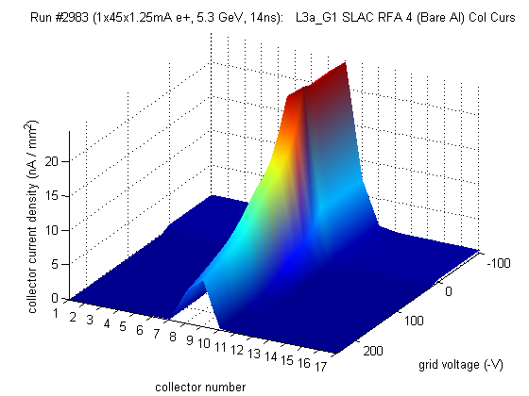
RFA Measurements: Dipoles
Dipole field pins cloud electrons into trajectories that are vertically aligned with passing bunches
Segmented RFAs show sharper peak aligned with transverse position of beam
Collector current density vs transverse position vs retarding voltage (Al chamber, I_{beam} ~ 56 mA)

Slide 27
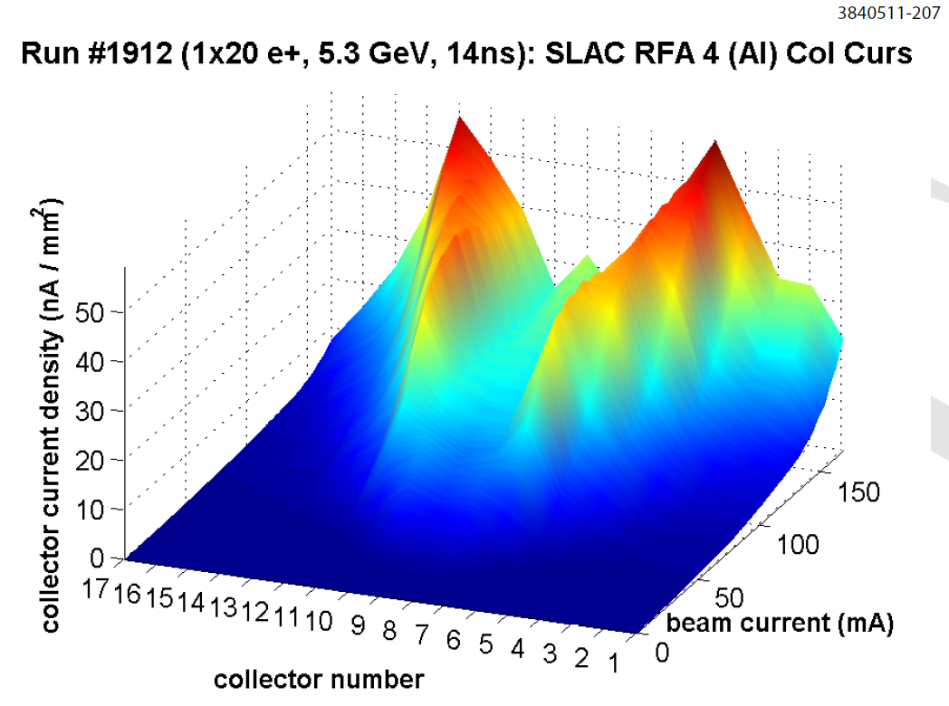
RFA Measurements: Dipoles
Dipole RFA’s show “bifurcation” at high beam current
Cloud electrons receive bigger kicks from passing bunches as the beam current increases; impacting electron energies match peak in SEY curve (~300 eV) at larger transverse distances
Collector current density vs transverse position
vs beam current
(Al chamber)

Slide 28
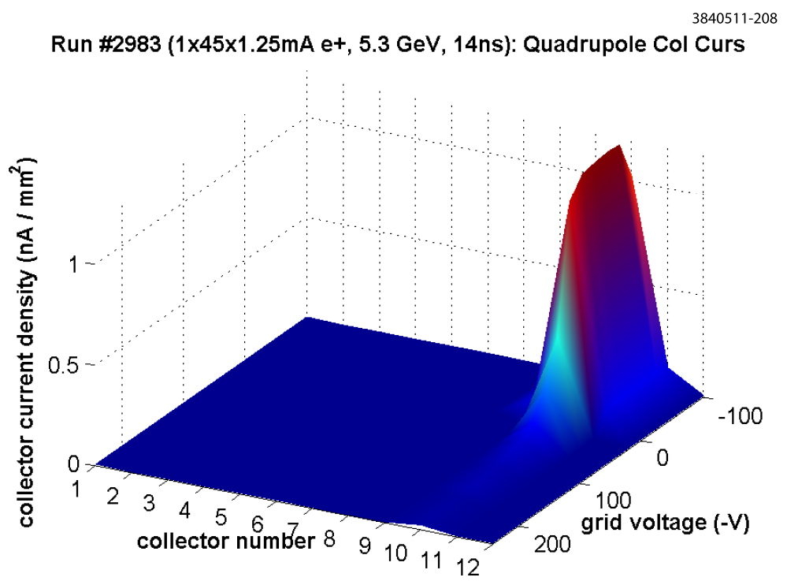
RFA Measurements: Quadrupoles
Quadrupole field guides electrons along field lines
Segmented RFAs show sharp peak in a single collector with high electron flux
Electrons can remain trapped long after the bunch has passed
Collector current density
vs transverse position vs retarding voltage (I_{beam} ~ 56 mA)

Slide 29
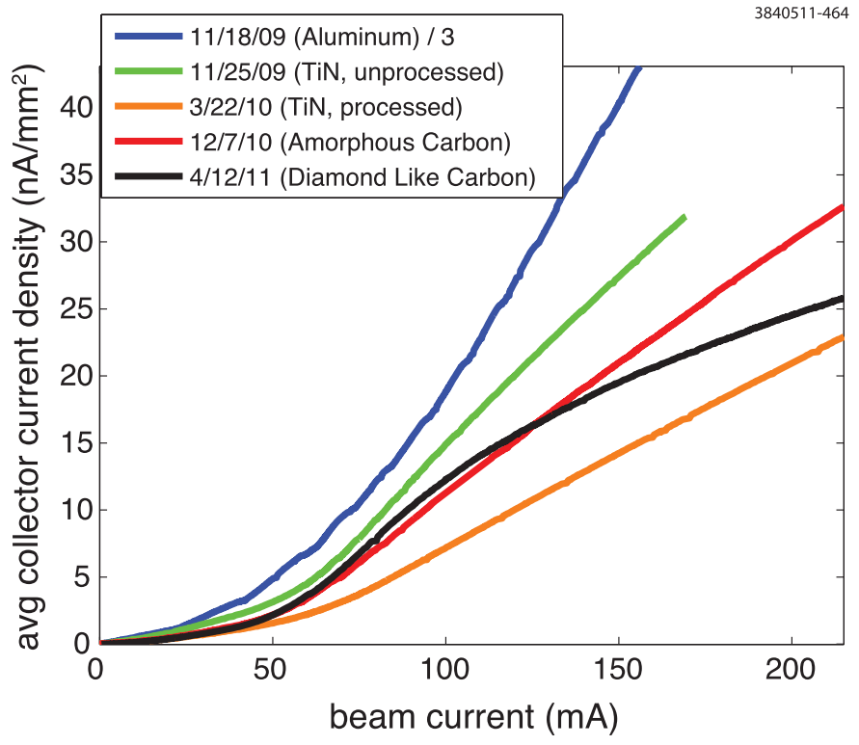
Mitigations
RFA provide quantitative measure of effects of surface coatings for mitigation of electron cloud
Coated chambers
TiN
Amorphous C
Diamond-like C
NEG
Uncoated Al chambers have much higher flux
Drift RFA in 15E with
different
chambers

Slide 30
Mitigations: Findings
Drifts
Effective mitigation via coatings: TiN (SLAC), amorphous C (CERN), diamond-like C (KEK), or NEG (SAES)
Dipoles and quadrupoles
Effective mitigation via coatings: TiN
Even more effective if grooves + coatings
Wigglers
Most effective mitigation: clearing electrode

Slide 31
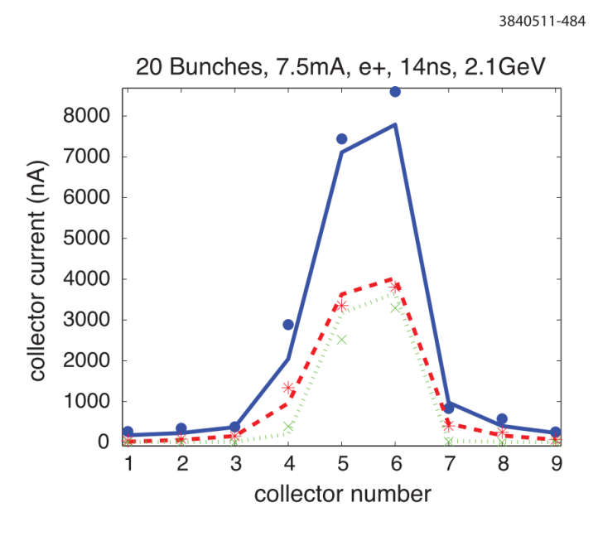
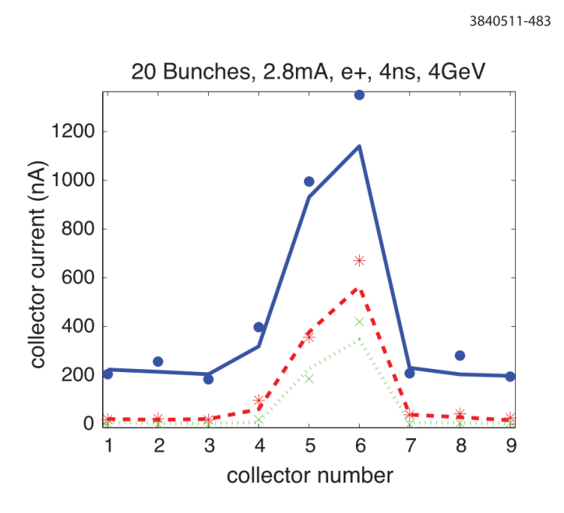
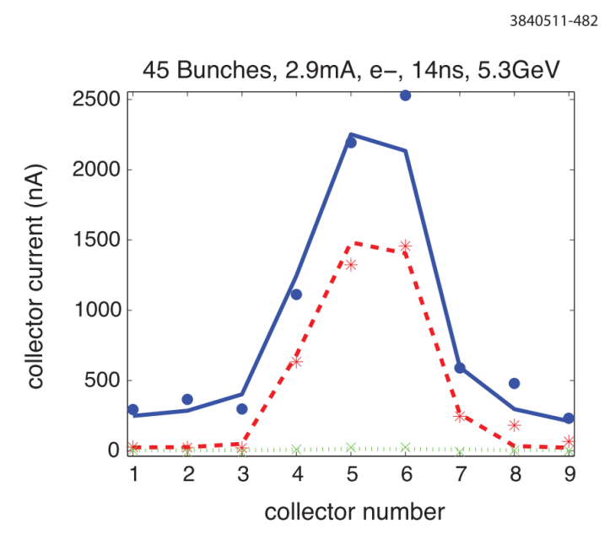
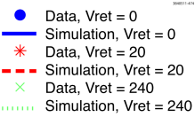
Quantitative Analysis of RFA Data
RFA measurements provide data for validation of models for electron cloud build-up
Models require parameters describing surface phenomena: photon reflectivity, electron photo-emission, electron secondary emission
This is a major aspect of the CesrTA RFA program. More info in Phase I Report and papers

Slide 32
Quantitative Analysis of RFA Data
Selected electron cloud model parameters
QE = quantum efficiency
(electron photo-emission)
Inc. angle = normal
δ_{ts}
δ_{red}
δ₀
E_{ts}
Model for SEY vs energy and angle of incident electron

Slide 33
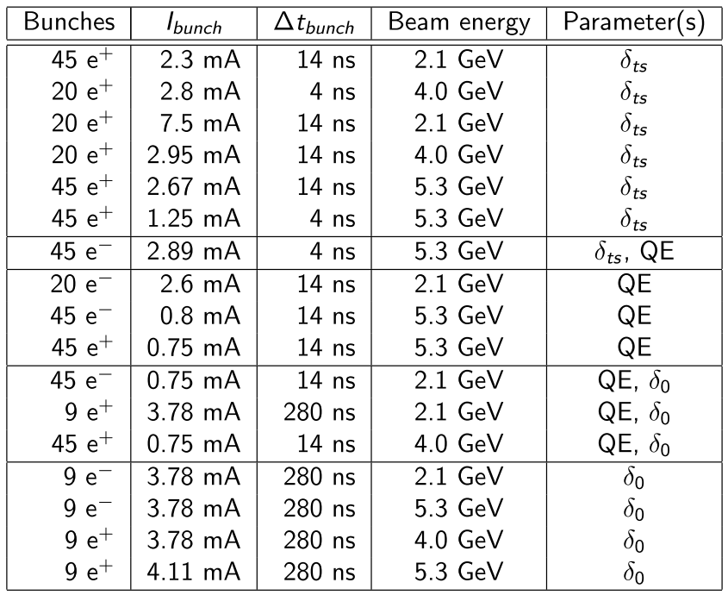
Quantitative Analysis: Example
Beam conditions used for one round of fitting
EC model parameters which are sensitive to conditions are shown

Slide 34
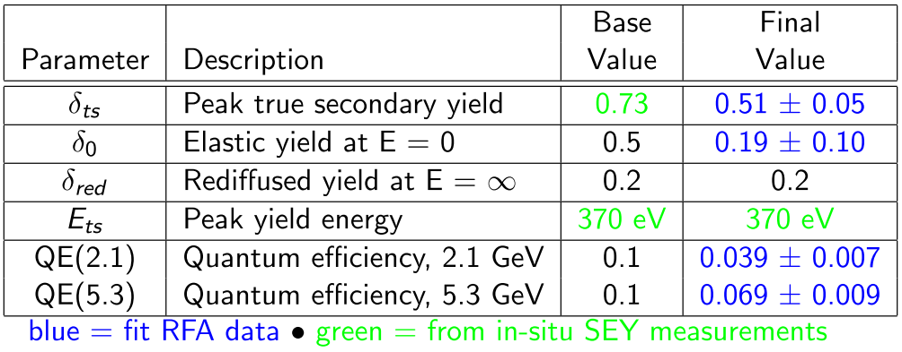
Quantitative Analysis: Example
EC model parameters are adjusted for best fit to RFA measurements, using large data set with different beam conditions
Best fit parameters: TiN-coated chamber in 15W
Uncertainty estimates do not take into account correlations within the model

Slide 35
Quantitative Analysis of RFA Data
Ideal RFAs would provide electron flux as a function of energy
Real RFAs have complications
They drain electrons from beam environment
Secondaries are produced in beam pipe holes
When retarding voltage is close to electron energy, the electrons are focussed
Work in progress
Modelling of electron transport into RFAs
Bench measurements with RFAs
Goal: proper interpretation of RFA data

Slide 36
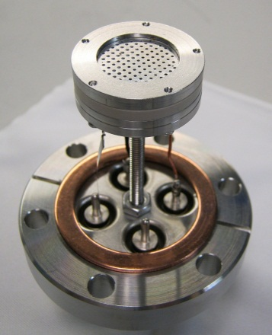
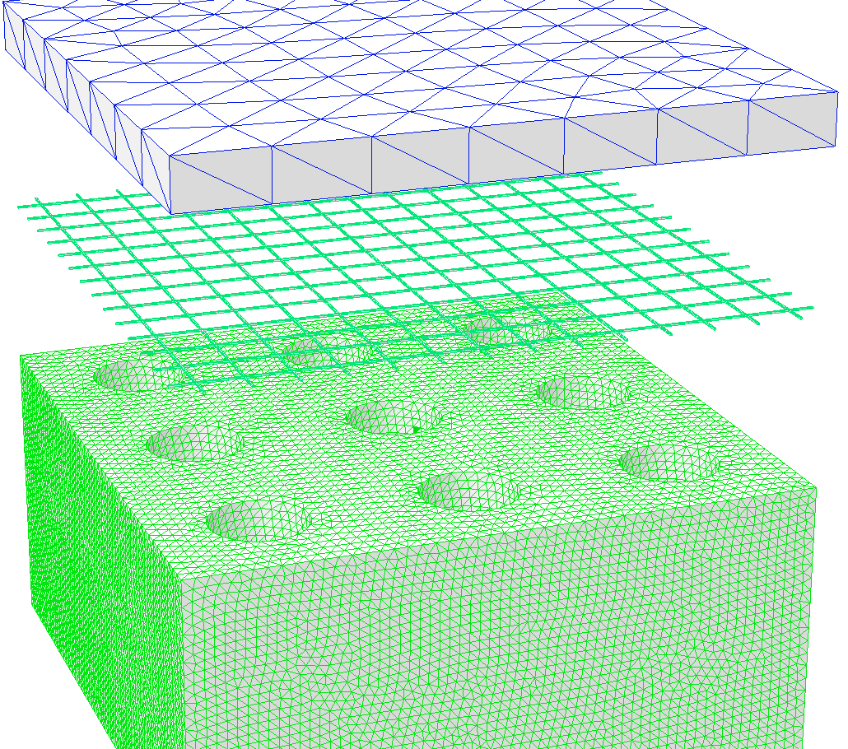
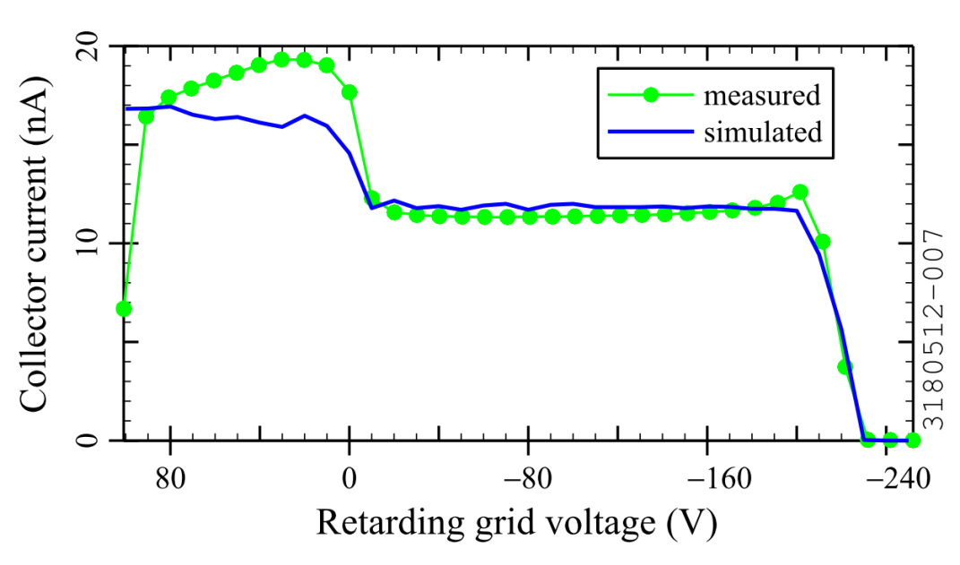
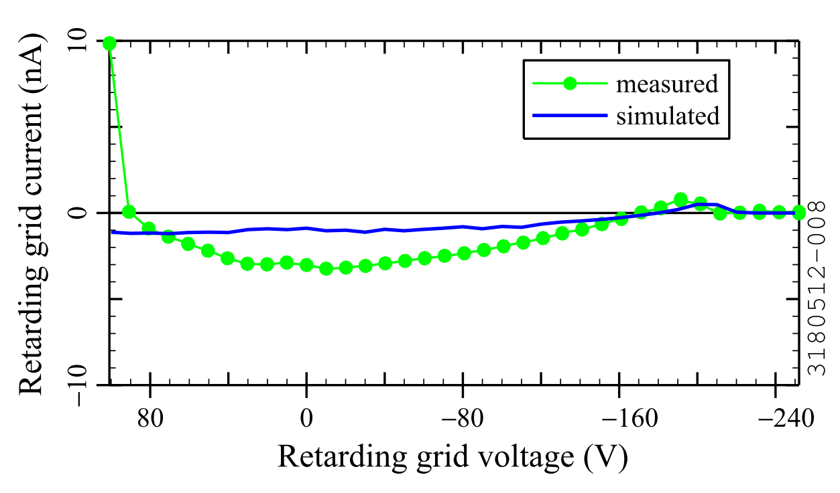
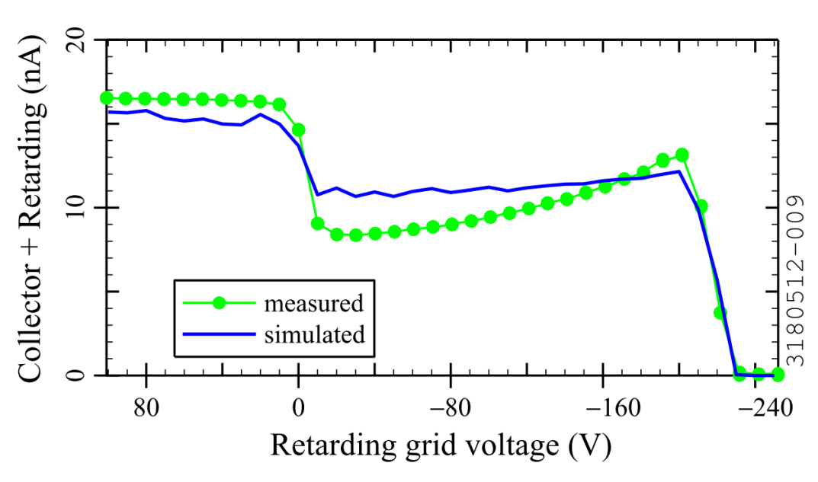
RFA Bench Measurements: Example
RFA for bench measurements
3D RFA model
Beam from DC electron gun (135 mm away): 200 eV, 100 nA

Slide 37
Conclusion
CesrTA RFA program
Large-scale deployment of RFAs and extensive measurements
Providing quantitative information
from different environments
on the effect of mitigations
for validation of electron cloud build up models
Ultimate goals: help in the development of electron cloud models with predictive capability

