Slide 1
Title Date
Author
for the CESRTA Collaboration
Notes:
1

Slide 2
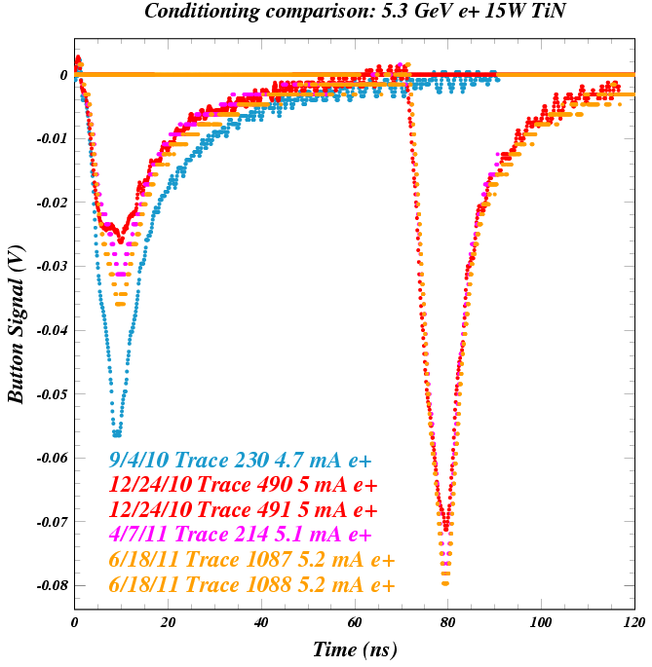
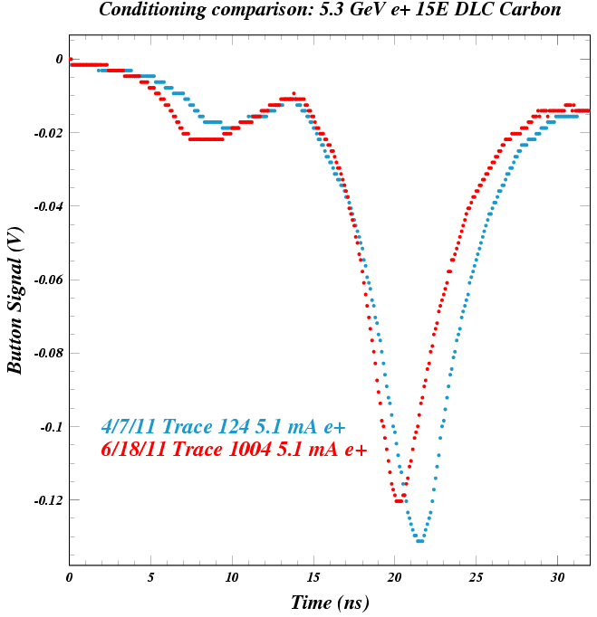
Shielded Pickup Measurements in June, 2011
Ryan Badman, Jim Crittenden, John Sikora
The TiN-coated vacuum chamber at 15W was installed in September, 2010.
The diamond-like carbon-coated chamber at 15E was installed in January, 2011.
Therefore, our standard data sets (solenoid, witness bunch, and bunch current scans)
at 2.1 and 5.3 GeV in June provided primarily information on conditioning (first such info for DLC).
We also took the first standard data sets at 4.0 GeV, as well as bias voltage scan data.

Slide 3
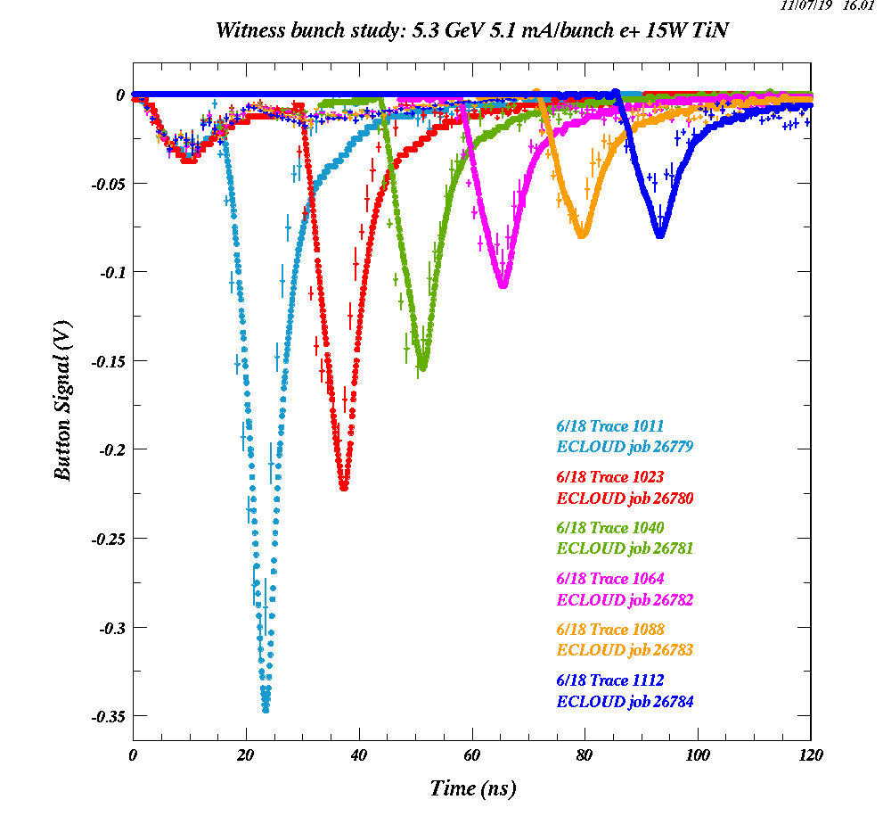
Ryan's Study of How the Witness Bunch Measurements Can Constrain Parameters of the Secondary Electron Production Kinematics Original ECLOUD Model vs. New Optimized Model
f(E_{sec}) ~ exp( -ln(E_{sec}/SEMAX)²/2 )
SEMAX=1.8 eV
f(E_{sec}) ~ E_{sec} exp (-E_{sec}/SEMAX )
SEMAX=0.8 eV

Slide 4
Sensitivity to SEMAX Parameter using exponential function (Note the late simulation peak at SEMAX>0.8 eV that is not present in the data)

Slide 5
Lower bound on SEMAX obtained from 14-ns witness bunch signal shape

Slide 6
New for this meeting:
The witness bunch measurements at 2.1 GeV provide constraints
very similar to those obtained with the 5.3 GeV data.

Slide 7
The 2.1 GeV measurements also provide an upper bound on the SEMAX parameter
similar to the one found with the 5.3 GeV data.

