Slide 1
Synchrotron Radiation Photon Scattering Phenomena in the Final-focus Quadrupoles of SuperKEKB and in CESR Quadrupole Q48W
Jim Crittenden
Electron Cloud Meeting
8 October 2014

Slide 2
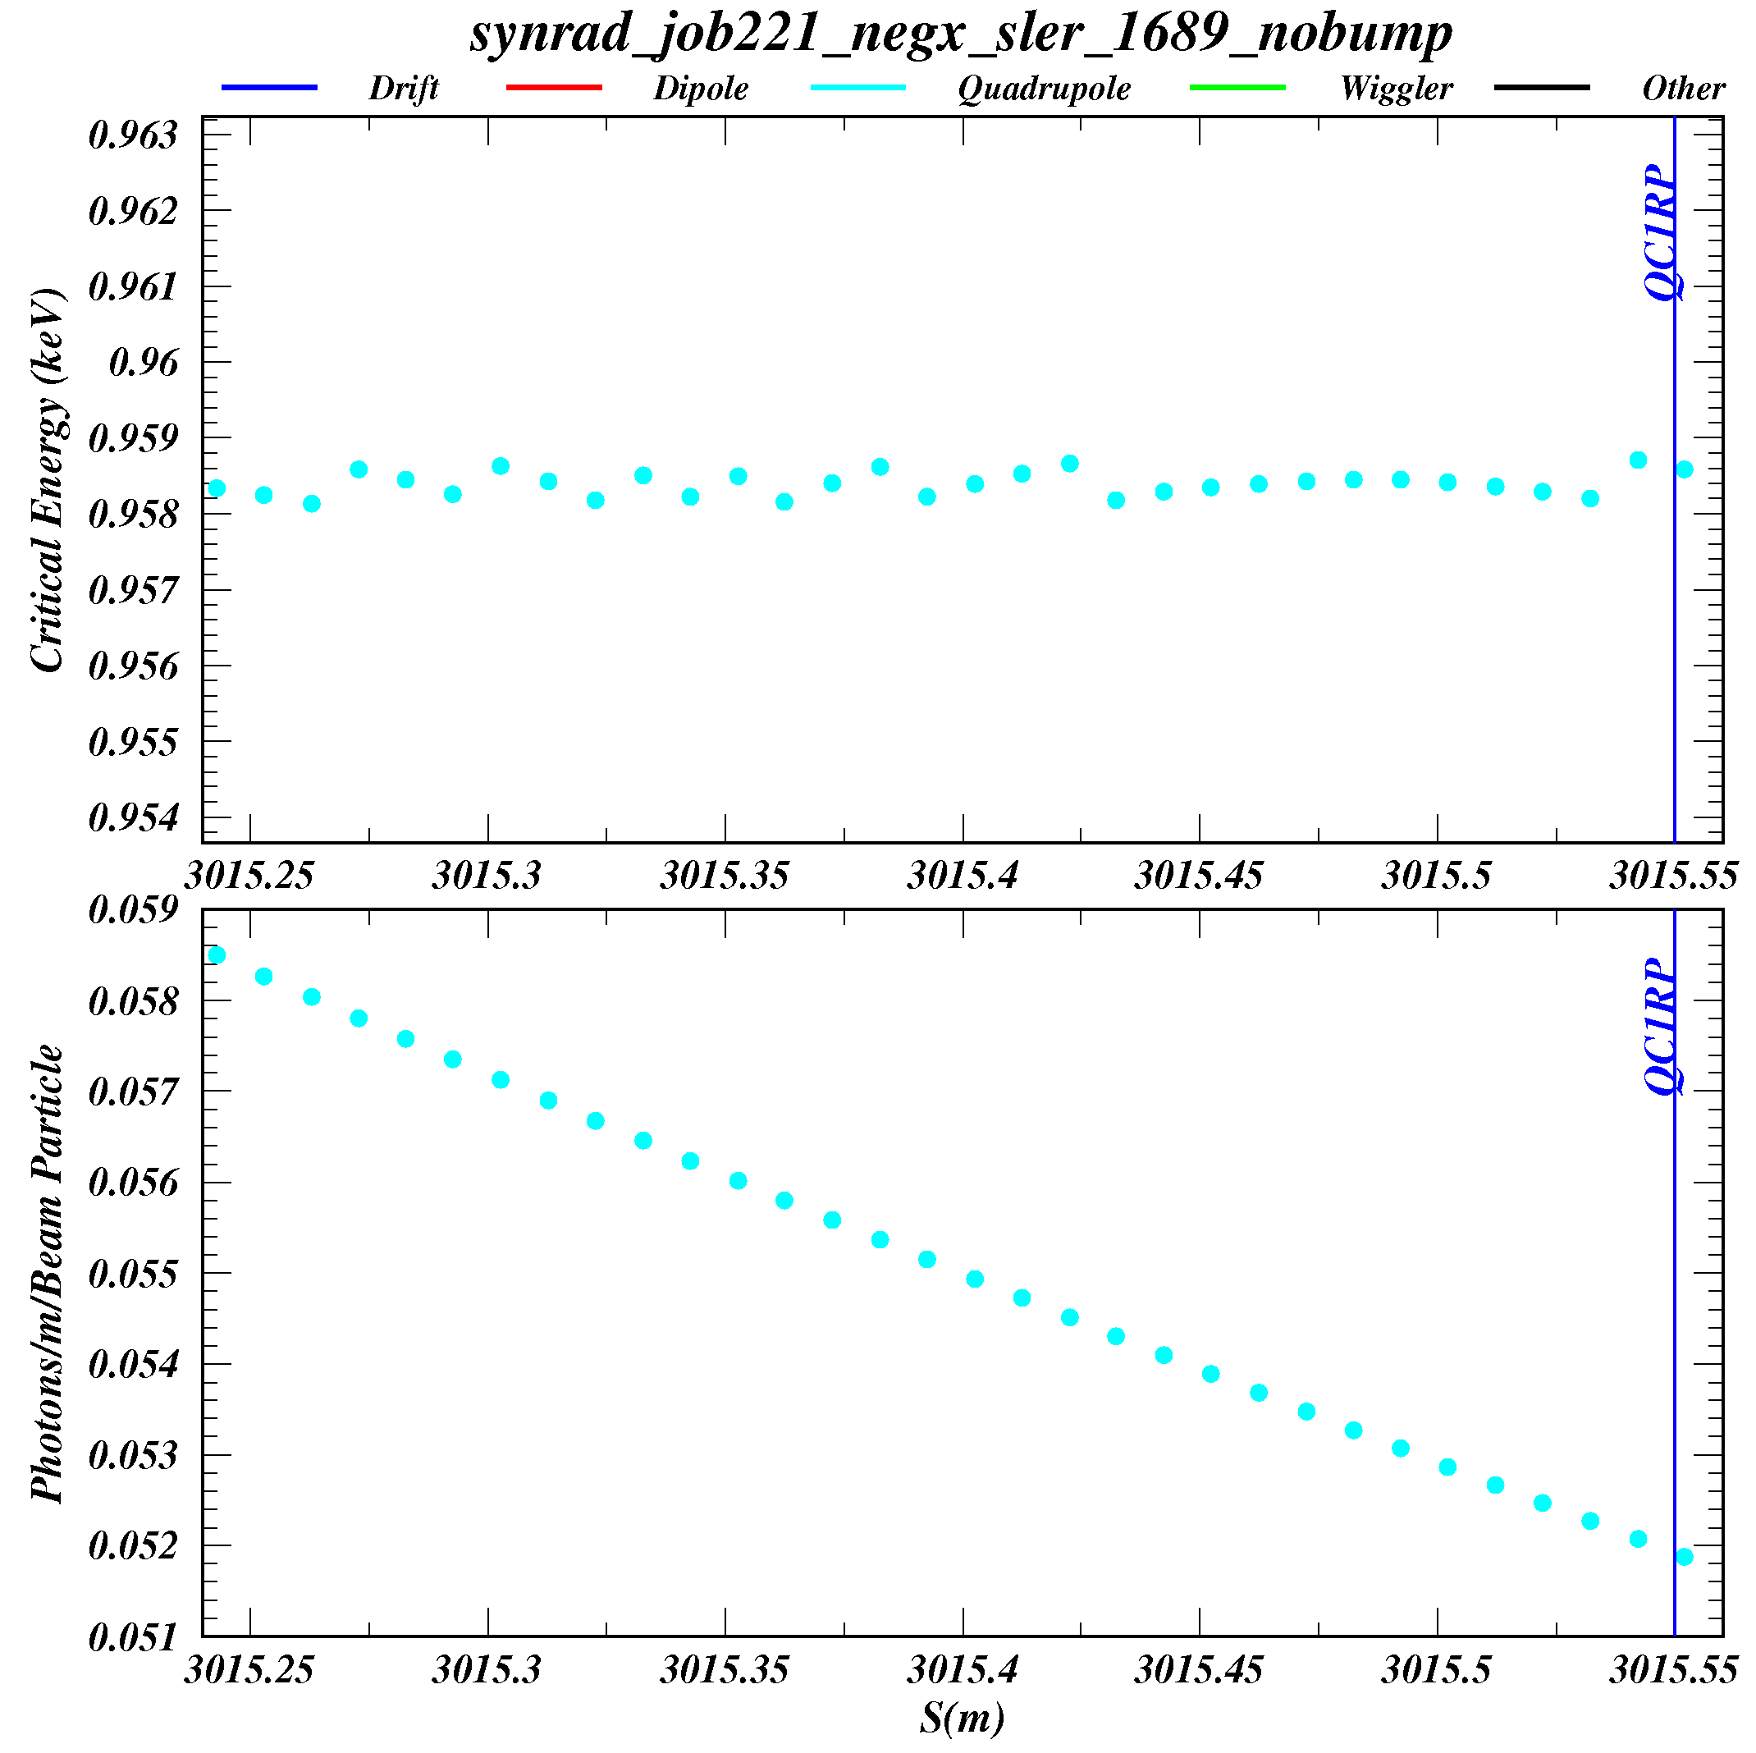
The anti-bend BLCWRP in SuperKEKB shines into the final-focus quadrupoles
QC1RP is 33 cm long.
The field gradient is 68 T/m.
BLCWRP is 2.23 m long and the field strength is 897 G.
It is 5 m upstream of QC1RP.
Ignoring photon scattering, the incident photon rate is
about 0.055 g/m/e+.
The critical energy of the photons is 958 eV.

Slide 3
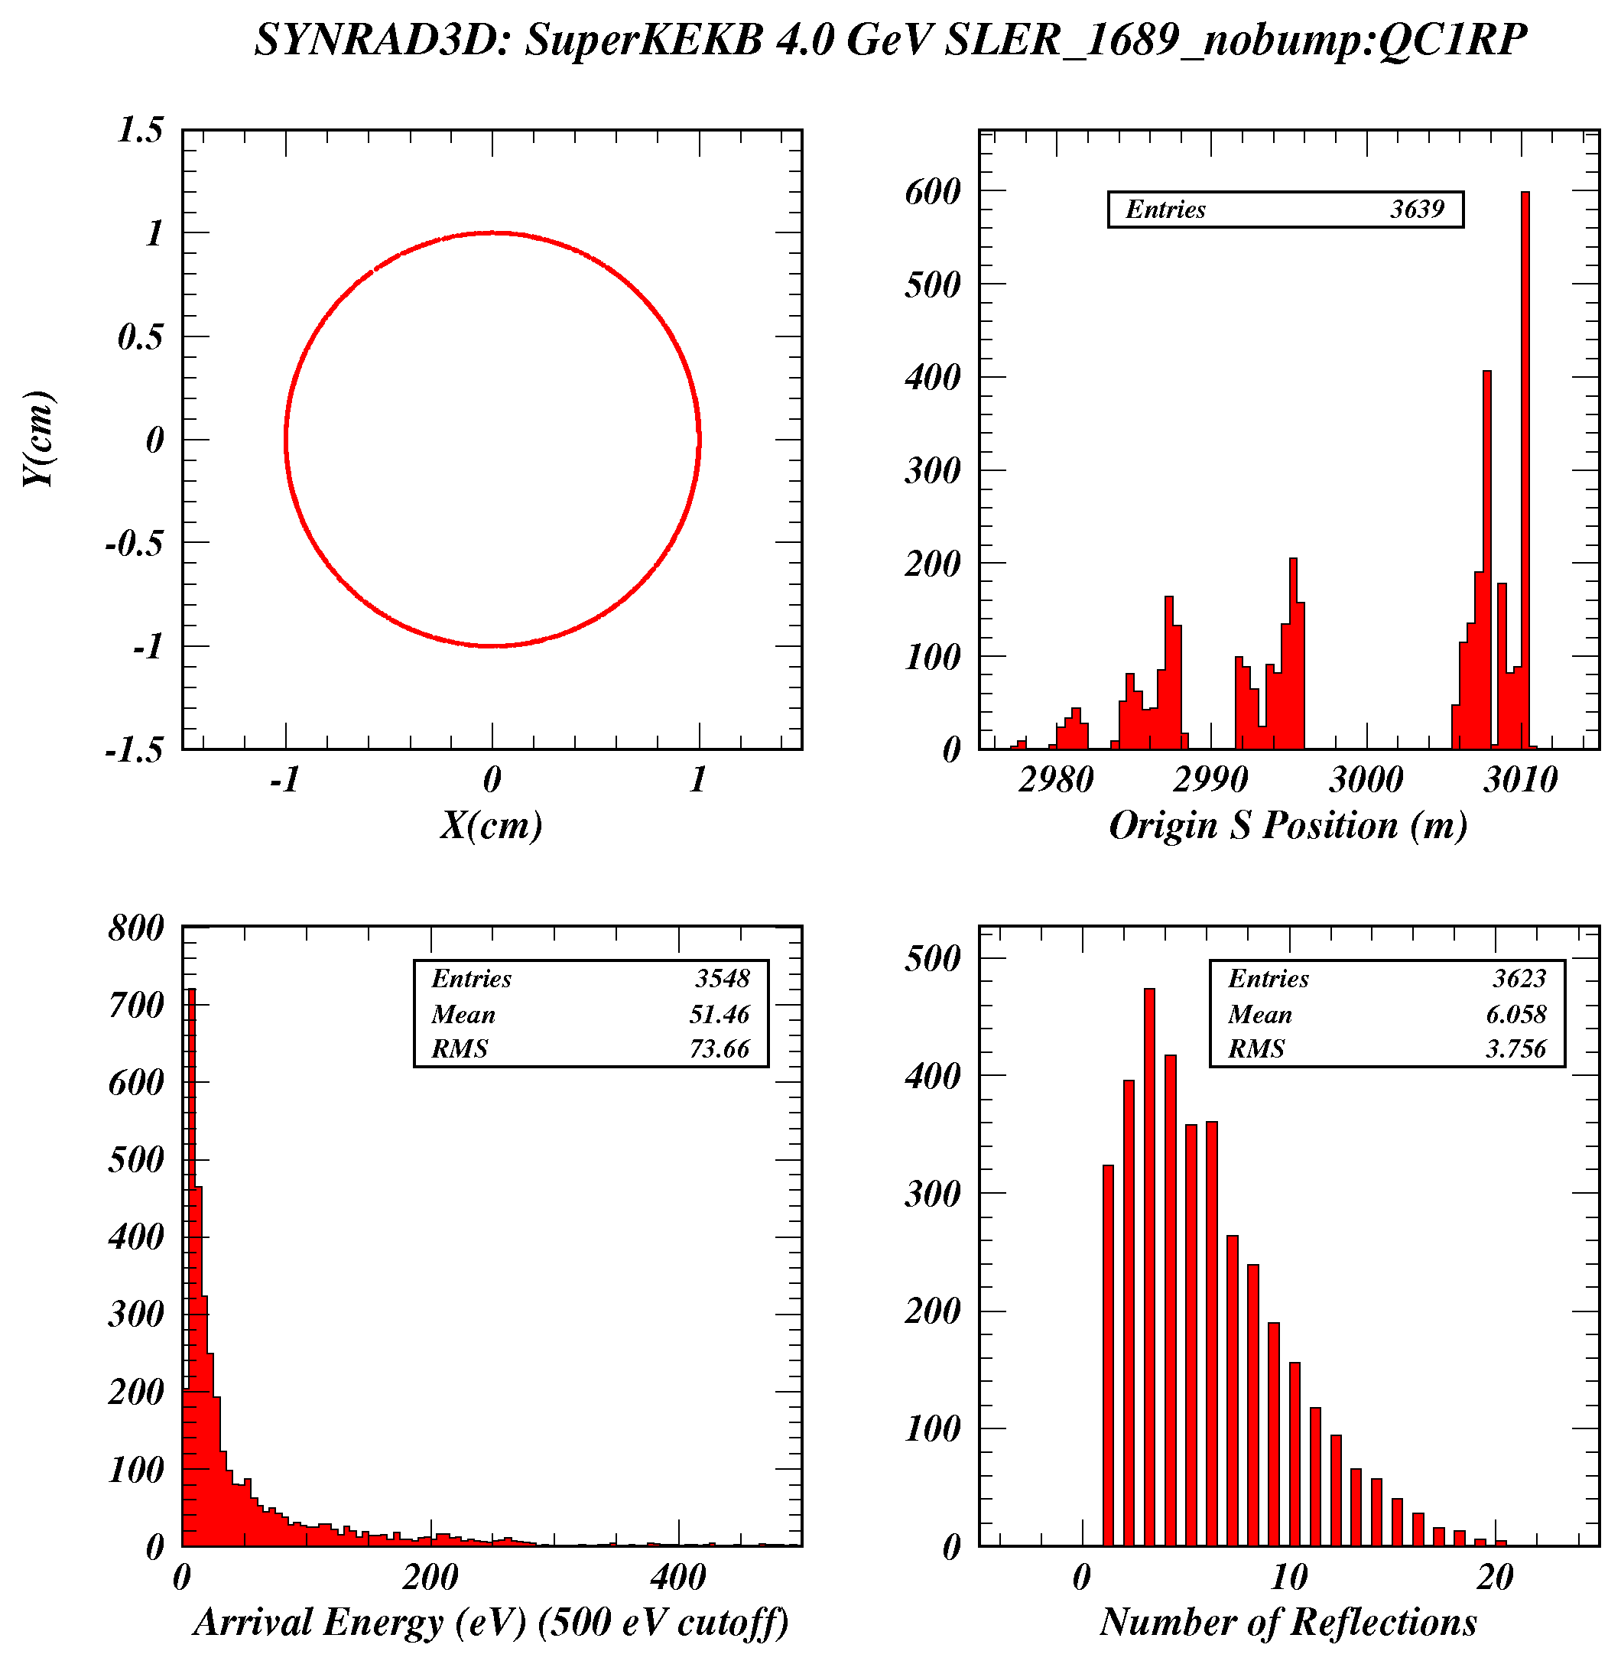
Synrad3D calculation of photon absorption in QC1RP
The calculated absorbed photon rate at QC1RP is 1.0 g/m/e+,
nearly 20 times the incident rate ignoring photon scattering.
But there are no cases of directly absorbed photons, i.e. those which have not scattered at least once off the vacuum chamber wall.
All the absorbed photons originate in bends upstream of BLCWRP.
Is this a discrepancy between Synrad and Synrad3D?

Slide 4
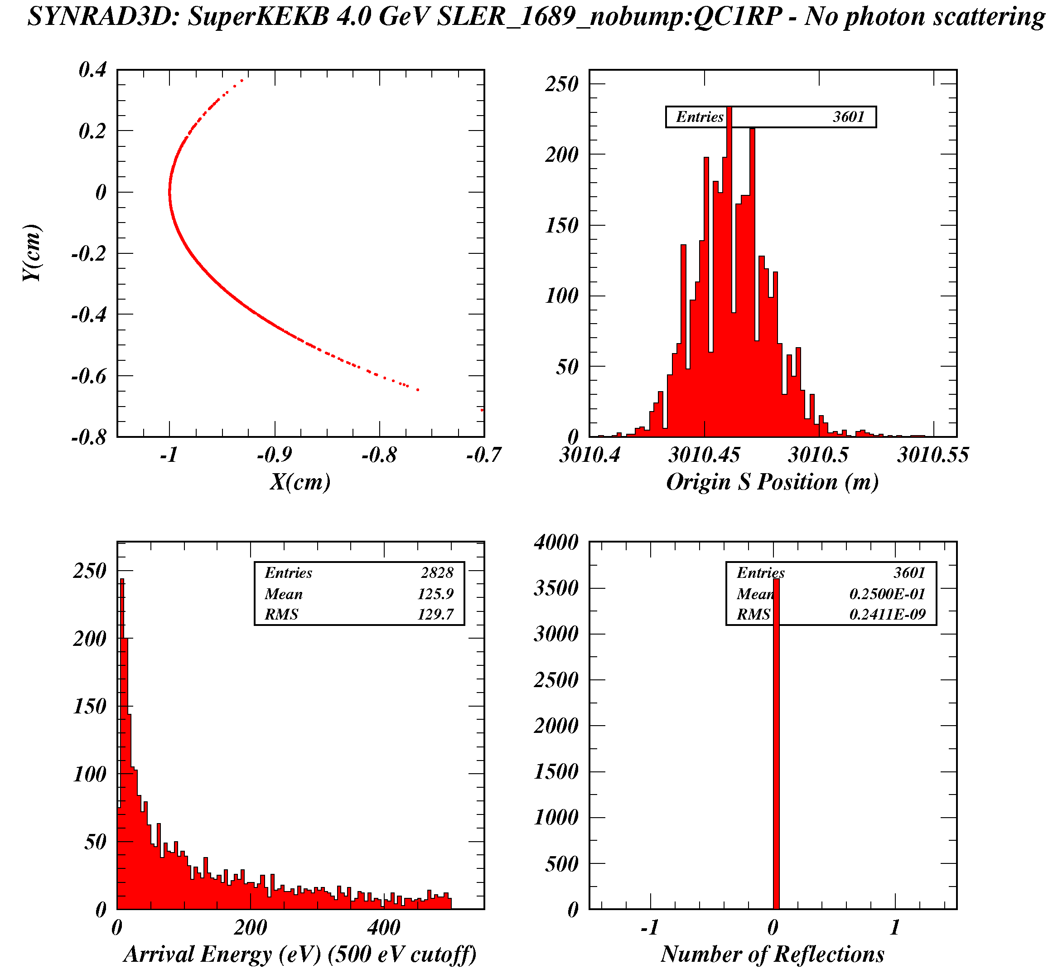
Check of Synrad3D with photon scattering turned off
Synrad3D correctly finds the photons from the anti-bend to be incident on the wall on the inside of the ring.
It also finds all the photons to come from BLCWRP, as does Synrad.
The rate is calculated to be
0.029 g/m/e+ , somewhat lower than Synrad (needs to be investigated).
So why are NONE of these photons absorbed in QC1RP?

Slide 5
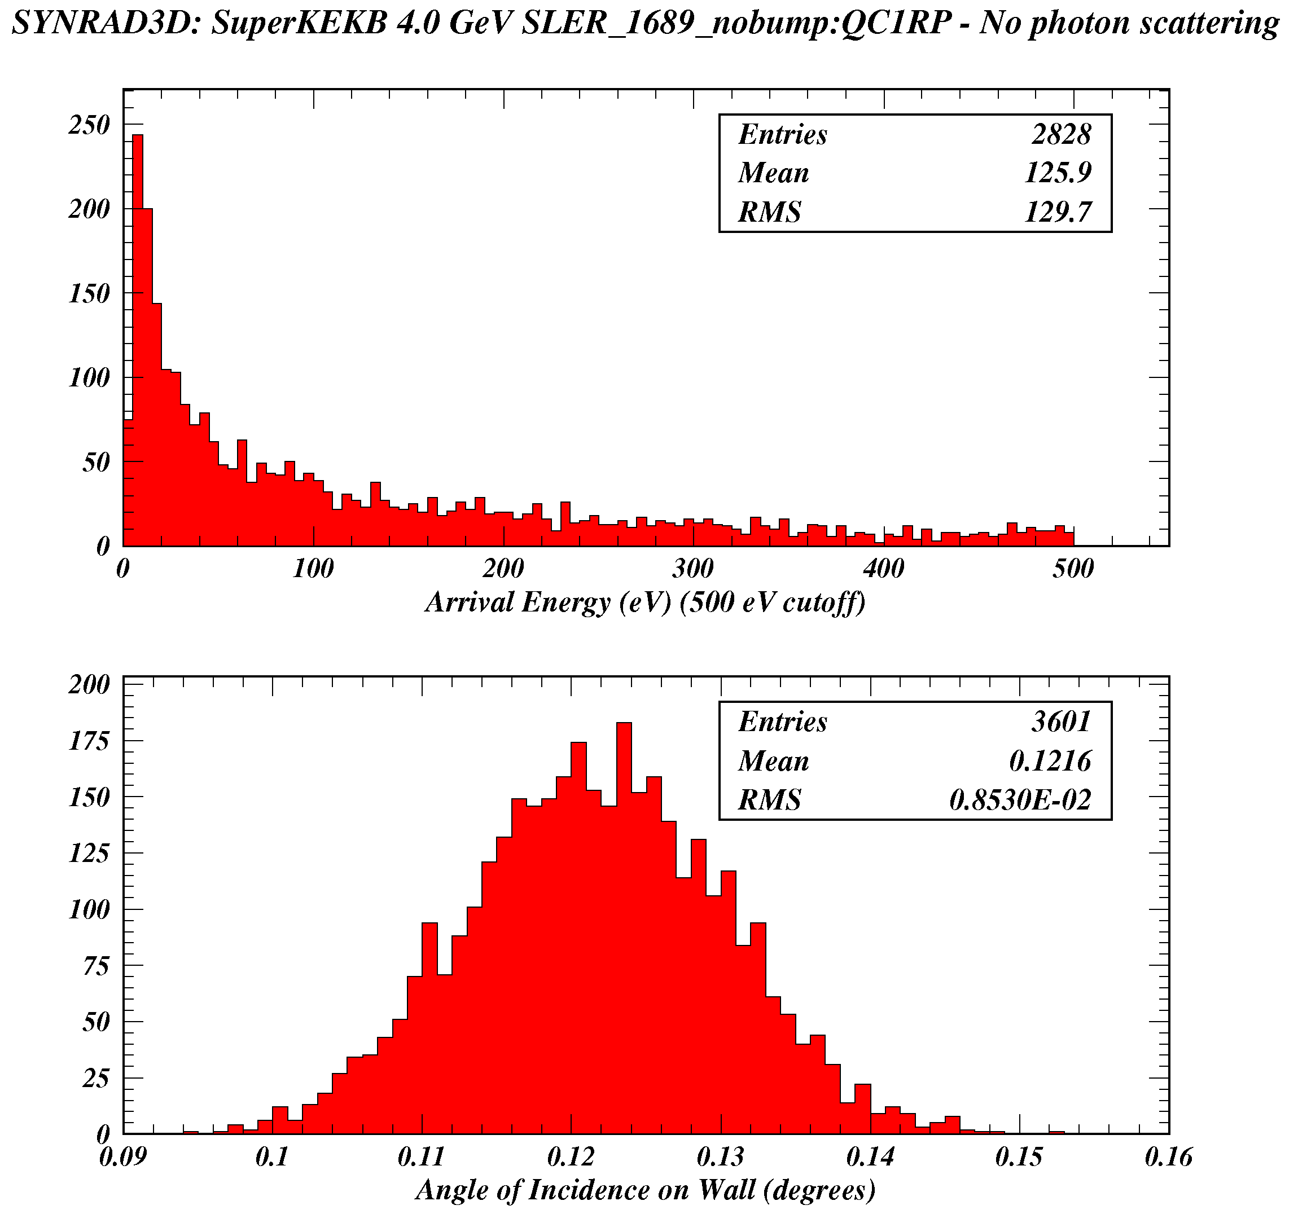
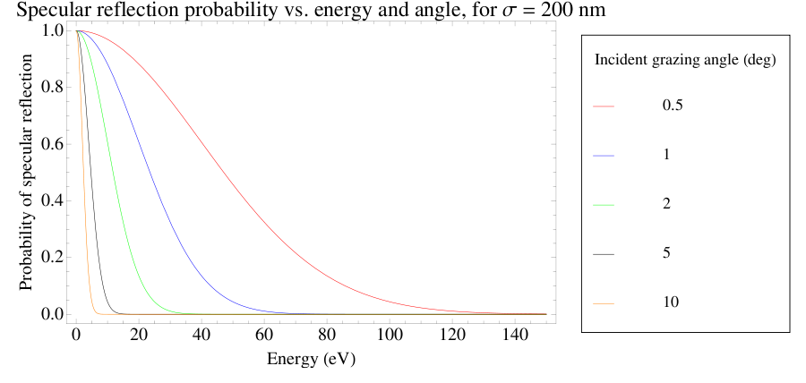
Incident angle and energy of photons from BLCWRP hitting the wall directly
The Synrad3D Photon Tracking Program
G. Dugan and D. Sagan
April/2013
Figure 1
The probability of specular reflection of the direct photons from BLCWRP is 100%
because their incident angle is so grazing.

Slide 6
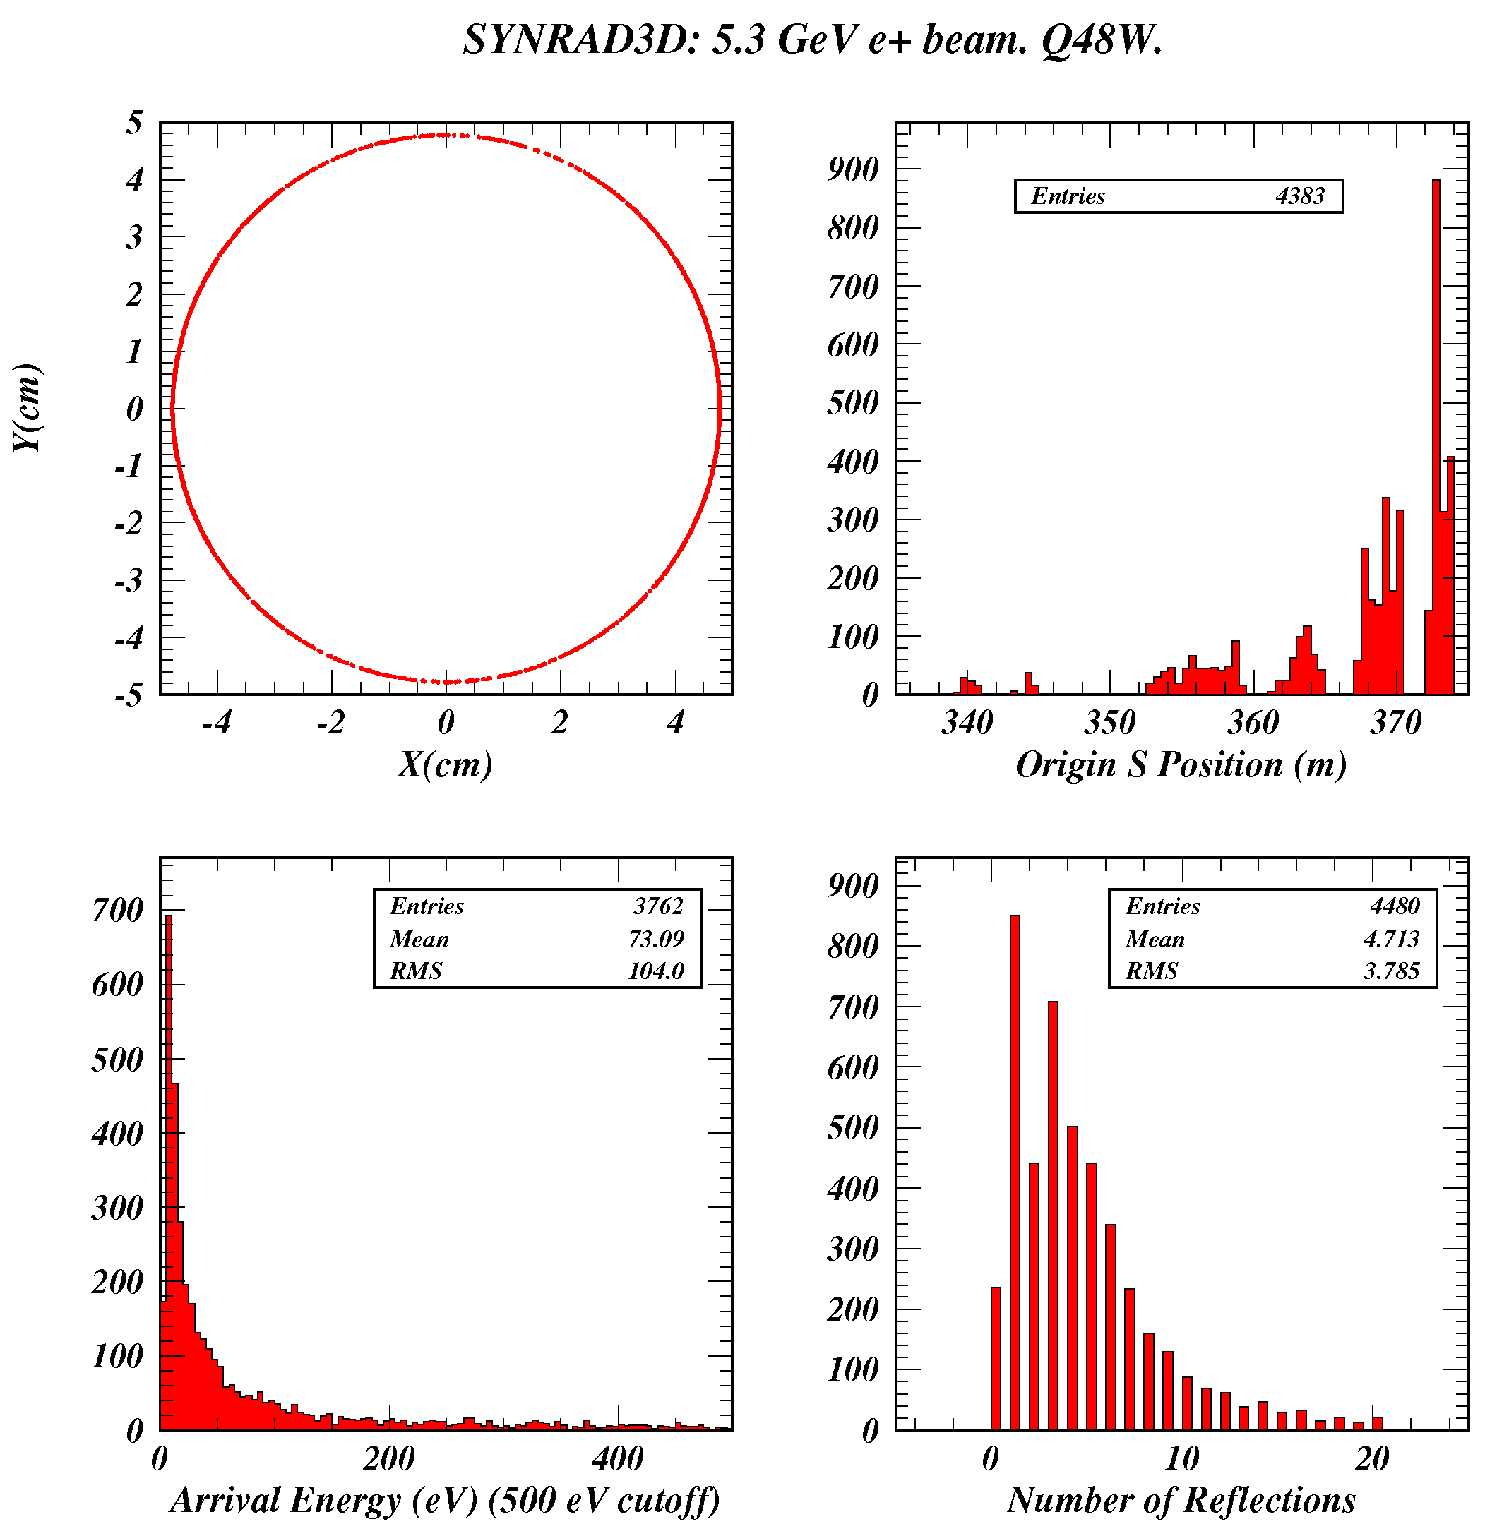
Synrad3D calculation of photon absorption in the CESR quadrupole Q48W
About 5% of the unscattered photons are absorbed in Q48W.
They originate in B48W
at s=373 m.
The absorbed rate is 0.42 g/m/e+.

Slide 7
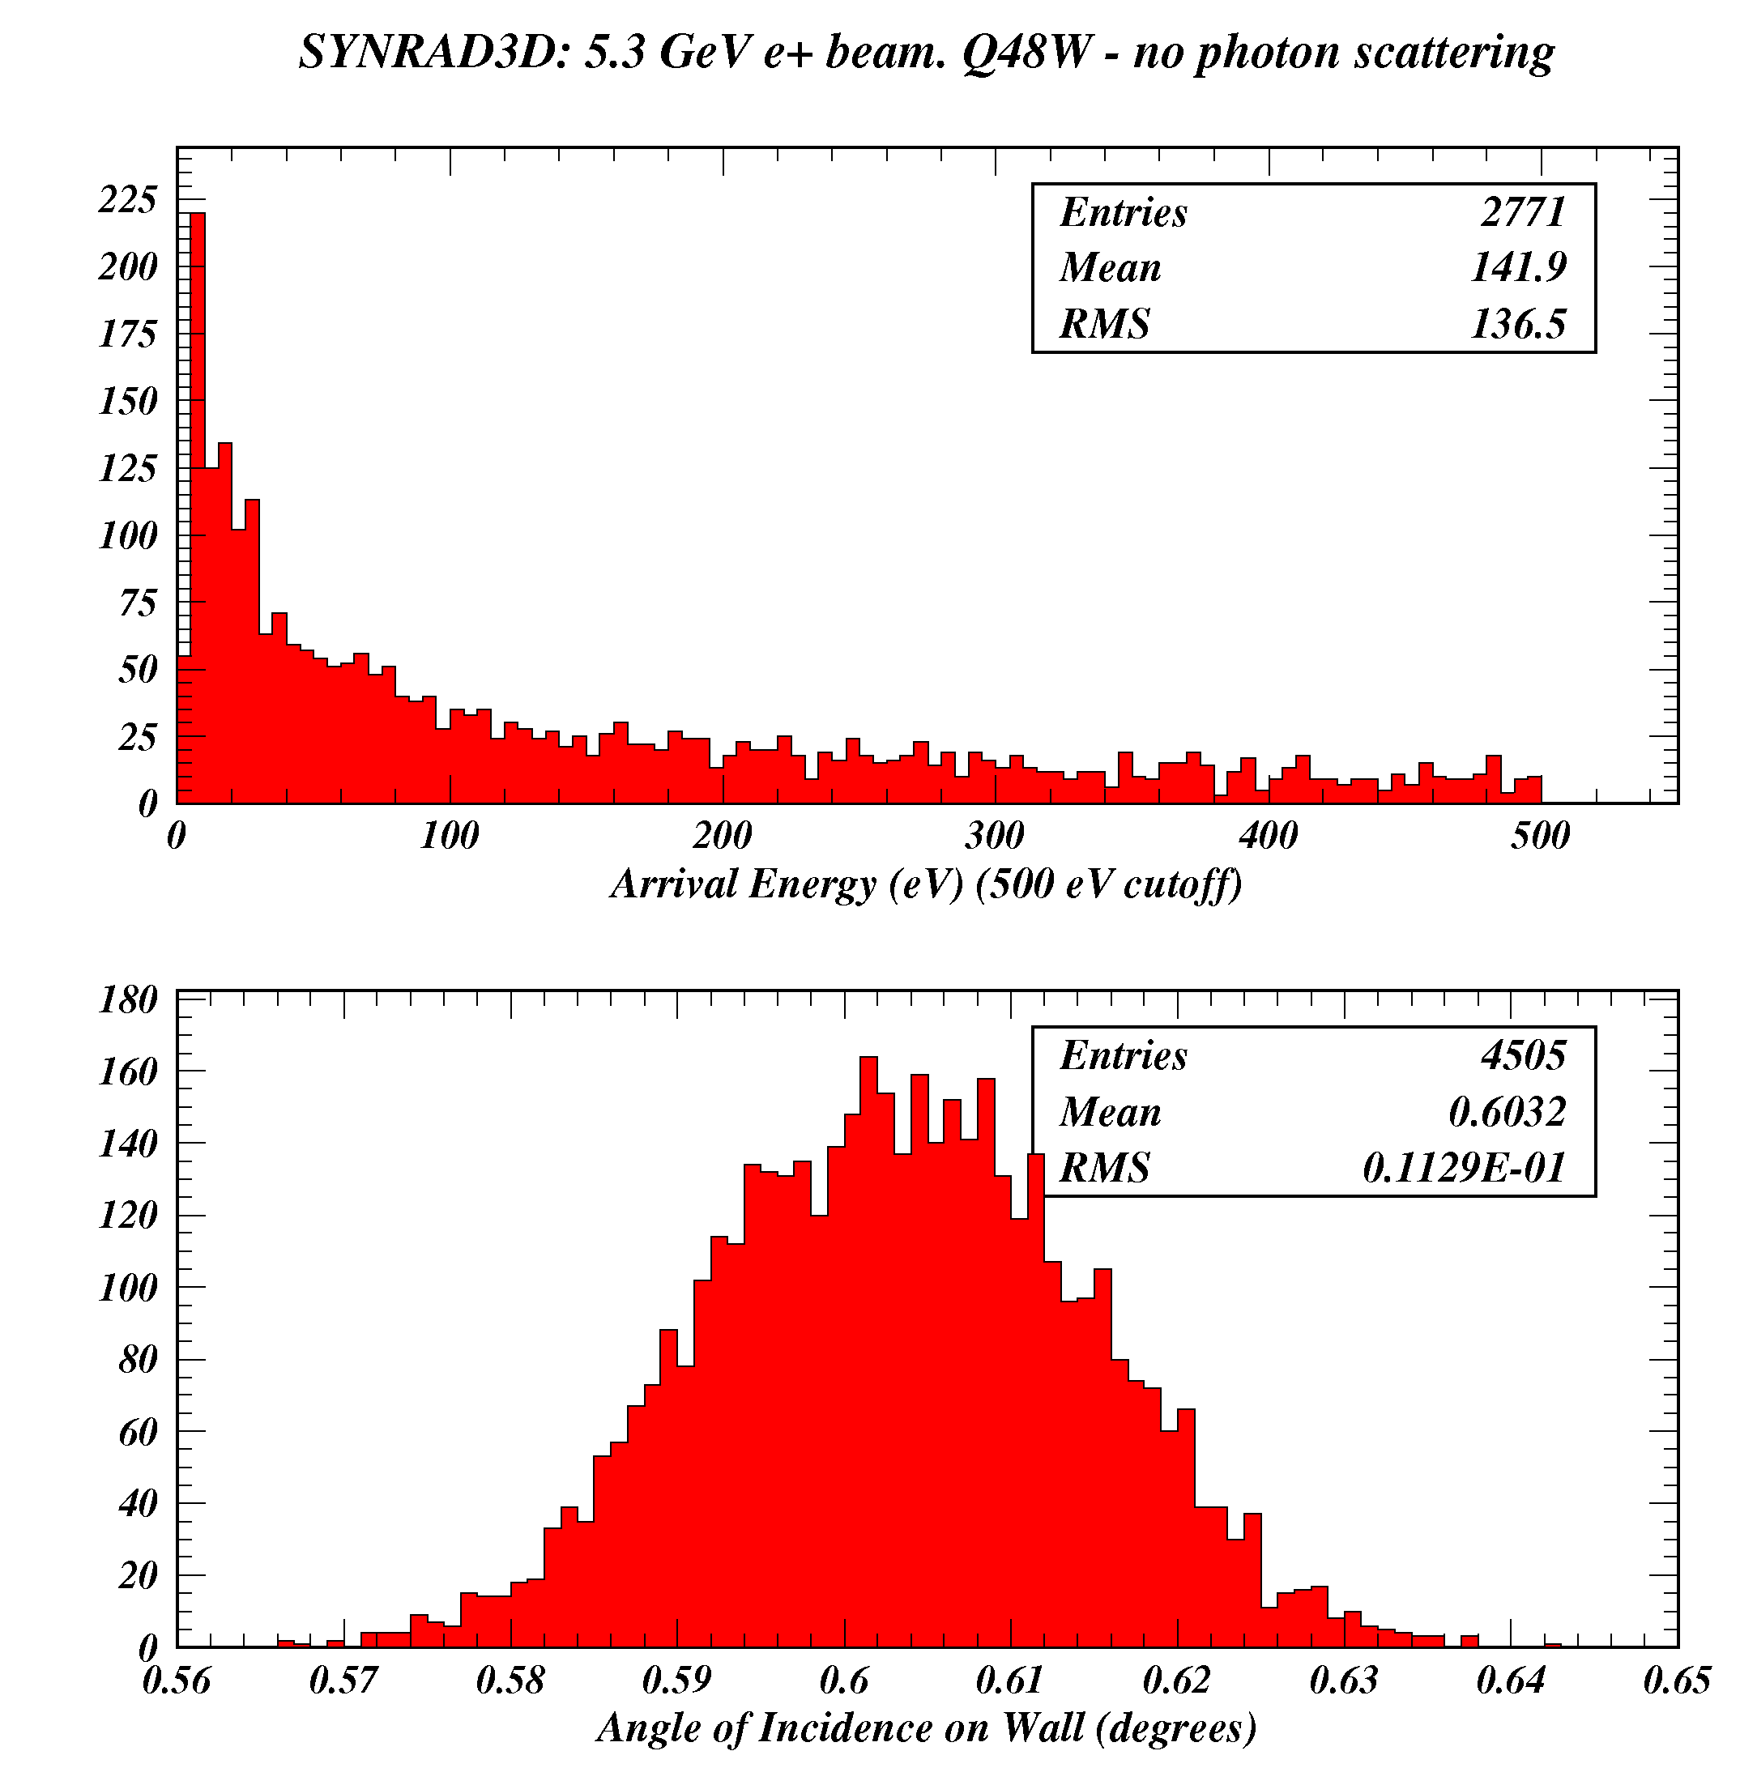
Synrad3D calculation in Q48W ignoring photon scattering
Synrad3D with photon scattering turned off finds a rate of 0.19 g/m/e+ ,
to be compared with the rate calculated by Synrad of 0.215 g/m/e+.
The direct photons from B48W hit the wall at about 0.6 degrees.
Their critical energy is 2.3 keV.
About 10% of them (0.05*0.42/0.19) are absorbed.

