Slide 1
Study of Fast Instability in Recycler
Sergey Antipov, The University of Chicago
Advisors: Young-Kee Kim (U.Chicago) and
Sergei Nagaitsev (FNAL/U.Chicago)
Notes:
<number>

Slide 2
Outline
What we know about the fast instability?
Electron cloud trapping in Recycler combined function magnets
Model of the instability
Microwave measurement of electron cloud
Stabilization with a clearing bunch
<number>
10/24/2016

Slide 3
Acknowledgements
Phillip Adamson, Ming-Jen Yang, Victor Grzelak, AD Operations for help with conducting the experiments
Alexey Burov, Yuri Alexakhin, Jeff Eldred, and all e-cloud group for numerous useful discussions of the results
<number>
10/24/2016

Slide 4
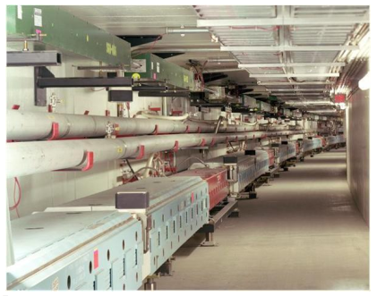
Fermilab’s Recycler
Proton momentum | 8.9 GeV/c
Circumference | 3.3 km
Max protons per batch | 4*10¹²
Number of batches | 6
Bunch spacing | 19 ns
Revolution period | 11 μs
Betatron frequencies (x, y) | 25.425, 24.415
The Recycler (top) and the Main Injector (bottom)
rings installed in a common tunnel.
8*10¹² after
upgrade
Gradient Dipole
Based on gradient dipoles
SPS (CERN) – similar issues
Quadrupole
Dipole
<number>
10/24/2016

Slide 5
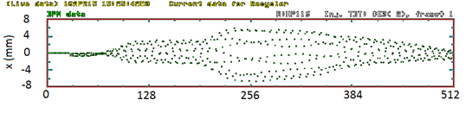
Fast instability in Recycler
Develops in 20-30 turns
Leads to increase of transverse emit.
Might be a challenge for PIP-II intensities
Beam center
hor. position (mm)
~ 20 turns
Revolution #
<number>
10/24/2016

Slide 6
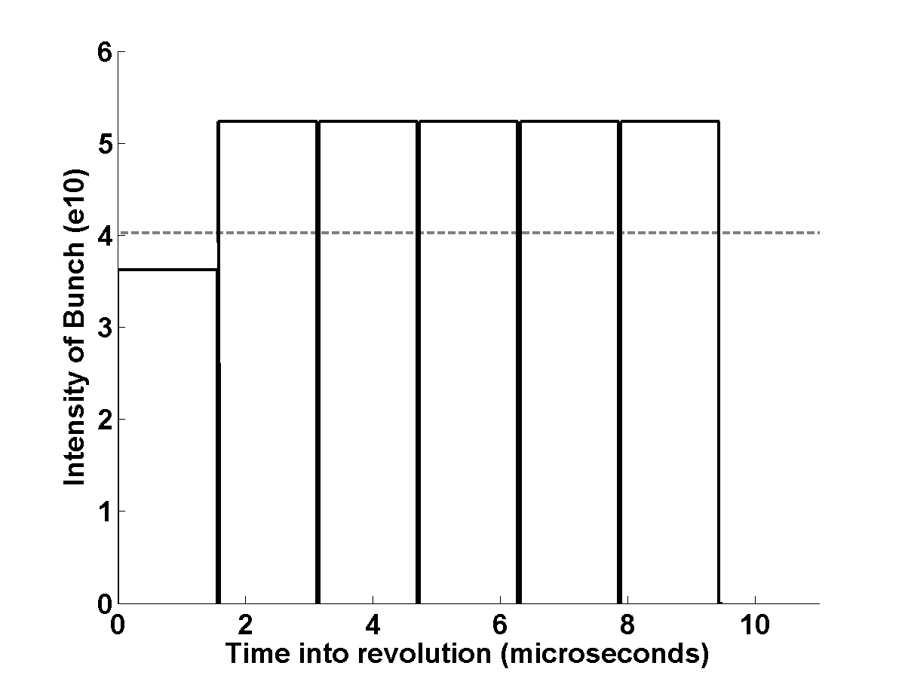
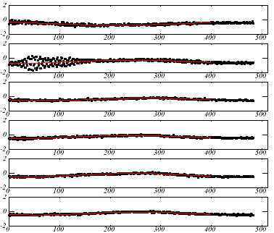
<number>
Fast instability affects the first batch above the threshold intensity
Horizontal Position
Threshold intensity
Number of Revolutions
Pictures provided by J. Eldred
<number>
10/24/2016
Notes:
<number>
<number>
<number>

Slide 7
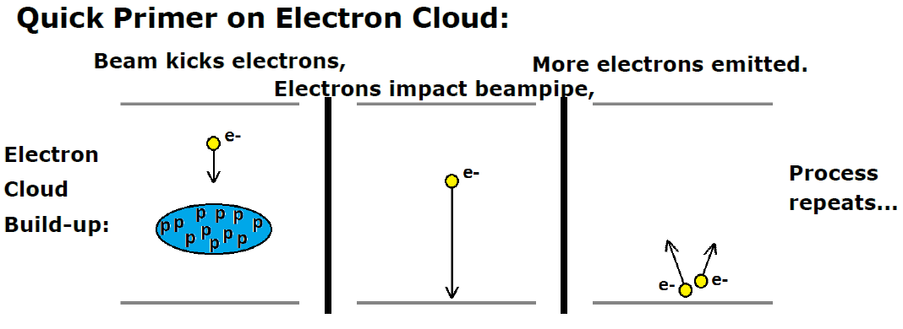
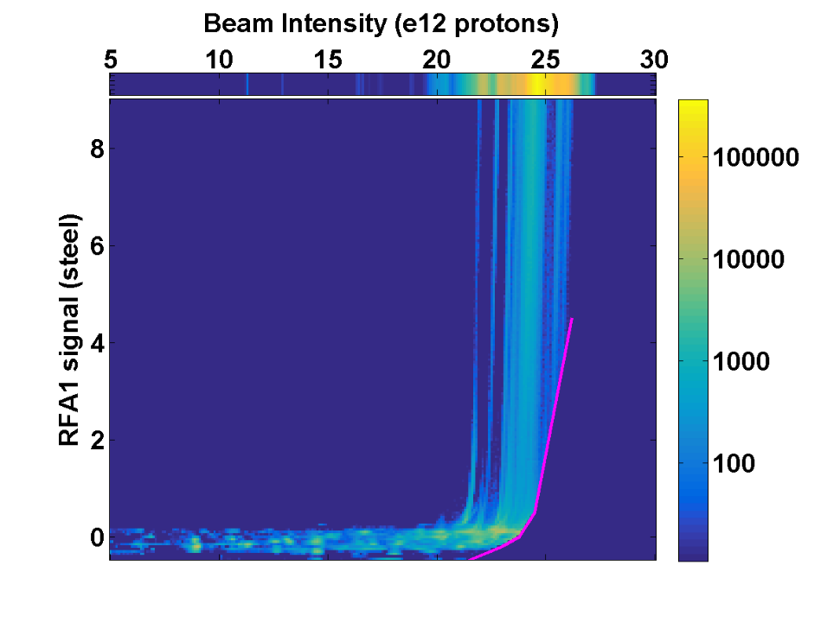
<number>
Electron cloud build-up
Pictures provided by J. Eldred
<number>
10/24/2016
Notes:
<number>
<number>
<number>
<number>
<number>
<number>

Slide 8
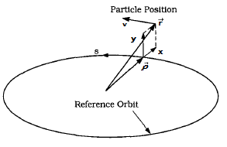
Electron cloud can lead to an instability
Ideal case
With electron cloud
Solution – oscillations around the reference orbit
‘Driven oscillator’
Can have unstable modes
Focusing strength
Kick by electron cloud
<number>
10/24/2016

Slide 9
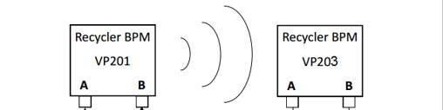
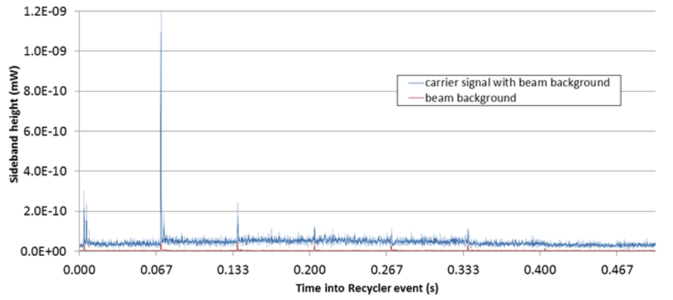
Direct measurement showed evidence of EC
Propagate a microwave signal
through the beampipe
Phase modulation at beam revolution freq., 90 kHz
2 GHz
50 m
Phase-delay:
Not enough temporal resolution to observe the evolution
<number>
10/24/2016
Pictures provided by J. Eldred

Slide 10
Why do we see an instability in Recycler but nothing in Main Injector?
Same energy
Same beam
Same beampipe
Gradient Dipole
Quadrupole
Dipole
<number>
10/24/2016

Slide 11
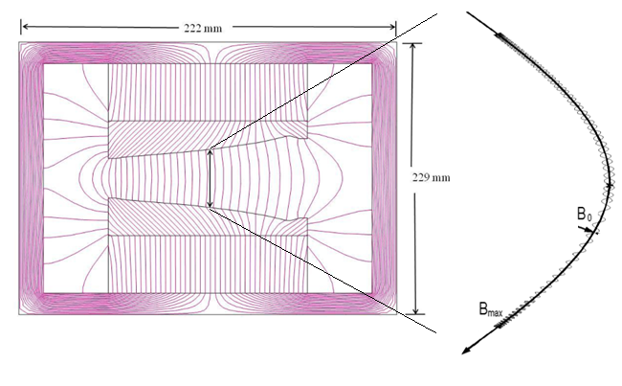
Trapping in combined function dipoles
Quadrupole component
Escape cone:
<number>
Dipole component
10/24/2016

Slide 12
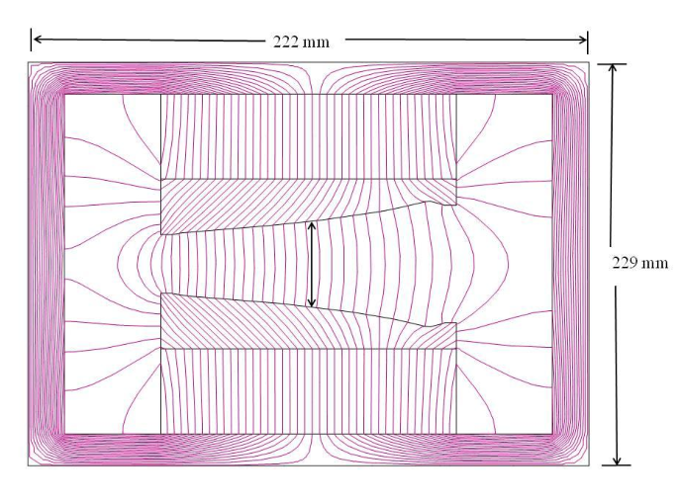
Trapping in combined function dipoles
Magnet | Central Field, kG | Bdl, kG-m | Quad, kG/m
RGF | 1.3752 | 6.182 | 3.355
RGD | 1.3752 | 6.183 | -3.238
SGF | 1.330 | 4.121 | 6.682
SGD | 1.330 | 4.121 | -6.824
Quadrupole component
Escape cone:
<number>
Dipole component
10/24/2016

Slide 13
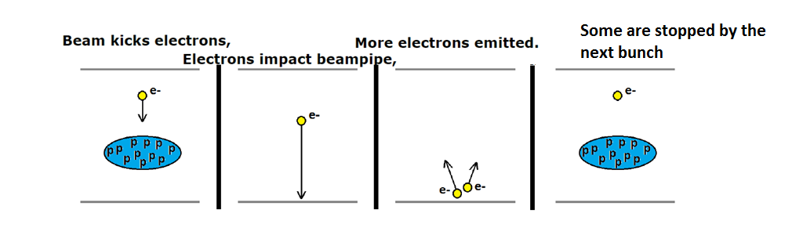
Up to 1% of the particles can be trapped by magnetic field
Current
intensity
Lifetime due to scattering: ~ 1 ms
All trapped particles survive until the next turn
<number>
10/24/2016

Slide 14
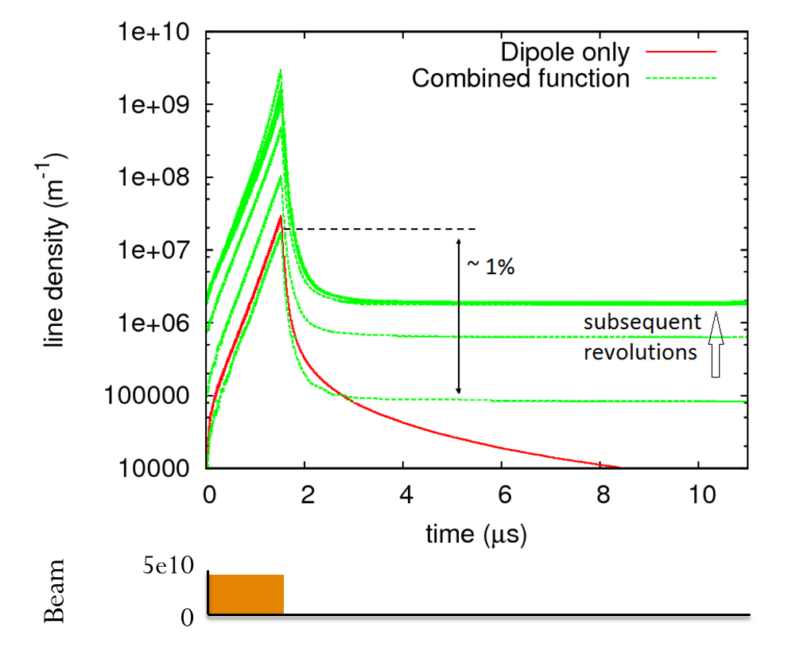
Presence of trapping changes the build-up
Linear particle density (m⁻¹)
<number>
10/24/2016

Slide 15
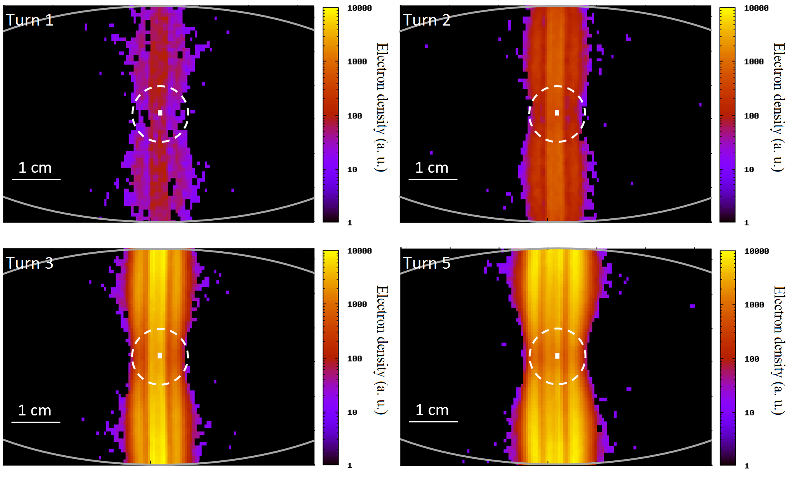
Electron cloud forms a vertical stripe inside the vacuum chamber; its horizontal position - beam center
2σ
<number>
10/24/2016

Slide 16
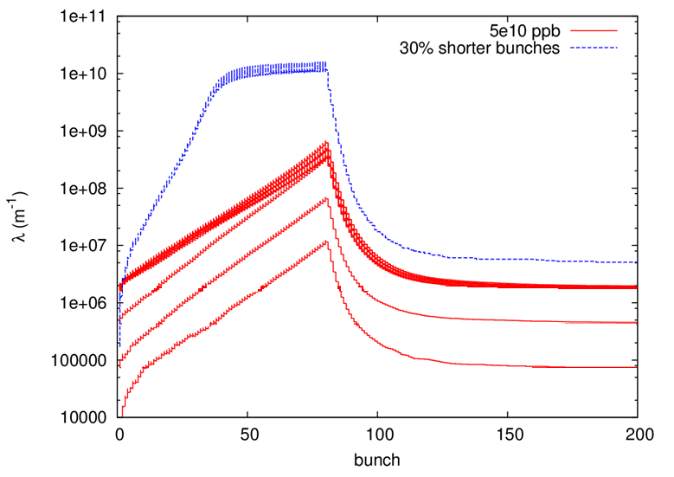

When bunches compress longitudinally,
the electron density reaches the beam density
beam
Linear particle density (m⁻¹)
0
1
2
3
4
<number>
time (μs)
10/24/2016
Notes:
<number>

Slide 17
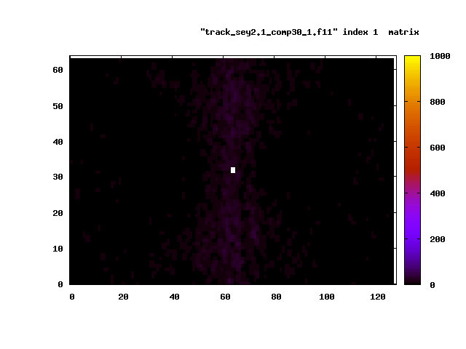
Fast instability happens when the cloud reaches the saturation
Beam center position (white) and electron cloud distribution every 4 bunches or 80 ns
Intensity - 5*10¹⁰ ppb, 80 bunches, σ_{z} = 40 cm
<number>
2 cm
10/24/2016

Slide 18
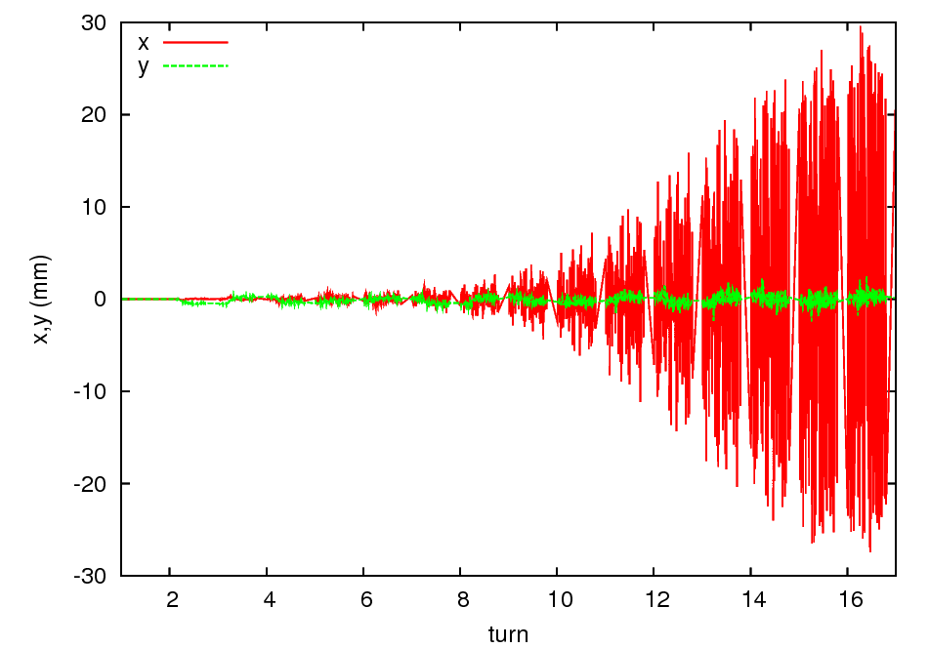
The instability only affects the horizontal motion
Growth rate ~ 4 revolutions (after the cloud has reached the saturation density)
<number>
10/24/2016

Slide 19
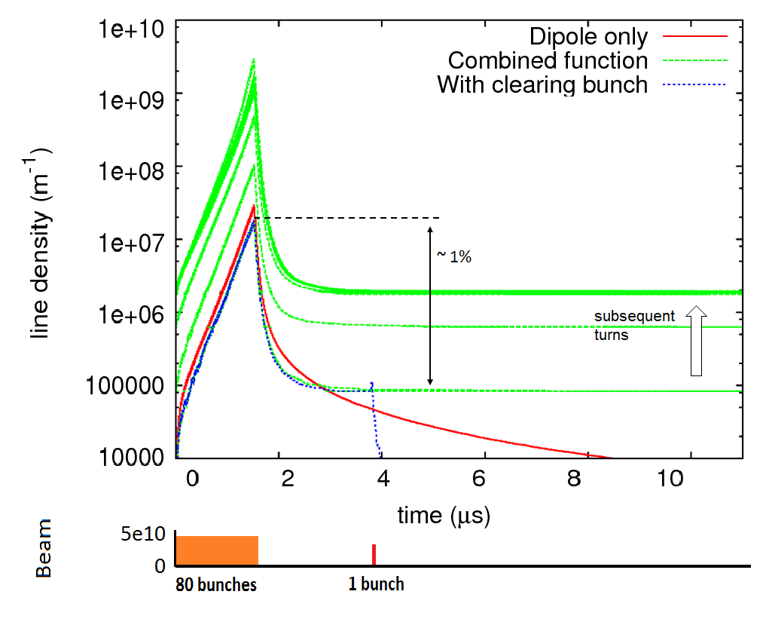
Clearing prevents the multi-turn accumulation of the electron cloud
Linear particle density (m⁻¹)
<number>
10/24/2016

Slide 20
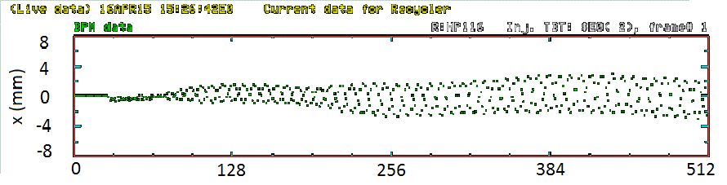
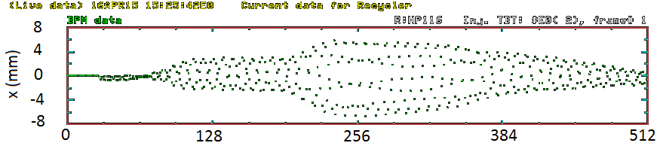
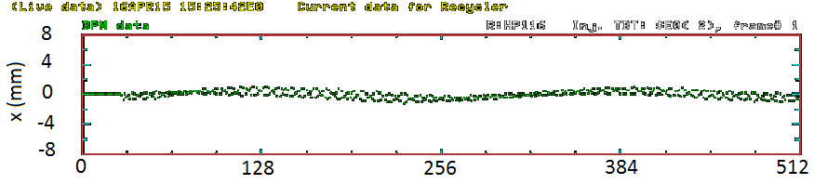
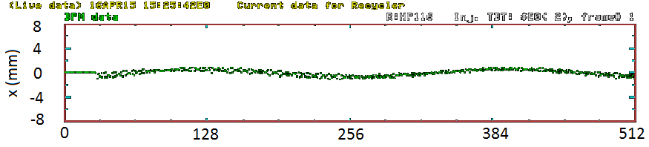
Stabilization by Single Low-Intensity Bunch
3.6e12 p
Increase clearing
bunch intensity:
3.6e12 p
5e9 p
1e10 p
1.5e10 p
<number>
10/24/2016

Slide 21
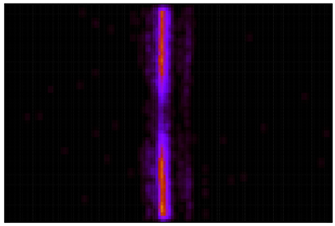
Electron cloud creates a shift in betatron frequencies between the head and the tail of the bunch train
Focusing horizontally (higher Q)
  Electron cloud is the only effect
  that can increase the frequency
Defocusing vertically (lower Q)
<number>
10/24/2016

Slide 22
Electron cloud creates a shift in betatron frequencies between the head and the tail of the bunch train
Use the data from 600 turns to evaluate the betatron frequencies (tunes)
Positive tune shift is a signature of electron cloud
No clearing
With clearing
<number>
10/24/2016

Slide 23
Can we estimate the rate of the electron cloud instability?

Slide 24
Analytical model of the instability: coasting beam
Solving the coupled e-p motion
Searching for solutions in the form
Im(Δω) – Growth rate
Re(Δω) – Frequency shift
Damping
Focusing
Linear coupling
Mobility of the cloud
<number>
10/24/2016

Slide 25
Analytical model of the instability: bunched beam
Impedance
The most unstable mode
Instability growth rate
Betatron frequency shift
Unknown
One can estimate the unknowns from the measurement of the betatron frequency shift
or from the simulation of the build-up
<number>
10/24/2016

Slide 26
Tune measurement agrees with the simulation
n_{e} = 6*10¹¹ m⁻³
λ = 2.7*10⁶ s⁻¹
Simulation
Main batch: 5e10 ppb
Witnesses: 8e9 p
<number>
10/24/2016

Slide 27
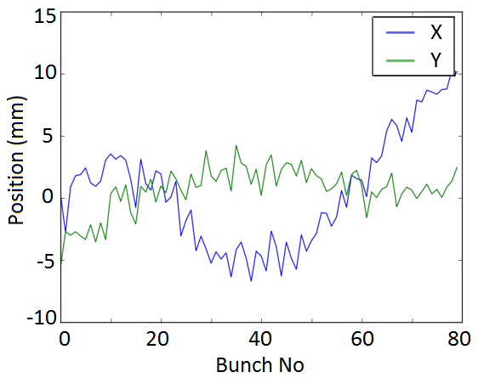
Growth rate and mode frequency are consistent with the observations
The most unstable mode is n_{max} = 30
Stripline measurement shows a horizontal
instability with a period of slightly less than
the length of a batch and a frequency < 1 MHz
The frequency of this mode is 0.4 MHz
<number>
10/24/2016
Notes:
<number>

Slide 28
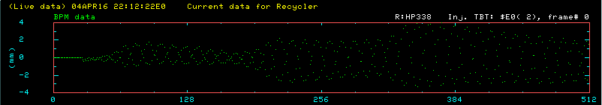
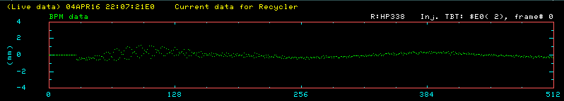
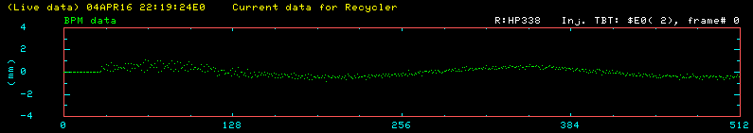
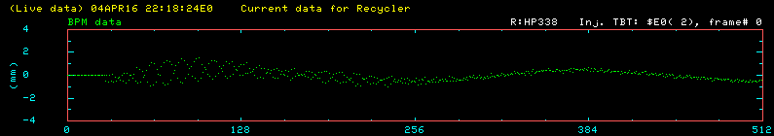
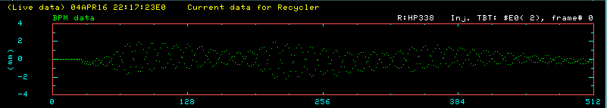
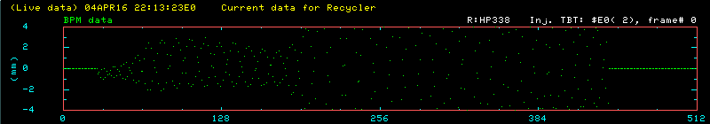
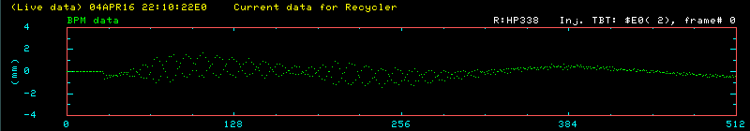
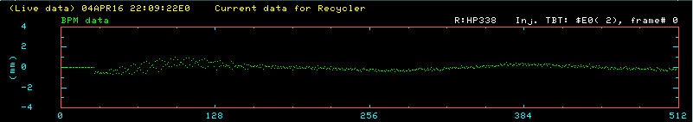
Instability goes Up and then down with intensity
7.0e10 ppb
6.3e10 ppb
5.0e10 ppb
6.6e10 ppb
4.6e10 ppb
5.8e10 ppb
5.4e10 ppb
4.2e10 ppb
<number>
10/24/2016

Slide 29
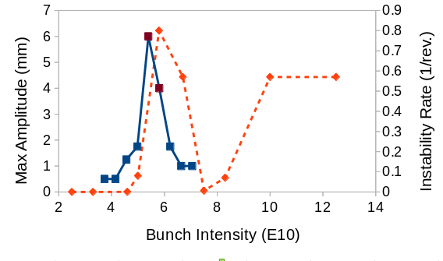
Peak of instability rate is consistent with electron cloud simulations
Experiment
Simulation
<number>
10/24/2016

Slide 30
Direct measurement of electron cloud

Slide 31
Microwave measurement procedure
2 GHz
Source
Dipole
Receiver
5.6 m
Isolate 1 gradient dipole
Shoot an RF wave, measure phase delay
Get an estimate of e-cloud density as a function of time:
  Density at saturation
  Rate of build-up
  Amount of trapped electrons
<number>
10/24/2016

Slide 32
First Data: Seems that what matters is the peak intensity, not the total charge in the beam
ECloud density is consistent with
the simulation
Problems:
  High noise
  Unable to make a fast measurement
Beam | p per batch | Cloud density (m⁻³)
41.2x10¹²: 4+6 batches | 4.12x10¹² | 17.9±4.9 x10¹¹
17.0x10¹²: 4 batches | 4.25x10¹² | 20.3±5.8 x10¹¹
<number>
10/24/2016

Slide 33
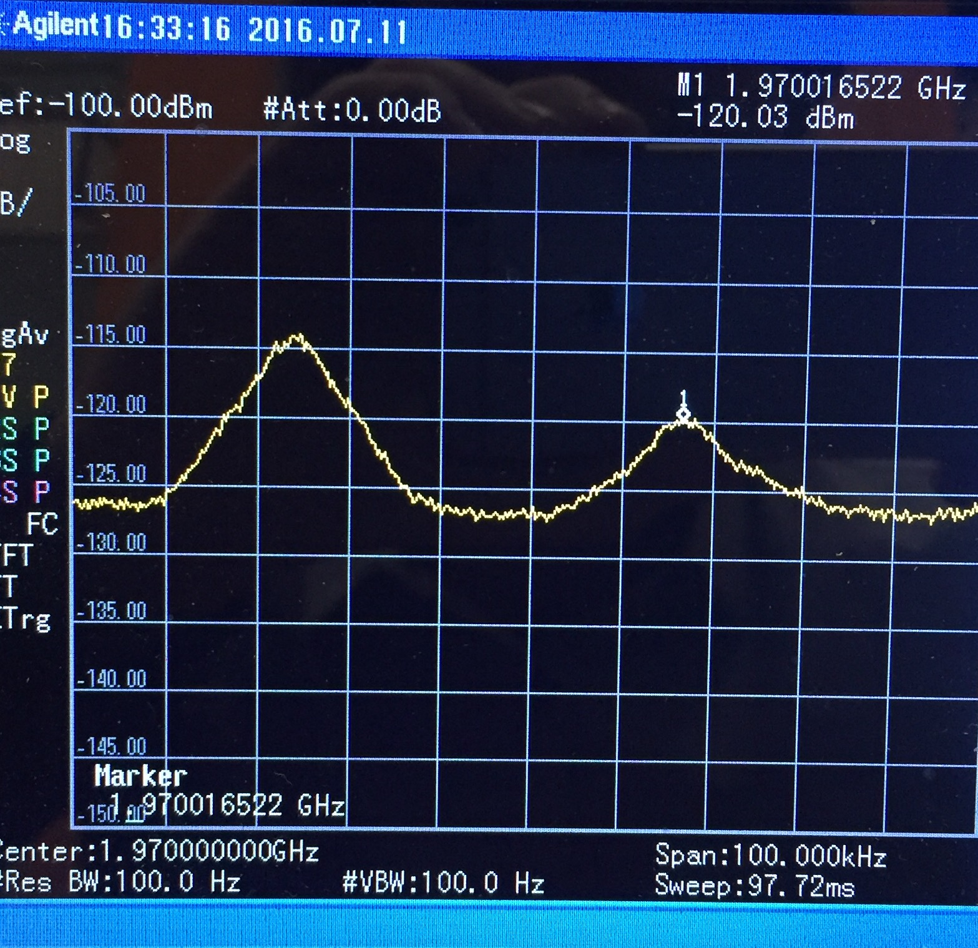
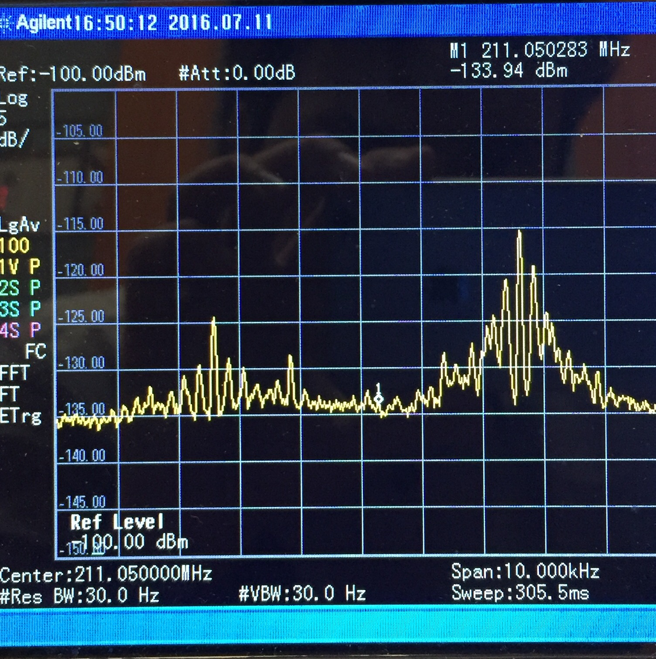
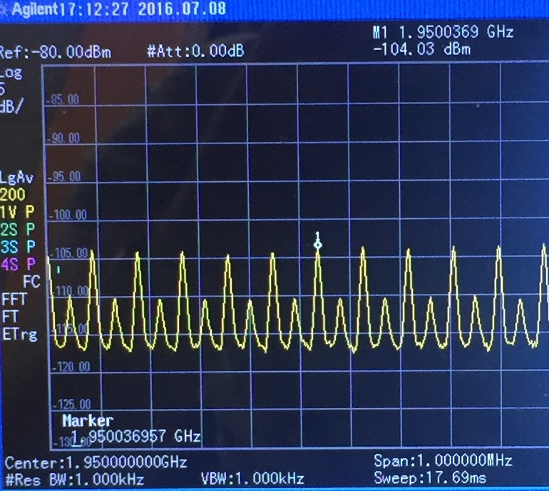
Broadband Schottky noise
At 200 MHz
At 2 GHz
45 kHz
Betatron
sideband
~ 250 Hz
90.9 kHz
Synchrotron
sidebands
<number>
10/24/2016

Slide 34
Improving signal/noise
Addition amplifier in the tunnel
Measure when no beam
Recommissioned old amps from Recycler Schottky detectors
  +30 dB at 2.0 GHz
Put it in the tunnel
Replace the amps if they burn
Triggering hardware to arm the scope already in place, need to reconfigure after shutdown
Need to add fast gating from RF
<number>
10/24/2016

Slide 35
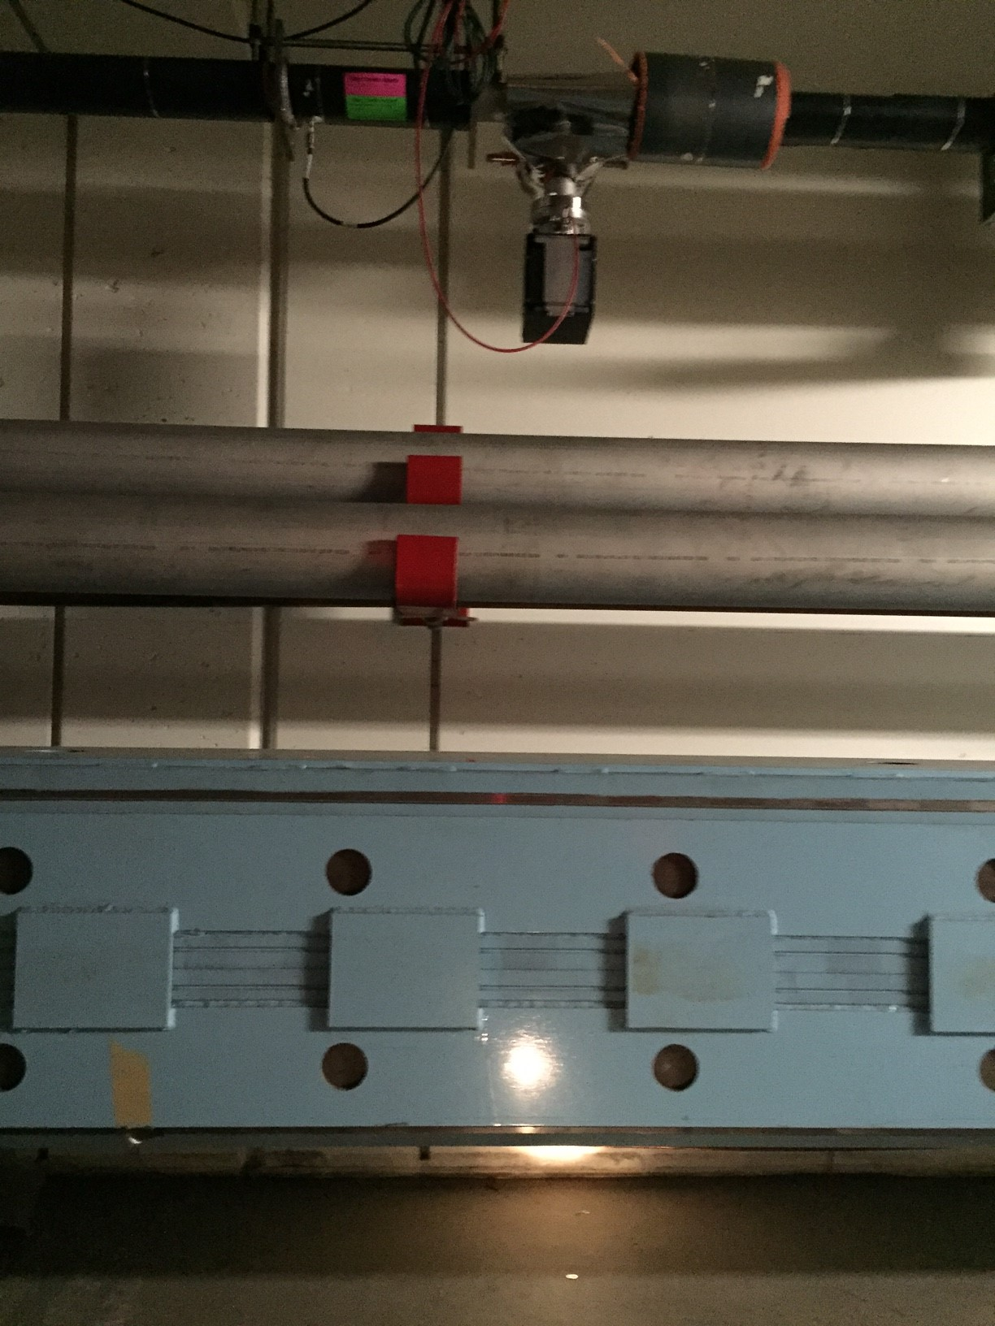
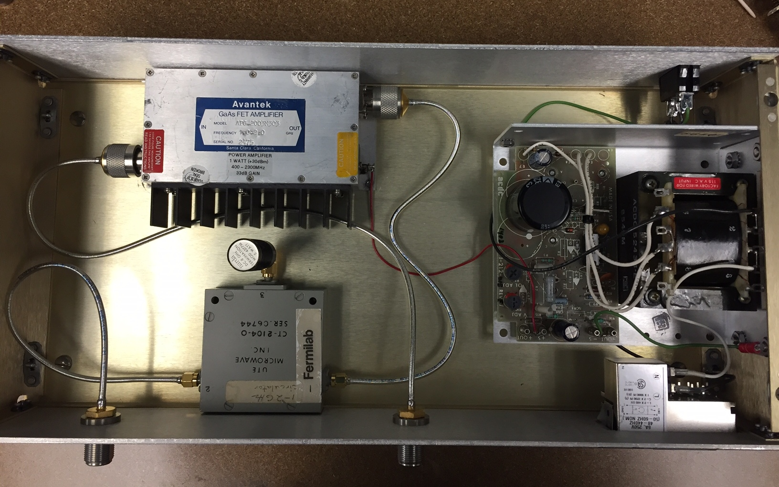
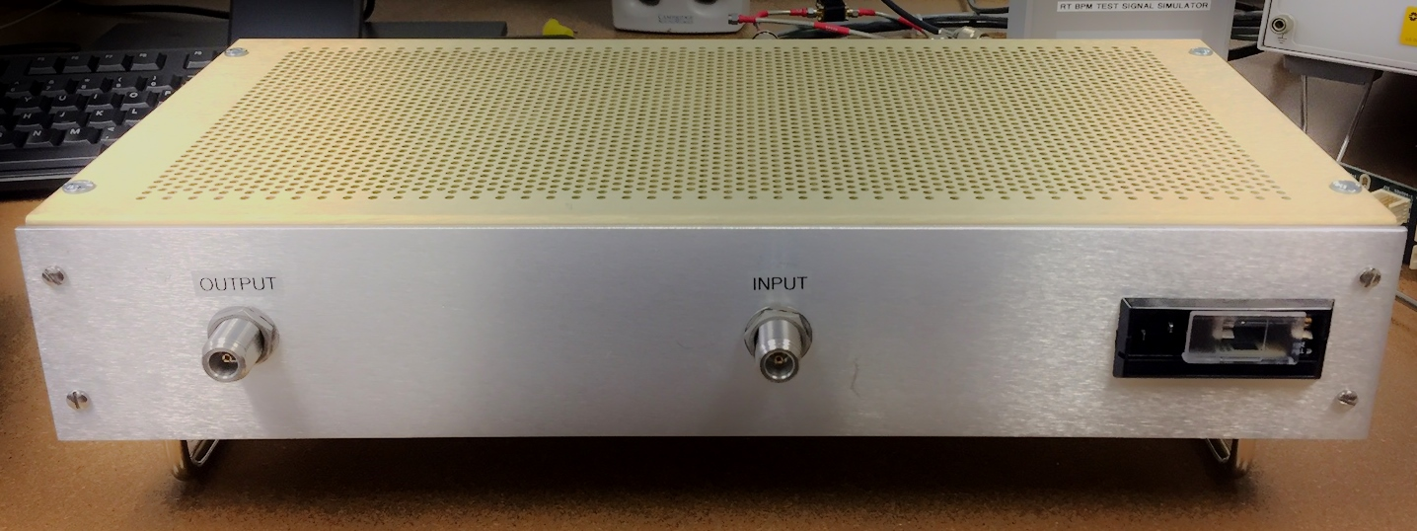
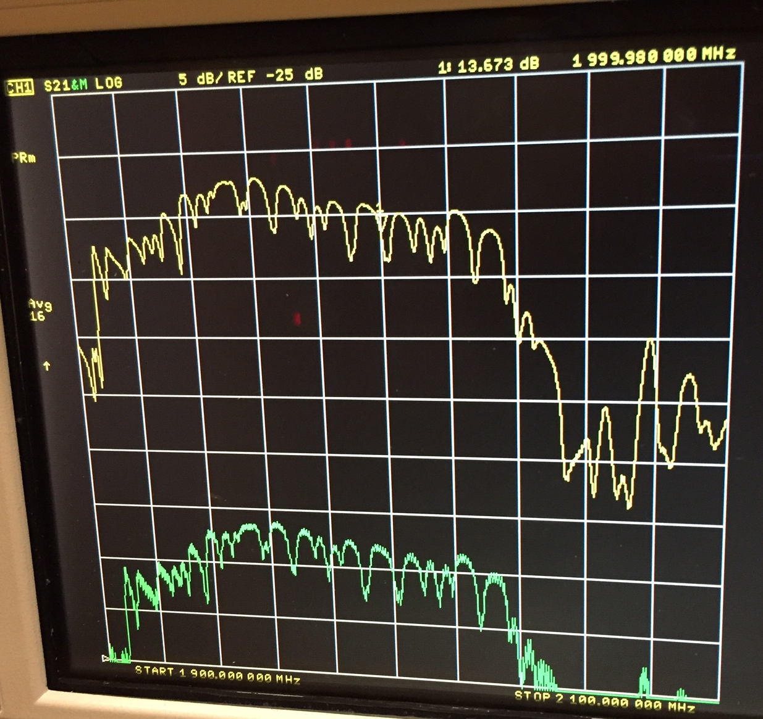
Amplifier in the tunnel
1 W Amplifier
15 V DC
Source BPM
50 Ω
Circulator
+ 30 dB
@ 2 GHz
1.9 GHz
2.1 GHz
<number>
10/24/2016

Slide 36
Can we do anything to reduce the instability?

Slide 37
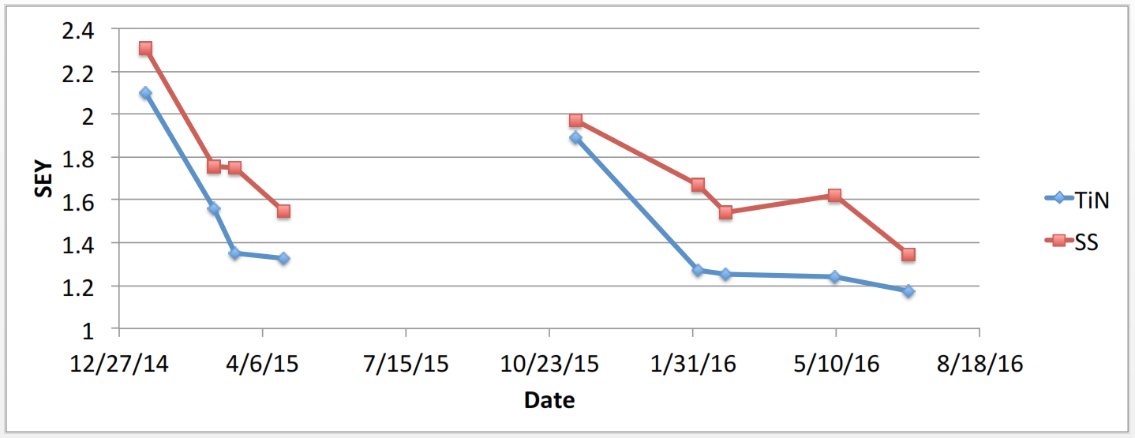
Conditioning helps
SEY of the beampipe drops down as it conditions
ξ_{x,y} = -2,-2;
no inst. below 17 turns at ξ_{x,y} = -6,-8
ξ_{x,y} = -6,-8
Yi-Chen Ji, ECloud test set up in MI
ξ_{x,y} = -6,-8
<number>
10/24/2016

Slide 38
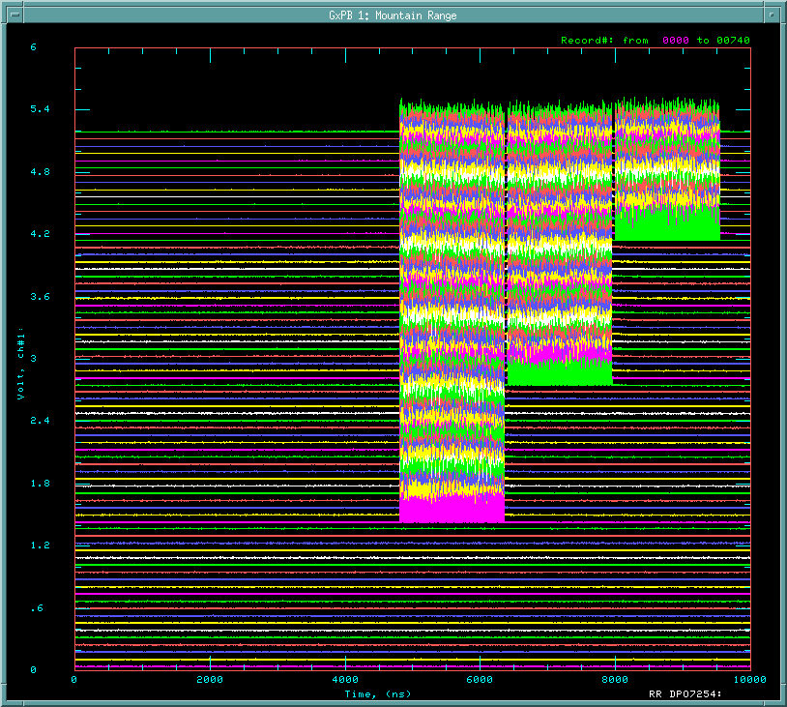
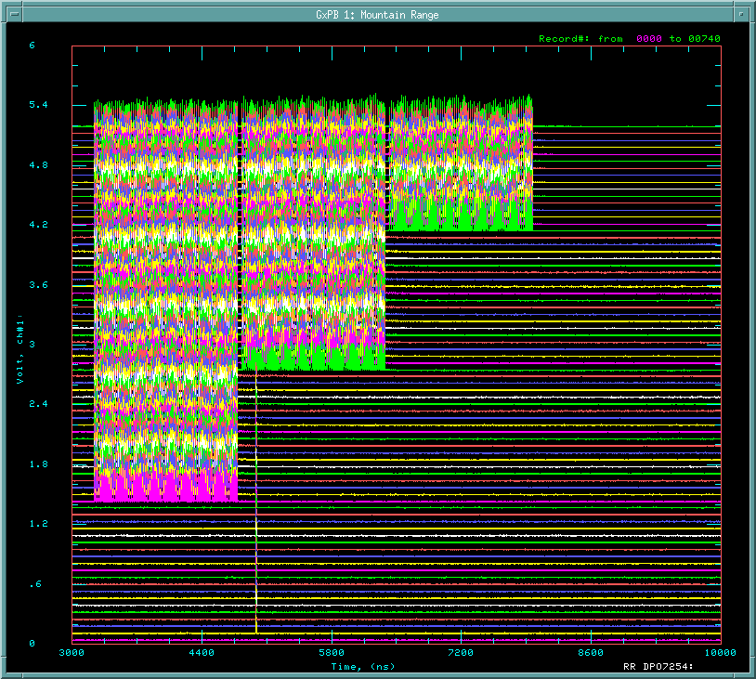
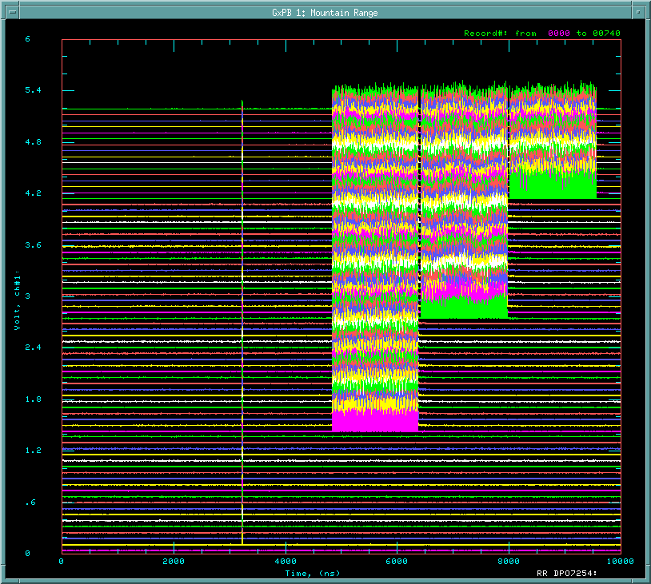
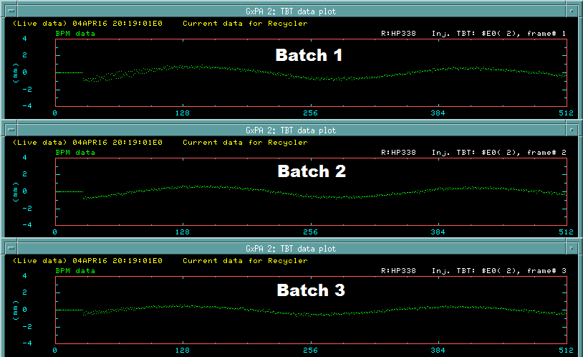
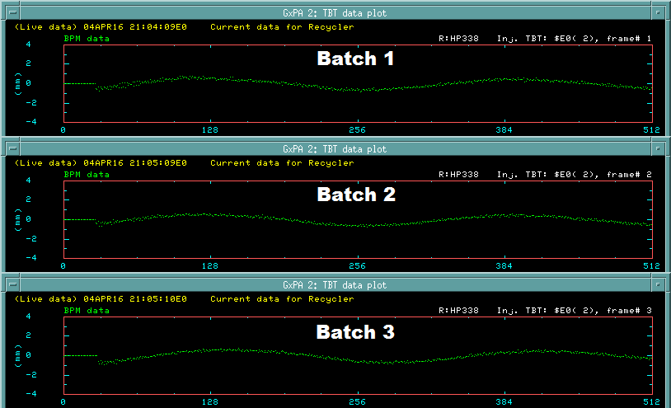
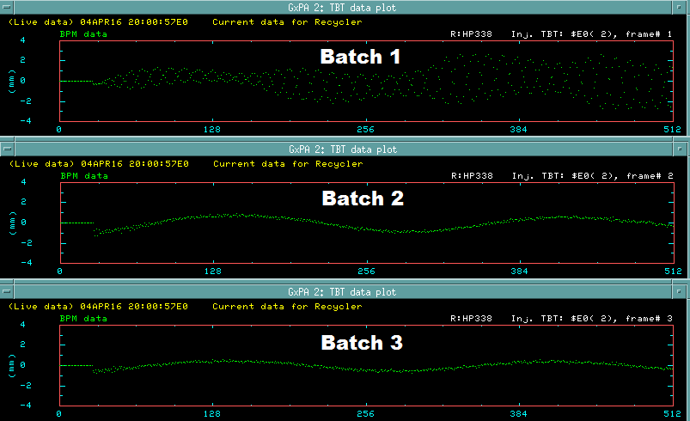
Stabilization with a clearing bunch
Add a clearing bunch – all bathes stable
Beam: 3 batches of 5.8*10¹⁰ ppb
No clearing bunch – the first batch is unstable
Beam: 3 batches of 5.8*10¹⁰ ppb
4.2*10¹⁰
time
time
time
At least 5-7 buckets apart
4.2*10¹⁰
<number>
10/24/2016
long. position (ns)
long. position (ns)
long. position (ns)

Slide 39
Summary
The fast instability in Recycler is caused by electron cloud
Combined function magnets trap the electron cloud
  Trapping of the order 10⁻³ – 10⁻² leads to multi-turn accumulation of the cloud
  The cloud reaches much higher densities than in a dipole
An analytical model of the instability has been created
Trapped electron cloud can be cleared out with a clearing bunch
  Need a gap of 5-7 RF buckets
<number>
10/24/2016

Slide 40
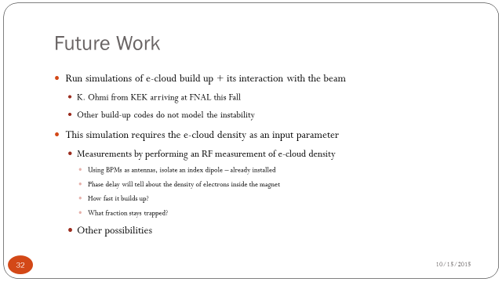
Current progress
Complete?
Yes
No
E-cloud density estimated from
the frequency shifts
Yes
<number>
10/24/2016

Slide 41
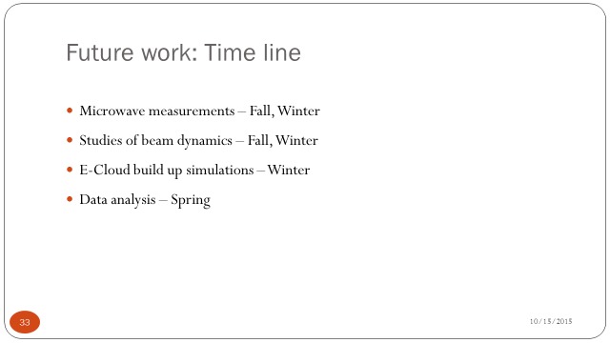
Time line
Right after the shutdown
Done
Done
Ongoing
<number>
10/24/2016

Slide 42
Thank you for your attention
Questions?

Slide 43
Back-up slides

Slide 44
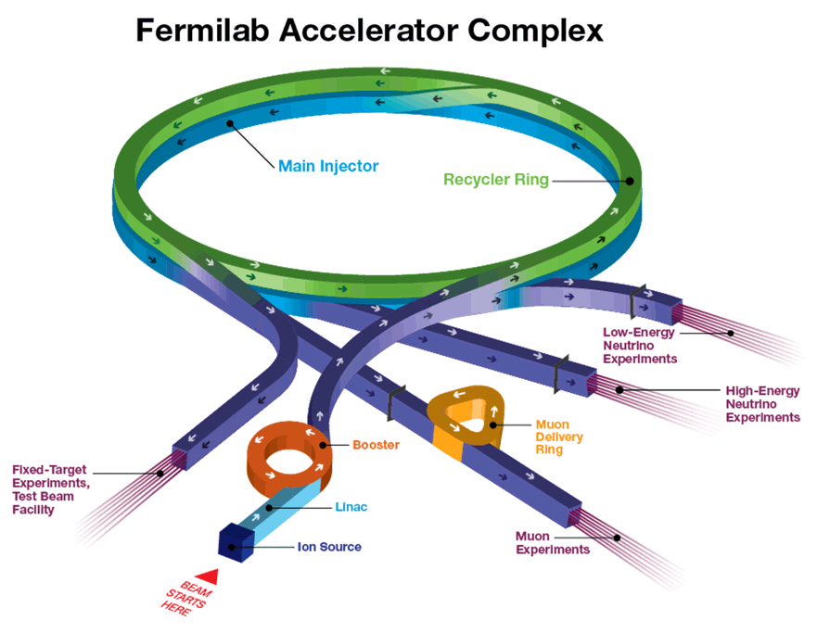
<number>
10/24/2016

Slide 45


Courant-Snyder Parameterization
Consider a ring with a one-turn transfer matrix M
det M = 1
α, β, γ – Twiss parameters
Emittance:
Φ – betatron phase advance
Φ/2π = Q – frequency of betatron oscillations (tune)
<number>
10/24/2016

Slide 46


History
1965 INP, Novosibirsk: coherent oscillations and beam losses above a threshold proton intensity of 1-1.5e10 | 1972 CERN ISR, 1988 Los Alamos PSR 1989 KEK: multibunch instability after switching from e to e+
ZGS, Argonne: vertical instability, threshold 2-8e11 proton | CERN SPS: instability different in two transverse planes
Beam intensity (top) and
position (bottom)
<number>
10/24/2016

Slide 47

Longitudinal Mismatch Leads to an Instability
Injecting a high-intensity batch
  4.5e10 p per bunch
Observe rapid increase of beam
center oscillations when
bunches shrink longitudinally
  In x-plane only
Damper helps
<number>
10/24/2016

Slide 48

Microwave Measurement Schematic
~ 2 GHz carrier signal propagated in beampipe.
The presence of ecloud causes a phase-delay.
Phase modulation at beam revolution freq., 90 kHz.
Ecloud measured in the 90 kHz sidebands of the carrier frequency.
<number>
10/24/2016
Notes:
<number>

Slide 49




EC in Dipoles Matches Instability
First Batch
Configuration
Second Batch
Configuration
<number>
10/24/2016
Notes:
<number>

Slide 50
SEY Measurements at MI (Y. Ji, J. Eldred et al.)
SEY of uncoated SS316L
Incident electron energy (eV)
Measurements performed over the course of first 4 months in 2015 (uncoated SS316L shown) demonstrate gradual conditioning due to exposure to the beam
SEY of SS316L with TiN coating is a few % lower (no big effect)
With large grazing angle in B-field SEY can be much higher
Special “scrubbing run” can reduce SEY if necessary
<number>
10/24/2016

Slide 51

SEY depends on the angle
Most particles hit the vacuum chamber at small angles
chamber at small angles
Mean incident angle ~ 15 deg
Effective SEY about 5% higher
1
¹ M. Furman, M. Pivi, Phys. Rev. ST Accel. Beams, Vol. 5, 124404 (2002)
<number>
10/24/2016

Slide 52





Electron trapping:
For some initial velocities final speed close to 0
Equation of motion:
Initial condition:
A – phys. aperture,
dt – time between bunches
Aperture limitation:
y(t) for different initial v_{y}
<number>
10/24/2016

Slide 53


Lifetime is limited by scattering
Residual gas
Coulomb scattering within the cloud
Pressure: p ~ 10⁻⁸ torr
Cross-section:
Cloud density²: n < 10⁷ cm⁻³
Energy ~ 5 eV or less
Scattering cross-section¹
P_{c}, cm⁻¹-torr⁻¹
σ_{c}, 10⁻¹⁶ cm²
P_{c}, cm⁻¹-torr⁻¹
σ_{c}, 10⁻¹⁸ cm²
Energy distribution of secondaries
G. Lladarola PhD thesis, dE = 1eV
E, eV
E, eV
Overall, τ ~ 1 ms
¹ MacDonald, A. D. Microwave Breakdown in Gases. New York: Wiley, 1966
² Elded, J. et al, Fast Transverse Instability and Electron Cloud Measurements in Fermilab Recycler, HB’14, 2014
<number>
10/24/2016

Slide 54
Microwave measurement procedure
Isolate 1 gradient dipole
Shoot an RF wave, measure phase delay
Get an estimate of e-cloud density as a function of time:
  Density at saturation
  Amount of trapped electrons
Use BPMs as antennas
  Signal attenuation < 10 dB
  2 for source – to kill reflections
  1 for receiver
  All BPMs already installed
Elements between source and receiver | 1 gradient dipole
Frequency, polarization | 2 GHz, vertical
Phase velocity in beampipe | 0.37 c
Path length | 560 cm
Number of data points per rev. period | 200
Estimated phase delay, trapped e | 10 mrad
<number>
10/24/2016

Slide 55

Parameters of the build-up simulation
<number>
10/24/2016

Slide 56
Stripline measurements
Goal: To get some information on the dynamics of fast instability in the Recycler
Can be used as input data to build a model of e-cloud instability
Procedure:
  Turn the damper OFF
  Create conditions for fast instability
  Observe dynamics with and without cleaning bunch
<number>
10/24/2016

Slide 57
Stripline measurements: What we did?
Measured:
  Averaged beam position
  Beam intensity
  WCM
  Stripline
Controlled:
  Charge
  Number of bunches
  Bunch rotation (long. mismatch)
  Tune chromaticity
Beyond control:
  Quality of Booster beam
Major source of uncertainty
<number>
10/24/2016

Slide 58


Stripline measurements:
Looking inside a bunch
Full batch
Close view
signal
12 data points
80 bunches
reflection
Temporal resolution: 0.2 ns
Both horizontal and vertical
Do 1 ns smoothing to remove HF noise
Stripline
Quaterwave for 53 MHz
Length: 140 cm
Hor. & vert. plates
Sensitivity of log(A/B): 2 mm/dB
Digitizer: 5 points/ns
<number>
10/24/2016

Slide 59
Analytical model of the instability: coasting beam
Solving the coupled e-p motion
Searching for solutions in the form
Growth rate:
Frequency shift:
<number>
10/24/2016

Slide 60
Analytical model of the instability: Input parameters
Parameter | Symbol | Value
Cyclotron frequency |  | 0.57e6 s⁻¹
Betatron tune, frequency | Q_{x}, | 25.45, 14.54e6 s⁻¹
Relativistic factor | γ | 10
Protons per bunch | N_{b} | 5e10
RF period |  | 18.87 ns
Electron cloud density | n_{e} | 6.1e11 m⁻³
Coupling frequency |  | 0.23e6 s⁻¹
Build-up rate | λ | 2.65e6 s⁻¹
Landau damping rate | Γ | 0
<number>
10/24/2016

