Slide 1
Studies of Electron Cloud Growth and Mitigation at CESR-TA
Joe Calvey
PhD Dissertation

Slide 2
Outline
Overview
  Electron cloud
  CESR-TA program
Retarding Field Analyzers
  Measurements
  Mitigation comparisons
Cloud simulations
  Detector modeling
  Fitting data
  Investigating interesting phenomena

Slide 3
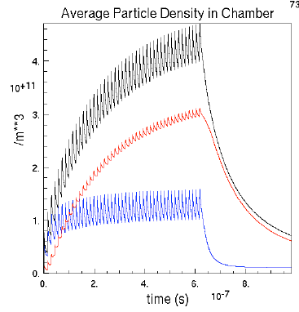
What is electron cloud?
F. Ruggiero
Buildup of low energy electrons inside vacuum chamber
  Typical density ~ 10¹¹ - 10¹² e- / m³
  Typical energy ~< 200 eV
Seeded by photoelectrons from synchrotron radiation
  Or ionization of residual gas, beam particle loss, etc
Additional electrons from secondary emission
  Usually low energy (< 20 eV)
Electrons gain energy from beam kicks
  If average SEY > 1, exponential cloud growth
Cloud growth ultimately limited by space charge
Decays after bunch passage
  Decay time ~100 ns
total
secondary
electrons
photo-
electrons

Slide 4
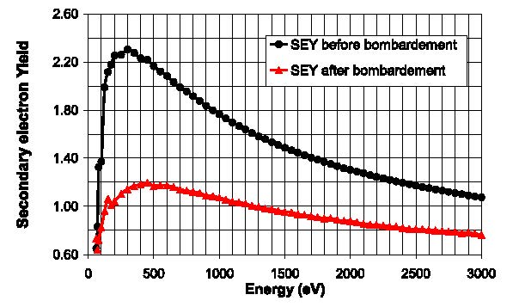
Secondary Emission Yield
Generation of secondaries is determined by the secondary emission yield (SEY) function δ(E):
  Characterized by peak value δ_{max} at E = E_{max}
  Low energy yield δ(0): determines survival time of cloud during train gap
  Typically, δ_{max}~1–3, and E_{max}~200-400 eV, δ(0) ~ .5
Many materials
“condition” with
electron cloud
bombardment
  Results in lower
  δ_{max}, higher E_{max}
N. Hilleret et al, PAC99
δ_{max}
Ε_{max}

Slide 5
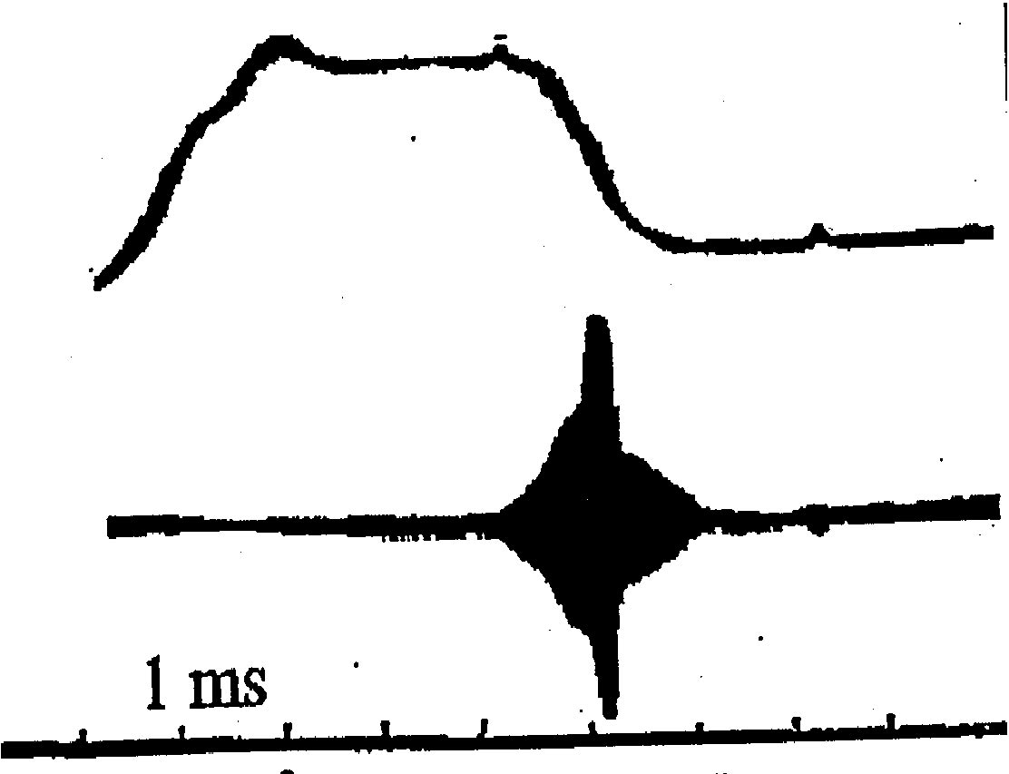
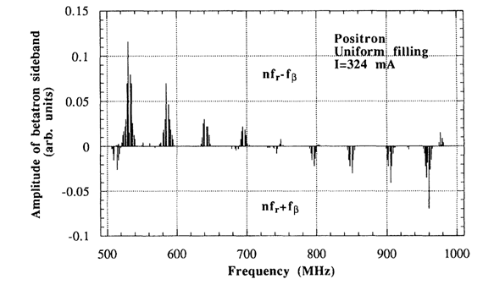
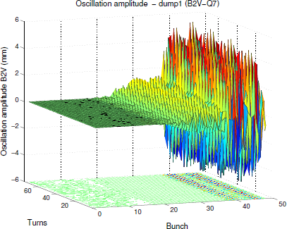
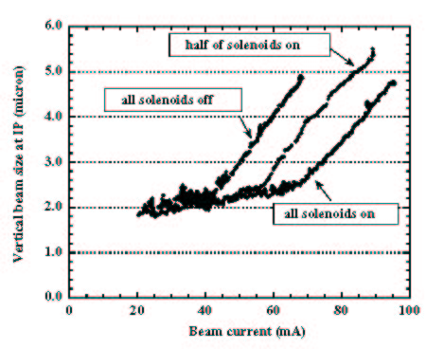
Why Study Electron Cloud?
Long history of troublemaking
  Early observations (60’s – 80’s): two-stream instabilities in proton storage rings
    BINP, ISR, Bevatron, PSR (LANL)
  1995: Coupled bunch instability at KEK Photon Factory
    Behaved differently for electron and positron beams
  PEP-II and KEKB limited by EC
    Needed mitigations to achieve luminosity goals
  LHC: pre-emptive action taken to reduce effect
    Currently limits 25 ns operation
In short, it causes a variety of negative effects
  Tune shifts, emittance growth, instabilities, beam loss…
  Especially bad for high current, low emittance,
  positively charged beams
Concern for
future machines
  LHC upgrade
  Next generation
  lepton colliders
Beam instability at BINP, 1965
G. Budker et al
Betatron sidebands at KEK PF, 1995
M. Izawa et al
Emittance growth at KEKB, 2000
H. Bartosik
et al
Single bunch instability at LHC, 2012
H. Fukuma et al

Slide 6
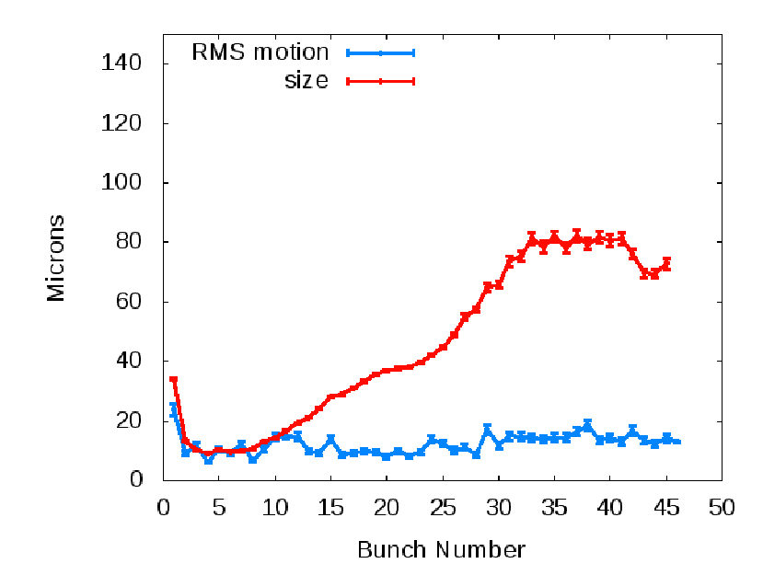
What is CESR-TA?
In mid 2008 CESR was converted from a e+/e- collider to a “damping ring” configuration, to study issues related to the ILC damping ring
  ILC = proposed next generation e+/e- collider
  Damping ring = reduce beam emittance before injection
  into main accelerator
Areas of research at CESR-TA:
  Low emittance tuning
  Studies of electron cloud growth and mitigation
  Studies of electron cloud induced emittance
  growth and instabilities
CESR is well suited to the task
  Very flexible
  Similar parameters to
  ILC damping ring
Collaborators: APS, SLAC, KEK,
CERN, LBL
Emittance growth
Parameter | ILC | CESR-TA
Circumference | 3239 | 768 | m
Horizontal Emittance | 0.64 | 2.6 - 133 | nm
Vertical Emittance | 2 | 10 - 1300 | pm
Bunch length | 5 | 12 - 20. | mm
Train length | 45 | 1 - 135 | bunches
Bunch population | 2.00E10 | 8E9 - 1.6E11 | particles
Bunch spacing | 6 | 4 - 280 | ns
Beam Energy | 5 | 2.1 - 5.3 | GeV
Beam Species | e+, e- | e+, e-

Slide 7
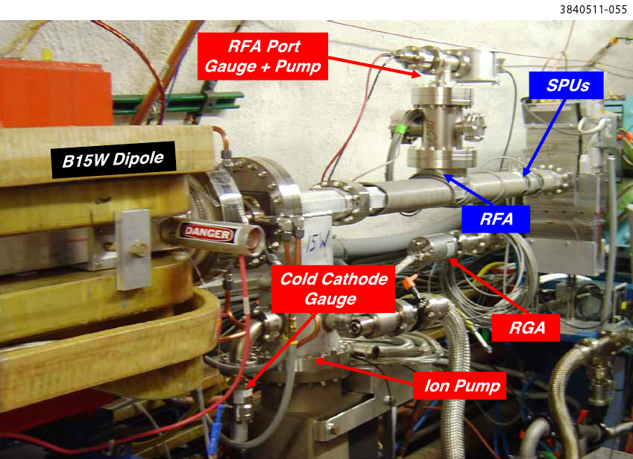
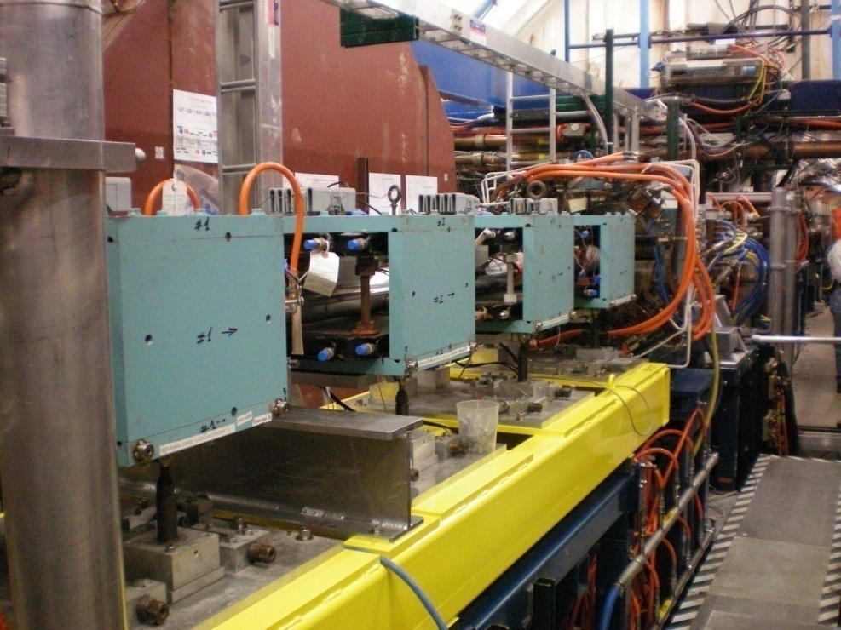
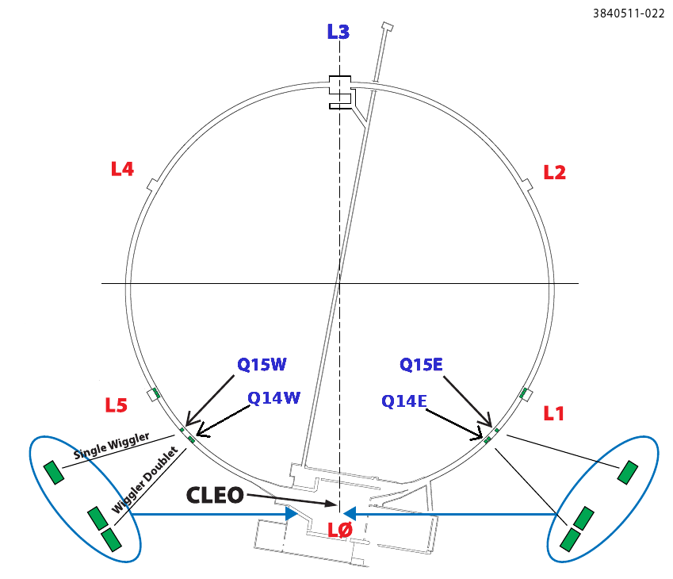
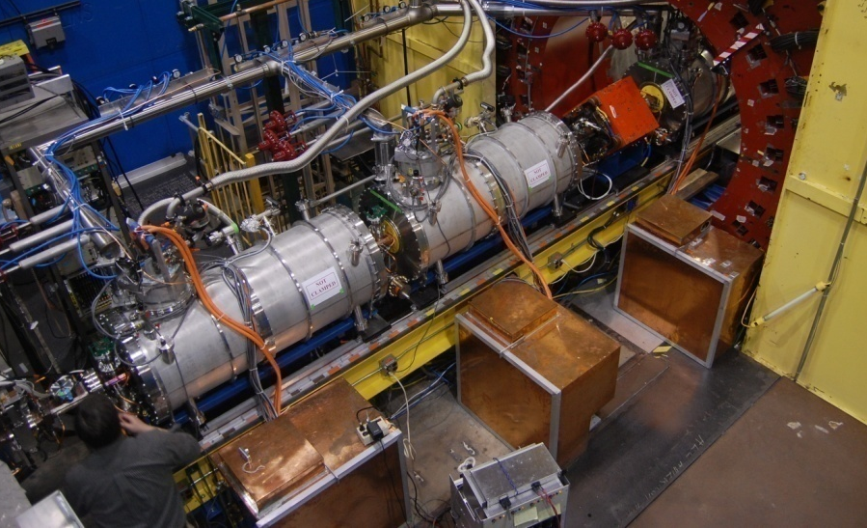
EC Buildup Studies at CESR-TA
Retarding field analyzers
  Measure electron cloud wall flux, with transverse and energy resolution
  Many RFAs (~30) deployed in CESR
  In different environments: drift (field free), dipole, quadrupole, wiggler
  Designs for insertion in confined spaces
  Dedicated RFA measurements
    Under different beam conditions
    In vacuum chambers with different mitigations
    Over time, to observe beam conditioning
    In combination with other EC diagnostics
      Shielded pickups
      Microwave propagation
      In situ SEY measurements
  Large data set, 4+ years of measurements
Main electron cloud experimental regions
  Q15 E/W: drift mitigation experiments
  L3: chicane dipoles, NEG section,
  quadrupole
  L0: wigglers
7/19/2013
7

Slide 8
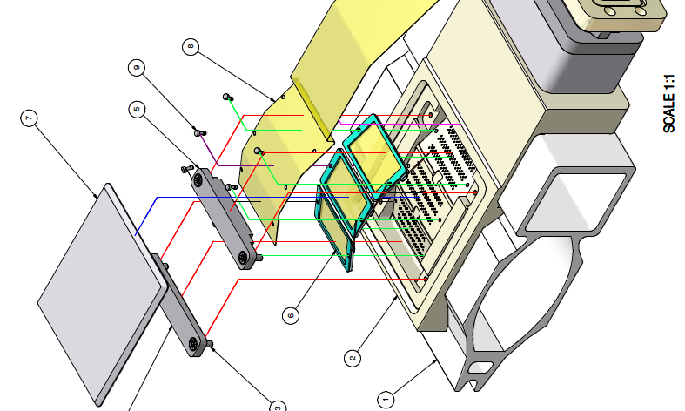
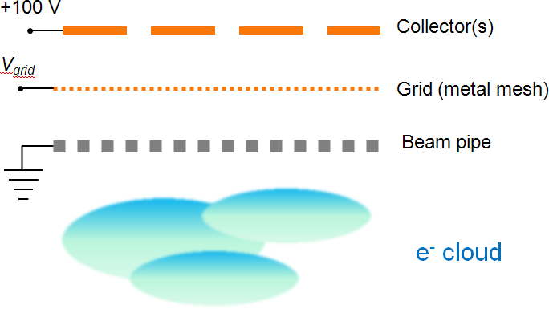
Retarding Field Analyzers
A method to measure the local electron cloud wall flux, and infer the cloud density, energy, and transverse distribution. They consist of:
  Holes drilled in vacuum chamber wall (allow electrons to enter device)
  Retarding grid (reject electrons with E < V_{grid})
    Scan retarding voltage -> integrated energy spectrum (“Voltage scan”)
    Or keep at +50V while beam is filled (“current scan”)
    Additional grounded grids optional
  One or more collectors
    Segmented transversely to study
    spatial distribution

Slide 9
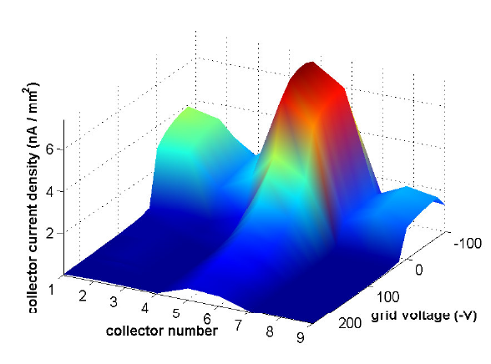
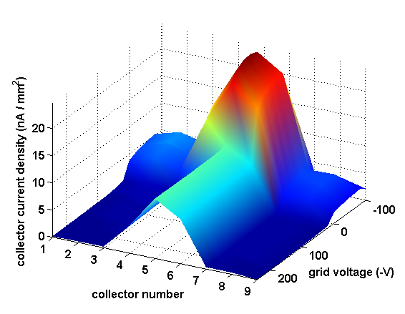
RFA Measurements: Drift
Plot shows voltage scan done with Q15W drift RFA
  Shows collector signal vs retarding voltage (~integral of energy) and collector number (~transverse position)
    left: 45 bunches, 14ns spacing, 2x10^10 positrons/bunch
    right: 20 bunches, 14ns spacing, 1.6x10^11 positrons/bunch
  Broad signal across collectors, peaked at center (beam location)
  High flux of low-energy electrons
  High beam current example shows more signal, especially at high voltage, central collectors
8x10¹⁰ e⁺/bunch
2x10¹⁰ e⁺/bunch

Slide 10
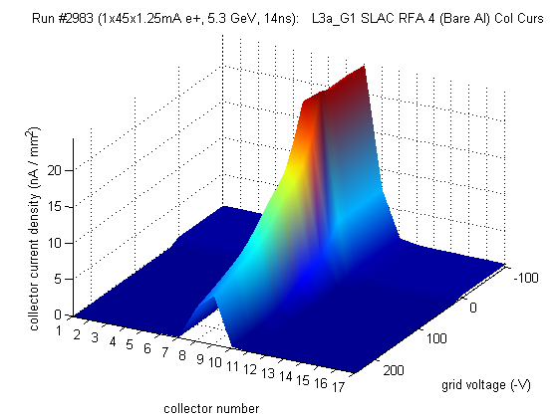
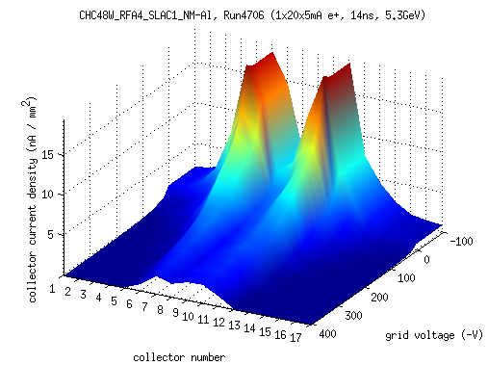
RFA Measurements: Dipoles
Dipole measurements done chicane of four dipoles built at SLAC
  Field is variable, 810 Gauss in plots
Dipole field pins cloud electrons into mostly vertical trajectories
Low current (left): electrons aligned with beam have the most energy -> highest SEY -> most secondaries -> highest RFA signal
High current (right): central electrons have E > Emax, central peak bifurcates
8x10¹⁰ e⁺/bunch
2x10¹⁰ e⁺/bunch

Slide 11
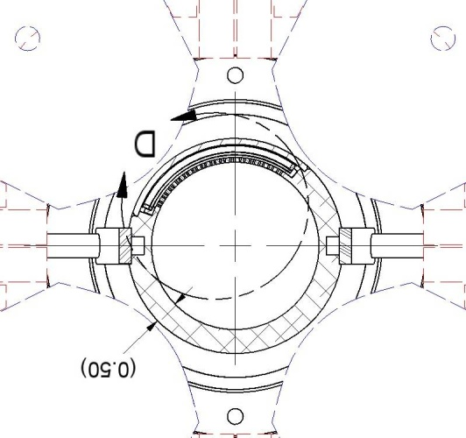
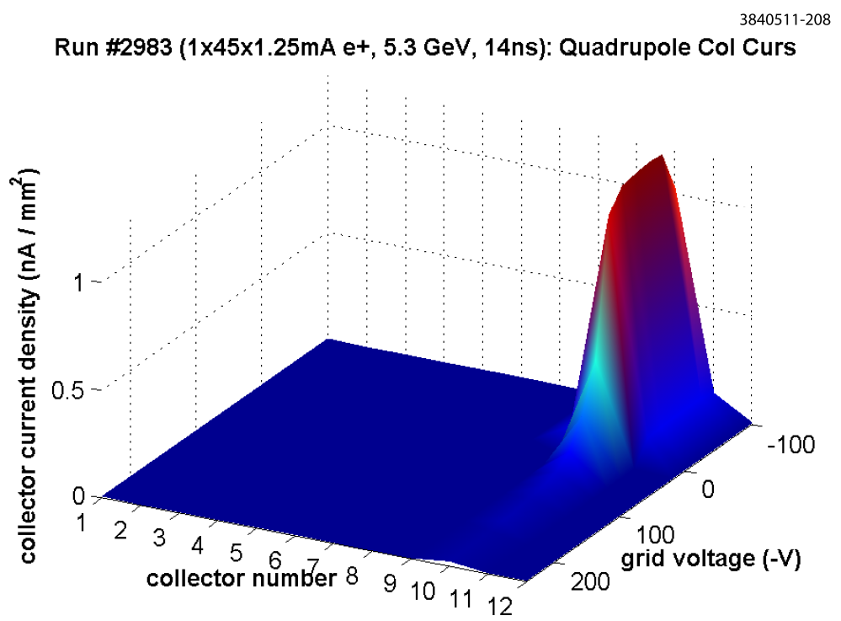
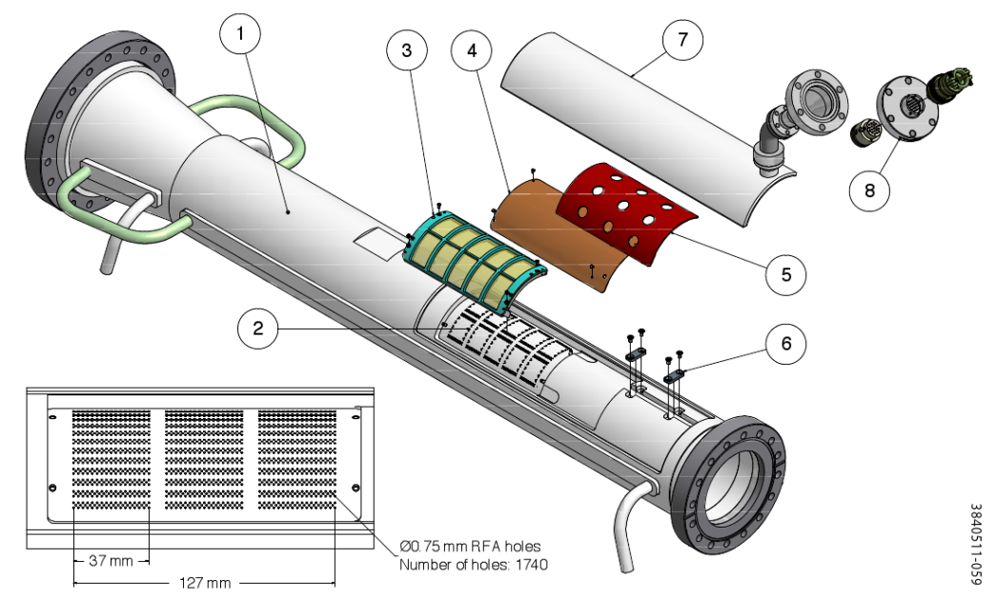
RFA Measurements: Quadrupoles
Detector wraps azimuthally around chamber
Quadrupole guides electrons along field lines
We observe sharp peak in a single collector aligned with quad pole tip
Electrons can remain trapped long after the bunch has passed

Slide 12
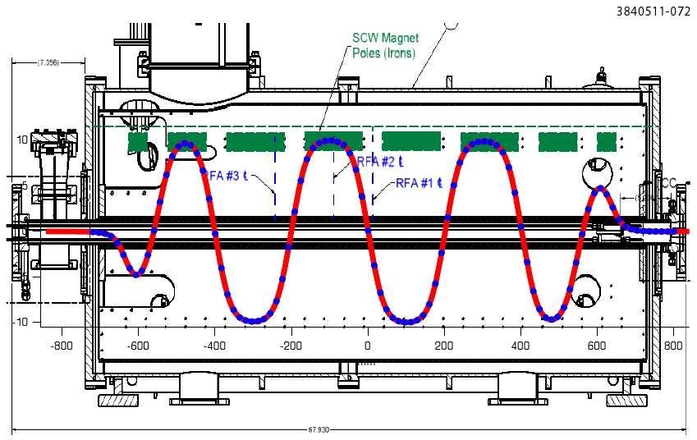
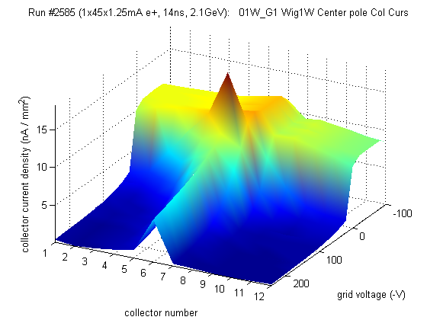
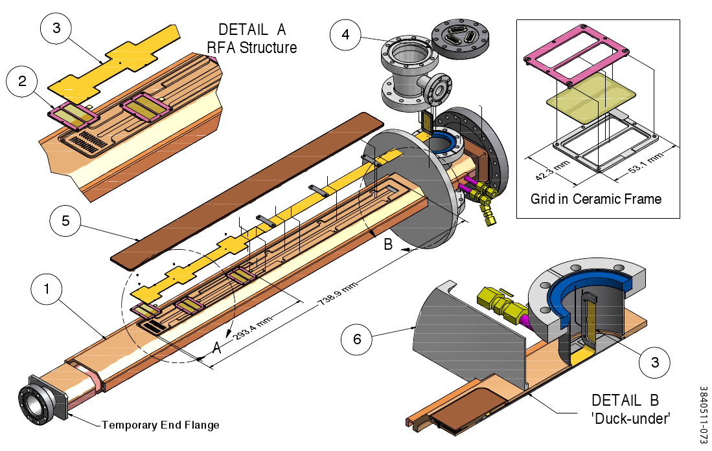
RFA Measurements: Wigglers
L0 straight contains six superconducting wigglers (1.9 T peak field), three with RFAs
RFAs in wiggler pole center, between poles, and intermediate region
  Shown: pole center (~1.9 T dipole)
Signal is fairly broad, though peaked in the center at high energy
Spike at low (but nonzero) retarding voltage, due to interaction between RFA and cloud

Slide 13
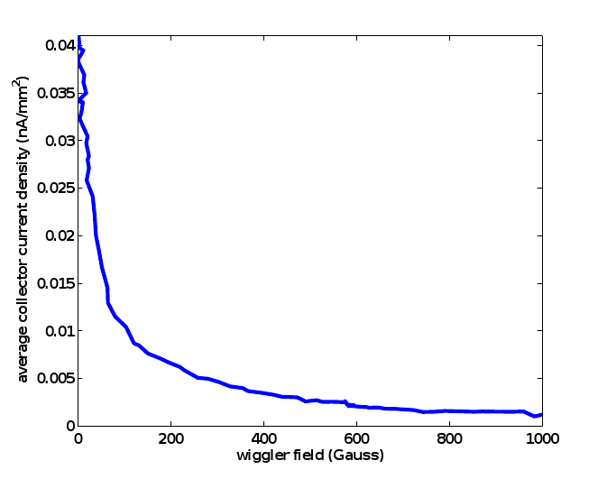
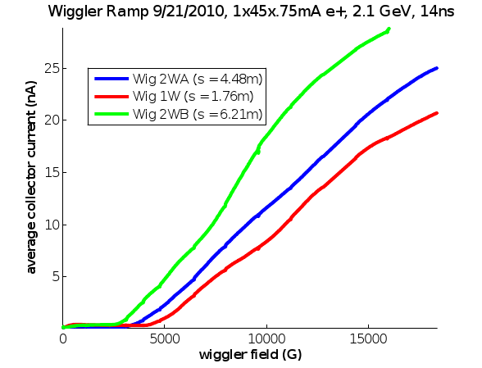
Wiggler Ramp
Plots show collector signal as a function of wiggler field
  Left: Center pole detectors show “turn on” behavior
    Downstream detectors turn on earlier
  Right: Longitudinal field detector signal mostly gone by ~1kG
Future work: correlate with simulations of photon production and scattering
Wiggler 1W
Longitudinal Field

Slide 14
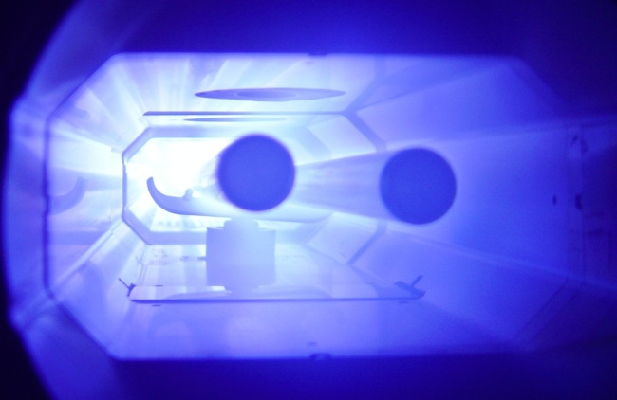
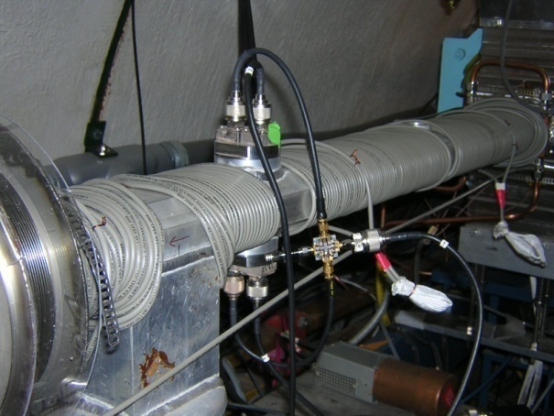
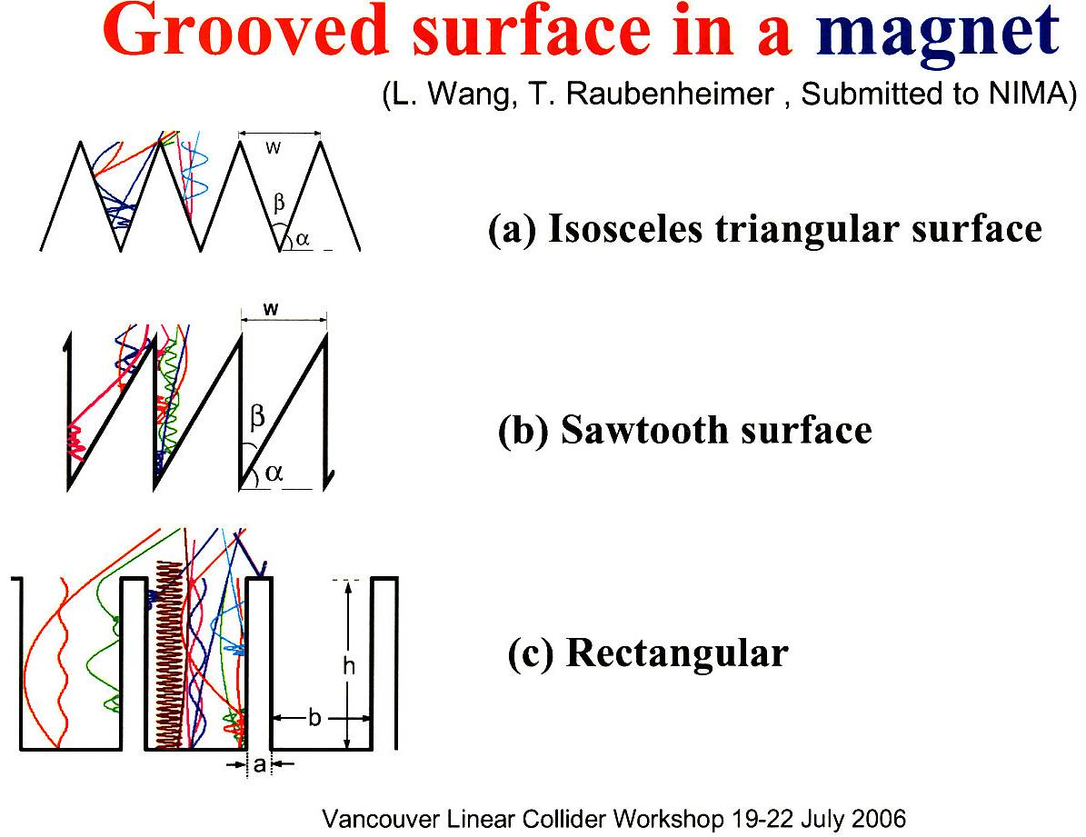
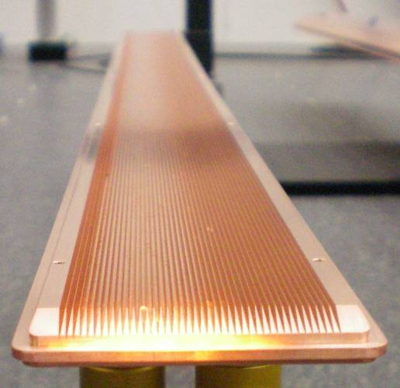
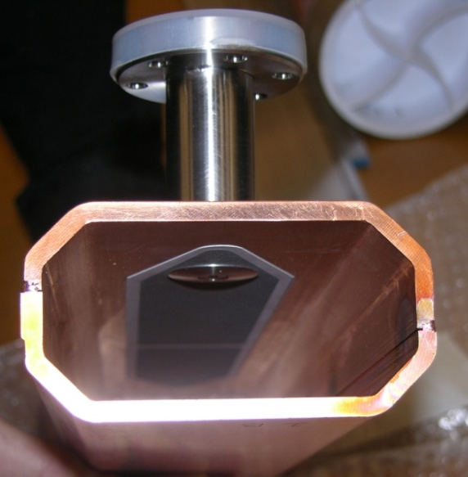
Cloud Mitigation at CESR-TA
TiN Coating
Beam pipe coatings
  Reduce SEY
  Useful in any field element
  TiN, aC, DLC, TiZrV
Solenoid windings (~20 G)
  Trap electrons near chamber wall
  Useful in field free regions
Longitudinal grooves
  Reduce effective SEY in a dipole field
Clearing electrode
  Push electrons out of the way
  Tested in a wiggler
  Need ~400 V
Solenoid Windings
  R_{t}
  (Roundness)
B
  d
  by L. Wang et al.
Grooved Insert for
CesrTA Wiggler
Clearing Electrode

Slide 15
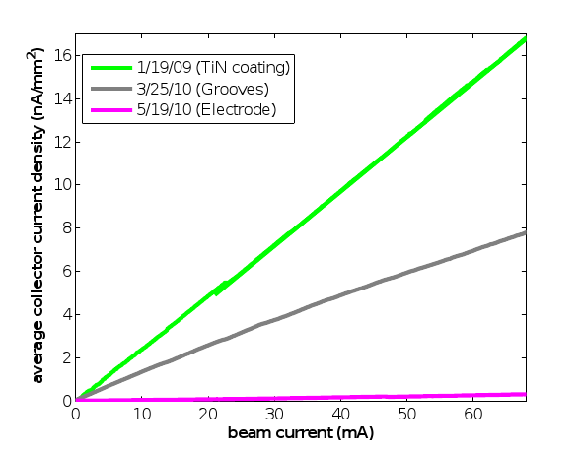
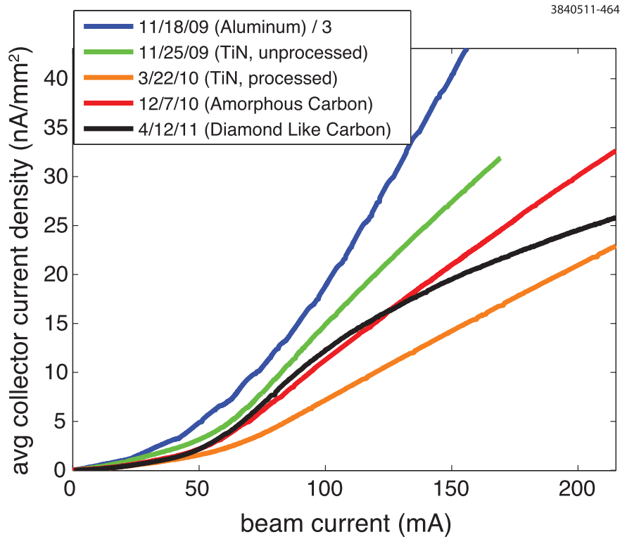
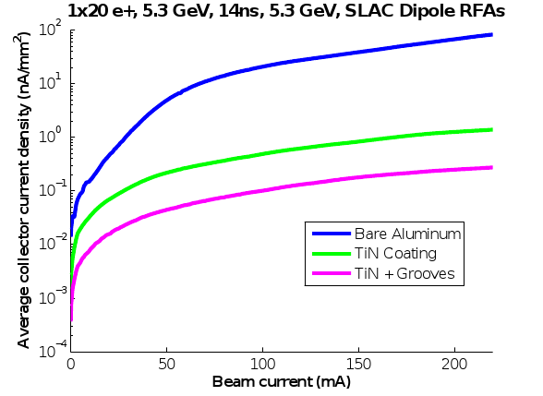
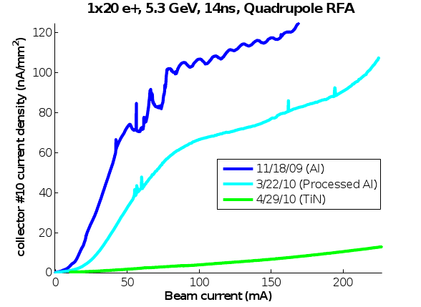
Mitigation Comparisons
Plots show average collector signal vs beam current for 20 bunches e+, 14ns spacing, 5.3GeV
  Drift: Cycling different chambers at the same locations in CESR allows for direct comparison of their effectiveness
    All coated chambers show significant improvement relative to aluminum
    Conditioned TiN shows lowest signal in this case
  Dipole: each chicane magnet has different mitigation
    Coating good, grooves + coating better
  Quadrupole: TiN coating effective
  Wiggler: mitigations cycled through the same two locations in L0 straight
    TiN coating relatively ineffective, clearing electrode clear winner
Quad
Dipole
Drift
Wiggler

Slide 16
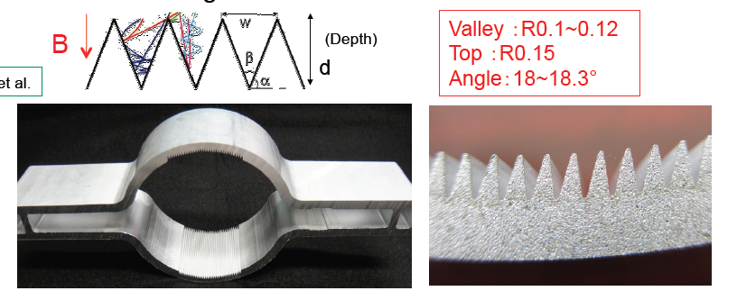
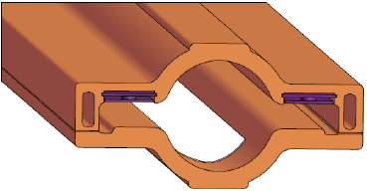
ILC Baseline Mitigation Plan (G. Dugan)
Mitigation Evaluation conducted at satellite meeting of ECLOUD`10
(October 13, 2010, Cornell University)
EC Working Group Baseline Mitigation Recommendation
 | Drift* | Dipole | Wiggler | Quadrupole*
Baseline Mitigation | TiN Coating+ Solenoid Windings | Grooves with TiN coating | Clearing Electrodes | TiN Coating
SuperKEKB Dipole Chamber Extrusion
DR Wiggler chamber concept with thermal spray clearing electrode – 1 VC for each wiggler pair.
Conway/Li
Y. Suetsugu

Slide 17
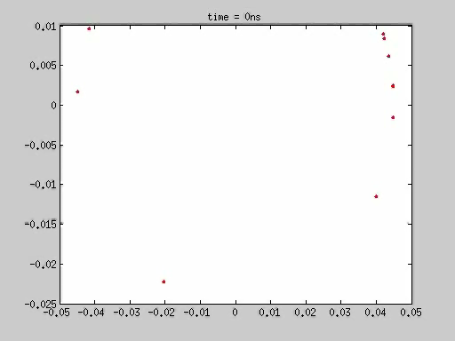
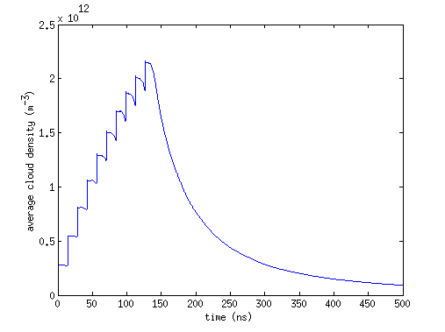
EC Simulations
Quantitative understanding of the cloud requires detailed simulations
Most simulations in this talk were done with POSINST (M. Furman & M. Pivi)
  Electrons represented by macroparticles, tracked under action of beam and space charge
  Primary and secondary electrons generated via probabilistic process
    Photoemission parameters: photon flux and azimuthal distribution, quantum efficiency, photoelectron energy and angular distribution
    Secondary emission parameters: SEY vs incident energy and angle δ(E,θ), secondary electron energy and angular distribution
  Dipole, solenoid, or quadrupole fields
  Well travelled (LBL, ANL, SLAC, LANL, Cornell…)
  Example movie: field free, 10 bunches, positrons, 14 ns spacing
Average cloud density

Slide 18
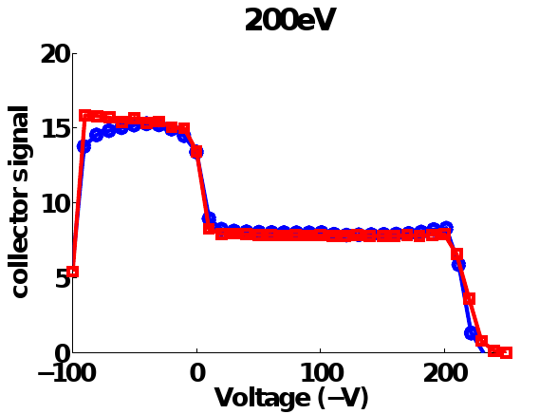
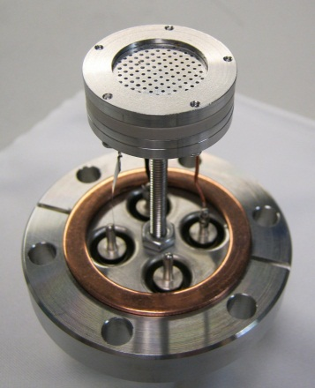
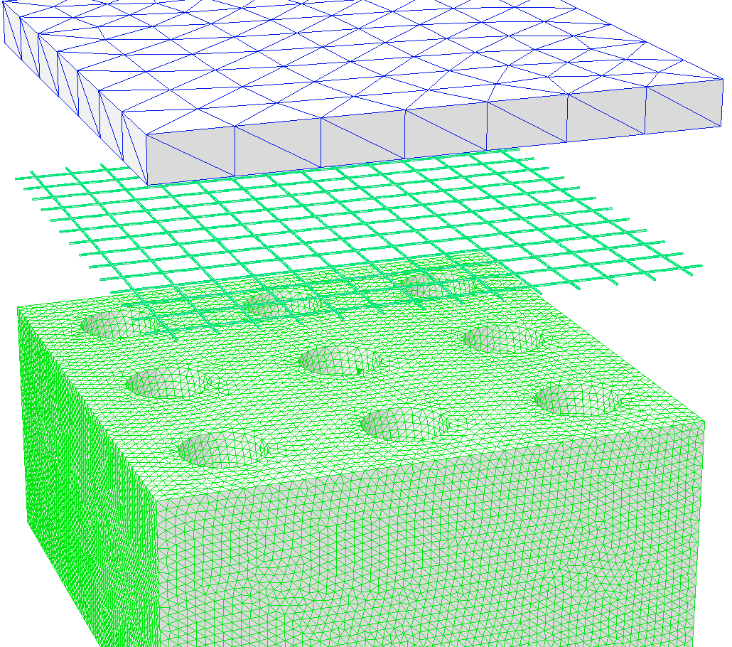
RFA Modeling (Field Free)
Also need a model of the RFA itself
  “Analytical model:” special function, called when particle collides in RFA region
  Maps incident particle position, energy, and angle into collector signals
  Binned by energy and transverse position to simulate a “voltage scan”
Drift RFA model features:
  Cross checked with bench measurements done with a test RFA and electron gun
    Measurement: blue, model: red
  Model of secondary electron production in beam pipe holes, and grid
    Results in enhancement of signal at low/positive voltage
  Realistic fields (from OPERA 3D)
    Results in non-ideal energy cutoff
Test RFA
OPERA3D Model

Slide 19
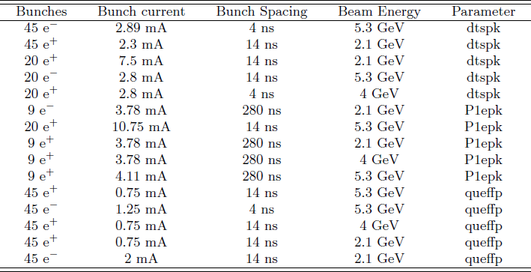
Fitting the Data
Using the “analytical” method, a large quantity of data can be simultaneously fit, using a chi squared minimization procedure
  Choose several different voltage scans, done under a wide variety of beam conditions
  Choose ~3, parameters which have significant/independent effects on the simulations
  Find parameter values which minimize difference between data and simulation
Photon flux and azimuthal distribution taken from SYNRAD3D
SEY parameters taken from in-situ measurements done at CESR
Table shows beam conditions used for one round of fitting, and which parameter was most strongly determined by each
δ_{max}
δ(0)
Q.E.

Slide 20
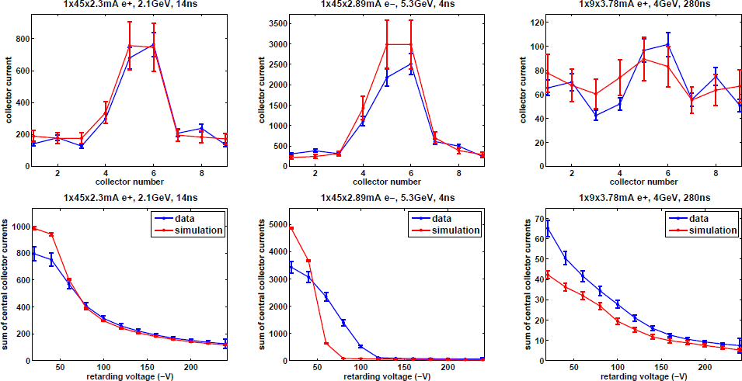
Fit Results I
Top plots show transverse distribution, bottom plots show retarding voltage scan (Aluminum chamber, field free)
  Data in blue, simulation in red

Slide 21
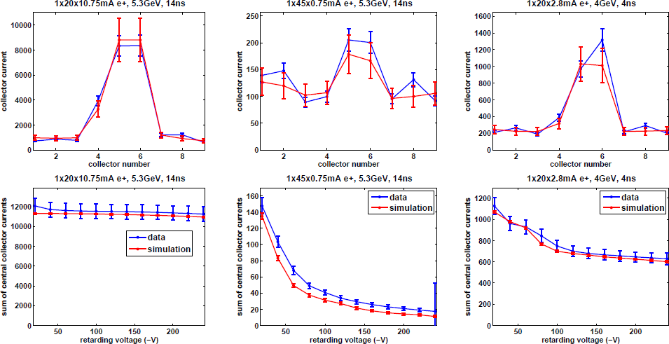
Fit Results II
Top plots show transverse distribution, bottom plots show retarding voltage scan (Aluminum chamber, field free)
  Data in blue, simulation in red

Slide 22
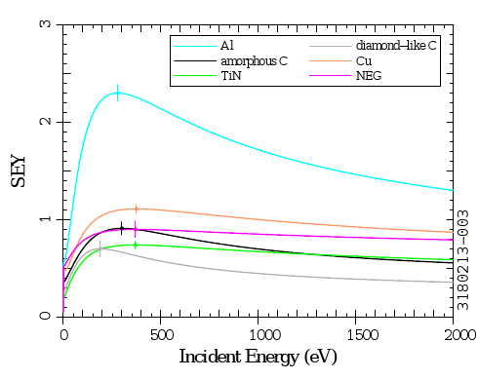
Best Fit Parameters
Have obtained best fit
primary and secondary emission parameters for
all instrumented surfaces
  Table shows results for Al chamber
  Errors on parameters
  derived from covariance
  matrix of fits
Plot shows best fit SEY curves
  TiN and DLC have lowest SEY
    Some question about effect of charging in DLC
  aC has lowest quantum
  efficiency
Parameter | Base | Best Fit
True secondary yield (δ_{ts}) | 1.37 | 2.08 ± .09
Elastic yield (δ₀) | .5 | .36 ± .03
Rediffused yield (δ_{red}) | .2 | .2
Peak yield energy (E_{ts}) | 280 eV | 280 eV
Quantum efficiency, 5.3 GeV | .1 | .11 ± .01
Quantum efficiency, 2.1 GeV | .1 | .08 ± .01

Slide 23
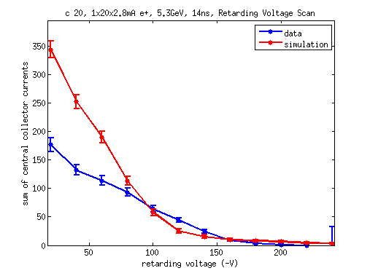
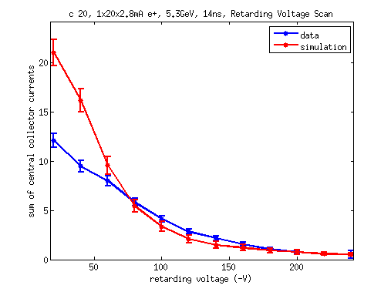
Dipole Simulations
More challenging than drift simulations, due to ~1D nature of electron movement
  Need to model exact locations of beam pipe holes, since RFA depletes the cloud it’s measuring
Plugging in best fit SEY parameters from drift data yields reasonable, not perfect results
  Example plots: SLAC chicane RFAs, 1x20x2.8 mA e+, 5.3 GeV, 14 ns
  Ignoring low energy
  Analytical RFA model probably not good enough
Can still reproduce qualitative behavior…
Al chamber
TiN chamber

Slide 24
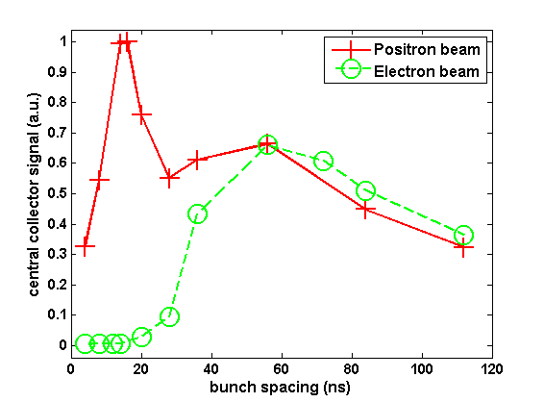
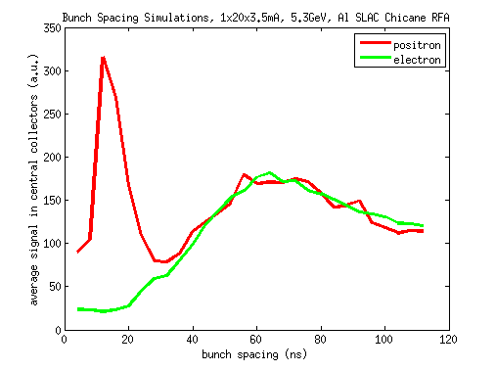
Multipacting Simulations
Looking at data taken vs bunch spacing, 1x20x3.5mA, 5.3GeV
  Aluminum SLAC chicane RFA
Both data and simulation show:
  Broad peak at ~60ns in both electron and positron data
    = time for secondary electron to drift into the center of the chamber
    Sensitive to secondary emission energy (= 1.5 eV)
  strong peak at ~12ns in positron data
    n = 2 resonance
Simulation
Data

Slide 25
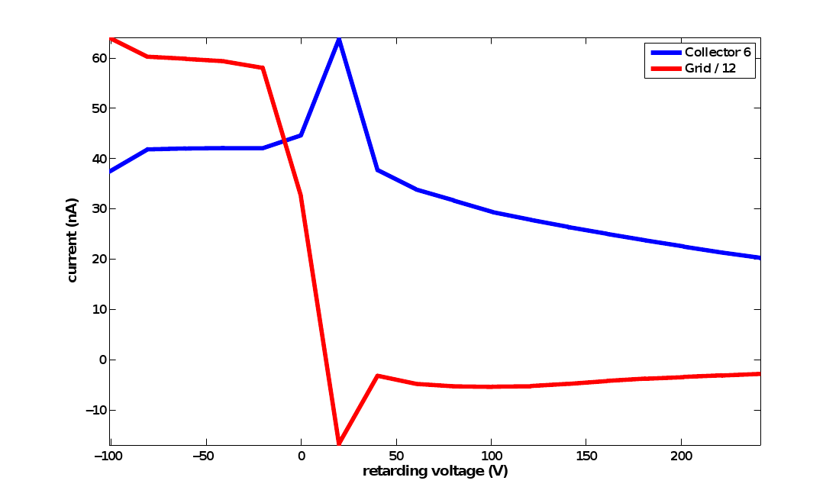

Full Particle Tracking Model
Analytical model assumes no significant interaction between RFA and cloud
  Misses some features of the data in high magnetic fields
  Ex: In the wiggler data, we observe an anomalous spike in current at low (but nonzero) retarding voltage
    Due to a resonance between the voltage and bunch spacing
    Extra signal comes from secondaries produced on the retarding grid
  Need full particle tracking model to observe this in simulation
    Track electron in RFA, using native POSINST routines
    Need to do a separate simulation for each retarding voltage
Data
Simulation

Slide 26



Quadrupole Simulations
Cloud particles follow field lines
Also predict most signal will be in collector 10
Suggest long term trapping of cloud
  Multi-turn simulation needed to reach equilibrium
M. Furman

Slide 27
Conclusions
Electron cloud is ubiquitous in accelerators
  Always bad, often a limiting factor
  Major issue for next generation machines
CESR-TA is (among other things) the most extensive investigation of electron cloud in a single machine to date
Many RFAs have been installed in CESR
  Drifts, dipoles, quadrupole, wigglers
  Different mitigations: coatings, grooves, clearing electrode…
  Measurements taken under a wide variety of beam conditions
Quantitative analysis is challenging, requires detailed model of the RFA
  For drift data, fits generally successful across wide variety of beam conditions
  In field regions, qualitative phenomena reproduced
Main accomplishments
  Detailed evaluation of different materials/mitigations
  Validation of buildup codes
  Input for future machines
  Holistic picture of electron cloud in an accelerator

Slide 28
Thanks!
G. Dugan, M. Palmer, D. Rubin, M. Furman
CESR-TA group: L. Bartnik, M.G. Billing, J.V. Conway, J.A. Crittenden, M. Forster, S. Greenwald, W. Hartung, Y. Li, X. Liu, J. Livezey, J. Makita, R.E. Meller, S. Roy, S. Santos, R.M. Schwartz, J. Sikora, and C.R. Strohman
Collaborators:
  LBL: C.M. Celata, M. Venturini
  SLAC: M. Pivi, L. Wang
  APS: K. Harkay
  CERN: S. Calatroni, G. Rumolo
  KEK: K. Kanazawa, S. Kato, Y. Suetsugu
You, for your attention

Slide 29
Bonus Slides

Slide 30

Beam-induced multipacting (BIM)
Low energy electrons near chamber wall kicked by positron beam, given energy E
Reach opposite wall in time Δt, generate secondaries determined by δ(E)
Resonant buildup if Δt = bunch spacing and δ(E) > 1
Has been observed in RFA data

Slide 31


Bifurcation of Central Peak
Observe splitting of central peak as electrons in the center of the chamber gain energy > peak SEY
  Plots show collector current vs beam current and collector number
  Qualitatively observed in both data (right) and simulation (left)
  Distance between peaks sensitive to Emax
Simulation
Data

Slide 32

Coherent tune measurements (G. Dugan)
A large variety of bunch-by-bunch coherent tune measurements have been made, using one or more gated BPM’s, in which a whole train of bunches is coherently excited, or in which individual bunches are excited.
These data cover a wide range of beam and machine conditions.
The change in tune along the train due to the buildup of the electron cloud has been compared with predictions based on the electron cloud simulation codes (POSINST and ECLOUD).
Quite good agreement has been found between the measurements and the computed tune shifts. The details have been reported in previous papers and conferences.
The agreement constrains many of the model parameters used in the buildup codes and gives confidence that the codes do in fact predict accurately the average density of the electron cloud measured in CesrTA.
Vertical
Horizontal
2.1 GeV positrons, 0.5 mA/bunch
Black: data
Blue, red, green: from POSINST simulations, varying total SEY by +/-10%

Slide 33

Photon reflectivity simulations (G. Dugan)
Since synchrotron radiation photons generate the photoelectrons which seed the cloud, the model predictions depend sensitively on the details of the radiation environment in the vacuum chamber. To better characterize this environment, a new simulation program, SYNRAD3D, has been developed.
This program predicts the distribution and energy of absorbed synchrotron radiation photons around the ring, including specular and diffuse scattering in three dimensions, for a realistic vacuum chamber geometry.
The output from this program can be used as input to the cloud buildup codes, thereby eliminating the need for any additional free parameters to model the scattered photons.
SYNRAD3D predictions for distributions of absorbed photons on the CesrTA vacuum chamber wall for drift and dipole regions, at 5.3 GeV.
polar angle
chamber wall
Direct radiation
Direct radiation

Slide 34

Analytical RFA Model

Slide 35

Fit Results III
Top plots show transverse distribution, bottom plots show retarding voltage scan

Slide 36

Fit Results IV
Top plots show transverse distribution, bottom plots show retarding voltage scan

Slide 37


Wiggler Ramp
Data taken during wiggler ramp on 12/18/2010
  Plots show signal in RFA and TEW detectors as a function of wiggler field
    RFAs = solid lines, Resonant TEW = dotted lines, Transmission TEW = dashed lines
    Red = further downstream, violet = further upstream
    All signals normalized to 1 at peak wiggler field
  Further downstream detectors turn on first
    TEW 2W-2W ~= TEW 0W-2W ~= RFA 2WB < RFA 2WA < RFA 1W ~= TEW 0W-0W < TEW 0W-2E
    RFA and TEW turn on points are roughly consistent

Slide 38
Secondary Electron Yield
Generation of secondaries is determined by the secondary emission yield (SEY) function δ(E):
  Characterized by peak value δ_{max} at E = E_{max}
  Low energy yield δ(0): determines survival time of cloud during train gap
    Typical lifetime ~100 ns
  Typically, δ_{max}~1–3, and E_{max}~200-400 eV, δ(0) ~ .5
Many materials “condition” with electron cloud bombardment
  Results in lower δ_{max}, higher E_{max}
N. Hilleret et al, PAC99
δ_{max}
total
secondary
electrons
photo-
electrons
Ε_{max}

Slide 39


Simulation Parameters
Many (~40) parameters in POSINST, but a few stand out
Photoelectron density determined by quantum efficiency
  Also: photon flux and azimuthal distribution, photoelectron energy and angular distribution
SEY has three components
  “True” secondaries: production peaks at Emax, generated with low energy
    Most important for cloud buildup
  “Elastic” secondaries: production peaks at E = 0, same energy as primary
    Determines survival time of cloud during train gap
  “Rediffused” secondaries: production peaks at E = ∞, can have high energy
  Also important: secondary electron energy and angular distribution
δ_{max}
Ε_{max}

Slide 40




Cyclotron Resonances
Increase in cloud density when bunch spacing is a multiple of the cyclotron period
  Since all beam kicks are in the same direction
Data: 45 e+ bunches, 4ns, 5 GeV
  Observe peaks in Al chamber, dips in coated chambers
Both reproduced by simulation
  Dip in coated chamber due to decrease in RFA
  efficiency for large cyclotron radius
Simulation
Data
Simulation

