Slide 1
Vacuum R&D Activities in Support of
Cornell Electron Storage Ring Test Accelerator and ERL-based Hard X-Ray Light Sources
Yulin Li
Cornell Laboratory for Accelerator-based ScienceS and Education (CLASSE)
Cornell University, Ithaca, New York, USA
Supported by: DOE (contract # DE-FC02-08ER41538) and NSF (PHY-0734867 & PHY-0131508)

Slide 2
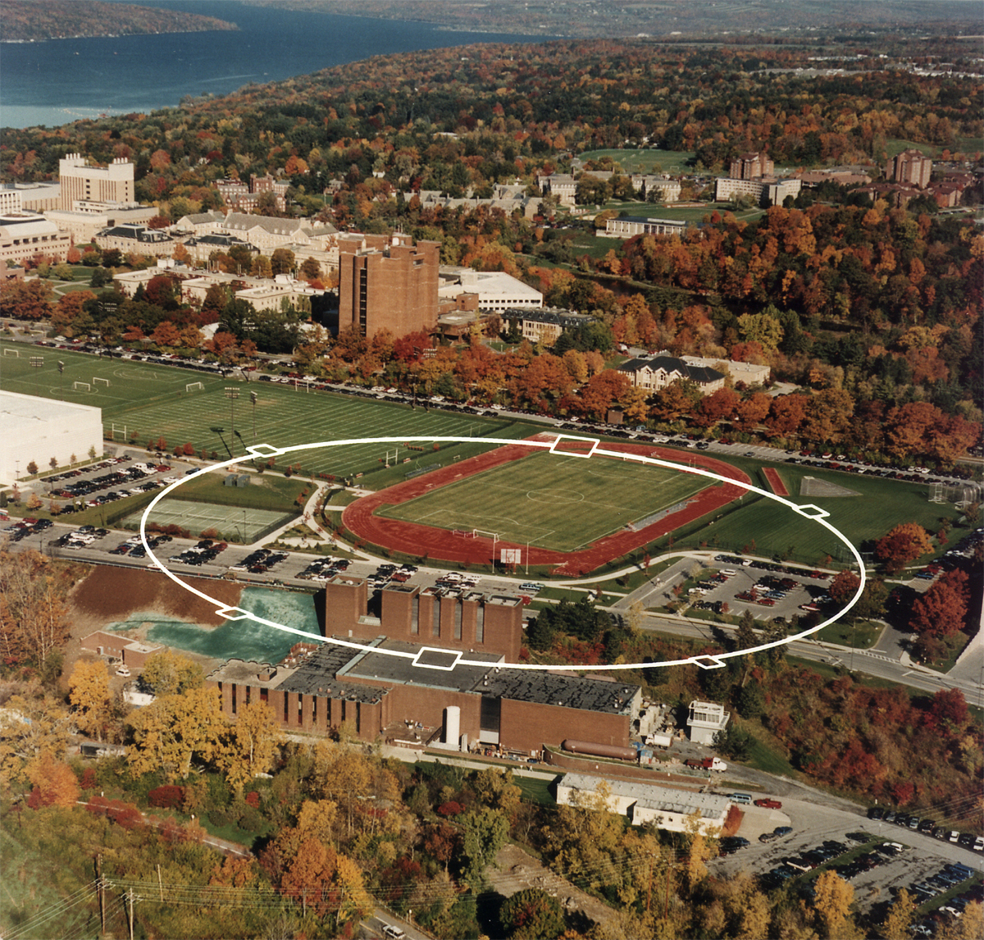
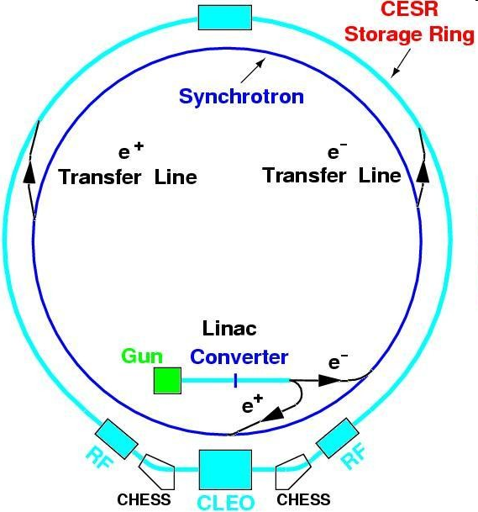
Current Research Programs @ CLASSE
Cornell High-Energy Synchrotron Sources as a user facility
Prototype ERL photo-cathode injector development
CesrTA for ILC DR Global Design Efforts
Superconducting RF R&D (ERL, ILC, etc.)

Slide 3
The Cornell ERL Project

Slide 4
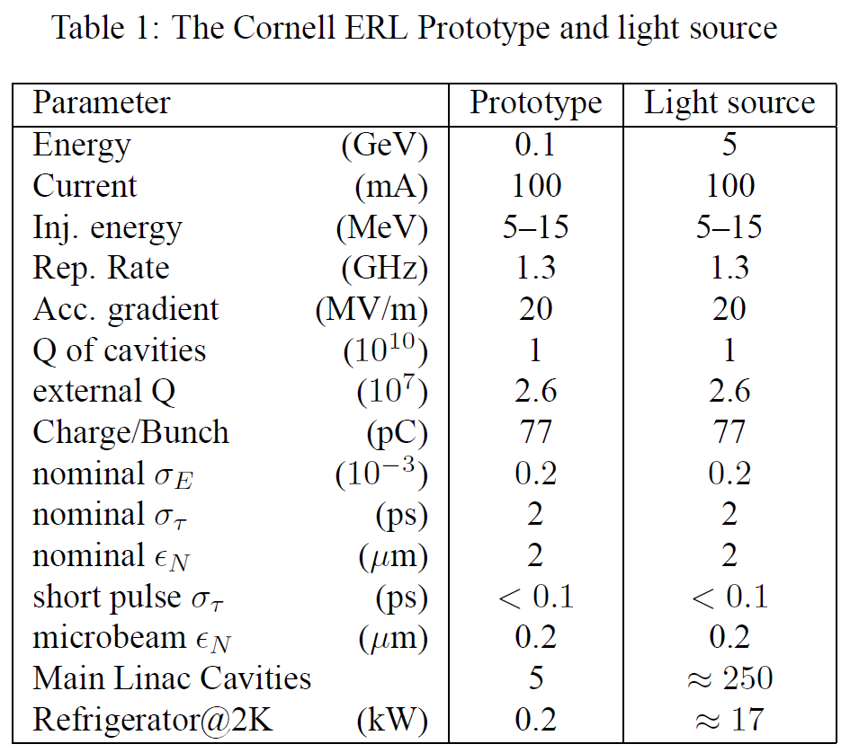
Cornell Prototype ERL Photo-cathode Injector
After prolonged waiting, finally received funding (~20M$) from US NSF in 2005. (Phase 1A)
Also received significant funding (12M$) from the New York State and Cornell
Phase 1B funding was also rewarded early this year.
Key components:
→ DC Photo-cathode gun
→ SC RF cavity cryo-module
→ Transport beamlines
→ Beam instrumentation
→ Beam Dumper

Slide 5
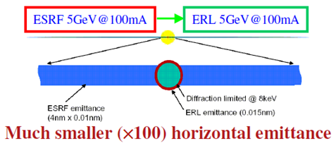
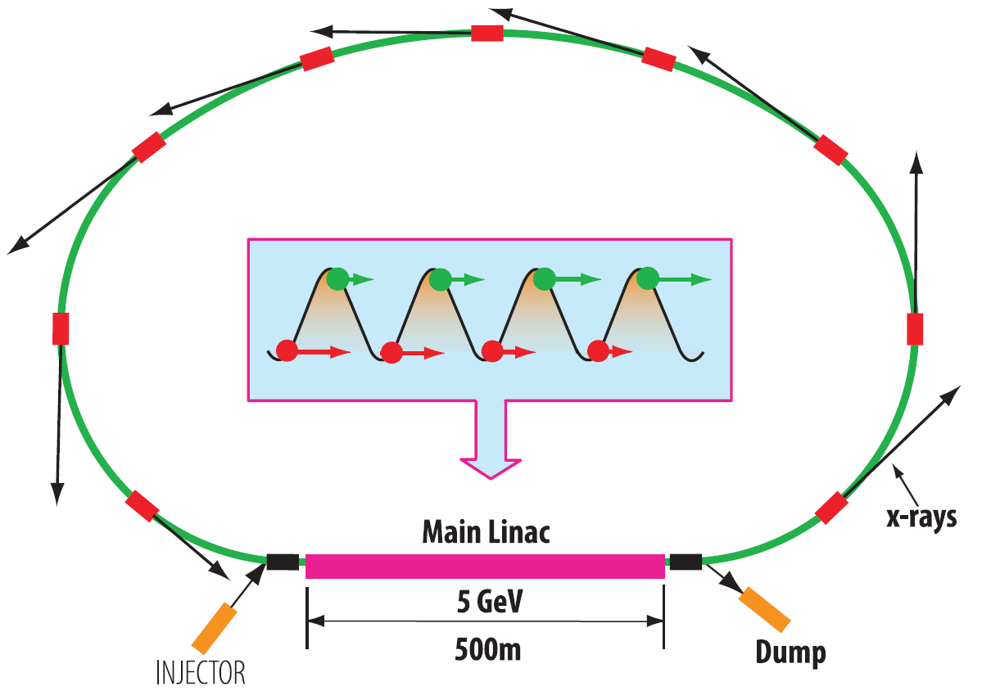
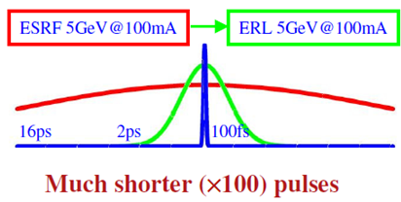
ERL: The Concept and Promises
The Concept
A CW Electron beam is generated from a photo-cathode injector
Electron beam is accelerated in a superconducting LINAC
After one-pass through X-ray insertion device, the electron beam energy is recovered in the LINAC, and then dumped

Slide 6
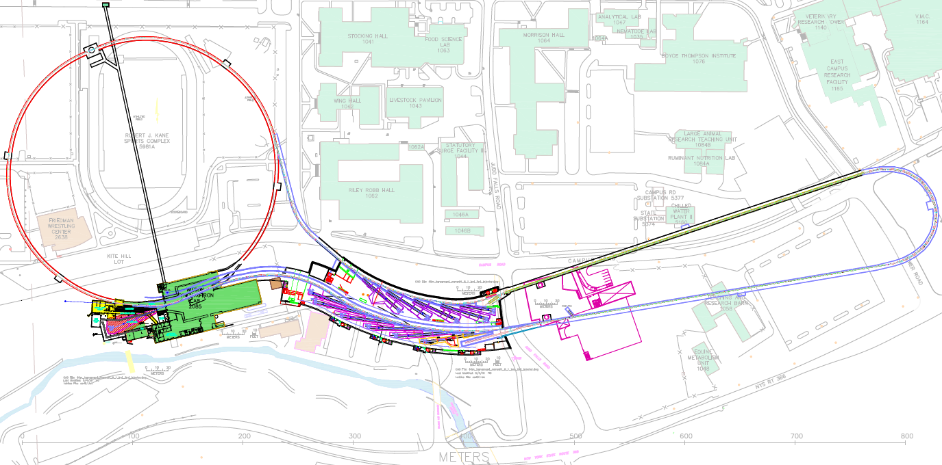
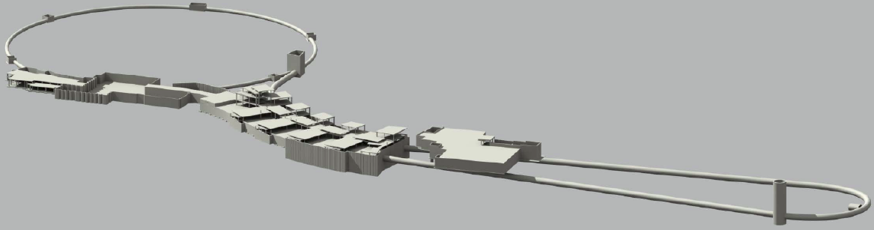
ERL @ CESR
1. Injector; 2. SC Linacs; 3. Return Arcs
4. IDs & X-Ray Beamlines; 5. CESR as a return loop
6. Beam Dump; 7. Cryo-Plant
5
7
2
1
4
3
6
Challenges:
A high current (100 mA) photo-cathode electron source (high QE, extreme-high vacuum system)
A high-power laser with very demanding specifications
Super-conducting RF cavities with high accelerating gradient
Laser (mode-locked) and RF system stabilities and synchronization
Electron beam emmittance preservation through transport, especially at low beam energies

Slide 7
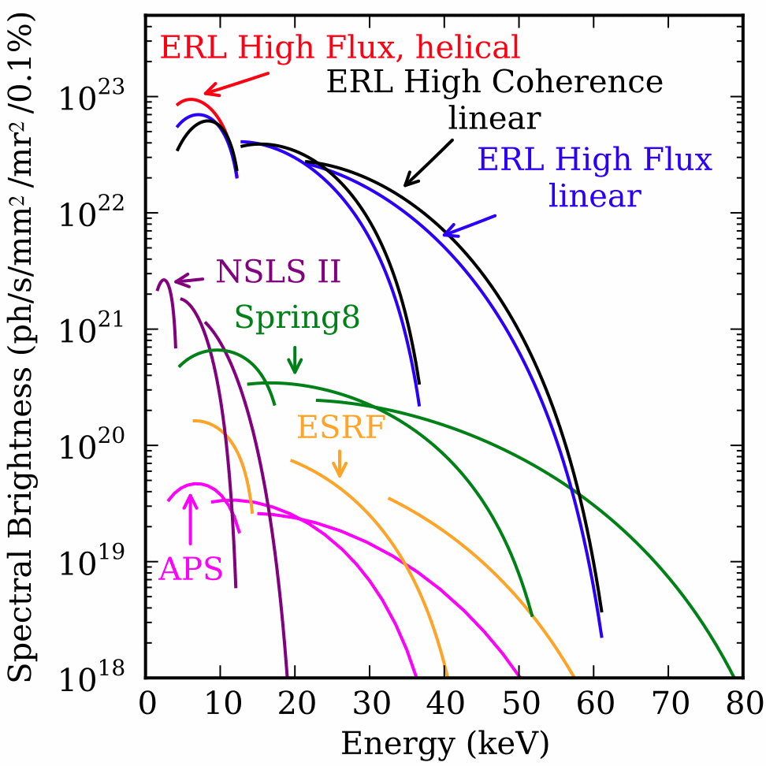
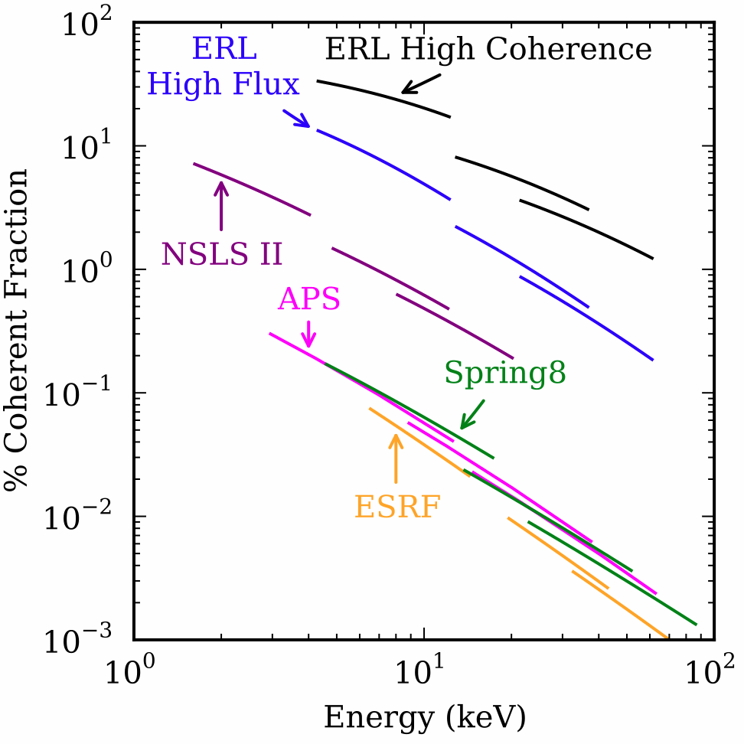
Projected CERL Performances

Slide 8
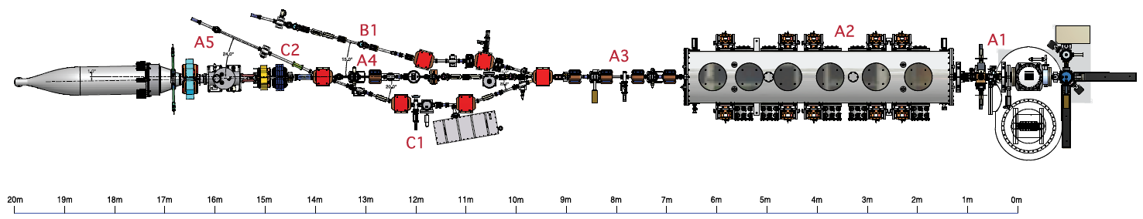
Prototype Injector with DC Photocathode
4
1
5
3
2
1
DC Photo-cathode gun
2
keV Beamline w/ Laser box, buncher, SLs, etc.
3
10-cell SC RF cavity Cryo-module
5
600 kW Beam Dump
4
MeV Beamlines w/ full suite of beam instrumentation
All Beamline components must be RF shielded

Slide 9
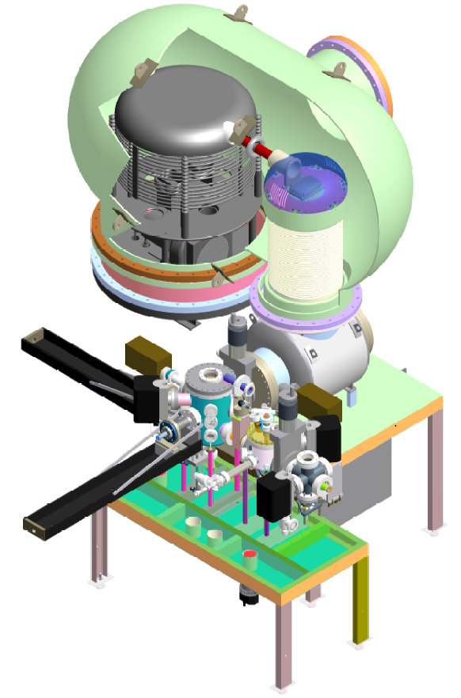
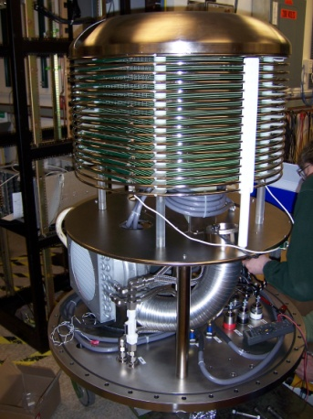
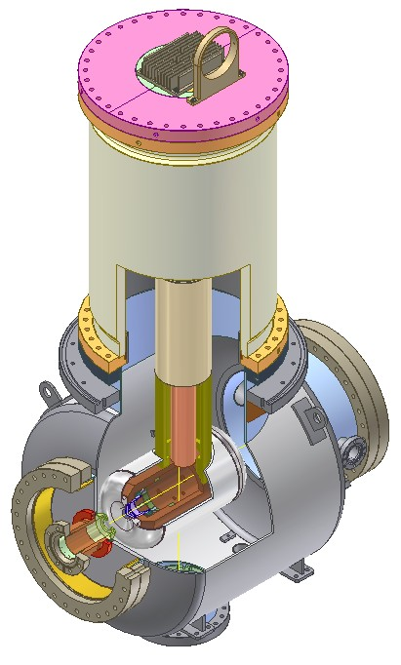
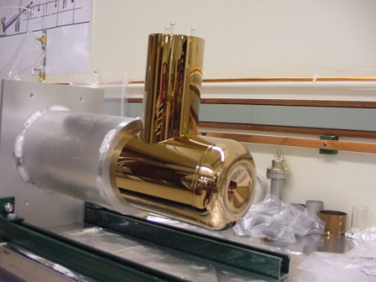
DC Photocathode Gun w/ Load-Lock
SF₆ Tank
HV Supply
Ceramic
GaAs Activation Chamber
100 mA @ DC V up to 750 kV
Achieve high quantum efficiency
Suppress field emission
XHV for long cathode lifetime
→ Material outgassing treatment
→ Massive pumping (Ion Pump + NEGs)
GaAs Cleaning Chamber
Load-lock

Slide 10
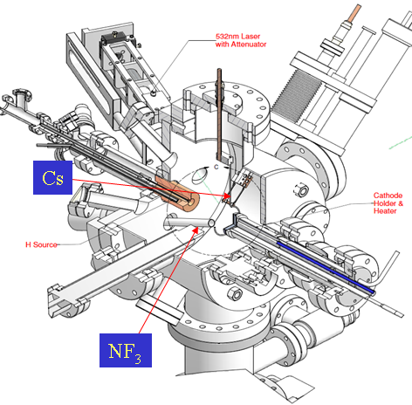
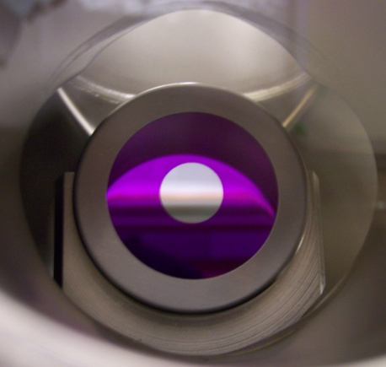
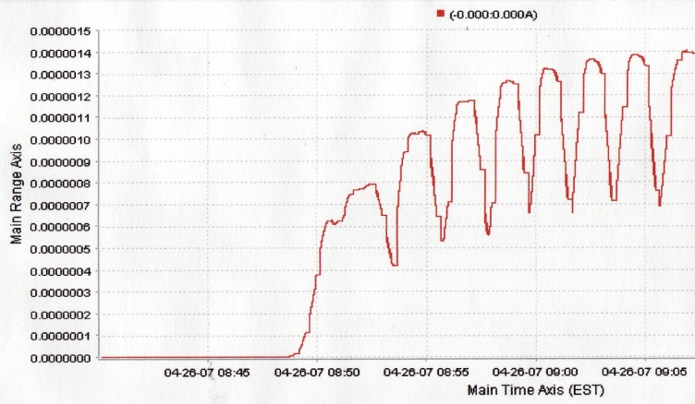
GaAs Photocathode Activations
A QE system used in early stage for cathode activation studies.
Atomically clean of a single crystalline GaAs surface is achieved via atomic hydrogen beam and thermal desorption.
A Q.E.~20% routinely achieved via alternative Cs/NF₃ doses (so-called yo-yo method)
GaAs Preparation
Degrease
Boiling in Trichloro-Ethylene
Ultrasonic in Acetone then methanol
Soak in methanol till etching
Wet chemical cleaning
H₂SO₄ : H₂O₂ : H₂O (20: 1 : 1 )
Rinse with DI-Water

Slide 11
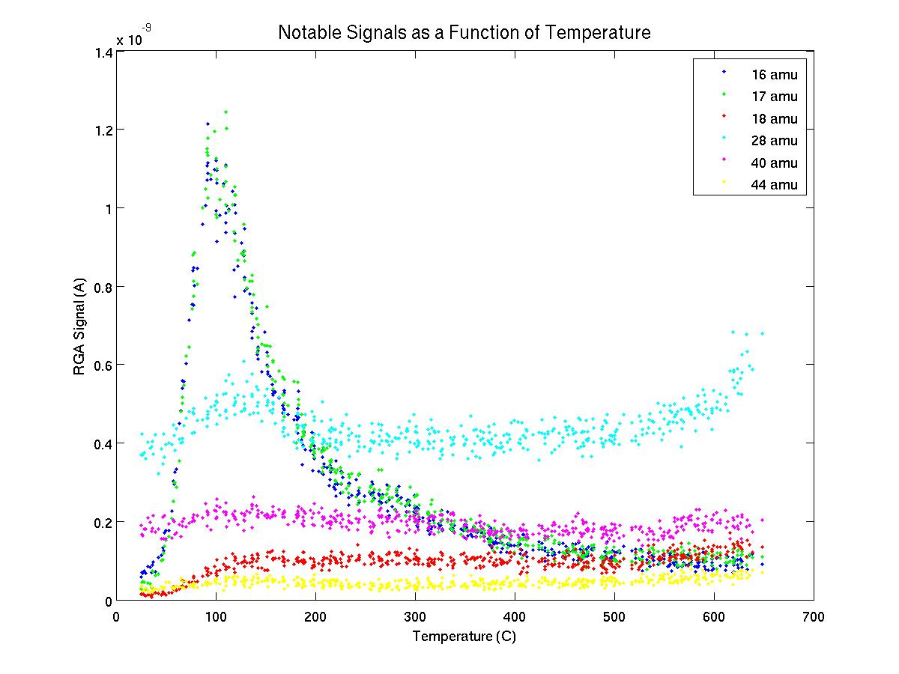
GaAs Photocathode Dark Lifetime
Cathode at high Q.E. appears to be very unstable
The initial fast decay seems not related to vacuum conditions
Suspecting the initial decay due to unstable surface state
NH₃ desorption from TDS indicating residual nitrogen on activated surface
SR XPS studies confirmed non-dissociated NF_{x} on Cs/NF₃ activated surface
NH₃ ~110°C
Study in progress:
→ Sources of nitrogen?
→ Activating using XeF₂ ?
Started working on other types of photo-cathodes – Multi-alkalis, CsSb, CsKSb, …,…

Slide 12
Achieving XHV in Photocathode Gun
Ultra-Low Outgassing in Stainless Steels by Mild Heat Treatment
The heat-treated (400°C bake in air for a duration of up to 100 hr) all stainless steel materials for the gun chamber.
SST outgassing rates below 10⁻¹³ torr·l/s·cm² achieved with F₀>3, a dimensionless time scale, F_{0.}
t – heating time; d –thickness
D=D₀ exp(-E_{d} /kT) – Hydrogen diffusion constant
Ref. C. D. Park, S. M. Chung, Xianghong Liu, and Yulin Li , J. Vac. Sci. Technol. A 26 1166 (2008)

Slide 13
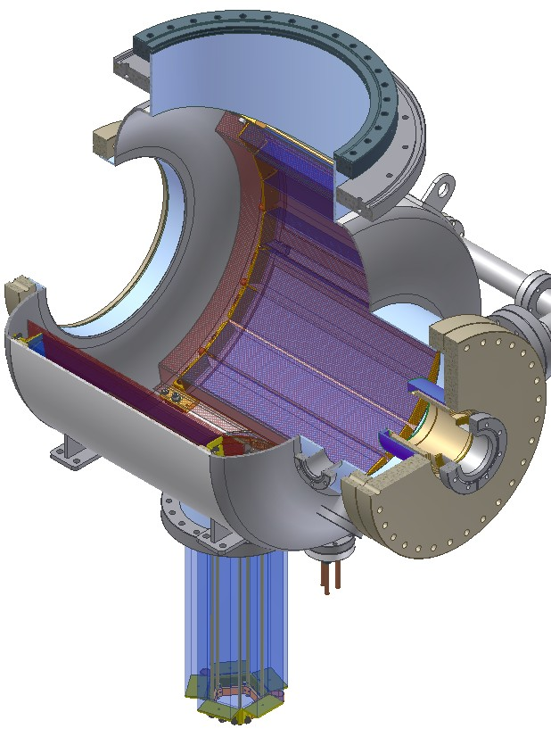
Max. Pumping in the Photocathode Gun
The gun chamber is lined with 12 SAES WR 1650 st707 NEG modules
5 SAES WR 950 st707 NEG modules inserted into a 400-l/s noble diode ion pump
Total H₂ pumping speed exceeding 10,000 l/s !!
However:
Base pressure ~ 5x10⁻¹² torr
Limited by equilibrium H₂ pressure of the NEGs and ion pump ??
NEG Modules
400 l/s Ion Pump

Slide 14
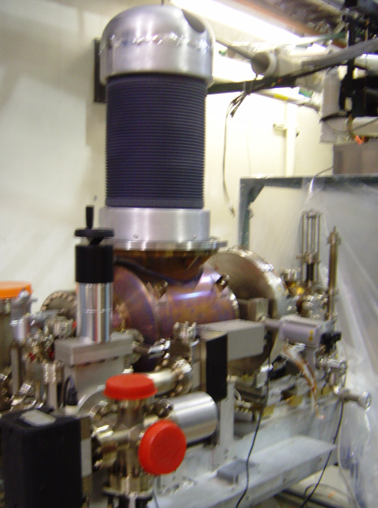
New Gun Ceramic Development I
Present gun ceramic is only with inner surface resistive coating
High energy field-emitted electron penetrate and accumulate in non-conductive bulk, resulting ‘punch-through’
The gun ceramic is now being replaced with a new ceramic with bulk resistivity

Slide 15
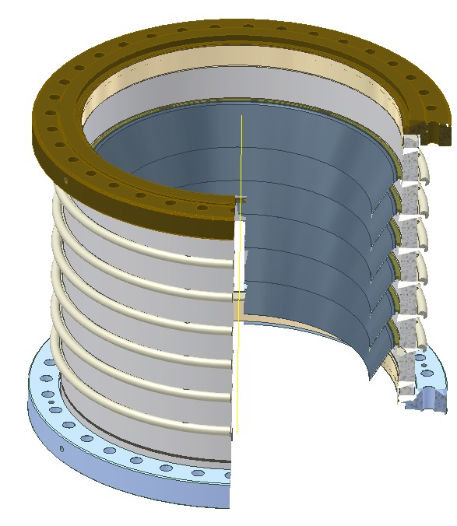
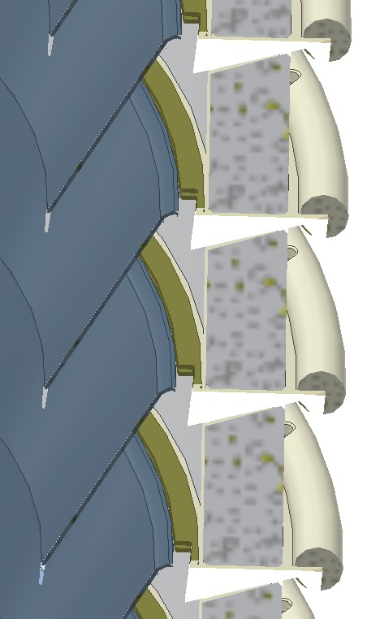
New Gun Ceramic Development II
Segmented ceramics is under development
Guarding rings protect ceramic from field-emit electrons

Slide 16
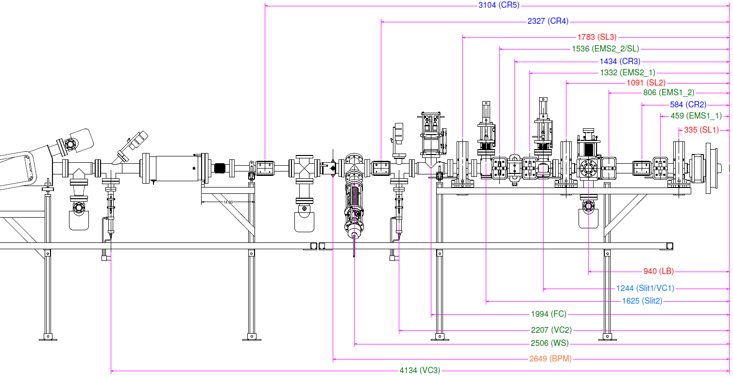
Initial Gun and Beam Instrument R&D
Strip-line BPM
Solenoids
Viewers
Dump
Gun
Wire Scanner
EMS Slits
A 6-m short beam line was set up for the photo-cathode gun, the laser system, and beam instrumentation development
All beampipes were NEG coated to handle gas from the dump
Reached 22 mA maximum beam current with Ar⁺ laser

Slide 17
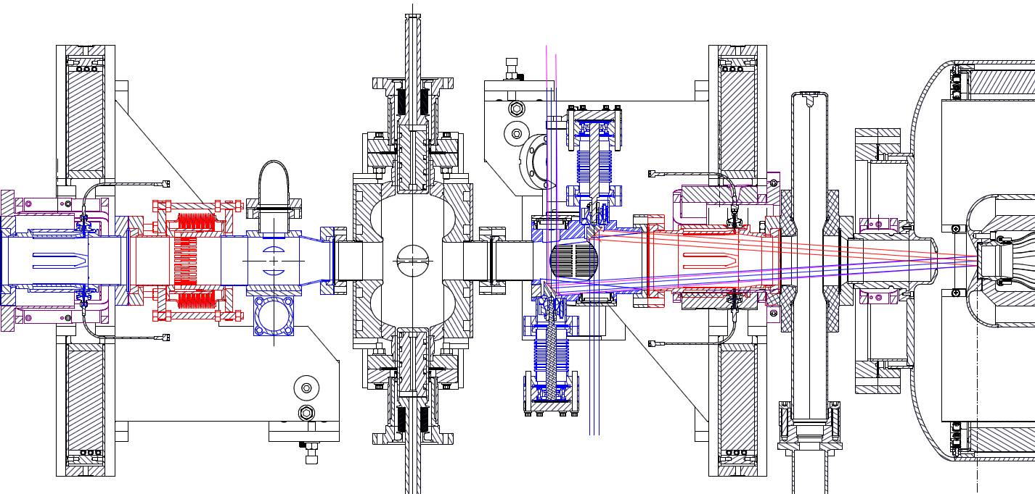
Injector Prototype -- keV Beamline
4
3
2
5
2
1
1 Meter
1
DC Photo-cathode gun
2
BPM/Corrector/Solenoid Packages
3
Laser Entrance with adjustable in-vacuum mirrors
4
RF Buncher
5
RF Shielded Sliding Joint and Beam Profile Viewer

Slide 18
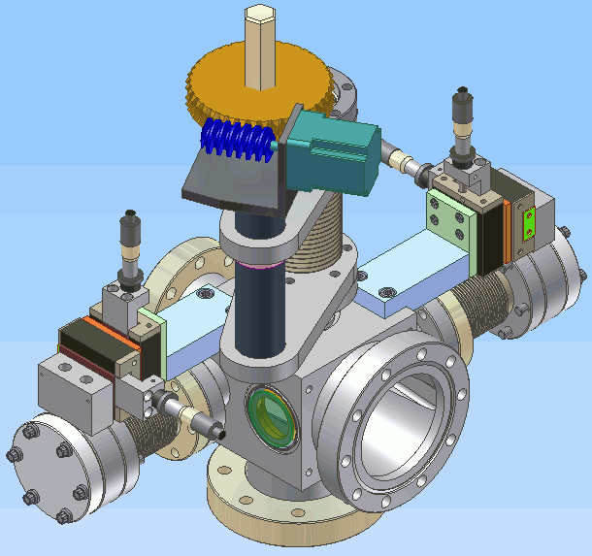
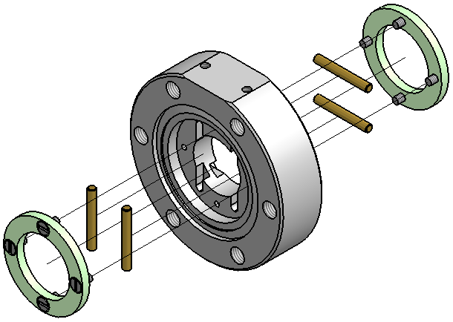
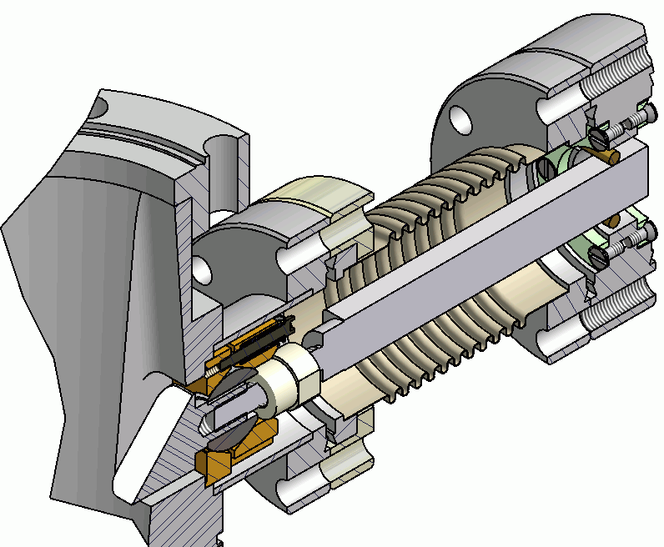
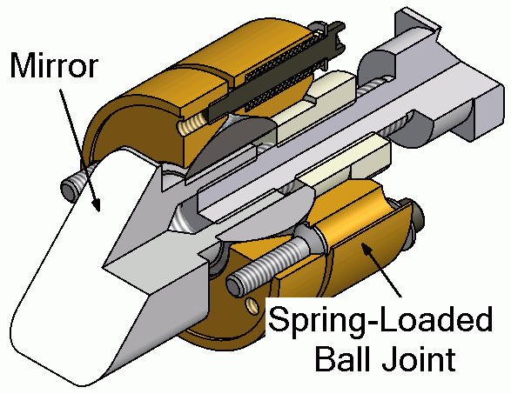
Laser Entrance w/ Adjustable in-Vacuum Mirrors
Inspection Mirror
Roller-pin joints
Weld-on windows w/ WB AR coating
SST mirror w/ WB HR coating
The UHV-compatible laser entrance/exit box is equipped with a pair of in-vacuum stainless steel mirrors. Both mirrors have ±2° angular adjustment in horizontal and vertical planes
It was difficult to achieve required optical finish on the SST mirror faces, due to the micron sized imperfection in the materials.

Slide 19
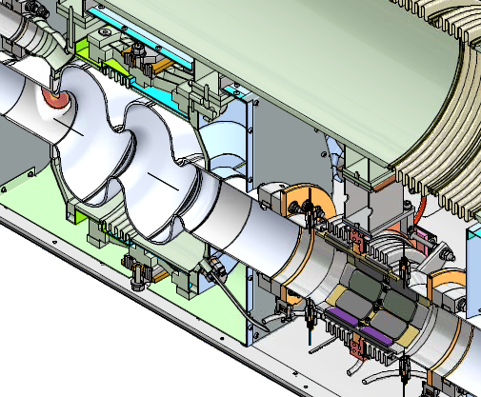
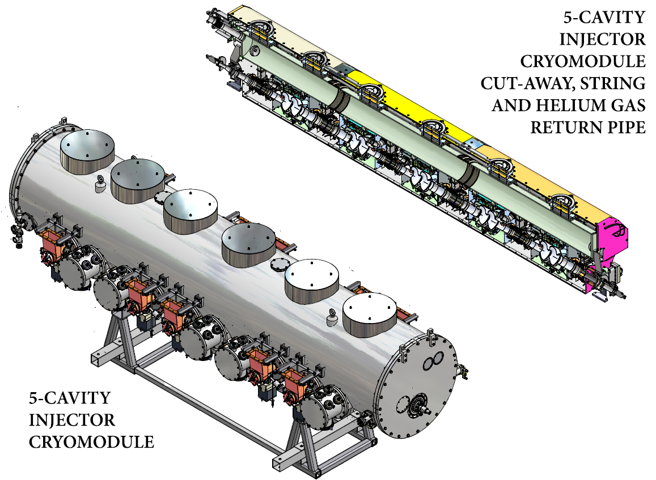
Injector Cryo-Module

Slide 20
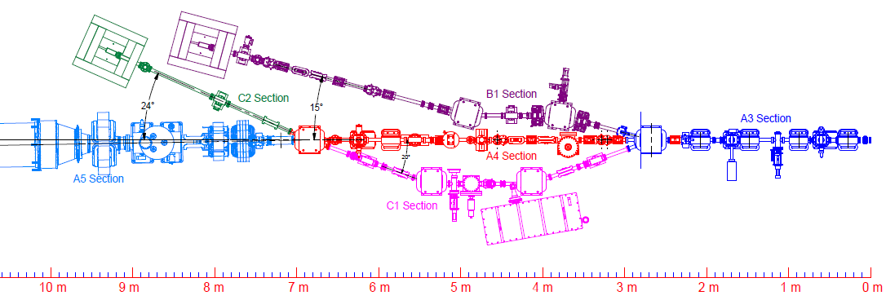
Electron Beam Diagnostic Beamlines
Straight through (A3-A4-A5) supports full 100mA short pulsed electron beam, with RF-shielded instruments
Chicane (C1) beamline for energy spread measurements
Low current beamline (B1) measures emittance delusion (or preservation ) through merger

Slide 21
A Suite of Beam Instrumentations
Strip-line beam position monitors (12 units) – fully functional at full range of beam current
Beam current monitors (4 units) – One retractable Faraday cup, two stationary F-cups and one DC Transductor
Beam viewers (7 units) – low current beam tuning, emmittance measurements. (Viewing mat’ls: BeO, CVD-diamond, YAG:Ce)
Beam slits (2 sets) –vertical and horizontal emmittance measurements at low current
RF Deflector -- temporal (longitudinal) measurements at low current
Flying-wires (2 units) –vertical and horizontal emmittance measurements at high current (yet to be commissioned)
T-Hz Spectrometer – temporal (longitudinal) measurements at high current (yet to be commissioned)

Slide 22
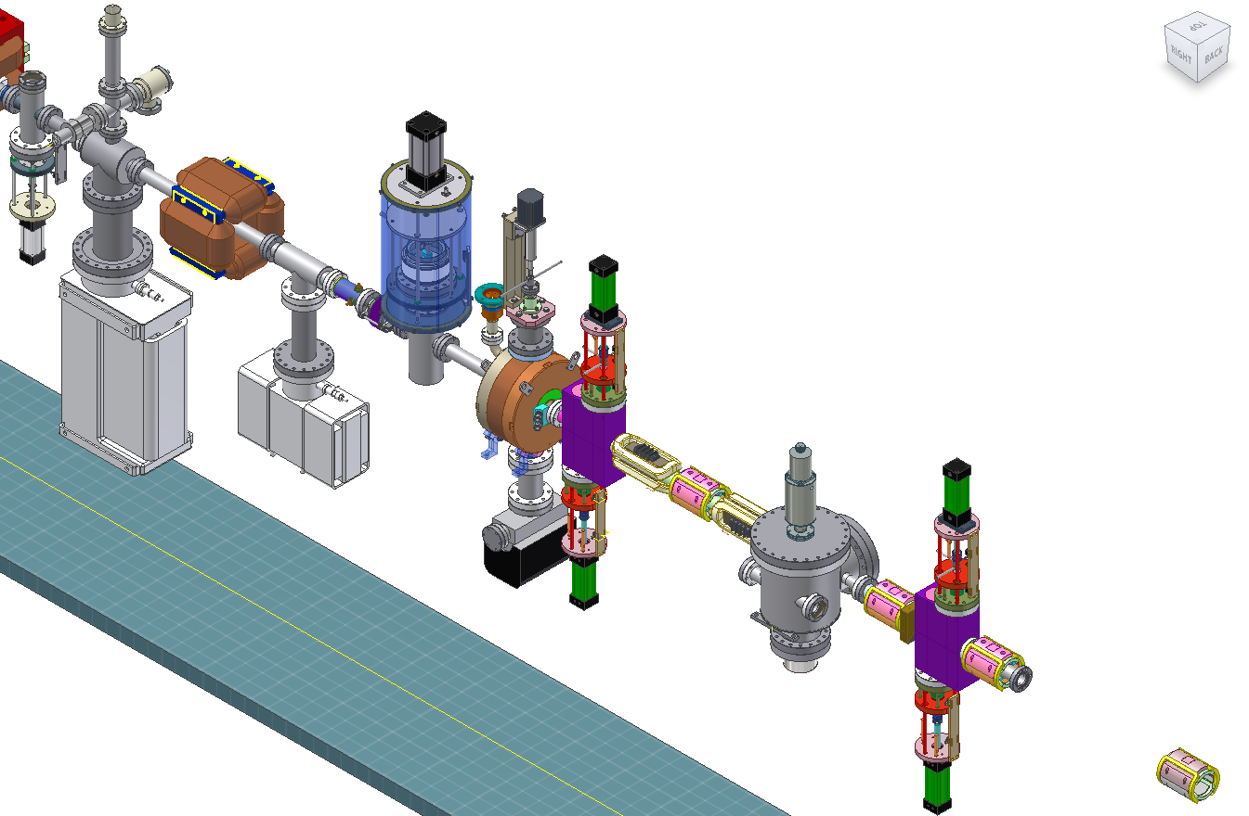
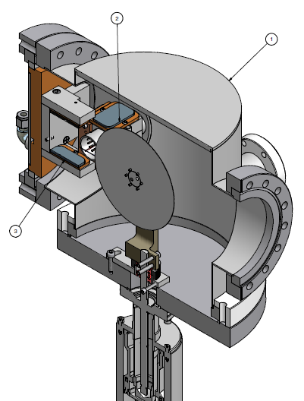
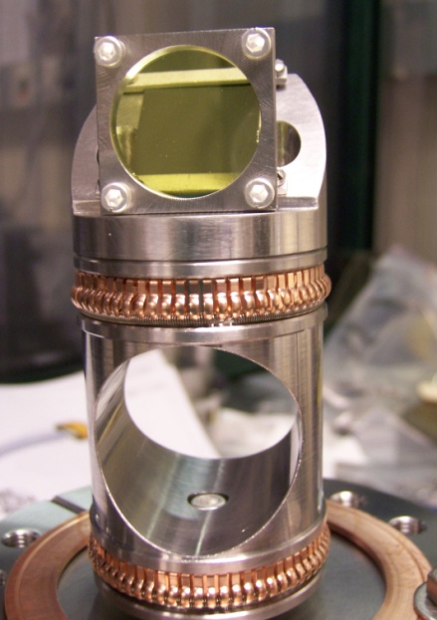
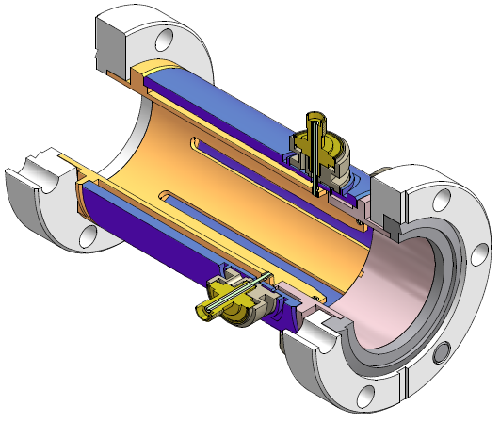
Beam Instrumentation – Examples
Faraday-Cup
RF Deflector
Beam Slits
Flying Wire
BPM
YAG:Ce Viewer

Slide 23
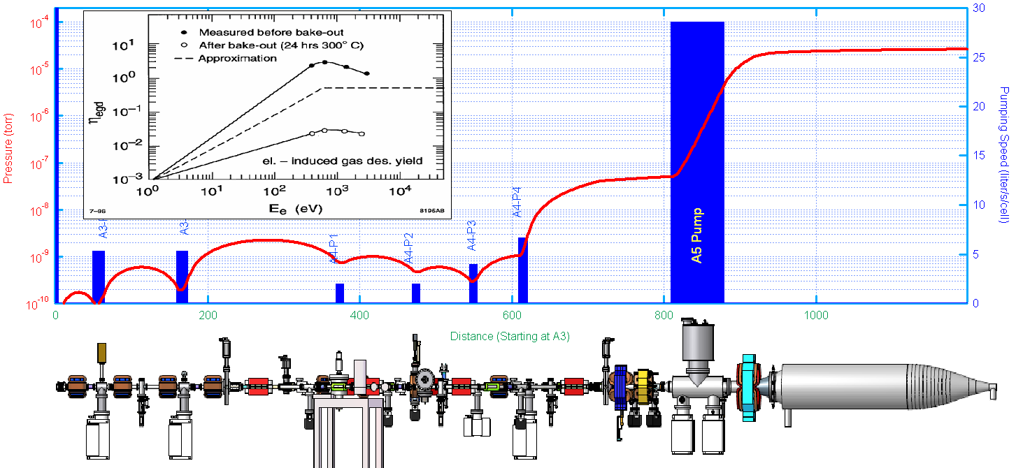
Pressure Profile in the Prototype Injector
Beam
TiSPs + Ion pumps to handle large dump gas load
No gas flux from the beam dump into the 2K cavities with 35mm-ID beam pipes

Slide 24
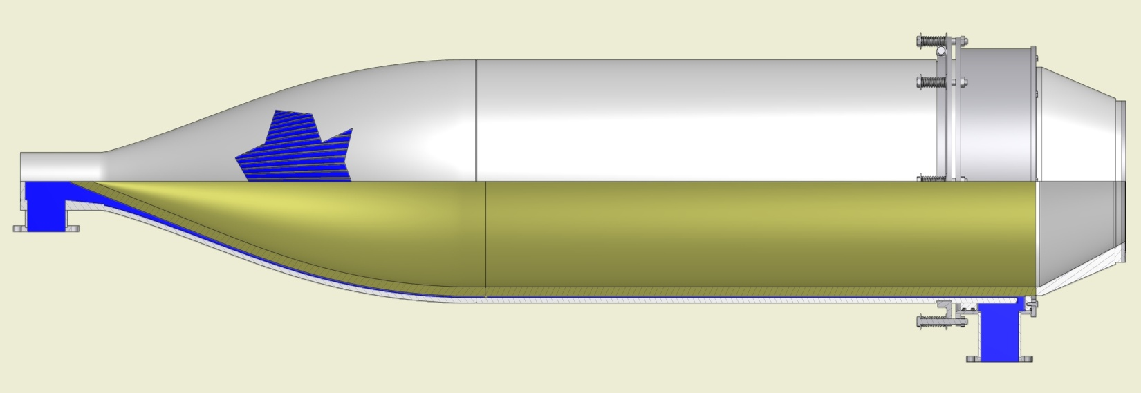
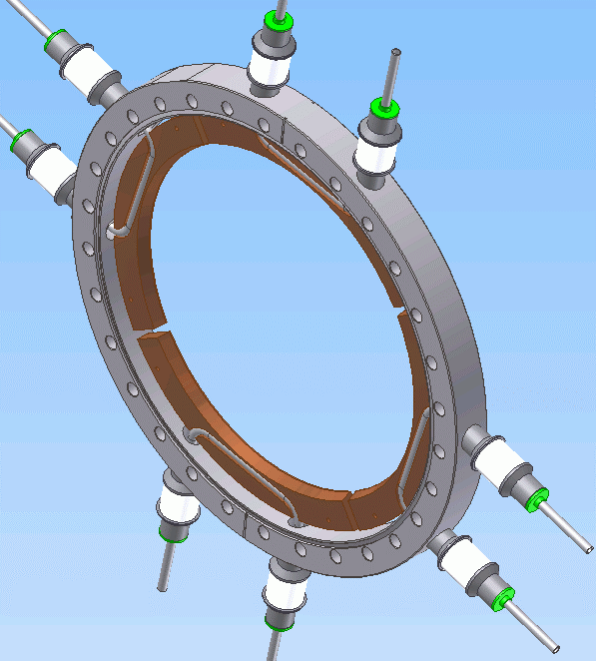
600 kW Electron Beam Dump
1m
2m
3m
Designed for 600 kW beam power
Beam current 100 mA max.
Beam energy 15 MeV max.
Main bodies are machined from a solid aluminum (6061-T6) ingots
Electron beam blown up by a pair of quad, then raster at 60 Hz to keep max. power density < 36 W/cm²
60 GPM water flow forced into finned channels for optimum cooling
A quad-element detector used to center the beam envelop at the entrance of the dump

Slide 25
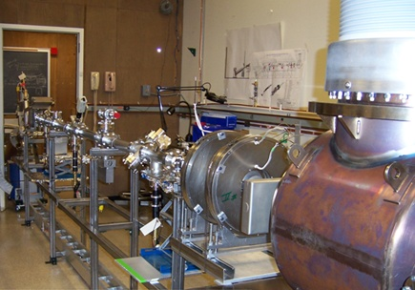
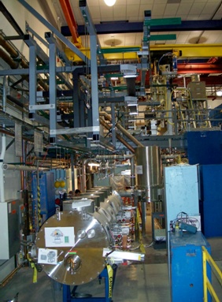
Status of the Prototype Injector
2006
Photocathode Gun
→ Reached 22 mA beam current in early gun test
beamline
→ HV processed to 420 kV, limited by field emission
and ceramic punch-through
→ New ceramic (with bulk-resistivity ) installed,
and segmented ceramics ordered
Beamline and Instrumentation
→ Full beamline installed in summer 2008
→ Full injector reached 8 mA @ 5 MeV (limited by
radiation shielding), and 13 MeV with low current
→ Majority beam instrumentation performed to spec
Inject Cryo-Module (ICM)
→ Cryo-system worked well at 1.8K
→ Low Q due to particle contamination
→ Beam profile distortion due to RF tiles charging-up
→The ICM was then refurbished and reinstalled in
early 2010
Current plans
→ Continuing NSF funding was rewarded
→ Beam emmittance optimizations – Measurements
and simulation bench-marking
→ Pushing for beam current, towards 100 mA
2008

Slide 26
CESR as International Linear Collider Damping Ring Test Accelerator (CesrTA)
As a part of ILC DR Globe Design efforts, Cornell Electron Storage has been reconfigured to support ILC DR R&D
CesrTA provides unique advantages, such as flexible lattice design and beam energy, wiggler dominated damping, both electron and positron sources
CesrTA program is jointly supported by NSF and DoE

Slide 27
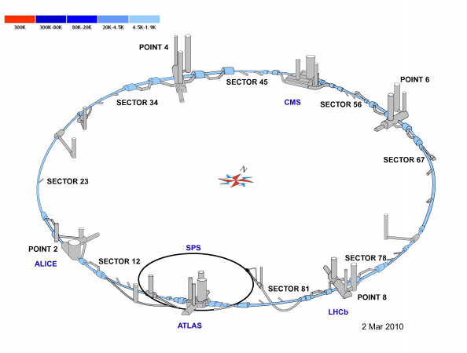
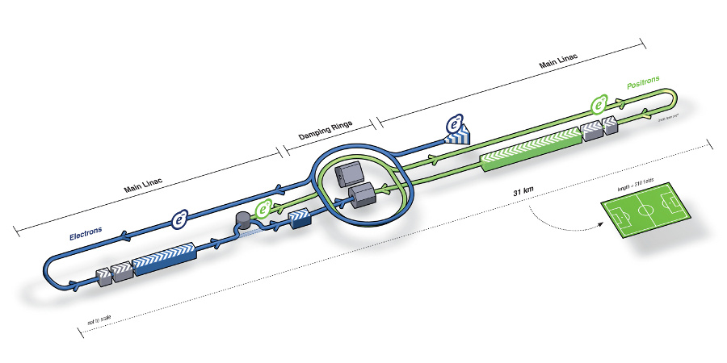
LHC to ILC
Large Hadron Collider (LHC) @ CERN
→ The ‘discovery machine’
International Linear Collider (ILC)
→ The ‘HEP Instrument’

Slide 28
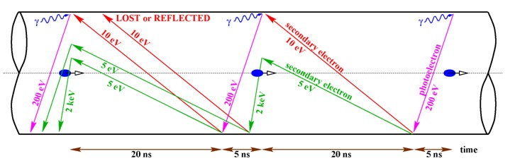
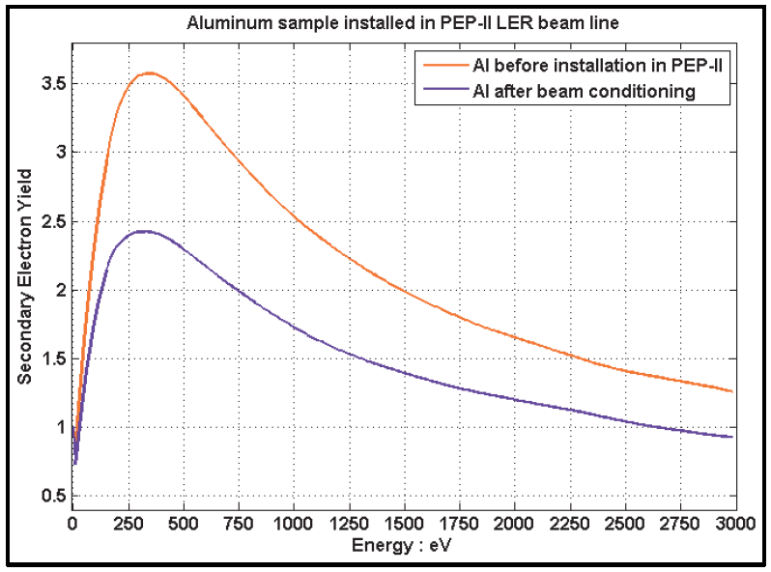
Electron Cloud and ILC DR
EC Growth w/ bunched positron beam
It is essential to the ILD DR to fully understand EC growth, and to develop effective EC suppression techniques.
CesrTA serves as a unique vehicle for EC studies at condition very similar to the ILC DR
Secondary Electron Yield of Aluminum

Slide 29
CesrTA Objectives
Electron Cloud Studies
→ EC measurement instrumentation development (RFAs, TE-wave, shielded pickups, etc.)
→ EC buildup measurement and characterization, and simulation bench-marking
→ EC mitigation, passive (coatings, grooves, etc.) and active (clearing electrode)
Ultra-Low Emittance Lattice and Tuning
→ Attain sufficiently low vertical emittance to enable exploration of dependence of electron cloud on emittance
→ Design/deploy ultra-low emittance optics (1.5 < E_{beam}< 5.0 GeV), with damping SC wigglers, to validate projections to the ILC DR operating regime
→ Beam-based alignment techniques and survey technology development
→ X-ray beam size measurement instrumentation development

Slide 30
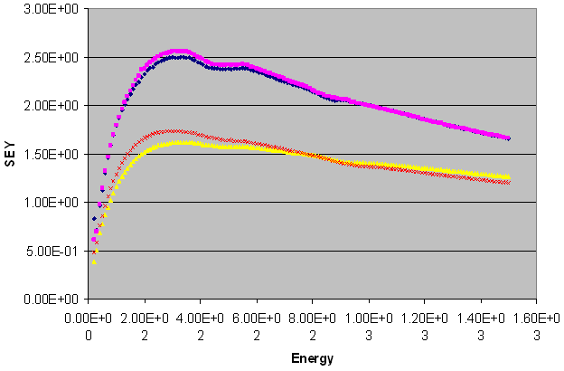
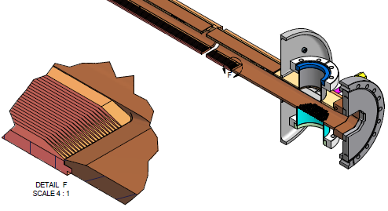

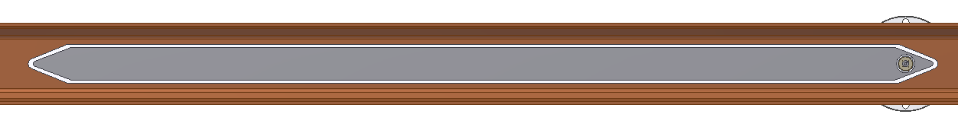
Electron Cloud Suppression
Passive Techniques:
→ Coatings with low SEY – NEG, TiN, a-C, etc.
→ Grooved surface – screening primary electrons from beam field
Active Techniques: Clearing Electrode
Electrode via Thermal-Spray

Slide 31
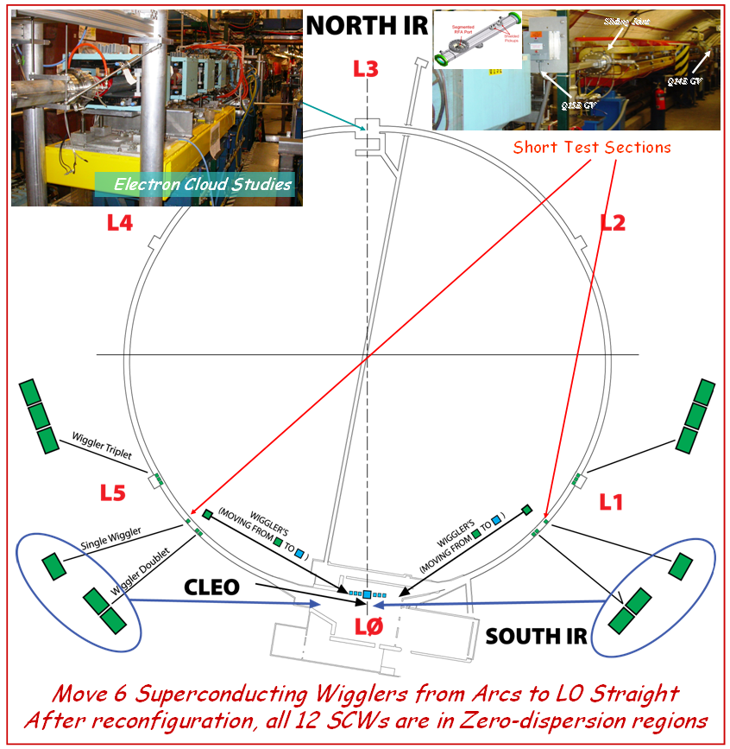
Vacuum Modifications for CesrTA
The vacuum system has been reconfigured to support both the CesrTA and the CHESS.
Six superconducting wigglers were moved to a sector with zero-dispersion.
A 12-m long gate-valve isolated straight sector was created in a second location, EC studies.
Configured 2 short sections in the arcs, allowing flexibility of testing various meter-long chambers
Majority of the CesrTA Vacuum Reconfigurations
were accomplished in ~3 months Shutdown

Slide 32
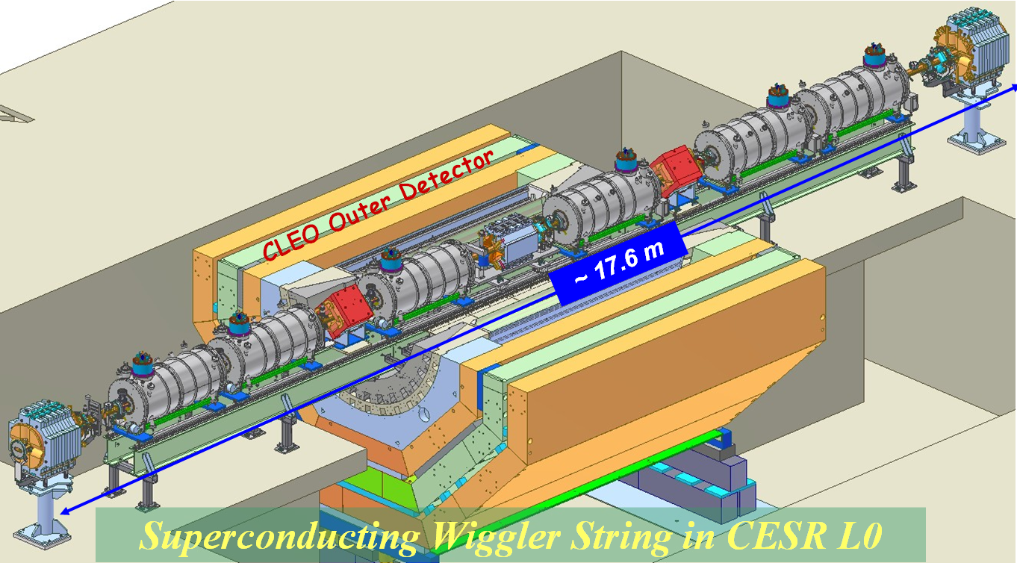
Vacuum Modifications – ‘IR Region’
SC Wigglers with RFAs
The section is densely populated with beam instrument and RFAs
A special photon stop chamber was build and installed to handle high power SR generated by the SCWs at 5 GeV

Slide 33





Vacuum Modifications – ‘L3 Region’
RFA Quad Pipe
Synch-Light Mirrors
PEP II Chicane
~11.7 m
NEG-coated Beampipe
W/ RFAs, Shielded pickup
SEY Stations

Slide 34

Retarding Field Analyzers
Typical RFA Structure
RFAs are primary tools for local EC density and distribution measurements
A typical RFA consists of one or two retarding grids, and a segmented electron collector
High transparency (>90%) Au-coated copper meshes used for retarding grids
Flexible Kapton/Cu printed circuit used for electron collectors
Small holes through beampipe wall allowing electrons drifting to the RFAs, while shielding beam-induced RF background

Slide 35




RFA – Grids and Collectors
RFA Retarding Grids:
Electroformed copper mesh (71 LPI, 15μm WW, 13μm THK) bonded to SST frames. T > 90%. 0.3 μm gold ‘flashing’ to reduce SEY on the meshes
RFA Electron Collectors:
Printed flexible circuits, Cu-clad Kapton ribbons, UHV compatible,
~13μm thick

Slide 36







RFA Implementations in Various Magnets
Dipole
SC Wiggler
Quad
3 RFAs at reprehensive
magnetic field
#1
#2
#3

Slide 37
Suppress SEY via Coating
Types of Coatings Evaluated @CesrTA, so far
NEG coating
→ Reduced SEY, insensitive saturation
→ Vacuum pumping
→ BUT, require activation at elevated temperature
TiN coating
→ Reduced SEY
→ No activation needed
→ Higher outgassing rate (??)
Amorphous carbon coating (CLIC)
→ Reduced SEY, insensitive to air exposure
→ Vacuum performance under SR

Slide 38

Vacuum Performances of TiN Coating
Vacuum beam conditioning of TiN coated chambers in the CESR L0 section has been very slow
RGA data clear show synchrotron radiation induced desorption of nitrogen

Slide 39


Vacuum Performances of a-C Coating
A aluminum beampipe with amorphous carbon coating was installed in CesrTA arc (Q15W), to expose to intense SR from the dipoles
A non-coated, otherwise identical beampipe was installed at a symmetric location in CESR (Q15E) as a reference
Vacuum beam conditioning went well, though the beam-induced pressure is about a factor of 2 higher

Slide 40

Surface Characterization & Mitigation Tests

Slide 41


RFA measurements in Drifts
TiN, α-C and NEG (activated) are all very effective in suppress EC

Slide 42


RFA measurements in SC Wiggler
Coating seems not as effective
Grooves are effective
Clearing electrode works well

Slide 43

In-situ SEY Measurement System
Two load-locked SEY stations allow expose samples to
SR photons (both direct and scattered), and measure SEY in situ

Slide 44
SEY Data – TiN coated Alum – Direct

Slide 45

SEY Data – TiN coated Alum – Scattered

Slide 46
Peak SEY vs. Beam Dose

Slide 47
Peak SEY Position vs. Beam Dose

Slide 48
Summary
Since Cornell ERL Prototype Photocathode Injector funded in 2005, all accelerator components were build and installed
Many lessons are learned in the first high-current photocathode injector
After refurbish of ICM and photo-cathode gun, we are focusing in emmittance optimization and in pushing for high beam current
CESR has been successfully re-configured in the past 1.5 yrs to support CesrTA ILC DR R&D efforts
All EC diagnostic instruments are performed as expected, and started to yield physics results
~30 visitors from 10 institutes joined CesrTA physics runs

Slide 49
Thank You !

