Slide 1
Damping Rings Baseline Lattice Choice ILC DR Technical Baseline Review Frascati, July 7, 2011
Mark Palmer
Cornell University

Slide 2
Introduction
This talk will briefly review the motivations and goals for the 2011 Damping Rings Group Lattice Down-Select process
We will briefly review the major lattice evaluation criteria and the results of the ALCPG11 evaluation process
Finally we will discuss the down-select which took place on June 28th and where we presently stand

Slide 3
Goals for the Lattice Evaluation I
Select a new baseline lattice consistent with the new ILC central region design
Reduced circumference
New operating requirements
Preserve key design features of existing baseline (DCO4)
Be ready to begin the process of integrating this design into the final ILC Technical Design
Detailed description
Costing
Performance Evaluation
ALCPG11

Slide 4
Key Design Modifications
Reduction in circumference – 6.4km a 3.2km
“Low power” operation with 1300 vs 2600 bunches (new baseline)
Maintain beam current and bunch structure a minimal impact on performance with respect to collective effects
Pursue lower momentum compaction design (target a fixed momentum compaction somewhere in the range of 1.7 to 2.7 × 10⁻⁴)
If the lattice allows the momentum compaction to be tuned, then we would be able, in the low power configuration, to go to higher momentum compaction if commissioning indicates problems with instability thresholds. Note that this depends on the fact that the baseline lattice leaves room for larger RF complements needed for high power and/or 10Hz operation.
Less conservative design with respect to collective effects
Smaller RF requirements for 6mm bunch length
Updated Specification for Straights
Minimize length consistent with 3.2km design requirements
Maintain injection/extraction layout
Minimize phase adjustment trombone
Adjust circumference chicane
Space in RF & wiggler sections for all design options (low & high power, 10Hz ops)
Added space in wiggler section for photon absorbers
Preserve CFS interface
Energy Acceptance Specification
Injection ±0.5%
For quantum lifetime desire at least ±0.75% a lattice evaluations at ±1%
ALCPG11

Slide 5
2011 Evaluation Criteria
Based on 2008 Evaluation Criteria
Lattice Design and Dynamical Properties
Conventional Facilities and Layout
Magnets, Supports and Power Supplies
Vacuum System and Radiation Handling
RF System
Injection and Extraction Systems
Space for Instrumentation and Diagnostics
Control system, availability, reliability
Eliminated from Review Pre-ALCPG11
aNo
Distinguishing
Criteria –
ALCPG11

Slide 6
Lattice Evaluation – Item 1
Lattice Design and Dynamical Properties
Is the design complete? Does it include all necessary systems, such as injection/extraction optics, RF, wiggler, circumference chicane, tune trombone, etc?
Is there sufficient margin in general dynamical parameters (damping times, equilibrium emittance and energy spread, etc.)?
Does the momentum compaction factor provide a good compromise between RF requirements, at 6 mm bunch length, and instability thresholds?
How does the lattice compare with others in terms of sensitivity to collective effects (such as impedance-driven instabilities, intrabeam scattering, space charge, ion effects, and electron cloud)?
How much flexibility is there in tuning the momentum compaction factor?
Is the dynamic aperture sufficient?
Are there any particular benefits or concerns with the dynamics, specific to the lattice?

Slide 7
Lattice Evaluation – Item 2
Magnets, Supports and Power Supplies
How does the number of magnets, and the number of different styles of magnet, compare with the other lattices?
Are the magnet parameters (length, field strength or gradient, spacing) reasonable?
Compare the degree of magnet optimization required for the various lattices?
How do the alignment and stability sensitivities compare with other lattices? In particular, what is the sensitivity of emittance dilution due to these effects.
How do the numbers and types of supports required for the magnets compare with other lattices?
How do the numbers and types of individually powered magnets compare with the other lattice options?
Are there any particular benefits or concerns with the magnets, supports and power supplies, specific to the lattice?

Slide 8
Lattice Evaluation – Item 4
RF System
How feasible is the RF voltage required, for the targeted momentum compaction factor, to provide a bunch length of 6 mm?
Is there sufficient space in the lattice for all required RF cavities (allowing some margin for klystron failure)?

Slide 9
Ranking System
Same system as previously used in 2008
All criteria are evaluated on a scale of 1 to 5
5: Item has been addressed in the lattice design and fully meets the DR specifications…
4: Item has been addressed in the lattice design but some refinement is still required to meet the DR specifications…
3: Item has only been partially addressed. Significant work remains in order to meet the DR specifications…
2: Item has not been directly addressed in the lattice design… With reasonable expectations…
1: Item has not been directly addressed in the lattice design… With serious questions…
Full description at: https://wiki.lepp.cornell.edu/ilc/pub/Public/DampingRings/WebHome/2011DRLatticeEval.docx

Slide 10
Ranking Criteria Clarifications
For questions where relative rankings are required, the ranking of the best lattice will be calibrated with the above absolute rating scale. For cases where insufficient information exists to make an evaluation, an entry of “Ins.” (insufficient) will be recorded.
Within each major evaluation item, a weighted average of the rankings for each sub-item will be used to generate the overall ranking for that item. Setting the weights of each sub-item was carried out as part of the TILC08 evaluation process and we propose to maintain the same weights for the present evaluation. In order to obtain an overall score for each lattice, each of the overall item rankings will be summed. Each major evaluation item will be looked at separately between the lattices to evaluate both the absolute and relative preparedness of each.
ALCPG11

Slide 11
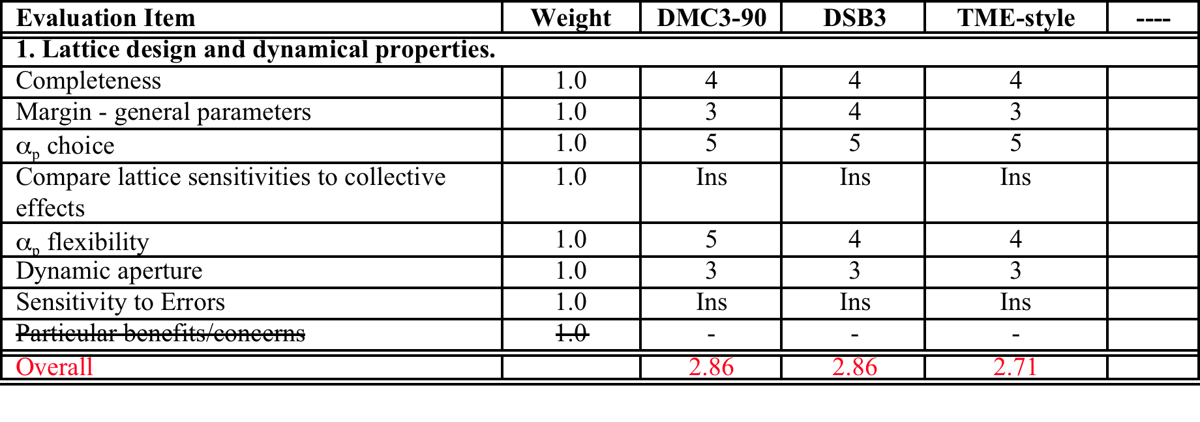
Lattice Design and Dynamical Properties
As of ALCPG11,NO Lattice was deemed
ready for a final down-select
The updated straights designs, while needing refinement, were acceptable

Slide 12
Magnets, Supports and Power Supplies
RF System

Slide 13
June 28 Down-Select
A consensus was reached on the basis of design completeness
Acceptable momentum compaction and RF complement
Acceptable DA evaluation for all 3 configurations
Implementation of key features of new reduced-length straights
Baseline Lattice Choice: DTC Lattice with TME-style arc cells DSB and DMC Lattices remain alternates

Slide 14
Status and Expectations
During the month of June, information about the updated straights concept was provided to the CFS group
Updated layout of key systems
Re-evaluation of beam line spacing a impact on tunnel diameter
Review of key utilities criteria
As of 1 week ago, a new baseline lattice, that meets the critical requirements for the damping ring design, was accepted
Provides a basis for more detailed physics evaluations planned for the remainder of this year
Many design details still being refined and brought into full compliance with ILC specifications/needs
Key evaluations (eg, DA including errors) need to be evaluated over the coming months
Anticipate that any necessary adjustments to systems specifications are possible on the 6 month timescale

