Slide 1
Electron Cloud R&D
ILC Damping ring Technical Baseline Review
July 7, 2011
Gerry Dugan (Cornell)

Slide 2
Outline
EC R&D at SLAC, KEK, INFN, CERN
  Details from KEK, INFN and CERN
EC R&D CesrTA
  Examples of RFA and SPU studies
  Survey of results on mitigations
  Buildup simulation code improvements
  Studies of head-tail instabilities and related simulations
Application to ILC damping ring design
Conclusion

Slide 3
  Recent EC R&D at SLAC, KEK, INFN, CERN
SLAC
EC studies in PEP-II chicane dipoles and drifts; in-situ SEY studies
Studies of mitigation effectiveness of TiN, NEG, rectangular grooves
  First observation of electron-cloud dipole resonance
        EC instability simulation code development (CMAD)
KEK
Tests of coated chambers, grooves, clearing electrodes, in dipoles, drifts and wigglers
Extensive study of dependence of groove mitigation on groove geometry
Developed ultra-thin low impedance clearing electrode structure and demonstrated its effectiveness in a wiggler
EC instability simulation code development (PEHTS)
INFN
Extensive experimental studies of photoemission and secondary emission from “scrubbed” surfaces.
Installed clearing electrodes in all dipole and wiggler chambers in DAΦNE
CERN
Amorphous carbon thin films tested at SPS

Slide 4
Mitigation results from KEK-1
Effect of coatings in drifts
From Kanazawa, ECLOUD’10
Cloud density near beam extracted from RFA data
Effect of antechamber

Slide 5
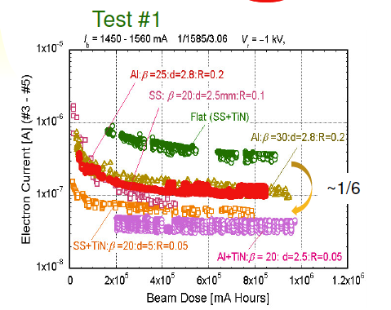
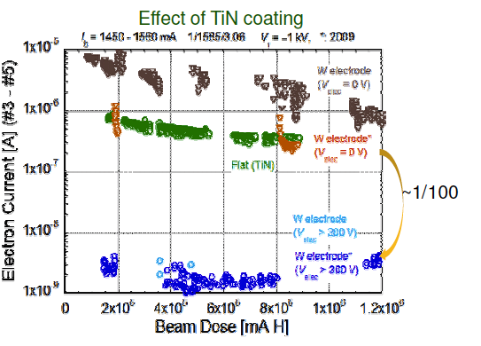
Mitigation results from KEK-2
From Yusuke, ECLOUD’10
Direct measurement of electron current in an RFA
Effect of grooves in a dipole
Effect of clearing electrodes in a wiggler

Slide 6
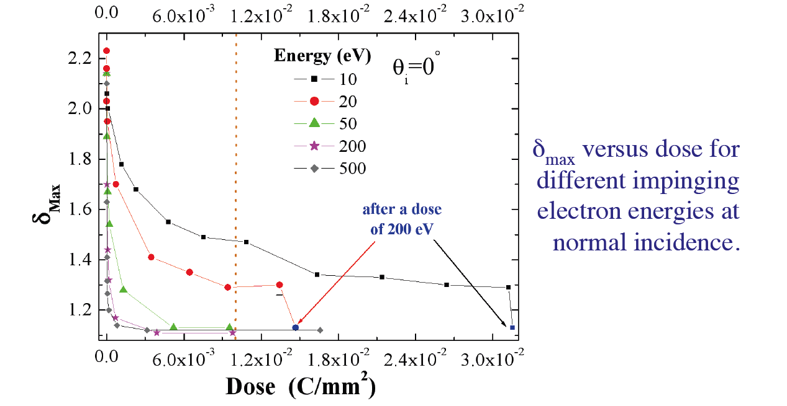
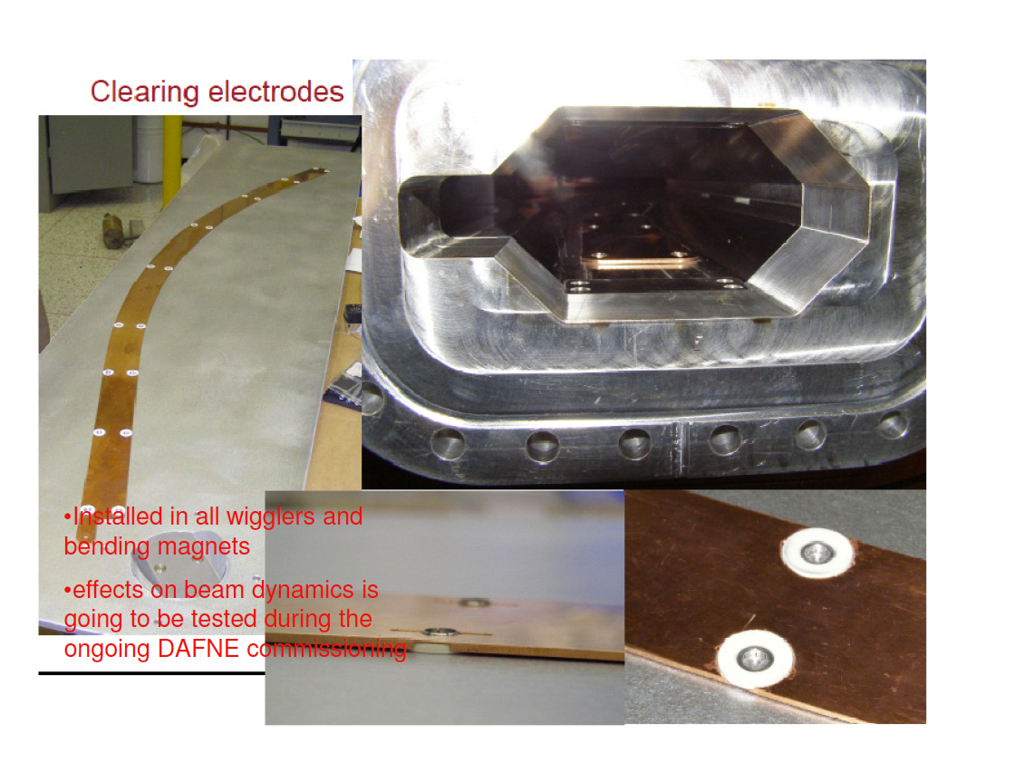
EC R&D at INFN
From Cimino, ECLOUD’10:
Demonstration that electron conditioning effectiveness depends on the electron energy
From Demma, ECLOUD’10:
Clearing electrodes to be installed in all bends and wigglers in DAΦNE

Slide 7
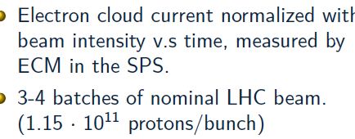

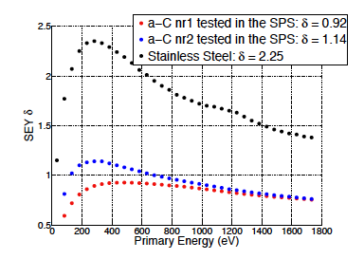
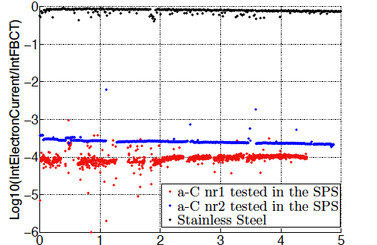

Measurement of alpha-Carbon films in SPS

Slide 8
EC R&D at CesrTA: summary
CESR Configuration
  Damping ring layout
  4 dedicated EC experimental regions
  Upgraded vacuum/EC instrumentation
  Energy flexibility from 1.8 to 5.3 GeV
  Regularly achieving <10pm vertical emittance
Beam Instrumentation
  xBSM for positrons and electrons
  High resolution digital BPM system
  Feedback system for 4ns bunch spacing
EC Diagnostics and Mitigation
  ~30 RFAs presently deployed
  TE wave measurement capability in each experimental region
  Time-resolved shielded pickups in 3 experimental locations (2 with transverse information)
  Over 20 individual mitigation studies conducted in Phase I
    20 chambers
    2 sets of in situ SEY measurements
    Follow-on studies in preparation for Phase II extension of program
Beam Dynamics Studies
  Extensive set of tune shift measurements
  Systematic studies of beam instability thresholds and emittance dilution
Simulations: to allow extrapolation to ILC DR
  Simulations of photon transport, including scattering (specular and diffuse) and fluorescence, in realistic chambers (including antechambers).
  EC growth: establishing physics model parameters for EC growth codes (POSINST, ECLOUD): models of primary photoemission and secondary emission
  Simulations of single bunch instabilities driven by the electron cloud (with SLAC and KEK): CMAD, PEHTS

Slide 9
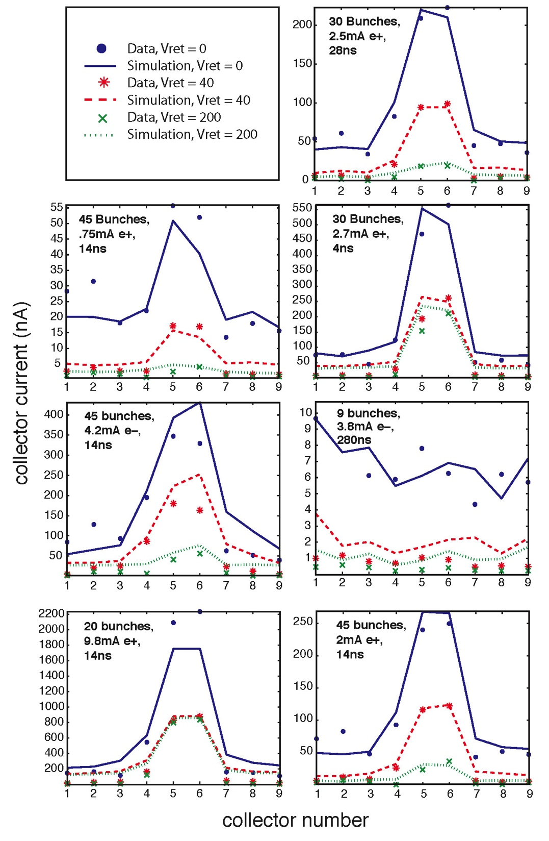
Drift Region RFA Data vs Simulation
Goal:
  Evaluate surfaces under a wide range of conditions to evaluate in situ surface parameters using the RFA data
  Use photon distributions from 3d photon transport simulations
  Vary: Bunch charge & spacing, species, beam energy, RFA retarding voltage
  Fit for:
  Peak value of the true SEY
  Energy of the SEY peak
  Elastic scattering fraction, δ(0)
  Rediffused scattering fraction
  Quantum efficiency
  Incorporate constraints from time-resolved shielded pickup (SPU) data
5.3GeV Dataa

Slide 10
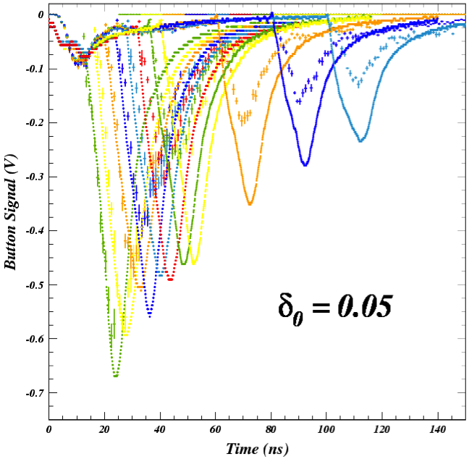
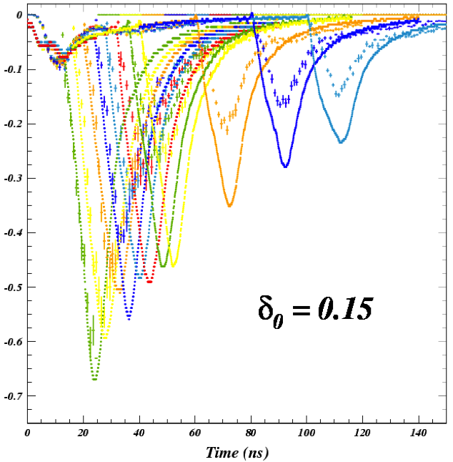
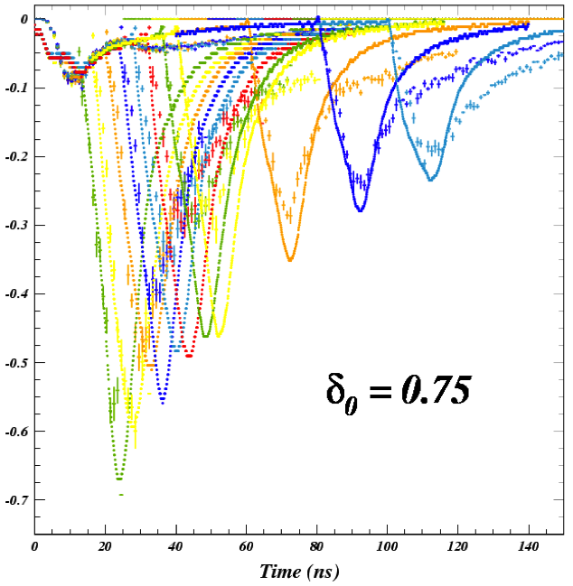
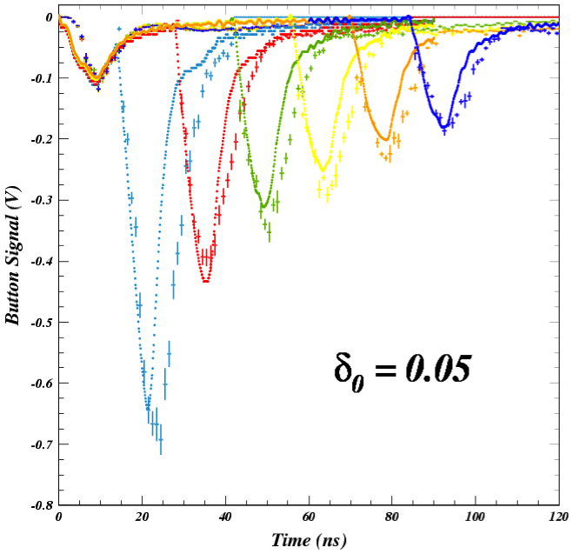
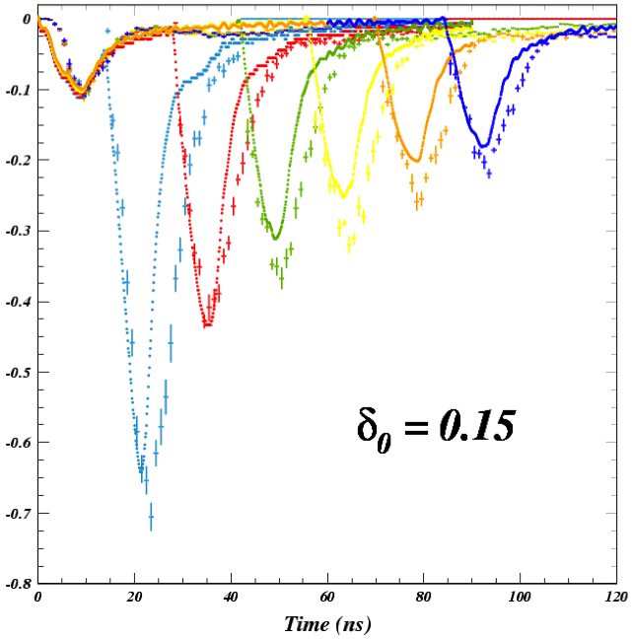
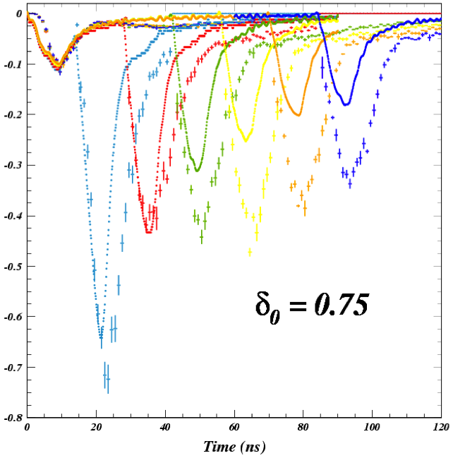
Time-Resolved (SPU) Data: δ(0)
spu
e- signal from B1
sensitive to PE model
Bare Al
TiN

Slide 11
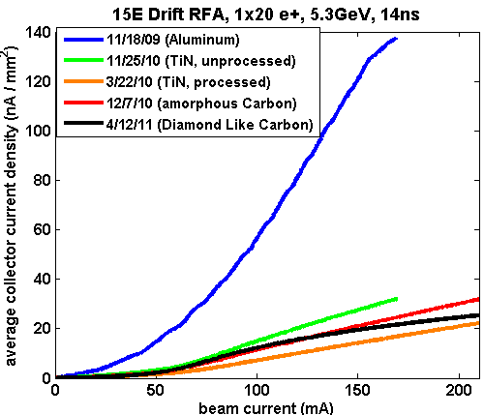
Drift Region Mitigation: Observations
Coating Tests
  Bare Al vs TiN, amorphous C, and diamond-like C (all on Al)
  EC performance of TiN and the carbon coatings in a similar range a consistent with in situ SEY measurements for processed TiN and aC near unity
Also NEG tests in L3 experimental region
  Requires detailed simulation capability for direct comparison
In Situ
SEY Station

Slide 12
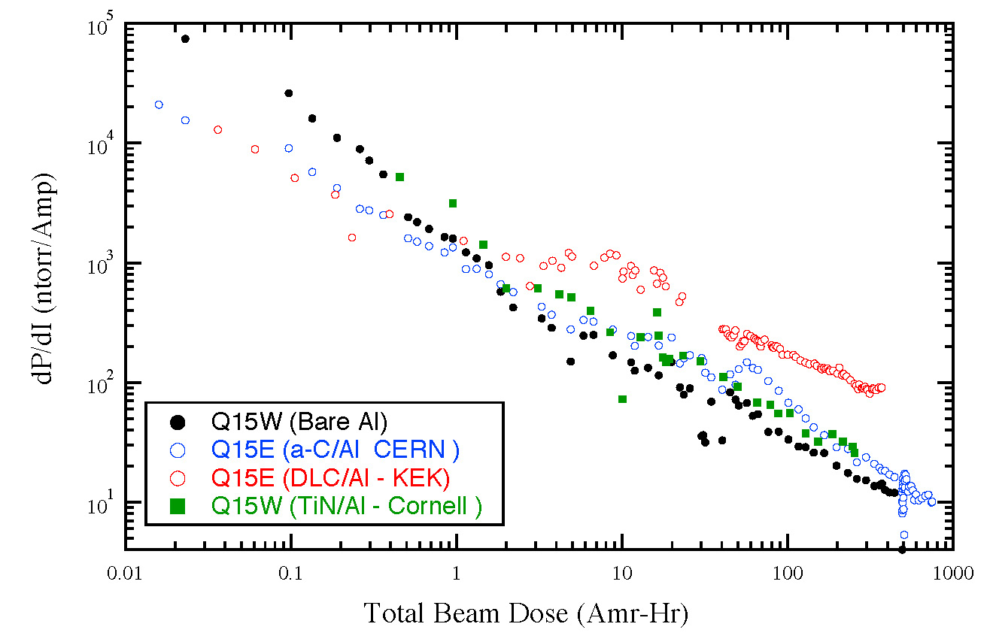
Drift Region Mitigation Evaluations
Efficacy
  Relative comparisons a TiN, after extended scrubbing, has achieved slightly better performance than the carbon coated chambers that we have deployed.
  In situ SEY station measurements with TiN and aC show peak SEY values around 1, processing towards lower values with TiN
  The use of solenoid coils in addition to any of the coatings would likely assure acceptable EC performance in the drifts
Risks
  Further monitoring of aging performance is desirable
  Possible Si contamination?
    CERN tests of 2 samples sent back after acceptance tests a presence of Si contamination in a-C chamber
    Follow-on test of 1st a-C chamber (entire chamber sent to CERN) did not detect Si after beam exposure
  Surface parameter analysis is still maturing a some caution should be exercised.
Impact on Machine Operations and Performance
  NEG would benefit overall machine vacuum performance, but activation requirements are difficult.
  a-C and TiN show somewhat higher beam-induced vacuum rise than bare Al. DLC very high.

Slide 13
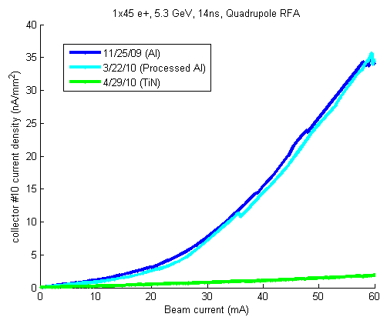
Quadrupole Observations and Evaluation
RFA currents higher than expected
from “single turn” simulations
  Turn-to-turn cloud buildup
  ~20 turn effect
  Issue also being studied in wigglers
Efficacy
  Strong multipacting on Al surface
  significantly suppressed with TiN
  coating
Risks
  Appear minimal with coating
  Concerns about trapped EC (multi-turn build-up)
  Final evaluation of acceptable surface parameters in quadrupoles is needed to decide whether coating (as opposed, say, to coating+grooves) is acceptable.
    ILCDR EC working group effort underway
45 bunch train e+

Slide 14
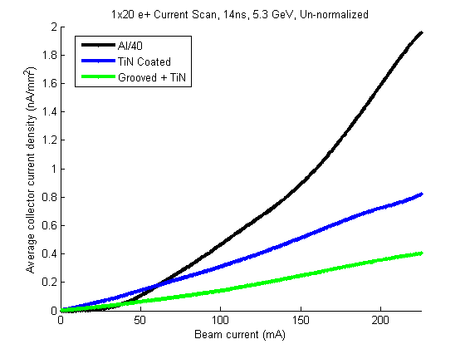
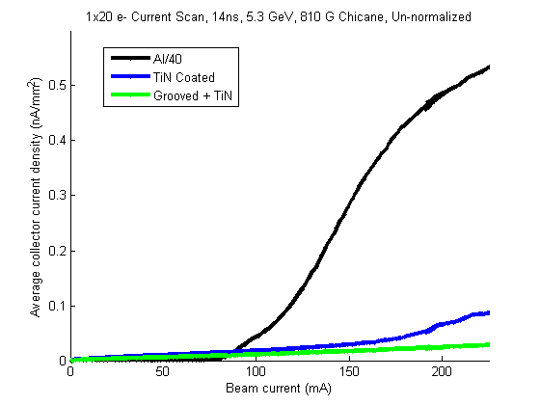
Dipole Mitigation Observations
Data shown: 5.3 GeV, 14ns
  810 Gauss dipole field
  Signals summed over all
  collectors
  Al signals ÷40
Longitudinally grooved surfaces offer significant promise for EC mitigation in the dipole regions of the damping rings
20 bunch train e+
20 bunch train e-

Slide 15
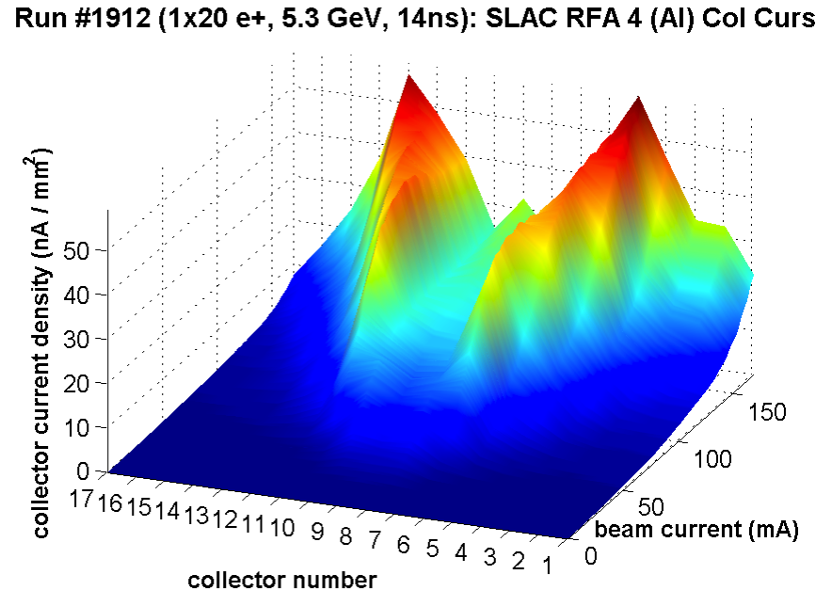
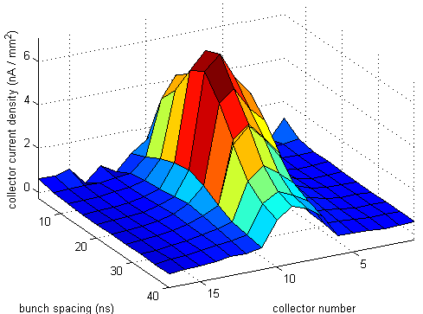
Dipole Mitigation Evaluation
Efficacy
  Of the methods tested, a grooved surface
  with TiN coating has significantly better
  performance than any other. Expect that
  other coatings would also be acceptable.
  NOTE: Electrodes not tested (challenging
  deployment of active hardware for entire
  arc regions of the ILC DR)
Risks
  Principal concern is the ability to make
  acceptable grooved surfaces via extrusion
    “Geometric suppression” limited by peak
    and valley sharpness
    Coating helps ameliorate this risk
  Machined surfaces of the requisite
  precision are expensive and challenging
Impact on Machine Performance
  Simulations (Suetsugu, Wang, others)
  indicate that impedance performance
  should be acceptable
Multipacting Resonance:
SLAC Al Chicane Dipole

Slide 16
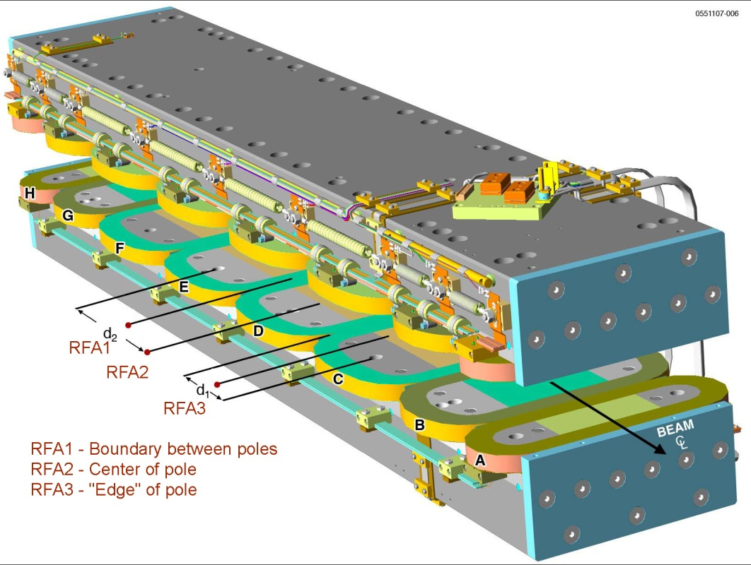
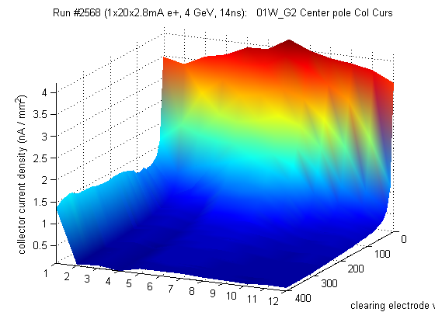
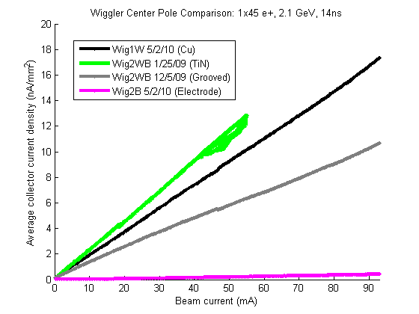
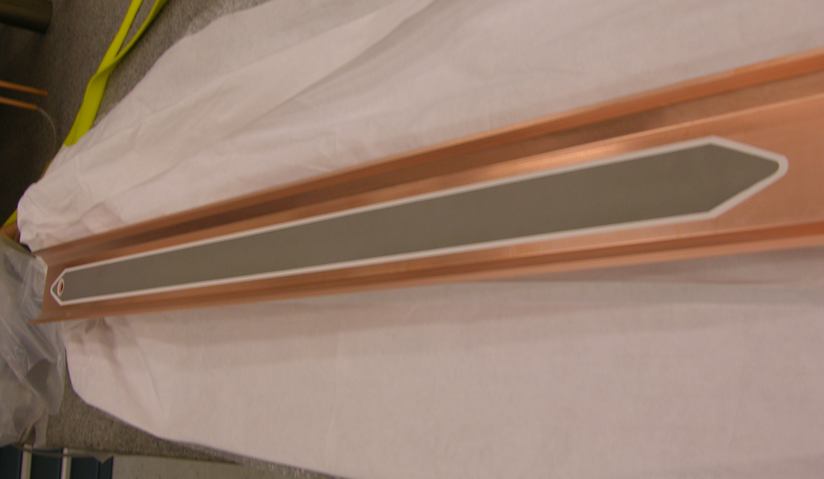
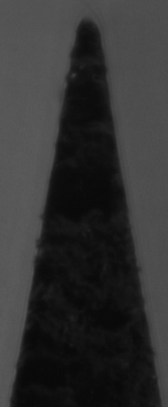
Wiggler Observations
0.002”
radius

Slide 17
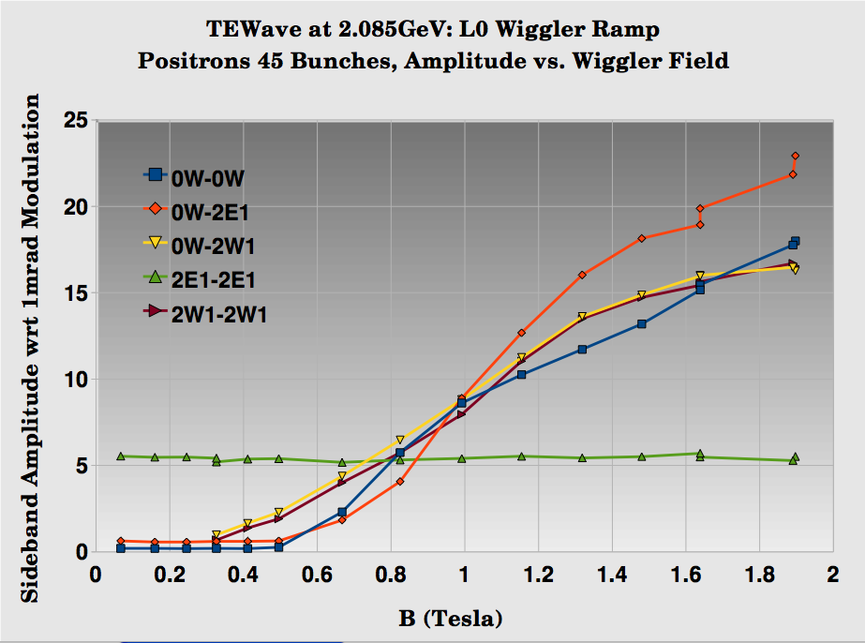
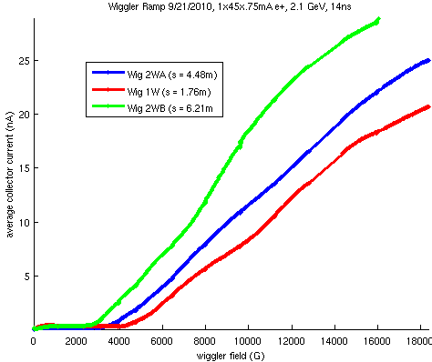
Wiggler Ramp
Plots show TE Wave and RFA response as a function of wiggler field strength
Large increase in signal as soon as radiation fan begins to strike local VC surface a significant diffuse scattering or fluorescence in Cu chamber
1x45x0.75mA e+, 2.1 GeV, 14ns bunch spacing
RFA Response
TEW Response

Slide 18
Wiggler Evaluation
Efficacy
  Best performance obtained with clearing electrode
Risks
  Electrode reliability
    Thermal spray method offers excellent thermal contact
    Ability to create “boat-tail” shape with no structural concerns helps to minimize HOM power
    Feedthrough and HV connection performance probably single largest concern
Impact on Machine Operation and Performance
  Impedance should be acceptable for the limited length of the wiggler section (see, eg., ECLOUD10 evaluation by Y. Suetsugu)
  Additional hardware required
    Power supplies
    Loads for HOM power

Slide 19
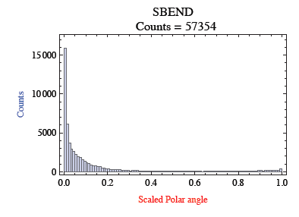
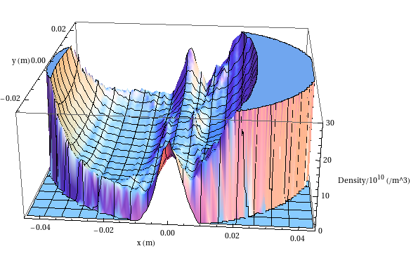
Improvements to EC growth simulations
Better photon reflection and transport model needed for simulations and data analysis
Synrad3D (Sagan, et al.) answers this need, but work remains
  Fully validate real VC geometries
  Incorporate diffuse scattering due to surface roughness and fluorescence
Photon distribution vs angle
Electron cloud distribution vs position,
after 10 bunch train
Time-resolved SPU measurements indicate that we also need to have a better photoelectron model (fitting of RFA data also requires this)

Slide 20
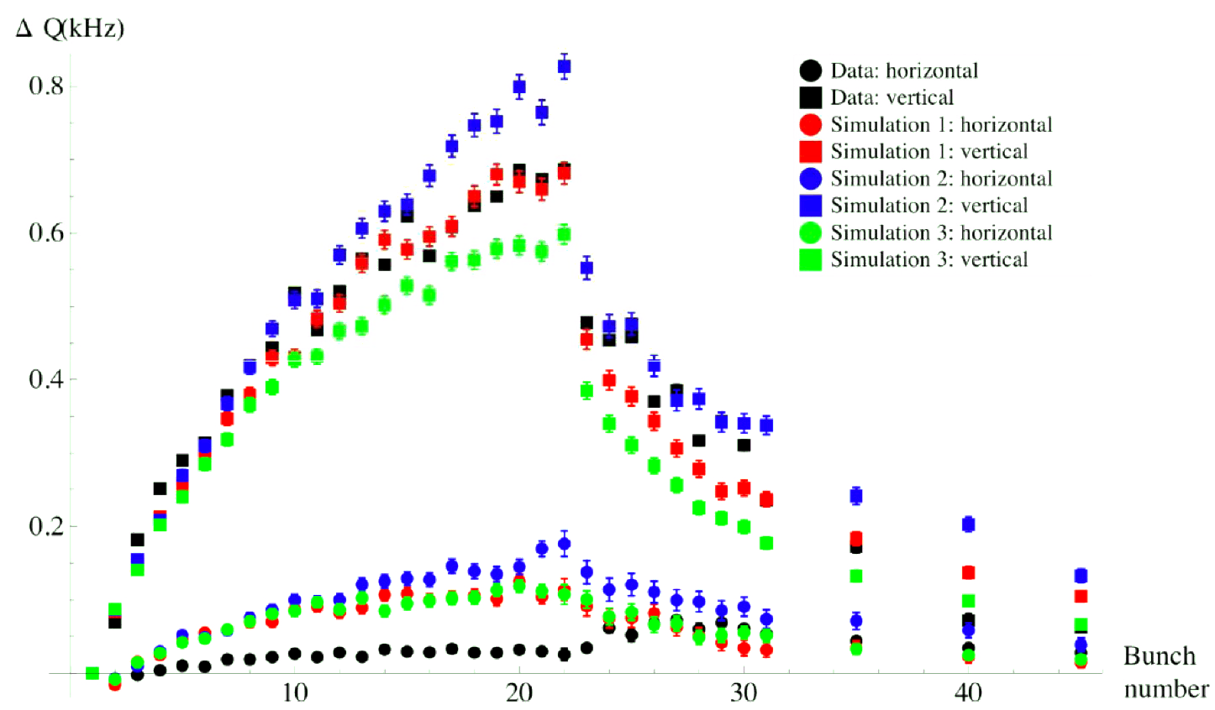
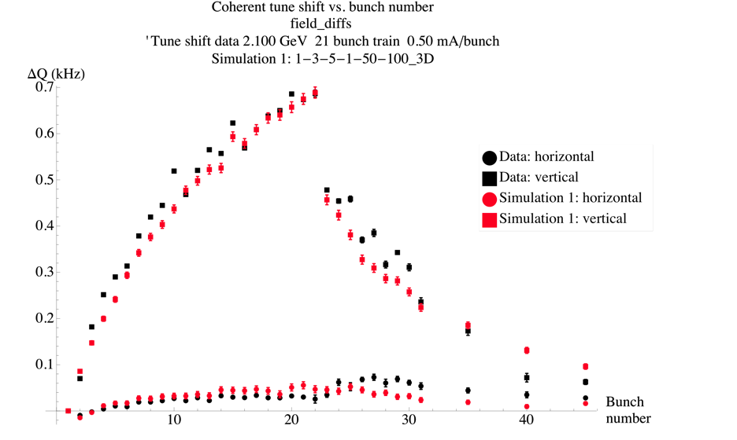
Effects on EC tune shifts: pinged train +witnesses
Simulations with direct radiation rates, reflectivity=15%, QE=12%, Gaussian PE spectrum
SEY=2
Simulations with Synrad3D distributions, QE=10.8% (9.7%) in dipoles(drifts), Lorentzian PE spectrum
SEY=2

Slide 21
Beam Dynamics Studies
Have taken advantage of the ability to achieve repeatable operation with ε_{y} ≤ 20pm in the
2 GeV low emittance lattice since spring 2010
Studies to date have examined the dependence on:
  Bunch spacing & intensity
  Chromaticity
  Feedback
  Emittance
  Beam energy
  Species

Slide 22
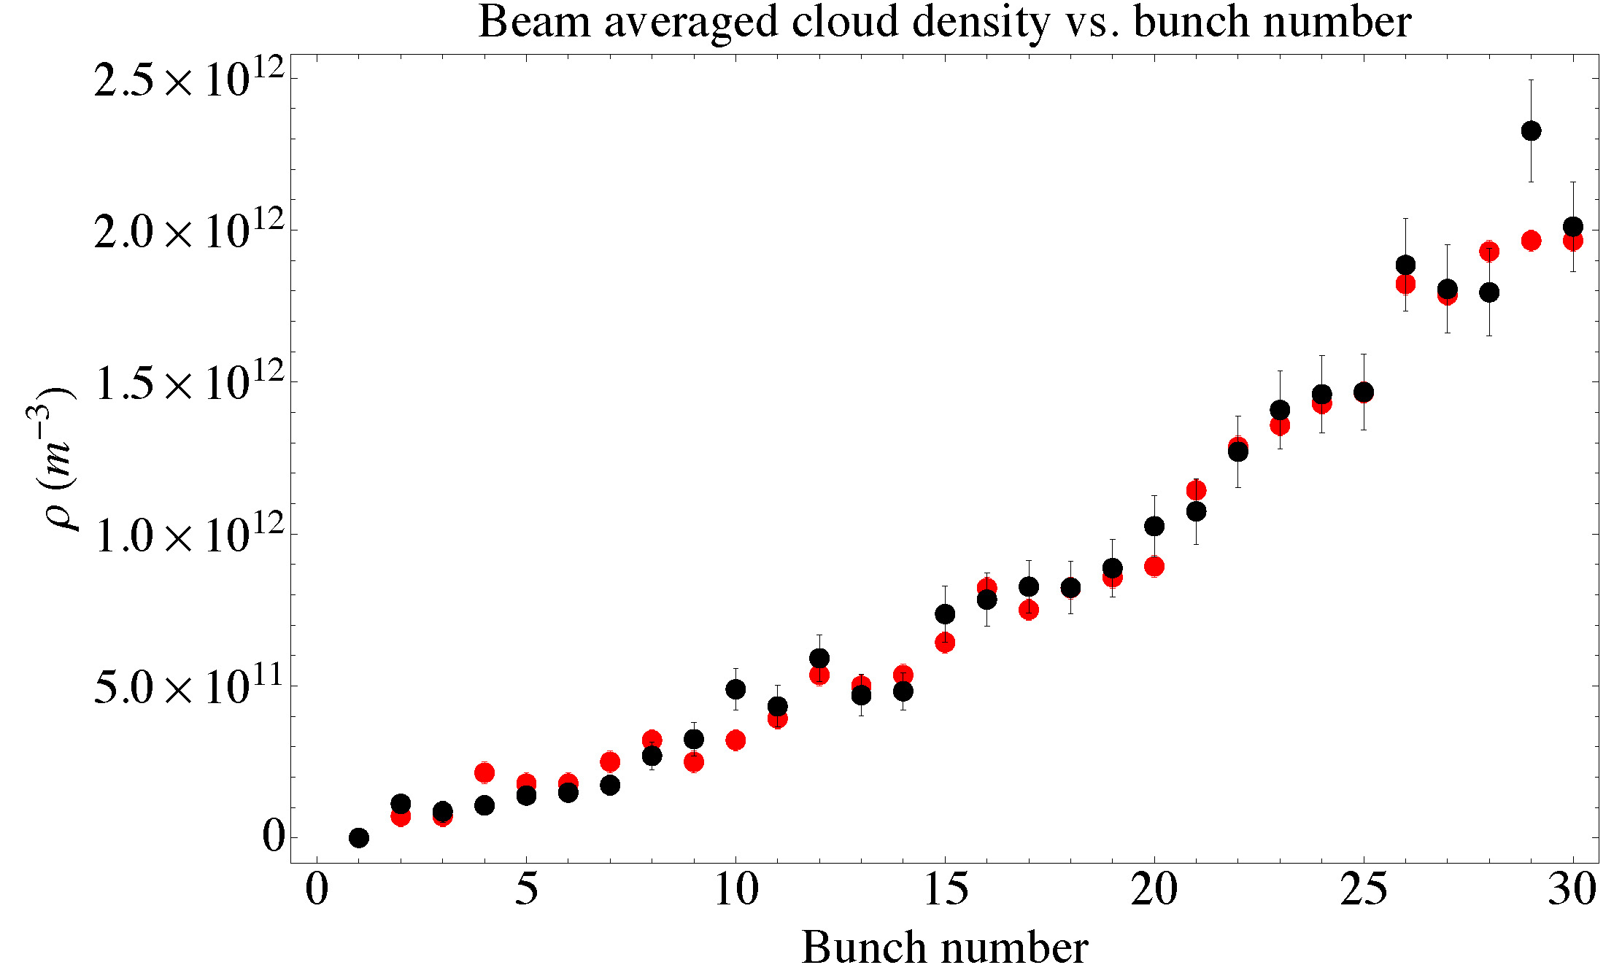
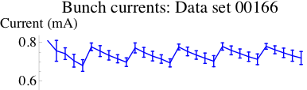
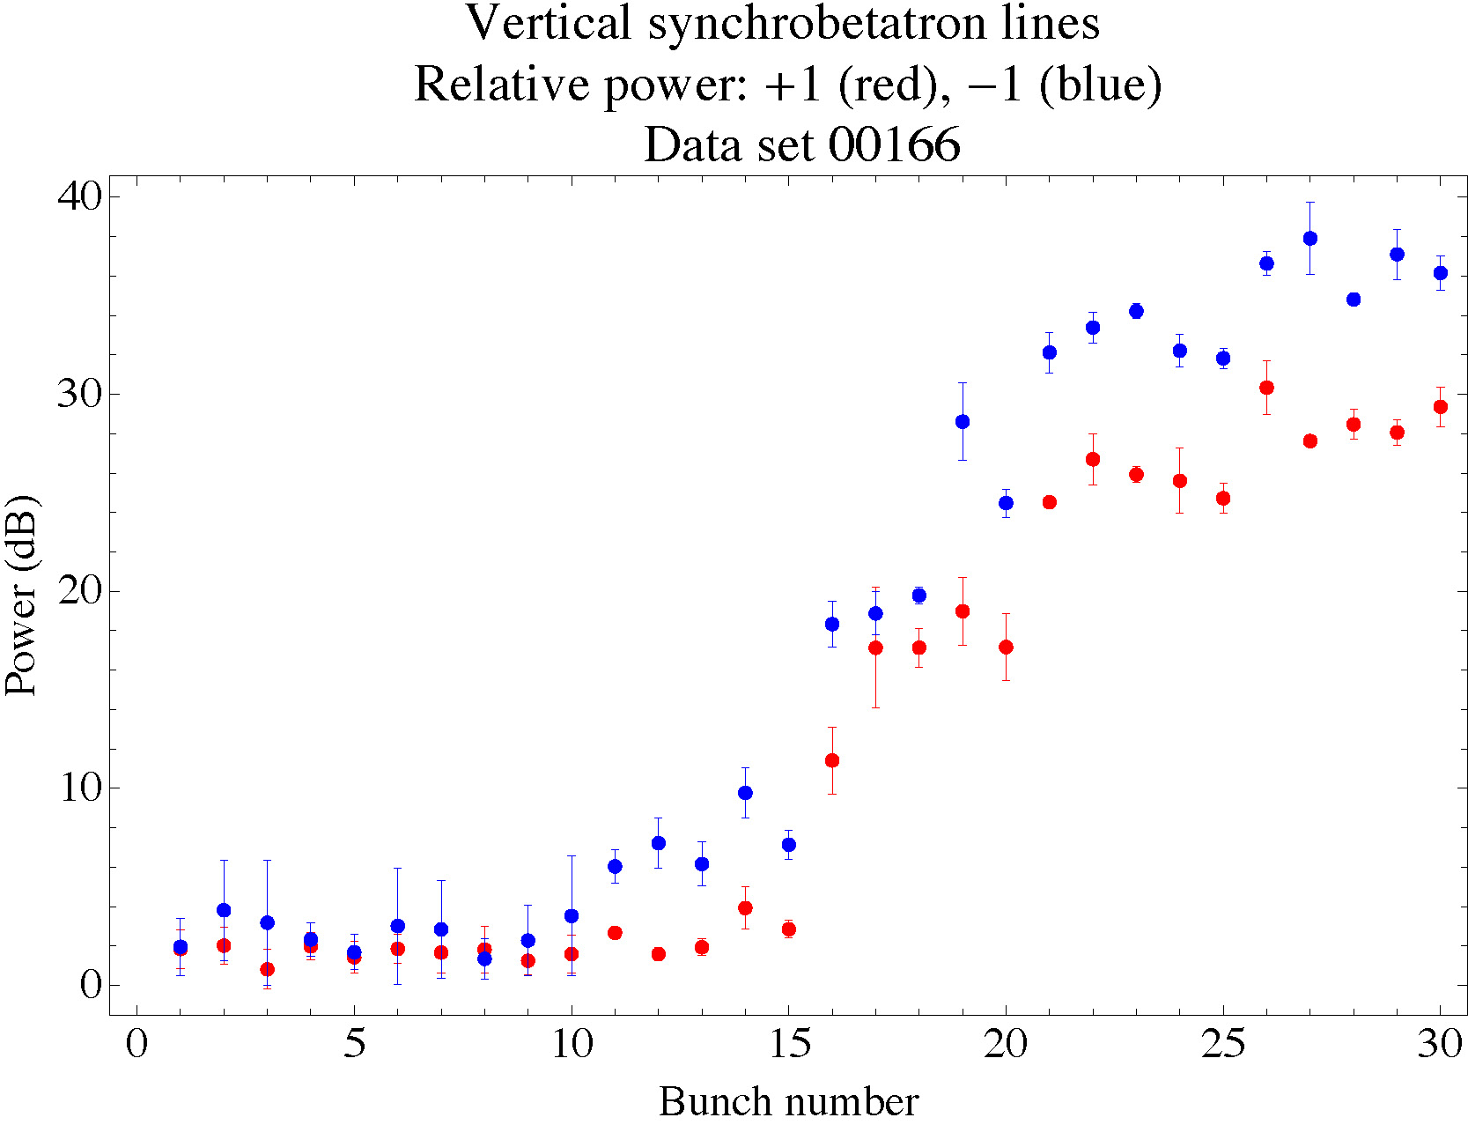
Systematic Studies of Instability Thresholds
Spectral methods offer powerful tool for self-consistent analysis
of the onset of instabilities
  Tune shifts along train a ring-wide integrated cloud density near beam
  Onset of synchrobetatron sidebands a instability thresholds
Data
POSINST Simulation
(H,V) chrom = (1.33,1.155)
Avg current/bunch 0.74 mA
Strength of upper &
lower synchrobetatron
sidebands
dBm

Slide 23
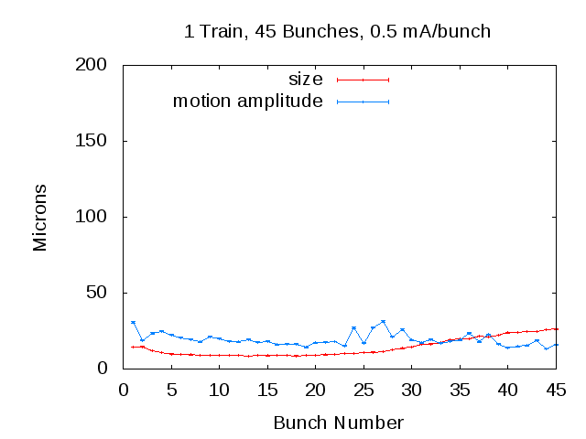
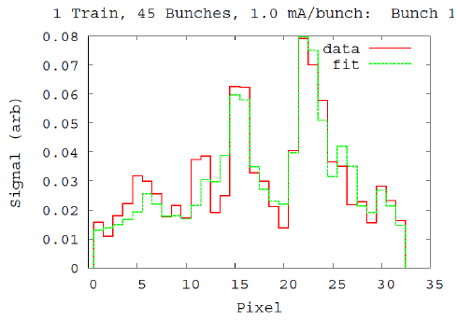
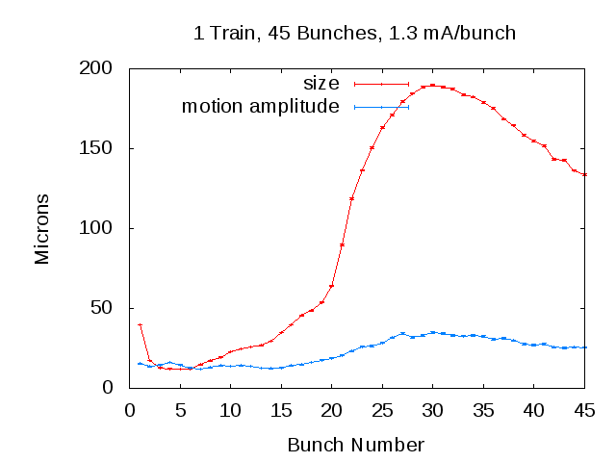
Beam Size
Measure Bunch-by-Bunch Beam Size
  Beam size enhanced at head and tail of train
  Source of blow-up at head appears to be due to a
  long lifetime component of the cloud
  Bunch lifetime of smallest bunches consistent with observed single bunch lifetimes during LET
  (Touschek-limited) consistent with relative bunch sizes.
  Beam size measured around bunch 5 is consistent with ε_{y} ~ 20pm-rad
  [σ_{y}=11.0±0.2 μm, β_{source}=5.8m]
0.8×10¹⁰ e+/bunch,
Each point:
Average of 4K single-turn fits
Consistent
with onset
of instability
Single Turn Fit
Bunch 5
Sub-threshold emittance growth?
2×10¹⁰ e+/bunch
Consistent
with
20 pm-rad

Slide 24
Summary of Key Beam Dynamics Observations
The basic observation is that, under a variety of conditions, single-bunch frequency spectra in multi-bunch positron trains exhibit the m=+/- 1 head-tail (HT) lines, separated from the vertical line by about the synchrotron frequency, for some of the bunches during the train. Beam size blowup is observed for roughly the same bunches as the HT lines.
For a 30 bunch train with 0.75 mA/bunch, the onset of these lines occurs at a cloud density (near the beam) of around 9x10¹¹/m⁻³. (Important for benchmarking simulations-> ILC DR extrapolations.)
The onset of the HT lines depends strongly on the vertical chromaticity, the beam current and the number of bunches. There is a weak dependence on the synchrotron tune, the vertical beam size, the vertical feedback.
Under some conditions, the first bunch in the train also exhibits a head-tail line and is blown up. The presence of a “precursor” bunch eliminates these effects. The implication is that there is a significant cloud density “trapped” near the beam which lasts at least a few microseconds.
There may be some incoherent emittance growth prior to the onset of the coherent instability.
Both effects could be important for ILC DR.

Slide 25
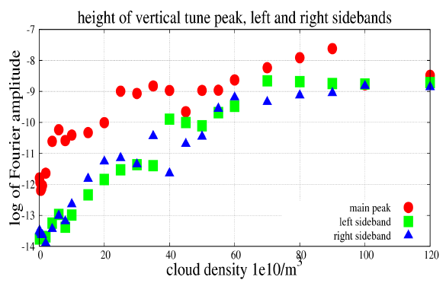
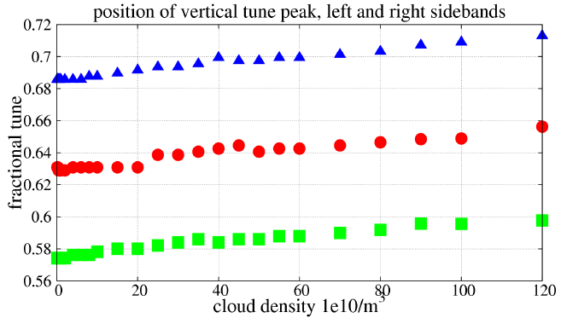
CMAD Simulations (SLAC, Cornell)
CMAD simulations
are being validated
against CESRTA measurements and
applied to analysis
of the ILC DR.
Emittance growth starts at a cloud density not far from what is observed experimentally.

Slide 26
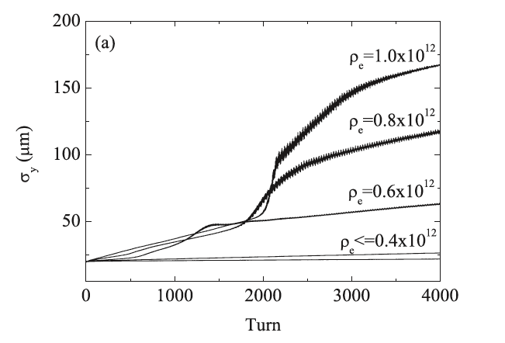
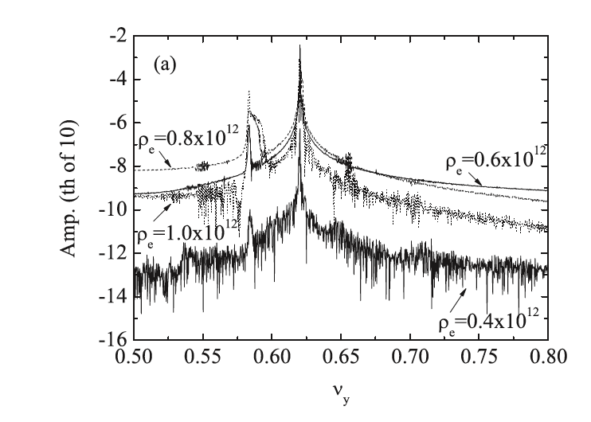
PEHTS Simulations (KEK)
Simulations for 2 GeV CesrTA show beam size growth, and head-tail line emergence, at a cloud density close to what is measured.
5 GeV simulations show splitting of dipole line, also seen in the data.
Simulations show very little incoherent emittance growth below threshold for CesrTA.
These simulations predict a threshold of about 2x10¹¹/m³ for a 6.4 km ILCDR with α =4x10⁻⁴
From Jin et al, “Electron Cloud Effects in Cornell Electron Storage Ring Test Accelerator
and International Linear Collider Damping Ring”, JJAP50 (2011) 026401

Slide 27
EC Working Group Baseline Mitigation Plan
Mitigation Evaluation conducted at satellite meeting of ECLOUD`10
(October 13, 2010, Cornell University)
EC Working Group Baseline Mitigation Recommendation
 | Drift* | Dipole | Wiggler | Quadrupole*
Baseline Mitigation I | TiN Coating | Grooves with TiN coating | Clearing Electrodes | TiN Coating
Baseline Mitigation II | Solenoid Windings | Antechamber | Antechamber
Alternate Mitigation | NEG Coating | TiN Coating | Grooves with TiN Coating | Clearing Electrodes or Grooves
*Drift and Quadrupole chambers in arc and wiggler regions will incorporate antechambers
Preliminary CESRTA results suggest the presence of sub-threshold emittance growth
  Further investigation required
  May require reduction in acceptable cloud density a reduction in safety margin
An aggressive mitigation plan is required to obtain optimum performance from the 3.2km positron damping ring and to pursue the high current option
S. Guiducci, M. Palmer, M. Pivi, J. Urakawa on behalf of the ILC DR Electron Cloud Working Group

Slide 28
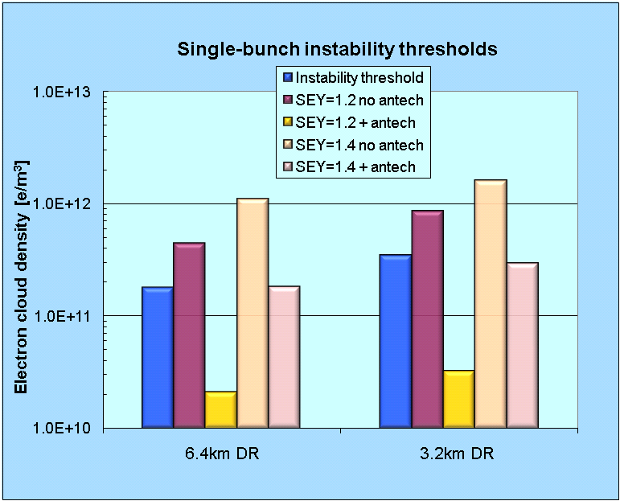
Comparison of 6.4 and 3.2 km DR Options
Summer 2010 Evaluation
Comparison of Single Bunch EC Instability Thresholds for:
  6.4km ring with 2600 bunches
  3.2km ring with 1300 bunches
  same average current
Both ring configurations exhibit similar performance
a 3.2km ring (low current option) is an acceptable baseline design choice
SEY 1.4
SEY 1.2
antechamber
antechamber
antechamber
antechamber
S. Guiducci, M. Palmer, M. Pivi, J. Urakawa on behalf of the ILC DR Electron Cloud Working Group

Slide 29
CONCLUSION
A comprehensive set of electron cloud related experiments and simulations, carried out at several laboratories around the world, have substantially improved our understanding of this complex phenomenon.
Based on these results, an EC mitigation plan has been developed for the baseline (low power) 3.2 km ILC positron damping ring. This plan will be incorporated into the design and costing reported in the ILC Technical Design Report.
R&D will continue to further refine our understanding of electron cloud effects, so that the risk of the ILC DR design can be further reduced, and the feasibility of realizing the high power option in the baseline ring can be fully evaluated.

