Slide 1
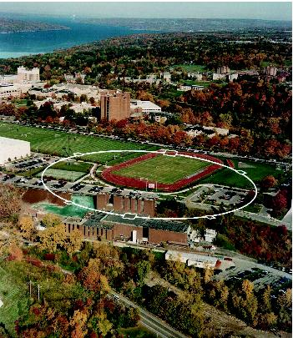
Electron Cloud Buildup Models and Plans
Jim Crittenden
Cornell Laboratory for Accelerator-Based Sciences and Education
LCWS11
29 September 2011

Slide 2
EC buildup modeling over > 15 years
– broadbased collaborative effort --
Example
ECLOUD'10
49th ICFA Advanced Beam Dynamic Workshop on Electron Cloud Physics
8-12 October 2010
M.A.Furman: Electron Cloud Buildup Simulations for the ILCDRs: Antechamber Benefit
T.Demma: Electron Cloud Buildup and Instability in DAΦNE
J.R. Calvey: Methods for Quantitative Interpretation of RFA Data
D.L.Kreinick: Using Coherent Tune Shifts to Evaluate Electron Cloud Effects on Beam Dynamics at CESRTA
L.Wang: Electron Cloud Trapping in Quadrupole and Sextupole Magnets
L.Boon: Analysis of Synchrotron Radiation Using SYNRAD3D and Plans to Create a Photoelectron Model
G.Dugan: SYNRAD3D Photon Propagation and Scattering Simulation
JAC: Electron Cloud Modeling for Shielded Pickup Measurements at CESRTA
C.Celata: Electron Dynamics in the Wigglers of CESRTA
P.LeBrun: Simulation of the Electron Cloud in the FNAL Main Injector Using VORPAL
S.Veitzer: Modeling Electron Cloud Buildup and Microwave Diagnostics with VORPAL
K.Harkay: Electron Cloud Issues for the APS Superconducting Undulator

Slide 3
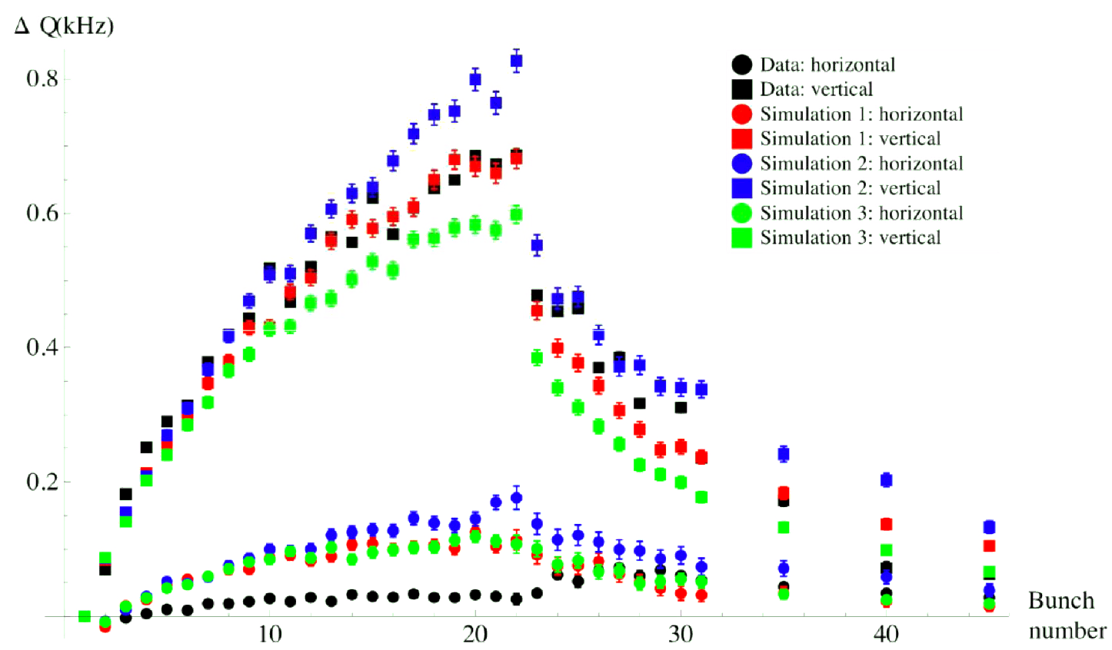
Modeling Coherent Tune Shift Measurements
PAC09, IPAC10, PAC11, IPAC11
POSINST simulations with direct radiation rates, reflectivity=15%, QE=12%, Gaussian PE energy spectrum
SEY=2.2
SEY=2.0
SEY=1.8

Slide 4
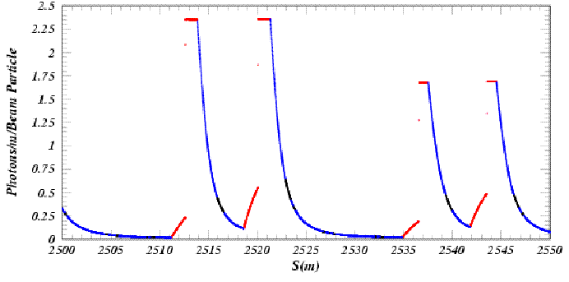
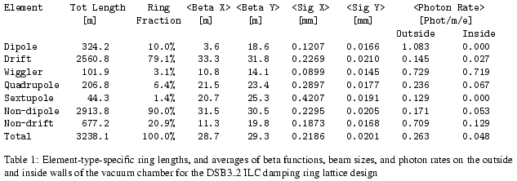
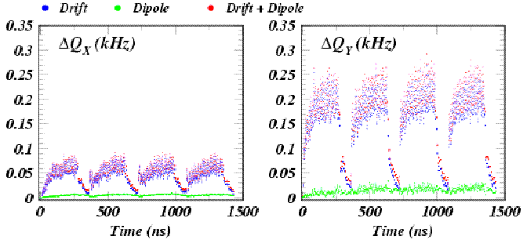
ILC DR Coherent Tune Shift Calculation
JAC & K.Sonnad, PAC11, WEP110
Synchrotron Radiation Pattern in the DSB3 Lattice Arcs
Element-type-specific beta functions and photon rates from BMAD/SYNRAD
Coherent Tune Shifts Calculated from Field Gradients Along Four 45-Bunch Trains
Contributions from drift and dipole regions
Compare to the fractional design tunes of 17.5 kHz and 22.3 kHz.
Coherent Tune Shifts Calculated from Field Gradients Along Four 45-Bunch Trains
Contributions from drift and dipole regions
Compare to the fractional design tunes of 17.5 kHz and 22.3 kHz.

Slide 5
EC Buildup R&D at CESRTA
CESR Configuration
  Damping ring layout
  4 dedicated EC experimental regions
  Upgraded vacuum/EC instrumentation
  Energy flexibility from 1.8 to 5.3 GeV
  Regularly achieving <10pm vertical emittance
EC Diagnostics and Mitigation
  ~30 RFAs presently deployed
  TE wave measurement capability in each experimental region
  Time-resolved shielded pickups in 3 experimental locations (2 with transverse information)
  Over 20 individual mitigation studies conducted in Phase I
    20 chambers
    2 sets of in situ SEY measurements
    Follow-on studies in preparation for Phase II extension of program
Simulations: to allow extrapolation to ILC DR
  Simulations of photon transport, including scattering (specular and diffuse) and fluorescence, in realistic chambers (including antechambers).
  EC growth: establishing physics model parameters for EC growth codes (POSINST, ECLOUD): models of primary photoemission and secondary emission

Slide 6
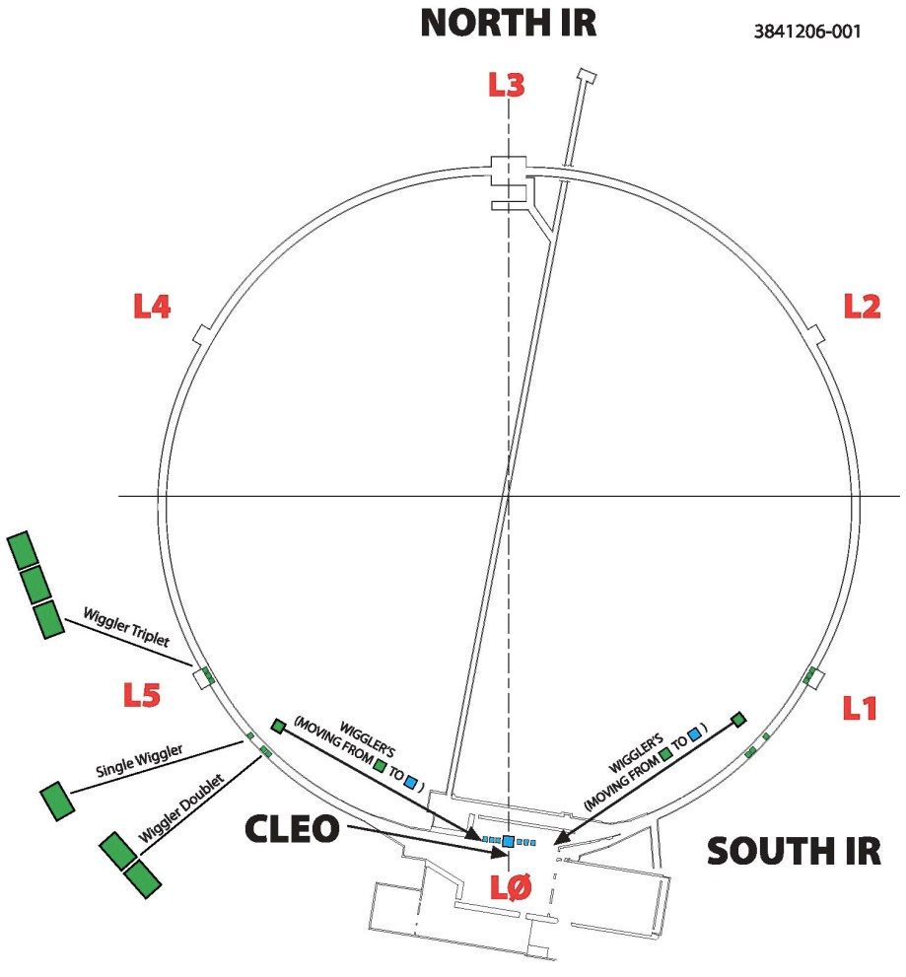
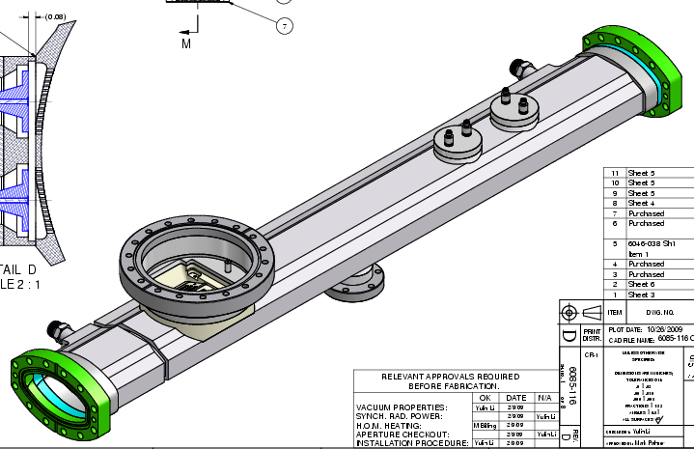

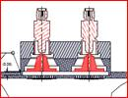
EC Buildup Detectors at CESRTA
L3 Electron cloud experimental region
PEP-II EC Hardware:
Chicane, upgraded SEY station
(commissioning in May 2009)
Drift and Quadrupole diagnostic chambers
New electron cloud experimental regions in arcs
(after 6 wigglers moved to L0 straight)
Locations for collaborator experimental
vacuum chambers
Custom vacuum chambers with shielded pickup detectors
Uncoated aluminum, and TiN, amorphous carbon, diamond-like carbon coatings
30 RFAs in drift regions, dipoles, quadrupoles, and wigglers

Slide 7
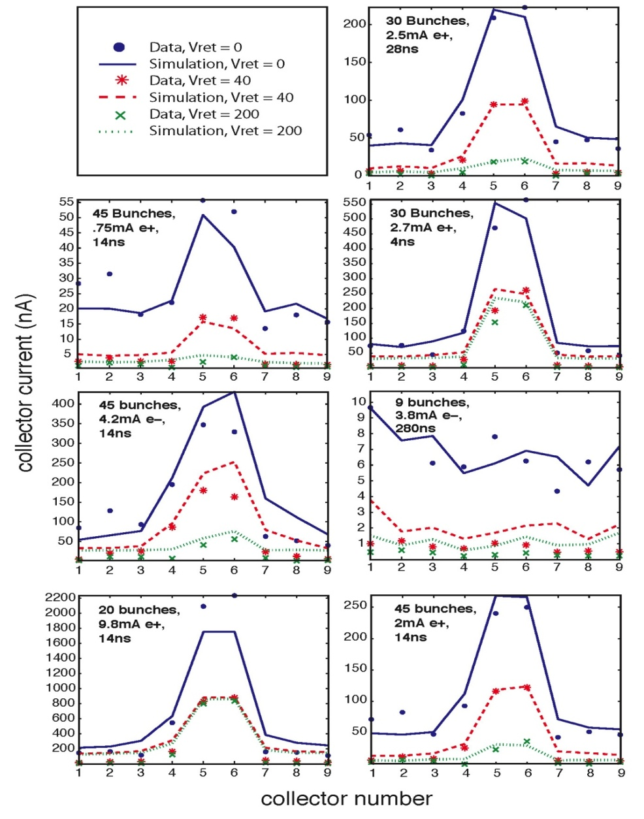
Drift Region RFA Data vs Simulation
J.R. Calvey et al, ECLOUD10, PaC11, IPAC11
Goals:
Evaluate surfaces under a wide range of conditions to evaluate in situ surface parameters using the RFA data
  Use photon distributions from 3d photon transport simulations
  Vary: Bunch charge & spacing, species, beam energy, RFA retarding voltage
  Fit for:
  Peak value of the true SEY
  Energy of the SEY peak
  Elastic scattering fraction, δ(0)
  Rediffused scattering fraction
  Quantum efficiency
  Incorporate constraints from time-resolved shielded pickup (SPU) data
5.3 GeV Data

Slide 8
ECLOUD Modeling of CESRTA Shielded Pickup Pulse Shapes: Photoelectrons
JAC et al, IPAC11, WEPC135, Recent Developments ...
Disentangling the Photoelectron Production Kinetic Energy Distribution from the Beam Kick Strengths
The early SPU signal from the leading bunch for a positron beam is largely due to photoelectrons produced on the bottom of the vacuum chamber. This is the closest production point where the beam kick attracts the photoelectrons toward the SPU. Thus the size and shape of the leading bunch signal is determined by the reflected photon rate, azimuthal distribution, the quantum efficiency for producing photoelectrons, and the kinetic energy distribution of the photoelectrons. In particular, the arrival time distribution determines the shape. By modeling the shape for different strengths of beam kick, we can determine the photoelectron energy distribution. An example of such an analysis is shown on the left. Note that the signal begins just a few nanoseconds after bunch passage even for weak beam kicks, indicating that high-energy photoelectrons were produced (hundreds of eV).

Slide 9
Example: 3 mA/bunch 5.3 GeV e+
15E a-Carbon
Two Power-Law Contributions
F(E) = E ^{P1} / ( 1 + E/E₀ ) ^{P2}
E₀ = E_{peak} (P₂-P₁)/P₁
This level of modeling accuracy was achieved with the photoelectron energy distribution shown below, using a sum of two power law distributions.
E_{peak}= 80 eV P₁= 4 P₂= 8.4
The high-energy component (22%) has a peak energy of 80 eV and an asymptotic power of 4.4. Its contribution to the signal is shown as yellow circles in the lower left plot.
E_{peak}= 4 eV P₁= 4 P₂= 6
The low-energy component (78%) has a peak energy of 4 eV and an asymptotic power of 2. It's contribution to the signal is shown as pink triangles.

Slide 10
Photoelectron Energy Distribution
5.3 GeV e+ 15E a-Carbon

Slide 11
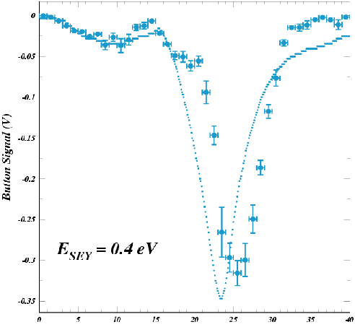
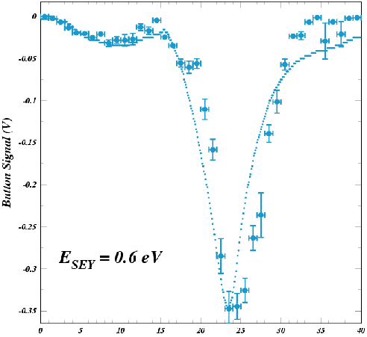
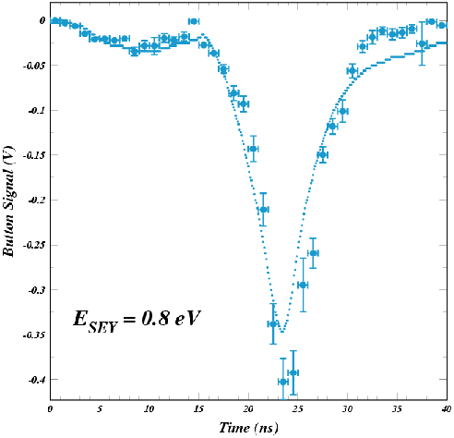
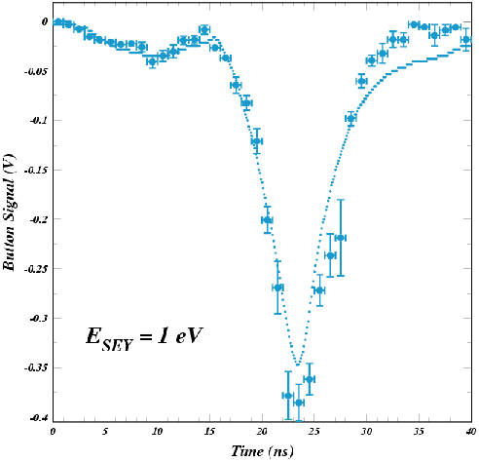
ECLOUD Modeling of CESRTA Shielded Pickup Pulse Shapes: Secondary electrons
Constraints on the
kinetic energy distribution
for secondary electrons
f(E_{sec}) ~ E_{sec} exp (-E_{sec}/E_{SEY} )
A Lower Bound on the E_{SEY} Parameter
The signal from a witness bunch following 14 ns after the leading bunch includes additionally a much larger contribution from secondary cloud electrons accelerated into the SPU detector by the witness-bunch kick.
The figures on the left show that if the secondary energy distribution does not include sufficiently high energies, the modeled 14-ns witness bunch signal shape is distorted and inconsistent with the measured signal.

Slide 12
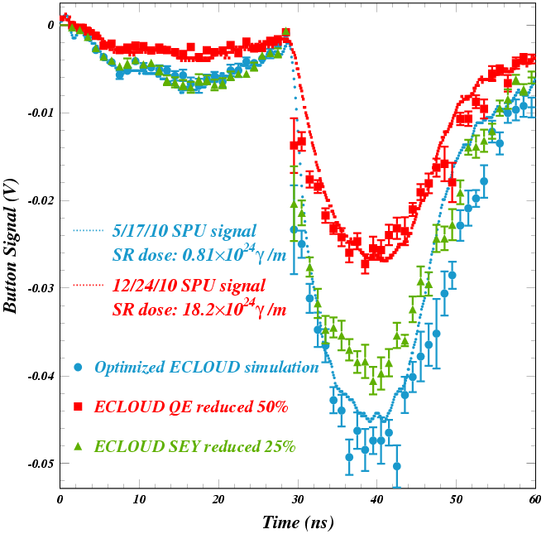
In Situ Vacuum Chamber Comparisons
– Conditioning Effects --
JAC et al, IPAC11, WEPC135, Recent Developments ...
Beam Conditioning in an Amorphous-carbon-coated Al Chamber
Shielded pickup signals measured in an amorphous-carbon-coated chamber in May (blue dotted line) and December (red dotted line) of 2010 for two bunches carrying 4.8×10¹⁰ 5.3 GeV positrons 28 ns apart. The synchrotron radiation dose increased by a factor of twenty during this time interval. The ECLOUD model optimized for the May data is shown as blue circles, the error bars showing the model statistical uncertainties.
The leading bunch arises from photoelectrons produced on the bottom of the vacuum chamber. Careful tuning of the energy distribution and quantum efficiency for photoelectrons produced by reflected photons is required to reproduce its size and shape. The signal from the witness bunch includes additionally the contribution from secondary cloud electrons accelerated into the SPU detector by the witness bunch kick and is therefore crucially dependent on the secondary yield and production kinematics. Since the conditioning affects both signals similarly, we can conclude that the conditioning change is in the quantum efficiency rather than in the secondary yield.
The December measurement is reproduced by a 50% decrease in the modeled quantum efficiency for photoelectron production. A reduction in the secondary yield of 25% is inconsistent with the observed effect, since the leading bunch signal is unchanged.

Slide 13
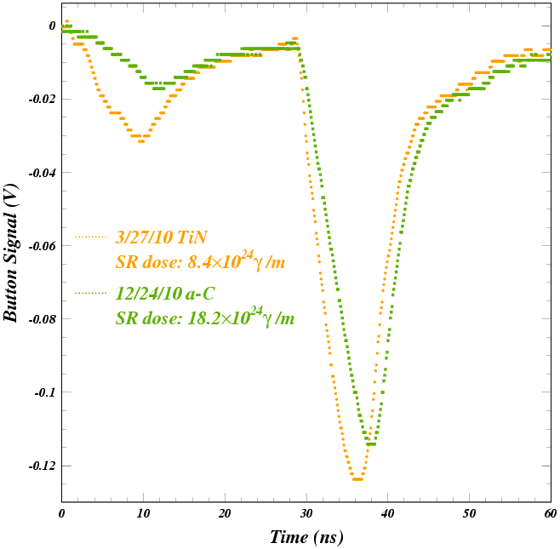
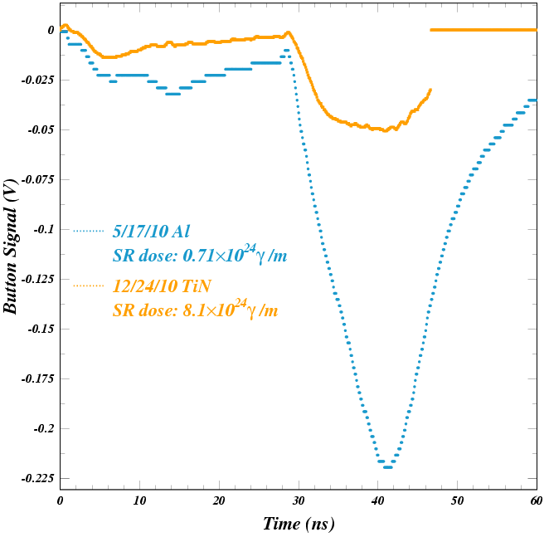
In Situ Vacuum Chamber Comparisons
– Coating Comparison --
The carbon coating suppresses photoelectron
production relative to the TiN coating, especially at high photoelectron energy. However, the secondary yield is somewhat higher.
The quantum efficiency for reflected photons and the secondary yield are both much smaller for conditioned TiN than for uncoated aluminum.

Slide 14
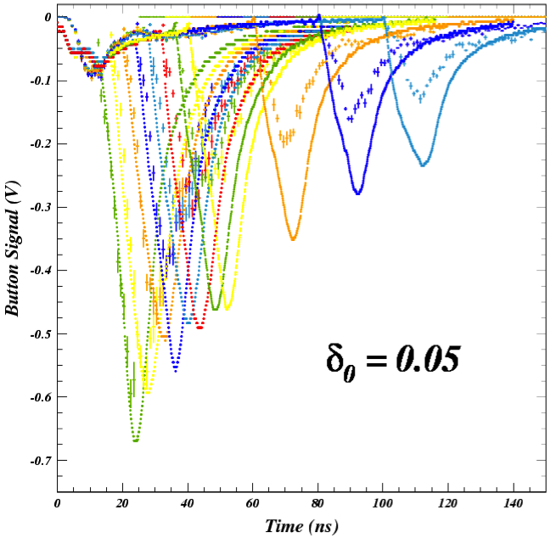
Shielded Pickup Witness Bunch Studies for Determining Cloud Lifetime
Superposition of eleven two-bunch SPU signals with time delays between 12 and 100 ns, compared to the ECLOUD model result
The cloud lifetime following passage of the final bunch is determined by the elastic secondary process, because it dominates at low incident electron energy, while the true and rediffused secondary processes both produce secondaries with reduced energy.
This was the original motivation for the shielded pickup development and was the analyis of first priority. These analyses have shown cloud lifetimes for the coated chambers (TiN, amorphous carbon, and diamond-like carbon) to be dramatically shorter than for the uncoated aluminum chamber.
This early study shows discrepancies with the measured signals which were later found to be due to an unrealistic model for photoelectron production. Despite these deficiencies in the model, the conclusion that an elastic yield value of 0.05 is too low for this uncoated aluminum chamber is clear.

Slide 15
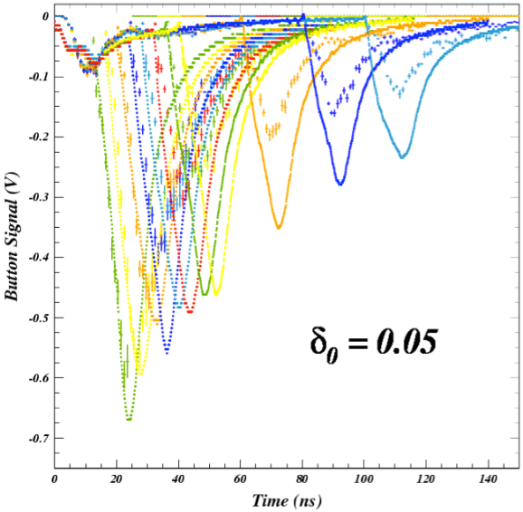
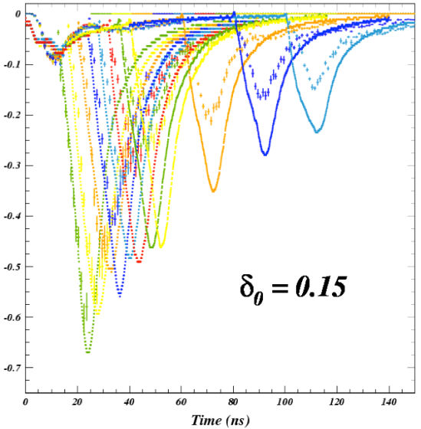
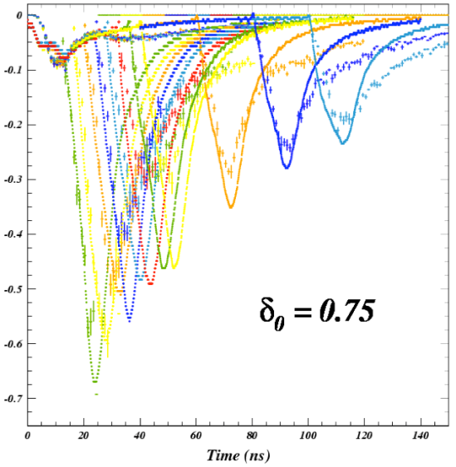
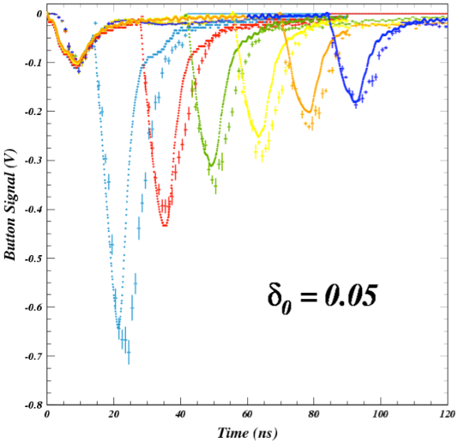
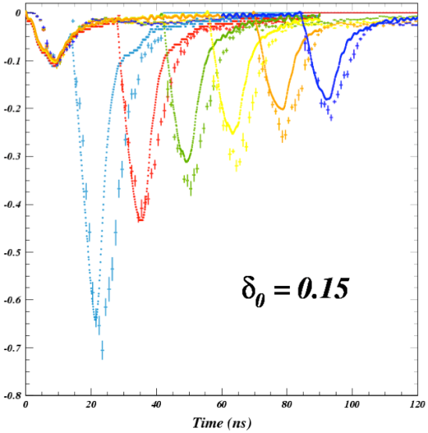
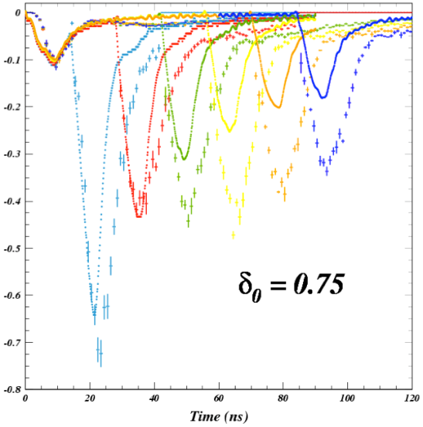
Determining the Elastic Yield Parameter δ₀
– Compare uncoated Al with TiN coating--
spu
e- signal from B1
sensitive to PE model
Bare Al
TiN
Witness bunch studies with delays up to 100 ns show clear sensitivity to the secondary elastic yield parameter,
giving a value of about 0.75 for bare aluminum and about 0.05 for the TiN coating.
The discriminating power is independent of the photoelectron model.

Slide 16
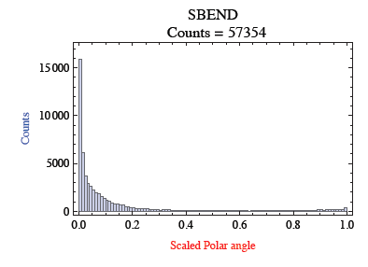
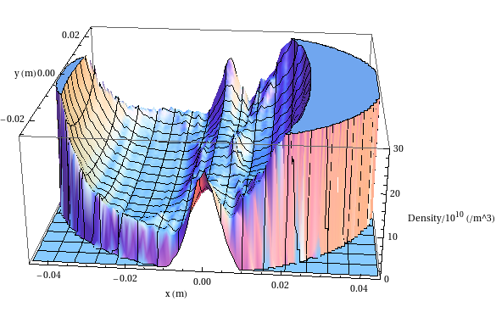
Planned Improvements to EC Growth Simulations
Better photon reflection and transport model needed for simulations and data analysis
Synrad3D (Sagan, et al.) answers this need, but work remains
  Fully validate CESRTA vacuum chamber geometries, then implement ILC DR designs
  Incorporate diffuse scattering due to surface roughness and fluorescence
Photon distribution vs angle
Electron cloud distribution vs position,after 10 bunch train
Time-resolved SPU measurements indicate that we also need to have a better photoelectron model (fitting of RFA data also requires this)

