Slide 1
Use of the Shielded-Pickup Measurements for Optimization of the Photoelectron Production Energy Distribution in ECLOUD
-- This topic was included in the poster sidepanel for WEPC135 at IPAC11 --
Jim Crittenden
Cornell Laboratory for Accelerator-Based Sciences and Education
Electron Cloud Meeting
7 September 2011

Slide 2
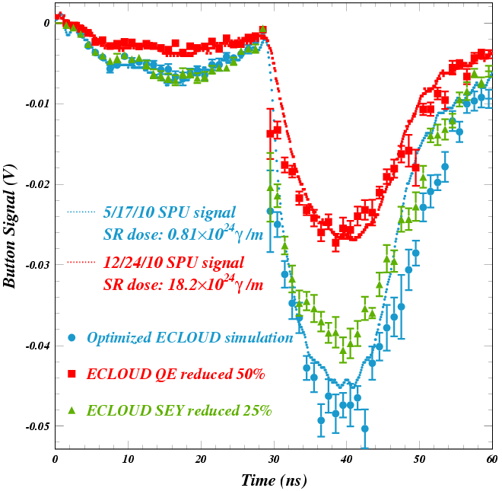
Bunch Current Scan Analysis
Disentangling the Photoelectron Production Kinetic Energy Distribution from the Beam Kick Strengths
The early SPU signal from the leading bunch for a positron beam is largely due to photoelectrons produced on the bottom of the vacuum chamber. This is the closest production point where the beam kick attracts the photoelectrons toward the SPU. Thus the size and shape of the leading bunch signal is determined by the reflected photon rate, azimuthal distribution, the quantum efficiency for producing photoelectrons, and the kinetic energy distribution of the photoelectrons. In particular, the arrival time distribution determines the shape. By modeling the shape for different strengths of beam kick, we can determine the photoelectron energy distribution. An example of such an analysis is shown on the left. Note that the signal begins just a few nanoseconds after bunch passage even for weak beam kicks, indicating that high-energy photoelectrons were produced (hundreds of eV).

Slide 3
Example: 3 mA/bunch 5.3 GeV e+ 15E a-Carbon
Two Power-Law Contributions
F(E) = E ^{P1} / ( 1 + E/E₀ ) ^{P2}
E₀ = E_{peak} (P₂-P₁)/P₁
This level of modeling accuracy was achieved with the photoelectron energy distribution shown below, using a sum of two power law distributions.
E_{peak}= 80 eV P₁= 4 P₂= 8.4
The high-energy component (22%) has a peak energy of 80 eV and an asymptotic power of 4.4. Its contribution to the signal is shown as yellow circles in the lower left plot.
E_{peak}= 4 eV P₁= 4 P₂= 6
The low-energy component (78%) has a peak energy of 4 eV and an asymptotic power of 2. It's contribution to the signal is shown as pink triangles.

Slide 4
Photoelectron Energy Distribution 5.3 GeV e+ 15E a-Carbon

