Slide 1
Lattice DSB (new version in progress) _{S. Guiducci}
Webex 8 February 2011

Slide 2
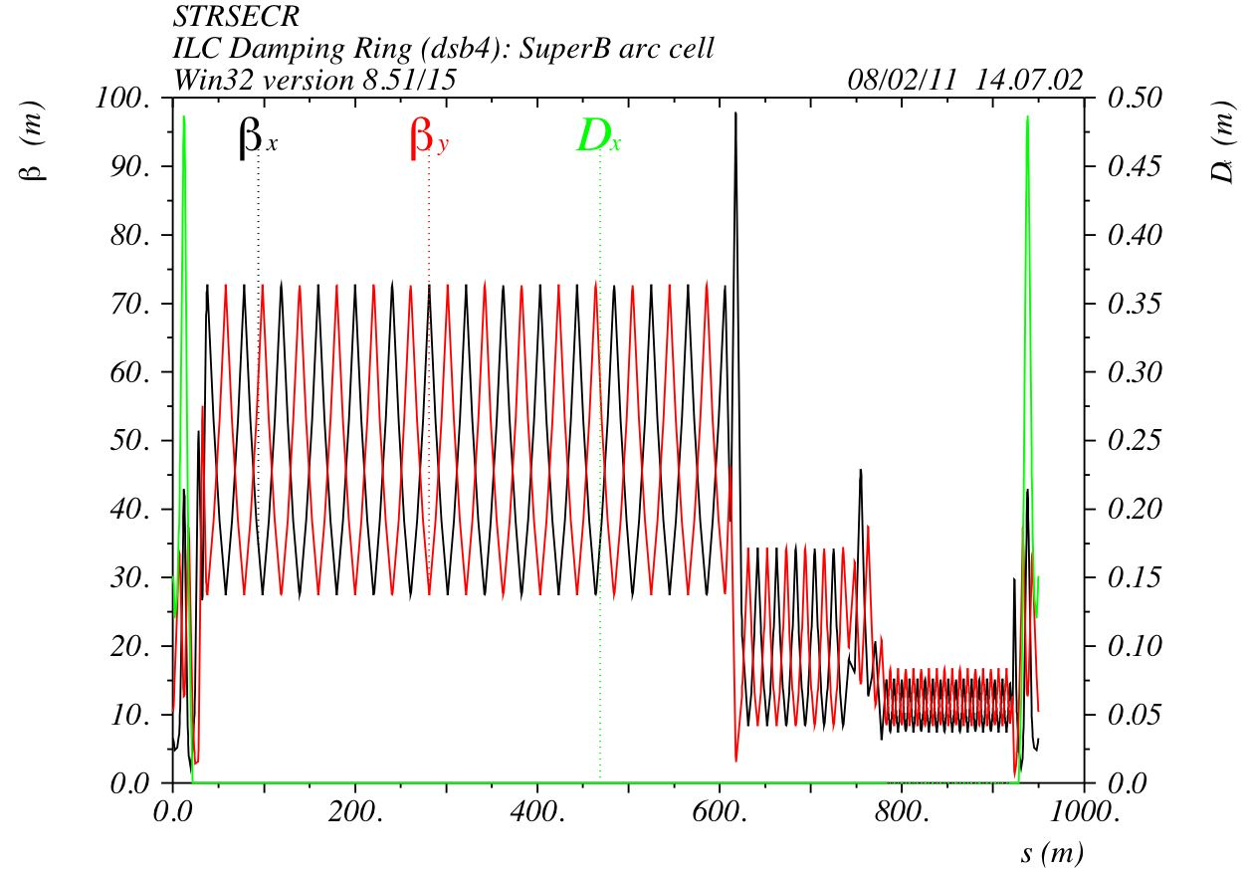
RF and wiggler straight section

Slide 3
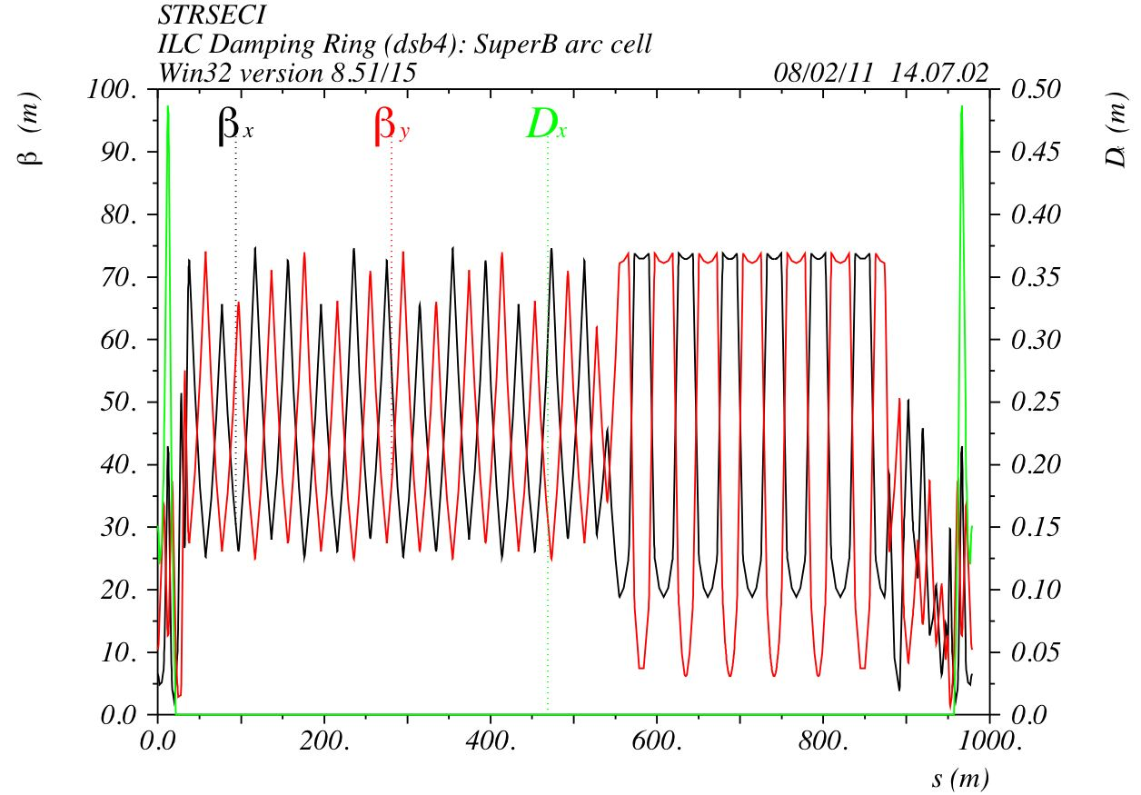
Injection extraction straight section
The length of the straight sections is slightly different, needs a correction

Slide 4
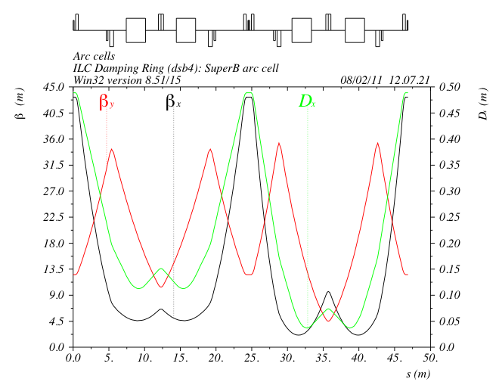
Arc cells
Δμ_{x}¹ = π
Δμ_{x}² = 1.5π
Δμ_{y}¹ = Δμ_{y}² =π/2
SF
SF

Slide 5
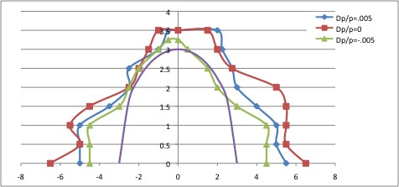
Dynamic Aperture
The violet line is the maximum beam size of the injected beam 3σ_{inj}
The horizontal acceptance is fine
The vertical acceptance is too small

Slide 6
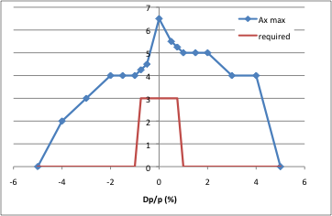
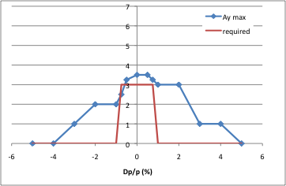
A_{x} e A_{y} vs Δp/p
Ax
Ay
The energy acceptance is much larger than 1%

Slide 7
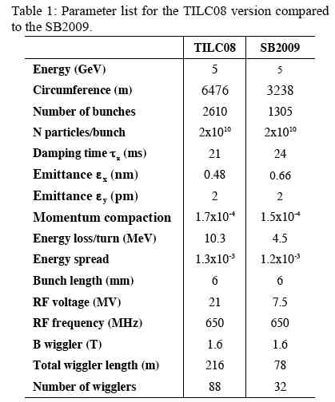
Parameters

Slide 8
Arc and straights
 | arc | Straight 1 | Straight 2 | Total
Qx | 34.245 | 7.220 | 5.730 | 47.195
Qy | 13.014 | 6.997 | 6.226 | 26.237
Cx | 59.2 | -8.8 | -8.0 | 76
Cy | 32.6 | -9.6 | -9.8 | 52
S (m) | 1311.4 | 949.9 | 978.7 | 3240
No chicane in the straights
The length of the straights needs to be adjusted

Slide 9
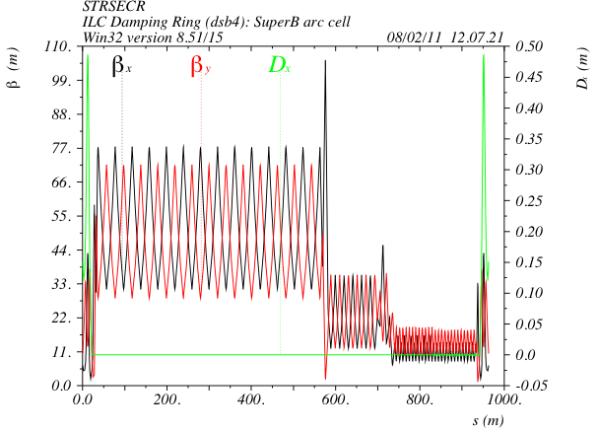
Straight sections corrected new wiggler model
To allow for 10 Hz operation:
50 wigglers (24 off)

Slide 10
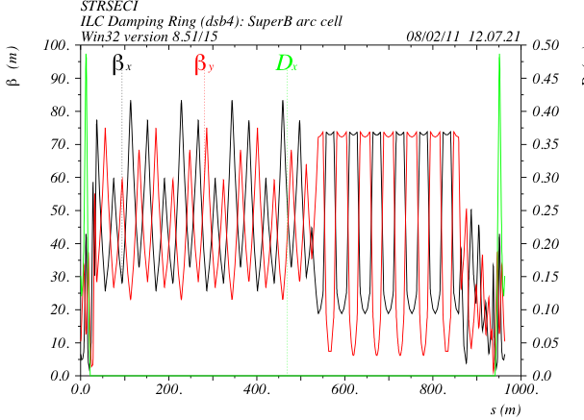
Straight sections corrected

Slide 11
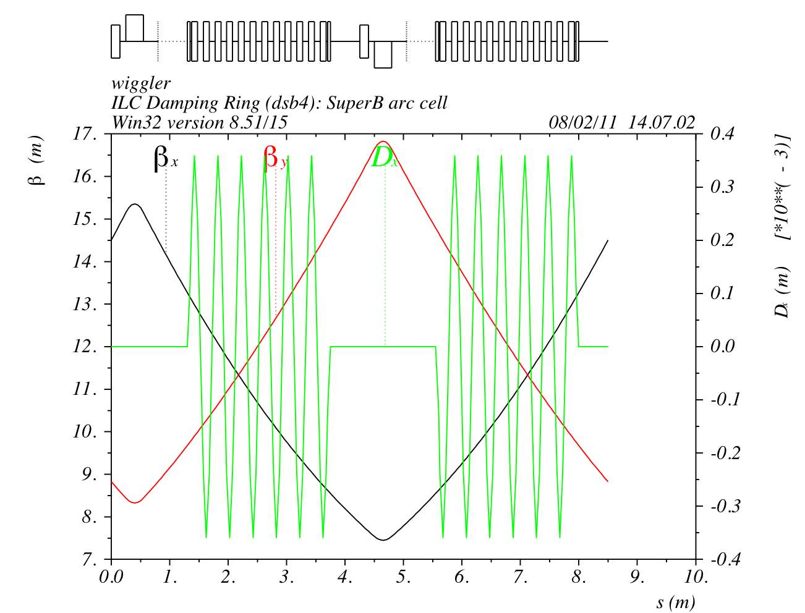
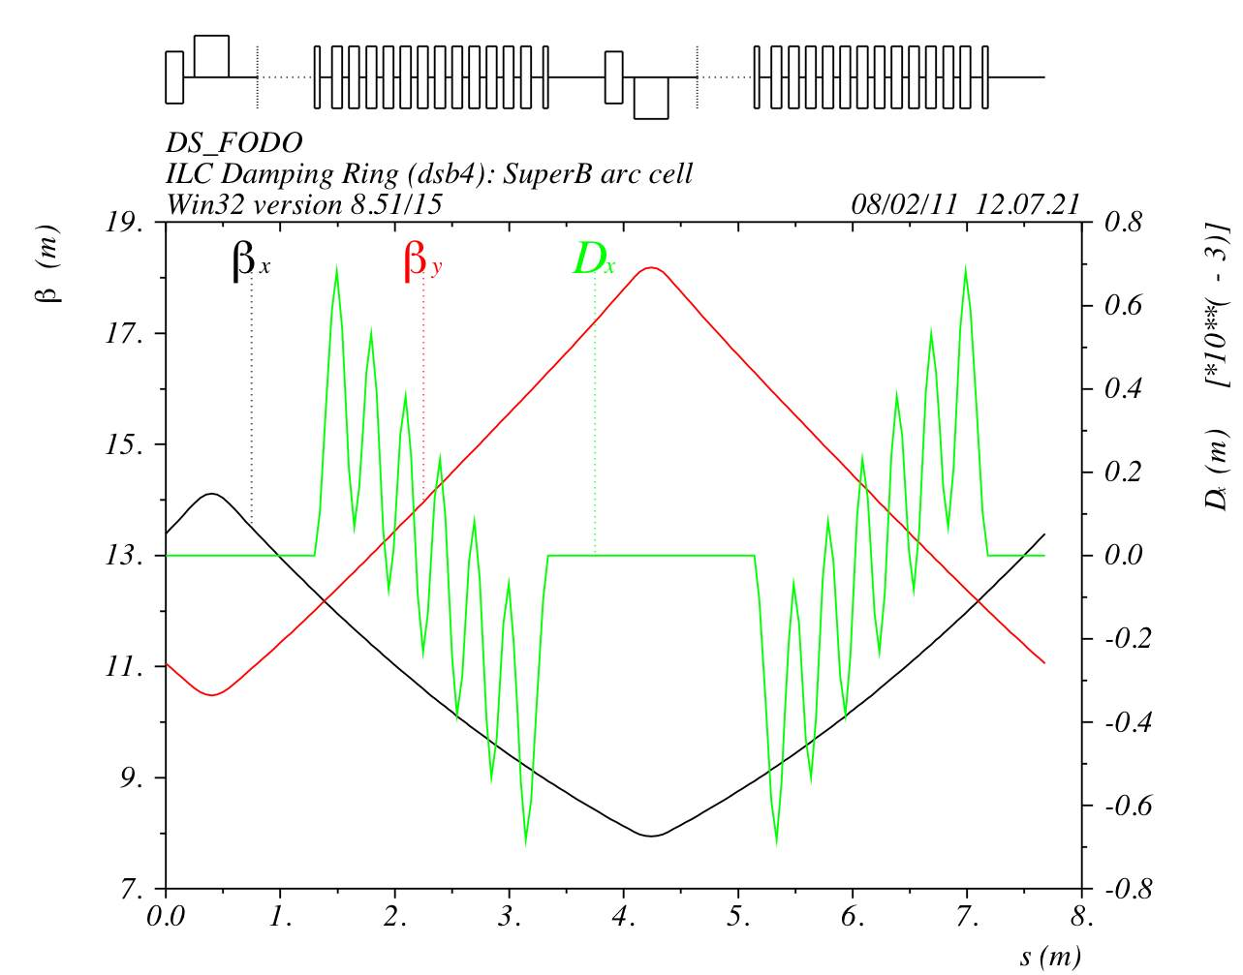
New wiggler model
DSB3
Period = 0.4 m
Field B = 1.6 T
Pole length 0.1 m
Pole distance 0.1 m
New
Period = 0.3 m
Field B = 1.9 T
Pole length 0.09 m
Pole distance 0.06 m

Slide 12
Dynamic aperture at Δp/p=0
The vertical dynamic aperture becomes worst

