Slide 1
DTC02 – DR 3.238km Lattice
Presenter
Cornell University

Slide 2
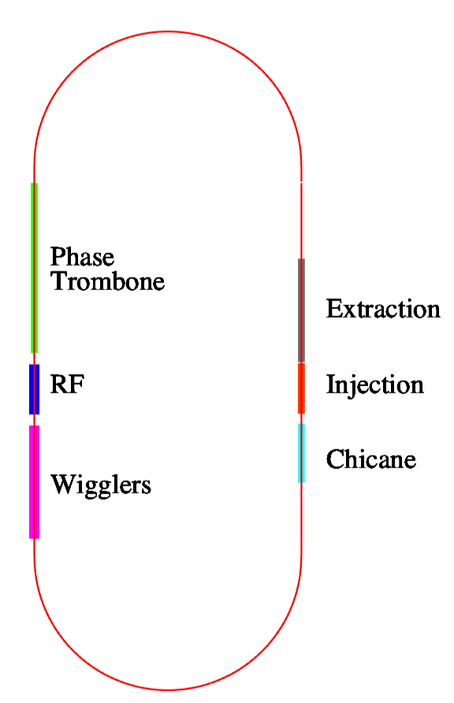
DTC02 Layout
Circumference = 3238.681m
a Harmonic number =7022
710m straights
Injection and extraction elements in stacked rings shifted for ELTR/PLTR beam line separation requirements
~ 6 phase trombone cells
Allow for 60 wigglers (allow for realistic wiggler parameters as opposed to sinusoidal or hard-edge models)
Wiggler period = 30cm
14-poles a 2.1m active length
B_{max} = 2.16T
Space for 16 RF cavities
Cryostats for upper and lower positron rings are interleaved
Spare space could also be used for 2nd harmonic cavities for bunch length control

Slide 3
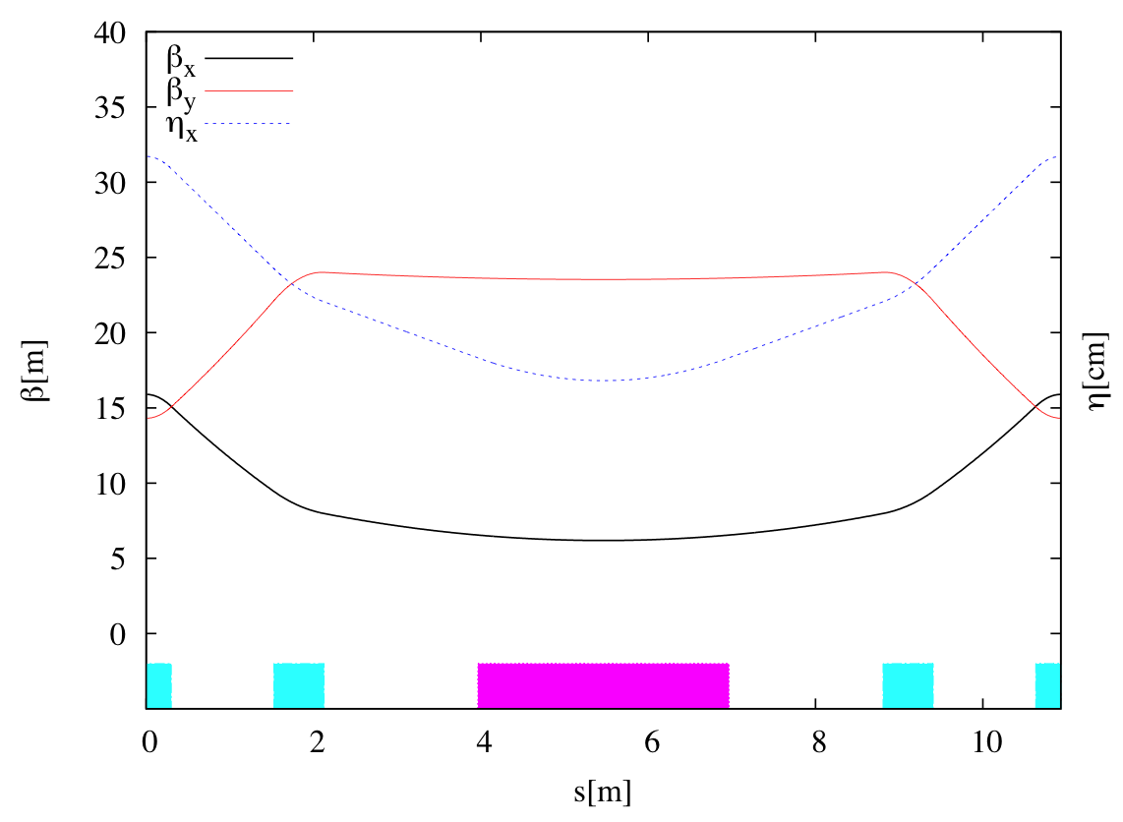
Arc Cell - FDBDF
Cell length = 10.93m
Bend length = 3.0m
75 cells/arc

Slide 4
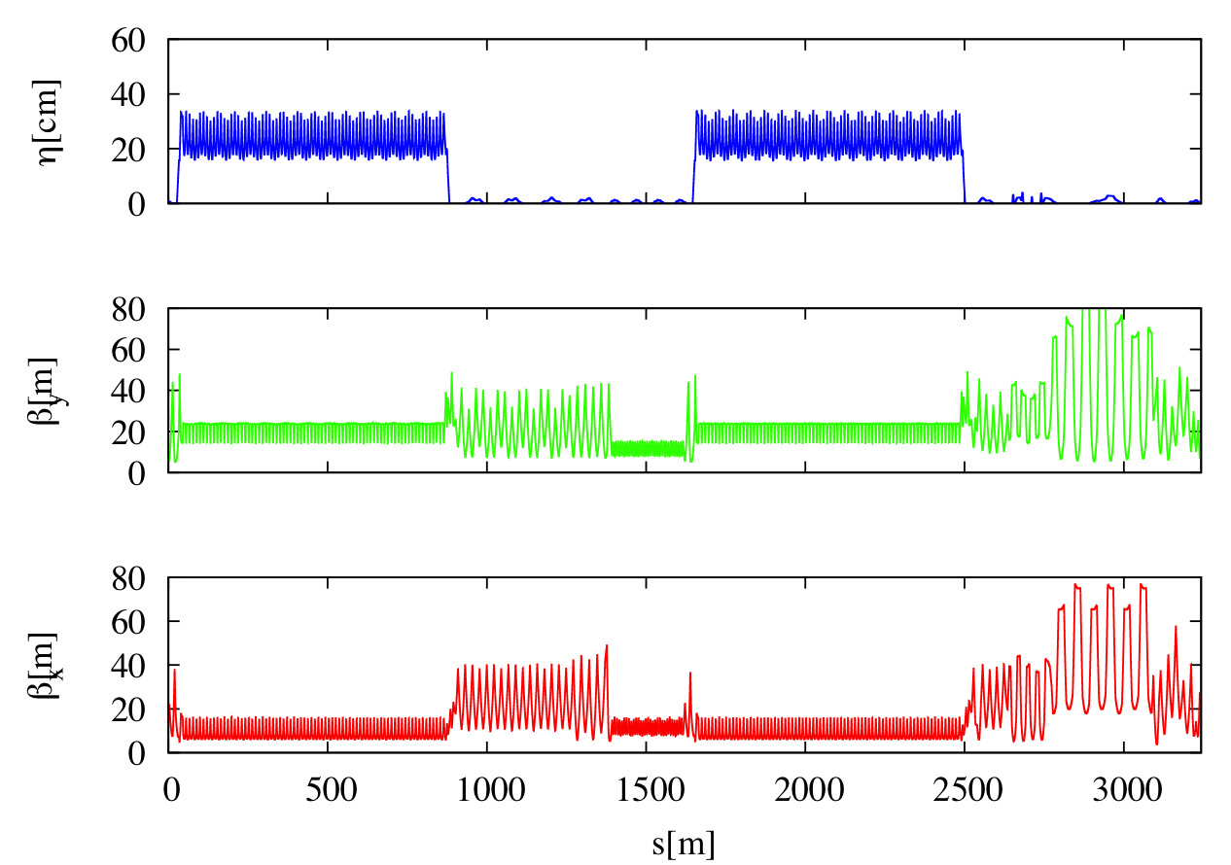
DTC02 Lattice Functions
Arc
Wig-RF
Straight
Arc
Inj-Ext
Straight

Slide 5
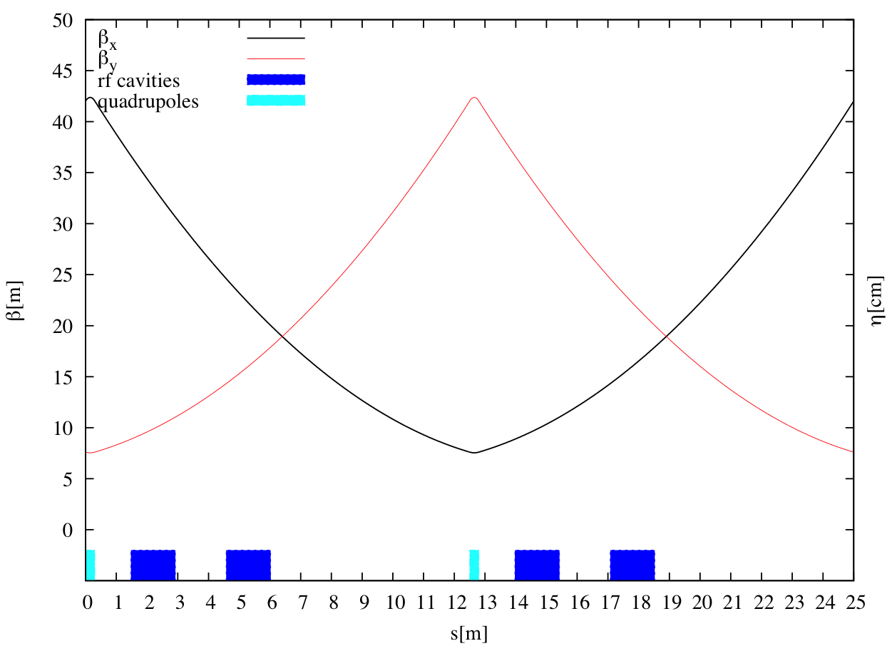
RF Cells

Slide 6
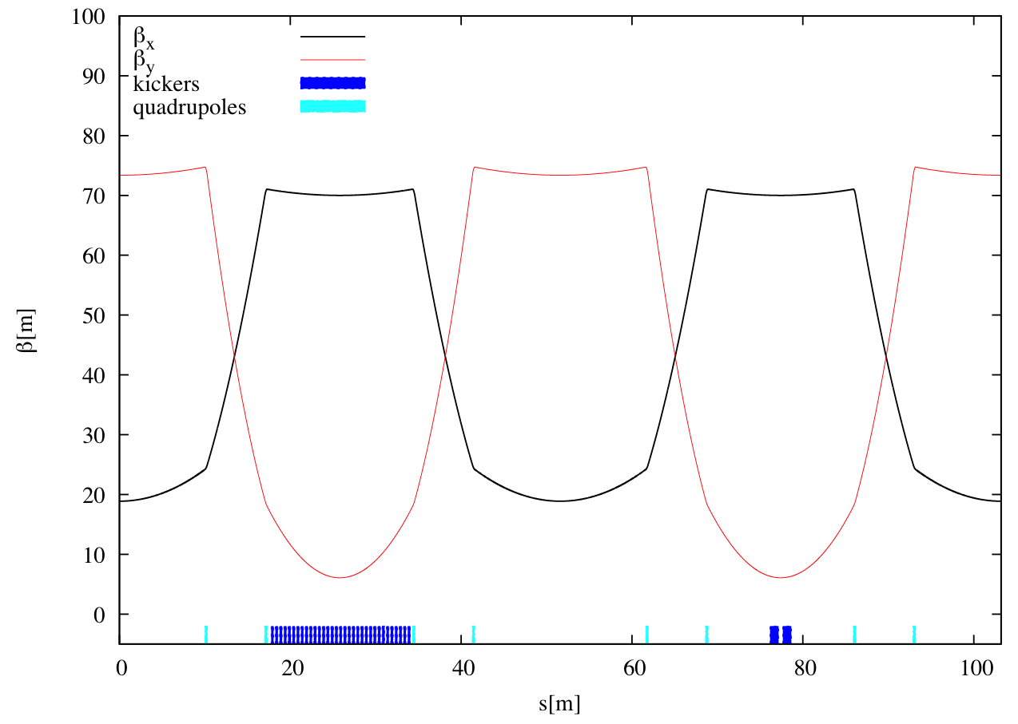
Extraction Straight

Slide 7
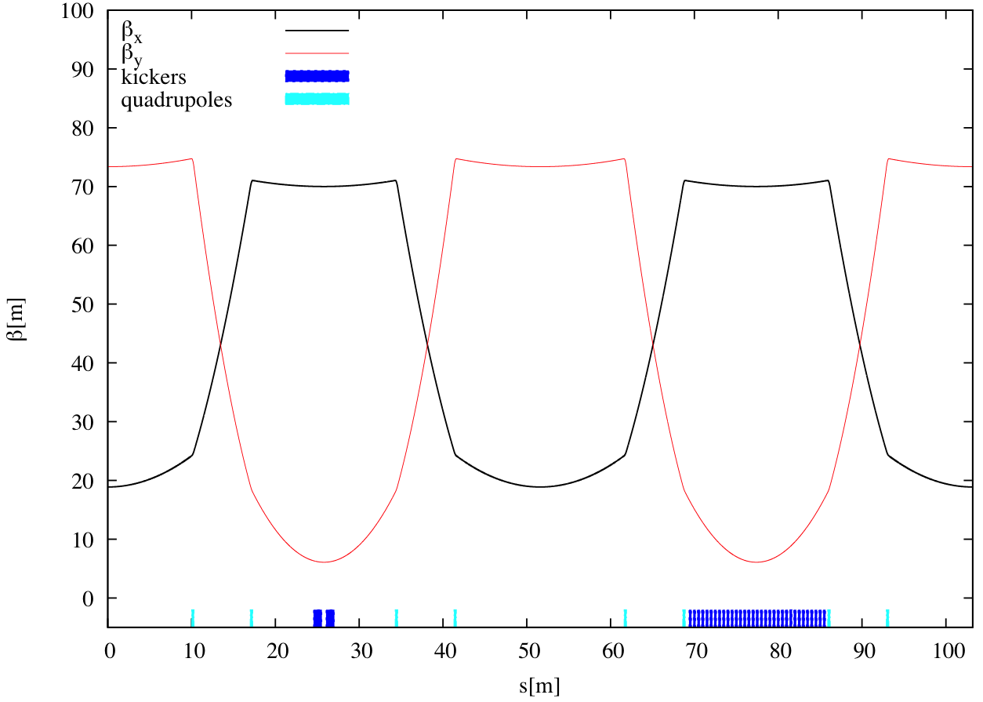
Injection straight

Slide 8
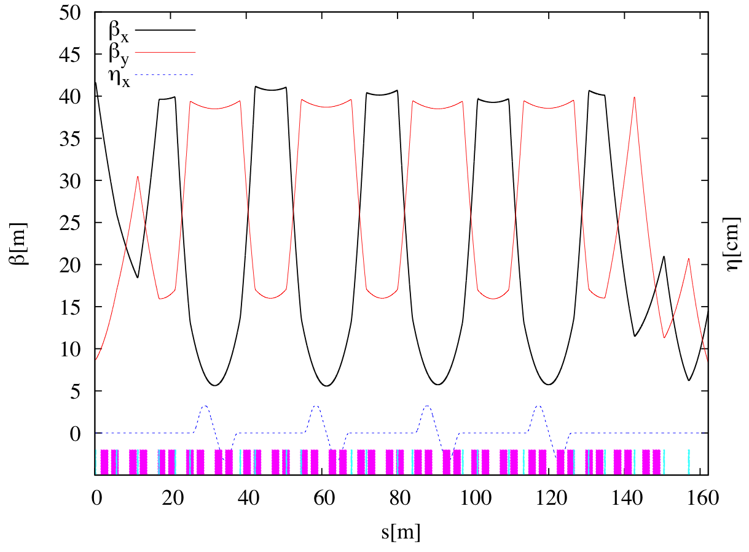
Circumference Changing Chicane

Slide 9
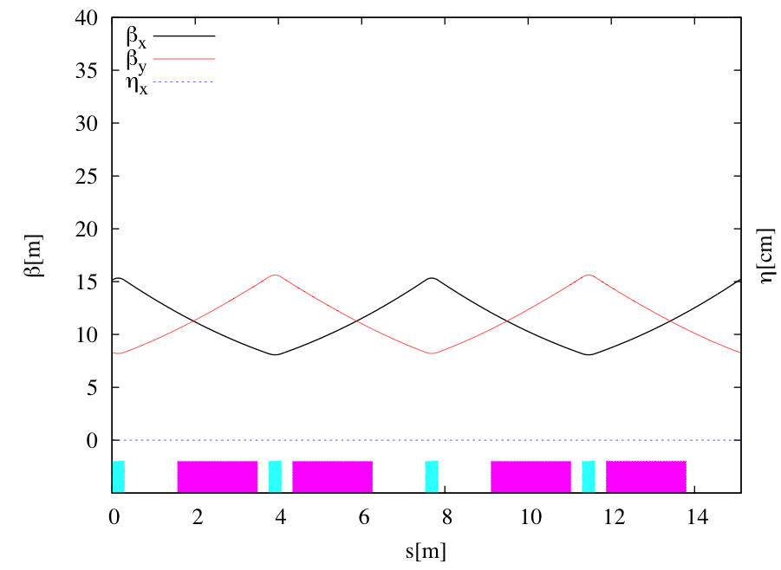
Wiggler
30cm wiggler params
14 poles
30cm period
Wiggler length = 2.1m
Cell length = 7.56 m
30 wiggler cells
2 wiggler cells

Slide 10
DTC02 Parameters
Parameter | 10 Hz(Low) | 5 Hz (Low) | 5 Hz (High)
Circumference | 3.23868 km | 3.23868 km | 3.23868 km
RF frequency | 650 MHz | 650MHz | 650 MHz
τ_{x}/τ_{y} [ms] | 13.5 | 24.1 | 24.1
Τ_{z} [ms] | 6.7 | 12.0 | 12.0
σ_{s} [mm] | 6 | 6 | 6
σ_{δ} | 0.134% | 0.11% | 0.11%
α_{p} | 3.3 X 10⁻⁴ | 3.3 X 10⁻⁴ | 3.3 X 10⁻⁴
γε_{x} [ μm] | 4.6 | 5.4 | 5.4
RF [MV] (12 cavities) Total/Per cav | 19.7/1.64 | 14 /1.17 | 14/1.17
ξ_{x}/ξ_{y} | -50.9/-44.1 | -51.3/-43.3 | -51.3/-43.3
Wigglers- N_{cells}@B[T] | 30@2.1 | 27@1.5 | 27@1.5
Energy loss/turn [MeV] | 8.0 | 4.5 | 4.5
sextupoles | 3.34/-4.34 | 3.34/-4.23 | 3.34/-4.23
Power/RF coupler @400mA [kW] | 267 | 150 | 300

Slide 11
RF
The lattice can accommodate 16 RF cavities
If we assume 12 then:
Voltage/ cavity in 10Hz mode is 1.64
Power/coupler in 5Hz, high power mode is 300kW

Slide 12
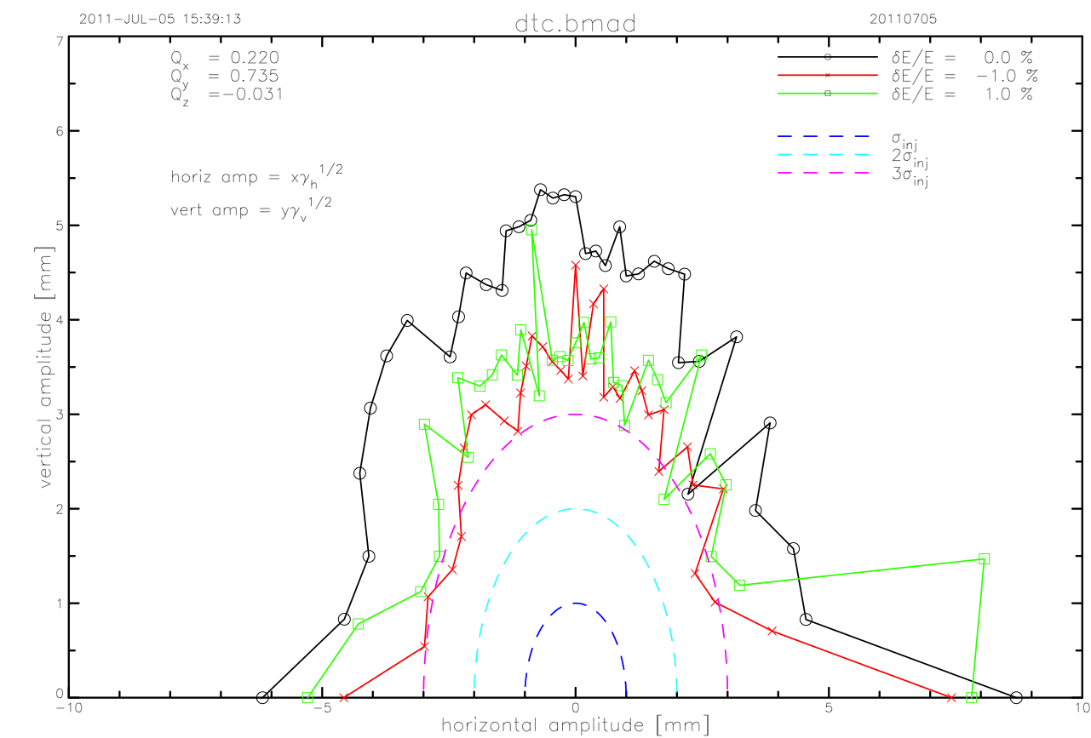
Dynamic Aperture: 5 Hz
Periodic type wiggler model, includes vertical focusing and cubic nonlinearity

Slide 13
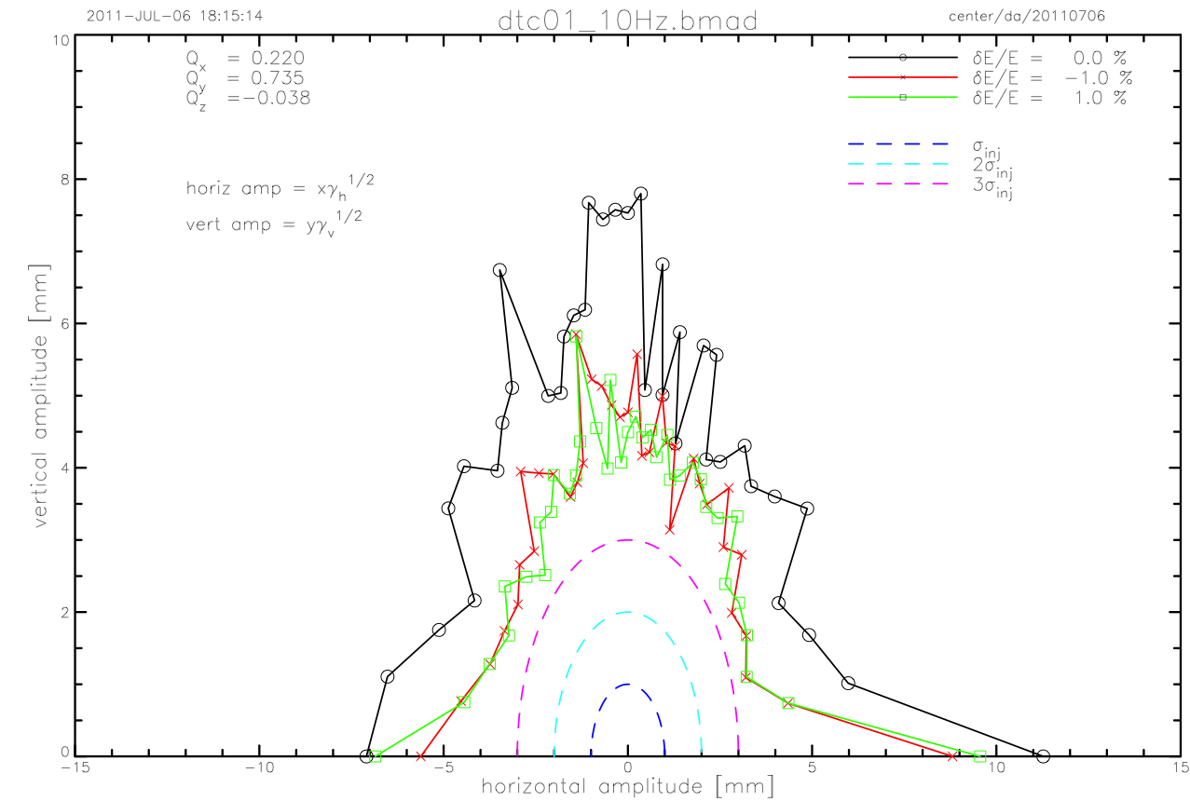
Dynamic Aperture:10 Hz
Periodic type wiggler model, includes vertical focusing and cubic nonlinearity

Slide 14
Magnet Count (Damping Ring)
Element | Length[m] | Strength | Number
Arc Dipoles | 3 | 2.28 kG | 150
Circumference changing chicane dipoles | 1 | 2.68 kG | 28
Other dipoles | 2 | < 2.28 kG | 4
Arc Quadrupoles | 0.6 | < 0.6 m⁻² | 450
Quadrupoles in dispersion suppressor and straights | 0.3 | < 0.55 m⁻² | 211
Sextupoles | 0.3 | < 4.34 m⁻³ | 600
RF cavities | 3 | < 1.64MV | 12
Wigglers | 2.1 | 2.16T | 60

Slide 15
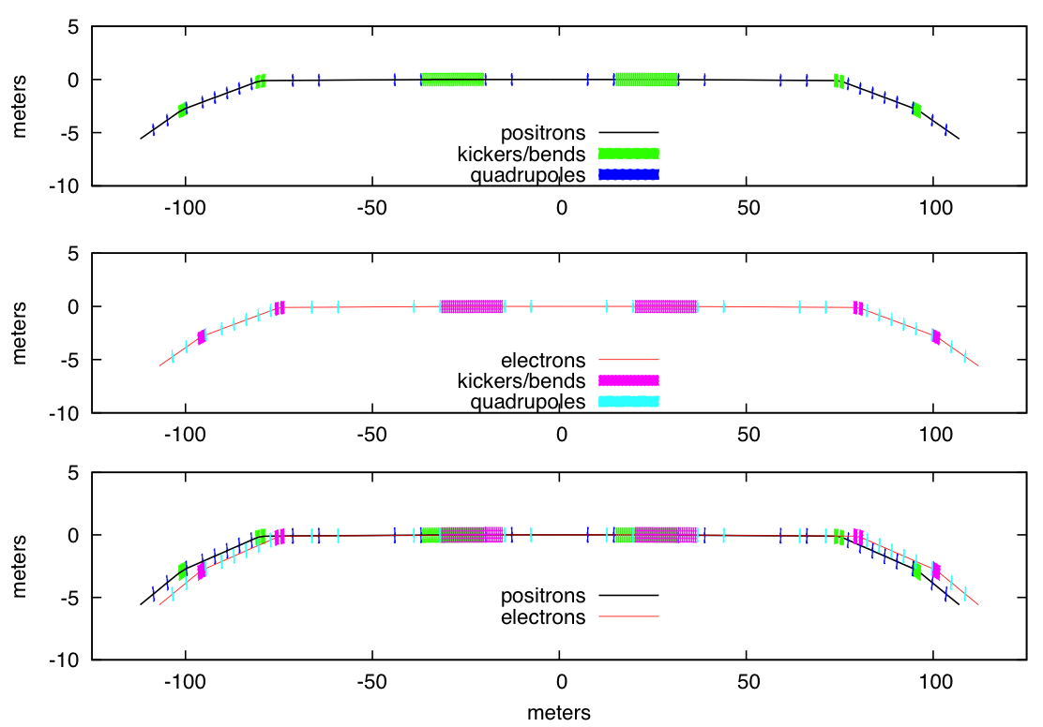
Injection/Extraction
Positrons – injection from left, extraction to right
Electrons – injection from right, extraction to left
Midpoint between injection and extraction kickers is 2.56m from center of straight
Angle at entrance/exit of transfer lines with respect to storage ring straight = 240mrad

Slide 16
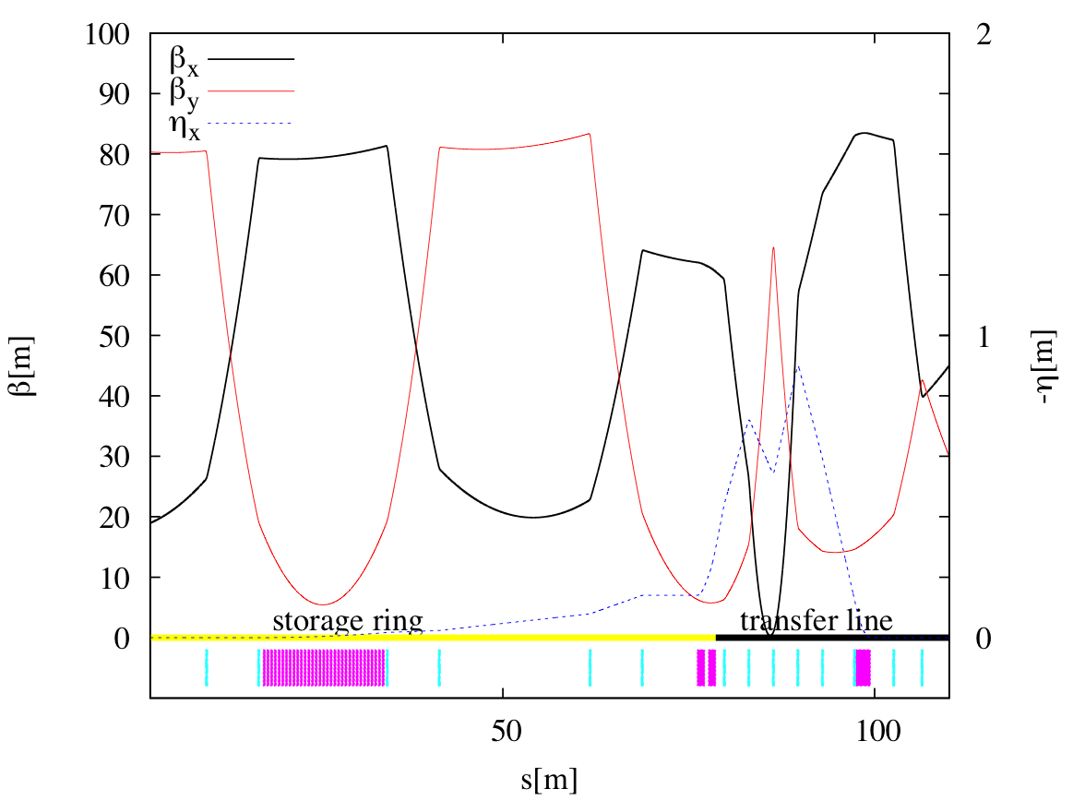
Injection/Extraction
Injection and extraction lines are identical
Angle with respect to damping ring straight = 240mrad

