Slide 1
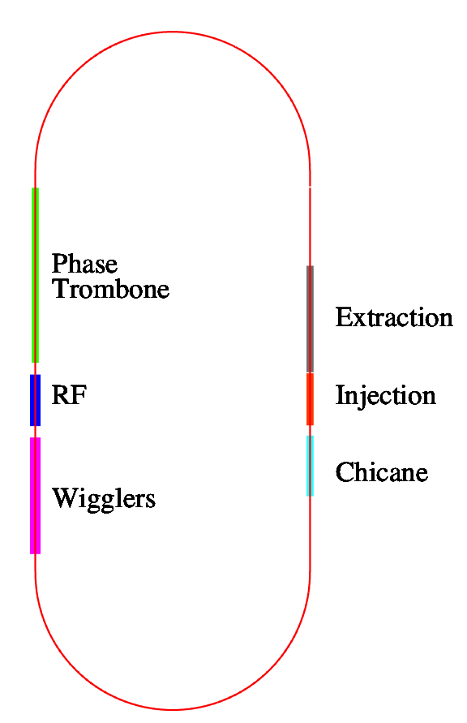
DTC02 Layout
Circumference = 3238.681m
Harmonic number =7022
710m straights
~ 6 phase trombone cells
60 – 2.1m long wigglers wiggler period = 30cm 14-poles B_{max} = 2.16T
Space for 16 RF cavities Cryostats for upper and lower positron rings are interleaved

