Slide 1
DR Layout Description
ILC DR Technical Baseline Review
Frascati, July 7, 2011
Mark Palmer
Cornell University

Slide 2
Introduction
Dave has provided an overview of the overall layout
This talk will focus on key elements of the present layout and the modifications from the previous baseline
  Principally:
    Straights and Alcove/Cavern Layout
    Beam Line Spacing/Tunnel Diameter Issues
  CFS Discussions included:
    Rough Arc Estimate
    Preliminary discussion of utilities specifications

Slide 3
Straights Layout
Layout Issues in Straights
  Minimize length consistent with 3.2km design requirements
  Maintain injection/extraction layout
  Minimize phase adjustment trombone
  Scale the circumference chicane with the size of the ring
  Space in RF & wiggler sections for all design options (low & high power, 10Hz ops)
  Added space in wiggler section for photon absorber

Slide 4
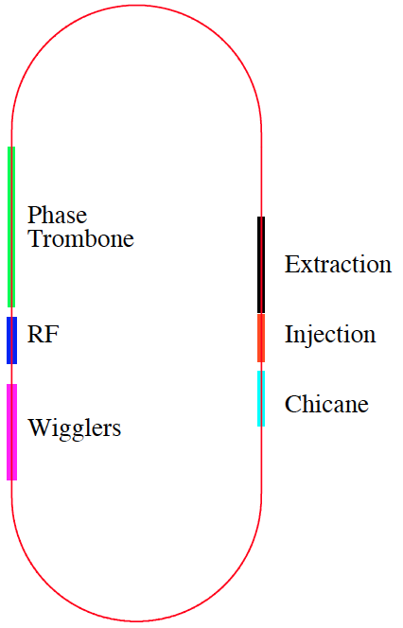
Interface with CFS
June 2, 2011 Meeting
  Review shorter straights
    RF-Wiggler Layout
    Cavern/Alcove Requirements
  Beam Line Spacing
  Presently set to 1.3m
  Set tunnel diameter
  Rough estimate of arcs

Slide 5
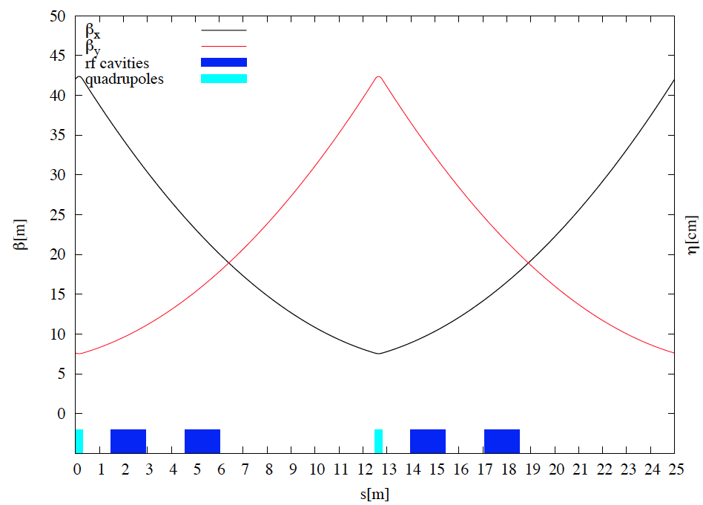
RF Longitudinal Picture
RF Cavity
Placement
Positron Ring #2
Positron Ring #1

Slide 6
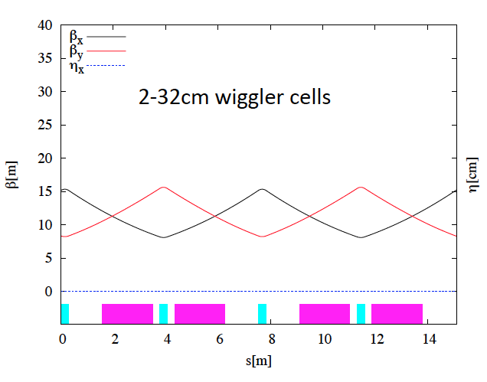
Wiggler Cell

Slide 7
RF-Wiggler Straight

Slide 8
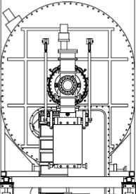
Tunnel Diameter Issues
Assumptions:
Remove large foot floor supports
Assume waveguides are re-routed
Reduce scale to 90% (~half of potential reduction with 500MHz a 650MHz cavities
1+2 a 0.85 × height, 3 gives another factor of 0.9
NOTE: No cryostats are located directly above each other when longitudinal positions are accounted for
Distributed
PS Racks?
42cm
dia
1.42 m
2.6 m
5.5 m
dia
6.0 m
dia
RF Alcove
2.09 m
~0.9 m
2.09 m

Slide 9
Injection-Extraction Straight

Slide 10
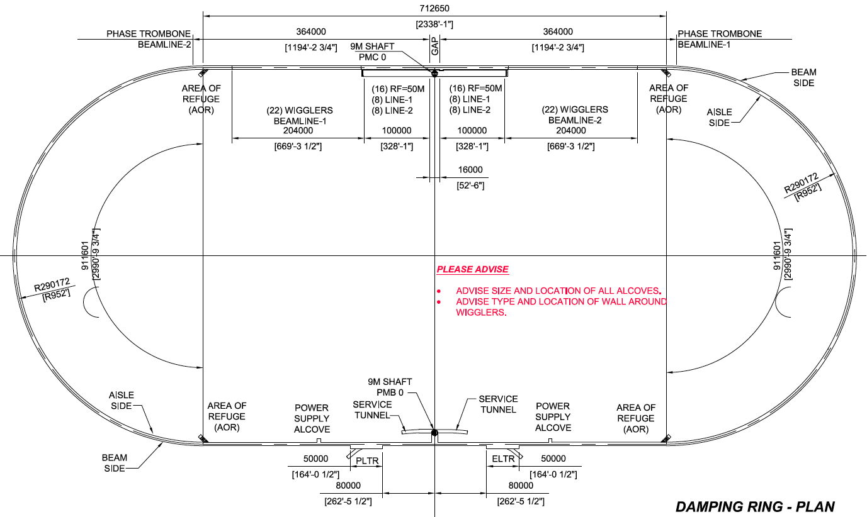
The Basic Racetrack

