Slide 1
Title Date
Author
for the CESRTA Collaboration

Slide 2
Vacuum System Design Effort
Work at Cornell directed towards:
Implementation of mitigation recommendations into the vacuum chambers
Need chamber profiles for next round of physics simulations
Need chamber and system conceptual design for costing

Slide 3
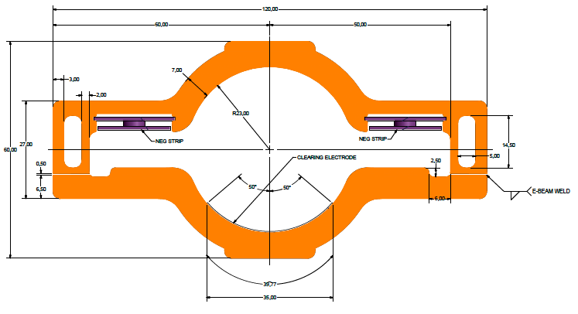
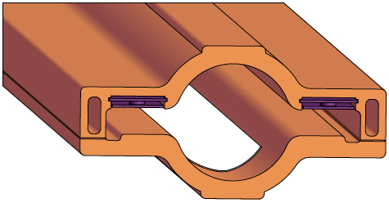
Wiggler Chamber Concept I
E-beam Weld Locations
NEG Strips for pumping
Clearing Electrode
Cu Chamber

Slide 4
Wiggler Chamber Concept II
Considering a scenario where 2 wigglers (with quad in center) are assembled as a unit and then installed
Would reduce the number of electrode chambers required

Slide 5
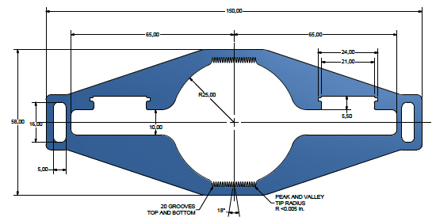
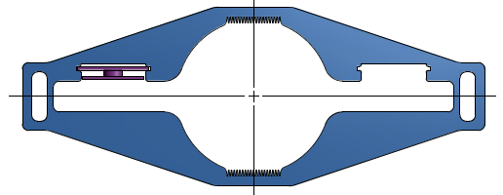
Dipole Chamber Concept
Al Chamber
Radial
outside
of
ring
Radial inside of ring
NEG Strips for distributed pumping

Slide 6
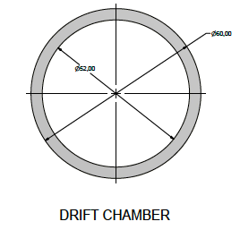
Vacuum System Summary
Tasks underway
Concepts for drift, quadrupole, sextupole chambers in arcs
Pumping requirements for straights
Will in-situ bakeout of chambers in the straights be required?
What are our options?
Full ring wall profile for EC simulations
Tasks to do
Photon stop & masks conceptual design in wiggler region
Full system concept for costing

