Slide 1
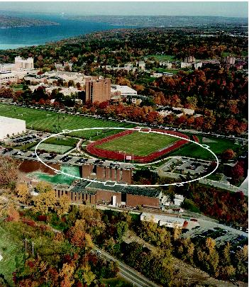
Baseline Damping Ring Lattice Design Status
Jim Crittenden
Cornell Laboratory for Accelerator-Based Sciences and Education
LCWS11
27 September 2011

Slide 2
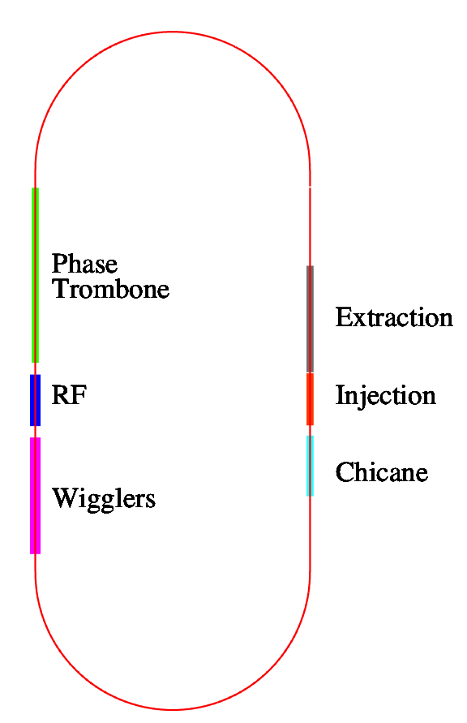
DTC02 Layout (D.L.Rubin)
Circumference = 3238.681 m
Harmonic number =7022
710-m straights
~ 6 phase trombone cells
Sixty 2.1-m long wigglers:
30-cm period, 14 poles B_{max} = 2.16T
Space for 16 RF cavities
The cryostats for upper and lower positron rings are interleaved.

Slide 3
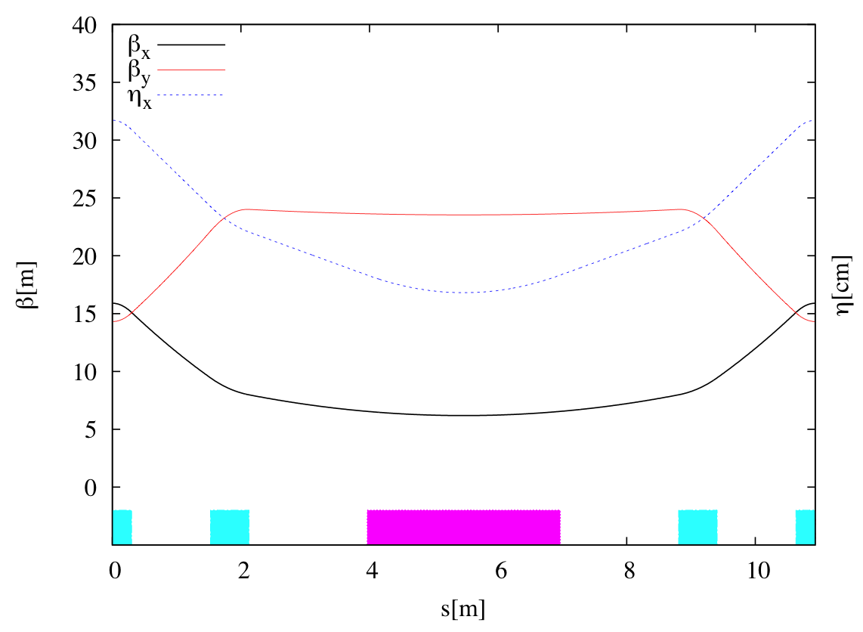
Arc Cell - FDBDF
Cell length = 10.93m
Bend length = 3.0m
75 cells/arc

Slide 4
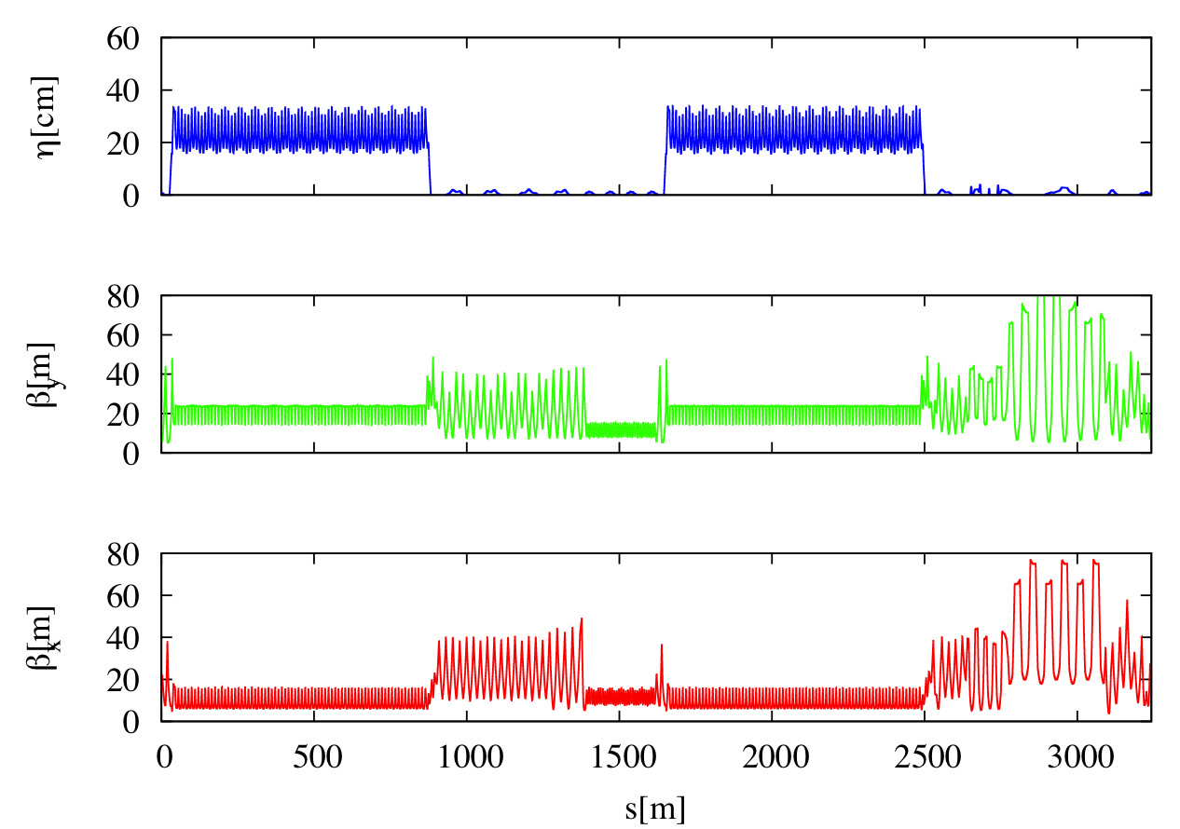
DTC02 Lattice Functions
Arc
Wig-RF
Straight
Arc
Inj-Ext
Straight

Slide 5
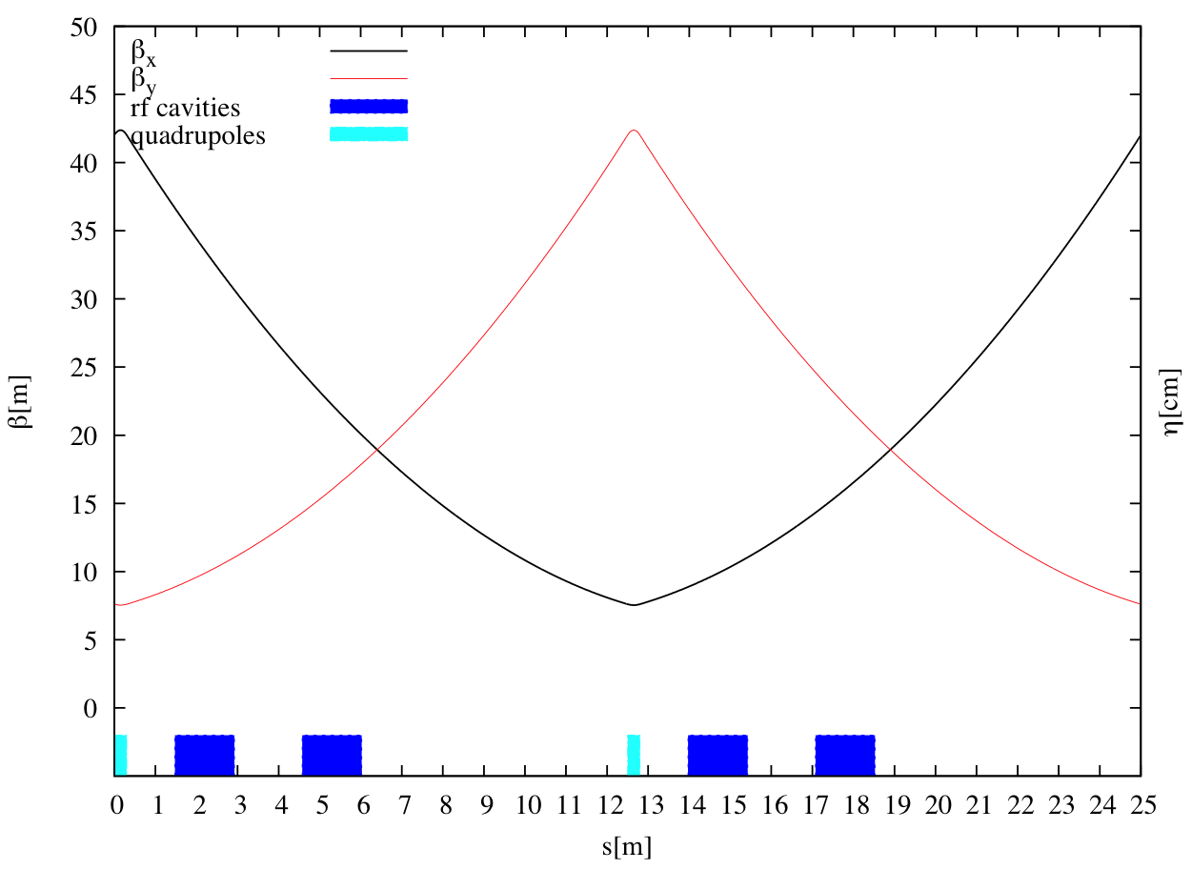
RF Cells

Slide 6
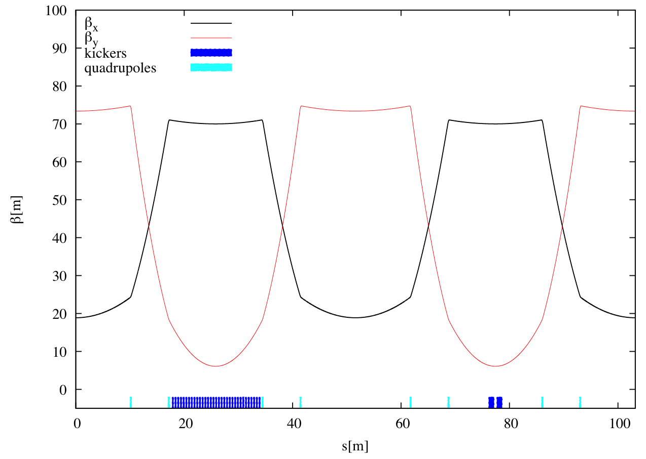
Extraction Straight

Slide 7
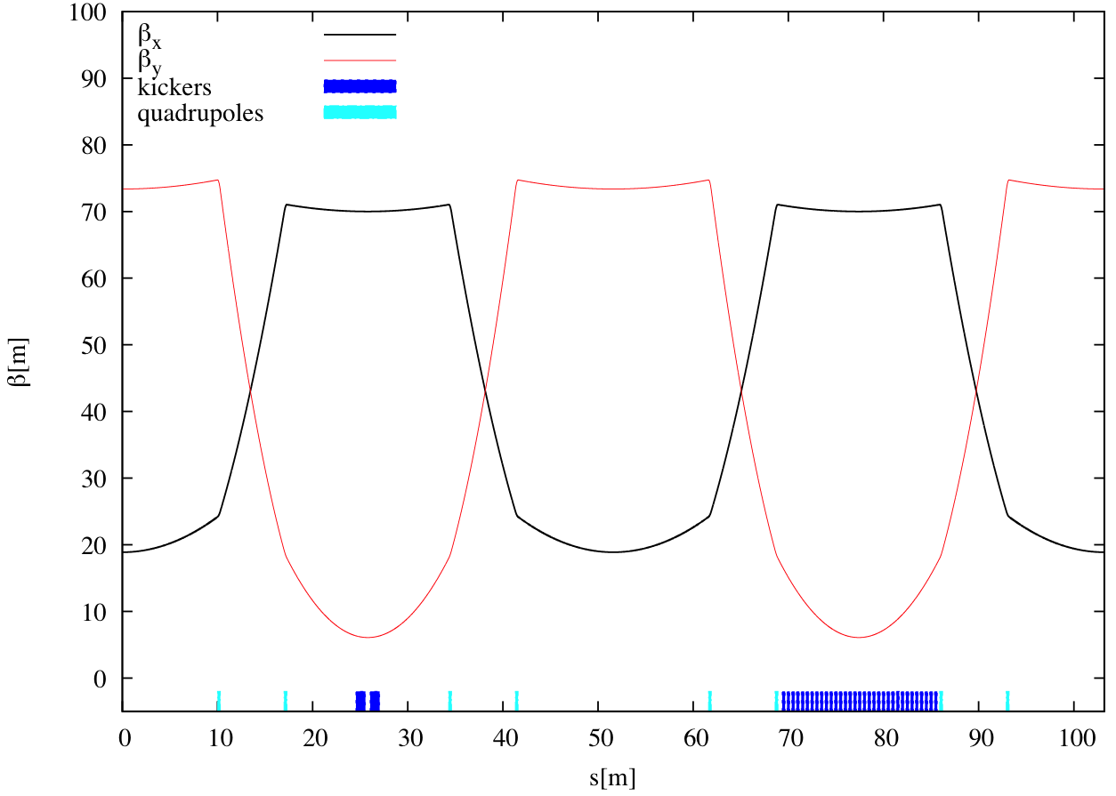
Injection Straight

Slide 8
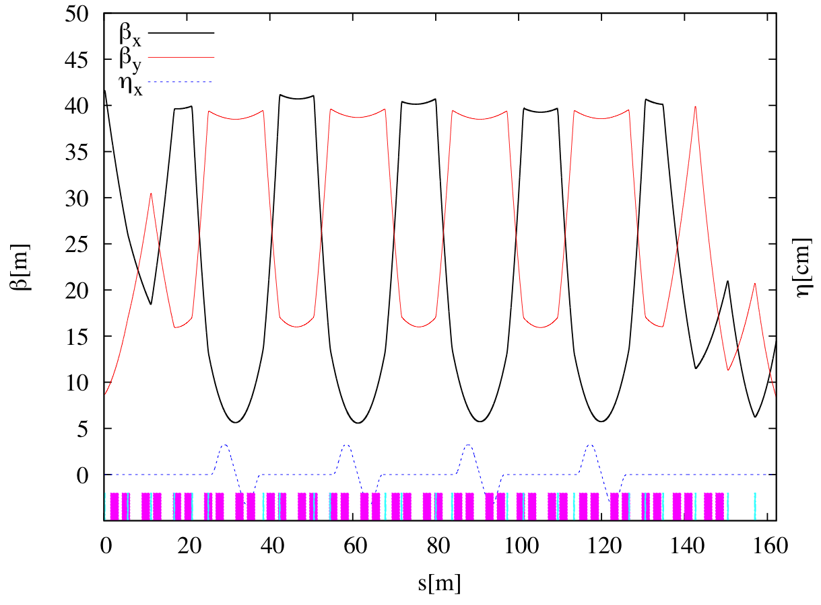
Circumference-Changing Chicane

Slide 9
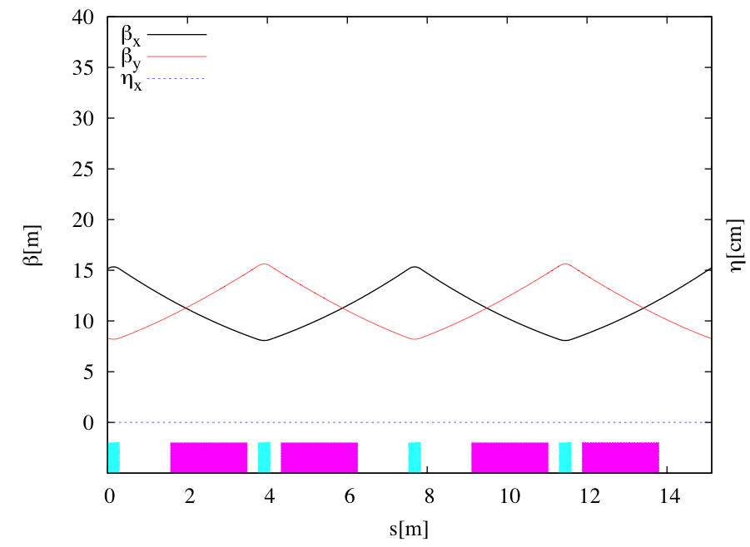
Wiggler Cells
Wiggler parameters
14 poles
30-cm period
Wiggler length = 2.1m
Cell length = 7.56 m
30 wiggler cells
2 wiggler cells

Slide 10
DTC02 Parameters
Parameter | 10 Hz(Low) | 5 Hz (Low) | 5 Hz (High)
Circumference | 3.23868 km | 3.23868 km | 3.23868 km
RF frequency | 650 MHz | 650MHz | 650 MHz
τ_{x}/τ_{y} [ms] | 13.5 | 24.1 | 24.1
Τ_{z} [ms] | 6.7 | 12.0 | 12.0
σ_{s} [mm] | 6 | 6 | 6
σ_{δ} | 0.134% | 0.11% | 0.11%
α_{p} | 3.3 X 10⁻⁴ | 3.3 X 10⁻⁴ | 3.3 X 10⁻⁴
γε_{x} [ μm] | 4.6 | 5.4 | 5.4
RF [MV] (12 cavities) Total/Per cav | 19.7/1.64 | 14 /1.17 | 14/1.17
ξ_{x}/ξ_{y} | -50.9/-44.1 | -51.3/-43.3 | -51.3/-43.3
Wigglers- N_{cells}@B[T] | 30@2.1 | 27@1.5 | 27@1.5
Energy loss/turn [MeV] | 8.0 | 4.5 | 4.5
sextupoles | 3.34/-4.34 | 3.34/-4.23 | 3.34/-4.23
Power/RF coupler @400mA [kW] | 267 | 150 | 300

Slide 11
RF Cavities
The lattice can accommodate 16 RF cavities
If we assume 12 cavities then:
Voltage/cavity in 10 Hz mode is 1.64 MV
Power/coupler in 5 Hz, high power mode is 300 kW

Slide 12
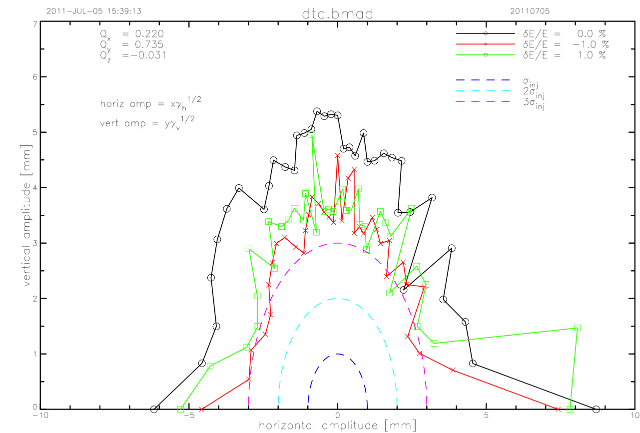
Dynamic Aperture 5 Hz
Periodic type wiggler model, includes vertical focusing and cubic nonlinearity

Slide 13
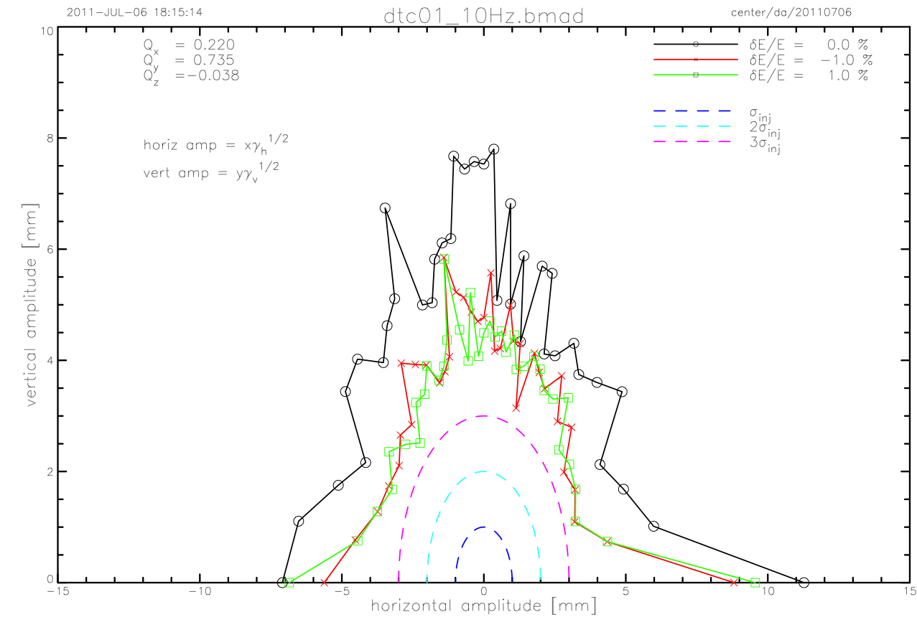
Dynamic Aperture 10 Hz
Periodic type wiggler model, includes vertical focusing and cubic nonlinearity

Slide 14
Magnet Count (Damping Ring)
Element | Length[m] | Strength | Number
Arc Dipoles | 3 | 2.28 kG | 150
Circumference changing chicane dipoles | 1 | 2.68 kG | 28
Other dipoles | 2 | < 2.28 kG | 4
Arc Quadrupoles | 0.6 | < 0.6 m⁻² | 450
Quadrupoles in dispersion suppressor and straights | 0.3 | < 0.55 m⁻² | 211
Sextupoles | 0.3 | < 4.34 m⁻³ | 600
RF cavities | 3 | < 1.64 MV | 12
Wigglers | 2.1 | 2.16 T | 60

Slide 15
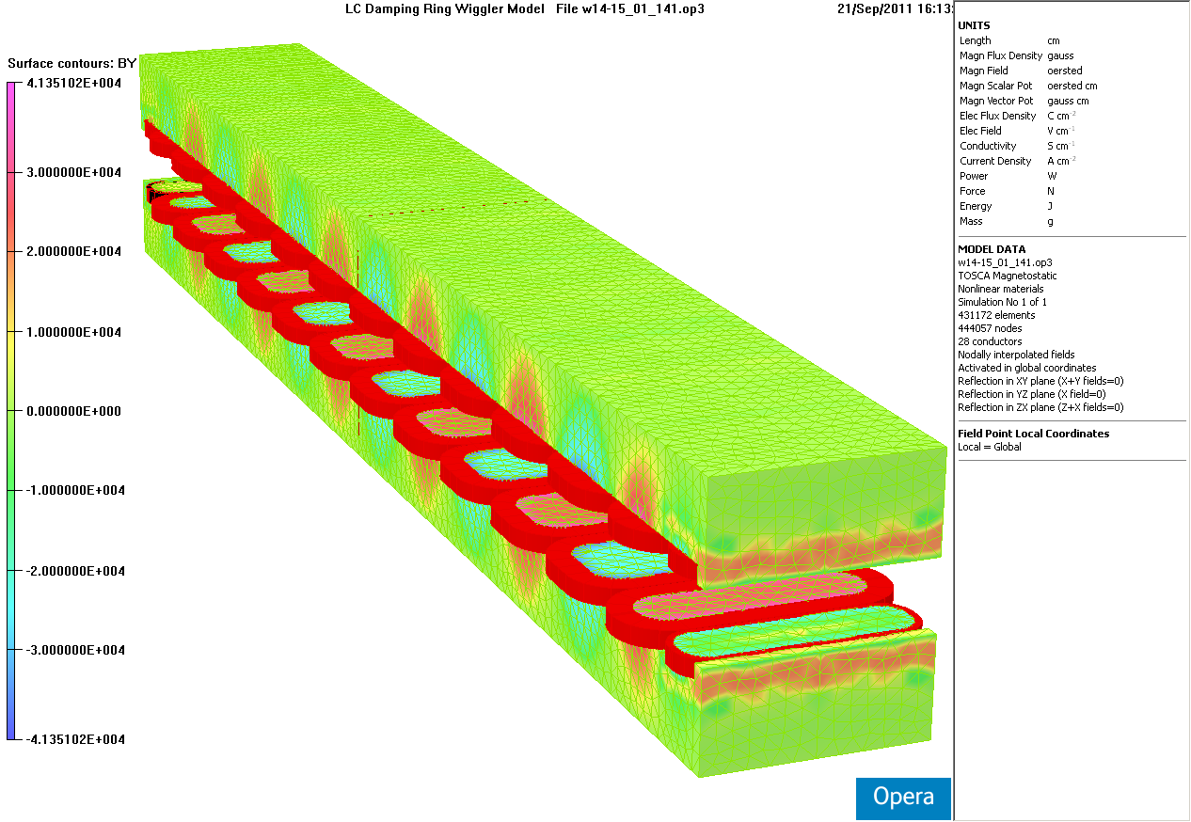
Damping Wiggler Redesign
CESR-c Damping Ring Studies in the Context of the ILC Damping Ring Wigglers
PAC 2005
J.Urban and G.Dugan
Design Considerations and Modeling Results
for ILC Damping Ring Wigglers
Based on the CESR-c Superconducting Wiggler
PAC 2007
M.A.Palmer, J.A.Crittenden and J.Urban
Period reduced from 32 to 30 cm and number of poles increased from 12 to 14.
Gap reduced from 8.64 cm to 7.62 cm. Peak field increased from 2.0 to 2.16 T.

Slide 16
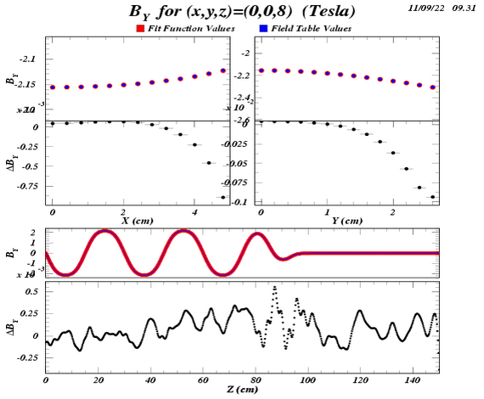
Wiggler Field Analytic Form for Symplectic Tracking
A Magnetic Field Model for Wigglers and Undulators, , PAC 2003, D. Sagan, J.A. Crittenden, D.L. Rubin and E. Forest
The field map has been posted on the ILC/CesrTA wiki.
A conceptual design for costing purposes is in preparation.
1200-term optimization underway.
Residuals presently at the level of a few gauss. The parameters have been posted on the wiki.

Slide 17
Vacuum System Design Effort
Work at Cornell directed towards:
Implementation of mitigation recommendations into the vacuum chambers
Need chamber profiles for next round of physics simulations
Need chamber and system conceptual design for costing

Slide 18
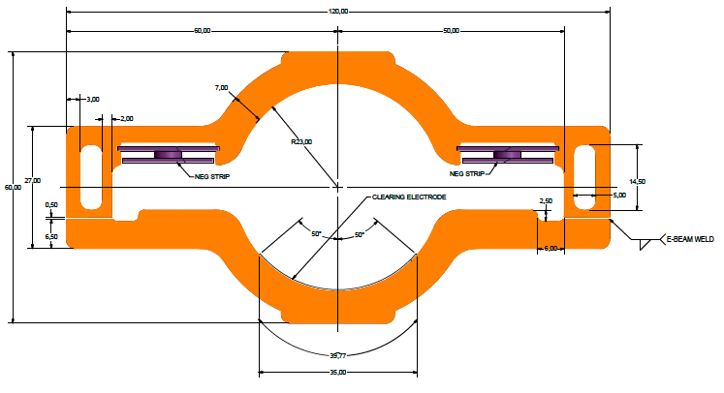
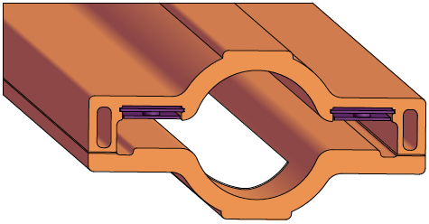
Wiggler Chamber Concept I
NEG strips
Clearing Electrode
E-beam weld locations
Copper Chamber

Slide 19
Wiggler Chamber Concept II
We are considering a scenario where 2 wigglers with a quad in center are assembled as a unit and then installed.
This would reduce the number of electrode chambers required.

Slide 20
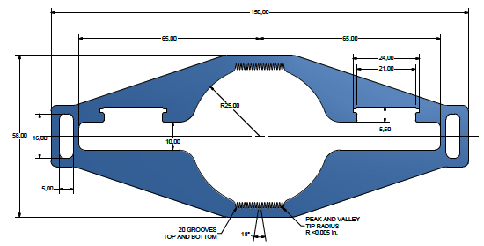
Aluminum Dipole Chamber Concept
Radial inside of ring
Radial outside of ring
Locations of NEG strips

Slide 21
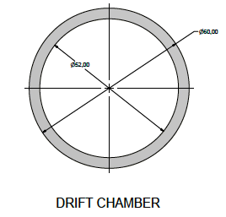
Vacuum System Summary
Tasks underway
Concepts for drift, quadrupole, sextupole chambers in arcs
Pumping requirements for straights
Will in-situ bakeout of chambers in the straights be required?
What are our options?
Full ring wall profile for EC simulations
Tasks to do
Photon stop & masks conceptual design in wiggler region
Full system concept for costing

