Slide 1
Baseline Lattice Design Status
LCWS11
September 26, 2011
Jim Crittenden for the CESRTA Collaboration

Slide 2
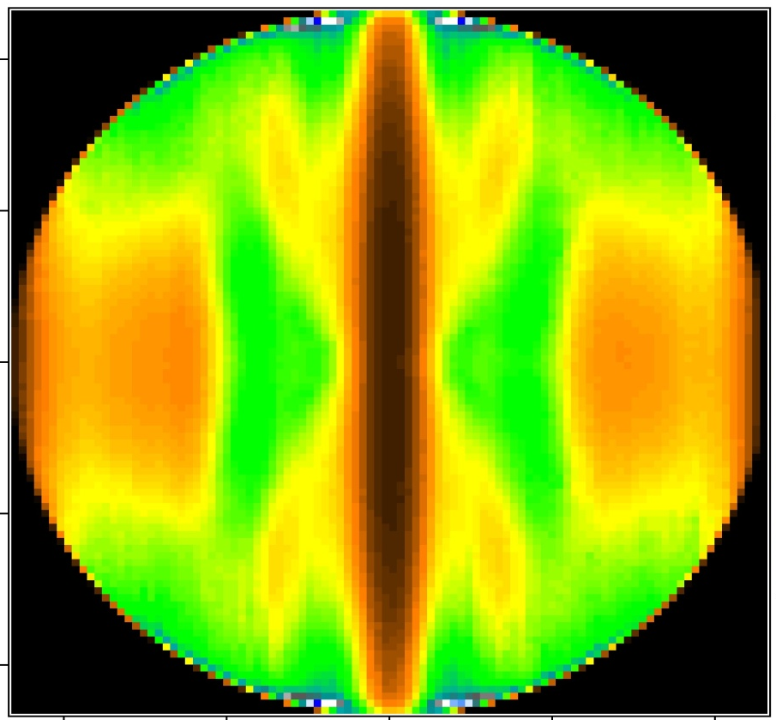
Outline
Collaboration
R&D Program Scope and Plan
R&D Results
Inputs for the ILC DR Technical Design
Documentation of Results
& Future Plans

Slide 3

The CESRTA Collaboration
The program has involved senior researchers, post-docs and graduate students from a dozen laboratories and universities from around the globe
Over 100 contributors to the Phase I Report – presently in preparation

Slide 4
R&D Goals
  Studies of Electron Cloud Growth and Mitigation
    Study EC growth and methods to mitigate it (particularly wigglers and dipoles)
    Benchmark and expand existing simulation codes a validate projections to the ILC DR
  Low Emittance Operations
    EC beam dynamics studies at ultra low emittance
    (CESRTA vertical emittance target: ε_{y}<20 pm-rad)
    Beam instrumentation for ultra low emittance beams
      x-Ray Beam Size Monitor targeting bunch-by-bunch (single pass) readout
      Beam Position Monitor upgrade
    Develop LET tuning tools
  Studies of EC Induced Instability Thresholds and Emittance Dilution
    Measure instability thresholds and emittance growth at ultra low emittance
    Validate EC simulations in the low emittance parameter regime
    Confirm the projected impact of the EC on ILC DR performance
  Inputs for the ILC DR Technical Design

Slide 5
The CESRTA R&D Program – Phase I…
2008
2009
2010
2011
Phase I Report
Inputs to the Technical Design
Document/
Implement
EC Growth/Mitigation Studies
LET
Experimental Program
Convert CESR to
DR Configuration
Add EC Experimental
Regions
Instrumentation
Upgrades
CESR Reconfiguration
BPM
xBSM
Vacuum Diagnostics
Instrumentation
Techniques
Machine Correction
EC Dynamics
Methods
Systematic Studies
Identify Critical Issues for Further Study
Publish Results
Updated Simulation Tools
March 1, 2008: Formal Start of Program
Start of Phase II Funding

Slide 6
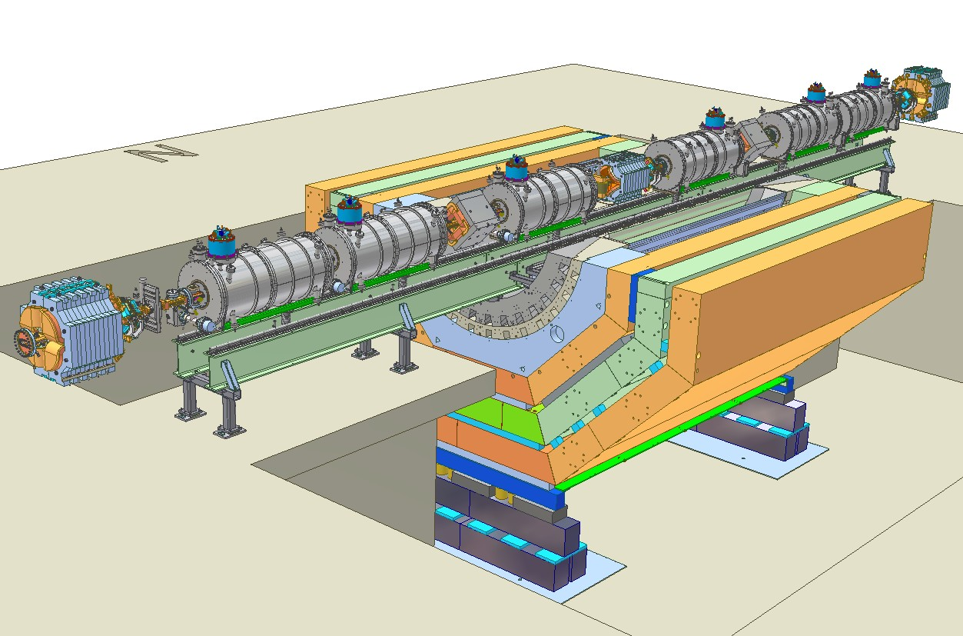
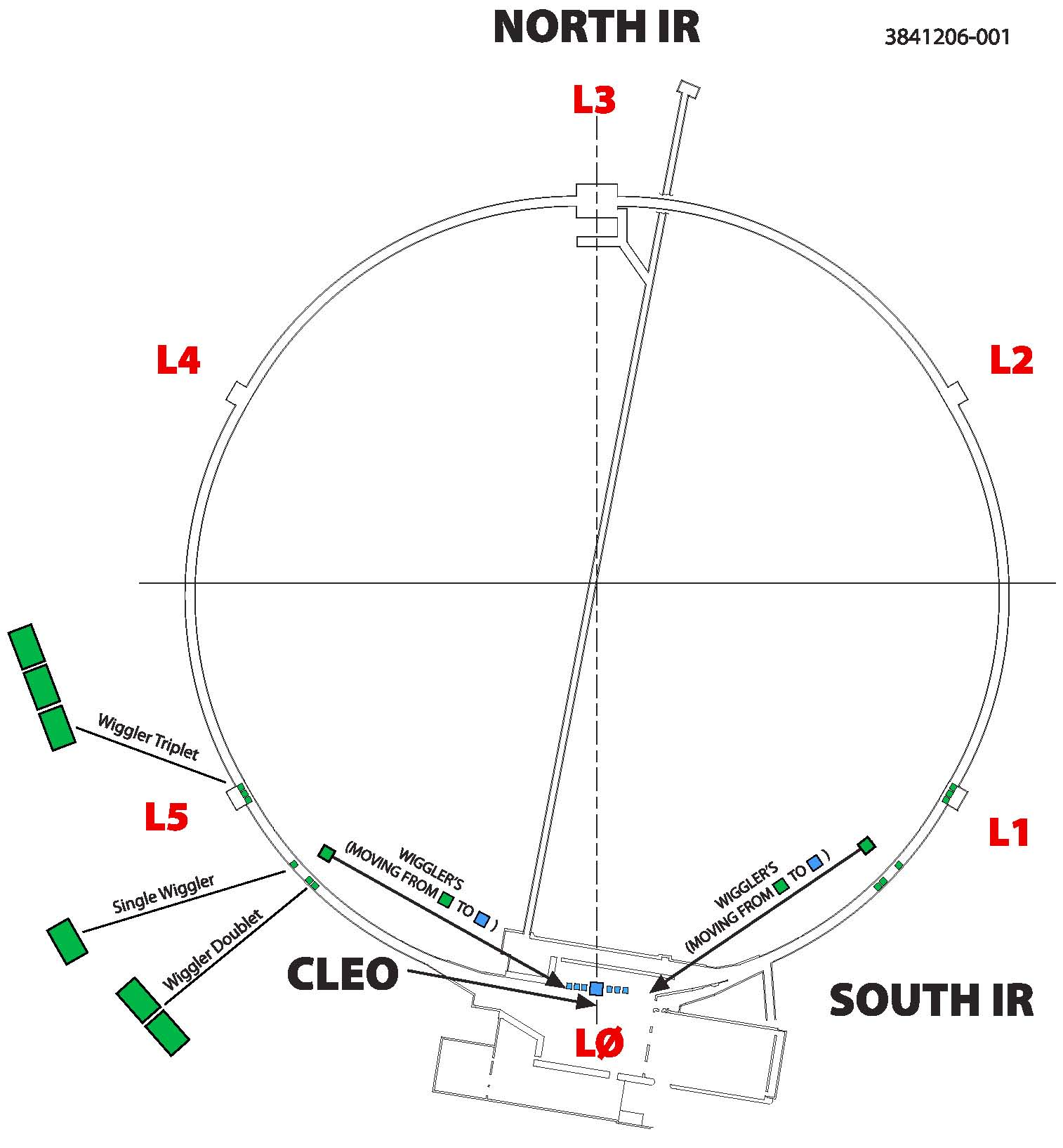
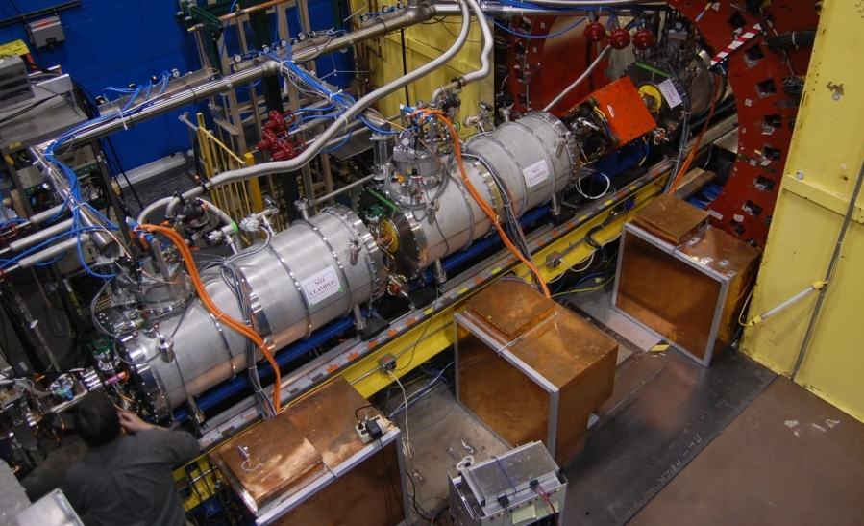
CESR Conversion: L0
Damping Wiggler Straight
Zero Dispersion for ultra low emittance operation
Instrumented for electron cloud studies (RFAs, TE Wave)
Installed Diagnostic
Wigglers

Slide 7
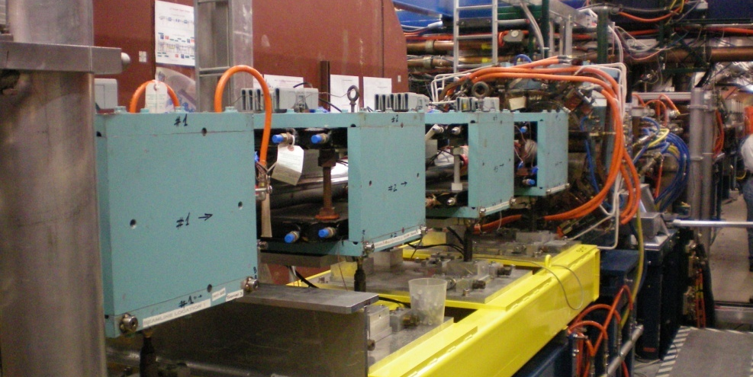
CESR Conversion: L3 Experimental Region
Electron Cloud Experiments
  Drift Chamber Studies
  Chicane Studies
  Quadrupole Studies
  In Situ SEY Station
Installed Diagnostic
Wigglers

Slide 8
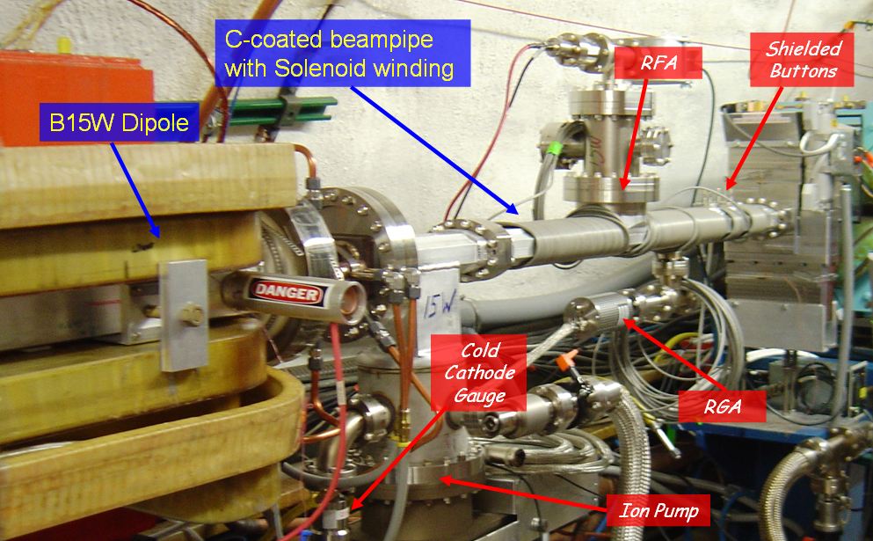
CESR Conversion: Arc Regions
Chambers for coating tests
  Arc photon environment
  Retarding field analyzer
  Shielded pickups for time-resolved measurements
Segmented RFA
Shielded Pickups
15E/W test
chamber design
for coating tests

Slide 9
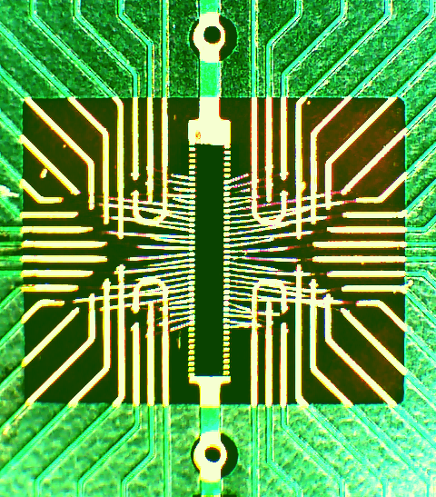
CESR Conversion: Low ε Instrumentation
X-ray Optics
  Pinhole
  Fresnel Zone Plate
  Coded Aperture
x-Ray Beamsize Monitor-xBSM
  Single pass measurement capability
  Targeted at ≤ 10 μm beams
BPM system upgrade
Pinhole
0.8×10¹⁰
particles
UHV
InGaAs
Array
CA
FZP

Slide 10
CESR Reconfiguration: CesrTA Parameters
Range of optics implemented
Beam dynamics studies
Control γ flux in EC experimental regions
Lattice Parameters
Ultra low emittance baseline lattice
Energy [GeV] | 2.085 | 5.0 | 5.0
No. Wigglers | 12 | 0 | 6
Wiggler Field [T] | 1.9 | ― | 1.9
Q_{x} | 14.57
Q_{y} | 9.62
Q_{z} | 0.075 | 0.043 | 0.043
V_{RF} [MV] | 8.1 | 8 | 8
ε_{x} [nm-rad] | 2.5 | 60 | 40
τ_{x,y} [ms] | 57 | 30 | 20
α_{p} | 6.76×10⁻³ | 6.23×10⁻³ | 6.23×10⁻³
σ_{l} [mm] | 9 | 9.4 | 15.6
σ_{E}/E [%] | 0.81 | 0.58 | 0.93
t_{b} [ns] | ≥4, steps of 2
E[GeV] | Wigglers (1.9T/PM) | ε_{x}[nm]
1.8* | 12/0 | 2.3
2.085 | 12/0 | 2.5
2.3 | 12/0 | 3.3
3.0 | 6/0 | 10
4.0 | 6 /0 | 23
4.0 | 0 /0 | 42
5.0 | 6/0 | 40
5.0 | 0/0 | 60
5.0 | 0/2 | 90
IBS
Studies
* Orbit/phase/coupling correction and injection but no ramp and recovery.
1.8 GeV optics implementation to be completed June 2011.

Slide 11
R&D Results
Overview
EC Mitigation Studies
Low Emittance Tuning Status
Beam Dynamics Studies
Will briefly touch on a few key highlights
More complete treatment to appear in the CESRTA Phase I Report

Slide 12
R&D Status Overview
CESR Configuration
  Damping ring layout
  4 dedicated EC experimental regions
  Upgraded vacuum/EC instrumentation
  Energy flexibility from 1.8 to 5.3 GeV
Beam Instrumentation
  xBSM for positrons and electrons
  High resolution digital BPM system
  Feedback system for 4ns bunch spacing
EC Diagnostics and Mitigation
  ~30 RFAs presently deployed
  TE wave measurement capability in each experimental region
  Time-resolved shielded pickups in 3 experimental locations (2 with transverse information)
  Over 20 individual mitigation studies conducted in Phase I
    20 chambers
    2 sets of in situ SEY measurements
    Follow-on studies in preparation for Phase II extension of program
Low Emittance Tuning and Beam Dynamics Studies
  Regularly achieving <10pm vertical emittance
  Continuing to explore the emittance reach of new instrumentation and techniques for LET
  Systematic studies of beam instability thresholds and emittance dilution
    Detailed comparison with simulation ongoing
    Additional tests envisioned based on initial observations
Tune shifts for 4ns bunch spacing - feedback error signal
D. Teytelman

Slide 13
EC Mitigations
 | Drift | Quad | Dipole | Wiggler | VC Fab
Al | ✓ | ✓ | ✓ |  | CU, SLAC
Cu | ✓ |  |  | ✓ | CU, KEK, LBNL, SLAC
TiN on Al | ✓ | ✓ | ✓ |  | CU, SLAC
TiN on Cu | ✓ |  |  | ✓, ✗ | CU, KEK, LBNL, SLAC
Amorphous C on Al | ✓ |  |  |  | CERN, CU
NEG on SS | ✓ |  |  |  | CU
Diamond-like C on Al | ✓ |  |  |  | CU, KEK
Solenoid Windings | ✓ |  |  |  | CU
Fins w/TiN on Al | ✓ |  |  |  | SLAC
Triangular Grooves on Cu |  |  |  | ✓ | CU, KEK, LBNL, SLAC
Triangular Grooves w/TiN on Al |  |  | ✓ |  | CU, SLAC
Triangular Grooves w/TiN on Cu |  |  |  | ✓ | CU, KEK, LBNL, SLAC
Clearing Electrode |  |  |  | ✓ | CU, KEK, LBNL, SLAC
✓ = chamber(s) deployed
✗ = deployed in CESR Arc, Jan 2011
✓ = installed Jan 2011

Slide 14
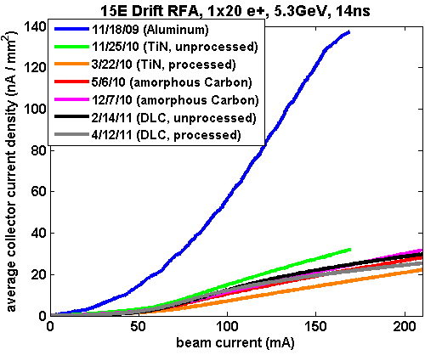
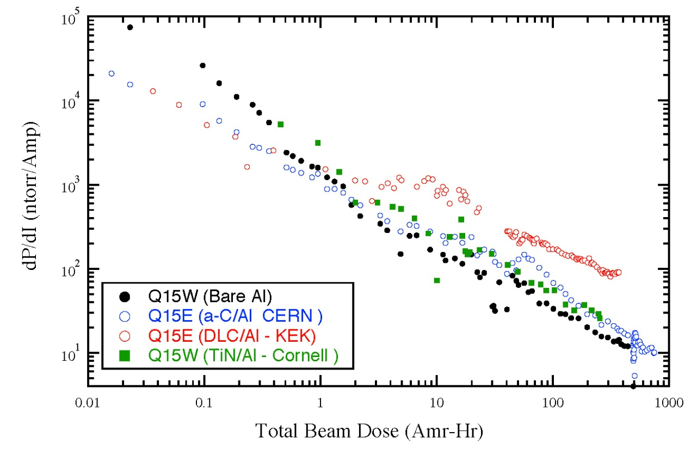
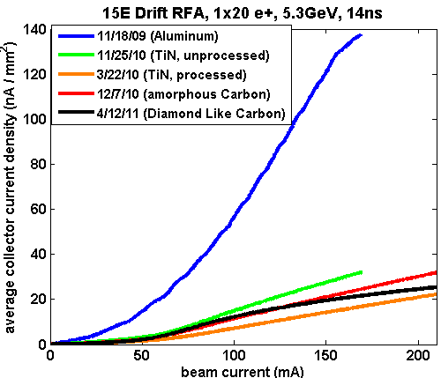
Drift Region Observations
Q15 E/W Arc Studies a Coating Tests
  Bare Al vs TiN, amorphous C, and diamond-like C (all on Al)
  Vacuum performance (eg. dP/dI) poorer for coatings
  EC performance of TiN and the carbon coatings in a similar range a consistent with in situ SEY measurements for processed TiN and aC near unity
Also NEG tests in L3 experimental region
  Requires detailed simulation capability for direct comparison
In Situ
SEY Station

Slide 15
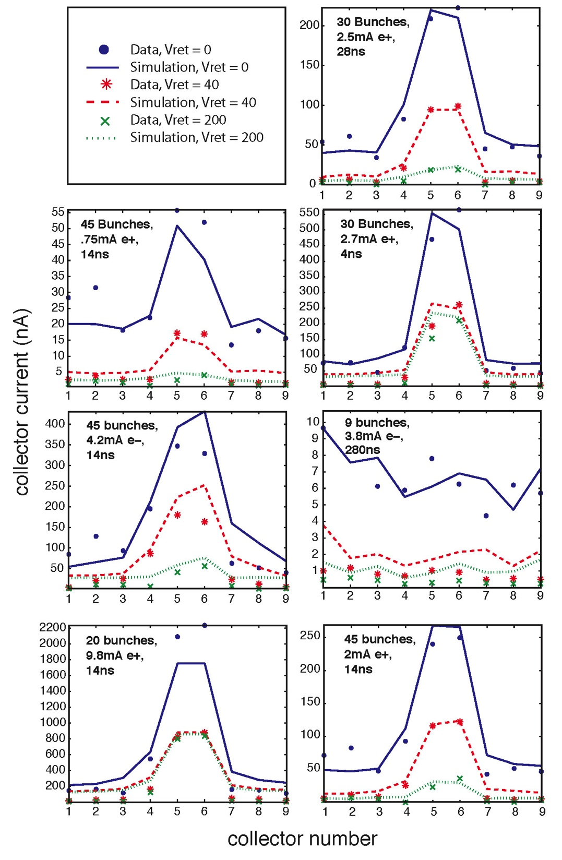
Drift Region Data vs Simulation
Goal:
  Evaluate surfaces under a wide range of conditions to evaluate in situ surface parameters using the RFA data
  Vary: Bunch charge & spacing, species, beam energy, RFA retarding voltage
  Fit for:
  Peak value of the true SEY
  Energy of the SEY peak
  Elastic scattering fraction, δ(0)
  Rediffused scattering fraction
  Quantum effeiciency
Incorporate constraints from other sources
  Time-resolved detector data
  3D photon transport model (Synrad3D)
5.3GeV Dataa

Slide 16
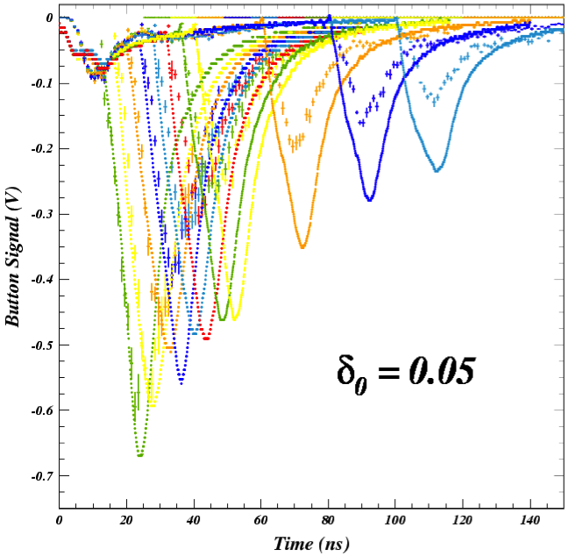
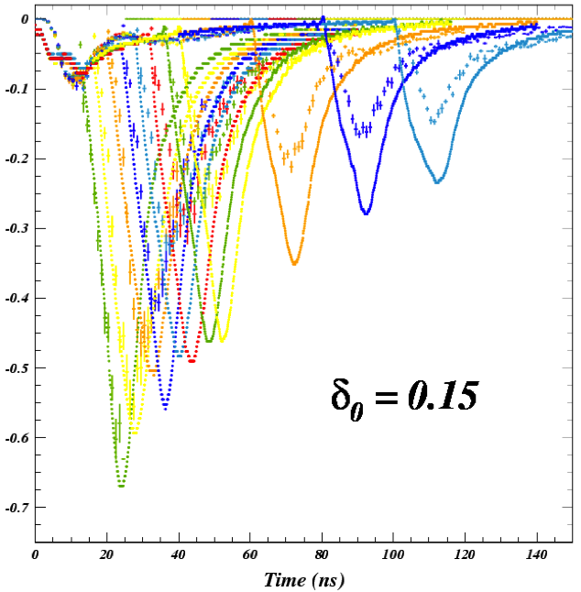
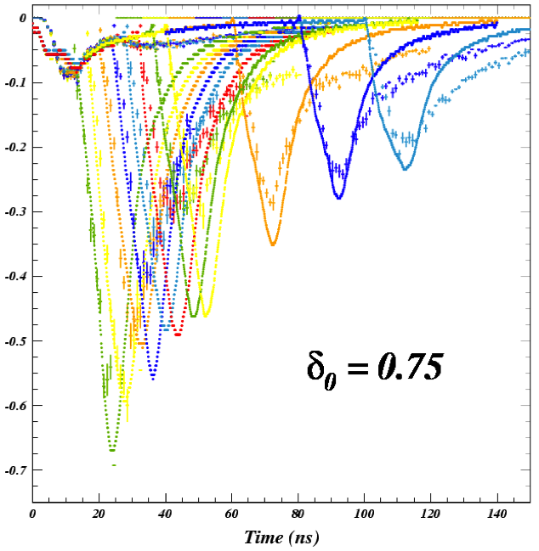
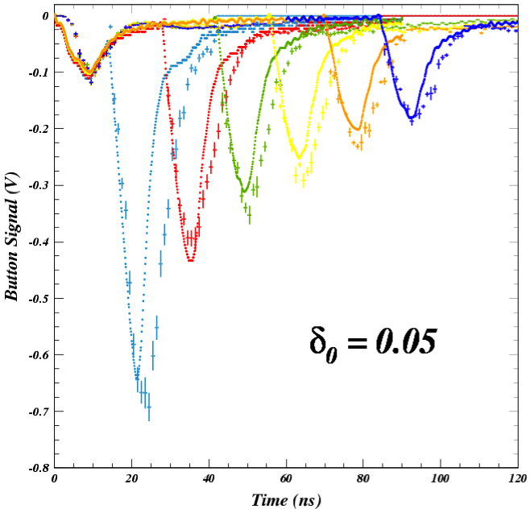
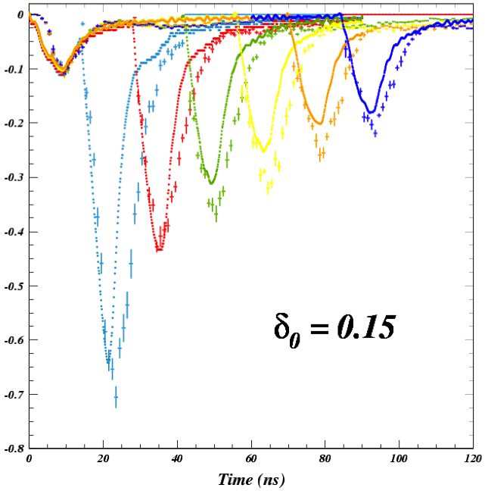
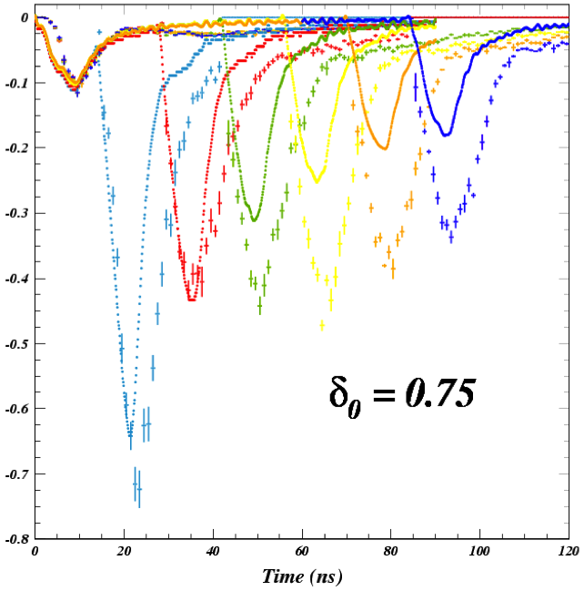
Time-Resolved (SPU) Comparisons: δ(0)
spu
e- signal from B1
sensitive to PE model
Bare Al
TiN

Slide 17
Drift Region Mitigation Evaluations
Efficacy
  Relative comparisons a TiN, after extended scrubbing, has achieved slightly better performance than the carbon coated chambers that we have deployed.
  In situ SEY station measurements with TiN and aC show peak SEY values around 1, processing towards lower values with TiN
  The use of solenoid coils in addition to any of the coatings would likely assure acceptable EC performance in the drifts
Risks
  Further monitoring of aging performance is desirable
  Possible Si contamination?
    CERN tests of 2 samples sent back after acceptance tests a presence of Si contamination in a-C chamber
    Follow-on test of 1st a-C chamber (entire chamber sent to CERN) did not detect Si after beam exposure
  Surface parameter analysis is still maturing a some caution should be exercised.
Impact on Machine Operations and Performance
  NEG would benefit overall machine vacuum performance, but activation requirements are difficult.
  a-C and TiN show somewhat higher beam-induced vacuum rise than bare Al. DLC very high.

Slide 18
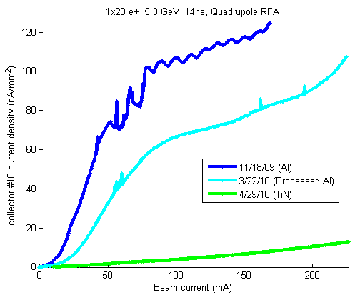
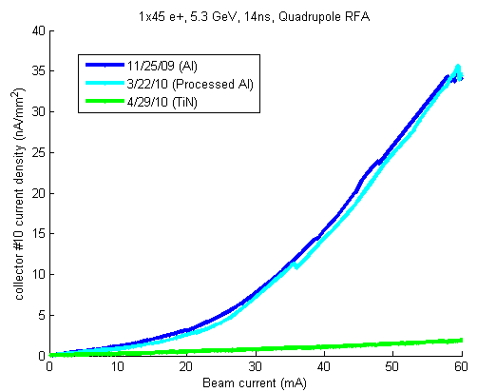
Quadrupole Observations
RFA currents higher than expected
from “single turn” simulations
  Turn-to-turn cloud buildup
  ~20 turn effect
  Issue also being studied in wigglers
Clear improvement with TiN
20 bunch train e+
45 bunch train e+

Slide 19
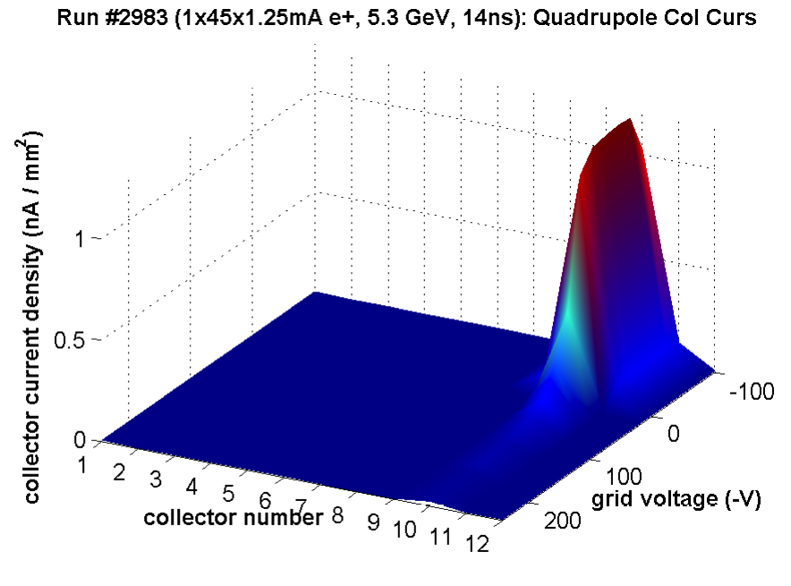
Quadrupole Evaluation
Efficacy
  Strong multipacting on
  Al surface significantly
  suppressed with TiN
  coating
Risks
  Appear minimal with coating
  Concerns about trapped EC (multi-turn build-up)
  Final evaluation of acceptable surface parameters in quadrupoles is needed to decide whether coating (as opposed, say, to coating+grooves) is acceptable.
    ILCDR EC working group effort underway

Slide 20
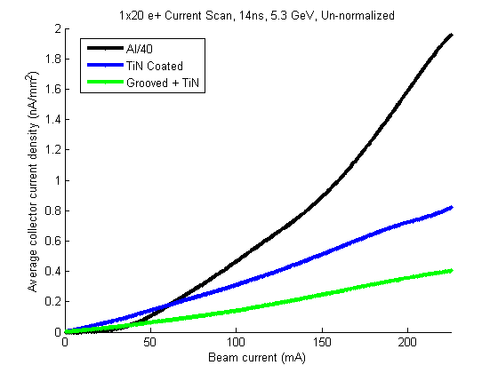
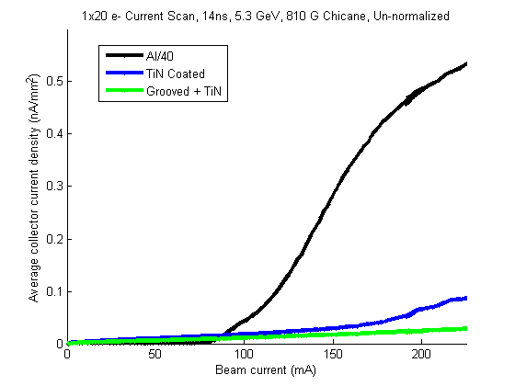
Dipole Observations
Data shown: 5.3 GeV, 14ns
  810 Gauss dipole field
  Signals summed over all
  collectors
  Al signals ÷40
Longitudinally grooved surfaces offer significant promise for EC mitigation in the dipole regions of the damping rings
20 bunch train e+
20 bunch train e-

Slide 21
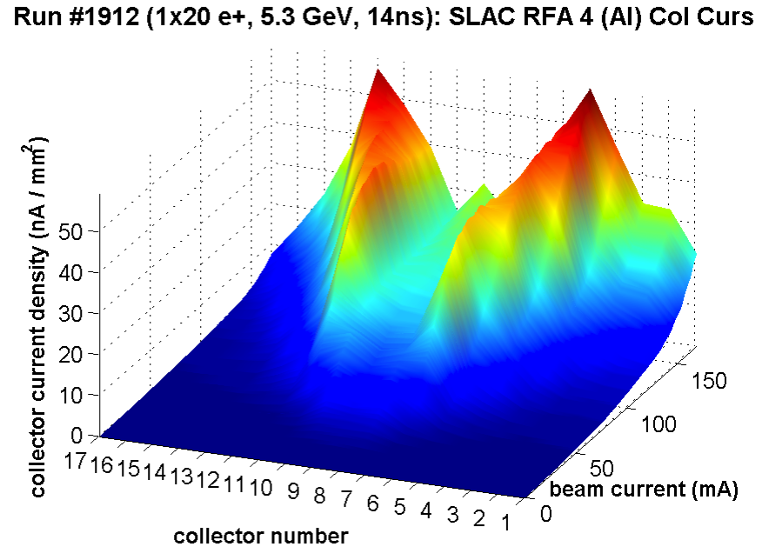
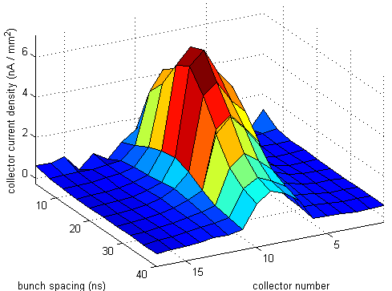
Dipole Evaluation
Efficacy
  Of the methods tested, a grooved surface
  with TiN coating has significantly better
  performance than any other. Expect that
  other coatings would also be acceptable.
  NOTE: Electrodes not tested (challenging
  deployment of active hardware for entire
  arc regions of the ILC DR)
Risks
  Principal concern is the ability to make
  acceptable grooved surfaces via extrusion
    “Geometric suppression” limited by peak
    and valley sharpness
    Coating helps ameliorate this risk
  Machined surfaces of the requisite
  precision are expensive and challenging
Impact on Machine Performance
  Simulations (Suetsugu, Wang, others)
  indicate that impedance performance
  should be acceptable
Multipacting Resonance:
SLAC Al Chicane Dipole

Slide 22
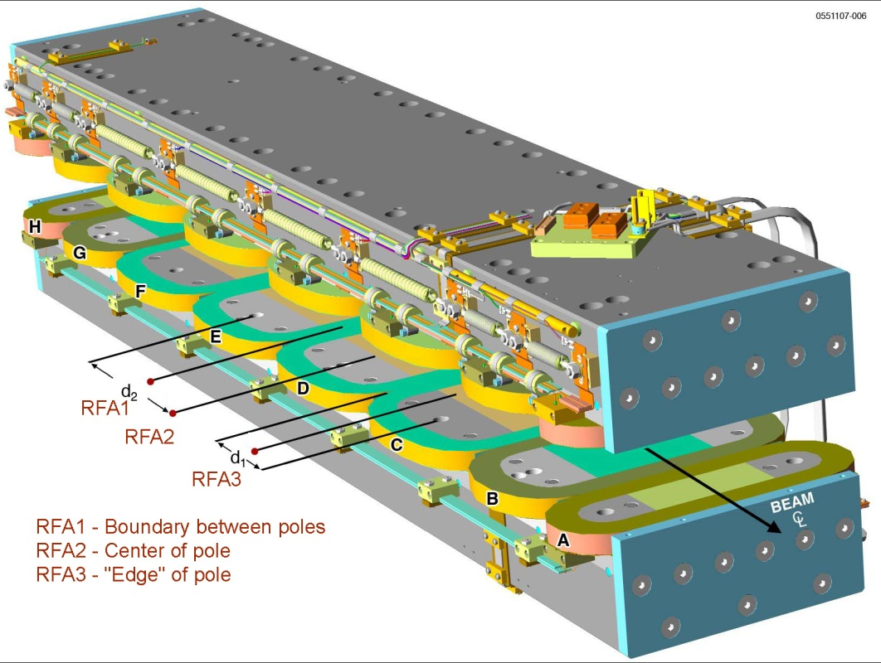
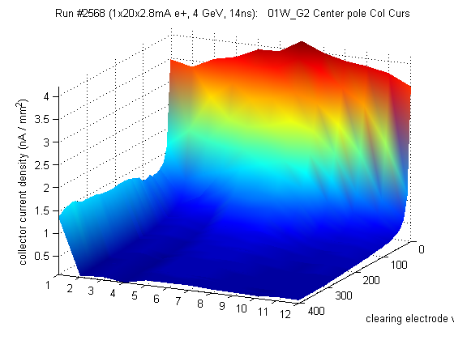
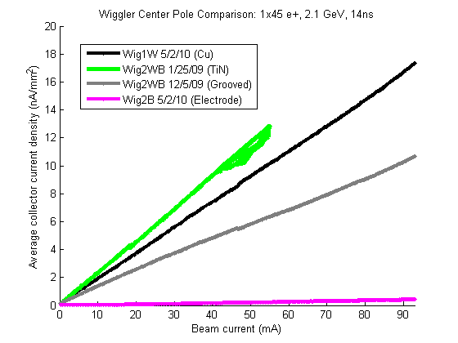
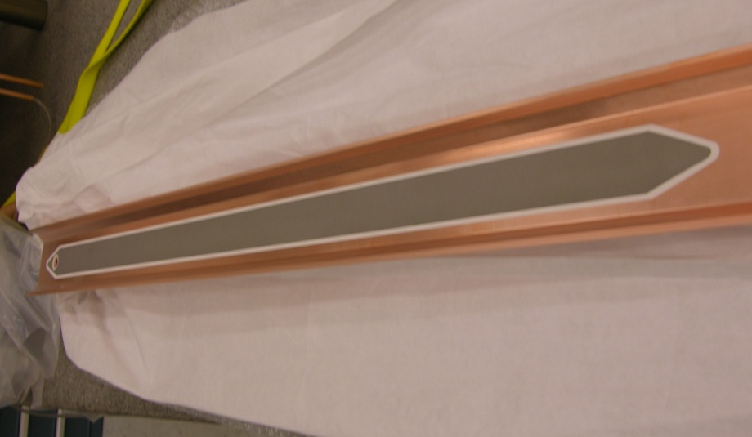
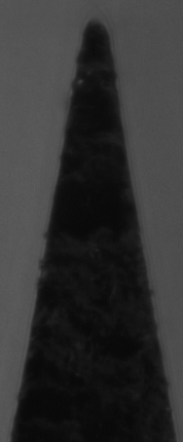
Wiggler Observations
0.002”
radius

Slide 23
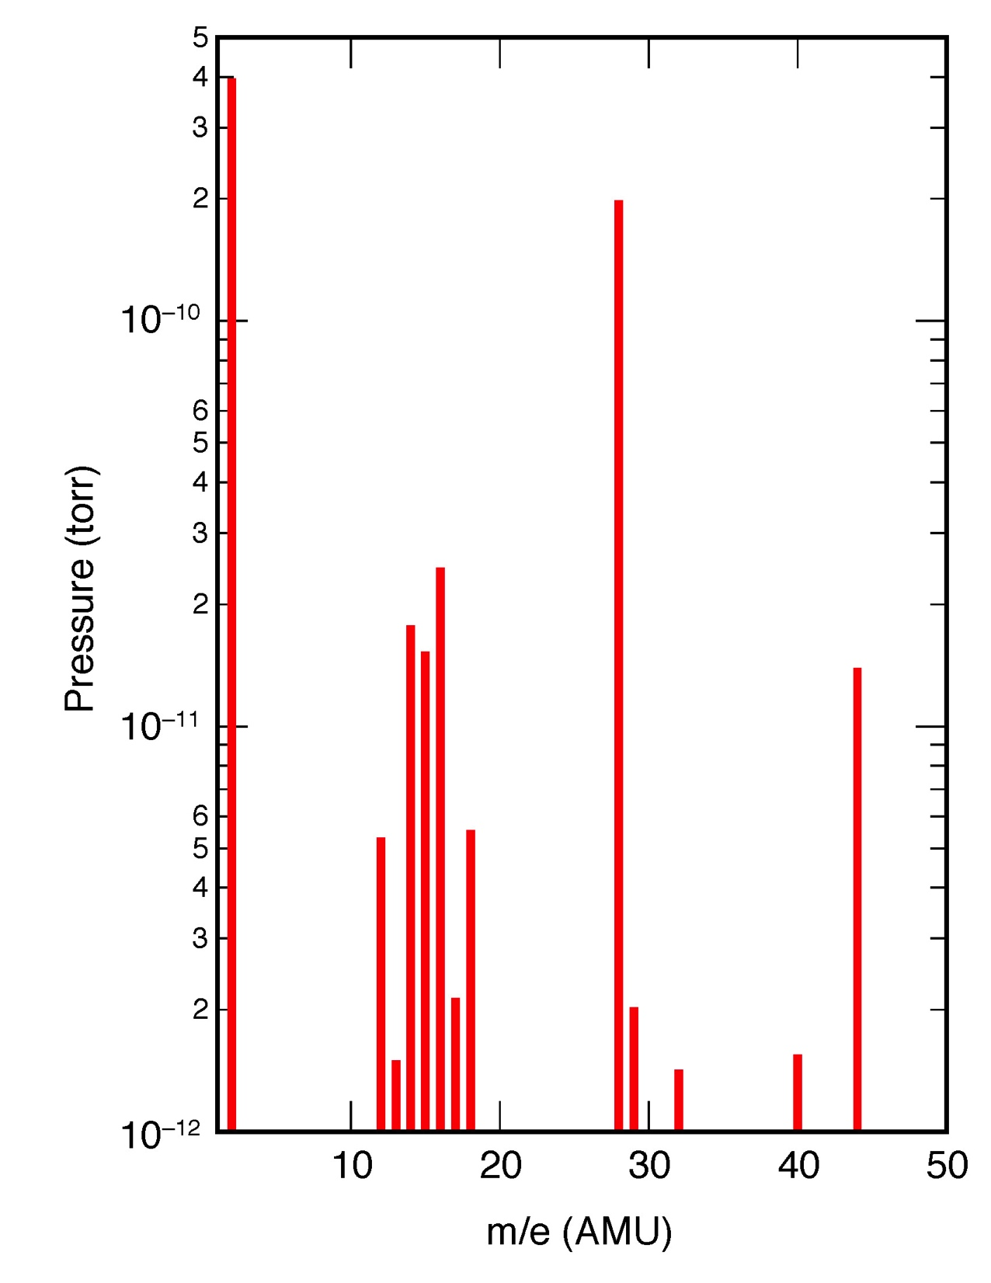
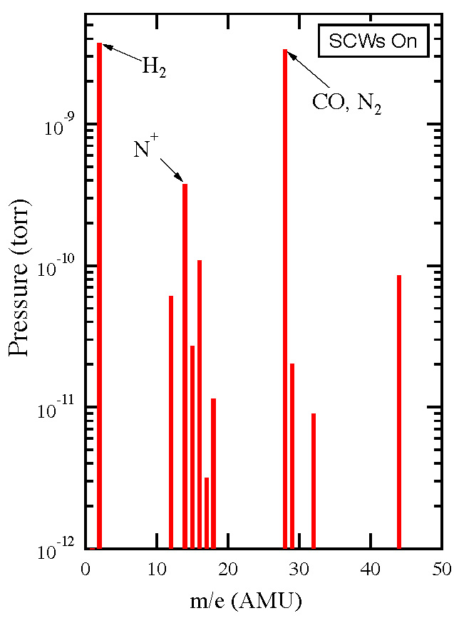
L0 Wiggler Straight Vacuum
test
120 mA e+, 4 GeV, SCWs Off
Not certain of TiN stability with high E_{c} photons

Slide 24
Wiggler Evaluation
Efficacy
  Best performance obtained with clearing electrode
Risks
  Electrode reliability
    Thermal spray method offers excellent thermal contact
    Ability to create “boat-tail” shape with no structural concerns helps to minimize HOM power
    Feedthrough and HV connection performance probably single largest concern
Impact on Machine Operation and Performance
  Impedance should be acceptable for the limited length of the wiggler section (see, eg., ECLOUD10 evaluation by Y. Suetsugu)
  Additional hardware required
    Power supplies
    Loads for HOM power

Slide 25
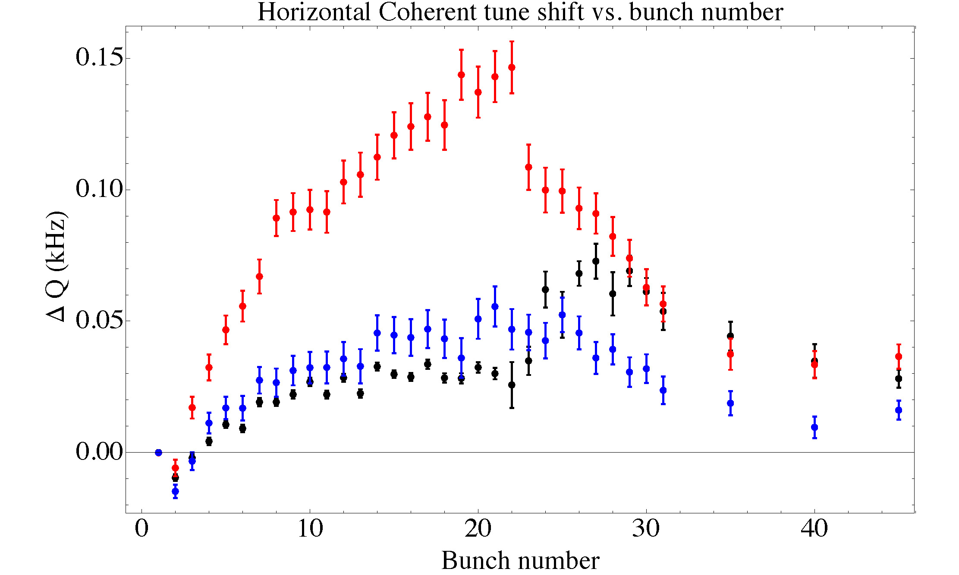
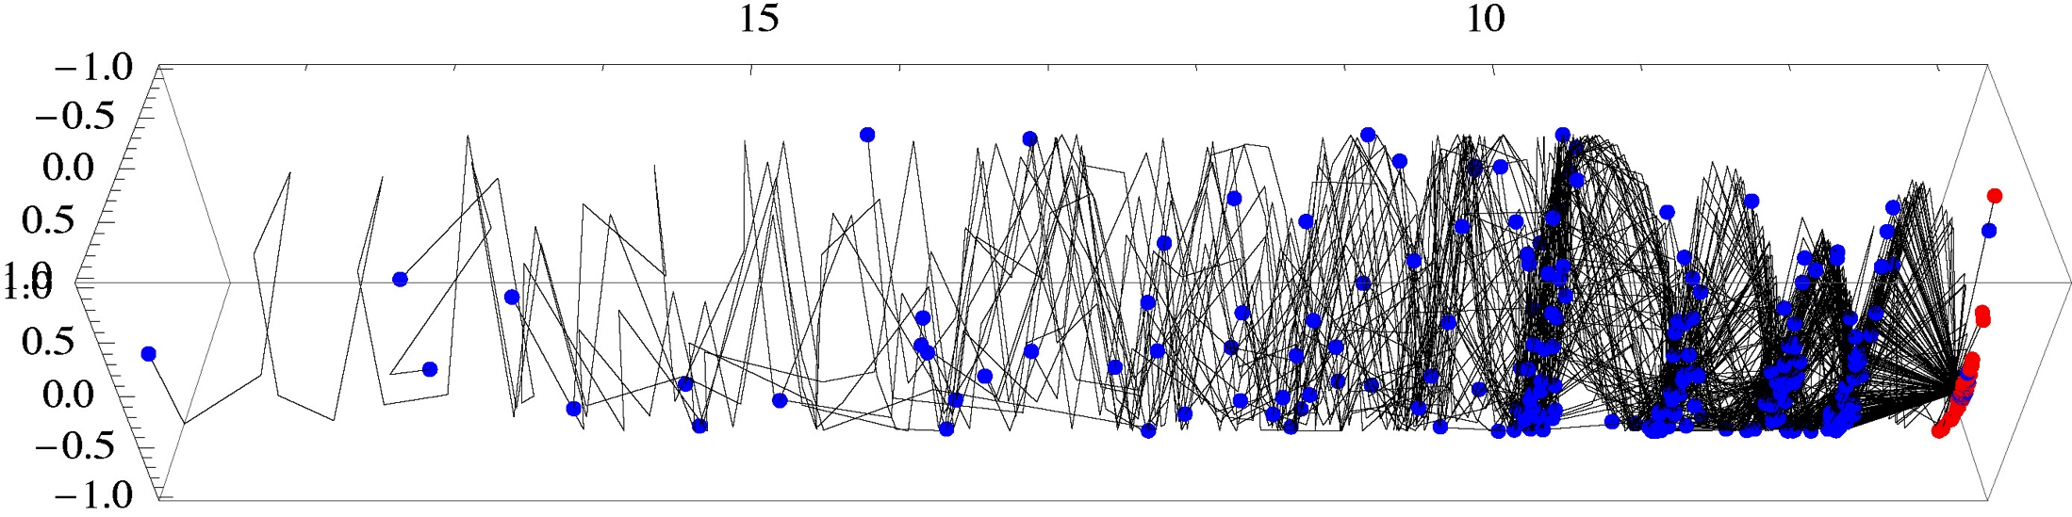
Photons and PEY
Better photon reflection and transport model
needed for simulations and data analysis
Time-resolved measurements indicate that
we also need to have a better PE spectrum
(fitting of RFA data also requires this)
Synrad3D (Sagan, et al.) answers this
need, but work remains
  Fully validate real VC geometries
  Diffuse scattering issues (see next slide)
  Surface roughness issues
Tune Shift Anal w/
Witness Bunches
Data
Synrad2D
Synrad3D
150m
100m
5.1 reflection typ.
Requirements for PE control in the ILC and CLIC DRs a High Priority

Slide 26
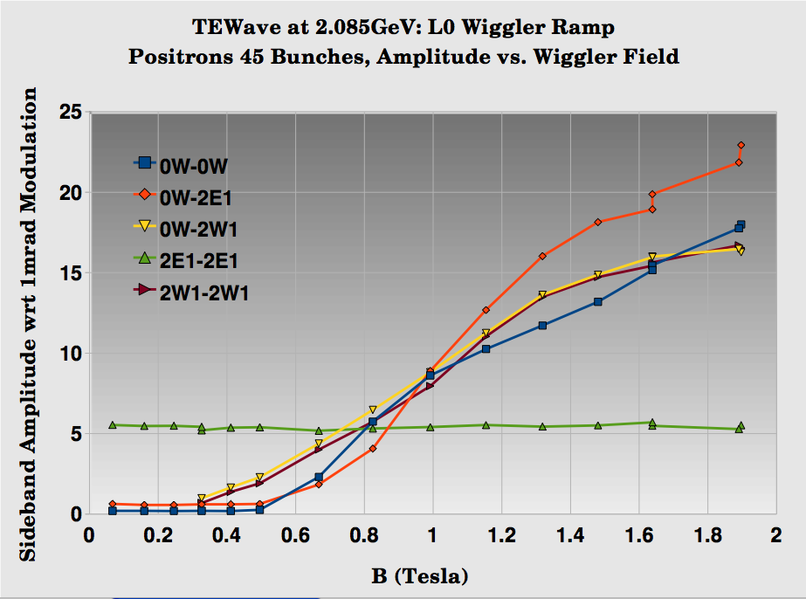
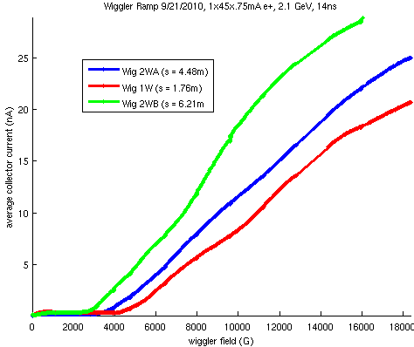
Wiggler Ramp
Plots show TE Wave and RFA response as a function of wiggler field strength
Large increase in signal as soon as radiation fan begins to strike local VC surface a significant diffuse scattering component
1x45x0.75mA e+, 2.1 GeV, 14ns bunch spacing
RFA Response
TEW Response

Slide 27
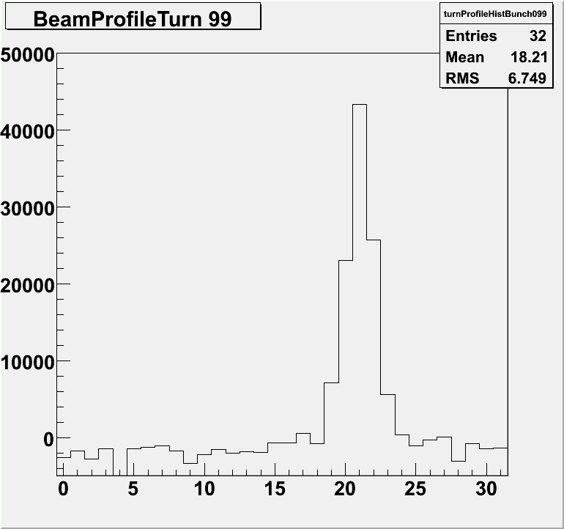
Low Emittance Tuning
Low ε Correction Procedures
  Measure orbit
    Correct orbit to reference using vertical correctors
  Measure betatron phase and coupling by resonant excitation.
    Correct phase and coupling using skew quads
  Re-measure orbit, phase and coupling. Measure dispersion by resonant excitation of synchrotron tune
    Simultaneously fit orbit, and minimized coupling and dispersion using all skew quads and all vertical correctors
  Measure emittance with xray beam size monitor
A correction “loop” can typically be completed in minutes, not hours.
Improvements in techniques and instrumentation calibration give potential for further gains
Dec 2010
Pinhole
σ_{y} = 17μm
ε_{y} ~ 7pm

Slide 28
LET – New Look at IBS
IBS Checks
  April 2011 Study
  Vertical emittance is dispersion dominated
  Projection to zero current consistent with ε_{y}(0) ~ 3pm

Slide 29
Beam Dynamics Studies
Have taken advantage of the ability to achieve repeatable operation with ε_{y} ≤ 20pm in the
2 GeV low emittance lattice since spring 2010
Studies to date have examined the dependence on:
  Bunch spacing & intensity
  Chromaticity
  Feedback
  Emittance
  Beam energy
  Species

Slide 30
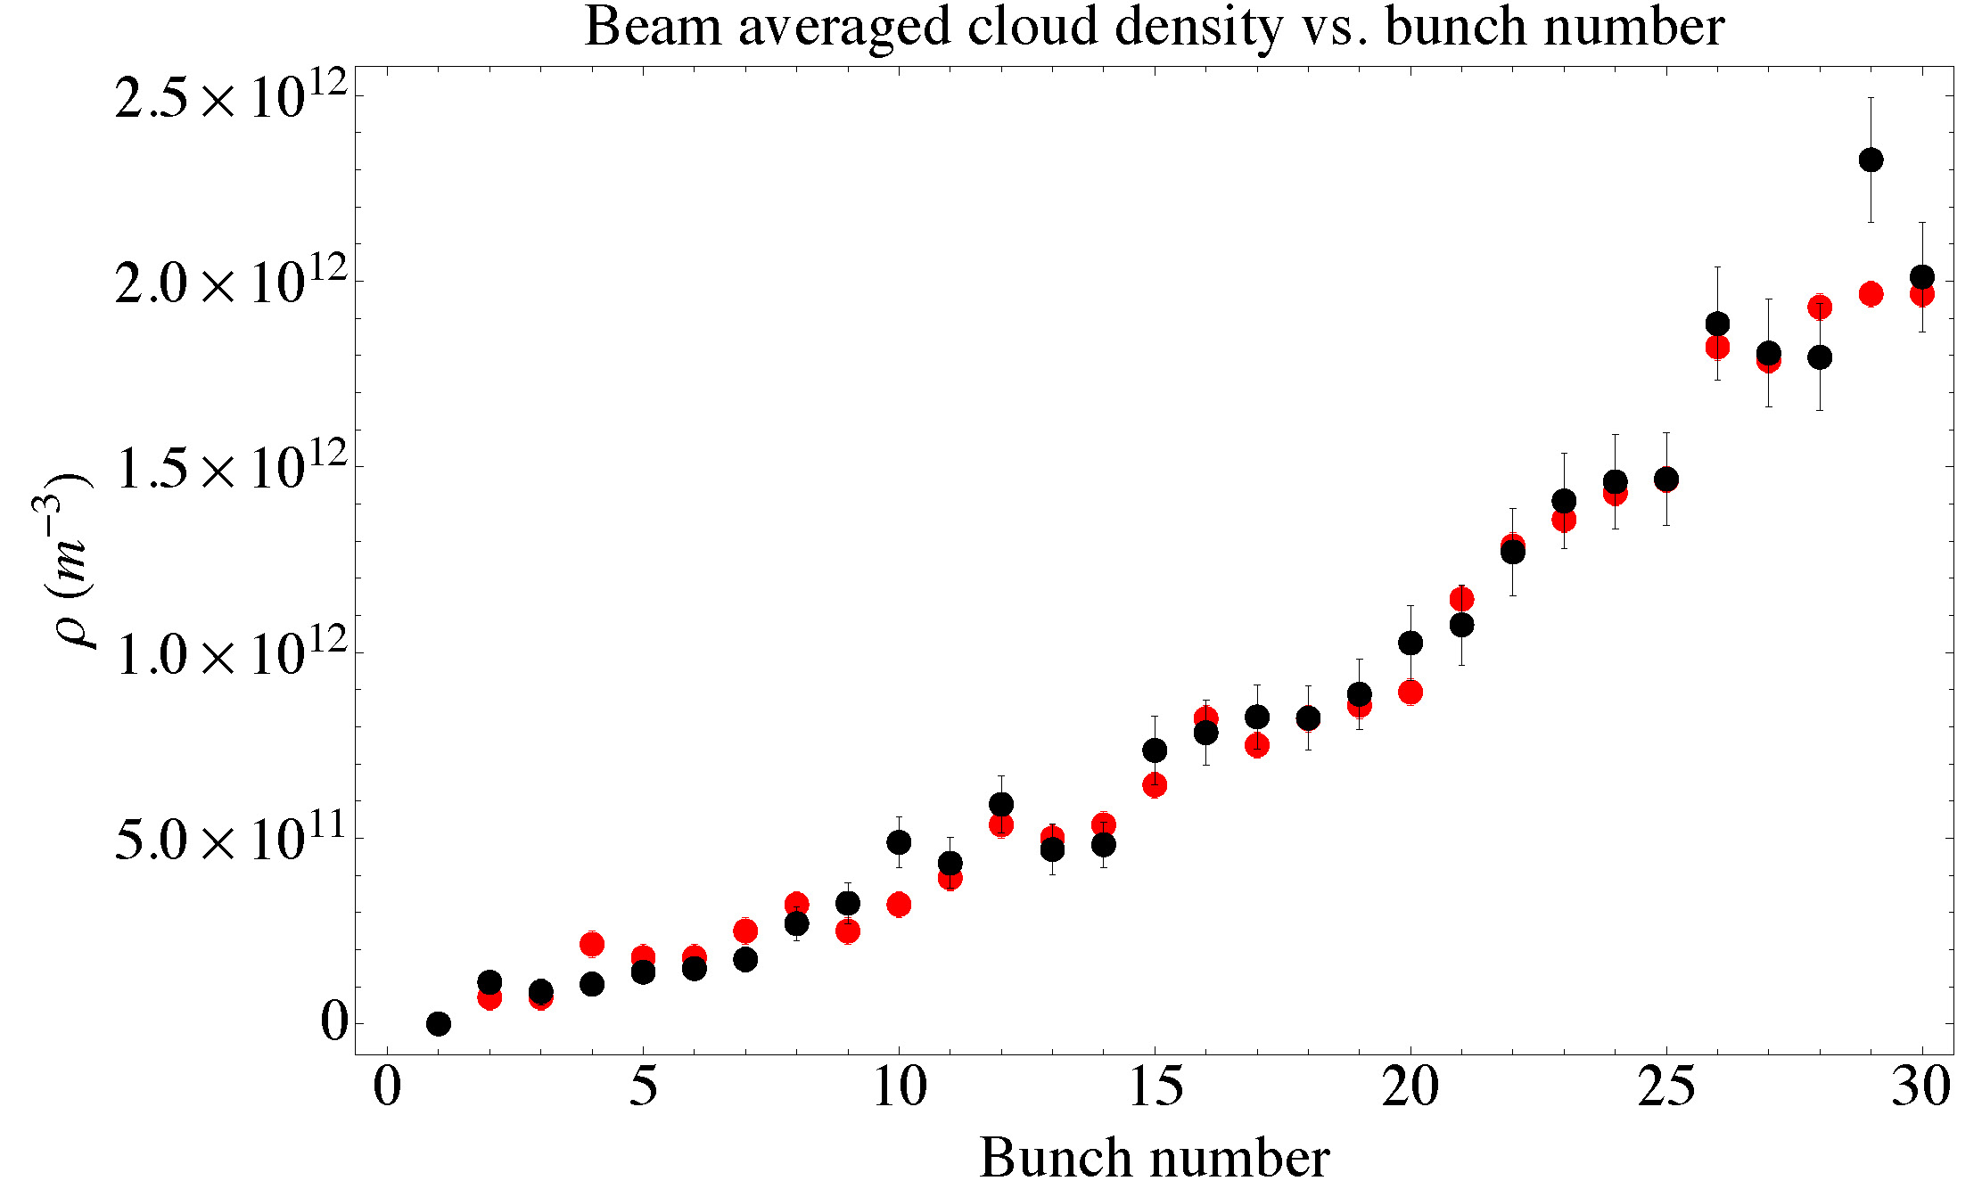
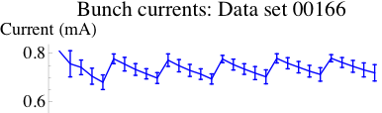
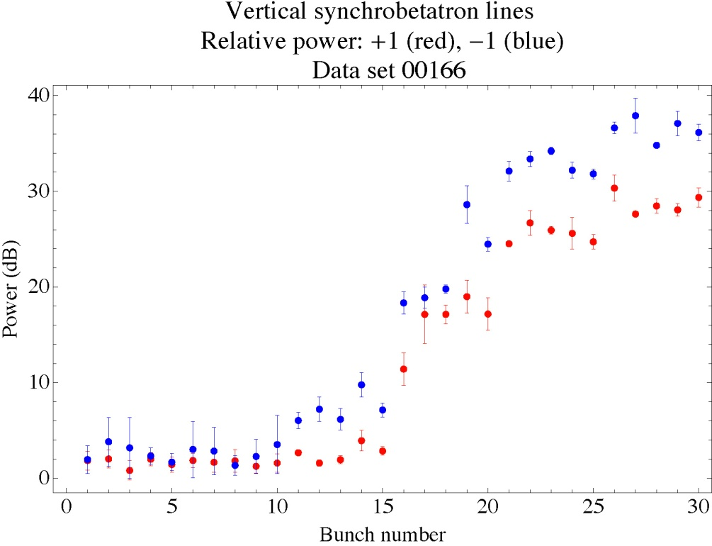
Systematic Studies of Instability Thresholds
Spectral methods offer powerful tool for self-consistent analysis
of the onset of instabilities
  Tune shifts along train a ring-wide integrated cloud density near beam
  Onset of synchrobetatron sidebands a instability thresholds
Data
POSINST Simulation
(H,V) chrom = (1.33,1.155)
Avg current/bunch 0.74 mA
Strength of upper &
lower synchrobetatron
sidebands
dBm

Slide 31
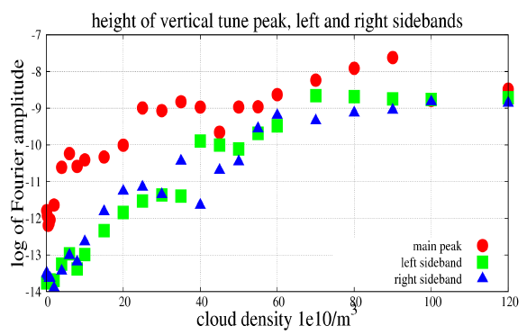
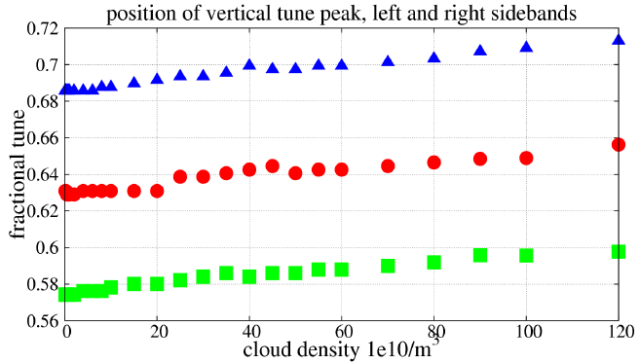
Simulation Program
CMAD simulations
are being validated
against CESRTA measurements and
applied to analysis
of the ILC DR

Slide 32
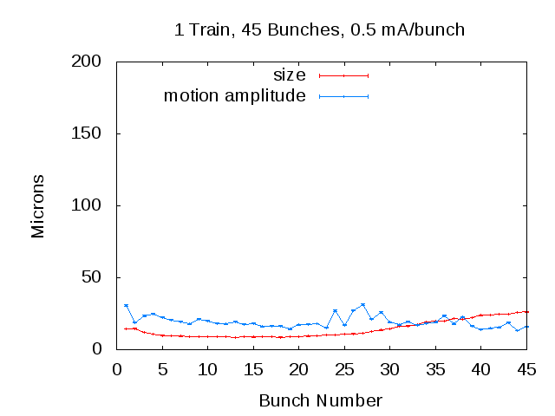
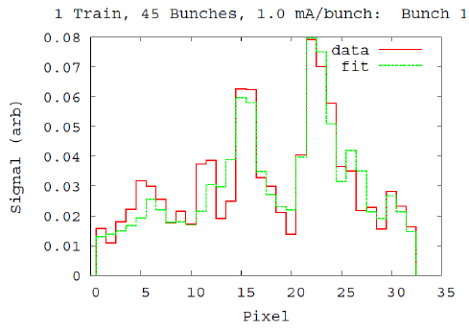
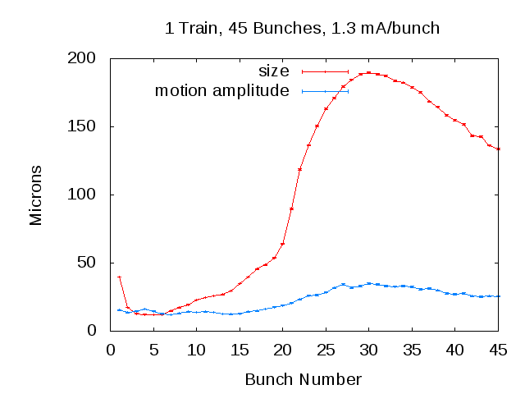
Beam Size
Measure Bunch-by-Bunch Beam Size
  Beam size enhanced at head and tail of train
  Source of blow-up at head appears to be due to a
  long lifetime component of the cloud
  Bunch lifetime of smallest bunches consistent with observed single bunch lifetimes during LET
  (Touschek-limited) consistent with relative bunch sizes.
  Beam size measured around bunch 5 is consistent with ε_{y} ~ 20pm-rad
  [σ_{y}=11.0±0.2 μm, β_{source}=5.8m]
0.8×10¹⁰ e+/bunch,
Each point:
Average of 4K single-turn fits
Single Turn Fit
Bunch 5
Consistent
with onset
of instability
1.6×10¹⁰ e+/bunch
Must
understand
this region
Consistent
with
20 pm-rad
Evidence for
Long-term
Cloud

Slide 33
Implications for the ILC DR
Overall we see reasonable agreement between data and simulation for the onset of the instabilities
  Provides confidence in our evaluations of head-tail instability thresholds
  Work is still ongoing to understand the impact of sub-threshold emittance growth
Trapped EC in the quadrupoles and wigglers has taken on greater significance given recent obesrvations
  Simulation and
  experimental efforts
  will continue in this
  area
No precursor bunch
With precursor bunch
2 GeV, 30 bunch train,
0.75 mA/bunch (1.2×10¹⁰)

Slide 34
Inputs for the ILC Technical Design
  ECLOUD `10 – October 8-12, 2010, Cornell University
    Presentation of all key CESRTA results allowed review and feedback from the EC community
    Satellite Meeting of the ILC DR EC Working Group on October 13, 2010
      Baseline EC mitigation plan for the ILCDR using CESRTA results along with results obtained from our collaborating laboratories (particularly CERN, INFN-LNF, KEK, SLAC)
    Evaluations of the beam dynamics studies suggest that our projections of head-tail instability thresholds for the ILC DR are reasonable
      One area of particular concern identified:
      Sub-threshold emittance growth a more margin may be required
  3.2 km ILC Damping Ring Design
    Phase I results on EC mitigations are consistent with the low power option (1300 bunches) achieving its design goals!
    Sufficient margin exists such that this design appears viable even in the event that the allowed EC density in the ring is lowered due to concerns about sub-threshold emittance growth. Further effort to make this statement more quantitative is highly desirable!
    Concerns remain about moving to the high power option (2600 bunches) with a single positron ring (baseline plan is to add another e+ ring). Further effort to determine whether we can avoid this option is desirable!

Slide 35
EC Working Group Baseline Mitigation Plan
Mitigation Evaluation conducted at satellite meeting of ECLOUD`10
(October 13, 2010, Cornell University)
EC Working Group Baseline Mitigation Recommendation
 | Drift* | Dipole | Wiggler | Quadrupole*
Baseline Mitigation I | TiN Coating | Grooves with TiN coating | Clearing Electrodes | TiN Coating
Baseline Mitigation II | Solenoid Windings | Antechamber | Antechamber
Alternate Mitigation | NEG Coating | TiN Coating | Grooves with TiN Coating | Clearing Electrodes or Grooves
*Drift and Quadrupole chambers in arc and wiggler regions will incorporate antechambers
Preliminary CESRTA results and simulations suggest the presence of sub-threshold emittance growth
  Further investigation required
  May require reduction in acceptable cloud density a reduction in safety margin
An aggressive mitigation plan is required to obtain optimum performance from the 3.2km positron damping ring and to pursue the high current option
S. Guiducci, M. Palmer, M. Pivi, J. Urakawa on behalf of the ILC DR Electron Cloud Working Group

Slide 36
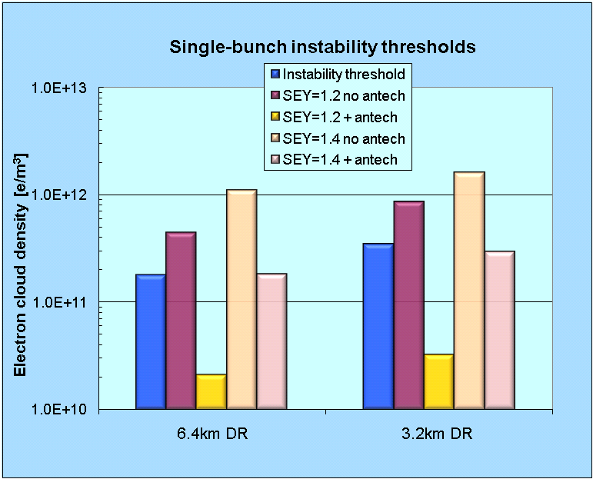
Comparison of 6.4 and 3.2 km DR Options
Summer 2010 Evaluation
Comparison of Single Bunch EC Instability Thresholds for:
  6.4km ring with 2600 bunches
  3.2km ring with 1300 bunches
  same average current
Both ring configurations exhibit similar performance
a 3.2km ring (low current option) is an acceptable baseline design choice
SEY 1.4
SEY 1.2
antechamber
antechamber
antechamber
antechamber
S. Guiducci, M. Palmer, M. Pivi, J. Urakawa on behalf of the ILC DR Electron Cloud Working Group
Notes:
36

Slide 37
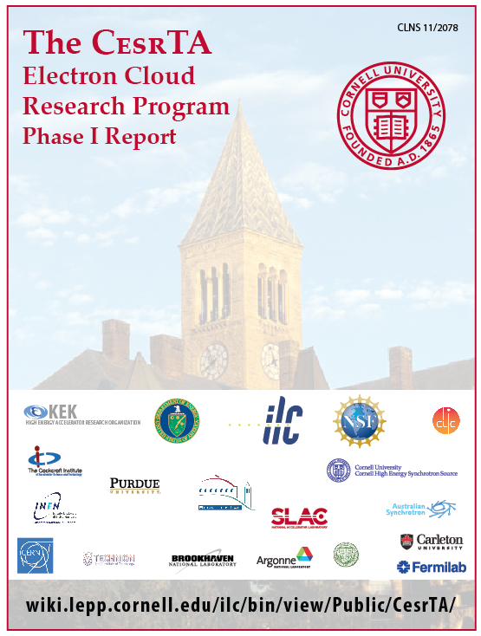
Documentation
  As of the conclusion of 2010, over 240 operations days provided by the CESRTA program
    Studies of EC mitigation performance, low emittance tuning, and EC induced instabilities were carried out as planned
    Data analysis is still in progress…
  Documentation of the Phase I Results
    Phase I Report in progress – targeting a late summer release
    Several results approaching readiness for journal publication
  Damping Ring Design
    EC Working Group will conduct an updated simulation campaign targeting the high power option
    To be followed by a detailed report containing EC plan for the ILC DR roughly at year’s end

Slide 38
The Future
  CESRTA
    Phase II program is now funded (3 years)
    Continue to compare simulation and data in a low emittance regime which approaches the ILC DR specification
    Validate EC simulations against data (including critical extensions to models)
    Time-resolved studies in dipoles and quadrupoles
    Continued evaluation of the durability of coatings
  Extended program allows for new studies
    IBS studies and detailed comparison with simulation are of particular importance for the CLIC DR design
    Tools and diagnostics are applicable to Fast Ion Instability studies
    Continue the development of instrumentation and techniques useful for low emittance rings
Continued refinement based
on Phase I results

