Slide 1




Colored ILC
Atsuto Suzuki (KEK)

Slide 2


1. Green ILC

Slide 3
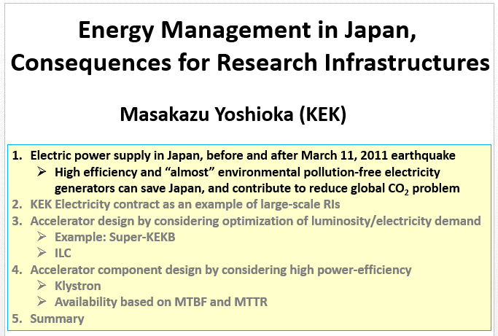
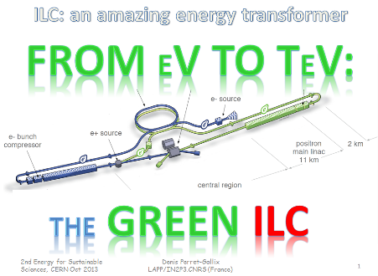
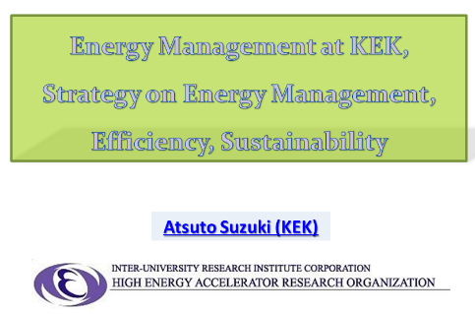

Slide 4
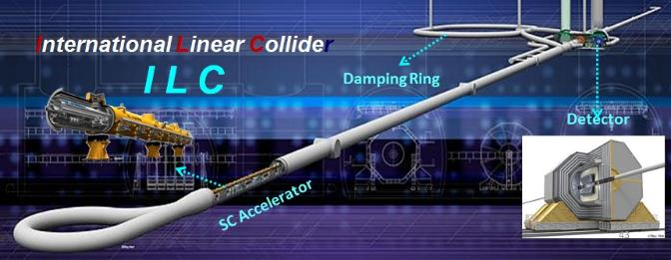
Improve Efficiency
of
Power Consumption
in
Accelerator Operation
serious issue for ILC

Slide 5
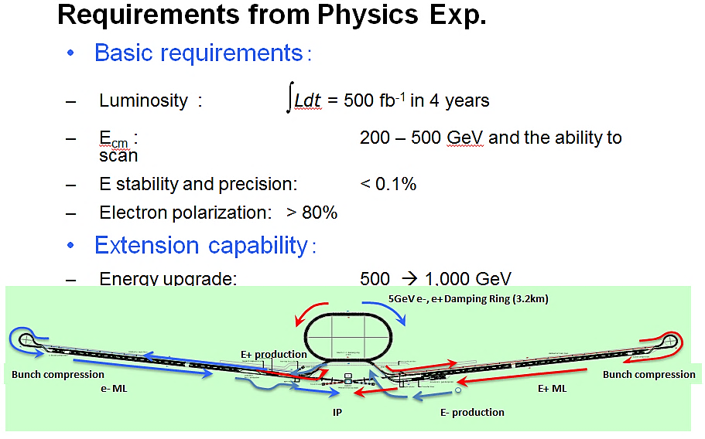
Power Balance of Consumption and Loss in ILC
ILC 500 GeV
Total Power
:
～200 MW
Improve efficiency
loss rate
50 % : 25 MW
50 % : 35 MW
90 % : 60 MW
100 % : 10 MW
～ 130 MW
Infrastructure : 50 MW
RF System : 70 MW
Cryogenics : 70 MW
Beam Dump : 10 MW
200 MW
Obligation to Us
Increase recovery

Slide 6
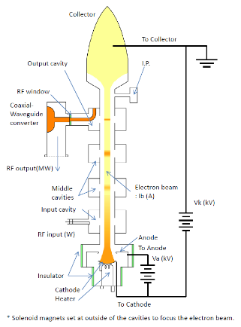
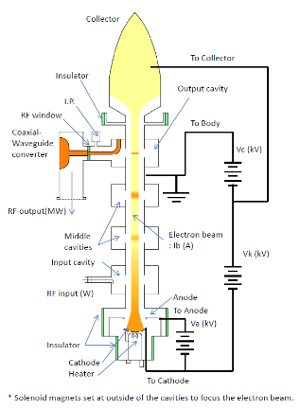
How to Improve RF Efficiency
R&D of CPD (Collector Potential Depression) Klystron
CPD is an energy-saving scheme that recovers the kinetic energy of the spent electrons after generating rf power.
Conventional
Schematic diagram of CPD
collector
collector

Slide 7
Simplified Schematic Concept
Without CPD
With CPD
Potential in the Klystron
Potential in the Klystron
Electron Energy
Electron Energy
U_{k}
RF
U_{k}
RF
Potential & Electron Energy
Potential & Electron Energy
E₀
E₀
E_{c}
U_{c}
E₁
E₁
CPD gap
E_{c}
U_{c}
Anode
Cathode
Anode
Cathode
Output cavity
Collector
Output cavity
Collector
Efficiency of RF Conversion (40-50) %
Beam Deceleration
Heat Loss
Energy Recovery/Reuse
Potential denotes the electron potential energy, eV. For simplicity, input and intermediate cavities are omitted here and the anode potential is set to zero.

Slide 8
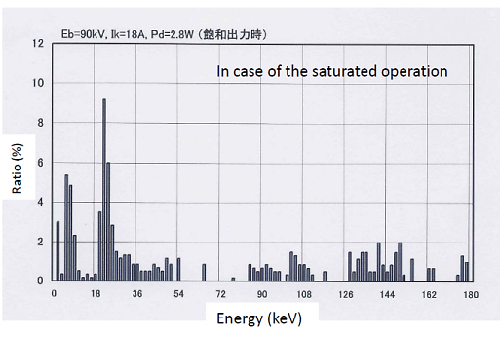
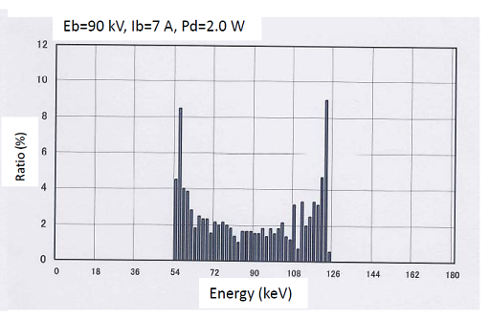
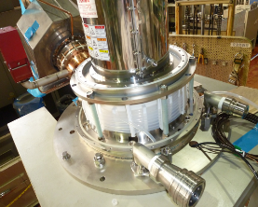
Issues must be addressed for CPD Klystron
(I) Energy spread
The spent electron beam has large energy spread through electromagnetic interaction in the cavities. Therefore, the collector potential cannot be increased beyond the lower limit of energy distribution of the spent electron beam, otherwise backward electrons hit the cavities or the gun, and then deteriorate the klystron performance.
Unsaturated: 200 kW out
Saturated: 1 MW out
E₀ = 90keV
E₀ = 90keV
(II) Pulse-to-DC conversion
The spent electron beam is longitudinally bunched, so that pulsed voltage is induced on the collector. An adequate pulse-to-DC converter has to be implemented.
Output Coupler
Collector
(III) RF Leakage
CPD klystron has to be equipped with an insulator between the collector and the body column in order to apply CPD voltage to the collector. Thus, it would be possible for the CPD klystron to leak rf power out more or less from the insulator.
Ceramic Insulator

Slide 9
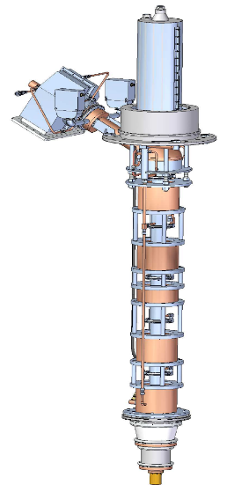
Present Status of R&D
Target
proof-of-principle of CPD in the unsaturated region (a maximum rf power of 500 kW) using a KEKB 1.2MW-klystron
Newly fabricated components
collector
ceramic insulator
output cavity
output coupler
R&D Schedule
2013.3: Modification of an existing klystron to CPD klystron (already done)
2014.3: until then, preparation and commissioning of the test station
~2014: Verification of klystron operation without CPD
~2015: Measurement of rf leakage from the gap between the body column and the collector (with no CPD voltage applied)
Measurement of induced pulse voltage on the collector with CPD
~2017: Test of rectification by Marx circuit
Integration test of the proof-of-principle of CPD operation
Recycled components
electron gun
input cavity
intemediate cavities
80 % efficiency

Slide 10
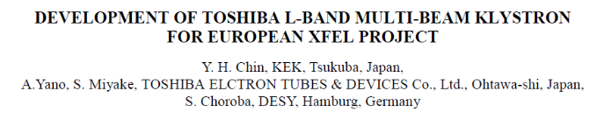
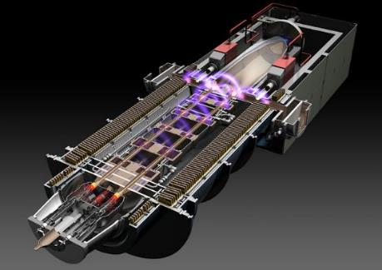
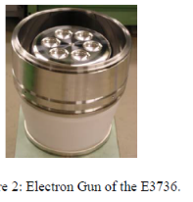
Multi(6) – Beam Klystron (MBK) for 26 Cavities for ILC
The design goal is to achieve 10 MW peak power with 65 % efficiency at 1.5 ms pulse length at 10 Hz repetition rates.
MBK has 6 low-perveance beams operated at low voltage of 115 kV for 10 MW to enable a higher efficiency than a single-beam klystron.
Frequency | 1.3 GHz
Peak power | 10 MW
Pulse width | 1.6 ms
Rep. rate | 5 Hz
Average power | 78 kW
Efficiency | 65 %
Gain | 47dB
BW (- 1dB) | 3 MHz
Voltage | 120 kV
Current | 140 A
Lifetime | 40,000 h

Slide 11
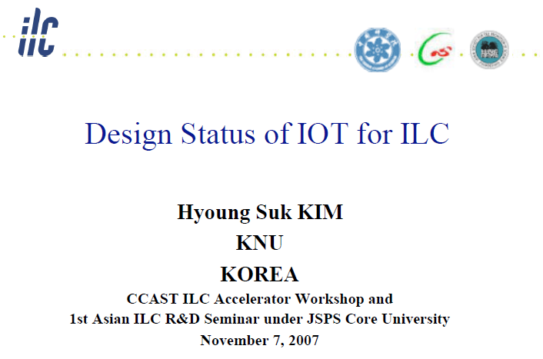
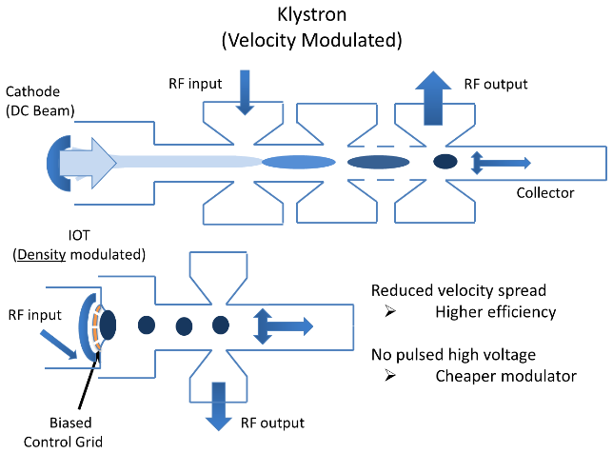
Inductive Output Tube
function : Vacuum Tube

Slide 12
Completely Old/New Idea for Klystron
RF output
Synchrotron Radiation Electron Tube
Bunched
Electron Beam
Synchrotron radiation
from small bend
1.3GHz Electron Gun
Cathode
Klystron
Advantages
  > 90% efficiency (small transient time factor by short bunch)
  Stabled by space charge limit operation
  Drivn from low charge low energy 1.3GHz electron beam
  (1/10 klystron ?)
  Very low cost and long lifetime
  Low cost beam line
  No switch, only HV & capacitor

Slide 13
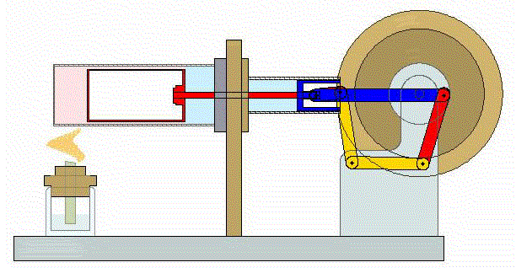
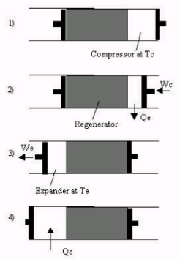
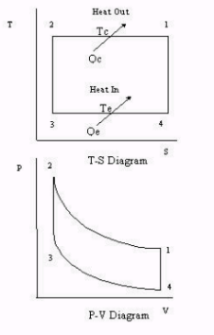
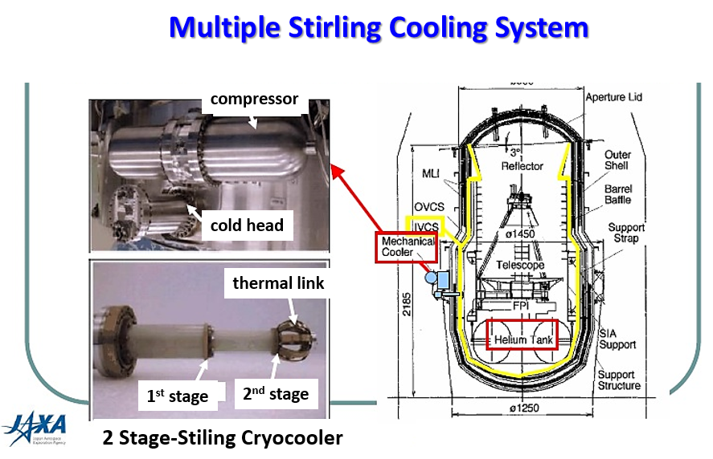
How to Save Power in Cryogenics
Cryogenics/Stirling Cryocooler
High temperature operation
  Klystron collector
  RF Dummy load

Slide 14
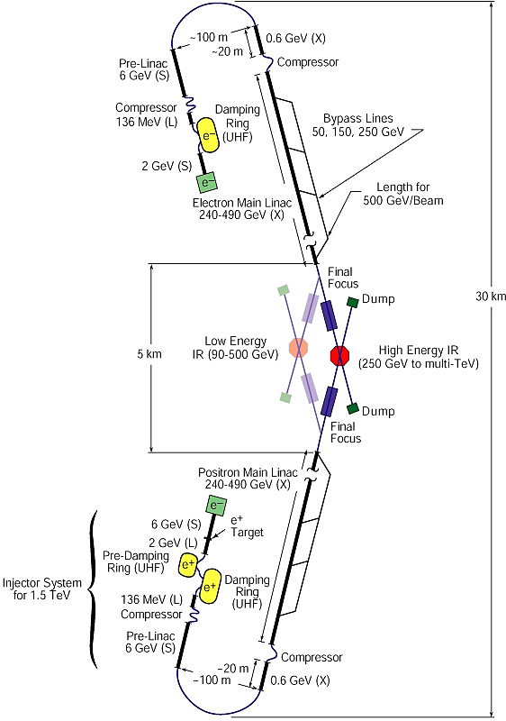
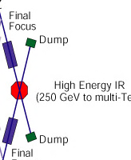
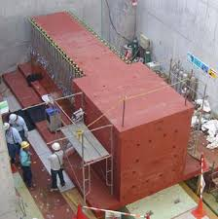
How to Recover Beam Dump Energy (～10 MW)
Recover Beam Energy
Reduce Radio-Activation

Slide 15
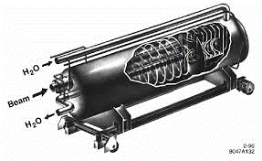
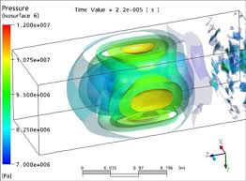
Water Dump
SLAC Dump
for 800 kW
Water Vortex Dump
(25 m long x 15 m height for 1 TeV)
Issue : shock wave management
Issue : management of tritium gas
and tritiated water in vapor form
Noble Gas Dump for ILC
About 1km of a noble gas (Ar looks the most promising) enclosed in a water cooled iron jacket (transport the heat).
This gas dump design may ease some issues such as radiolysis and tritium production.
Issue : particle beam heating of the gas and ionization effects.

Slide 16
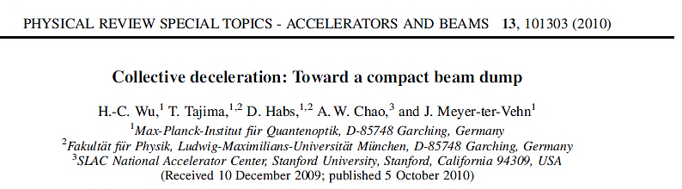
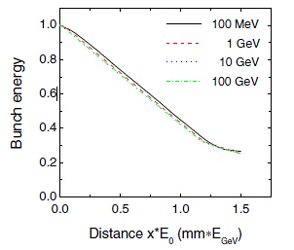
Plasma Deceleration Dumping
Use Collective Fields of Plasmas for Deceleration
10 cm for 100 GeV
The deceleration distance in the underdense plasma is 3 orders of magnitude smaller than the stopping in condensed matter.
The muon fluence is highly peaked in the forward direction.

Slide 17




Collective Stopping Power for ILC
here
&
(electron bunch)
ILC
σ_{T} ≈ 50 μm, σ_{L} ≈ 3 σ_{T} ≈ 150 μm
→ L = 10 m for Li gas
Next Trials
Experiment of Proof-of-Principle
Deposit mechanism of Wake-Field energy

Slide 18
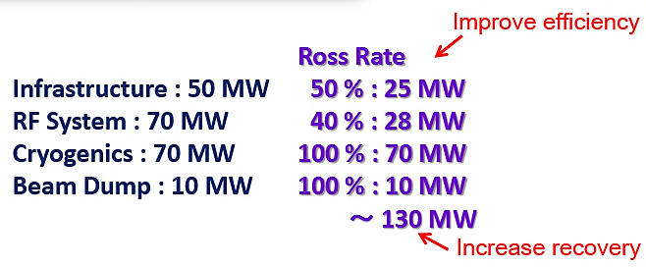
Improve
:
Power Storage to Reuse

Slide 19
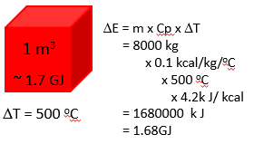
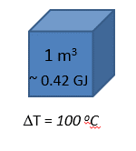

Storage of Thermal Energy
Heat Capacity Iron vs. Water
Heat Capacity of Iron
Heat Capacity of Water
Storage of Electric Energy as Heat in Iron
10 m
Electric Energy
100 MW x 1 0 hours
10 m
3 x 10³ m³ ~ 1.7 GJ x ~ 5100 GJ
3000
Store the surplus
electric energy
as thermal energy
E = 100 M J / sec
x 3600 sec / hr x 10 hr
= 3600 GJ
10 m

Slide 20
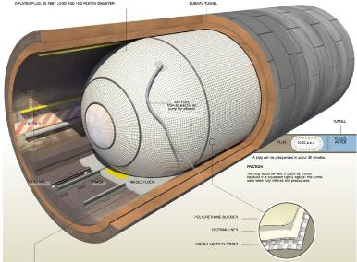
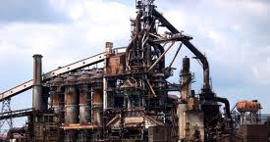
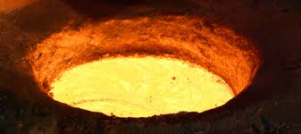
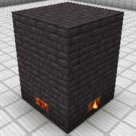
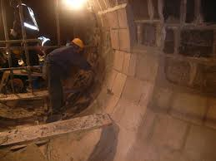
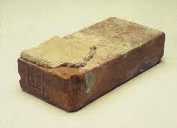
how to keep iron heat
Blast Furnace
ILC Tunnel
Fire Brick

Slide 21
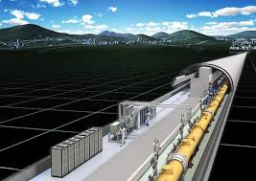



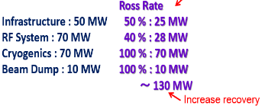
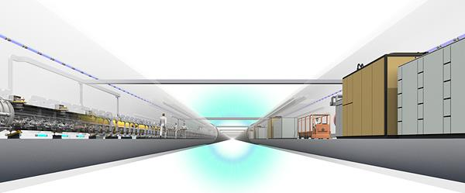
Summary
ILC
Reuse
Energy
Reuse
Energy
Improve
Efficiency
Stand Alone
Energy System
Recover
Energy

Slide 22
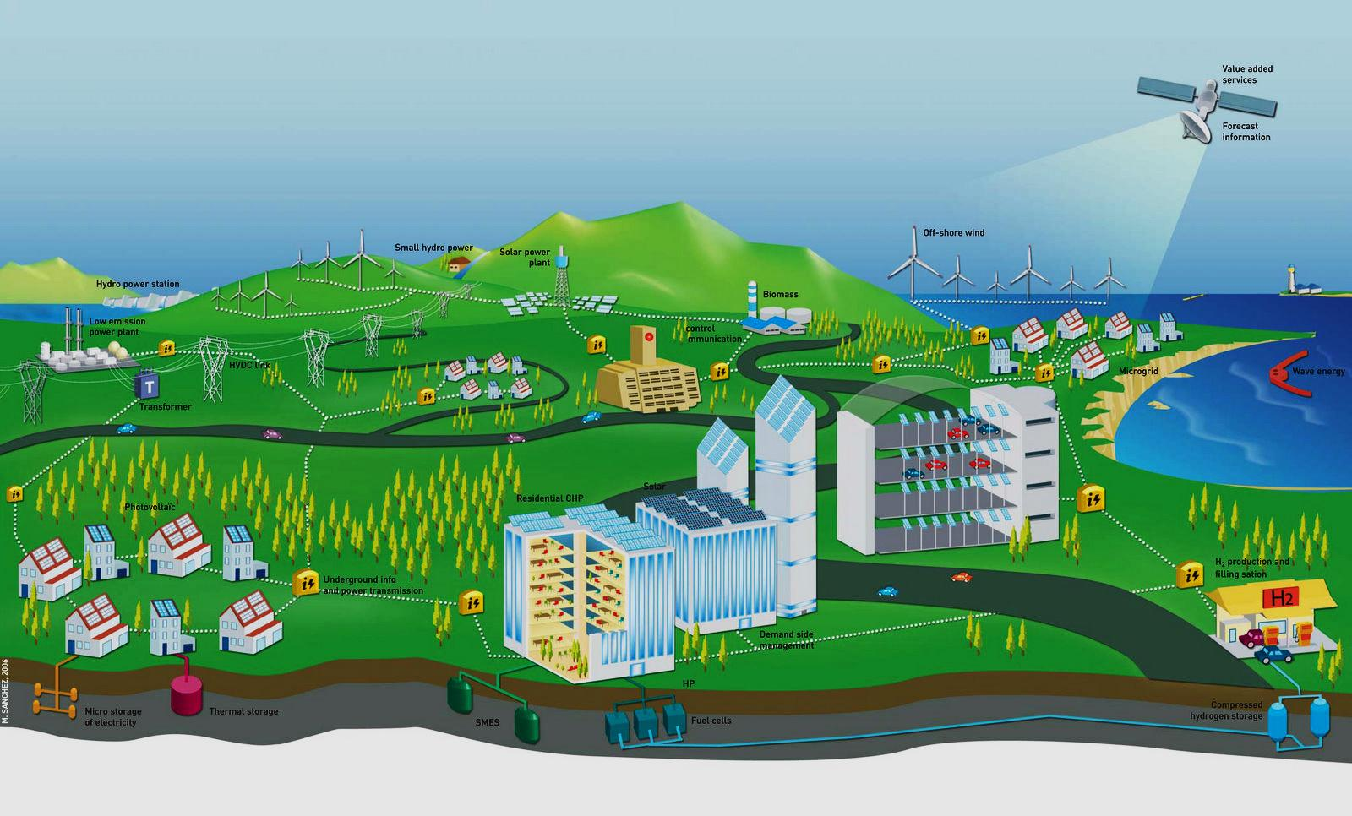
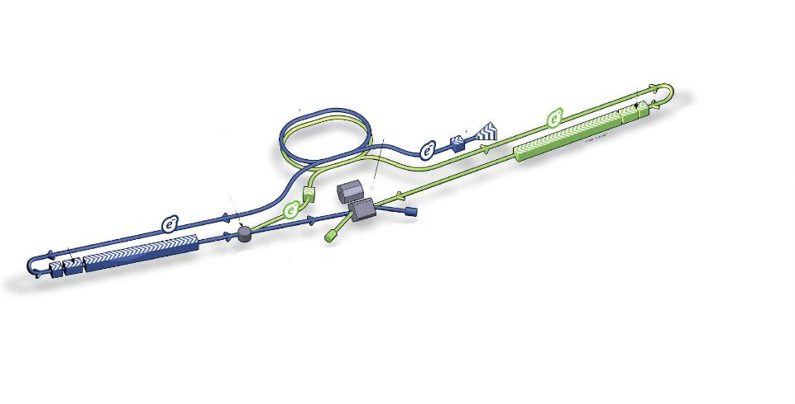

ILC center futuristic view
Forecast and data management
Hydro storage
Wind turbine
Off-shore wind
Solar Power Plant
Biomass
Geothermal Plant
Smart GRID
Wave/stream energy
Photovoltaic and thermal
Photovoltaic
He, H2 storage
Courtesy of:

Slide 23

2. Yellow ILC

Slide 24
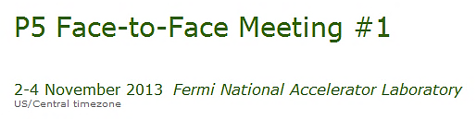
Strategic Planning
for the Japanese Program
Atsuto Suzuki (KEK)

Slide 25
P5 Report → Government (Nov. 7)
The world HEP scientists are strongly disappointed with media remarks about the JSC findings on the ILC project. This damage looks too serious.
Scientists are deeply concerned that the Japanese government would hesitate to advance the realization of the ILC project.
Given these, it is urgent that the government unfolds its view on the JSC findings.
The government should now pay much attention on how to define interests to host the ILC in Japan. It is the next step to start governmental discussions about the budget and man-power sharing.

Slide 26
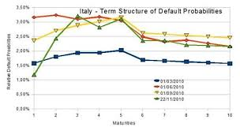
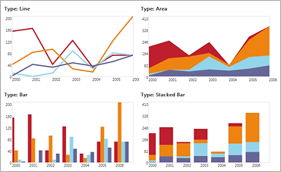
The world HEP community understands that the next FALC is the best opportunity for the government message.
The Rolf Heuer (CERN), Nigel Lockyer (FNAL) and A.S (KEK) had the consensus that the timeprofiles of budget-breakdown (CFS, accelerator, detector ・・・) and man-power-breakdown are essential for the governmental negotiation.
budget
manpower
year
year

Slide 27

3. Red ILC

Slide 28


Summary
More/More Efforts on Hosting the ILC in Japan

