Slide 1
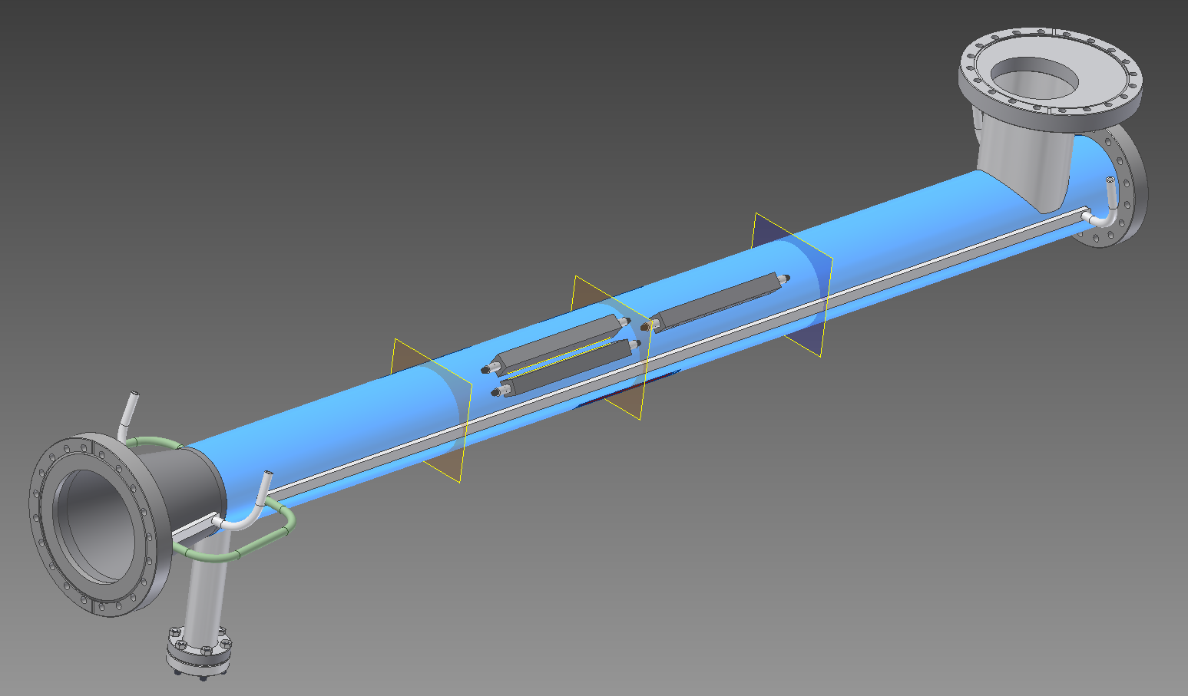
ISO view of pipe w/ individual EC detector installed
Smaller 0.375” diameter SMA connectors on each end.
½’’ gap between ends of SMA connectors.
Planes on ends represent magnet edge. So the gap between SMA connectors can be increased so detectors are center between the magnet planes and the center plane

Slide 2
Let’s start with bad news first
The single enclosure design does not allow for enough clearance for the weld between the two detectors.
Below is the perforated plates superimposed on each other azimuthally.
There are dead zones where there are no perforations between the plates where electrons cannot pass and data is lost
Possible solutions:
Make the two detectors that are directly next to each other in one enclosure with a barrier to block as much RF as possible.
Add another row of holes to each of detectors and make conductor slightly wider

Slide 3
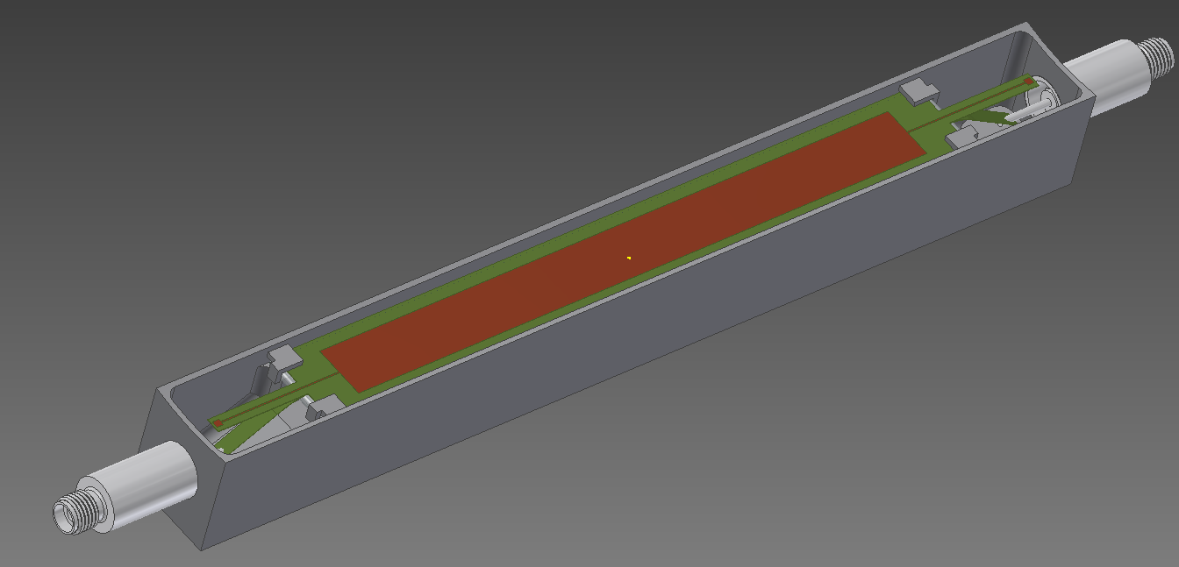
Here is a look of the detector assembly itself
SMA end to end is 22 cm x 18 mm wide
Wall thickness 1 mm
Small weld plates that clamp the stripline down to the ceramic in addition to small beams of adhesive in the center

Slide 4
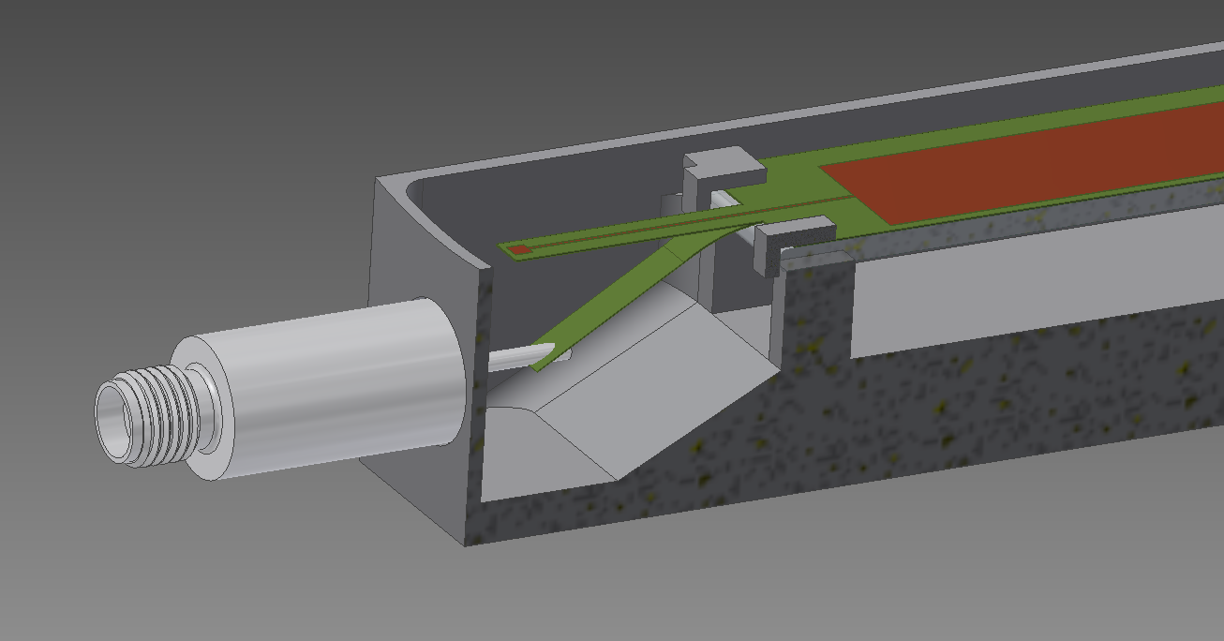
Here is a lengthwise cross section of the detector
Manufactured shape vs actual installed shape of strip line
7 mm gap maintained to ends except for where detector is clamped to housing

Slide 5
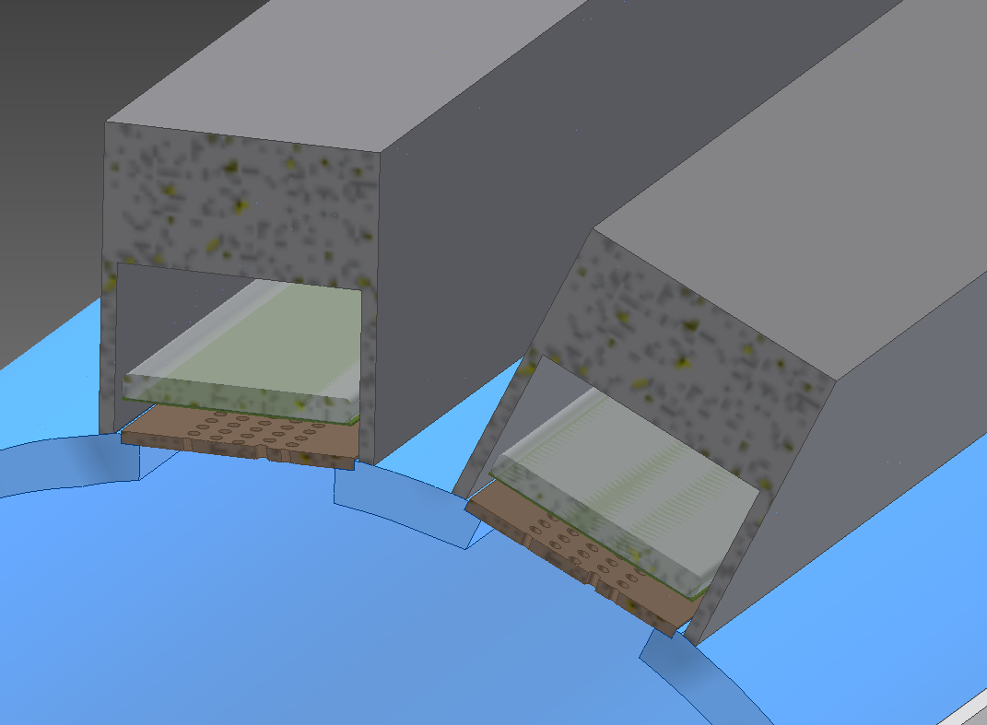
Cross section of detector installed on pipe. 5.2mm gap between detectors for weld bead.
5.2mm

Slide 6
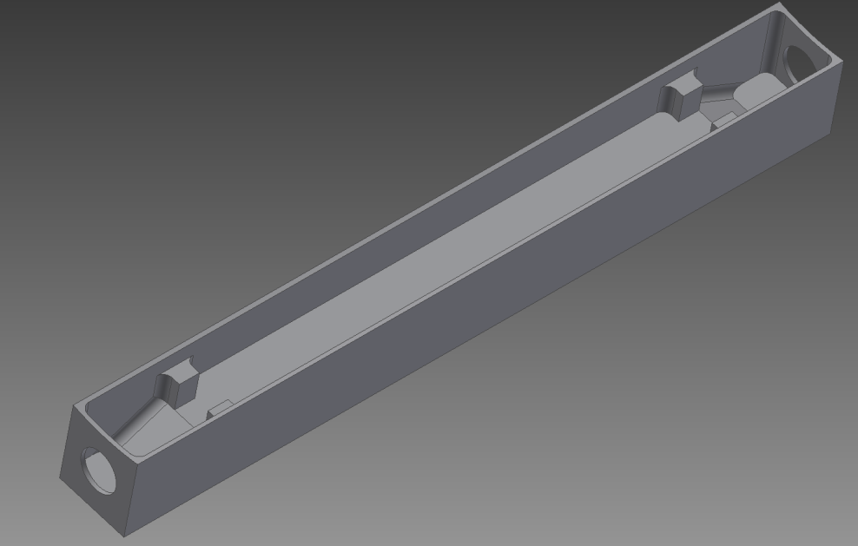
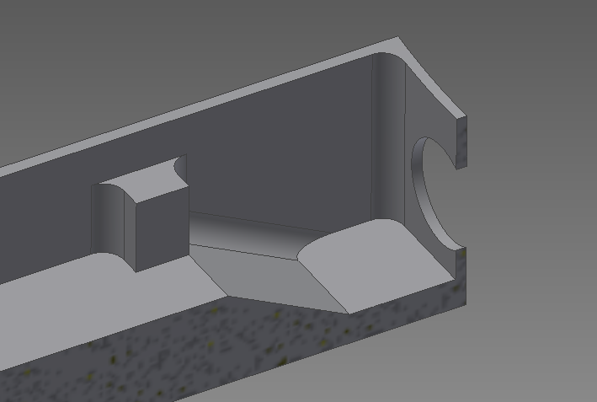
Enclosure with no parts machined from solid bar

Slide 7
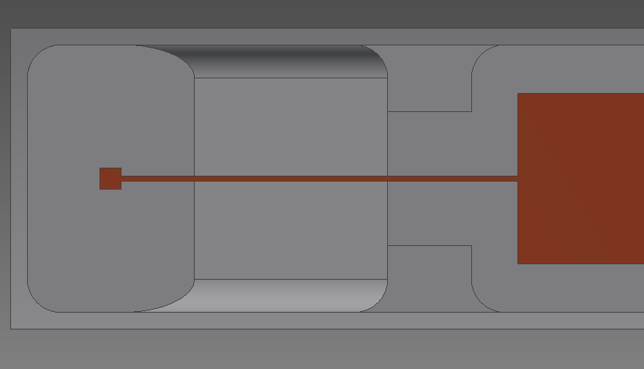
Detector relative to enclosure boundaries.
If needed, It’s possible to make all dimensions the same (3 mm)
Making the conductor 7mm from all ground surfaces is impossible with the enclosure at this width
3mm
4.2 mm
3.2mm

