Slide 1
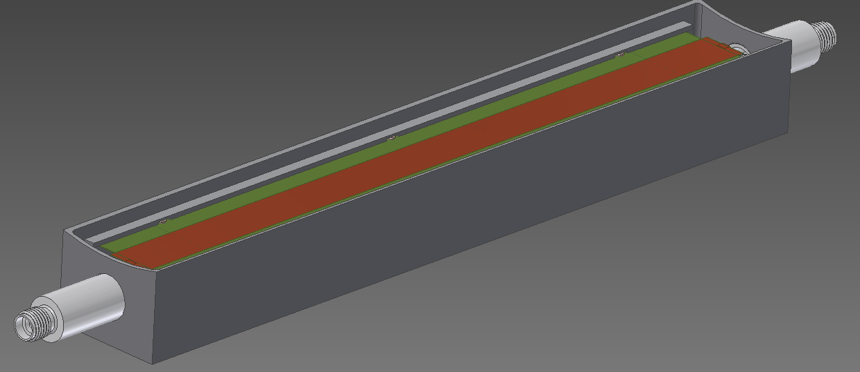
Single Detector Design

Slide 2
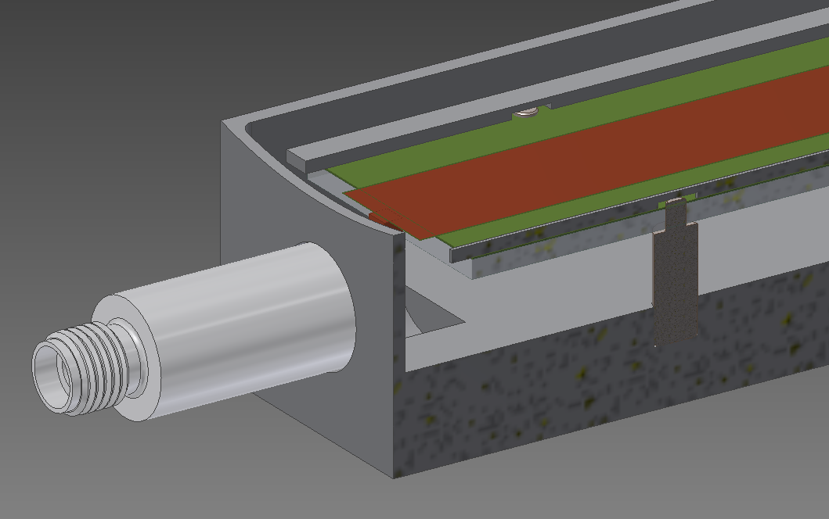
Single Detector Design

Slide 3
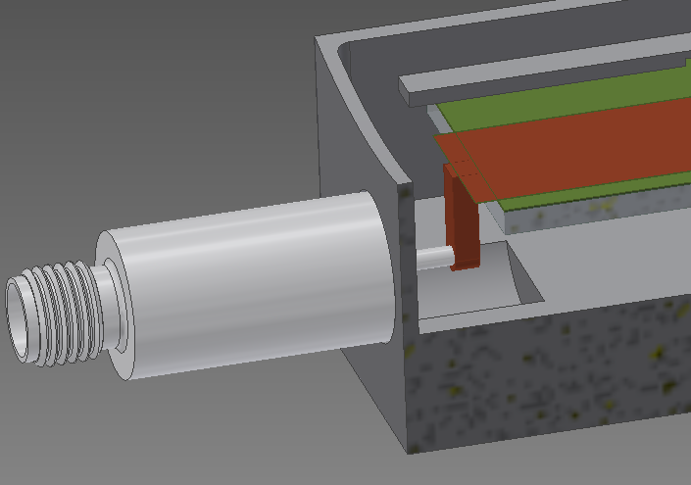
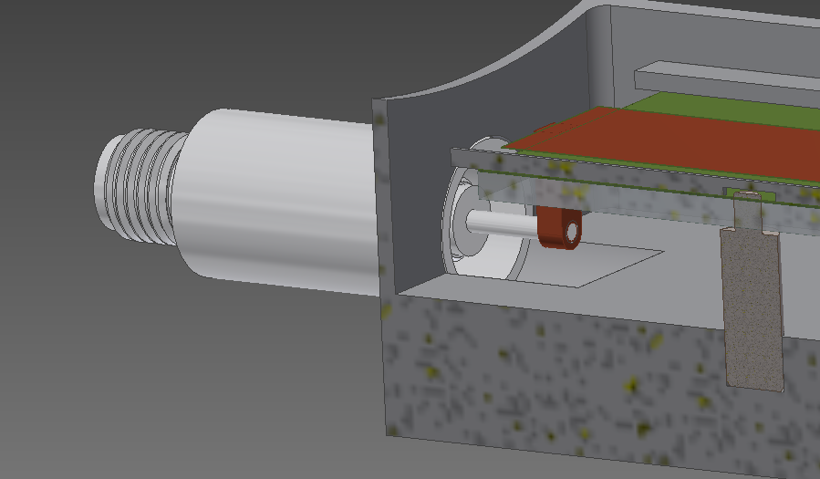
Single Detector Design
Clamped to 3 mm thick ceramic
Sits on six ceramic dowel pins
Inner length 6.811”
Inner width 0.945”
Inner depth 0.305’’ from detector face to ground plane
Thickness 0.031’’ (1 mm)

Slide 4
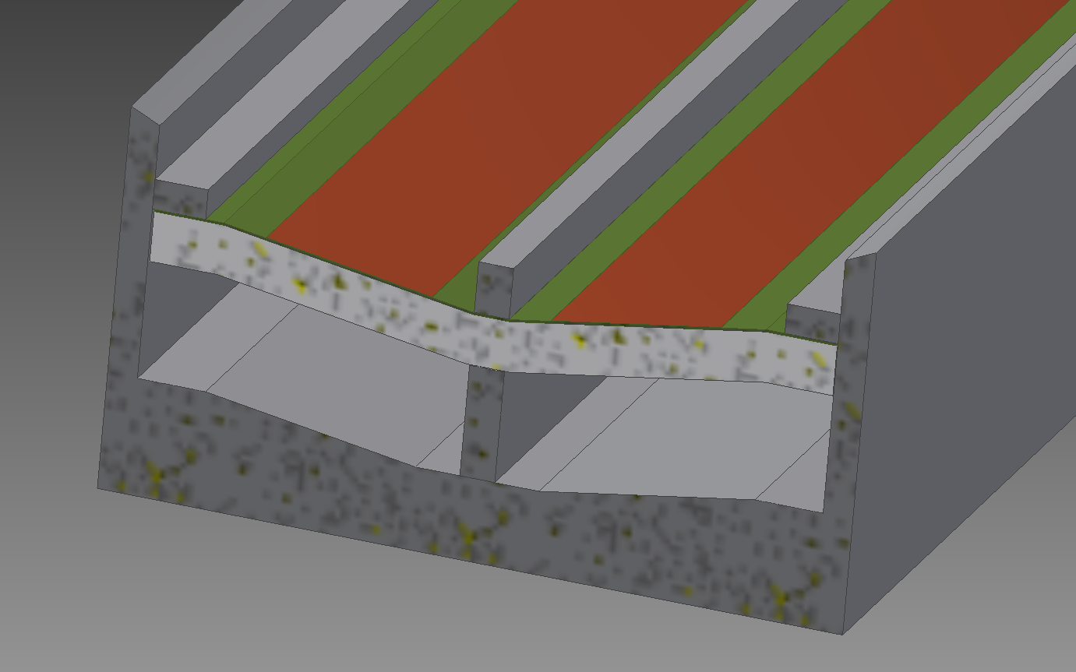
Dual Detector Design
Same idea as single detector except with much less space to work with
Strip line detector is two detectors on one piece of kapton.
I used a “2 in 1” clamp design for the barrier between the two detectors. The tall middle barrier is placed with pins, then the ceramic is place on same pins then stripline is clamped down and the ends tack welded to the enclosure. See next slide for detail

Slide 5
Dual Detector Design
Same idea as single detector except with much less space to work with
Strip line detector is two detectors on one piece of kapton.
I used a “2 in 1” clamp design for the barrier between the two detectors. The tall middle barrier is placed with pins, then the ceramic is place on same pins then stripline is clamped down and the ends tack welded to the enclosure. See next slide for detail

Slide 6
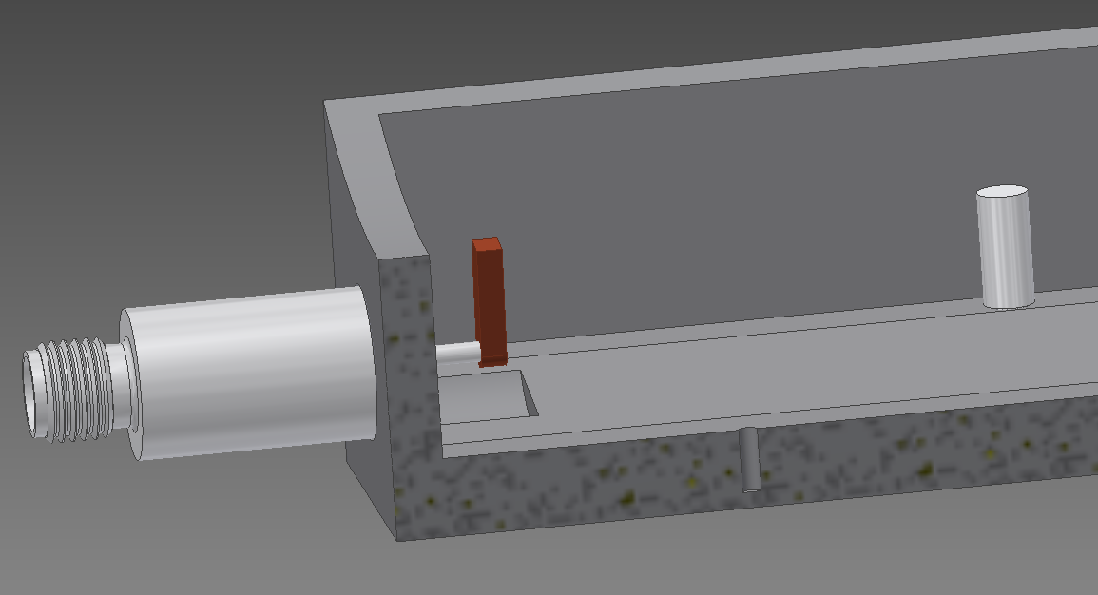
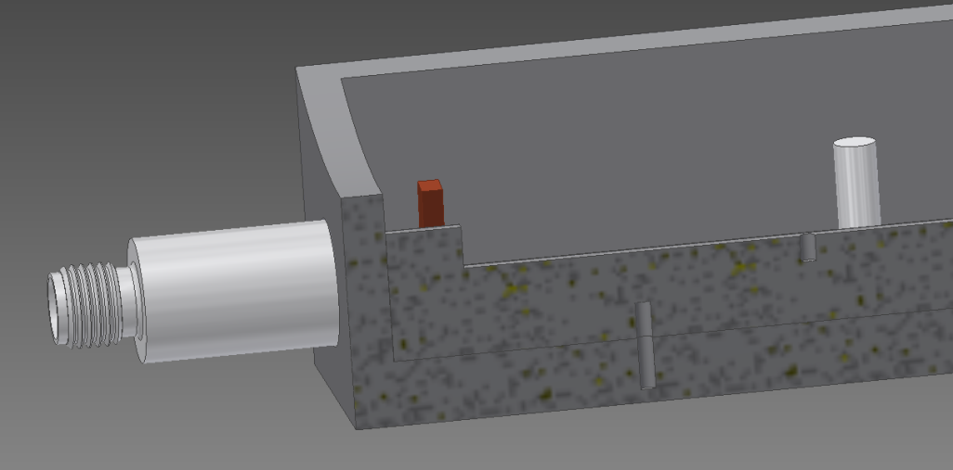
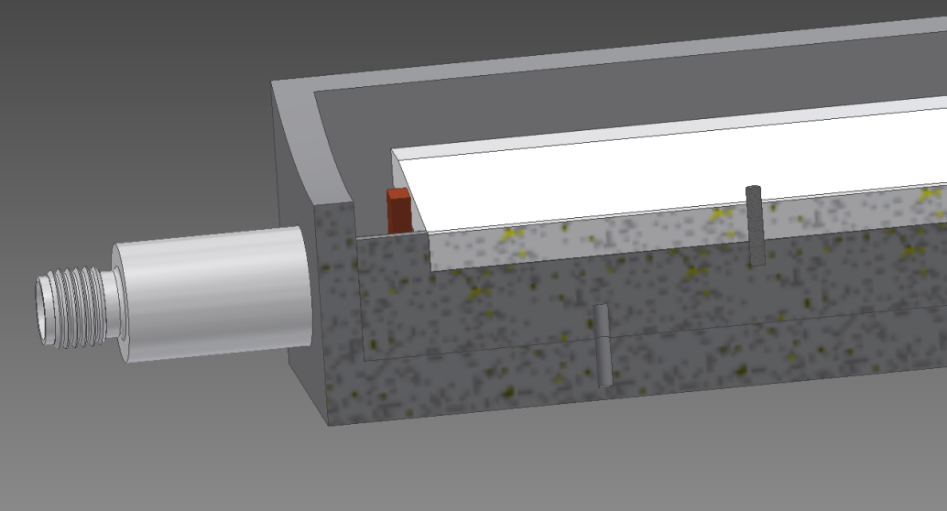
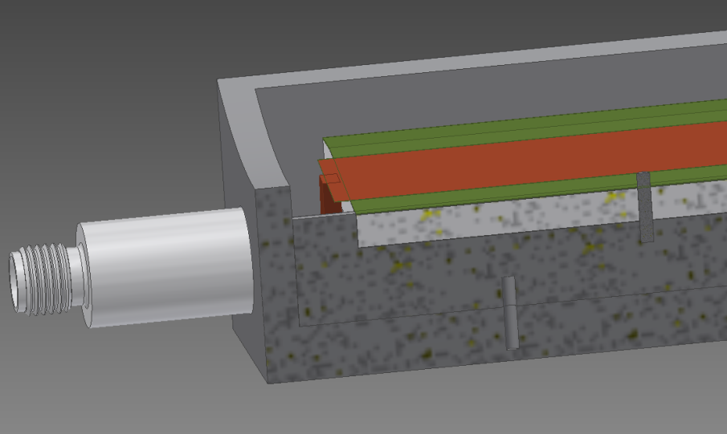
Dual Detector Design
Install clamp base pins and clamp base plate
Install one piece ceramic
Place stripline detector

Slide 7
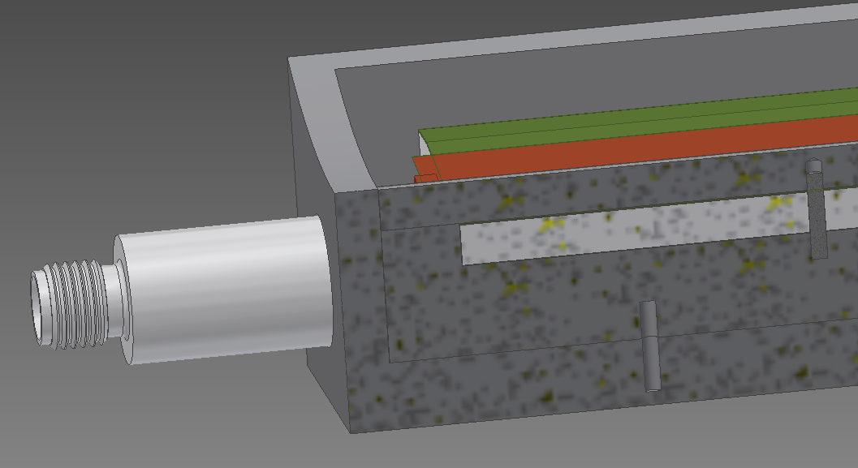
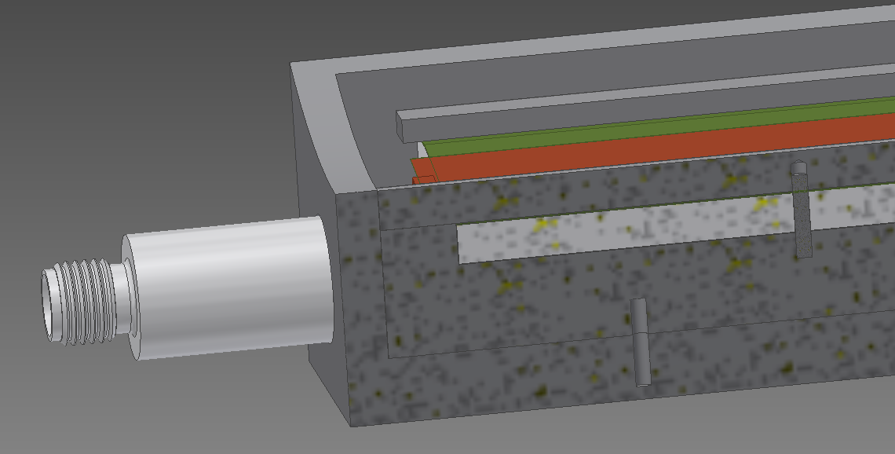
Install barrier clamp & tack weld ends
Install circuit edge clamp. Tack weld in place.
Nominal gaps are 0.002”
Inner width of each detector box is 0.764”

Slide 8
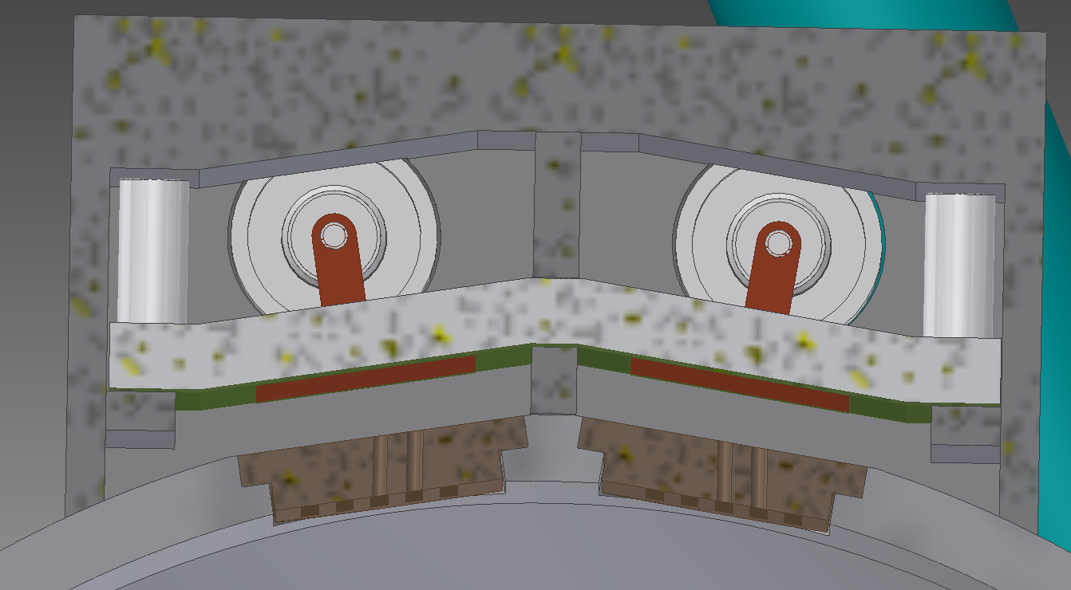
Dual detector on beam pipe

Slide 9
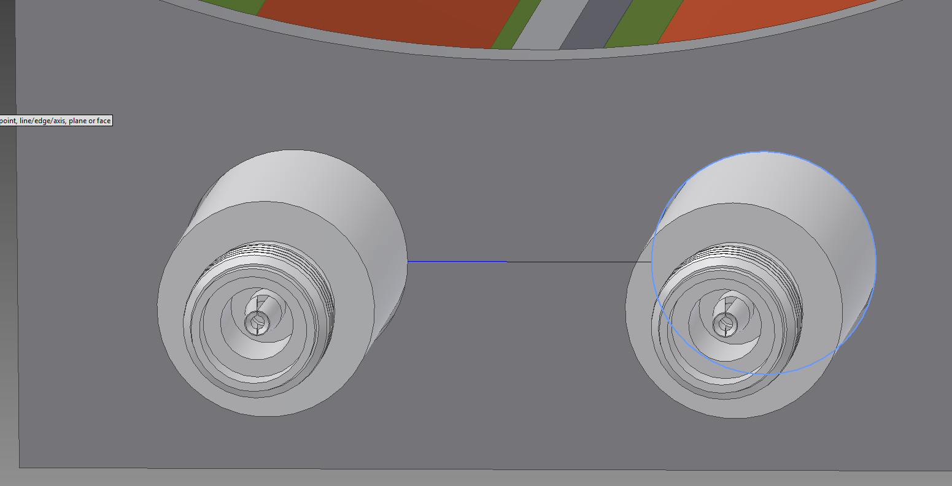
Possible weld issue? Only 0.416’’ between SMA connect edges.

Slide 10
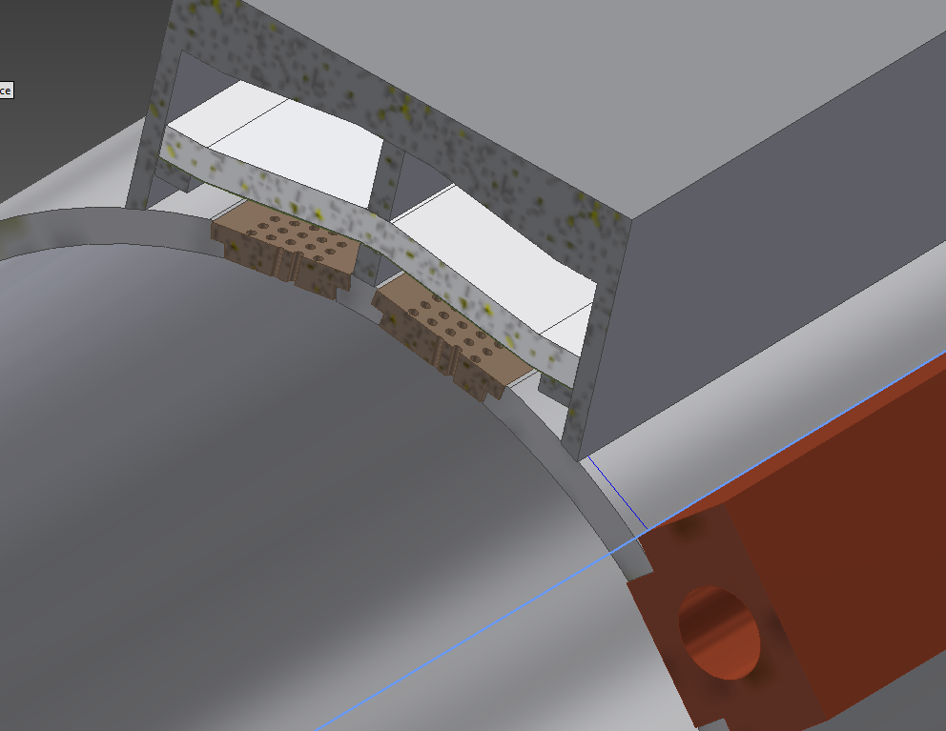
Possible weld issue? Only 0.3’’ between dual detector and cooling channel

Slide 11
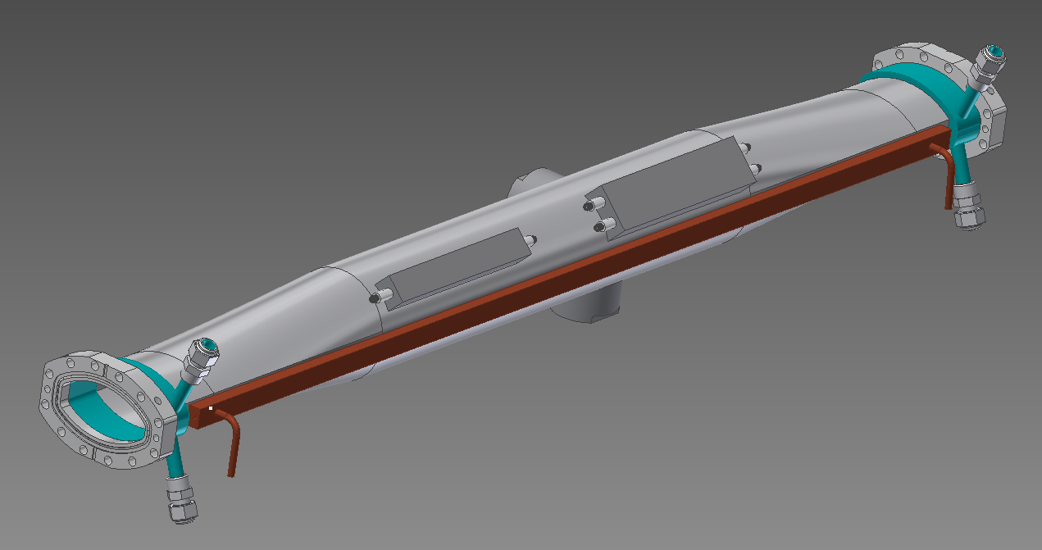
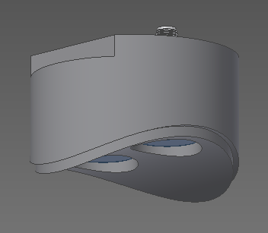
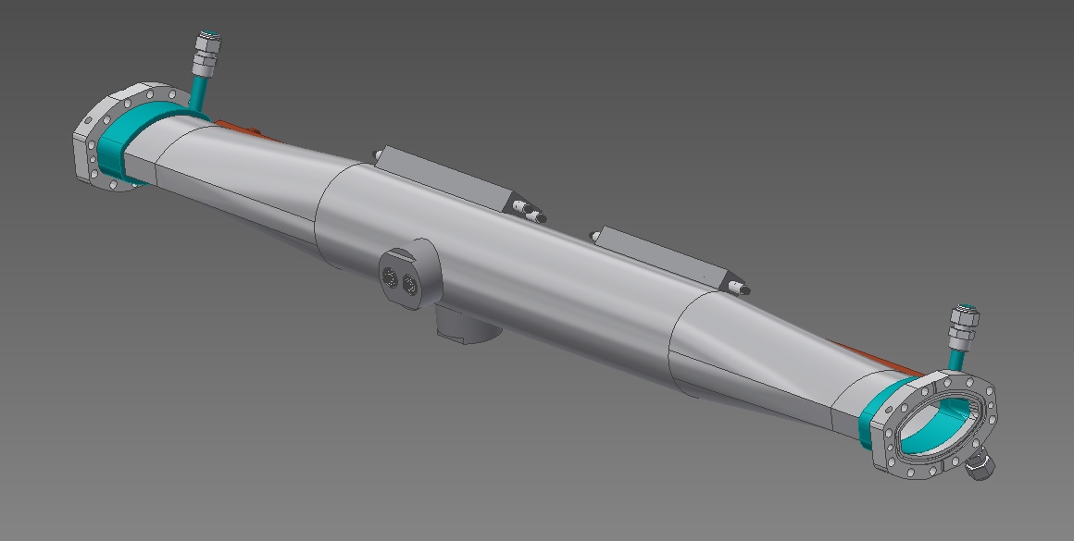
Vacuum Chamber Design
Stainless BPM
Cooled flanges
Extruded copper cooling channel (0.31 diam). Delta P is 1.18 psi. (32’’ H20)

Slide 12
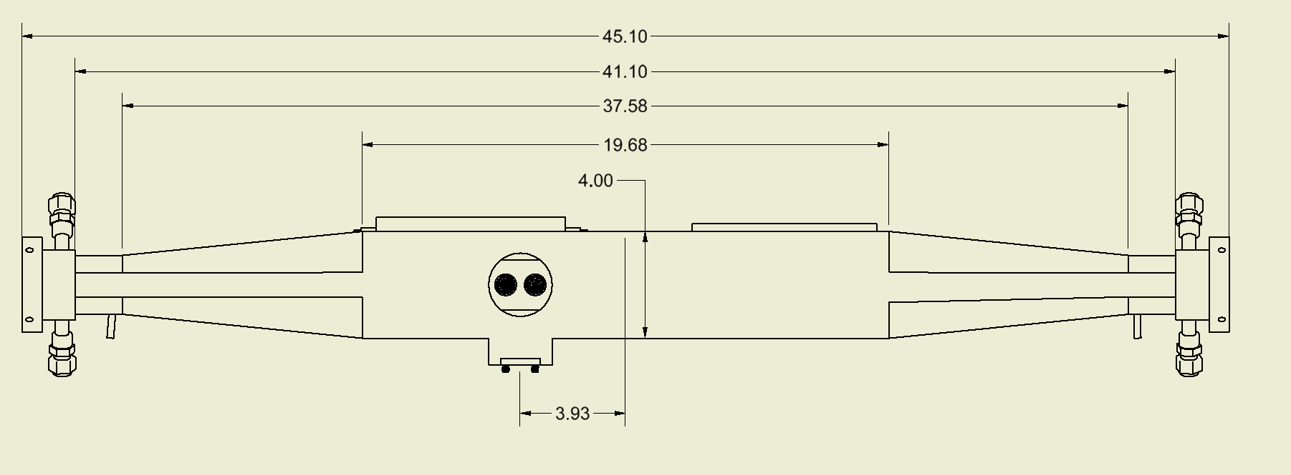
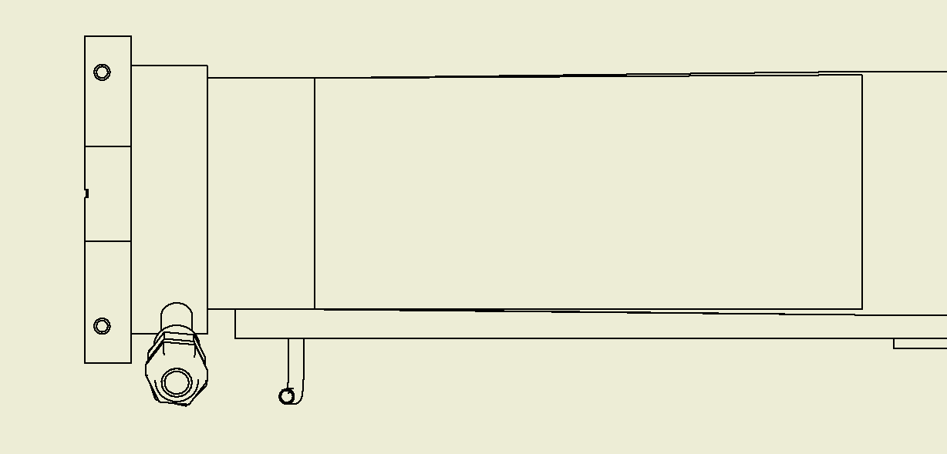
Vacuum Chamber Design
Round to taper joint is welded.
¼’’ horizontal taper in pipe

Slide 13
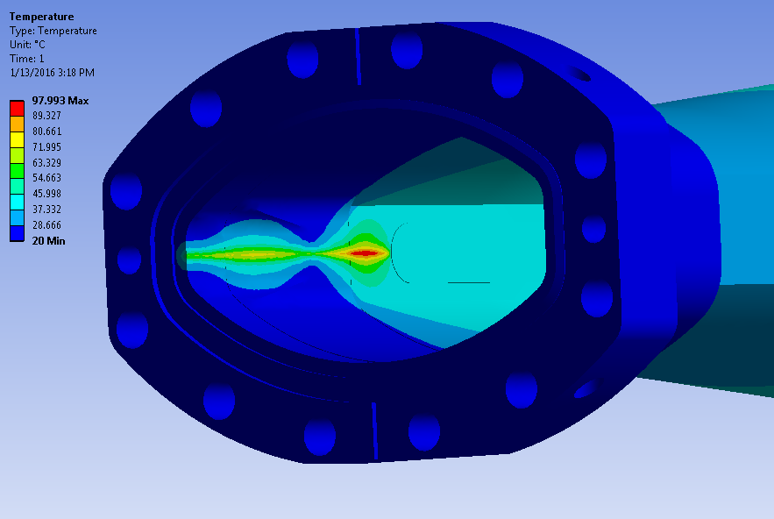
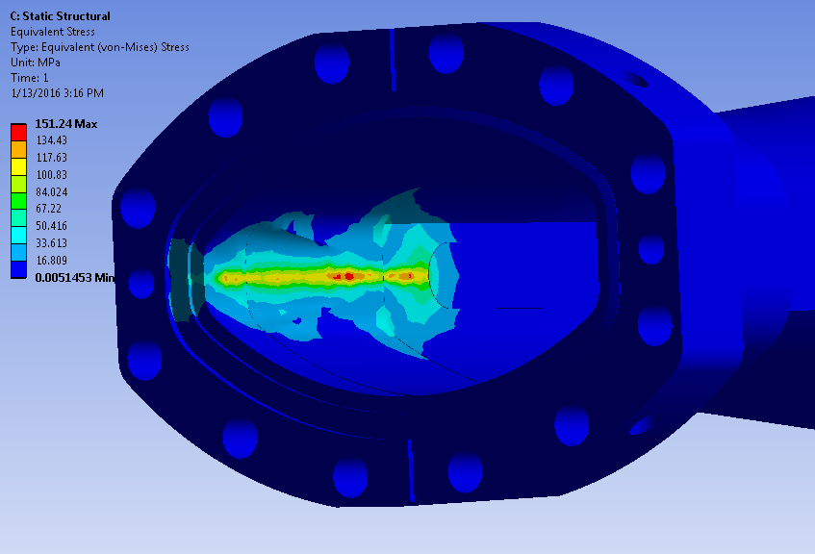
Chamber Heat Load
Conditions:
250 mA operation - 0.97 W/mm² heat flux input. 0.67 mm tall strip
40 ºC water temperature of cooling channel
20 ºC water temperature of cooling channels in flanges
Results
Safety factor of yield stress is 1.667 vs. the preferred 3
100 Celsius max temp of inside of pipe

Slide 14
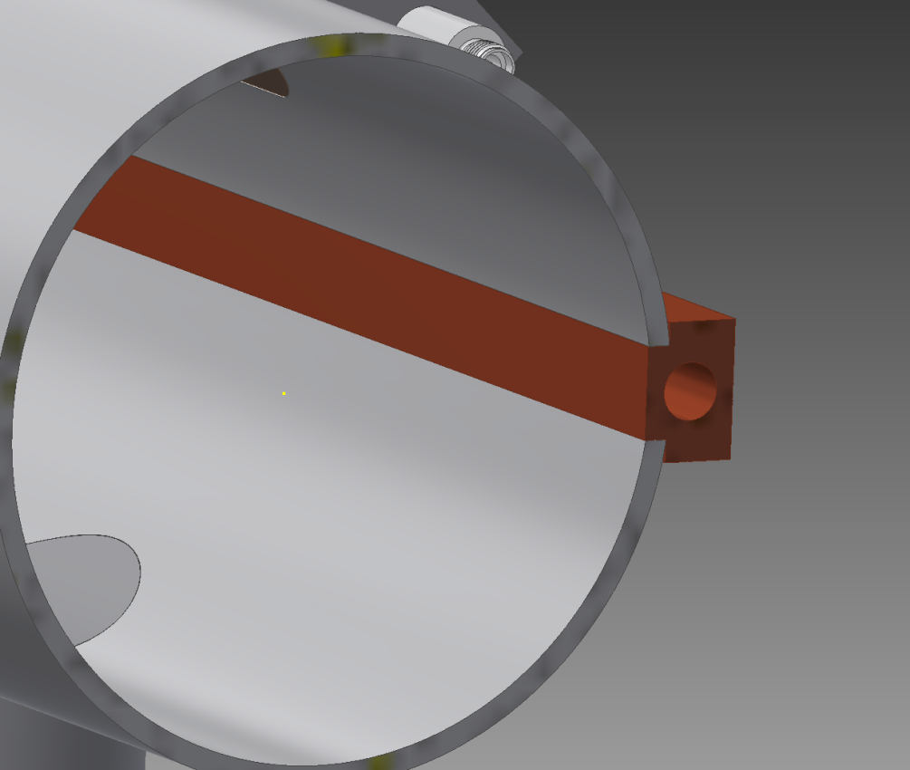
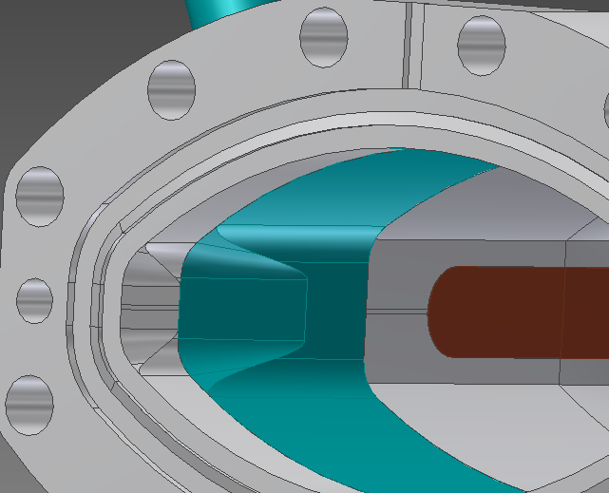
Cooling Channel
L= 40.2’’
Flush with inside of pipe entire length

