Slide 1
CesrTA Future Plans
David Rubin
September 11, 2012

Slide 2
Summary- Electron Cloud R&D
CESR converted for low emittance operation
Developed and implemented a dozen lattice configurations for multiple energies, emittances, with varying numbers of wigglers, etc.
Instrumented storage ring to study electron cloud growth and mitigation
Anchored electron cloud models with extensive and complementary measurements
Recommended complete set of mitigations for ILC damping ring
Used models to evaluate tolerance of ILC positron ring to electron cloud

Slide 3
Summary – Low emittance
Instrumented CESR for simultaneous measurement of bunch height, width and length
Developed techniques for routine lattice correction and emittance tuning
Exploited instrumentation and flexibility to make most extensive measurements to date of Intra-beam scattering in an electron/positron ring

Slide 4
Outstanding questions and investigations
Completeness of electron cloud model
Cloud induced emittance growth and instabilities
Long lived cloud in quadrupoles/wigglers (precursor studies)
TE wave measurement technique
Minimum vertical emittance
Sources of emittance dilution
Emittance tuning techniques
X-ray beam size measurement
optimization/interpretation of coded aperture images
Visible light beam size measurement
horizontal and vertical – turn by turn
Optical and Xray diffraction radiation beam size monitor
Intra-beam scattering
Fast Ion instability

Slide 5
Electron cloud model
Is there a self consistent set of model parameters ?
Fit of model to measured tune shifts in a long train constrains model parameters
Simultaneous fits to multiple data sets with varying beam current, bunch configuration, beam energy, beam species further constrains parameters and tests the completeness of the model
Similarly, RFA and SPU measurements can be fit to ecloud models with different sensitivities to the various parameters
Time resolving RFA’s (very recently installed) will give complementary data that can likewise be fit to the model
Our goal is simultaneous fit of all data sets
(RFA,SPU, tune shifts) to best constrain parameters and establish that the model does (or does not) include all of the relevant physics consistent with SEY data

Slide 6
Electron cloud model
Photon Reflectivity
Development of cloud depends on nature of scattering of synchrotron radiation photons
Angular distribution of scattering depends on details of the surface of scatter on the scale of photon wavelength
That dependence is parameterized in the model
Reflectivity collaboration aims to measure dependence on
- Surface material and roughness
- Photon energy
- Angle of incidence

Slide 7
Electron cloud - dynamics
Instabilities and emittance blow up
We observe cloud induced head tail instability and emittance dilution
Connection between the two is not entirely clear. Does head-tail instability contribute to emittance growth or are the phenomena unrelated ?
Simulations (CMAD, PHETS) and analytic calculations are in rough agreement with measurement of both growth and instability – although not in detail
We aim to better understand the cause of sub-threshold emittance growth, connection to instability, nature of instability
We would like to measure internal bunch motion

Slide 8
Electron cloud - dynamics
Instrumentation for investigation of instability
xBSM bunch slicing
Measure vertical position and size versus longitudinal position along bunch
Fast diode array – 35 ps rise time
4 size/position samples along the ~ 10 mm (30 ps) long bunch at 10 ps intervals
Component testing beginning this fall

Slide 9
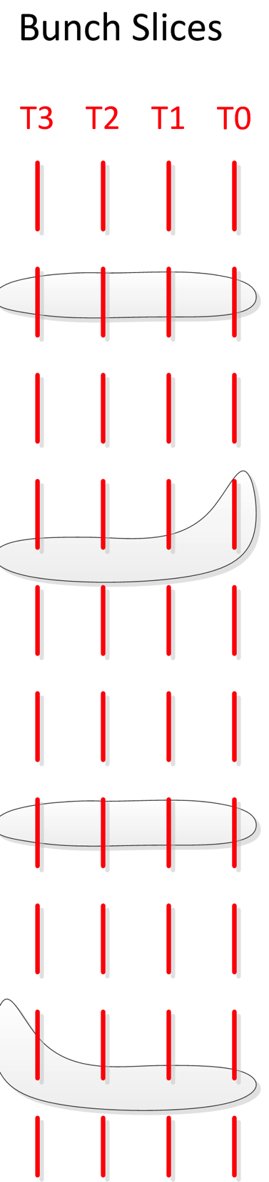
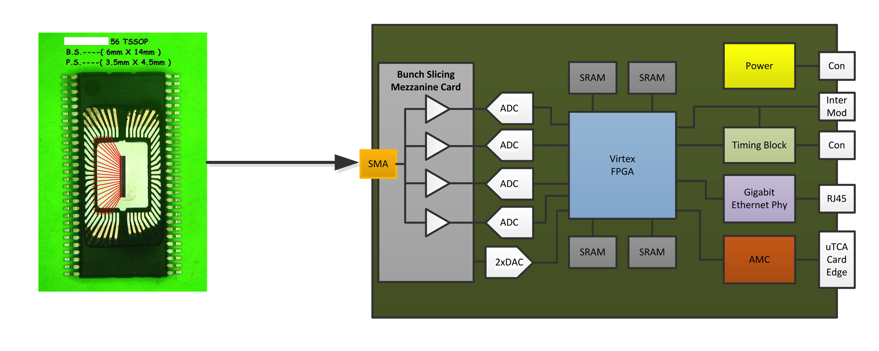
Bunch slicing with xBSM
Multi channel data acquisition system with individual phase delay
High speed
Diode array

Slide 10
Electron cloud dynamics
Simulation of bunch/cloud interaction
Simulations (PHETS, CMAD) computationally intensive
Calculations of thresholds for instabilities and emittance growth
Typically based on hundreds of turns (fraction of a damping time)
Limited to cloud within 20 σ of beam
We need more efficient algorithms, and implementations to get at all of the physics

Slide 11
Long lived electron cloud
Observation of Blowup of lead bunch
Effect is mitigated with the help of a precursor bunch
Depends on bunch spacing, number of bunches, total current, . . .
Hypothesis
Long lived cloud that accumulates along beam line in quadrupoles and/or wigglers, and is blown away by the precursor bunch
Evidence
The relatively high current measured in the quadrupole RFA suggests buildup over multiple turns
3-D modeling of cloud in wigglers indicates that electrons are trapped in strong longitudinal field component

Slide 12
Long lived electron cloud
We plan to test that hypothesis with
Simulation:
Simulation of multi-turn effects is computationally intensive
3 D model may be required if longitudinal magnetic fields in wigglers, or in fringing fields of quadrupoles are important
Instrumentation: Time Resolving RFA in quadrupole
Measurements:
Investigate dependence on various machine parameters, bunch configurations, species, etc.
How do other features (tune shifts, internal bunch motion) respond to precursor
A long lived cloud that is trapped in quadrupoles could
have a significant impact on positron rings.

Slide 13
TE wave measurement technique
Noninvasive
No special in vacuum hardware
(Couple to TE wave via BPM buttons)
Possibility of measurement of transverse distribution of cloud density
Requires:
Better understand relation of side band amplitude to cloud density
Details of spectrum of trapped modes

Slide 14
Emittance
We have achieved 10-15 pm-rad
Theoretical zero current limit (quantum limit) is nearly 100 times smaller
Measured residual vertical dispersion and coupling can not account for observed vertical emittance.
Evidently there are other sources of emittance dilution
Magnet motion, detector motion, unstable corrector magnet currents, noise coupled to the beam through RF system, . . .
We observe significant motion at high frequencies. (Betatron tunes are self excited)
Perhaps there is an electron cloud or ion effect that is relevant even at very low bunch current
Our goal is to continue to identify and mitigate sources of emittance dilution and to approach the quantum limit

Slide 15
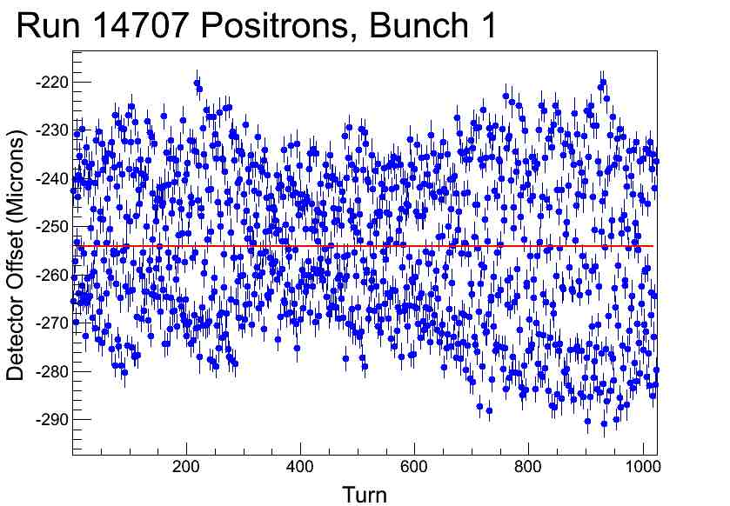
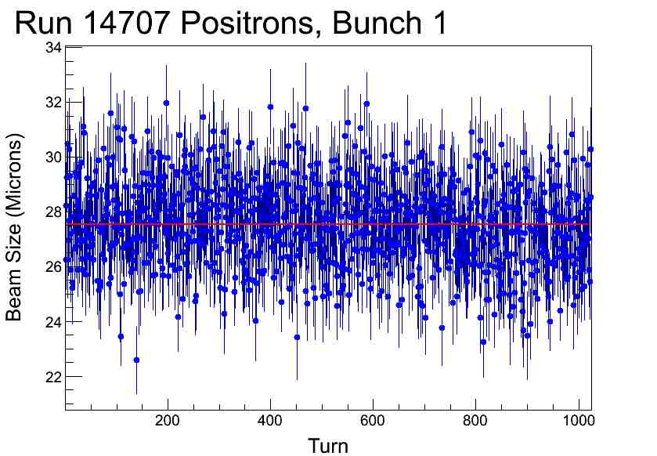
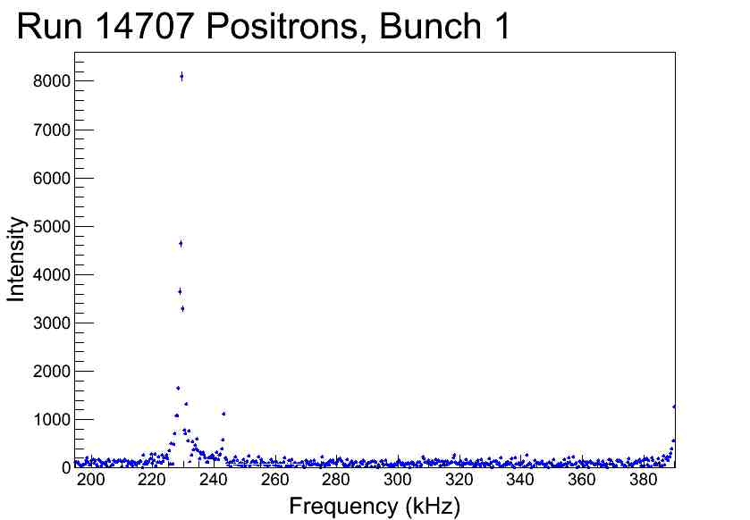
Emittance dilution due to beam motion
Turn by turn xBSM data
~30 micron variation in centroid position
~ 3 micron variation in beam size
FFT identifies vertical betatron motion
We need to identify (and eliminate) source of excitation

Slide 16
Emittance dilution due to beam motion
Low current
High current
IBS run

Slide 17
Emittance
Real time emittance tuning
Measurement of lattice errors via resonant excitation affords the possibility to continuously monitor betatron phase/coupling and vertical dispersion (as well as orbit)
Drive a witness bunch using gated tune tracker at 3 normal mode frequencies
Turn by turn position at each BPM
=> Orbit, phase, coupling, dispersion

Slide 18
X-ray beam size monitor
Optimize coded aperture for
X-ray energy spectrum
Bunch size
Intensity
Match x-ray energy to diode and optimize layout of diode array
Refine fitting techniques for extracting size from coded aperture data
All vacuum x-ray beam lines for full sensitivity across the spectrum

Slide 19
Visible light beam size monitor
Developing turn by turn capability based on linear array of photomultiplier tubes
Exploring measurement of vertical beam size
Interferometry
Polarization
As complement and check of xray beam size monitor

Slide 20
ODR/XDR
Goal
Measure vertical beam size with 1μm resolution
Phase I – optical diffraction radiation (Dec. 2012)
- 400μm and 1 mm diffraction slit width
=> image odr pattern from ~ 20 μm beam
Phase II – x-ray diffraction radiation (Dec. 2013)
- 10 μm slit width
=> image xdr pattern from ~ 1 μm beam
Depends on installation of mini-β insert
to achieve 1 μm beam in CESR

Slide 21
Collective effects
As we continue to achieve smaller vertical emittance, our sensitivity to collective effects (especially emittance diluting effects) is enhanced.

Slide 22
Intra-beam scattering
Continue to explore IBS and test theory with ever smaller zero current emittance
IBS has strong energy dependence.
Measurements at 1.8 and 2.3GeV planned for December 2012, will bracket the 2.1GeV data
Preliminary tests at 1.8/2.3 to explore dependence of xBSM on xray spectrum have been completed
Anomalous blowup of vertical beam size at high current ?
Dependence on dispersion in RF ?
New capability in next run =>
Synchronized single pass measurement of horizontal
and vertical beam size

Slide 23
Fast Ion
Fast-ion instability
CesrTA well instrumented for study of fast-ion effect
Sensitivity expected to increase as vertical emittance shrinks
xBSM and beam position monitors provides bunch by bunch and turn by turn measure of vertical emittance and position spectra (similarly to investigation of ecloud emittance growth)
We plan direct measure of fast ion instability, and the threshold for emittance growth.

Slide 24
CesrTA Students
Graduate students
J. Calvey, N. Eggert, M. Ehrlichman, R. Helms, W. Hopkins, B. Kreis, J. Shanks, J. Urban, Y. Yariv
Undergraduates
K. Butler, H. Kaminsky, J. Kim, Z. Leong, H. Liu, J. Livezey, J. Makita, M. McDonald, G. Ramirez, S. Santos, R. Schwartz, S. Vishniakou, W. Whitney, H. Williams, L. Fabrizzio, M. Randazzo, R.Campbell, S. Roy, J. Ginsberg
REU (Research Experience for Undergraduates)
D. Carmody, C. Cude, P. Kehayias, M. Lawson, B. Carlson, D. Gonnella, E. Wilkinson, L. Hales, K. Hammond, N. Omcikus, Z. Warecki, J. Bonilla, D. Duggins, E. Hemingway, K. Williams

Slide 25
Funding
Phase I (2008−2011)
80% NSF(CESR Conversion), 20% DOE (ILC-ART)
Total of 240 days dedicated CESR running time
Phase II (2011 – 2014)
NSF (Lepton Collider)
40 days dedicated CESR running time/year
Phase III (2014 − ?) Proposal due 9/13
Request
Beam physics and instrumentation for low emittance electron/positron rings
40 days/year machine time
Details depend on CHESS upgrade plans

Slide 26
Conclusion
CesrTA is a well instrumented laboratory for investigation of beam physics of low emittance rings
Flexible optics – mature interface of design/optimization/measurement/analysis tools (BMAD/CESRV/Tao)
State of the art instrumentation, and ongoing development
Sophisticated modeling and simulation capability based on integrated library of accelerator modeling code (BMAD)
Contributions
Electron cloud physics, emittance tuning, intra-beam scattering, materials characterization, beam instrumentation
Collaborative effort (14 institutions)
Accelerator physics education
Compelling program of beam physics, experiment and theory

Slide 27
End
Thank you for your attention

